Slide 1

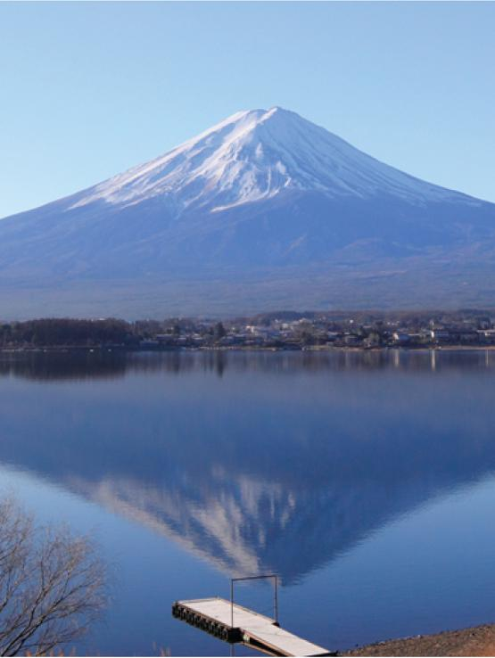
15
Multiple Integrals
Copyright © Cengage Learning. All rights reserved.

Slide 2

15.6
Surface Area
Copyright © Cengage Learning. All rights reserved.

Slide 3
Surface Area
In this section we apply double integrals to the problem of computing the area of a surface.
Here we compute the area of a surface with equation
z = f (x, y), the graph of a function of two variables.
Let S be a surface with equation z = f (x, y), where f has continuous partial derivatives.
For simplicity in deriving the surface area formula, we assume that f (x, y) ≥ 0 and the domain D of f is a rectangle.
We divide D into small rectangles R_{ij} with area ΔA = ΔxΔy.

Slide 4
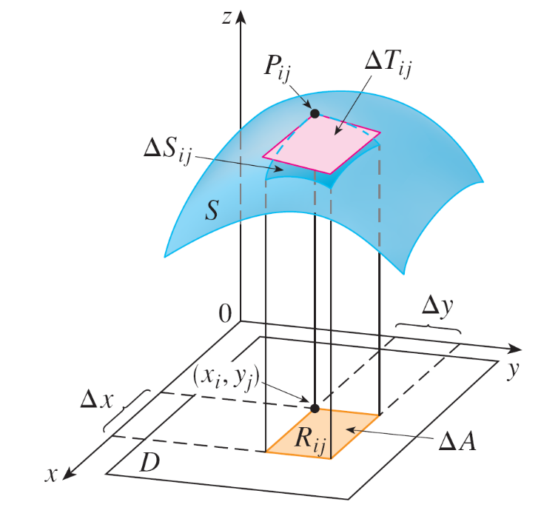
Surface Area
If (x_{i}, y_{j}) is the corner of R_{ij} closest to the origin, let
P_{ij} (x_{i}, y_{j}, f (x_{i}, y_{j})) be the point on S directly above it
(see Figure 1).
Figure 1

Slide 5
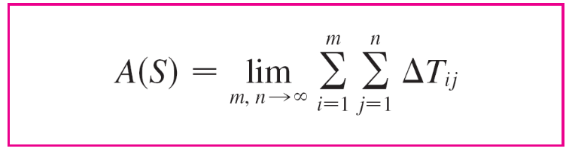

Surface Area
The tangent plane to S at P_{ij} is an approximation to S near P_{ij}. So the area ΔT_{ij} of the part of this tangent plane
(a parallelogram) that lies directly above R_{ij} is an approximation to the area ΔS_{ij} of the part of S that lies directly above R_{ij}.
Thus the sum ΣΣΔT_{ij} is an approximation to the total area
of S, and this approximation appears to improve as the number of rectangles increases.
Therefore we define the surface area of S to be

Slide 6
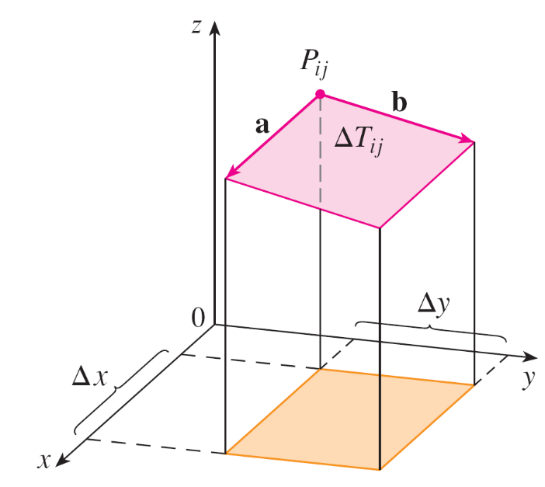
Surface Area
To find a formula that is more convenient than Equation 1 for computational purposes, we let a and b be the vectors that start at P_{ij} and lie along the sides of the parallelogram
with area ΔT_{ij}. (See Figure 2.)
Figure 2

Slide 7
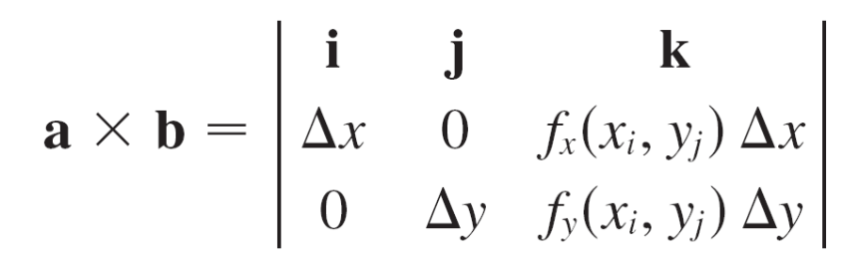
Surface Area
Then ΔT_{ij} = |a × b|. Recall that f_{x} (x_{i}, y_{j}) and f_{y} (x_{i}, y_{j}) are the slopes of the tangent lines through P_{ij} in the directions of
a and b.
Therefore
a = Δxi + f_{x} (x_{i}, y_{j}) Δxk
b = Δyj + f_{y} (x_{i}, y_{j}) Δyk
and

Slide 8
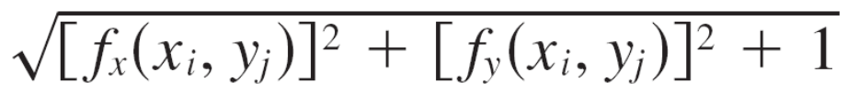
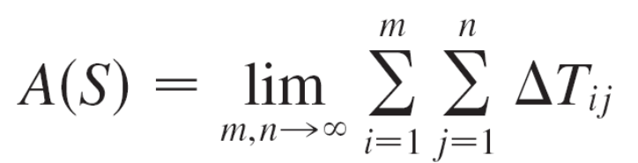
Surface Area
= –f_{x} (x_{i}, y_{j}) Δx Δyi – f_{y} (x_{i}, y_{j}) Δx Δyj + Δx Δyk
= [–f_{x} (x_{i}, y_{j})i – f_{y} (x_{i}, y_{j})j + k] ΔA
Thus
ΔT_{ij} = |a × b| = ΔA
From Definition 1 we then have

Slide 9
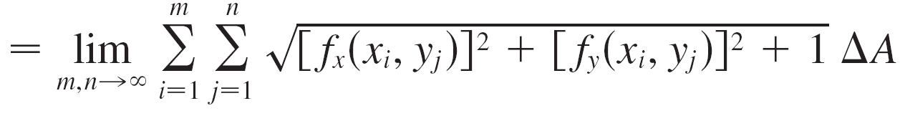
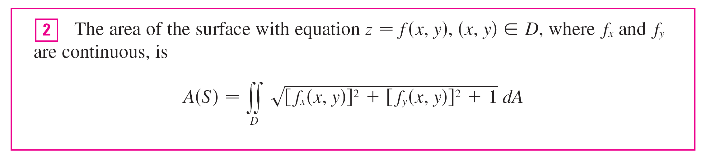
Surface Area
and by the definition of a double integral we get the following formula.

Slide 10
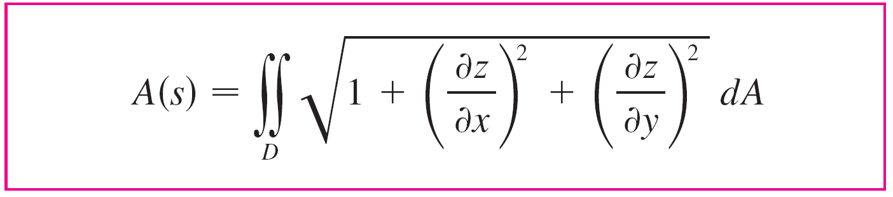

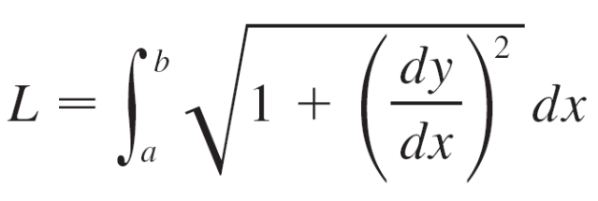
Surface Area
If we use the alternative notation for partial derivatives, we can rewrite Formula 2 as follows:
Notice the similarity between the surface area formula in Equation 3 and the arc length formula

Slide 11
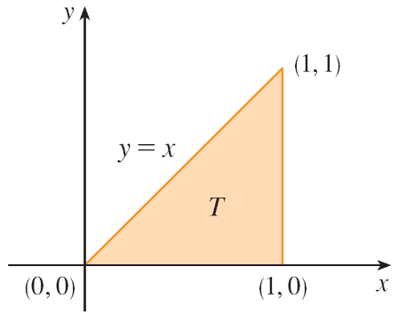
Example 1
Find the surface area of the part of the surface z = x² + 2y that lies above the triangular region T in the xy-plane with
vertices (0, 0), (1, 0), and (1, 1).
Solution:
The region T is shown in Figure 3 and is described by
T = {(x, y) | 0 ≤ x ≤ 1, 0 ≤ y ≤ x}
Figure 3

Slide 12
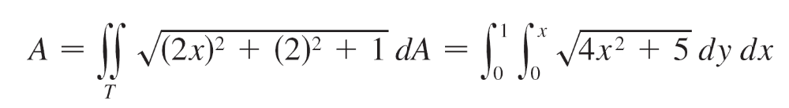
Example 1 – Solution
cont’d
Using Formula 2 with f (x, y) = x² + 2y, we get

Slide 13
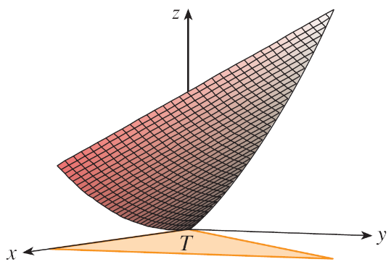
Example 1 – Solution
cont’d
Figure 4 shows the portion of the surface whose area
we have just computed.
Figure 4

