Slide 1


15
Multiple Integrals
Copyright © Cengage Learning. All rights reserved.

Slide 2

Change of Variables in
Multiple Integrals
15.10
Copyright © Cengage Learning. All rights reserved.

Slide 3

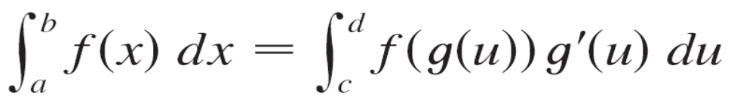
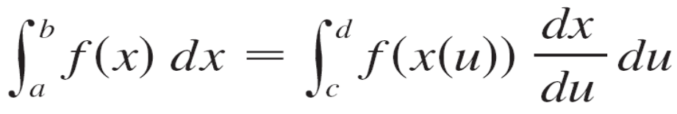

Change of Variables in Multiple Integrals
In one-dimensional calculus we often use a change of variable (a substitution) to simplify an integral. By reversing the roles of x and u, we can write
where x = g(u) and a = g(c), b = g(d). Another way of writing Formula 1 is as follows:

Slide 4


Change of Variables in Multiple Integrals
A change of variables can also be useful in double integrals. We have already seen one example of this: conversion to polar coordinates. The new variables r and θ are related to the old variables x and y by the equations
x = r cos θ y = r sin θ
and the change of variables formula can be written as
f (x, y) dA = f (r cos θ, r sin θ) r dr dθ
where S is the region in the rθ -plane that corresponds to the region R in the xy-plane.

Slide 5

Change of Variables in Multiple Integrals
More generally, we consider a change of variables that is given by a transformation T from the uv-plane to the
xy-plane:
T(u, v) = (x, y)
where x and y are related to u and v by the equations
x = g (u, v) y = h (u, v)
or, as we sometimes write,
x = x (u, v) y = y (u, v)

Slide 6

Change of Variables in Multiple Integrals
We usually assume that T is a C¹ transformation, which means that g and h have continuous first-order partial derivatives.
A transformation T is really just a function whose domain and range are both subsets of
If T(u₁, v₁) = (x₁, y₁), then the point (x₁, y₁) is called the image of the point (u₁, v₁).
If no two points have the same image, T is called
one-to-one.

Slide 7
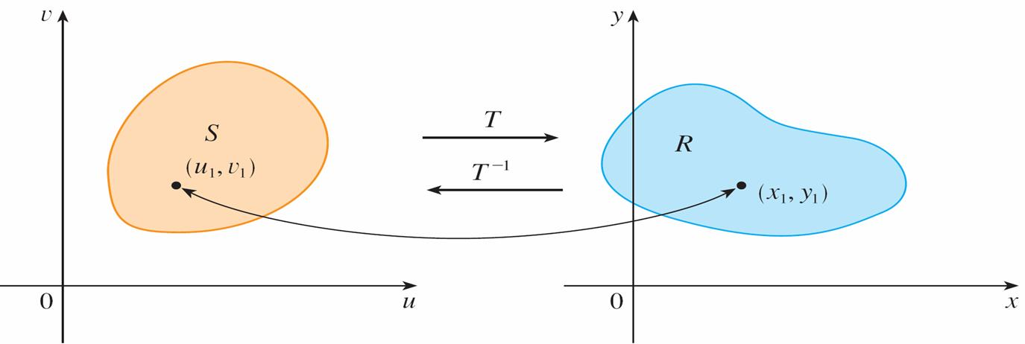
Change of Variables in Multiple Integrals
Figure 1 shows the effect of a transformation T on a region S in the uv-plane.
T transforms S into a region R in the xy-plane called the image of S, consisting of the images of all points in S.
Figure 1

Slide 8
Change of Variables in Multiple Integrals
If T is a one-to-one transformation, then it has an inverse transformation T ^{–1} from the xy-plane to the uv-plane and it may be possible to solve Equations 3 for u and v in terms of x and y :
u = G (x, y) v = H (x, y)

Slide 9
Example 1
A transformation is defined by the equations
x = u² – v² y = 2uv
Find the image of the square
S = {(u, v) | 0 ≤ u ≤ 1 , 0 ≤ v ≤ 1}.
Solution:
The transformation maps the boundary of S into the boundary of the image.
So we begin by finding the images of the sides of S.

Slide 10
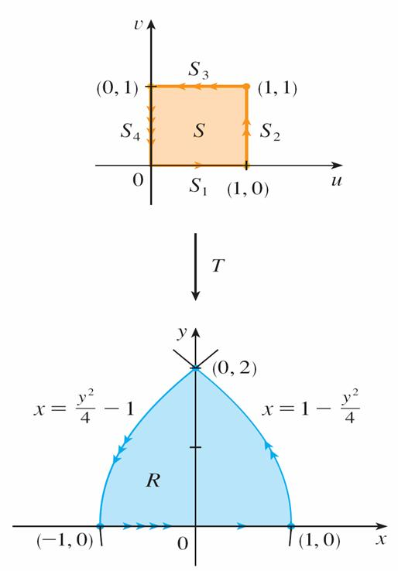
Example 1 – Solution
cont’d
The first side, S₁, is given by v = 0 (0 ≤ u ≤ 1 ).
(See Figure 2.)
Figure 2

Slide 11
Example 1 – Solution
cont’d
From the given equations we have x = u², y = 0, and so
0 ≤ x ≤ 1.
Thus S₁ is mapped into the line segment from (0, 0) to
(1, 0) in the xy-plane.
The second side, S₂, is u = 1 (0 ≤ v ≤ 1) and, putting u = 1 in the given equations, we get
x = 1 – v² y = 2v

Slide 12



Example 1 – Solution
cont’d
Eliminating v, we obtain
x = 1 – 0 ≤ x ≤ 1
which is part of a parabola.
Similarly, S₃ is given by v = 1 (0 ≤ u ≤ 1) , whose image is
the parabolic arc
x = – 1 –1 ≤ x ≤ 0

Slide 13
Example 1 – Solution
cont’d
Finally, S₄ is given by u = 0 (0 ≤ v ≤ 1) whose image is
x = –v², y = 0, that is, –1 ≤ x ≤ 0. (Notice that as we move around the square in the counterclockwise direction, we also move around the parabolic region
in the counterclockwise
direction.)
The image of S is the region R
(shown in Figure 2) bounded by
the x-axis and the parabolas
given by Equations 4 and 5.
Figure 2

Slide 14
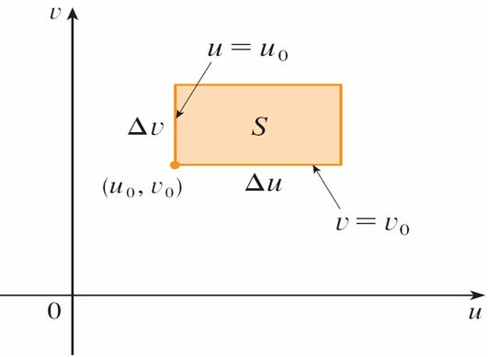
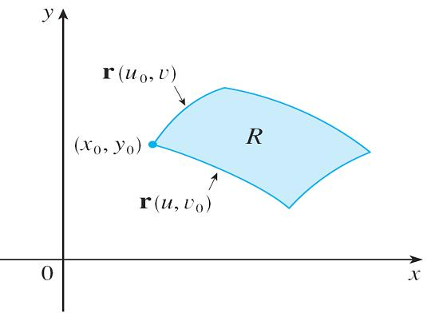

Change of Variables in Multiple Integrals
Now let’s see how a change of variables affects a double integral. We start with a small rectangle S in the uv-plane whose lower left corner is the point (u₀, v₀) and whose dimensions are Δu and Δv. (See Figure 3.)
Figure 3

Slide 15
Change of Variables in Multiple Integrals
The image of S is a region R in the xy-plane, one of whose boundary points is (x₀, y₀) = T(u₀, v₀).
The vector
r(u, v) = g(u, v) i + h(u, v) j
is the position vector of the image of the point (u, v).
The equation of the lower side of S is v = v₀, whose image curve is given by the vector function r(u, v₀).

Slide 16
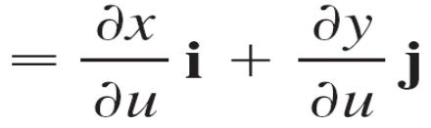
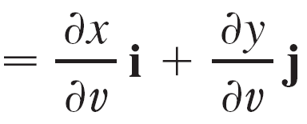
Change of Variables in Multiple Integrals
The tangent vector at (x₀, y₀) to this image curve is
r_{u} = g_{u}(u₀, v₀) i + h_{u}(u₀, v₀) j
Similarly, the tangent vector at (x₀, y₀) to the image curve of the left side of S (namely, u = u₀) is
r_{v} = g_{v}(u₀, v₀) i + h_{v}(u₀, v₀) j

Slide 17
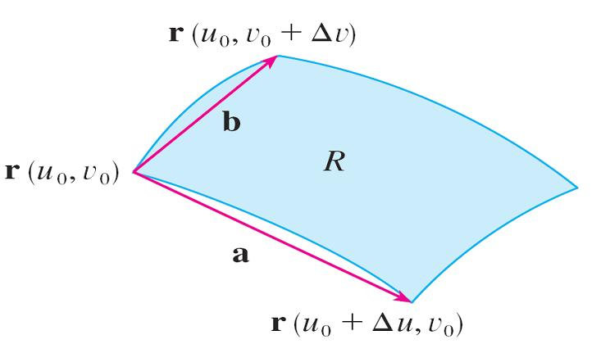
Change of Variables in Multiple Integrals
We can approximate the image region R = T(S) by a parallelogram determined by the secant vectors
a = r(u₀ + Δu, v₀) – r(u₀, v₀) b = r(u₀, v₀ + Δv) – r(u₀, v₀)
shown in Figure 4.
Figure 4

Slide 18
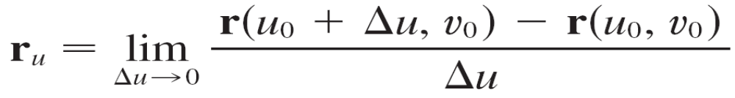
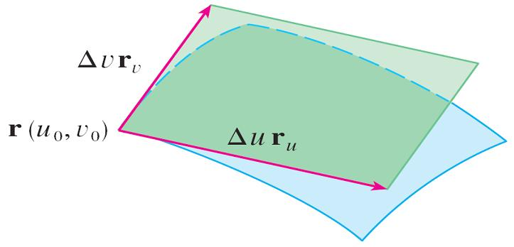
Change of Variables in Multiple Integrals
But
and so r(u₀ + Δu, v₀) – r(u₀, v₀) ≈ Δu r_{u}
Similarly r(u₀, v₀ + Δv) – r(u₀, v₀) ≈ Δv r_{v}
This means that we can approximate R by a parallelogram determined by the vectors Δu r_{u} and Δv r_{v}. (See Figure 5.)
Figure 5

Slide 19

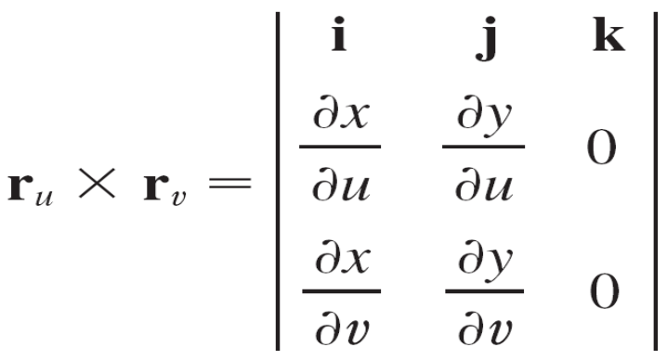
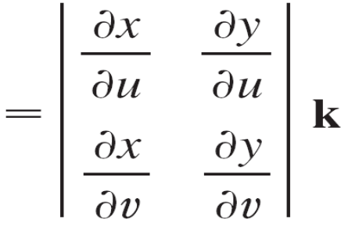
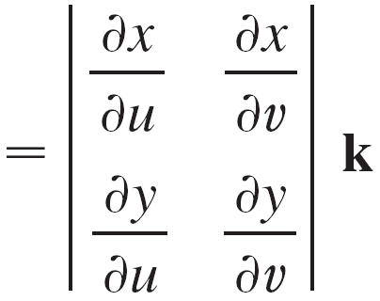
Change of Variables in Multiple Integrals
Therefore we can approximate the area of R by the area
of this parallelogram, which is
| (Δu r_{u}) × (Δv r_{v}) | = | r_{u} × r_{v} | Δu Δv
Computing the cross product, we obtain

Slide 20
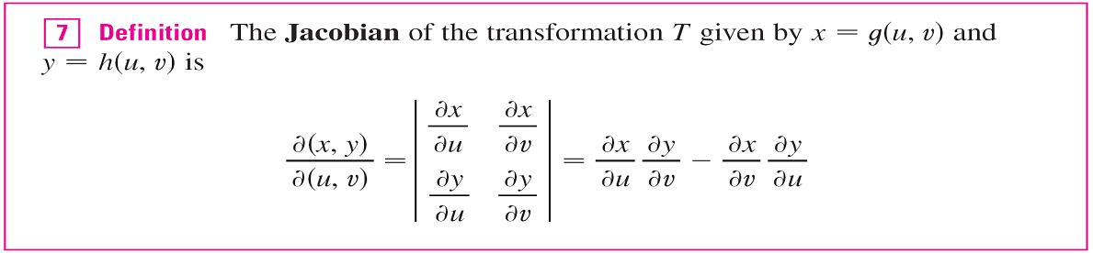
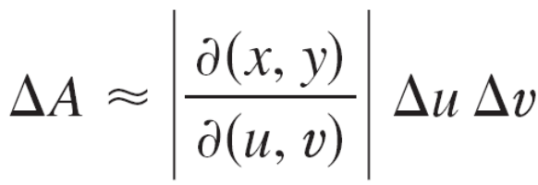

Change of Variables in Multiple Integrals
The determinant that arises in this calculation is called the Jacobian of the transformation and is given a special notation.
With this notation we can use Equation 6 to give an approximation to the area ΔA of R:
where the Jacobian is evaluated at (u₀, v₀).

Slide 21
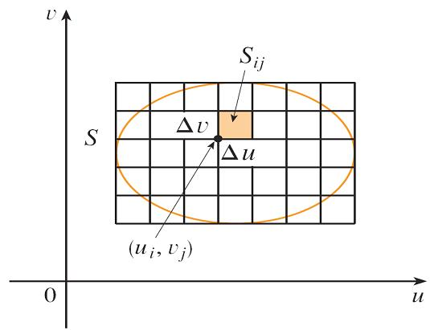
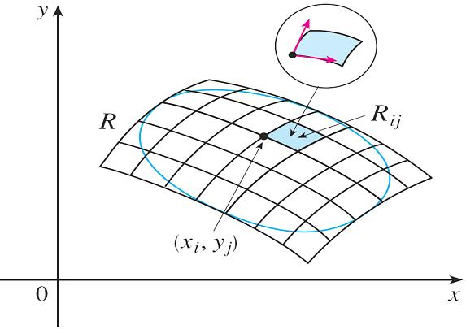
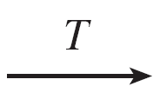
Change of Variables in Multiple Integrals
Next we divide a region S in the uv-plane into rectangles S_{ij} and call their images in the xy-plane R_{ij}. (See Figure 6.)
Figure 6

Slide 22
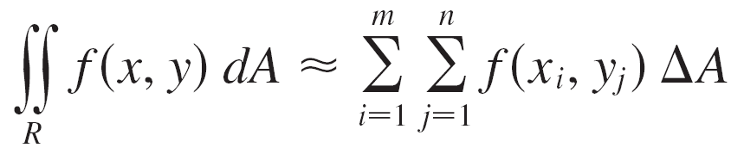
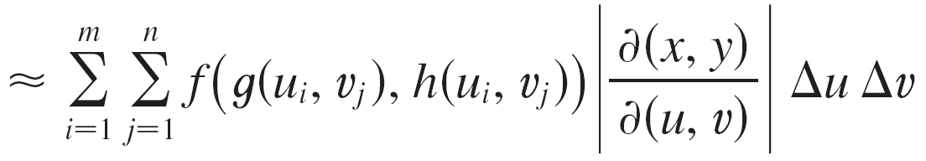
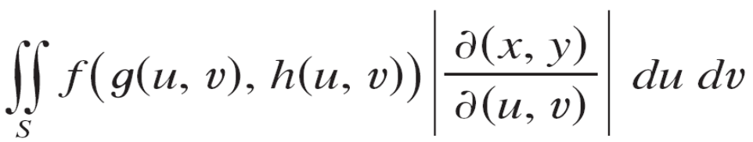
Change of Variables in Multiple Integrals
Applying the approximation (8) to each R_{ij}, we approximate the double integral of f over R as follows:
where the Jacobian is evaluated at (u_{i}, v_{j}). Notice that this
double sum is a Riemann sum for the integral

Slide 23
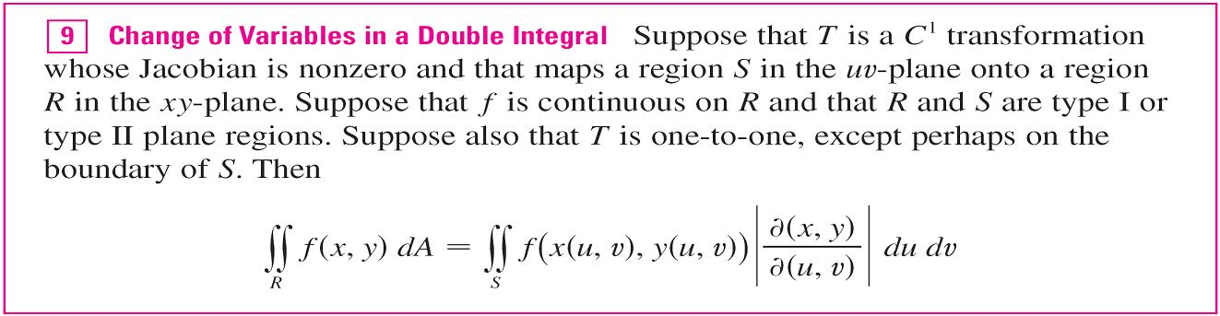
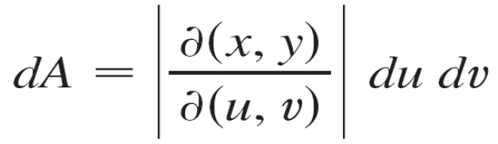
Change of Variables in Multiple Integrals
The foregoing argument suggests that the following theorem is true.
Theorem 9 says that we change from an integral in x and y to an integral in u and v by expressing x and y in terms of
u and v and writing

Slide 24
Change of Variables in Multiple Integrals
Notice the similarity between Theorem 9 and the one-dimensional formula in Equation 2.
Instead of the derivative dx/du, we have the absolute value of the Jacobian, that is, | ∂(x, y)/∂(u, v) |.
As a first illustration of Theorem 9, we show that the formula for integration in polar coordinates is just a special case.

Slide 25
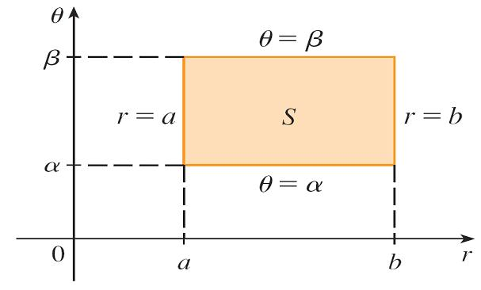
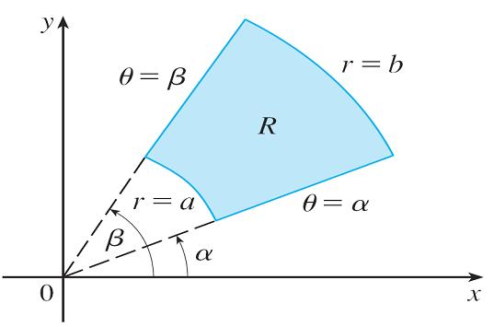
Change of Variables in Multiple Integrals
Here the transformation T from the rθ -plane to the xy-plane is given by
x = g(r, θ) = r cos θ y = h(r, θ) = r sin θ
and the geometry of the transformation is shown in Figure 7: T maps an ordinary rectangle in the rθ -plane to a polar rectangle in the xy-plane.
The polar coordinate transformation
Figure 7

Slide 26
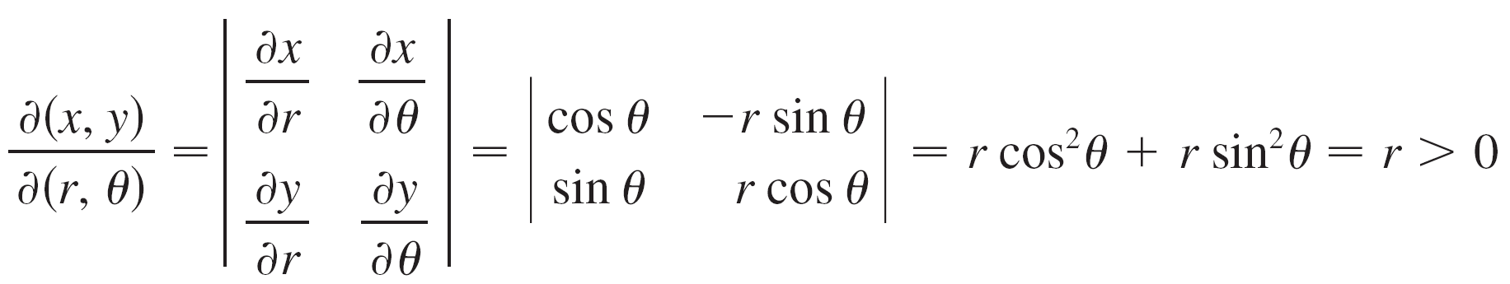
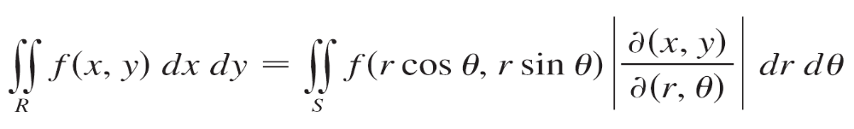
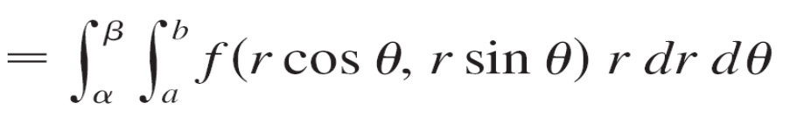
Change of Variables in Multiple Integrals
The Jacobian of T is
Thus Theorem 9 gives

Slide 27
Triple Integrals

Slide 28
Triple Integrals
There is a similar change of variables formula for triple integrals.
Let T be a transformation that maps a region S in
uvw-space onto a region R in xyz-space by means of the equations
x = g(u, v, w) y = h(u, v, w) z = k(u, v, w)

Slide 29
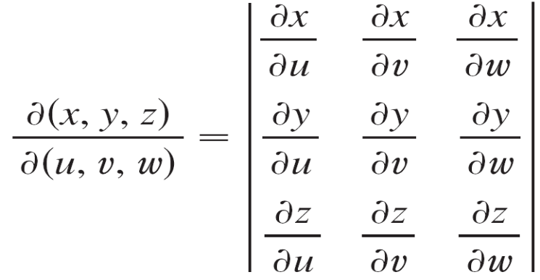

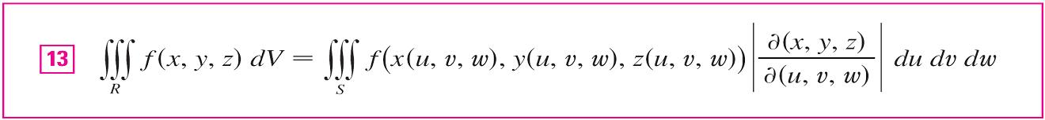
Triple Integrals
The Jacobian of T is the following 3 × 3 determinant:
Under hypotheses similar to those in Theorem 9, we have the following formula for triple integrals:

Slide 30
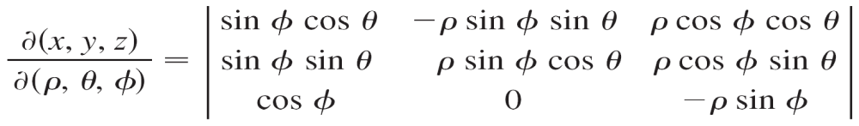
Example 4
Use Formula 13 to derive the formula for triple integration in spherical coordinates.
Solution:
Here the change of variables is given by
x = ρ sin φ cos θ y = ρ sin φ sin θ z = ρ cos φ
We compute the Jacobian as follows:

Slide 31
Example 4 – Solution
cont’d
= cos φ (–ρ² sin φ cos φ sin² θ – ρ² sin φ cos φ cos² θ)
– ρ sin φ (ρ sin² φ cos² θ + ρ sin² φ sin² θ)
= –ρ² sin φ cos² φ – ρ² sin φ sin² φ
= –ρ² sin φ
Since 0 ≤ φ ≤ π, we have sin φ ≥ 0.

Slide 32
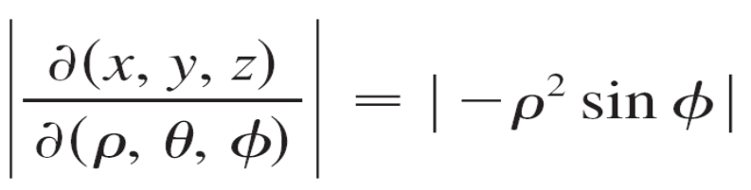


Example 4 – Solution
cont’d
Therefore
and Formula 13 gives
f (x, y, z) dV
= f (ρ sin φ cos θ, ρ sin φ sin θ, ρ cos φ) ρ² sin φ dρ dθ dφ

