Slide 1

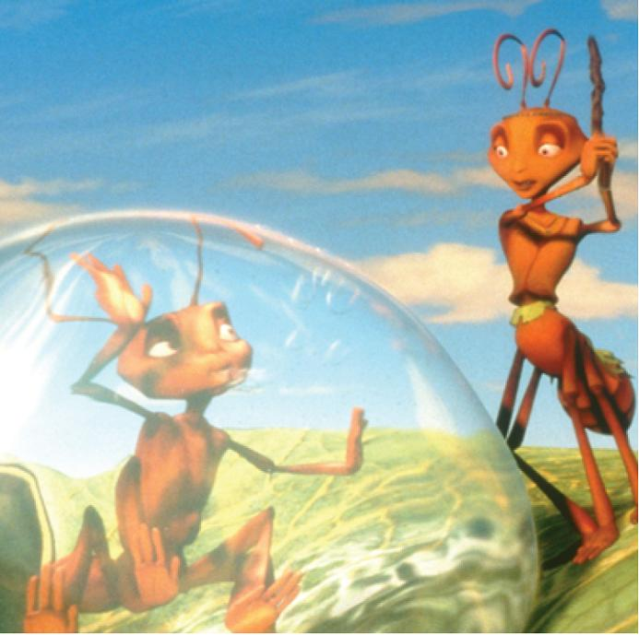
16
Vector Calculus
Copyright © Cengage Learning. All rights reserved.

Slide 2

16.1
Vector Fields
Copyright © Cengage Learning. All rights reserved.

Slide 3
Vector Fields
The vectors in Figure 1 are air velocity vectors that indicate the wind speed and direction at points 10 m above the surface elevation in the San Francisco Bay area.
We see at a glance from the largest arrows in part (a) that the greatest wind speeds at that time occurred as the winds entered the bay across the Golden Gate Bridge. Part (b) shows the very different wind pattern 12 hours earlier.

Slide 4
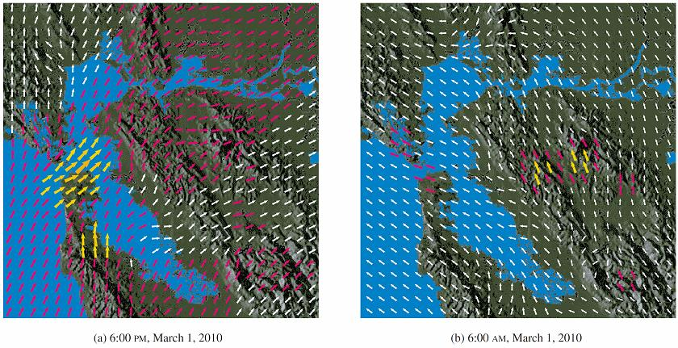
Vector Fields
Velocity vector fields showing San Francisco Bay wind patterns
Figure 1

Slide 5
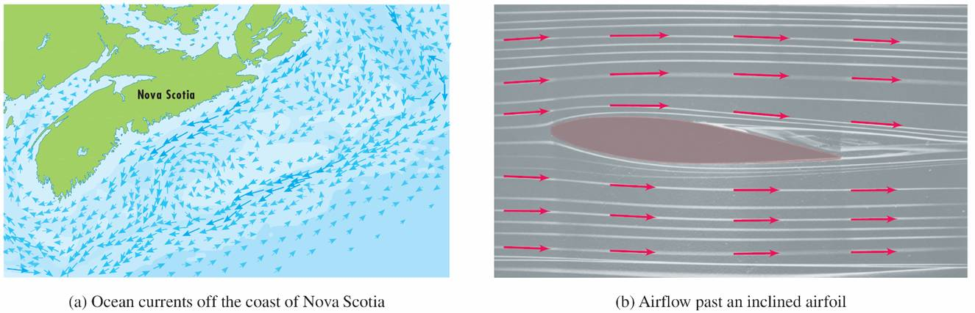
Vector Fields
Associated with every point in the air we can imagine a wind velocity vector. This is an example of a velocity vector field.
Other examples of velocity vector fields are illustrated in Figure 2: ocean currents and flow past an airfoil.
Velocity vector fields
Figure 2

Slide 6


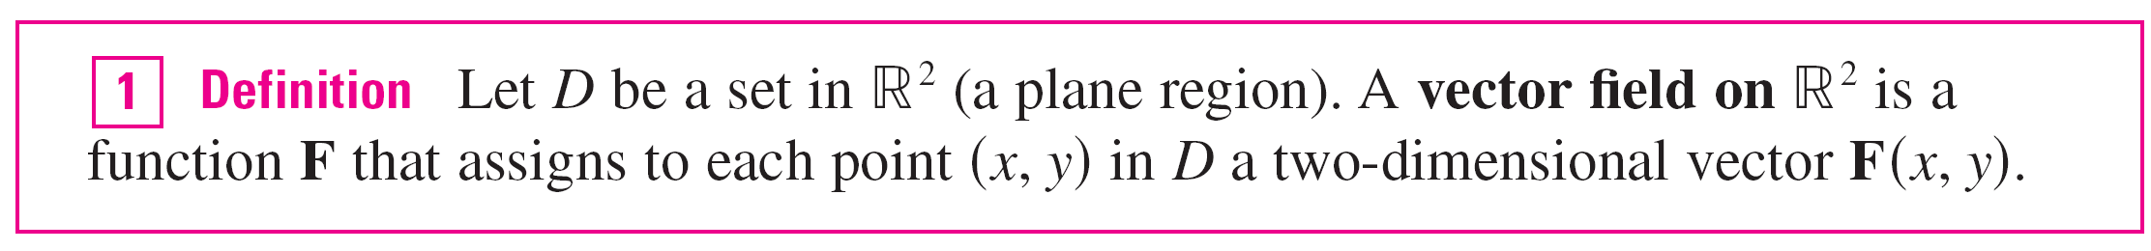
Vector Fields
Another type of vector field, called a force field, associates a force vector with each point in a region. An example is the gravitational force field.
In general, a vector field is a function whose domain is a set of points in (or ) and whose range is a set of vectors in V₂ (or V₃).

Slide 7
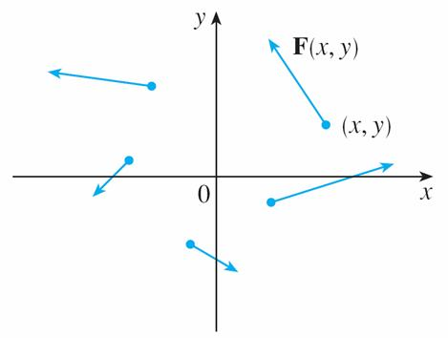
Vector Fields
The best way to picture a vector field is to draw the arrow representing the vector F(x, y) starting at the point (x, y).
Of course, it’s impossible to do this for all points (x, y), but we can gain a reasonable impression of F by doing it for a few representative points in D as in Figure 3.
Vector field on
Figure 3

Slide 8
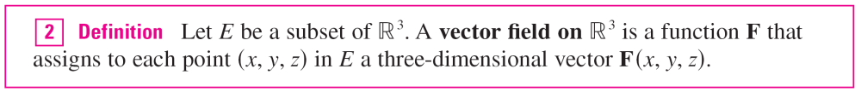
Vector Fields
Since F(x, y) is a two-dimensional vector, we can write it in terms of its component functions P and Q as follows:
F(x, y) = P(x, y) i + Q(x, y) j = ⟨P(x, y), Q(x, y)⟩
or, for short, F = P i + Q j
Notice that P and Q are scalar functions of two variables and are sometimes called scalar fields to distinguish them from vector fields.

Slide 9
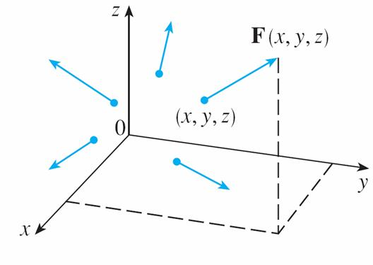
Vector Fields
A vector field F on is pictured in Figure 4.
We can express it in terms of its component functions P, Q, and R as
F(x, y, z) = P(x, y, z) i + Q(x, y, z) j + R(x, y, z) k
Vector field on
Figure 4

Slide 10
Vector Fields
As with the vector functions, we can define continuity of vector fields and show that F is continuous if and only if its component functions P, Q, and R are continuous.
We sometimes identify a point (x, y, z) with its position vector x = ⟨x, y, z⟩ and write F(x) instead of F(x, y, z).
Then F becomes a function that assigns a vector F(x) to a vector x.

Slide 11
Example 1
A vector field on is defined by F(x, y) = –y i + x j. Describe F by sketching some of the vectors F(x, y) as in Figure 3.
Vector field on
Figure 3

Slide 12
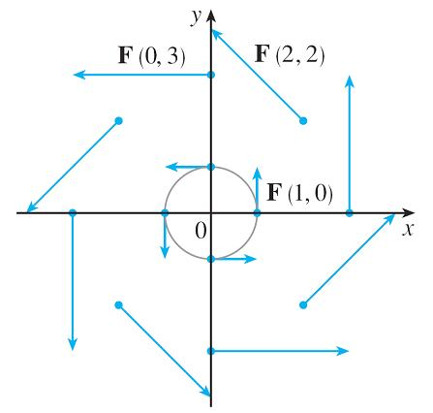
Example 1 – Solution
Since F(1, 0) = j, we draw the vector j = ⟨0, 1⟩ starting at the point (1, 0) in Figure 5.
Since F(0, 1) = –i, we draw the vector ⟨–1, 0⟩ with starting point (0, 1).
F(x, y) = –y i + x j
Figure 5

Slide 13
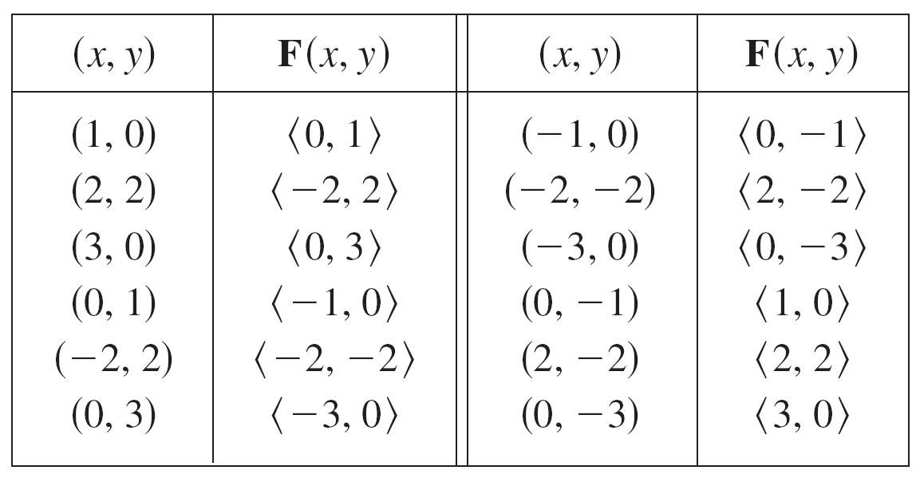
Example 1 – Solution
cont’d
Continuing in this way, we calculate several other representative values of F(x, y) in the table and draw the corresponding vectors to represent the vector field in Figure 5.

Slide 14
Example 1 – Solution
cont’d
It appears from Figure 5 that each arrow is tangent to a
circle with center the origin.
F(x, y) = –y i + x j
Figure 5

Slide 15




Example 1 – Solution
cont’d
To confirm this, we take the dot product of the position vector x = x i + y j with the vector F(x) = F(x, y):
x  F(x) = (x i + y j)  (–y i + x j)
= –xy + yx
This shows that F(x, y) is perpendicular to the position vector ⟨x, y⟩ and is therefore tangent to a circle with center
the origin and radius
Notice also that
so the magnitude of the vector F(x, y) is equal to the radius of the circle.
= 0

Slide 16
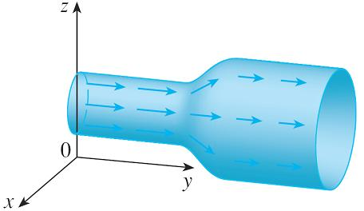
Example 3
Imagine a fluid flowing steadily along a pipe and let V(x, y, z) be the velocity vector at a point (x, y, z).
Then V assigns a vector to each point (x, y, z) in a certain domain E (the interior of the pipe) and so V is a vector field on called a velocity field.
A possible velocity field is illustrated in Figure 13.
Velocity field in fluid flow
Figure 13

Slide 17
Example 3
cont’d
The speed at any given point is indicated by the length of the arrow.
Velocity fields also occur in other areas of physics.
For instance, the vector field in Example 1 could be used as the velocity field describing the counterclockwise rotation of a wheel.

Slide 18
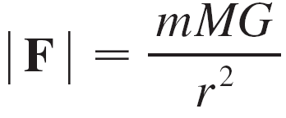
Example 4
Newton’s Law of Gravitation states that the magnitude of the gravitational force between two objects with masses m and M is
where r is the distance between the objects and G is the gravitational constant.
(This is an example of an inverse square law.)
Let’s assume that the object with mass M is located at the origin in . (For instance, M could be the mass of the earth and the origin would be at its center.)

Slide 19
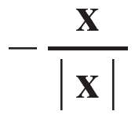
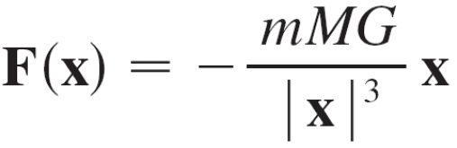

Example 4
cont’d
Let the position vector of the object with mass m be x = ⟨x, y, z⟩. Then r = | x |, so r² = | x |².
The gravitational force exerted on this second object acts toward the origin, and the unit vector in this direction is
Therefore the gravitational force acting on the object at
x = ⟨x, y, z⟩ is
[Physicists often use the notation r instead of x for the position vector, so you may see Formula 3 written in the form F = –(mMG/r³)r.]

Slide 20

Example 4
cont’d
The function given by Equation 3 is an example of a vector field, called the gravitational field, because it associates a vector [the force F(x)] with every point x in space.
Formula 3 is a compact way of writing the gravitational field, but we can also write it in terms of its component functions by using the facts that x = x i + y j + z k and

Slide 21
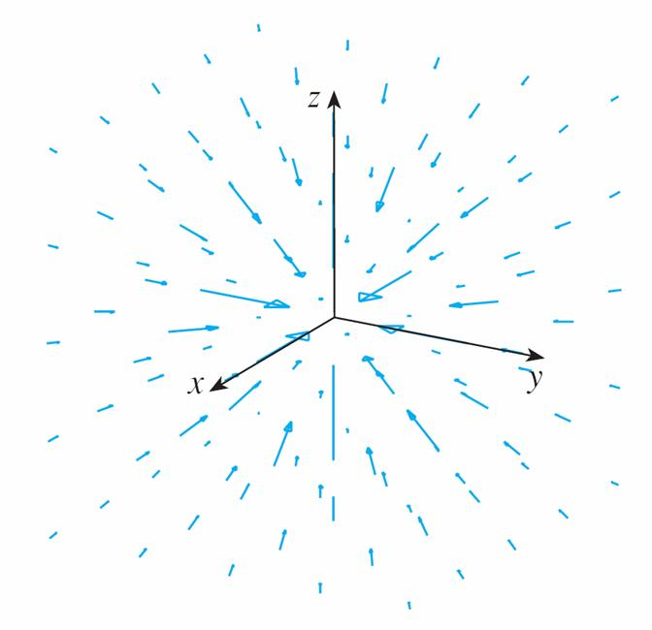
Example 4
cont’d
The gravitational field F is pictured in Figure 14.
Gravitational force field
Figure 14

Slide 22

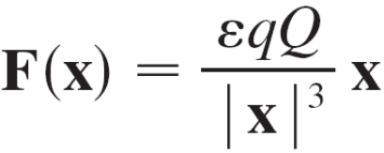
Example 5
Suppose an electric charge Q is located at the origin. According to Coulomb’s Law, the electric force F(x) exerted by this charge on a charge q located at a point (x, y, z) with position vector x = ⟨x, y, z⟩ is
where ε is a constant (that depends on the units used).
For like charges, we have qQ > 0 and the force is repulsive; for unlike charges, we have qQ < 0 and the force is attractive.

Slide 23
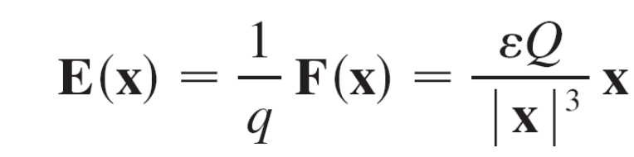
Example 5
cont’d
Notice the similarity between Formulas 3 and 4. Both vector fields are examples of force fields.
Instead of considering the electric force F, physicists often consider the force per unit charge:
Then E is a vector field on called the electric field of Q.

Slide 24
Gradient Fields

Slide 25
Gradient Fields
If f is a scalar function of two variables, recall that its gradient ∇f (or grad f ) is defined by
∇f (x, y) = f_{x}(x, y) i + f_{y}(x, y) j
Therefore ∇f is really a vector field on and is called a gradient vector field.
Likewise, if f is a scalar function of three variables, its gradient is a vector field on given by
∇f (x, y, z) = f_{x}(x, y, z) i + f_{y}(x, y, z) j + f_{z}(x, y, z) k

Slide 26
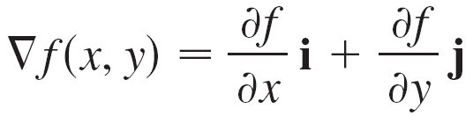

Example 6
Find the gradient vector field of f (x, y) = x²y – y³. Plot the gradient vector field together with a contour map of f. How are they related?
Solution:
The gradient vector field is given by

Slide 27
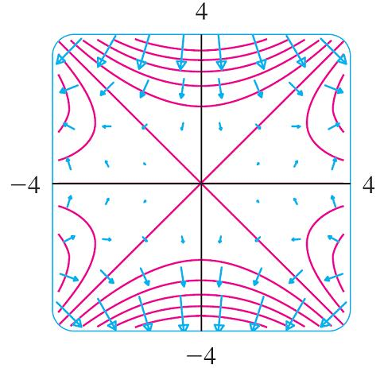
Example 6 – Solution
cont’d
Figure 15 shows a contour map of f with the gradient vector field.
Notice that the gradient vectors are perpendicular to the level curves.
Figure 15

Slide 28
Example 6 – Solution
cont’d
Notice also that the gradient vectors are long where the level curves are close to each other and short where the curves are farther apart.
That’s because the length of the gradient vector is the value of the directional derivative of f and closely spaced level curves indicate a steep graph.

Slide 29
Gradient Fields
A vector field F is called a conservative vector field if it is the gradient of some scalar function, that is, if there exists a function f such that F = ∇f .
In this situation f is called a potential function for F.
Not all vector fields are conservative, but such fields do arise frequently in physics.

Slide 30
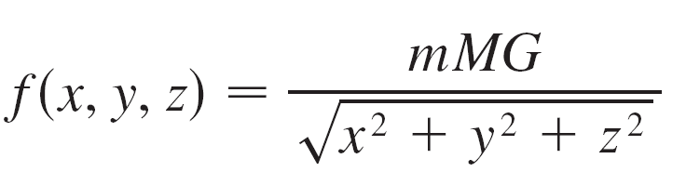
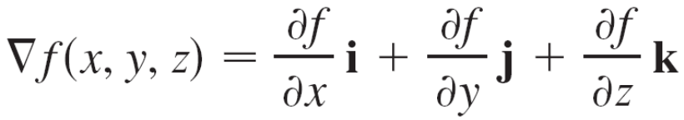

Gradient Fields
For example, the gravitational field F in Example 4 is conservative because if we define
then

