Slide 1


16
Vector Calculus
Copyright © Cengage Learning. All rights reserved.

Slide 2

16.7
Surface Integrals
Copyright © Cengage Learning. All rights reserved.

Slide 3
Surface Integrals
The relationship between surface integrals and surface area is much the same as the relationship between line integrals and arc length.
Suppose f is a function of three variables whose domain includes a surface S.
We will define the surface integral of f over S in such a way that, in the case where f (x, y, z) = 1, the value of the surface integral is equal to the surface area of S.
We start with parametric surfaces and then deal with the special case where S is the graph of a function of two variables.

Slide 4
Parametric Surfaces

Slide 5
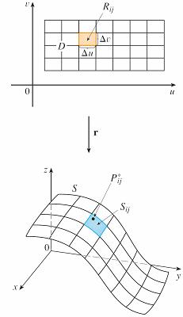
Parametric Surfaces
Suppose that a surface has a vector equation
r(u, v) = x(u, v) i + y(u, v) j + z(u, v) k (u, v) ∈ D
We first assume that the parameter
domain D is a rectangle and we
divide it into subrectangles R_{ij} with
dimensions Δu and Δv.
Then the surface S is divided
into corresponding patches
S_{ij} as in Figure 1.
Figure 1

Slide 6

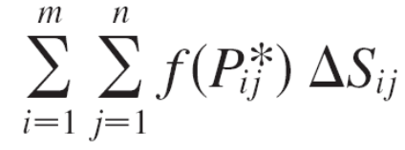
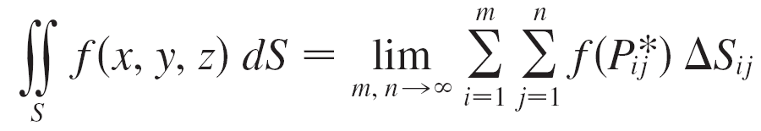

Parametric Surfaces
We evaluate f at a point in each patch, multiply by the area ΔS_{ij} of the patch, and form the Riemann sum
Then we take the limit as the number of patches increases and define the surface integral of f over the surface S as
Notice the analogy with the definition of a line integral and also the analogy with the definition of a double integral.

Slide 7
Parametric Surfaces
To evaluate the surface integral in Equation 1 we approximate the patch area ΔS_{ij} by the area of an
approximating parallelogram in the tangent plane.
In our discussion of surface area we made the approximation
ΔS_{ij} ≈ | r_{u} × r_{v} | Δu Δv
where
are the tangent vectors at a corner of S_{ij}.

Slide 8
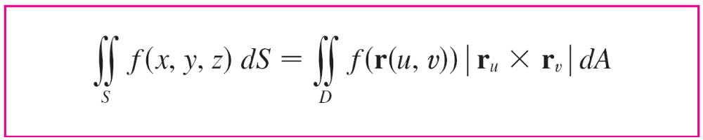

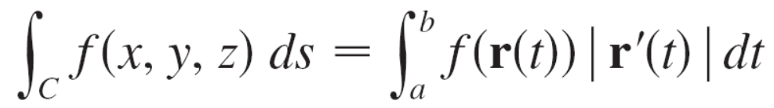
Parametric Surfaces
If the components are continuous and r_{u} and r_{v} are nonzero and nonparallel in the interior of D, it can be shown from Definition 1, even when D is not a rectangle, that
This should be compared with the formula for a line integral:

Slide 9
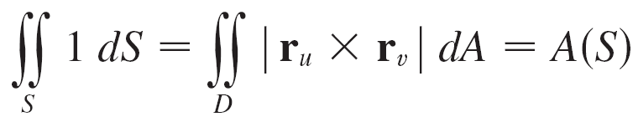
Parametric Surfaces
Observe also that
Formula 2 allows us to compute a surface integral by converting it into a double integral over the parameter domain D.
When using this formula, remember that f (r(u, v)) is
evaluated by writing x = x(u, v), y = y(u, v), and z = z(u, v) in the formula for f (x, y, z).

Slide 10
Example 1
Compute the surface integral ∫∫_{S} x² dS, where S is the unit sphere x² + y² + z² = 1.
Solution:
We use the parametric representation
x = sin φ cos θ y = sin φ sin θ z = cos φ 0 ≤ φ ≤ π 0 ≤ θ ≤ 2π
That is,
r(φ, θ ) = sin φ cos θ i + sin φ sin θ j + cos φ k
We can compute that
| r_{φ} × r_{θ} | = sin φ

Slide 11
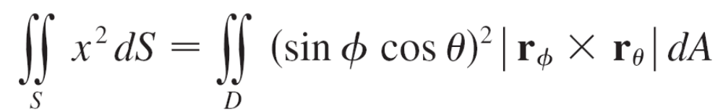
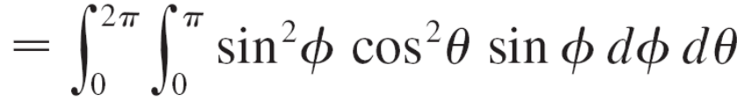
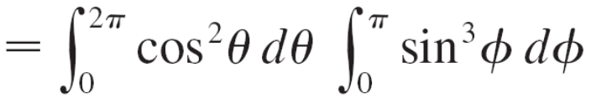


Example 1 – Solution
cont’d
Therefore, by Formula 2,

Slide 12
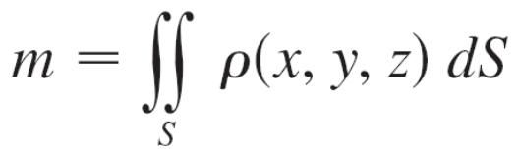

Parametric Surfaces
If a thin sheet (say, of aluminum foil) has the shape of a surface S and the density (mass per unit area) at the
point (x, y, z) is ρ (x, y, z), then the total mass of the sheet is
and the center of mass is , where

Slide 13
Graphs

Slide 14
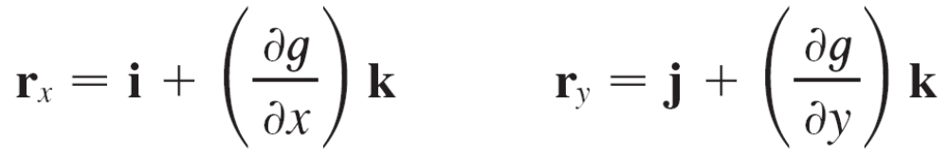
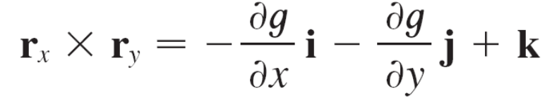

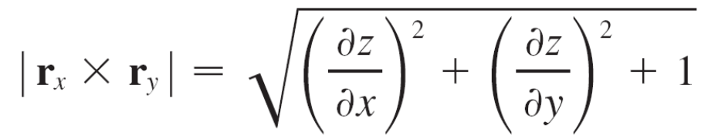
Graphs
Any surface S with equation z = g(x, y) can be regarded as a parametric surface with parametric equations
x = x y = y z = g(x, y)
and so we have
Thus
and

Slide 15
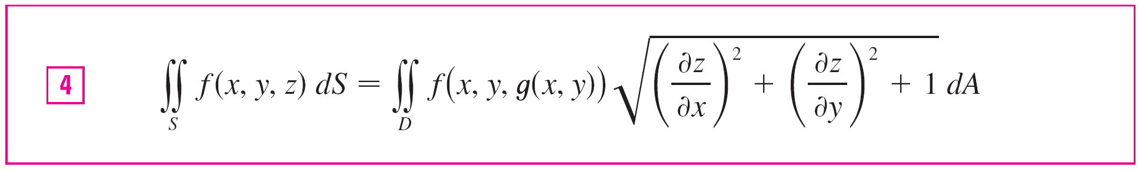
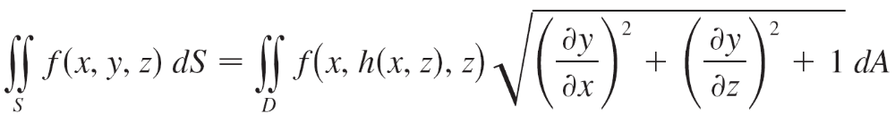
Graphs
Therefore, in this case, Formula 2 becomes
Similar formulas apply when it is more convenient to project S onto the yz-plane or xz-plane. For instance, if S is a surface with equation y = h(x, z) and D is its projection onto the xz-plane, then

Slide 16
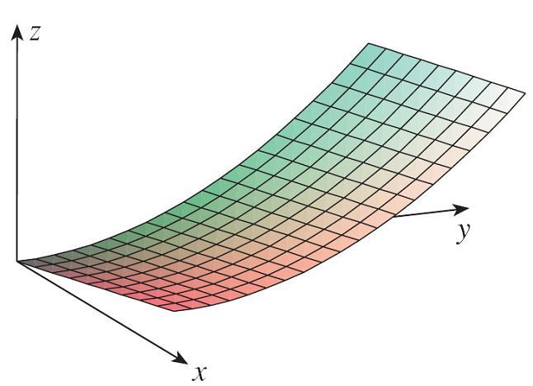
Example 2
Evaluate ∫∫_{S} y dS, where S is the surface z = x + y²,
0 ≤ x ≤ 1, 0 ≤ y ≤ 2. (See Figure 2.)
Figure 2

Slide 17
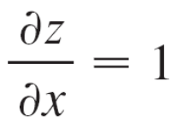
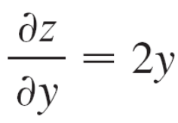
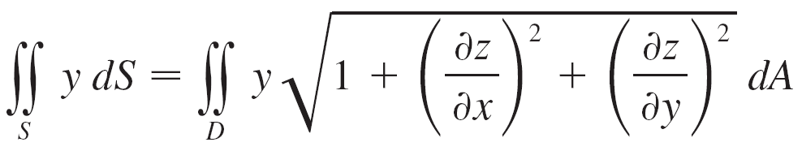
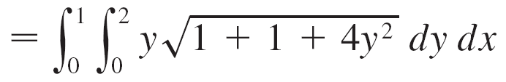
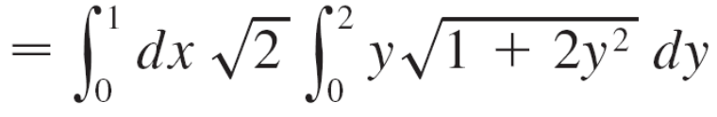


Example 2 – Solution
Since
and
Formula 4 gives

Slide 18
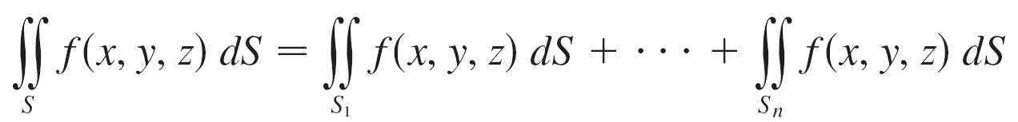
Graphs
If S is a piecewise-smooth surface, that is, a finite union of smooth surfaces S₁, S₂, . . . , S_{n} that intersect only along their boundaries, then the surface integral of f over S is defined by

Slide 19
Oriented Surfaces

Slide 20
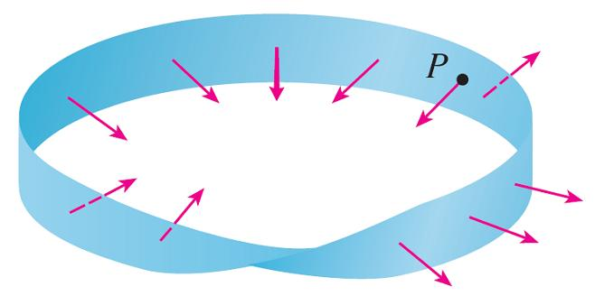
Oriented Surfaces
To define surface integrals of vector fields, we need to rule out nonorientable surfaces such as the Möbius strip shown in Figure 4. [It is named after the German geometer August
Möbius (1790–1868).]
A Möbius strip
Figure 4

Slide 21
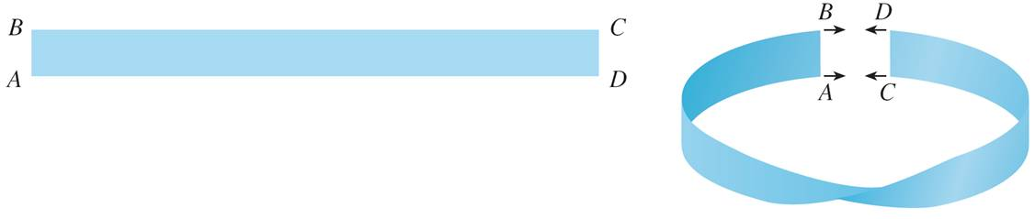
Oriented Surfaces
You can construct one for yourself by taking a long rectangular strip of paper, giving it a half-twist, and taping the short edges together as in Figure 5.
Constructing a Möbius strip
Figure 5

Slide 22
Oriented Surfaces
If an ant were to crawl along the Möbius strip starting at a point P, it would end up on the “other side” of the strip (that is, with its upper side pointing in the opposite direction).
Then, if the ant continued to crawl in the same direction, it would end up back at the same point P without ever having crossed an edge. (If you have constructed a Möbius strip, try drawing a pencil line down the middle.)
Therefore a Möbius strip really has only one side.
From now on we consider only orientable (two-sided) surfaces.

Slide 23
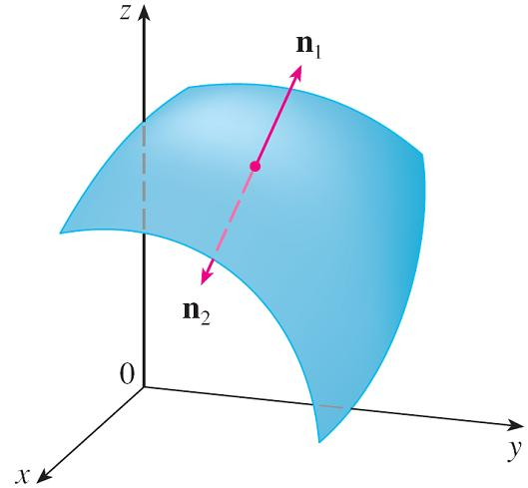
Oriented Surfaces
We start with a surface S that has a tangent plane at every point (x, y, z) on S (except at any boundary point).
There are two unit normal vectors n₁ and n₂ = –n₁
at (x, y, z). (See Figure 6.)
Figure 6

Slide 24
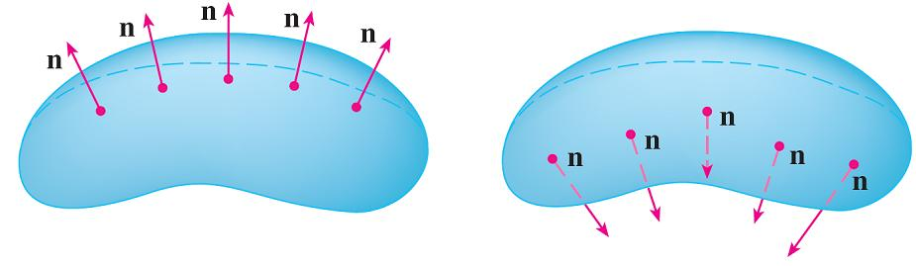
Oriented Surfaces
If it is possible to choose a unit normal vector n at every such point (x, y, z) so that n varies continuously over S, then S is called an oriented surface and the given choice of n provides S with an orientation.
There are two possible orientations for any orientable surface (see Figure 7).
The two orientations of an orientable surface
Figure 7

Slide 25
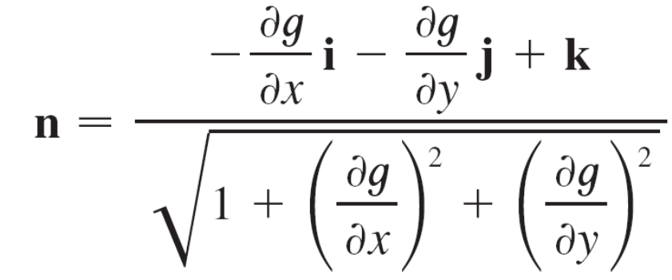

Oriented Surfaces
For a surface z = g(x, y) given as the graph of g, we use Equation 3 to associate with the surface a natural orientation given by the unit normal vector
Since the k-component is positive, this gives the upward orientation of the surface.

Slide 26
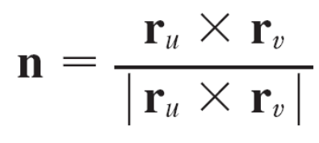

Oriented Surfaces
If S is a smooth orientable surface given in parametric form by a vector function r(u, v), then it is automatically supplied with the orientation of the unit normal vector
and the opposite orientation is given by –n.
For instance, the parametric representation is
r(φ, θ ) = a sin φ cos θ i + a sin φ sin θ j + a cos φ k
for the sphere x² + y² + z² = a².

Slide 27
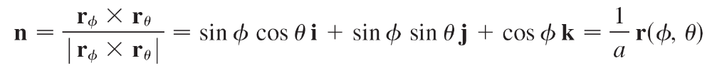
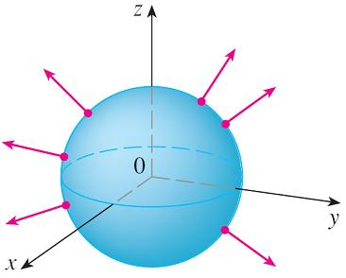
Oriented Surfaces
We know that
r_{φ} × r_{θ} = a² sin² φ cos θ i + a² sin² φ sin θ j + a² sin φ cos φ k
and | r_{φ} × r_{θ} | = a² sin φ
So the orientation induced by r(φ, θ ) is defined by the unit normal vector
Observe that n points in the same
direction as the position vector,
that is, outward from the sphere
(see Figure 8).
Positive orientation
Figure 8

Slide 28
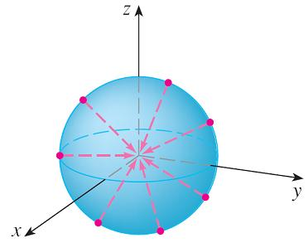
Oriented Surfaces
The opposite (inward) orientation would have been obtained (see Figure 9) if we had reversed the order of the parameters because r_{θ} × r_{φ} = –r_{φ} × r_{θ} .
For a closed surface, that is, a surface that is the boundary of a solid region E, the convention is that the positive orientation is the one for which the normal vectors point outward from E, and inward-pointing normals give the negative orientation (see Figures 8 and 9).
Negative orientation
Positive orientation
Figure 9
Figure 8

Slide 29
Surface Integrals of Vector Fields

Slide 30
Surface Integrals of Vector Fields
Suppose that S is an oriented surface with unit normal
vector n, and imagine a fluid with density ρ (x, y, z) and velocity field v(x, y, z) flowing through S. (Think of S as an
imaginary surface that doesn’t impede the fluid flow, like a fishing net across a stream.)
Then the rate of flow (mass per unit time) per unit area is
ρ v.

Slide 31

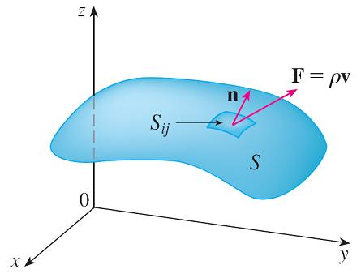
Surface Integrals of Vector Fields
We divide S into small patches S_{ij}, as in Figure 10 (compare with Figure 1).
Figure 10
Figure 1

Slide 32
Surface Integrals of Vector Fields
Then S_{ij} is nearly planar and so we can approximate the mass of fluid per unit time crossing S_{ij} in the direction of the normal n by the quantity
(ρ v  n)A(S_{ij})
where ρ, v, and n are evaluated at some point on S_{ij}. (Recall that the component of the vector ρ v in the direction
of the unit vector n is ρ v  n.)

Slide 33

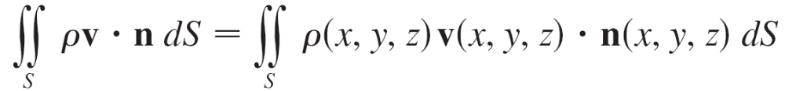

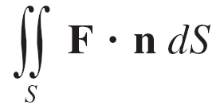
Surface Integrals of Vector Fields
By summing these quantities and taking the limit we get, according to Definition 1, the surface integral of the function
ρ v  n over S:
and this is interpreted physically as the rate of flow through S.
If we write F = ρ v, then F is also a vector field on and
the integral in Equation 7 becomes

Slide 34
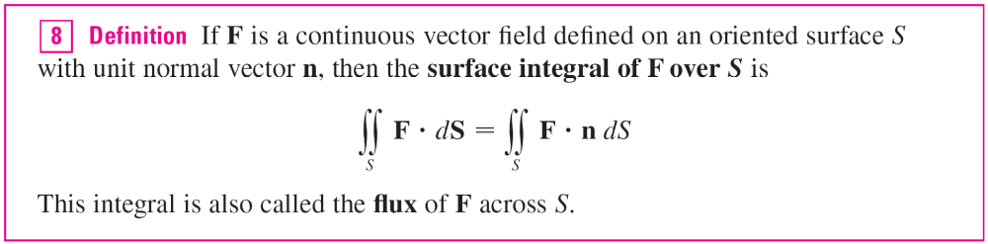
Surface Integrals of Vector Fields
A surface integral of this form occurs frequently in physics, even when F is not ρ v, and is called the surface integral (or flux integral ) of F over S.
In words, Definition 8 says that the surface integral of a vector field over S is equal to the surface integral of its normal component over S.

Slide 35
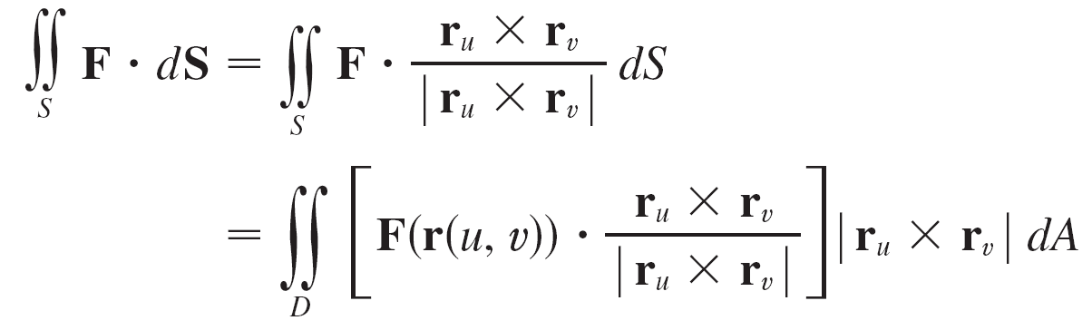
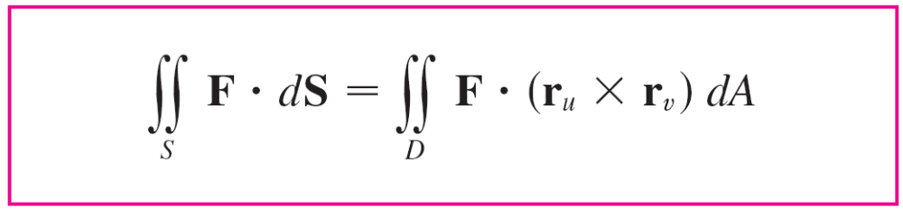

Surface Integrals of Vector Fields
If S is given by a vector function r(u, v), then n is given by Equation 6, and from Definition 8 and Equation 2 we have
where D is the parameter domain. Thus we have

Slide 36
Example 4
Find the flux of the vector field F(x, y, z) = z i + y j + x k across the unit sphere x² + y² + z² = 1.
Solution:
As in Example 1, we use the parametric representation
r(φ, θ ) = sin φ cos θ i + sin φ sin θ j + cos φ k
0 ≤ φ ≤ π 0 ≤ θ ≤ 2π
Then
F(r(φ, θ )) = cos φ i + sin φ sin θ j + sin φ cos θ k
and,
r_{φ} × r_{θ} = sin² φ cos θ i + sin² φ sin θ j + sin φ cos φ k

Slide 37
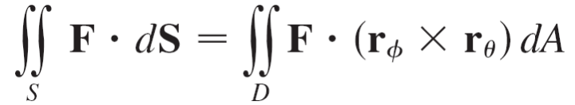
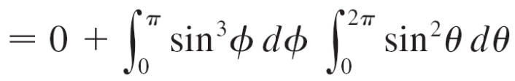
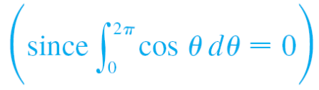
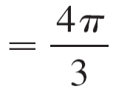
Example 4 – Solution
cont’d
Therefore F(r(φ, θ ))  (r_{φ} × r_{θ} ) = cos φ sin² φ cos θ + sin³ φ sin² θ + sin² φ cos φ cos θ and, by Formula 9, the flux is
by the same calculation as in Example 1.

Slide 38
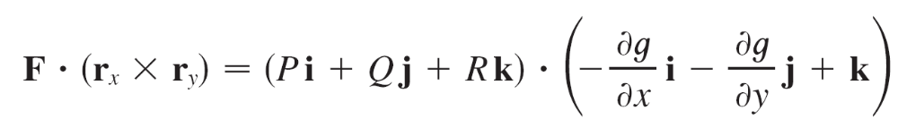
Surface Integrals of Vector Fields
If, for instance, the vector field in Example 4 is a velocity field describing the flow of a fluid with density 1, then the answer, 4π/3, represents the rate of flow through the unit sphere in units of mass per unit time.
In the case of a surface S given by a graph z = g(x, y), we can think of x and y as parameters and use Equation 3 to write

Slide 39
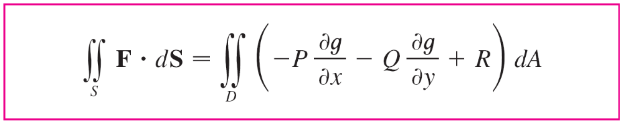

Surface Integrals of Vector Fields
Thus Formula 9 becomes
This formula assumes the upward orientation of S; for a downward orientation we multiply by –1.
Similar formulas can be worked out if S is given by
y = h(x, z) or x = k(y, z).
Although we motivated the surface integral of a vector field using the example of fluid flow, this concept also arises in other physical situations.

Slide 40
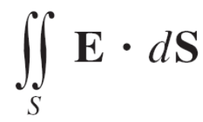

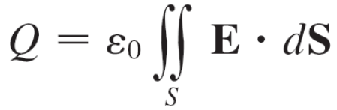
Surface Integrals of Vector Fields
For instance, if E is an electric field, then the surface integral
is called the electric flux of E through the surface S. One of the important laws of electrostatics is Gauss’s Law, which says that the net charge enclosed by a closed surface S is
where ε₀ is a constant (called the permittivity of free space) that depends on the units used. (In the SI system, ε₀ ≈ 8.8542 × 10^{–12} C²/N  m².)

Slide 41

Surface Integrals of Vector Fields
Therefore, if the vector field F in Example 4 represents an electric field, we can conclude that the charge enclosed by S is Q = πε₀.
Another application of surface integrals occurs in the study of heat flow. Suppose the temperature at a point (x, y, z) in a body is u(x, y, z). Then the heat flow is defined as the vector field
F = –K ∇u
where K is an experimentally determined constant called the conductivity of the substance.

Slide 42
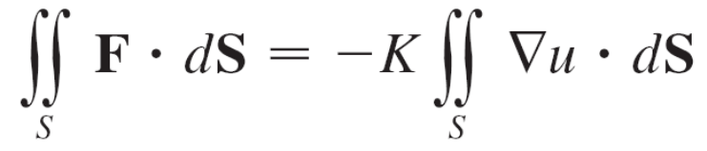
Surface Integrals of Vector Fields
The rate of heat flow across the surface S in the body is then given by the surface integral

