Slide 1


16
Vector Calculus
Copyright © Cengage Learning. All rights reserved.

Slide 2

16.8
Stokes’ Theorem
Copyright © Cengage Learning. All rights reserved.

Slide 3
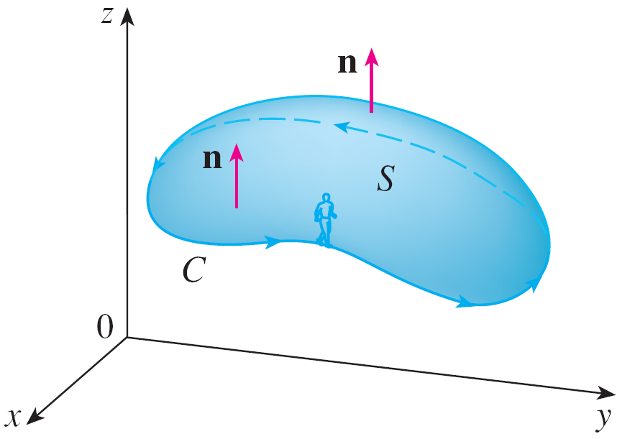
Stokes' Theorem
Stokes’ Theorem can be regarded as a higher-dimensional version of Green’s Theorem.
Whereas Green’s Theorem relates a double integral over
a plane region D to a line integral around its plane boundary curve, Stokes’ Theorem relates a surface integral over a surface S to a line integral around the boundary curve of S (which is a space curve).
Figure 1 shows an oriented
surface with unit normal
vector n.
Figure 1

Slide 4
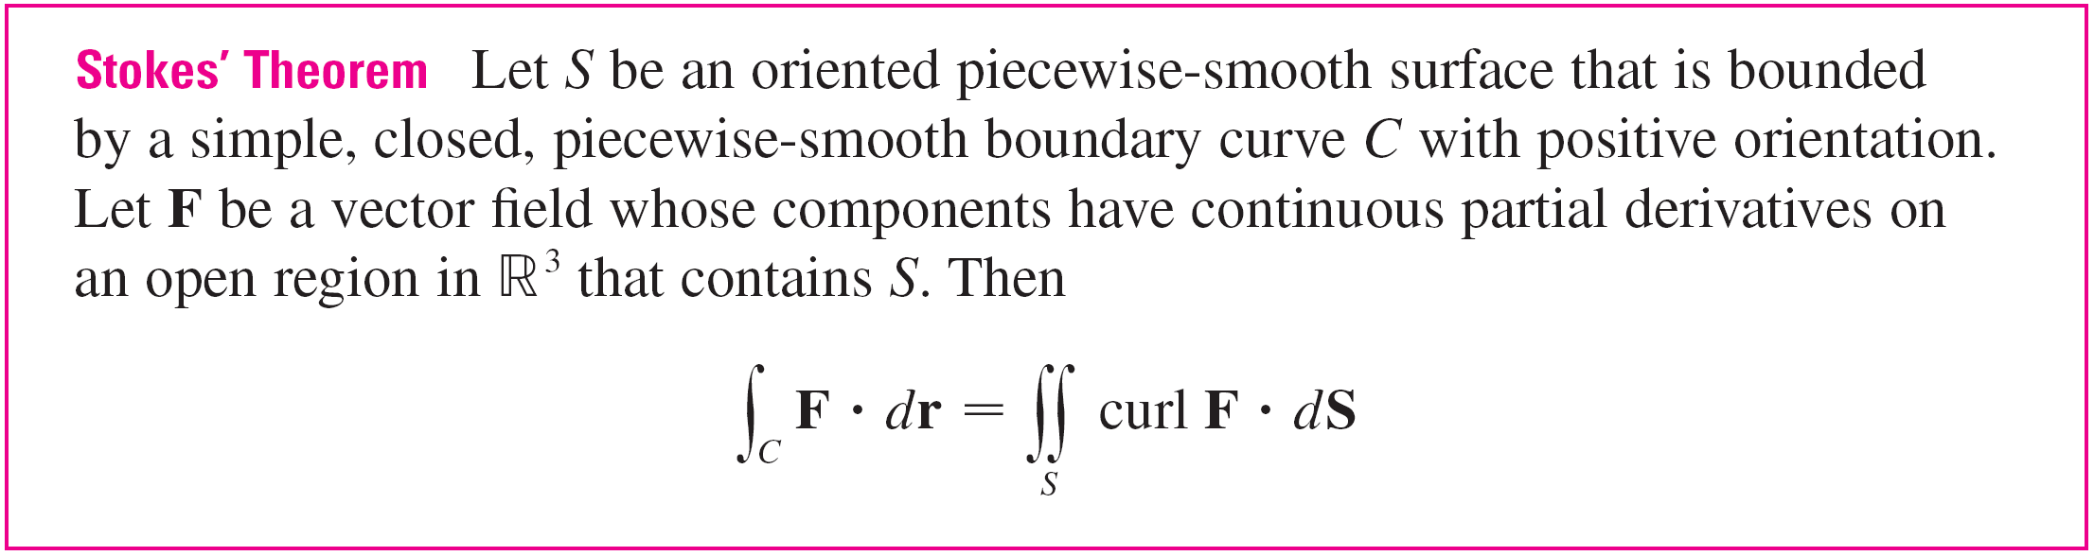
Stokes' Theorem
The orientation of S induces the positive orientation of the boundary curve C shown in the figure.
This means that if you walk in the positive direction around C with your head pointing in the direction of n, then the surface will always be on your left.

Slide 5



Stokes' Theorem
Since
∫_{C} F  dr = ∫_{C} F  T ds and curl F  dS = curl F  n dS
Stokes’ Theorem says that the line integral around the boundary curve of S of the tangential component of F is equal to the surface integral over S of the normal component of the curl of F.
The positively oriented boundary curve of the oriented surface S is often written as ∂S, so Stokes’ Theorem can be expressed as
curl F  dS = F  dr

Slide 6
Stokes' Theorem
There is an analogy among Stokes’ Theorem, Green’s Theorem, and the Fundamental Theorem of Calculus.
As before, there is an integral involving derivatives on the left side of Equation 1 (recall that curl F is a sort of derivative of F) and the right side involves the values of F only on the boundary of S.

Slide 7
Stokes' Theorem
In fact, in the special case where the surface S is flat and lies in the xy-plane with upward orientation, the unit normal is k, the surface integral becomes a double integral, and Stokes’ Theorem becomes
∫_{C} F  dr = curl F  dS = (curl F)  k dA
This is precisely the vector form of Green’s Theorem.
Thus we see that Green’s Theorem is really a special case of Stokes’ Theorem.

Slide 8
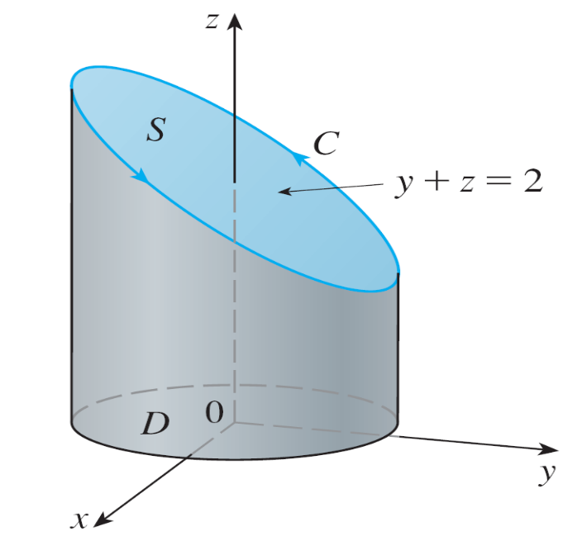
Example 1
Evaluate ∫_{C} F  dr, where F(x, y, z) = –y² i + x j + z² k and C is the curve of intersection of the plane y + z = 2 and the cylinder x² + y² = 1. (Orient C to be counterclockwise when viewed from above.)
Solution:
The curve C (an ellipse) is
shown in Figure 3.
Figure 3

Slide 9
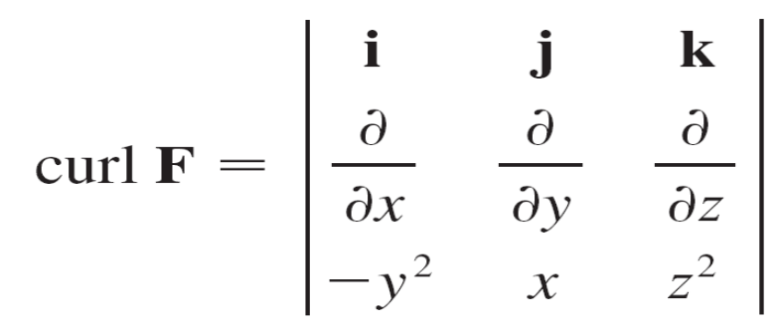

Example 1 – Solution
cont’d
Although ∫_{C} F  dr could be evaluated directly, it’s easier to use Stokes’ Theorem.
We first compute
Although there are many surfaces with boundary C, the most convenient choice is the elliptical region S in the plane y + z = 2 that is bounded by C.

Slide 10
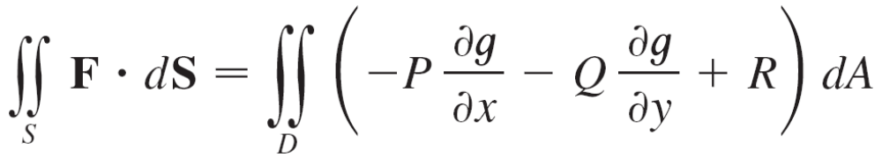
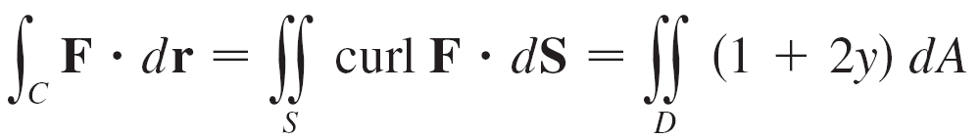
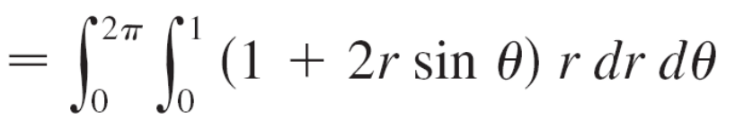
Example 1 – Solution
cont’d
If we orient S upward, then C has the induced positive orientation.
The projection D of S onto the xy-plane is the disk x² + y² ≤ 1 and so using equation
with z = g(x, y) = 2 – y, we have

Slide 11
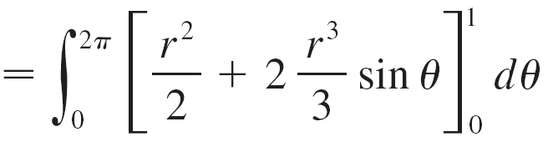
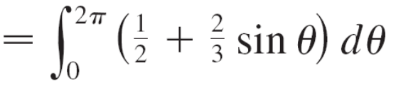


Example 1 – Solution
cont’d

Slide 12

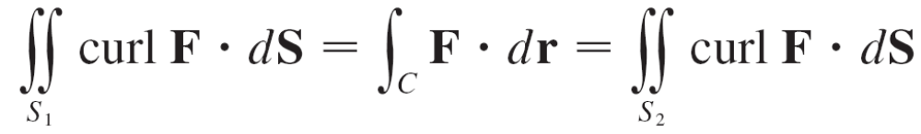
Stokes' Theorem
In general, if S₁ and S₂ are oriented surfaces with the same oriented boundary curve C and both satisfy the hypotheses of Stokes’ Theorem, then
This fact is useful when it is difficult to integrate over one surface but easy to integrate over the other.
We now use Stokes’ Theorem to throw some light on the meaning of the curl vector.

Slide 13
Stokes' Theorem
Suppose that C is an oriented closed curve and v represents the velocity field in fluid flow.
Consider the line integral
∫_{C} v  dr = ∫_{C} v  T ds
and recall that v  T is the component of v in the direction of the unit tangent vector T.

Slide 14
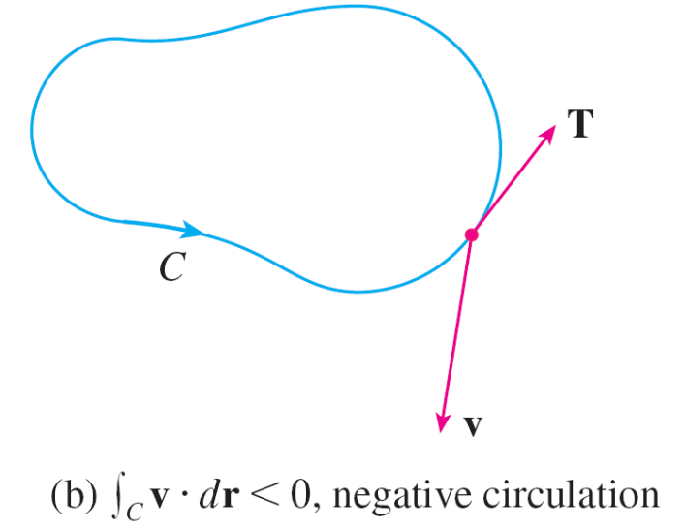
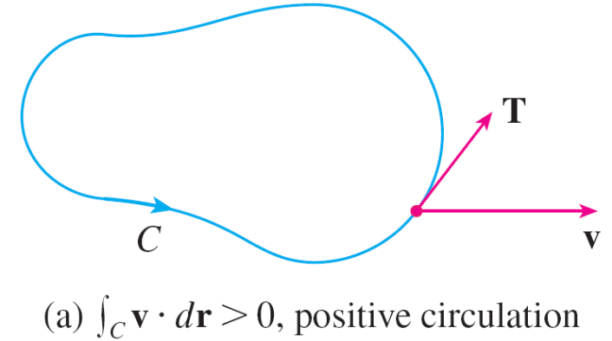
Stokes' Theorem
This means that the closer the direction of v is to the direction of T, the larger the value of v  T.
Thus ∫_{C} v  dr is a measure of the tendency of the fluid to move around C and is called the circulation of v around C.
(See Figure 5.)
Figure 5

Slide 15
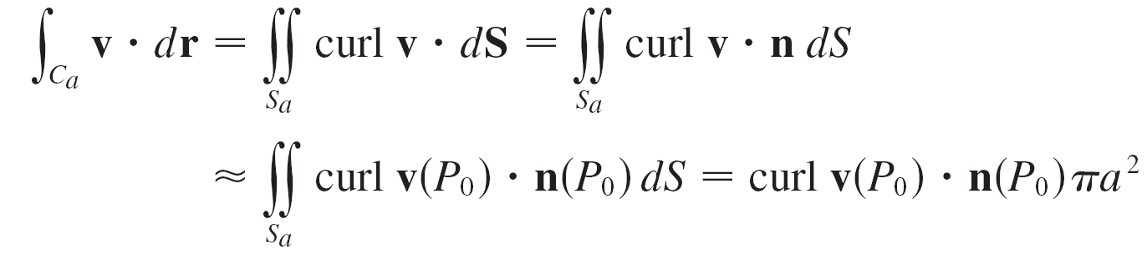
Stokes' Theorem
Now let P₀(x₀, y₀, z₀) be a point in the fluid and let S_{a} be a small disk with radius a and center P₀.
Then (curl F)(P) ≈ (curl F)(P₀) for all points P on S_{a} because curl F is continuous.
Thus, by Stokes’ Theorem, we get the following approximation to the circulation around the boundary
circle C_{a}:

Slide 16
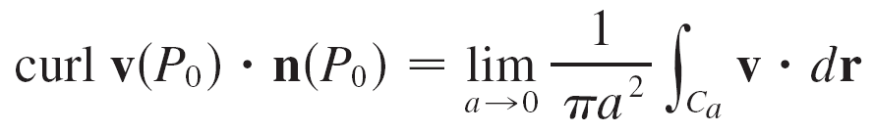

Stokes' Theorem
This approximation becomes better as a → 0 and we have
Equation 4 gives the relationship between the curl and the circulation.
It shows that curl v  n is a measure of the rotating effect of the fluid about the axis n.
The curling effect is greatest about the axis parallel to
curl v.

Slide 17
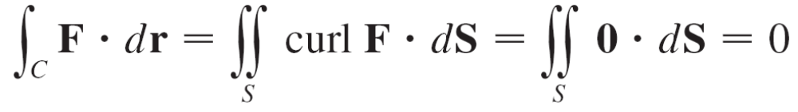
Stokes' Theorem
We know that F is conservative if ∫_{C} F  dr = 0 for every closed path C. Given C, suppose we can find an orientable surface S whose boundary is C.
Then Stokes’ Theorem gives
A curve that is not simple can be broken into a number of simple curves, and the integrals around these simple curves are all 0.
Adding these integrals, we obtain ∫_{C} F  dr = 0 for any closed curve C.

