Slide 1


16
Vector Calculus
Copyright © Cengage Learning. All rights reserved.

Slide 2

The Divergence Theorem
16.9
Copyright © Cengage Learning. All rights reserved.

Slide 3
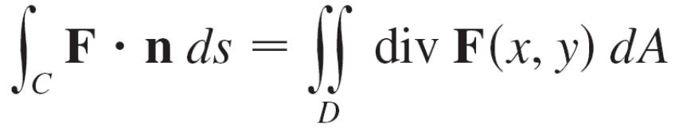


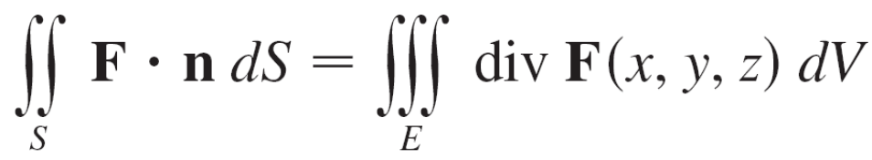
The Divergence Theorem
We write Green’s Theorem in a vector version as
where C is the positively oriented boundary curve of the plane region D.
If we were seeking to extend this theorem to vector fields on we might make the guess that
where S is the boundary surface of the solid region E.

Slide 4
The Divergence Theorem
It turns out that Equation 1 is true, under appropriate hypotheses, and is called the Divergence Theorem.
Notice its similarity to Green’s Theorem and Stokes’ Theorem in that it relates the integral of a derivative of a function (div F in this case) over a region to the integral of the original function F over the boundary of the region.
We state the Divergence Theorem for regions E that are simultaneously of types 1, 2, and 3 and we call such regions simple solid regions. (For instance, regions bounded by ellipsoids or rectangular boxes are simple solid regions.)

Slide 5
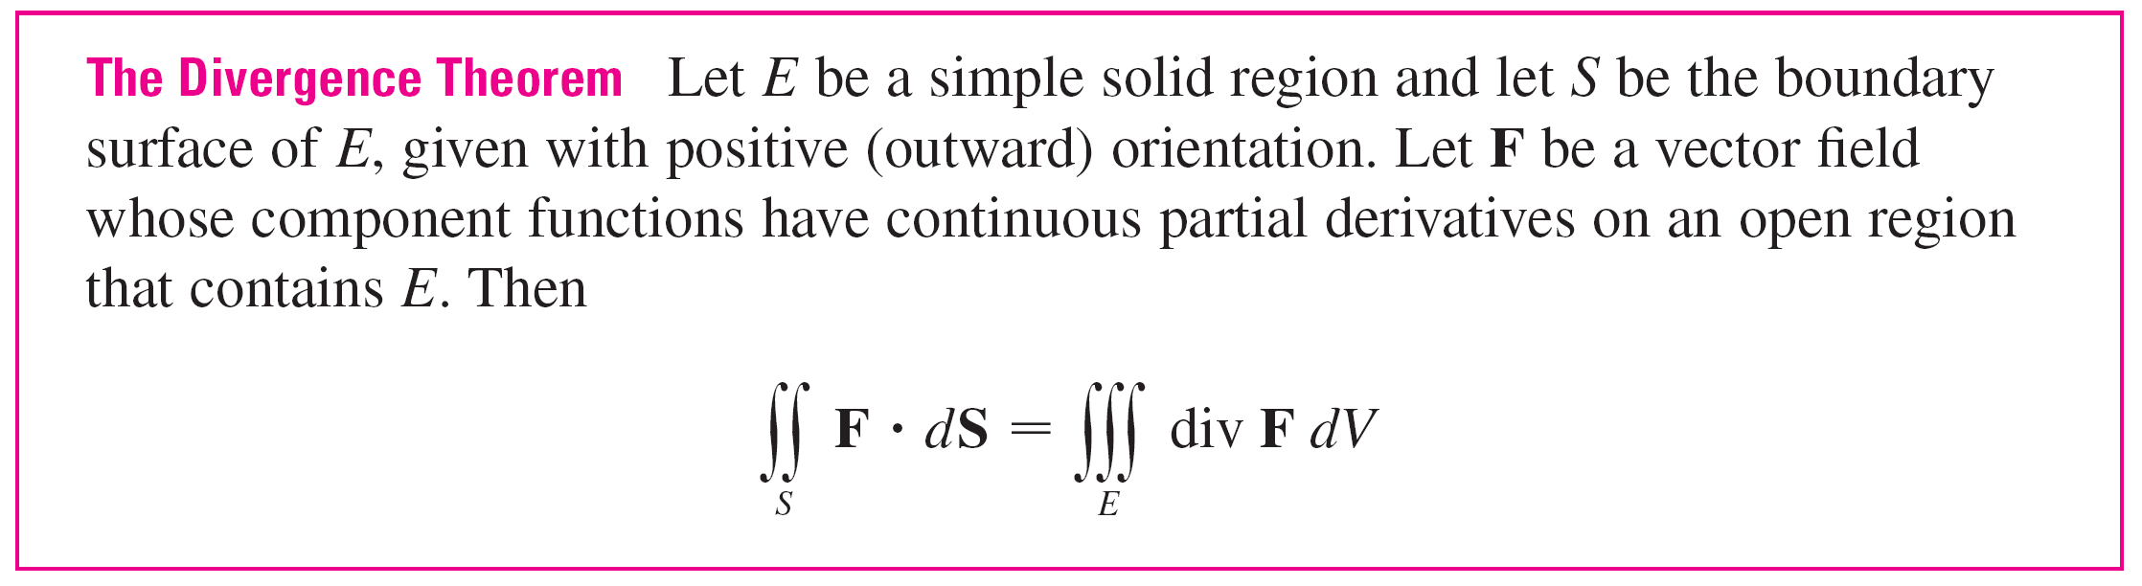
The Divergence Theorem
The boundary of E is a closed surface, and we use the convention, that the positive orientation is outward; that is, the unit normal vector n is directed outward from E.
Thus the Divergence Theorem states that, under the given conditions, the flux of F across the boundary surface of E is equal to the triple integral of the divergence of F over E.

Slide 6
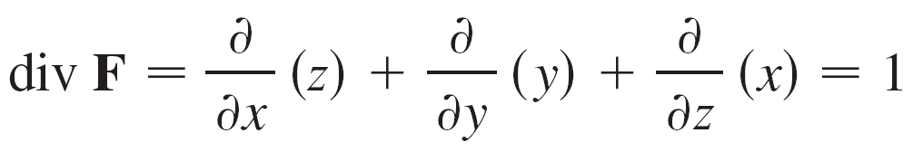
Example 1
Find the flux of the vector field F(x, y, z) = z i + y j + x k over the unit sphere x² + y² + z² = 1.
Solution:
First we compute the divergence of F:
The unit sphere S is the boundary of the unit ball B given by x² + y² + z² ≤ 1.

Slide 7
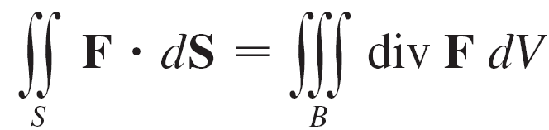
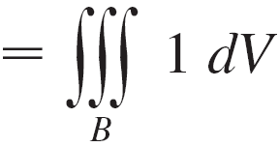


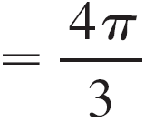
Example 1 – Solution
cont’d
Thus the Divergence Theorem gives the flux as

Slide 8
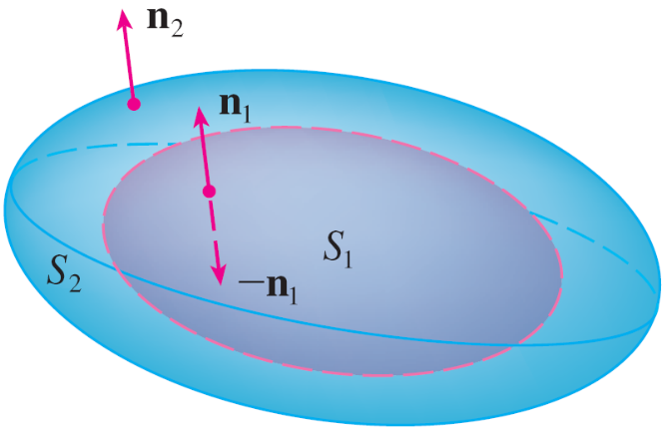
The Divergence Theorem
Let’s consider the region E that lies between the closed surfaces S₁ and S₂, where S₁ lies inside S₂. Let n₁ and n₂ be outward normals of S₁ and S₂.
Then the boundary surface of E is S = S₁ U S₂ and its normal n is given by n = –n₁ on S₁ and n = n₂ on S₂. (See Figure 3.)
Figure 3

Slide 9

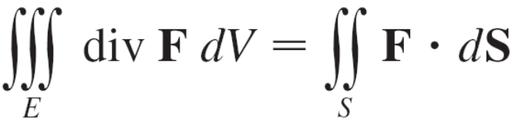
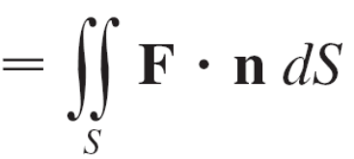
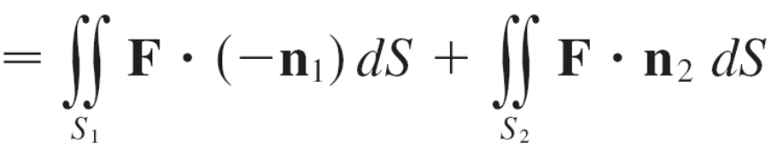
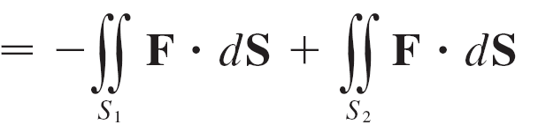
The Divergence Theorem
Applying the Divergence Theorem to S, we get

Slide 10
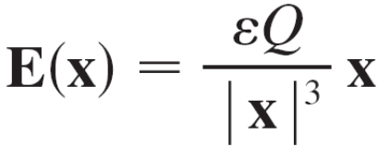

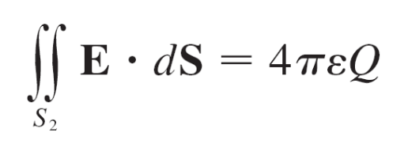
Example 3
We considered the electric field:
where the electric charge Q is located at the origin and
is a position vector.
Use the Divergence Theorem to show that the electric flux of E through any closed surface S₂ that encloses the origin is

Slide 11
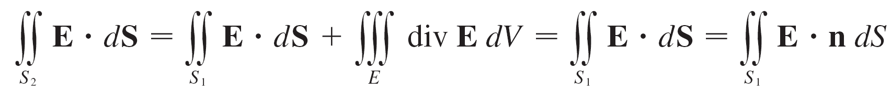
Example 3 – Solution
The difficulty is that we don’t have an explicit equation for S₂ because it is any closed surface enclosing the origin. The simplest such surface would be a sphere, so
we let S₁ be a small sphere with radius a and center the origin. You can verify that div E = 0.
Therefore Equation 7 gives

Slide 12
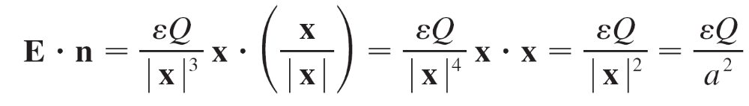
Example 3 – Solution
cont’d
The point of this calculation is that we can compute the surface integral over S₁ because S₁ is a sphere. The normal vector at x is x/| x |.
Therefore
since the equation of S₁ is | x | = a.

Slide 13
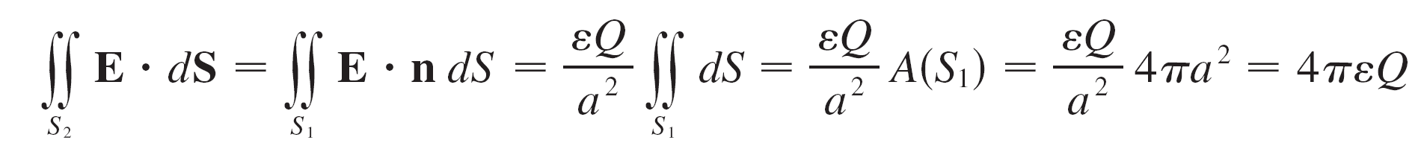
Example 3 – Solution
cont’d
Thus we have
This shows that the electric flux of E is 4πεQ through any closed surface S₂ that contains the origin. [This is a special case of Gauss’s Law for a single charge. The relationship between ε and ε₀ is ε =1/(4πε₀).]

Slide 14
The Divergence Theorem
Another application of the Divergence Theorem occurs in fluid flow. Let v(x, y, z) be the velocity field of a fluid with constant density ρ. Then F = ρ v is the rate of flow per unit area.

Slide 15
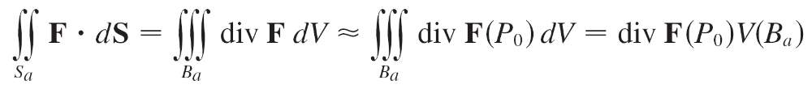
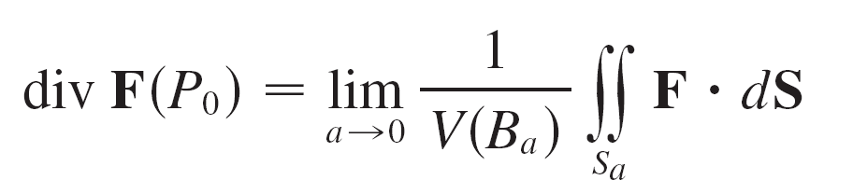

The Divergence Theorem
If P₀(x₀, y₀, z₀) is a point in the fluid and B_{a} is a ball with center P₀ and very small radius a, then div F(P) ≈ div F(P₀) for all points in B_{a} since div F is continuous. We approximate the flux over the boundary sphere S_{a} as follows:
This approximation becomes better as a → 0 and suggests that

Slide 16
The Divergence Theorem
Equation 8 says that div F(P₀) is the net rate of outward flux per unit volume at P₀. (This is the reason for the name divergence.)
If div F(P) > 0, the net flow is outward near P and P is called a source.
If div F(P) < 0, the net flow is inward near P and P is called a sink.

Slide 17
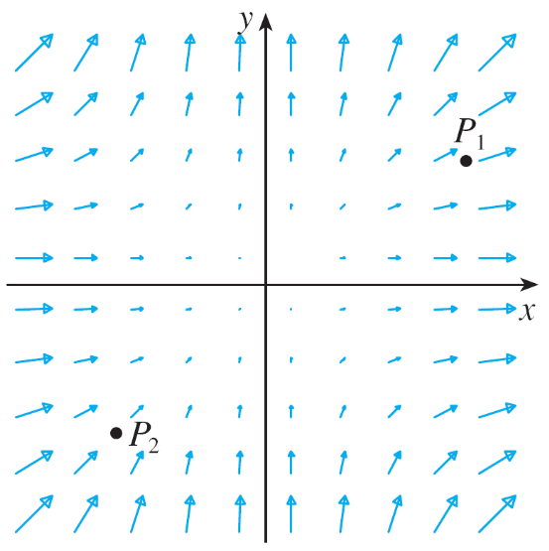
The Divergence Theorem
For the vector field in Figure 4, it appears that the vectors that end near P₁ are shorter than the vectors that start
near P₁.
Figure 4
The vector field F = x² i + y² j

Slide 18
The Divergence Theorem
Thus the net flow is outward near P₁, so div F(P₁) > 0 and P₁ is a source. Near P₂, on the other hand, the incoming arrows are longer than the outgoing arrows.
Here the net flow is inward, so div F(P₂) < 0 and P₂ is a sink.
We can use the formula for F to confirm this impression. Since F = x² i + y² j, we have div F = 2x + 2y, which is positive when y > –x. So the points above the line y = –x are sources and those below are sinks.

