Slide 1

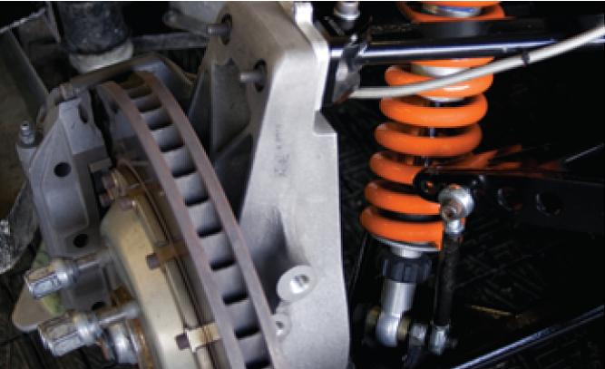
Second-Order Differential
Equations
17
Copyright © Cengage Learning. All rights reserved.

Slide 2

17.1
Second-Order Linear Equations
Copyright © Cengage Learning. All rights reserved.

Slide 3
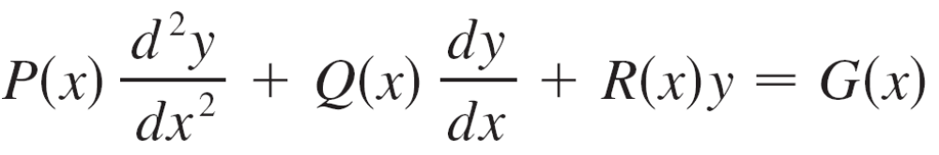

Second-Order Linear Equations
A second-order linear differential equation has the form
where P, Q, R, and G are continuous functions.
In this section we study the case where G(x) = 0, for all x, in Equation 1.
Such equations are called homogeneous linear equations.

Slide 4
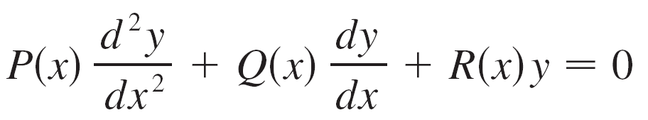

Second-Order Linear Equations
Thus the form of a second-order linear homogeneous differential equation is
If G(x) ≠ 0 for some x, Equation 1 is nonhomogeneous.

Slide 5
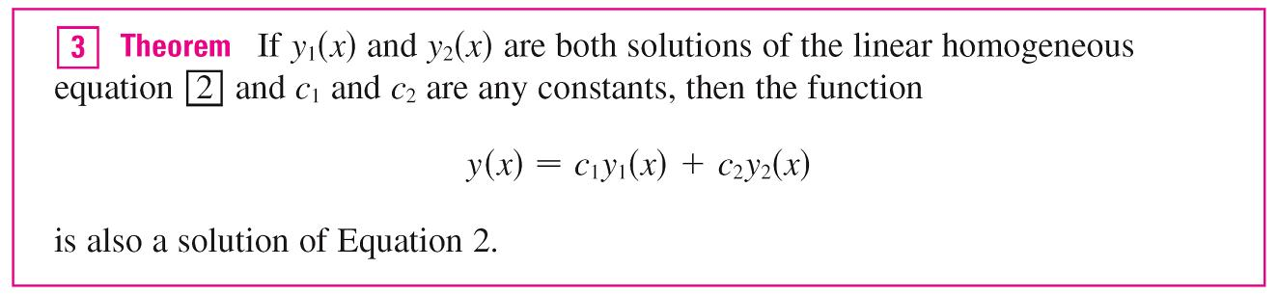
Second-Order Linear Equations
Two basic facts enable us to solve homogeneous linear equations.
The first of these says that if we know two solutions y₁ and y₂ of such an equation, then the linear combination
y = c₁y₁ + c₂y₂ is also a solution.

Slide 6
Second-Order Linear Equations
The other fact we need is given by the following theorem, which is proved in more advanced courses.
It says that the general solution is a linear combination of two linearly independent solutions y₁ and y₂.
This means that neither y₁ nor y₂ is a constant multiple of the other.
For instance, the functions f (x) = x² and g(x) = 5x² are linearly dependent, but f (x) = e^{x} and g(x) = xe^{x} are linearly independent.

Slide 7
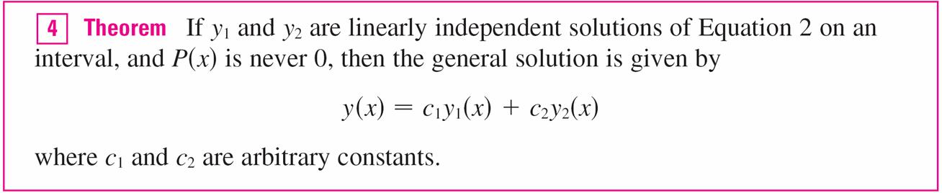
Second-Order Linear Equations
Theorem 4 is very useful because it says that if we know two particular linearly independent solutions, then we know every solution.
In general, it’s not easy to discover particular solutions to a second-order linear equation.

Slide 8


Second-Order Linear Equations
But it is always possible to do so if the coefficient functions
P, Q, and R are constant functions, that is, if the differential equation has the form
where a, b, and c are constants and a ≠ 0.
It’s not hard to think of some likely candidates for particular solutions of Equation 5 if we state the equation verbally.

Slide 9
Second-Order Linear Equations
We are looking for a function y such that a constant times
its second derivative y ″ plus another constant times y ′ plus a third constant times y is equal to 0.
We know that the exponential function y = e^{r x} (where r is a constant) has the property that its derivative is a constant multiple of itself: y ′ = re^{rx}. Furthermore, y ″ = r²e^{r x}. If we substitute these expressions into Equation 5, we see that
y = e^{r x} is a solution if
ar²e^{r x} + bre^{r x} + ce^{r x} = 0
or
(ar² + br + c)e^{r x} = 0

Slide 10


Second-Order Linear Equations
But e^{rx} is never 0. Thus y = e^{rx} is a solution of Equation 5 if r is a root of the equation
Equation 6 is called the auxiliary equation (or characteristic equation) of the differential equation
ay ″ + by ′ + cy = 0.
Notice that it is an algebraic equation that is obtained from the differential equation by replacing y ″ by r², y ′ by r, and y by 1.

Slide 11
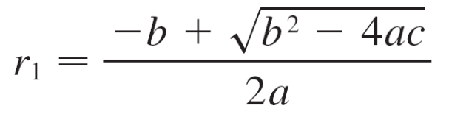
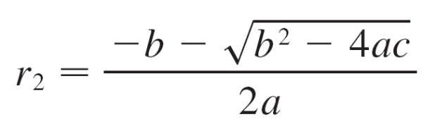

Second-Order Linear Equations
Sometimes the roots r₁ and r₂ of the auxiliary equation can be found by factoring. In other cases they are found by using the quadratic formula:
We distinguish three cases according to the sign of the discriminant b² – 4ac.

Slide 12


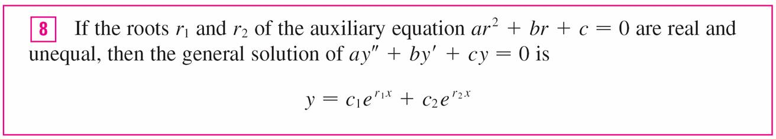
Second-Order Linear Equations
Case I: b² – 4ac > 0
In this case the roots r₁ and r₂ of the auxiliary equation are real and distinct, so y₁ = and y₂ = are two linearly independent solutions of Equation 5. (Note that is not a
constant multiple of .)
Therefore, by Theorem 4, we have the following fact.

Slide 13

Example 1
Solve the equation y ″ + y ′ – 6y = 0.
Solution:
The auxiliary equation is
r² + r – 6 = (r – 2)(r + 3) = 0
whose roots are r = 2, –3.
Therefore, by , the general solution of the given
differential equation is
y = c₁e^{2x} + c₂e^{–3x}

Slide 14
Example 1 – Solution
cont’d
We could verify that this is indeed a solution by differentiating and substituting into the differential equation.

Slide 15
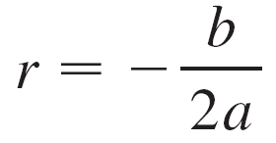

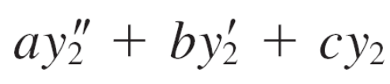
Second-Order Linear Equations
Case II: b² – 4ac = 0
In this case r₁ = r₂; that is, the roots of the auxiliary equation are real and equal. Let’s denote by r the common value of r₁ and r₂. Then, from Equations 7, we have
so 2ar + b = 0
We know that y₁ = e^{r x} is one solution of Equation 5. We now verify that y₂ = xe^{r x} is also a solution:
= a(2re^{r x} + r²xe^{r x}) + b(e^{r x} + rxe^{r x}) + cxe^{r x}
= (2ar + b)e^{r x} + (ar² + br + c)xe^{r x}

Slide 16
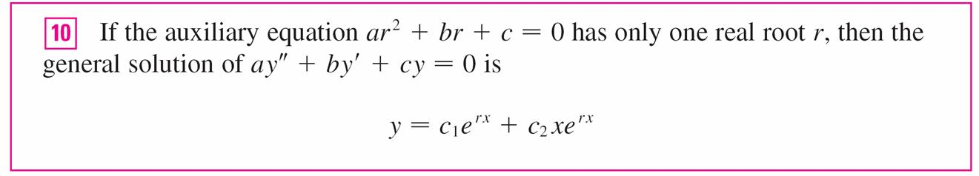
Second-Order Linear Equations
= 0(e^{r x}) + 0(xe^{r x}) = 0
The first term is 0 by Equations 9; the second term is 0 because r is a root of the auxiliary equation.
Since y₁ = e^{r x} and y₂ = xe^{r x} are linearly independent solutions, Theorem 4 provides us with the general solution.

Slide 17


Example 3
Solve the equation 4y ″ + 12y ′ + 9y = 0.
Solution:
The auxiliary equation is 4r² + 12r + 9 = 0 can be factored as
(2r + 3)² = 0
so the only root is r = By , the general solution is
y = c₁e^{–3x/2} + c₂xe^{–3x/2}

Slide 18

Second-Order Linear Equations
Case III: b² – 4ac < 0
In this case the roots r₁ and r₂ of the auxiliary equation are complex numbers. We can write
r₁ = α + iβ r₂ = α – iβ
Where α and β are real numbers. [In fact, α = –b/(2a),
β = ] Then, using Euler’s equation
e^{iθ} = cos θ + i sin θ

Slide 19


Second-Order Linear Equations
We write the solution of the differential equation as
y = C₁ + C₂ = C₁e^{(α +iβ)x} + C₂e^{(α – iβ)x}
= C₁e^{α x}(cos βx + i sin βx) + C₂e^{α x}(cos βx – i sin βx)
= e^{α x}[(C₁ + C₂) cos βx + i(C₁ – C₂) sin βx]
= e^{α x}(c₁ cos βx + c₂ sin βx)
Where c₁ = C₁ + C₂, c₂ = i(C₁ – C₂).

Slide 20
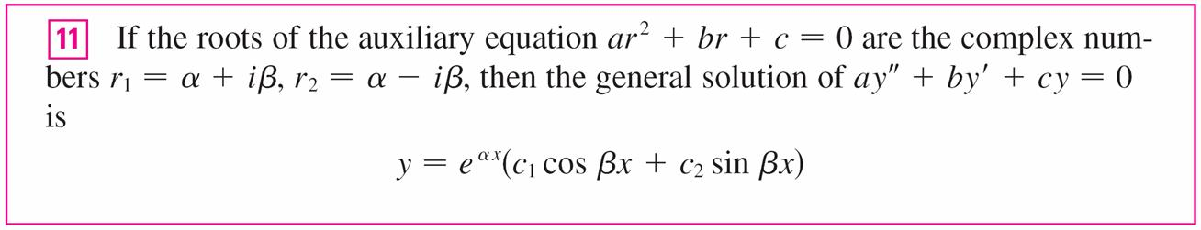
Second-Order Linear Equations
This gives all solutions (real or complex) of the differential
equation. The solutions are real when the constants c₁ and c₂ are real.
We summarize the discussion as follows.

Slide 21
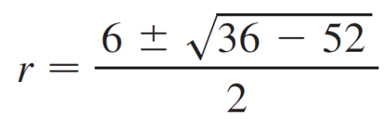
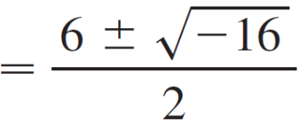

Example 4
Solve the equation y ″ – 6y ′ + 13y = 0.
Solution:
The auxiliary equation is r² – 6r + 13 = 0. By the quadratic formula, the roots are

Slide 22

Example 4 – Solution
cont’d
By , the general solution of the differential equation is
y = e^{3x}(c₁ cos 2x + c₂ sin 2x)

Slide 23
Initial-Value and
Boundary-Value Problems

Slide 24
Initial-Value and Boundary-Value Problems
An initial-value problem for the second-order Equation 1 or 2 consists of finding a solution y of the differential equation that also satisfies initial conditions of the form
y(x₀) = y₀ y ′(x₀) = y₁
Where y₀ and y₁ are given constants.
If P, Q, R, and G are continuous on an interval and P(x) ≠ 0 there, then a theorem found in more advanced books guarantees the existence and uniqueness of a solution to this initial-value problem. Examples 5 illustrate the technique for solving such a problem.

Slide 25
Example 5
Solve the initial-value problem
y ″ + y ′ – 6y = 0 y(0) = 1 y ′(0) = 0
Solution:
From Example 1 we know that the general solution of the differential equation is
y (x) = c₁e^{2x} + c₂e^{–3x}
Differentiating this solution, we get
y ′(x) = 2c₁e^{2x} – 3c₂e^{–3x}

Slide 26







Example 5 – Solution
cont’d
To satisfy the initial conditions we require that
y (0) = c₁ + c₂ = 1
y ′ (0) = 2c₁ – 3c₂ = 0
From we have c₂ = c₁ and so gives
c₁ + c₁ = 1 c₁ = c₂ =

Slide 27
Example 5 – Solution
cont’d
Thus the required solution of the initial-value problem is
y = e^{2x} + e^{–3x}

Slide 28
Initial-Value and Boundary-Value Problems
A boundary-value problem for Equation 1 or 2 consists of finding a solution y of the differential equation that also satisfies boundary conditions of the form
y (x₀) = y₀ y (x₁) = y₁
In contrast with the situation for initial-value problems, a boundary-value problem does not always have a solution. The method is illustrated in Example 7.

Slide 29
Example 7
Solve the boundary-value problem
y ″ + 2y ′ + y = 0 y (0) = 1 y (1) = 3
Solution:
The auxiliary equation is
r² + 2r + 1 = 0 or (r + 1)² = 0
whose only root is r = –1.
Therefore the general solution is
y (x) = c₁e^{–x} + c₂xe^{–x}

Slide 30
Example 7 – Solution
cont’d
The boundary conditions are satisfied if
y (0) = c₁ = 1
y (1) = c₁e^{–1} + c₂e^{–1} = 3
The first condition gives c₁ = 1, so the second condition becomes
e^{–1} + c₂e^{–1} = 3

Slide 31
Example 7 – Solution
cont’d
Solving this equation for c₂ by first multiplying through by e, we get
1 + c₂ = 3e so c₂ = 3e – 1
Thus the solution of the boundary-value problem is
y = e^{–x} + (3e – 1)xe^{–x}

