Slide 1

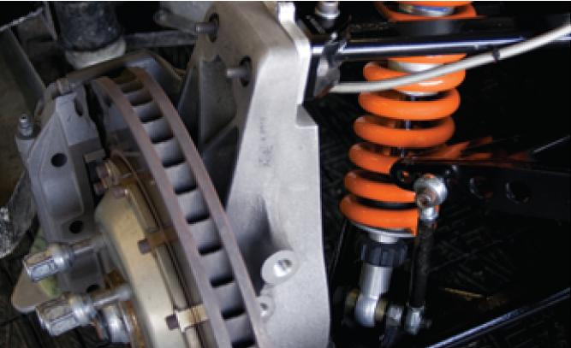
Second-Order Differential
Equations
17
Copyright © Cengage Learning. All rights reserved.

Slide 2

17.2
Nonhomogeneous Linear Equations
Copyright © Cengage Learning. All rights reserved.

Slide 3



Nonhomogeneous Linear Equations
In this section we learn how to solve second-order nonhomogeneous linear differential equations with constant coefficients, that is, equations of the form
ay ″ + by ′ + cy = G(x)
where a, b, and c are constants and G is a continuous function. The related homogeneous equation
ay ″ + by ′ + cy = 0
is called the complementary equation and plays an important role in the solution of the original nonhomogeneous equation

Slide 4
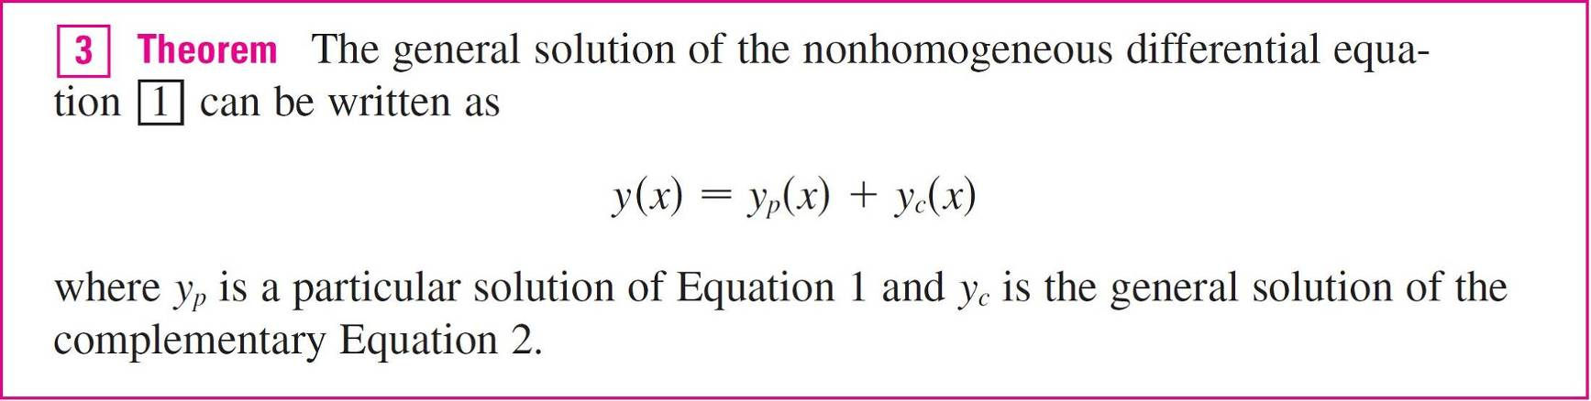
Nonhomogeneous Linear Equations
There are two methods for finding a particular solution:
The method of undetermined coefficients is straightforward
but works only for a restricted class of functions G.
The method of variation of parameters works for every function G but is usually more difficult to apply in practice.

Slide 5
The Method of Undetermined
Coefficients

Slide 6
The Method of Undetermined Coefficients
We first illustrate the method of undetermined coefficients for the equation
ay ″ + by ′ + cy = G(x)
where G(x) is a polynomial.
It is reasonable to guess that there is a particular solution y_{p} that is a polynomial of the same degree as G because if y is a polynomial, then ay ″ + by ′ + cy is also a polynomial.
We therefore substitute y_{p}(x) = a polynomial (of the same degree as G) into the differential equation and determine the coefficients.

Slide 7
Example 1
Solve the equation y ″ + y ′ – 2y = x².
Solution:
The auxiliary equation of y ″ + y ′ – 2y = 0 is
r² + r – 2 = (r – 1)(r + 2) = 0
with roots r = 1, –2.
So the solution of the complementary equation is
y_{c} = c₁e^{x} + c₂e ^{–2x}

Slide 8


Example 1 – Solution
cont’d
Since G(x) = x² is a polynomial of degree 2, we seek a particular solution of the form
y_{p}(x) = Ax² + Bx + C
Then = 2Ax + B and = 2A so, substituting into the given differential equation, we have
(2A) + (2Ax + B) – 2(Ax² + Bx + C) = x²
or
– 2Ax² + (2A – 2B)x + (2A + B – 2C) = x²
Polynomials are equal when their coefficients are equal.

Slide 9



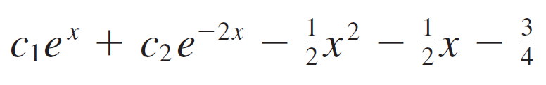
Example 1 – Solution
cont’d
Thus
– 2A = 1 2A – 2B = 0 2A + B – 2C = 0
The solution of this system of equations is
A = B = C =
A particular solution is therefore
y_{p}(x) =
and, by Theorem 3, the general solution is
y = y_{c} + y_{p} =

Slide 10


Example 3
Solve y ″ + y ′ – 2y = sin x.
Solution:
We try a particular solution
y_{p}(x) = A cos x + B sin x
Then
= –A sin x + B cos x
= –A cos x – B sin x

Slide 11
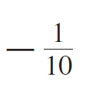

Example 3 – Solution
cont’d
So substitution in the differential equation gives
or
This is true if
–3A + B = 0 and –A – 3B = 1
The solution of this system is
A = B =

Slide 12
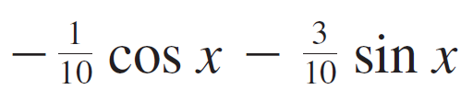
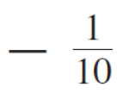
Example 3 – Solution
cont’d
So a particular solution is
y_{p}(x) =
In Example 1 we determined that the solution of the complementary equation is
y_{c} = c₁e^{x} + c₂e^{–2x}.
Thus the general solution of the given equation is
y(x) = c₁e^{x} + c₂e ^{–2x} – (cos x + 3sin x)

Slide 13
The Method of Undetermined Coefficients
If G(x) is a product of functions of the preceding types, then we take the trial solution to be a product of functions of the same type.
For instance, in solving the differential equation
y ″ + 2y ′ + 4y = x cos 3x
we would try
y_{p}(x) = (Ax + B) cos 3x + (Cx + D) sin 3x

Slide 14



The Method of Undetermined Coefficients
If G(x) is a sum of functions of these types, we use the easily verified principle of superposition, which says that if
and are solutions of
ay ″ + by ′ + cy = G₁(x)
ay ″ + by ′ + cy = G₂(x)
respectively, then is a solution of
ay ″ + by ′ + cy = G₁(x) + G₂(x)

Slide 15
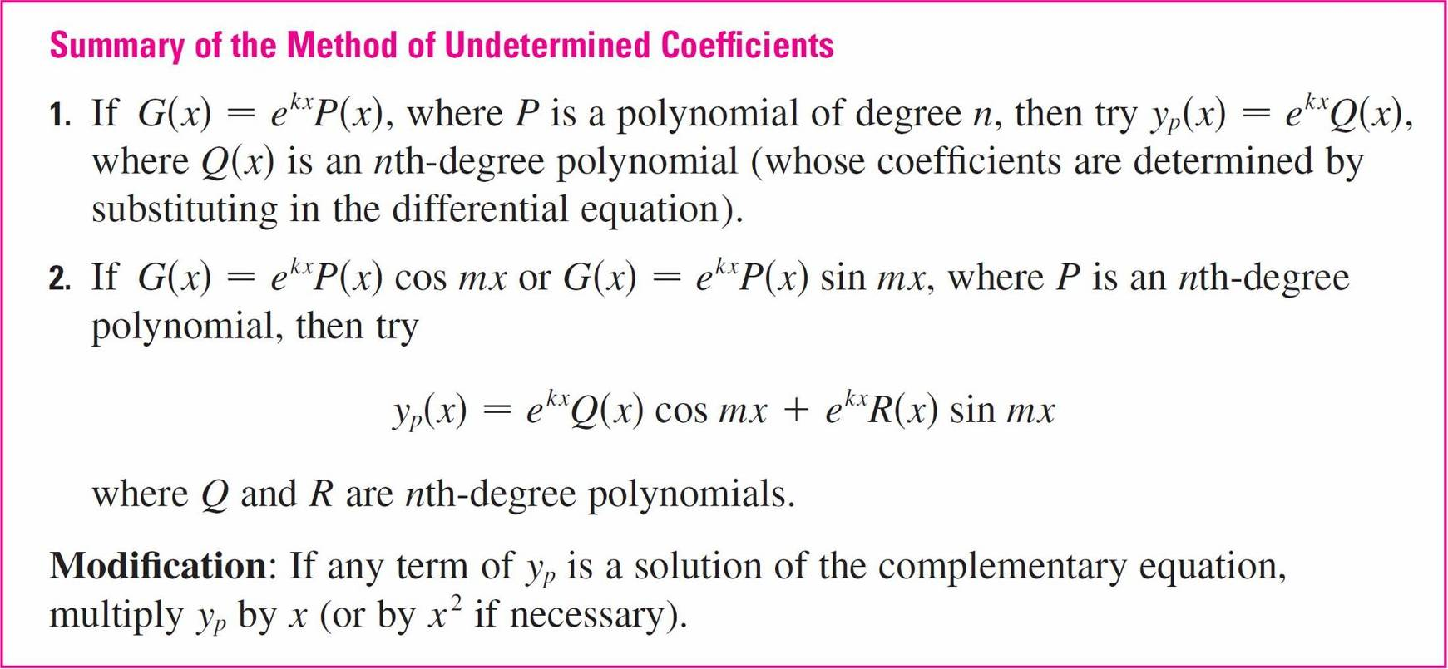
The Method of Undetermined Coefficients

Slide 16
Example 6
Determine the form of the trial solution for the differential equation
y ″ – 4y + 13y = e^{2x} cos 3x.
Solution:
Here G(x) has the form of part 2 of the summary, where
k = 2, m = 3, and P(x) = 1.
So, at first glance, the form of the trial solution would be
y_{p}(x) = e^{2x} (A cos 3x + B sin 3x)

Slide 17
Example 6 – Solution
cont’d
But the auxiliary equation is r² – 4r + 13 = 0, with roots
r = 2 ± 3i, so the solution of the complementary equation is
y_{c}(x) = e^{2x} (c₁cos 3x + c₂sin 3x)
This means that we have to multiply the suggested trial solution by x.
So, instead, we use
y_{p}(x) = xe^{2x} (A cos 3x + B sin 3x)

Slide 18
The Method of Variation
of Parameters

Slide 19

The Method of Variation of Parameters
Suppose we have already solved the homogeneous equation ay ″ + by ′ + cy = 0 and written the solution as
y(x) = c₁y₁(x) + c₂y₂(x)
where y₁ and y₂ are linearly independent solutions.
Let’s replace the constants (or parameters) c₁ and c₂ in Equation 4 by arbitrary functions and u₁(x) and u₂(x).

Slide 20

The Method of Variation of Parameters
We look for a particular solution of the nonhomogeneous equation ay ″ + by ′ + cy = G(x) of the form
y_{p}(x) = u₁(x) y₁(x) + u₂(x) y₂(x)
(This method is called variation of parameters because we have varied the parameters c₁ and c₂ to make them functions.)

Slide 21

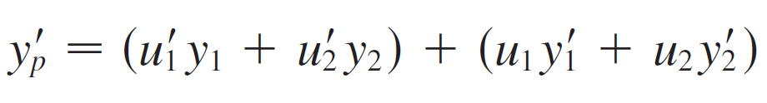
The Method of Variation of Parameters
Differentiating Equation 5, we get
Since u₁ and u₂ are arbitrary functions, we can impose two conditions on them.
One condition is that y_{p} is a solution of the differential equation; we can choose the other condition so as to simplify our calculations.

Slide 22


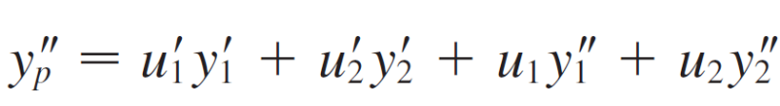

The Method of Variation of Parameters
In view of the expression in Equation 6, let’s impose the condition that
Then
Substituting in the differential equation, we get
or

Slide 23






The Method of Variation of Parameters
But y₁ and y₂ are solutions of the complementary equation, so
and
and Equation 8 simplifies to
Equations 7 and 9 form a system of two equations in the unknown functions and .
After solving this system we may be able to integrate to find u₁ and u₂ then the particular solution is given by Equation 5.

Slide 24
Example 7
Solve the equation
y ″ + y = tan x, 0 < x < π /2.
Solution:
The auxiliary equation is r² + 1 = 0 with roots ±i, so the solution of y ″ + y = 0 is y (x) = c₁ sin x + c₂ cos x.
Using variation of parameters, we seek a solution of the form
y_{p} (x) = u₁(x) sin x + u₂ (x) cos x
Then

Slide 25

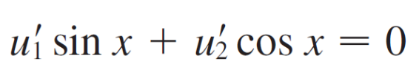

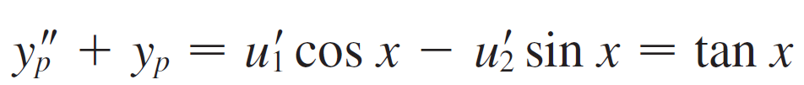

Example 7 – Solution
cont’d
Set
Then
For y_{p} to be a solution we must have
Solving Equations 10 and 11, we get
(sin²x + cos²x) = cos x tan x

Slide 26
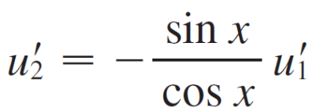
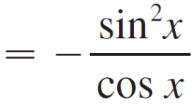
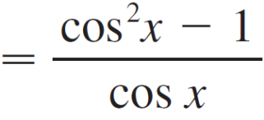
Example 7 – Solution
cont’d
= sinx u₁(x) = –cos x
(We seek a particular solution, so we don’t need a constant of integration here.)
Then, from Equation 10, we obtain

Slide 27
Example 7 – Solution
cont’d
= cos x – sec x
So
u₂(x) = sin x – ln(sec x + tan x)
(Note that sec x + tan x > 0 for 0 < x < π /2.)
Therefore
y_{p}(x) = –cos x sin x + [sin x – ln(sec x + tan x)] cos x
= –cos x ln(sec x + tan x)
and the general solution is
y (x) = c₁sin x + c₂cos x – cos x ln (sec x + tan x)

