Slide 1


1
Functions and Limits
Copyright © Cengage Learning. All rights reserved.

Slide 2

Mathematical Models:
A Catalog of Essential Functions
1.2
Copyright © Cengage Learning. All rights reserved.

Slide 3
Mathematical Models: A Catalog of Essential Functions
A mathematical model is a mathematical description (often by means of a function or an equation) of a
real-world phenomenon such as the size of a population, the demand for a product, the speed of a falling object, the concentration of a product in a chemical reaction, the life expectancy of a person at birth, or the cost of emission reductions.
The purpose of the model is to understand the phenomenon and perhaps to make predictions about future behavior.

Slide 4
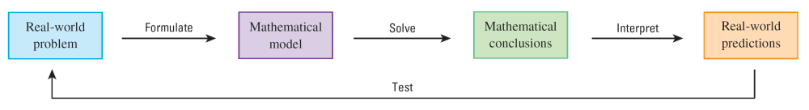
Mathematical Models: A Catalog of Essential Functions
Figure 1 illustrates the process of mathematical modeling.
Figure 1
The modeling process

Slide 5
Mathematical Models: A Catalog of Essential Functions
A mathematical model is never a completely accurate
representation of a physical situation—it is an idealization. A good model simplifies reality enough to permit mathematical calculations but is accurate enough to provide valuable conclusions.
It is important to realize the limitations of the model. In the end, Mother Nature has the final say.
There are many different types of functions that can be used
to model relationships observed in the real world. In what follows, we discuss the behavior and graphs of these functions and give examples of situations appropriately modeled by such functions.

Slide 6
Linear Models

Slide 7
Linear Models
When we say that y is a linear function of x, we mean that
the graph of the function is a line, so we can use the
slope-intercept form of the equation of a line to write a
formula for the function as
y = f (x) = mx + b
where m is the slope of the line and b is the y-intercept.

Slide 8
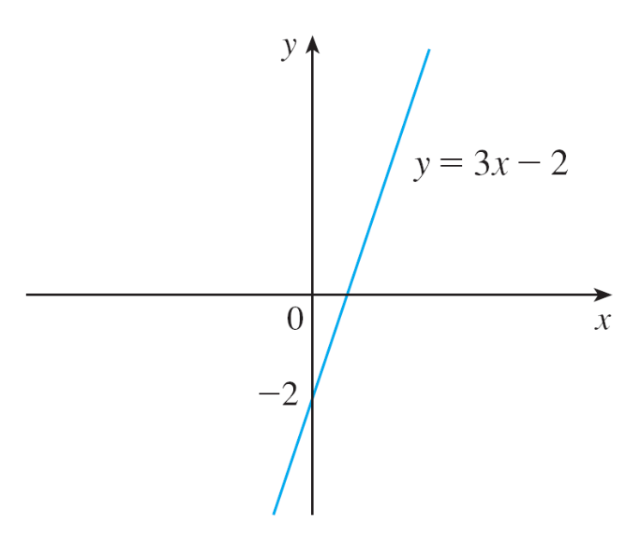
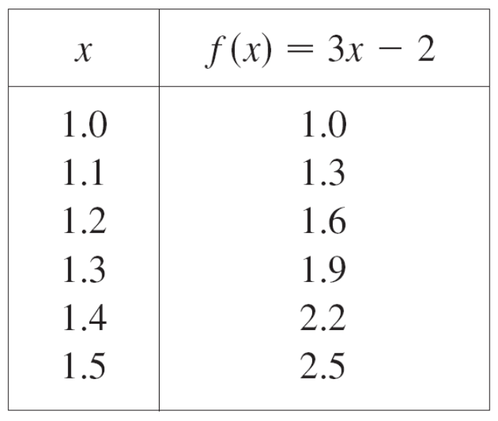
Linear Models
A characteristic feature of linear functions is that they grow at a constant rate.
For instance, Figure 2 shows a graph of the linear function
f (x) = 3x – 2 and a table of sample values.
Figure 2

Slide 9
Linear Models
Notice that whenever x increases by 0.1, the value of f (x) increases by 0.3.
So f (x) increases three times as fast as x. Thus the slope of the graph y = 3x – 2, namely 3, can be interpreted as the rate of change of y with respect to x.

Slide 10
Example 1
(a) As dry air moves upward, it expands and cools. If the
ground temperature is 20°C and the temperature at a
height of 1 km is 10°C, express the temperature T
(in °C) as a function of the height h (in kilometers),
assuming that a linear model is appropriate.
(b) Draw the graph of the function in part (a). What does
the slope represent?
(c) What is the temperature at a height of 2.5 km?

Slide 11
Example 1(a) – Solution
Because we are assuming that T is a linear function of h,
we can write
T = mh + b
We are given that T = 20 when h = 0, so
20 = m • 0 + b = b
In other words, the y-intercept is b = 20.
We are also given that T = 10 when h = 1, so
10 = m • 1 + 20
The slope of the line is therefore m = 10 – 20 = –10 and the required linear function is
T = –10h + 20

Slide 12
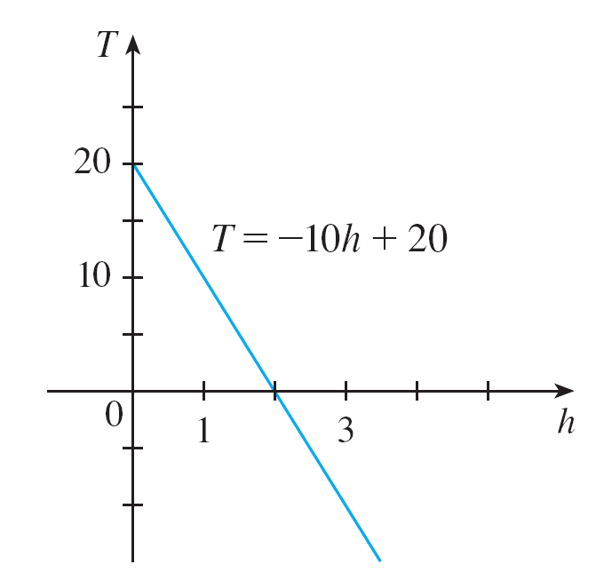
Example 1(b) – Solution
cont’d
The graph is sketched in Figure 3.
The slope is m = –10°C/km, and this represents the rate of change of temperature with respect to height.
Figure 3

Slide 13
Example 1(c) – Solution
cont’d
At a height of h = 2.5 km, the temperature is
T = –10(2.5) + 20 = –5°C

Slide 14
Linear Models
If there is no physical law or principle to help us formulate a model, we construct an empirical model, which is based entirely on collected data.
We seek a curve that “fits” the data in the sense that it captures the basic trend of the data points.

Slide 15
Polynomials

Slide 16

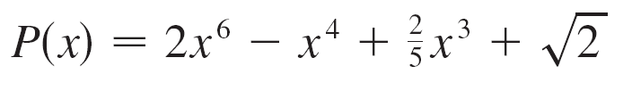
Polynomials
A function P is called a polynomial if
P (x) = a_{n}x^{n} + a_{n–1}x^{n–1} + . . . + a₂x² + a₁x + a₀
where n is a nonnegative integer and the numbers
a₀, a₁, a₂, . . ., a_{n} are constants called the coefficients of the polynomial.
The domain of any polynomial is If the leading coefficient a_{n} ≠ 0, then the degree of the polynomial is n. For example, the function
is a polynomial of degree 6.

Slide 17
Polynomials
A polynomial of degree 1 is of the form P (x) = mx + b and so it is a linear function.
A polynomial of degree 2 is of the form P (x) = ax² + bx + c and is called a quadratic function.

Slide 18
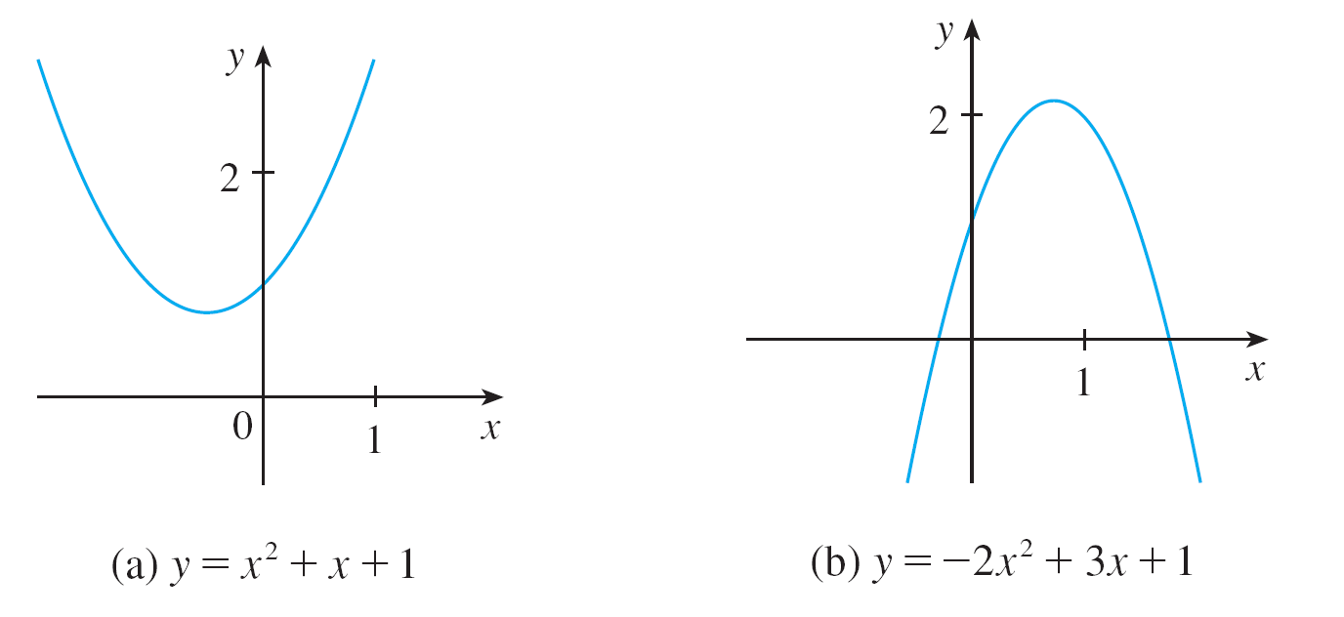
Polynomials
Its graph is always a parabola obtained by shifting the parabola y = ax². The parabola opens upward if a > 0 and downward if a < 0. (See Figure 7.)
The graphs of quadratic functions are parabolas.
Figure 7

Slide 19
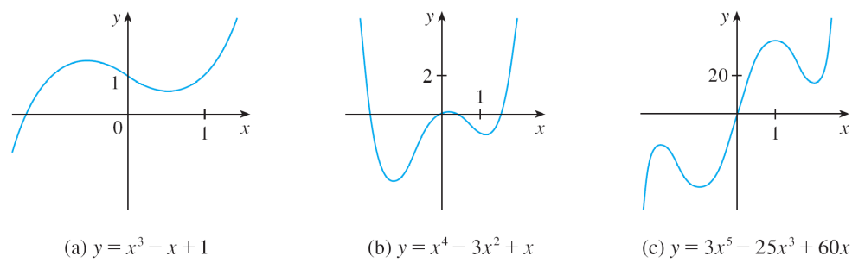
Polynomials
A polynomial of degree 3 is of the form
P (x) = ax³ + bx² + cx + d a ≠ 0
and is called a cubic function. Figure 8 shows the graph of a cubic function in part (a) and graphs of polynomials of degrees 4 and 5 in parts (b) and (c).
Figure 8

Slide 20
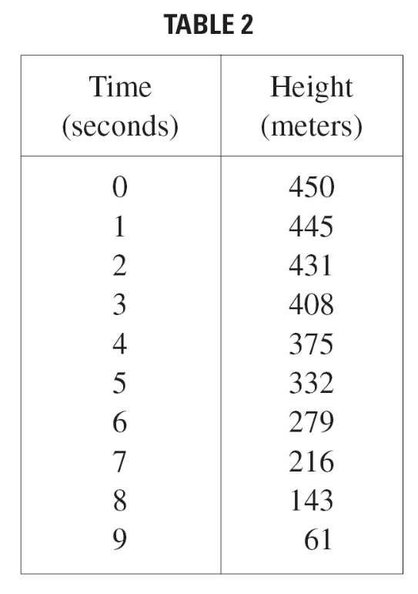
Example 4
A ball is dropped from the upper observation deck of the
CN Tower, 450 m above the ground, and its height h above the ground is recorded at 1-second intervals in Table 2.
Find a model to fit the data
and use the model to predict
the time at which the ball hits
the ground.

Slide 21
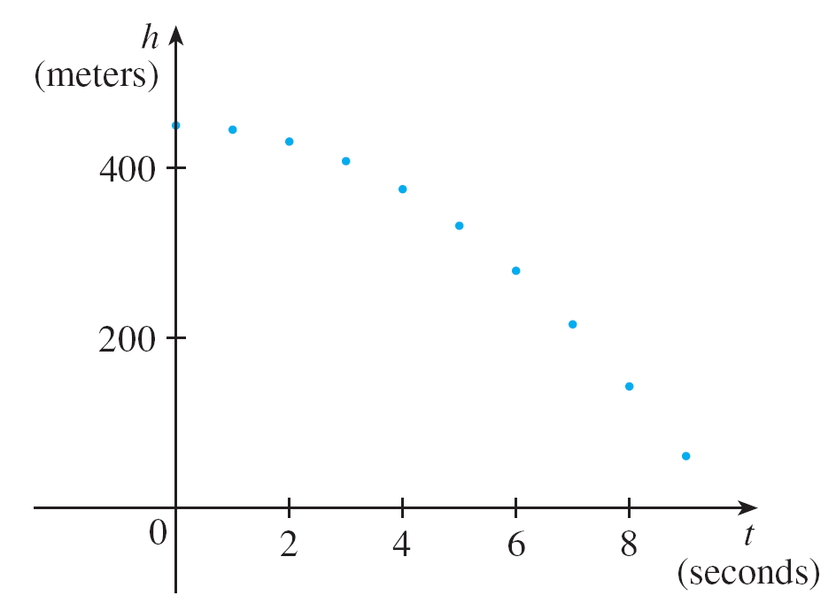
Example 4 – Solution
We draw a scatter plot of the data in Figure 9 and observe that a linear model is inappropriate.
Scatter plot for a falling ball
Figure 9

Slide 22

Example 4 – Solution
cont’d
But it looks as if the data points might lie on a parabola, so we try a quadratic model instead.
Using a graphing calculator or computer algebra system (which uses the least squares method), we obtain the following quadratic model:
h = 449.36 + 0.96ts – 4.90t²

Slide 23
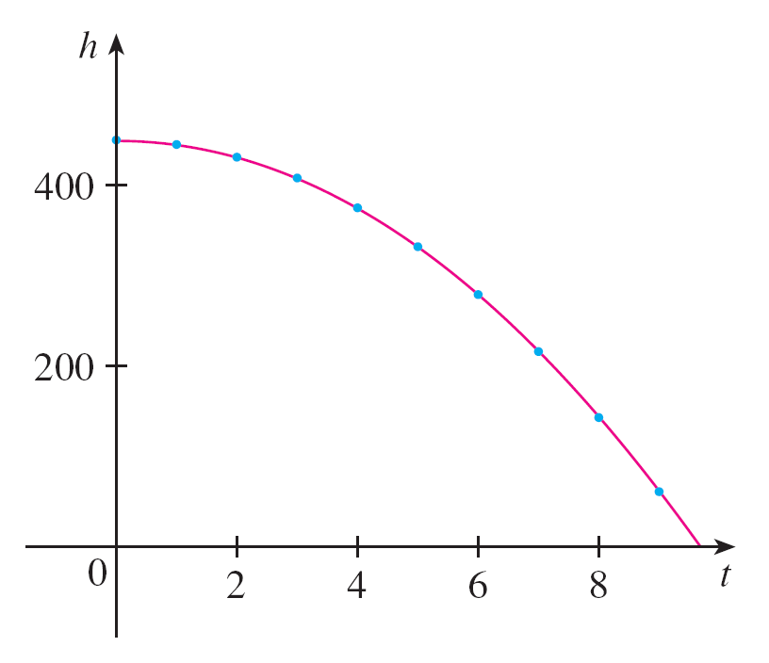
Example 4 – Solution
cont’d
In Figure 10 we plot the graph of Equation 3 together with the data points and see that the quadratic model gives a very good fit.
The ball hits the ground when h = 0, so we solve the quadratic equation
–4.90t² + 0.96t + 449.36 = 0
Quadratic model for a falling ball
Figure 10

Slide 24
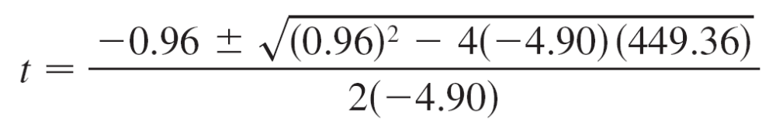
Example 4 – Solution
cont’d
The quadratic formula gives
The positive root is t ≈ 9.67, so we predict that the ball will hit the ground after about 9.7 seconds.

Slide 25
Power Functions

Slide 26
Power Functions
A function of the form f(x) = xª, where a is a constant, is called a power function. We consider several cases.
(i) a = n, where n is a positive integer
The graphs of f(x) = x^{n} for n = 1, 2, 3, 4, and 5 are shown in Figure 11. (These are polynomials with only one term.)
We already know the shape of the graphs of y = x (a line through the origin with slope 1) and y = x² (a parabola).

Slide 27
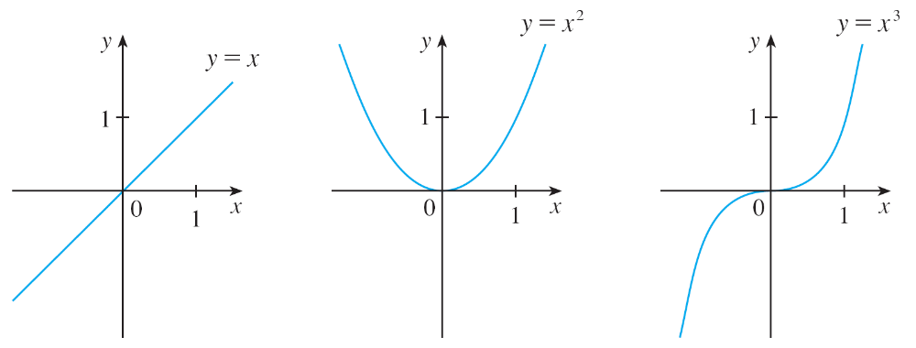
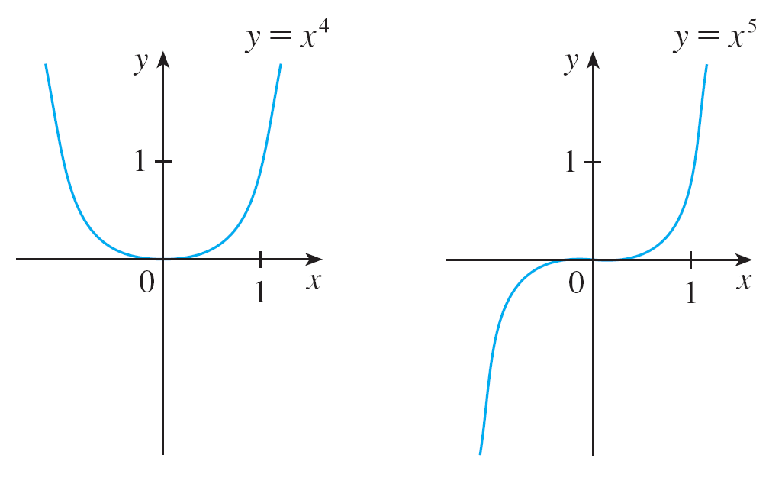
Power Functions
Graphs of f (x) = x^{n} for n = 1, 2, 3, 4, 5
Figure 11

Slide 28
Power Functions
The general shape of the graph of f (x) = x^{n} depends on whether n is even or odd.
If n is even, then f (x) = x^{n} is an even function and its graph is similar to the parabola y = x².
If n is odd, then f (x) = x^{n} is an odd function and its graph is similar to that of y = x³.

Slide 29
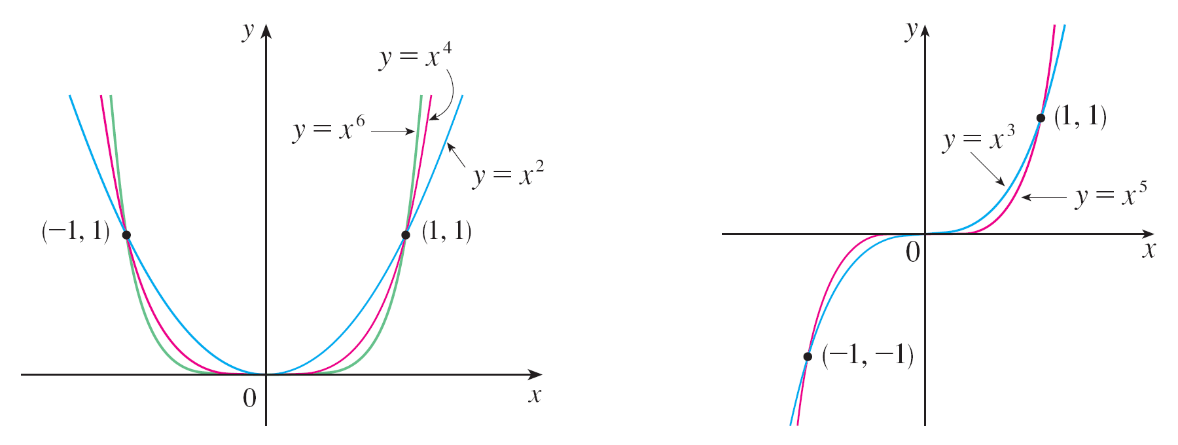
Power Functions
Notice from Figure 12, however, that as n increases, the graph of y = x^{n} becomes flatter near 0 and steeper when
| x | ≥ 1. (If x is small, then x² is smaller, x³ is even smaller,
x⁴ is smaller still, and so on.)
Families of power functions
Figure 12

Slide 30



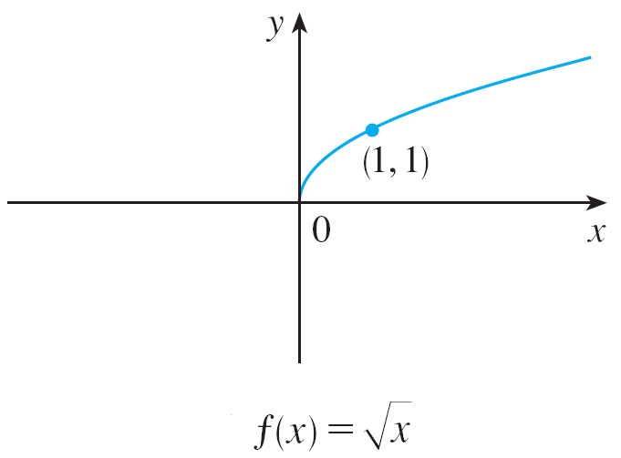
Power Functions
(ii) a = 1/n, where n is a positive integer
The function is a root function. For n = 2 it is the square root function whose domain is [0, ) and whose graph is the upper half of the
parabola x = y². [See Figure 13(a).]
Graph of root function
Figure 13(a)

Slide 31





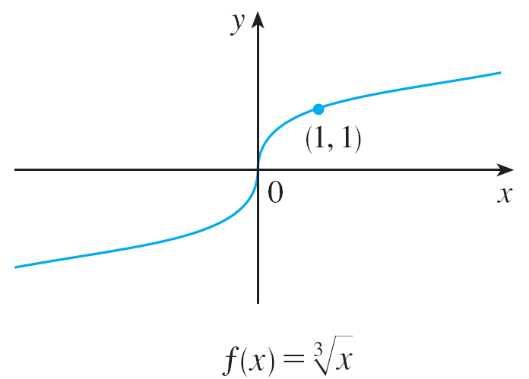
Power Functions
For other even values of n, the graph of is similar to that of
For n = 3 we have the cube root function whose domain is (recall that every real number has a cube root) and whose graph is shown in Figure 13(b). The graph of
for n odd (n > 3) is similar to that of
Graph of root function
Figure 13(b)

Slide 32
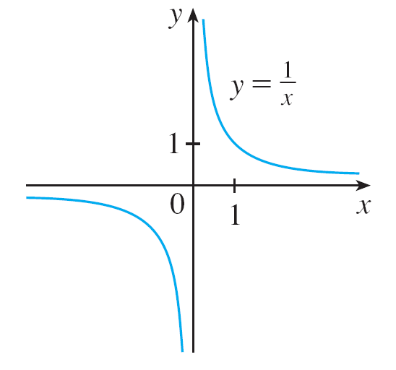
Power Functions
(iii) a = –1
The graph of the reciprocal function f (x) = x ^{–1} = 1/x is shown in Figure 14. Its graph has the equation y = 1/x, or
xy = 1, and is a hyperbola with the coordinate axes as its
asymptotes.
The reciprocal function
Figure 14

Slide 33
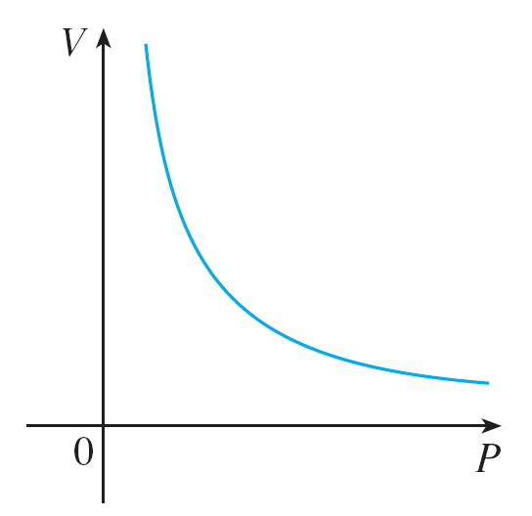
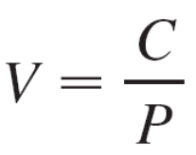
Power Functions
This function arises in physics and chemistry in connection with Boyle’s Law, which says that, when the temperature is constant, the volume V of a gas is inversely proportional to the pressure P:
where C is a constant.
Thus the graph of V as a
function of P (see Figure 15)
has the same general shape
as the right half of Figure 14.
Volume as a function of pressure
at constant temperature
Figure 15

Slide 34
Rational Functions

Slide 35
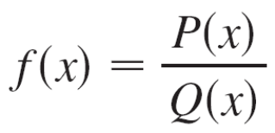
Rational Functions
A rational function f is a ratio of two polynomials:
where P and Q are polynomials. The domain consists of all values of x such that Q(x) ≠ 0.
A simple example of a rational
function is the function f (x) = 1/x,
whose domain is {x | x ≠ 0}; this
is the reciprocal function graphed
in Figure 14.
The reciprocal function
Figure 14

Slide 36
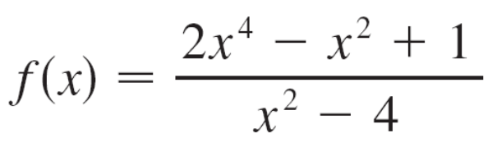
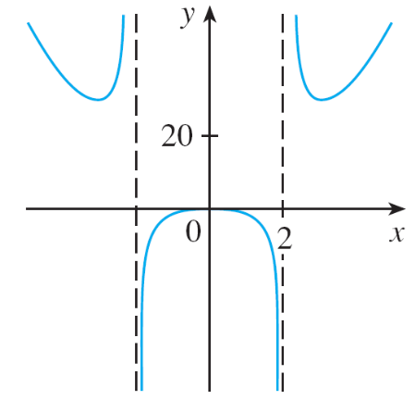
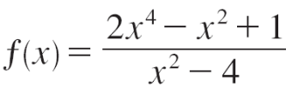
Rational Functions
The function
is a rational function with domain {x | x ≠ ±2}. Its graph is shown in Figure 16.
Figure 16

Slide 37
Algebraic Functions

Slide 38
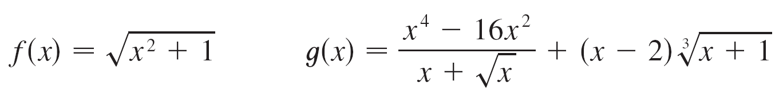
Algebraic Functions
A function f is called an algebraic function if it can be constructed using algebraic operations (such as addition, subtraction, multiplication, division, and taking roots) starting with polynomials. Any rational function is automatically an algebraic function.
Here are two more examples:

Slide 39
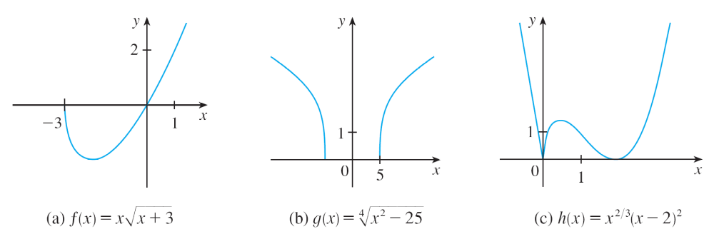
Algebraic Functions
The graphs of algebraic functions can assume a variety of shapes. Figure 17 illustrates some of the possibilities.
Figure 17

Slide 40
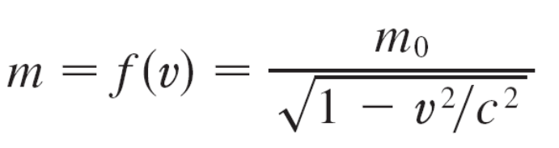
Algebraic Functions
An example of an algebraic function occurs in the theory of relativity. The mass of a particle with velocity v is
where m₀ is the rest mass of the particle and
c = 3.0 x 10⁵ km/s is the speed of light in a vacuum.

Slide 41
Trigonometric Functions

Slide 42
Trigonometric Functions
In calculus the convention is that radian measure is always
used (except when otherwise indicated).
For example, when we use the function f (x) = sin x, it is
understood that sin x means the sine of the angle whose
radian measure is x.

Slide 43
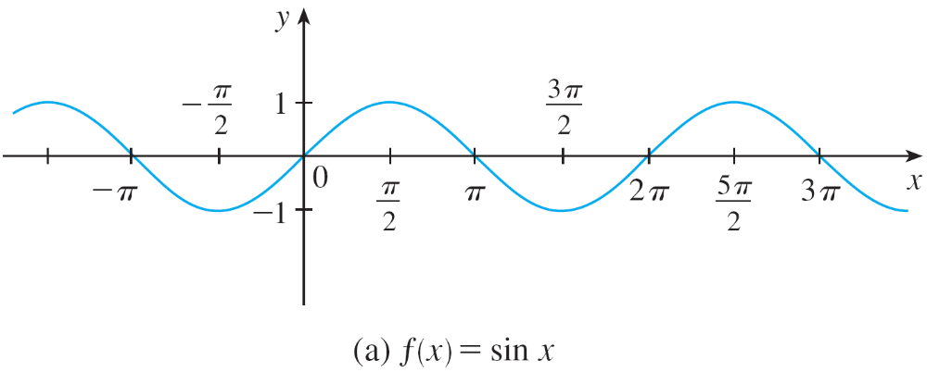
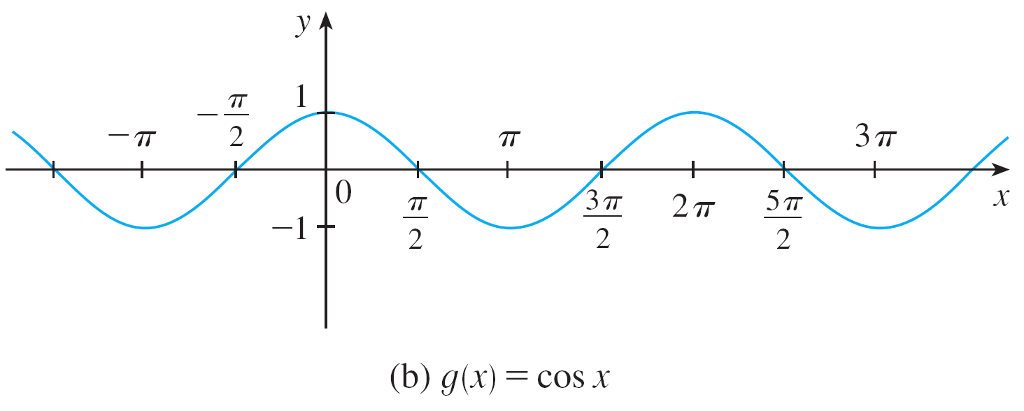
Trigonometric Functions
Thus the graphs of the sine and cosine functions are as
shown in Figure 18.
Figure 18

Slide 44

Trigonometric Functions
Notice that for both the sine and cosine functions the domain
is ( , ) and the range is the closed interval [–1, 1].
Thus, for all values of x, we have
or, in terms of absolute values,
| sin x | ≤ 1 | cos x | ≤ 1

Slide 45

Trigonometric Functions
Also, the zeros of the sine function occur at the integer
multiples of π ; that is,
sin x = 0 when x = nπ n an integer
An important property of the sine and cosine functions is
that they are periodic functions and have period 2π.
This means that, for all values of x,

Slide 46
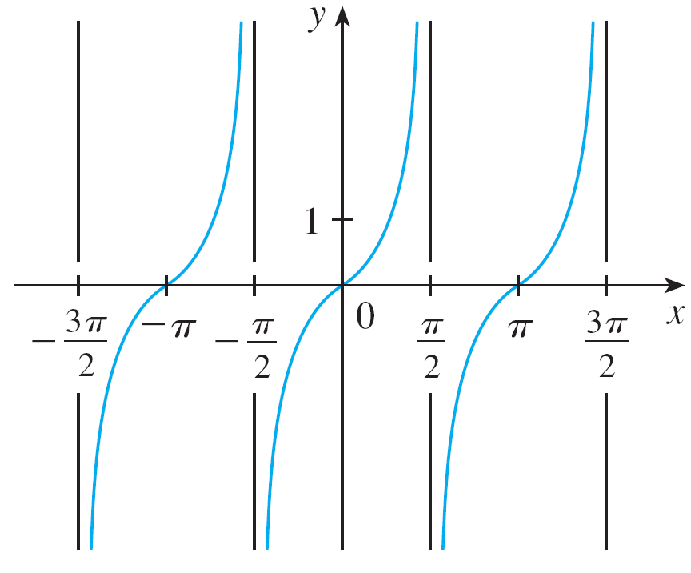
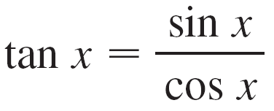
Trigonometric Functions
The tangent function is related to the sine and cosine
functions by the equation
and its graph is shown in
Figure 19. It is undefined
whenever cos x = 0, that is,
when x = ±π /2, ±3π /2, . . . .
Its range is ( , ).
y = tan x
Figure 19

Slide 47
Trigonometric Functions
Notice that the tangent function has period π :
tan (x + π) = tan x for all x
The remaining three trigonometric functions (cosecant,
secant, and cotangent) are the reciprocals of the sine,
cosine, and tangent functions.

Slide 48
Exponential Functions

Slide 49
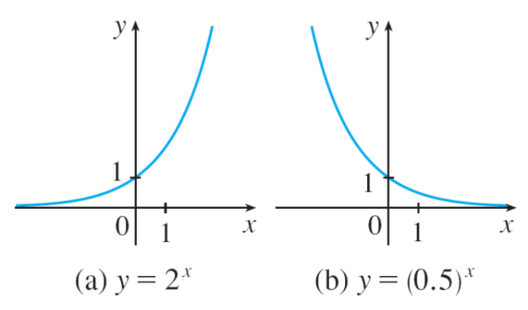
Exponential Functions
The exponential functions are the functions of the form
f (x) = a^{x}, where the base a is a positive constant.
The graphs of y = 2^{x} and y = (0.5)^{x} are shown in Figure 20.
In both cases the domain is ( , ) and the range is
(0, ).
Figure 20

Slide 50
Exponential Functions
Exponential functions are useful for modeling many natural
phenomena, such as population growth (if a > 1) and
radioactive decay (if a < 1).

Slide 51
Logarithmic Functions

Slide 52
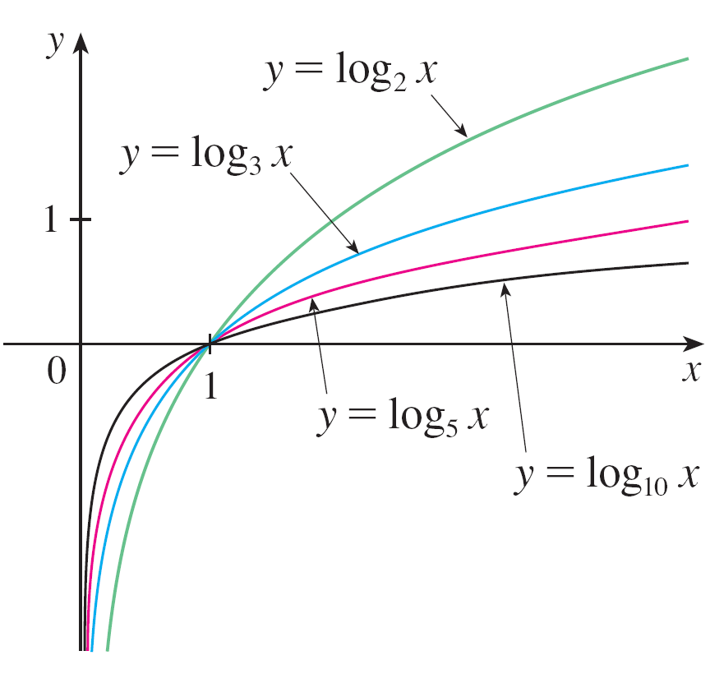
Logarithmic Functions
The logarithmic functions f (x) = log_{a}x, where the base a is a
positive constant, are the inverse functions of the exponential
functions. Figure 21 shows the graphs of four logarithmic
functions with various bases.
In each case the domain is
(0, ), the range is ( , ),
and the function increases
slowly when x > 1.
Figure 21

Slide 53
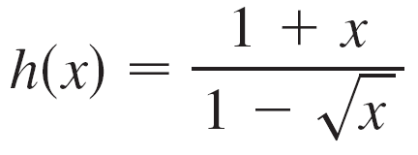
Example 5
Classify the following functions as one of the types of
functions that we have discussed.
(a) f(x) = 5^{x}
(b) g (x) = x⁵
(c)
(d) u (t) = 1 – t + 5t ⁴

Slide 54
Example 5 – Solution
(a) f(x) = 5^{x} is an exponential function.
(The x is the exponent.)
(b) g (x) = x⁵ is a power function. (The x is the base.)
We could also consider it to be a polynomial of degree 5.
(c) is an algebraic function.
(d) u (t) = 1 – t + 5t ⁴ is a polynomial of degree 4.

