Slide 1


1
Functions and Limits
Copyright © Cengage Learning. All rights reserved.

Slide 2

1.5
The Limit of a Function
Copyright © Cengage Learning. All rights reserved.

Slide 3
The Limit of a Function
To find the tangent to a curve or the velocity of an object, we now turn our attention to limits in general and numerical and graphical methods for computing them.
Let’s investigate the behavior of the function f defined by
f (x) = x² – x + 2 for values of x near 2.

Slide 4
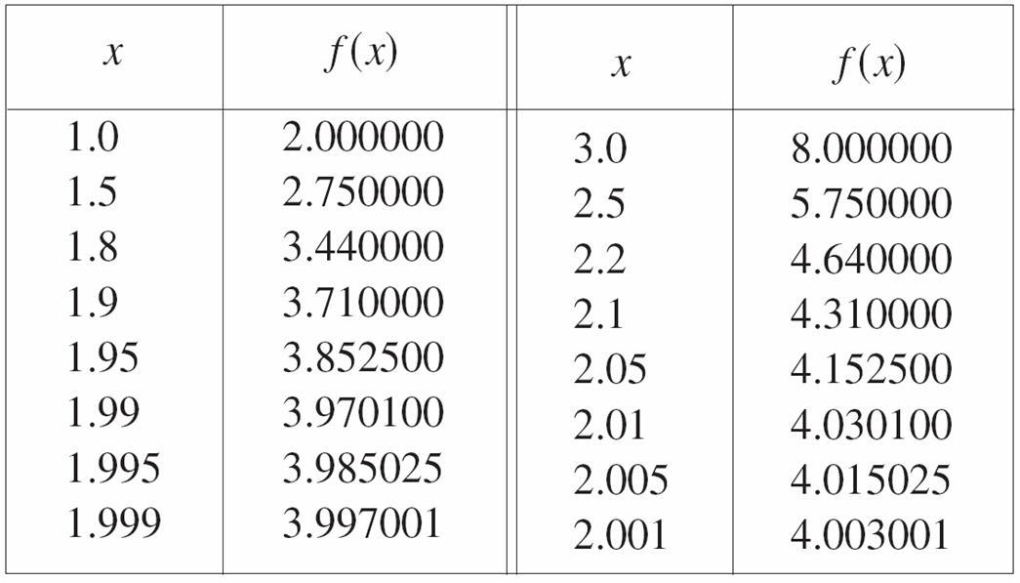
The Limit of a Function
The following table gives values of f (x) for values of x close to 2 but not equal to 2.

Slide 5
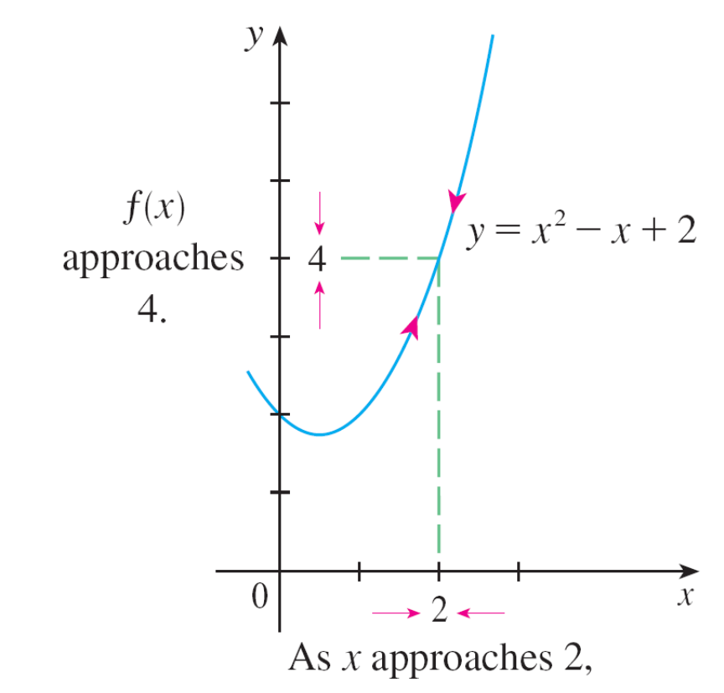
The Limit of a Function
From the table and the graph of f (a parabola) shown in Figure 1 we see that when x is close to 2 (on either side of 2), f (x) is close to 4.
Figure 1

Slide 6
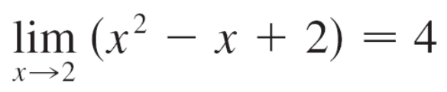
The Limit of a Function
In fact, it appears that we can make the values of f (x) as close as we like to 4 by taking x sufficiently close to 2.
We express this by saying “the limit of the function
f (x) = x² – x + 2 as x approaches 2 is equal to 4.”
The notation for this is

Slide 7
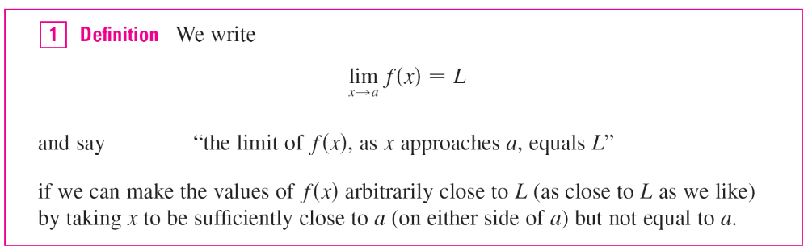
The Limit of a Function
In general, we use the following notation.
This says that the values of f (x) tend to get closer and closer to the number L as x gets closer and closer to the number a (from either side of a) but x ≠ a.

Slide 8

The Limit of a Function
An alternative notation for
is f (x) → L as x → a
which is usually read “f (x) approaches L as x approaches a.”
Notice the phrase “but x ≠ a” in the definition of limit. This means that in finding the limit of f (x) as x approaches a, we never consider x = a. In fact, f (x) need not even be defined when x = a. The only thing that matters is how f is defined near a.

Slide 9
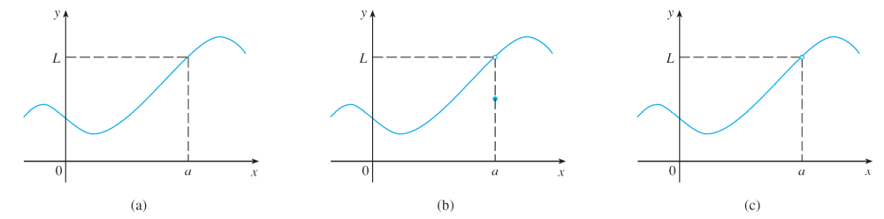

The Limit of a Function
Figure 2 shows the graphs of three functions. Note that in part (c), f (a) is not defined and in part (b), f (a) ≠ L.
But in each case, regardless of what happens at a, it is true that lim_{x→a} f (x) = L.
in all three cases
Figure 2

Slide 10
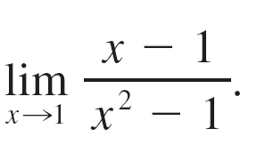
Example 1
Guess the value of
Solution:
Notice that the function f (x) = (x – 1)/(x² – 1) is not defined when x = 1, but that doesn’t matter because the definition of lim_{x→a} f (x) says that we consider values of x that are close to a but not equal to a.

Slide 11
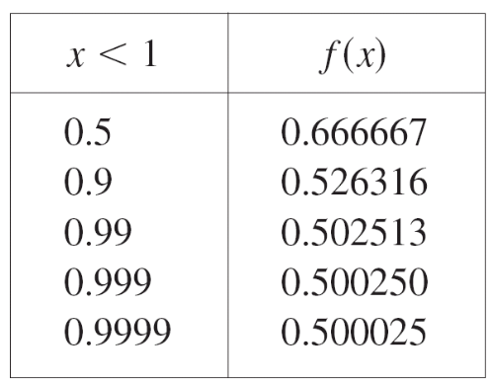
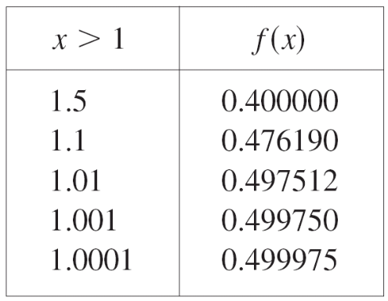
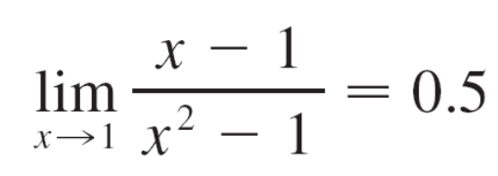
Example 1 – Solution
cont’d
The tables below give values of f (x) (correct to six decimal places) for values of x that approach 1 (but are not equal to 1).
On the basis of the values in the tables, we make the guess that

Slide 12
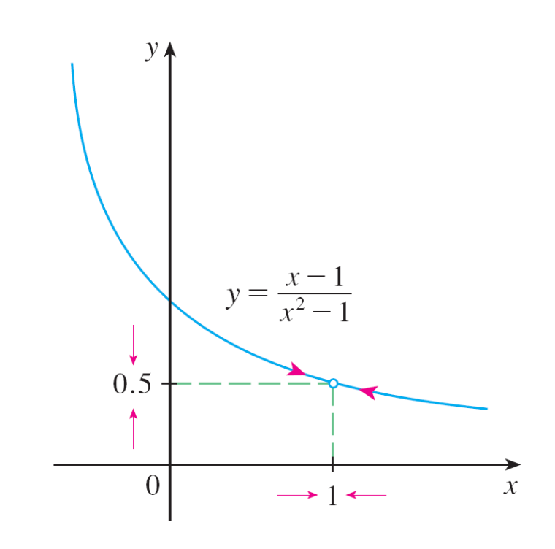
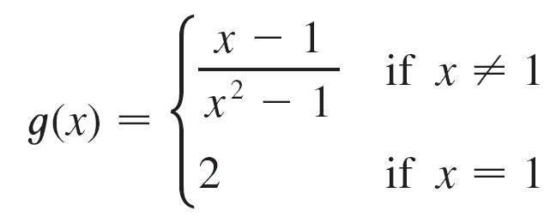
The Limit of a Function
Example 1 is illustrated by the graph of f in Figure 3.
Now let’s change f slightly by giving it the value 2 when
x = 1 and calling the resulting function g:
Figure 3

Slide 13
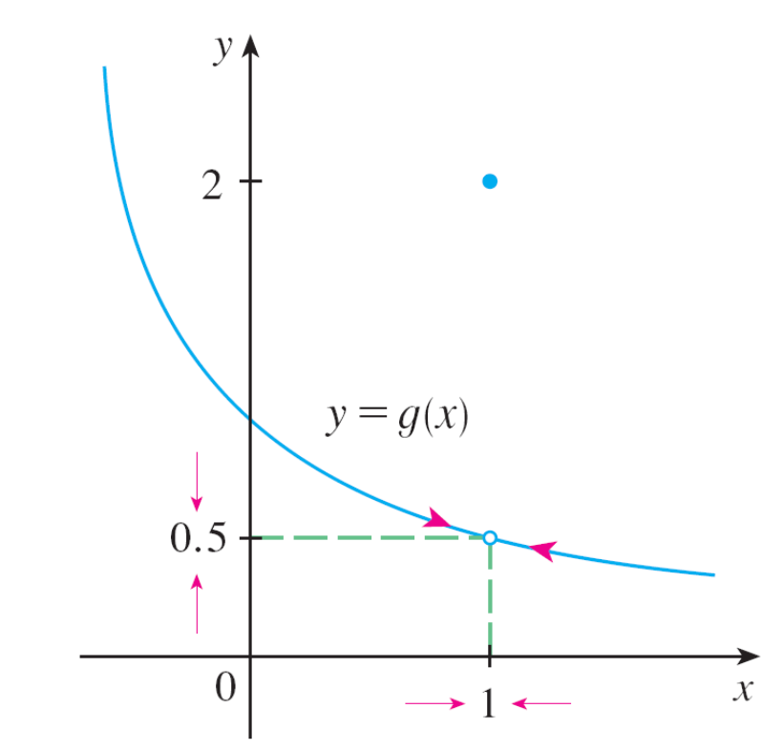
The Limit of a Function
This new function g still has the same limit as x approaches 1. (See Figure 4.)
Figure 4

Slide 14
One-Sided Limits

Slide 15
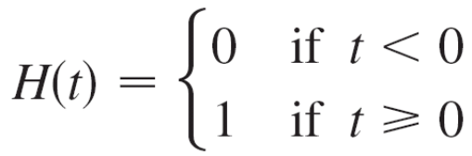
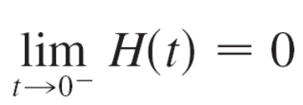
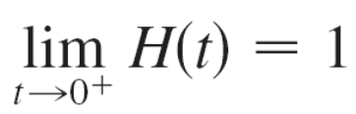
One-Sided Limits
The function H is defined by
.
H (t) approaches 0 as t approaches 0 from the left and H (t) approaches 1 as t approaches 0 from the right.
We indicate this situation symbolically by writing
and

Slide 16
One-Sided Limits
The symbol “t → 0–” indicates that we consider only values of t that are less than 0.
Likewise, “t → 0⁺” indicates that we consider only values of t that are greater than 0.

Slide 17
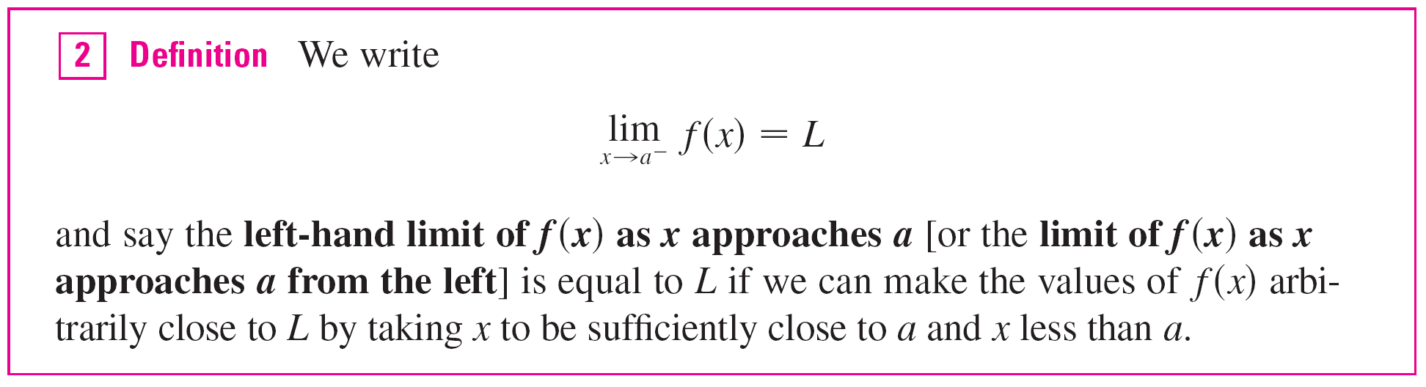
One-Sided Limits
Notice that Definition 2 differs from Definition 1 only in that we require x to be less than a.

Slide 18
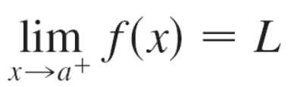
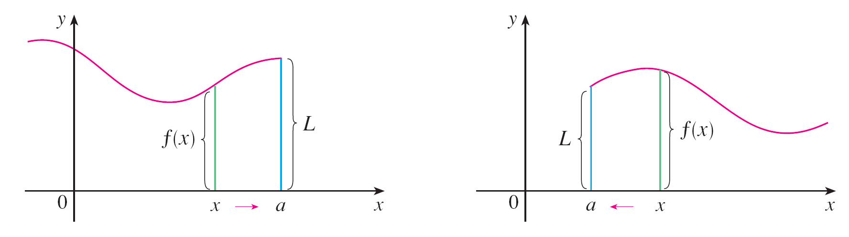


One-Sided Limits
Similarly, if we require that x be greater than a, we get “the right-hand limit of f (x) as x approaches a is equal to L” and we write
Thus the symbol “x → a⁺” means that we consider only x > a. These definitions are illustrated in Figure 9.
Figure 9

Slide 19
One-Sided Limits
By comparing Definition 1 with the definitions of one-sided limits, we see that the following is true.

Slide 20
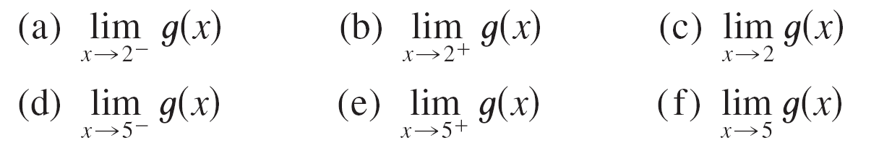
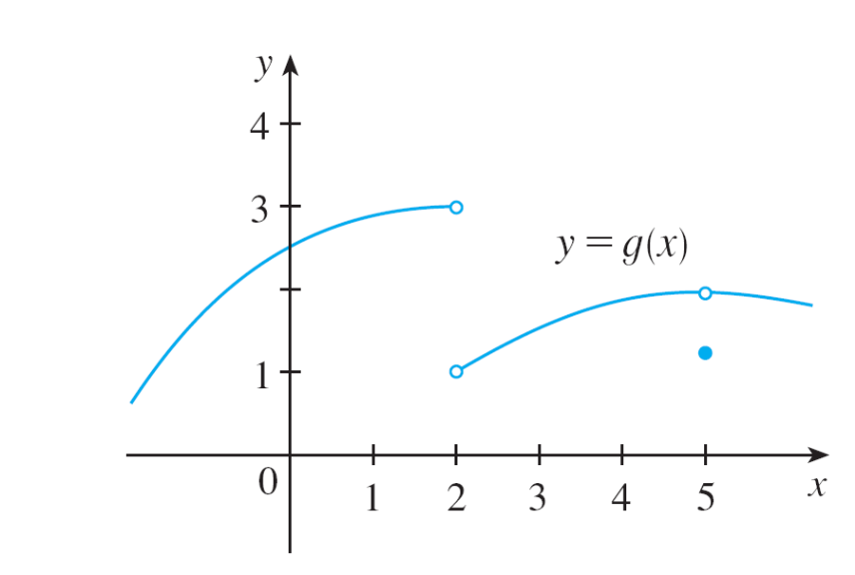
Example 7
The graph of a function g is shown in Figure 10. Use it to state the values (if they exist) of the following:
Figure 10

Slide 21
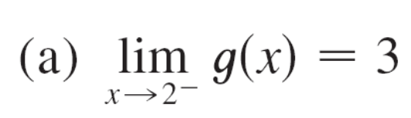
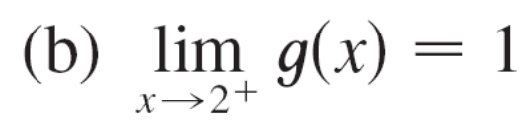

Example 7 – Solution
From the graph we see that the values of g(x) approach 3 as x approaches 2 from the left, but they approach 1 as
x approaches 2 from the right.
Therefore
and
(c) Since the left and right limits are different, we conclude
from that lim_{x→2} g(x) does not exist.

Slide 22
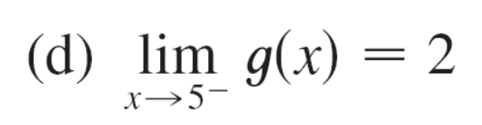
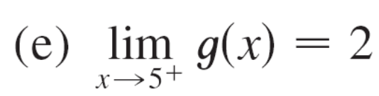
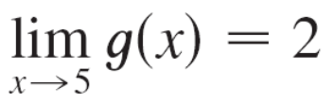
Example 7 – Solution
cont’d
The graph also shows that
and
(f) This time the left and right limits are the same and so, by
, we have
Despite this fact, notice that g(5) ≠ 2.

Slide 23
Infinite Limits

Slide 24
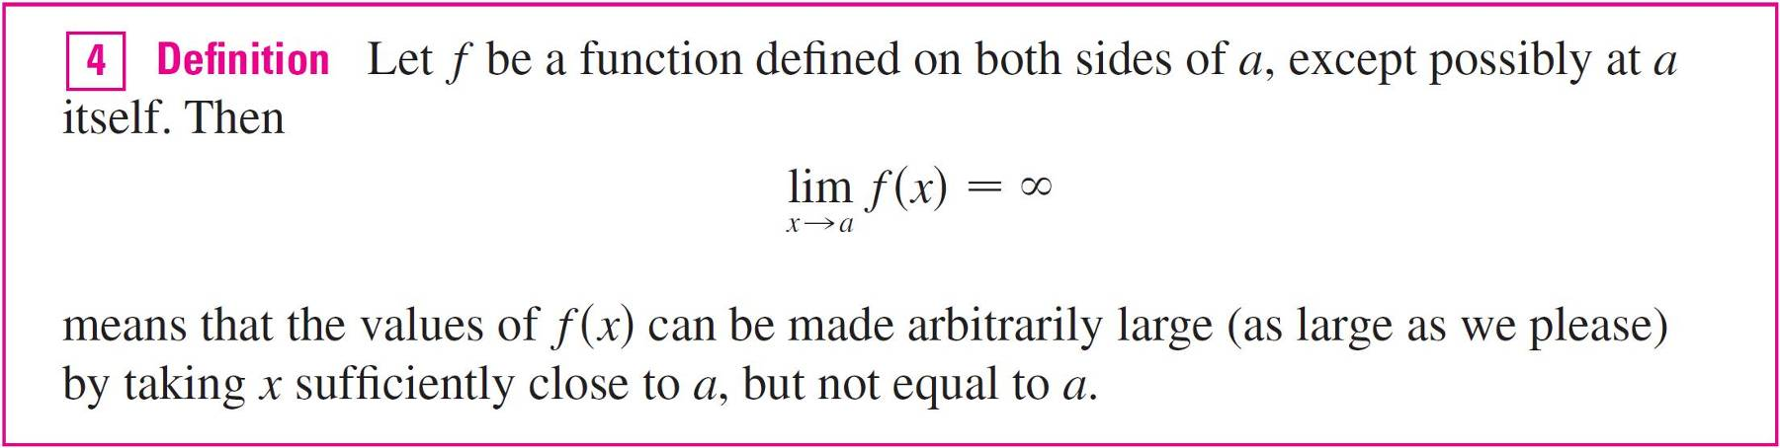
Infinite Limits
Another notation for lim_{x→a} f (x) = ∞ is
f (x) → ∞ as x → a

Slide 25
Infinite Limits
Again, the symbol ∞ is not a number, but the expression lim_{x→a} f (x) = ∞ is often read as
“the limit of f (x), as approaches a, is infinity”
or “f (x) becomes infinite as approaches a”
or “f (x) increases without bound as approaches a”

Slide 26
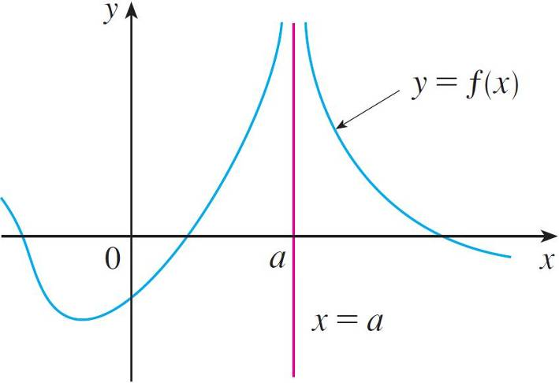

Infinite Limits
This definition is illustrated graphically in Figure 12.
Figure 12

Slide 27
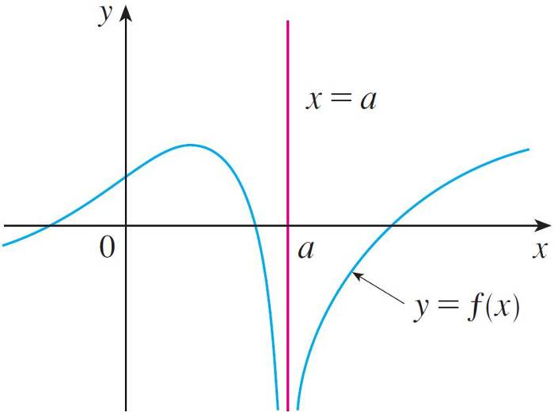

Infinite Limits
A similar sort of limit, for functions that become large negative as x gets close to a, is defined in Definition 5 and is illustrated in Figure 13.
Figure 13

Slide 28
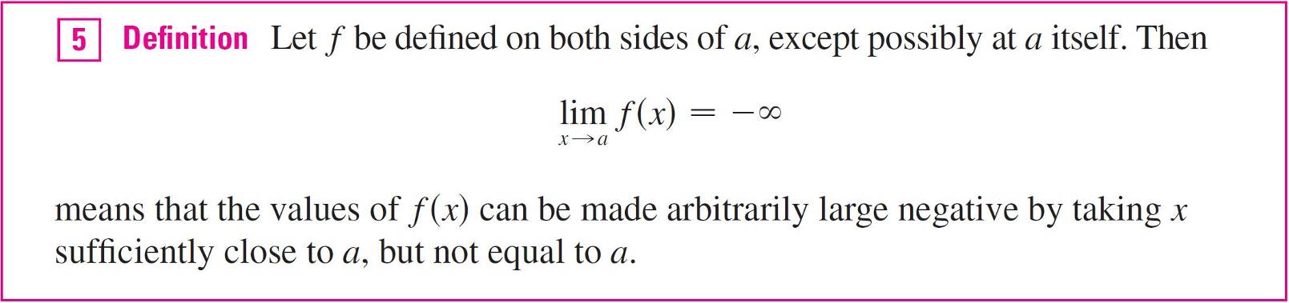
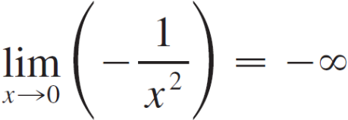
Infinite Limits
The symbol lim_{x→a} f (x) = – ∞ can be read as “the limit of f (x), as x approaches a, is negative infinity” or “f (x) decreases without bound as x approaches a.” As an example we have

Slide 29
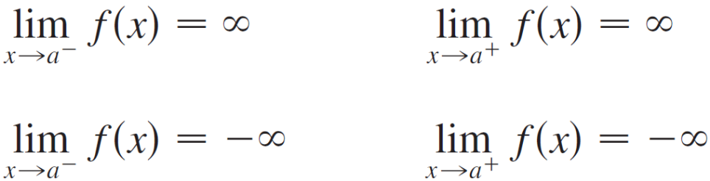
Infinite Limits
Similar definitions can be given for the one-sided infinite limits
remembering that “x → a–” means that we consider only values of that are less than a, and similarly “x → a⁺” means that we consider only x > a.

Slide 30
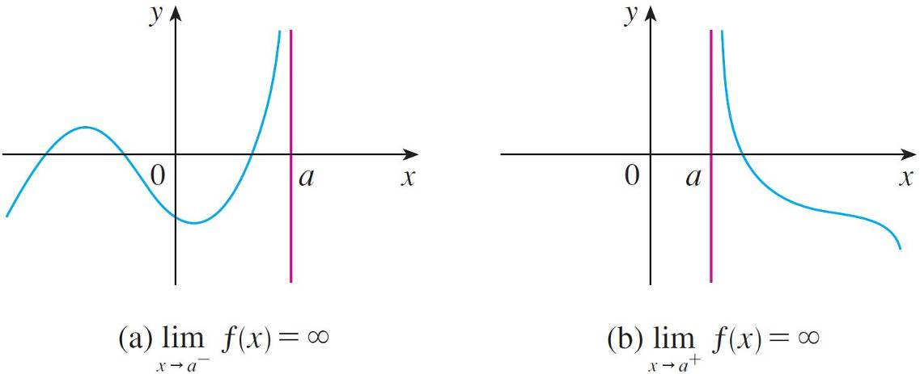
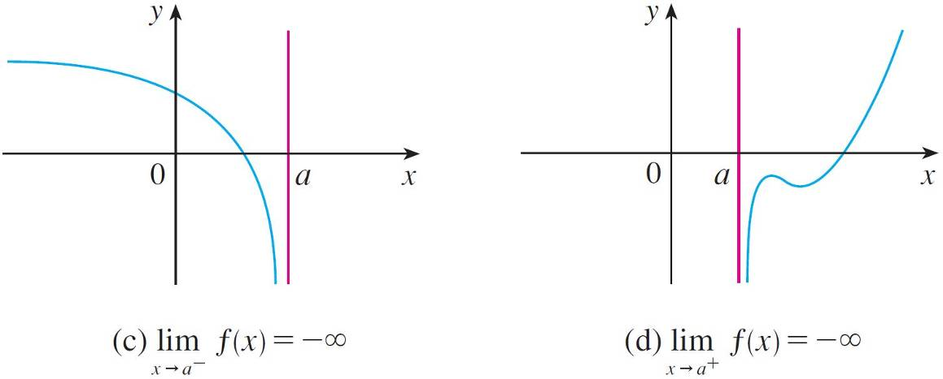
Infinite Limits
Illustrations of these four cases are given in Figure 14.
Figure 14

Slide 31
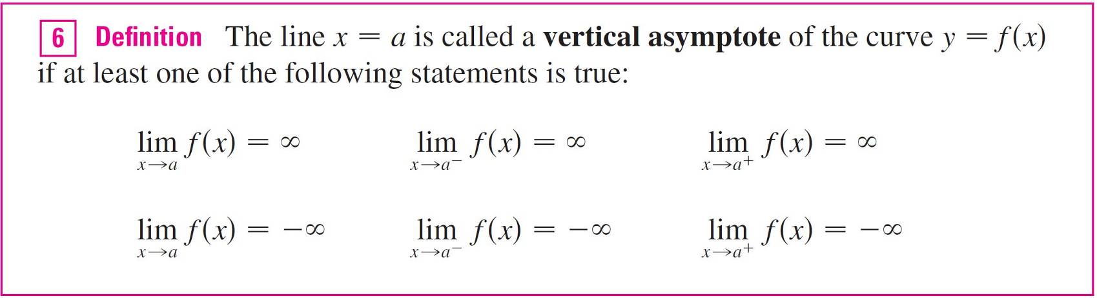
Infinite Limits

Slide 32
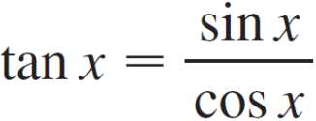
Example 10
Find the vertical asymptotes of f (x) = tan x.
Solution:
Because
there are potential vertical asymptotes where cos x = 0.
In fact, since cos x → 0⁺ as x → (π /2)⁺, whereas sin x is positive when x is near π /2, we have

Slide 33
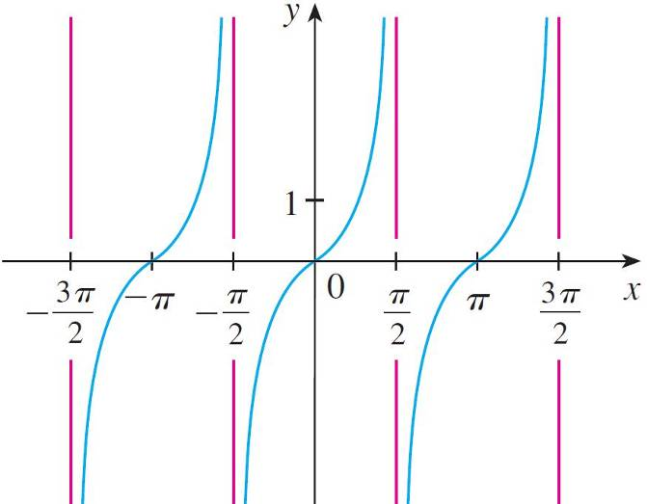
Example 10 – Solution
cont’d
This shows that the line x = π /2 is a vertical asymptote. Similar reasoning shows that the lines x = (2n + 1)π /2, where n is an integer, are all vertical asymptotes of
f (x) = tan x.
The graph in Figure 16 confirms this.
y = tan x
Figure 16

