Slide 1


1
Functions and Limits
Copyright © Cengage Learning. All rights reserved.

Slide 2

Calculating Limits Using the Limit Laws
1.6
Copyright © Cengage Learning. All rights reserved.

Slide 3
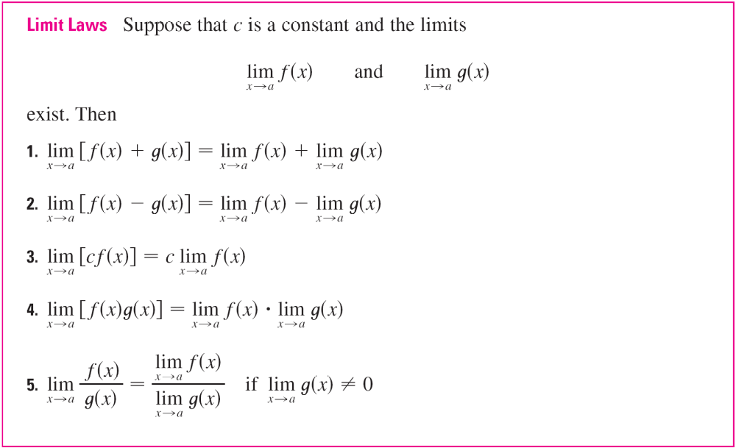
Calculating Limits Using the Limit Laws
In this section we use the following properties of limits, called the Limit Laws, to calculate limits.

Slide 4
Calculating Limits Using the Limit Laws
These five laws can be stated verbally as follows:
Sum Law 1. The limit of a sum is the sum of the limits.
Difference Law 2. The limit of a difference is the difference of the limits.
Constant Multiple Law 3. The limit of a constant times a function is the constant times the limit of the function.

Slide 5
Calculating Limits Using the Limit Laws
Product Law 4. The limit of a product is the product of the limits.
Quotient Law 5. The limit of a quotient is the quotient of the limits (provided that the limit of
the denominator is not 0).
For instance, if f (x) is close to L and g(x) is close to M, it is reasonable to conclude that f (x) + g(x) is close to L + M.

Slide 6


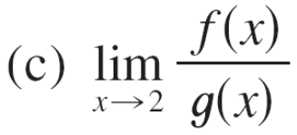
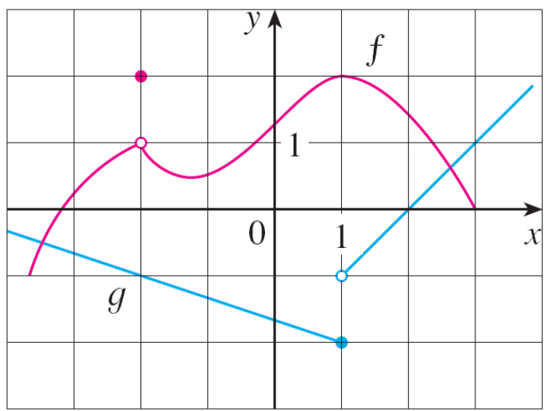
Example 1
Use the Limit Laws and the graphs of f and g in Figure 1 to evaluate the following limits, if they exist.
Figure 1

Slide 7
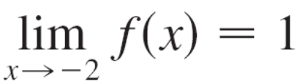
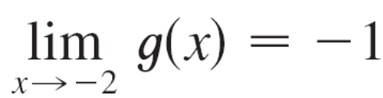
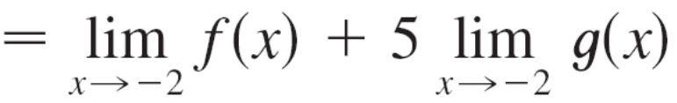
Example 1(a) – Solution
From the graphs of f and g we see that
and
Therefore we have
= 1 + 5(–1)
= –4
(by Law 1)
(by Law 3)

Slide 8

Example 1(b) – Solution
cont’d
We see that lim_{x →1} f (x) = 2. But lim_{x →1} g(x) does not exist because the left and right limits are different:
So we can’t use Law 4 for the desired limit. But we can use Law 4 for the one-sided limits:
The left and right limits aren’t equal, so lim_{x →1} [f (x)g(x)] does not exist.

Slide 9


Example 1(c) – Solution
cont’d
The graphs show that
and
Because the limit of the denominator
is 0, we can’t use Law 5.
The given limit does not exist because the denominator approaches 0 while the numerator approaches a nonzero
number.
Figure 1

Slide 10
Calculating Limits Using the Limit Laws
If we use the Product Law repeatedly with g(x) = f (x), we obtain the following law.
In applying these six limit laws, we need to use two special limits:
These limits are obvious from an intuitive point of view (state them in words or draw graphs of y = c and y = x).
Power Law

Slide 11
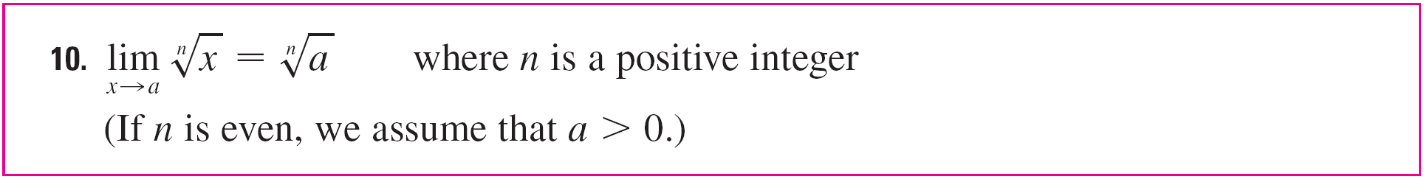
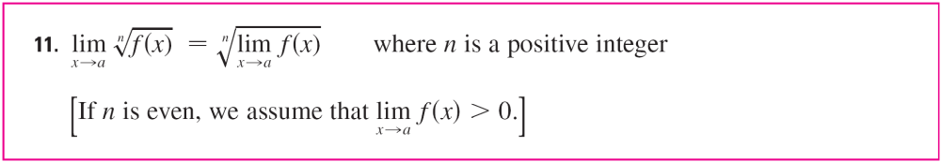
Calculating Limits Using the Limit Laws
If we now put f (x) = x in Law 6 and use Law 8, we get another useful special limit.
A similar limit holds for roots as follows.
More generally, we have the following law.
Root Law

Slide 12
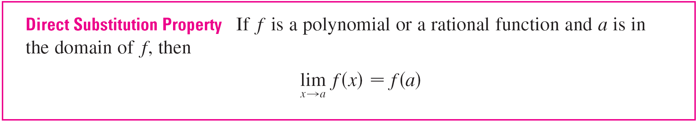
Calculating Limits Using the Limit Laws
Functions with the Direct Substitution Property are called continuous at a.
In general, we have the following useful fact.

Slide 13
Calculating Limits Using the Limit Laws
Some limits are best calculated by first finding the left- and right-hand limits. The following theorem says that a
two-sided limit exists if and only if both of the one-sided limits exist and are equal.
When computing one-sided limits, we use the fact that the Limit Laws also hold for one-sided limits.

Slide 14



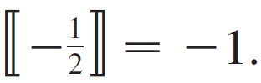

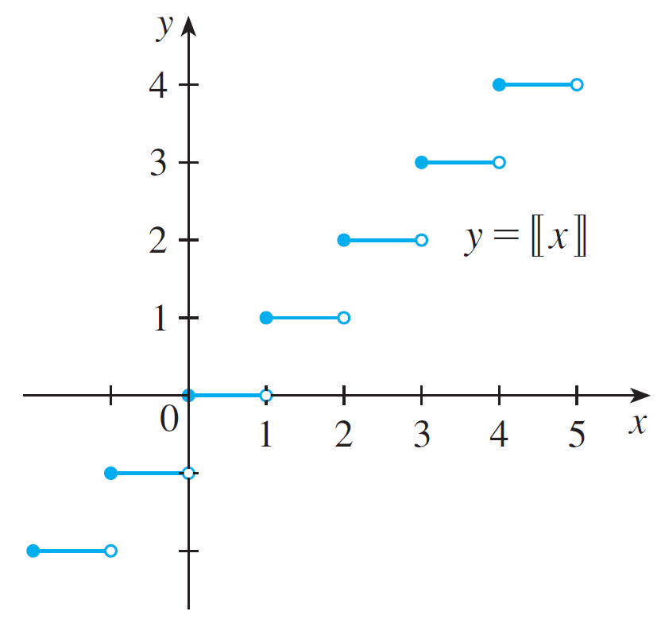

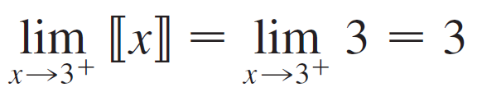
Example 10
The greatest integer function is defined by the largest integer that is less than or equal to x. (For instance,
) Show that
does not exist.
Solution:
The graph of the greatest integer
function is shown in Figure 6.
Since for 3 ≤ x < 4,
we have
Greatest integer function
Figure 6

Slide 15

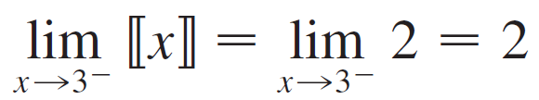

Example 10 – Solution
cont’d
Since for 2 ≤ x < 3, we have
Because these one-sided limits are not equal,
does not exist by Theorem 1.

Slide 16
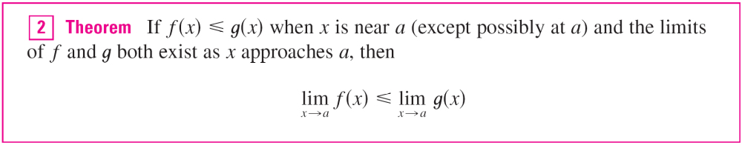
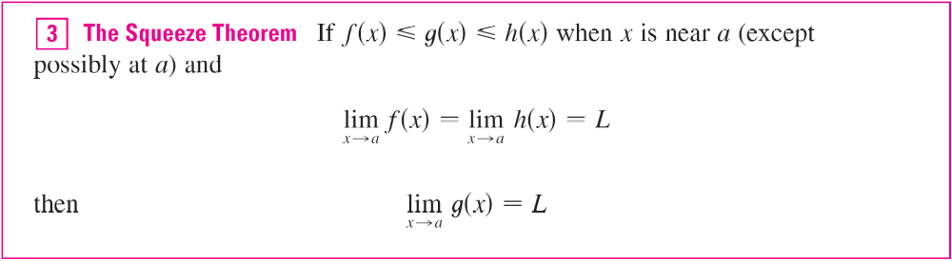
Calculating Limits Using the Limit Laws
The next two theorems give two additional properties of limits.

Slide 17
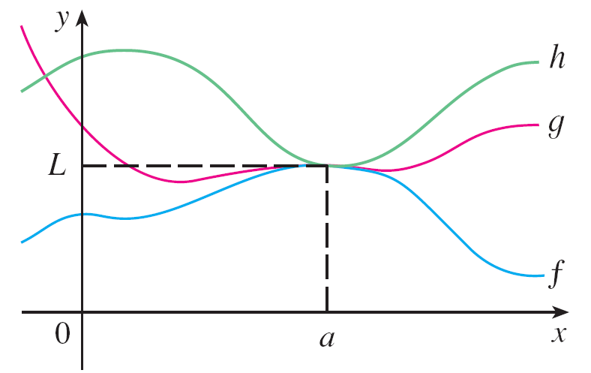
Calculating Limits Using the Limit Laws
The Squeeze Theorem, which is sometimes called the Sandwich Theorem or the Pinching Theorem, is illustrated by Figure 7.
It says that if g(x) is squeezed between f (x) and h(x) near a, and if f and h have the same limit L at a, then g is forced to have the same limit L at a.
Figure 7

