Slide 1


1
Functions and Limits
Copyright © Cengage Learning. All rights reserved.

Slide 2

1.8
Continuity
Copyright © Cengage Learning. All rights reserved.

Slide 3

Continuity
The limit of a function as x approaches a can often be found simply by calculating the value of the function at a. Functions with this property are called continuous at a.
We will see that the mathematical definition of continuity corresponds closely with the meaning of the word continuity in everyday language. (A continuous process is one that takes place gradually, without interruption or abrupt change.)

Slide 4
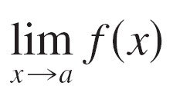
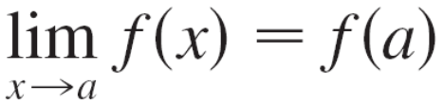
Continuity
Notice that Definition 1 implicitly requires three things if f is continuous at a:
1. f (a) is defined (that is, a is in the domain of f )
2. exists
3.
The definition says that f is continuous at a if f (x) approaches f (a) as x approaches a. Thus a continuous function f has the property that a small change in x produces only a small change in f (x).

Slide 5
Continuity
In fact, the change in f (x) can be kept as small as we please by keeping the change in x sufficiently small.
If f is defined near a (in other words, f is defined on an open interval containing a, except perhaps at a), we say that f is discontinuous at a (or f has a discontinuity at a) if f is not continuous at a.
Physical phenomena are usually continuous. For instance, the displacement or velocity of a vehicle varies continuously with time, as does a person’s height. But discontinuities do occur in such situations as electric currents.

Slide 6
Continuity
Geometrically, you can think of a function that is continuous at every number in an interval as a function whose graph has no break in it. The graph can be drawn without removing your pen from the paper.

Slide 7
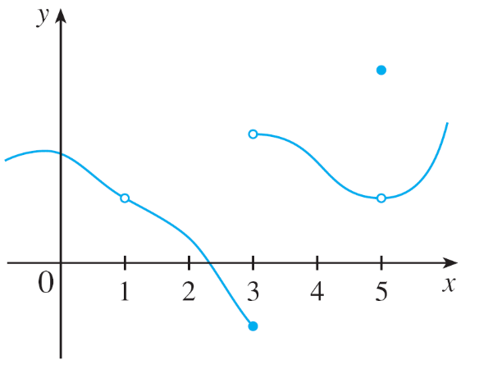
Example 1
Figure 2 shows the graph of a function f. At which numbers is f discontinuous? Why?
Solution:
It looks as if there is a discontinuity when a = 1 because the graph has a break there. The official reason that f is discontinuous at 1 is that f (1) is not defined.
Figure 2

Slide 8
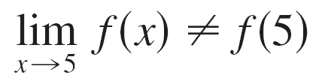
Example 1 – Solution
cont’d
The graph also has a break when a = 3, but the reason for the discontinuity is different. Here, f (3) is defined, but lim_{x→3} f (x) does not exist (because the left and right limits are different). So f is discontinuous at 3.
What about a = 5? Here, f (5) is defined and lim_{x→5} f (x) exists (because the left and right limits are the same).
But
So f is discontinuous at 5.

Slide 9
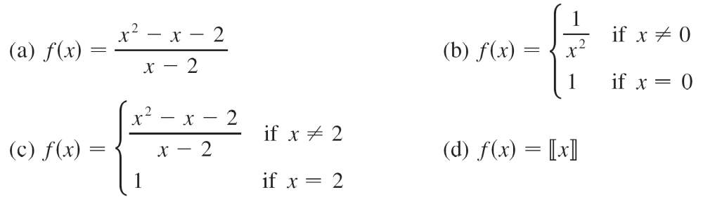
Example 2
Where are each of the following functions discontinuous?
Solution:
(a) Notice that f (2) is not defined, so f is discontinuous at 2.
Later we’ll see why f is continuous at all other numbers.

Slide 10
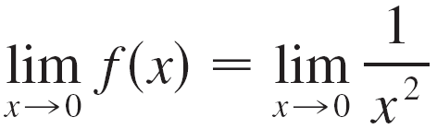
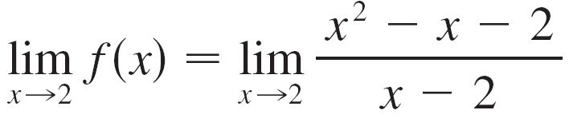
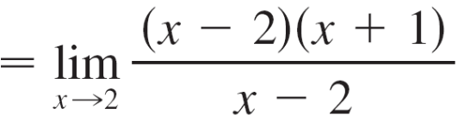
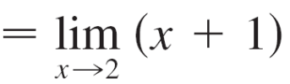
Example 2 – Solution
cont’d
(b) Here f (0) = 1 is defined but
does not exist. So f is discontinuous at 0.
(c) Here f (2) = 1 is defined and
= 3 exists.

Slide 11



Example 2 – Solution
cont’d
But
so f is not continuous at 2.
(d) The greatest integer function f (x) = has
discontinuities at all of the integers because
does not exist if n is an integer.

Slide 12
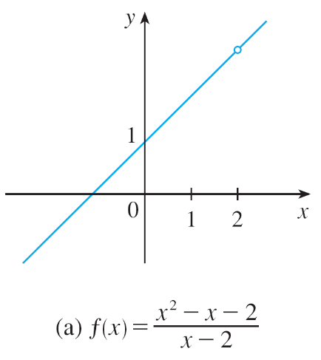
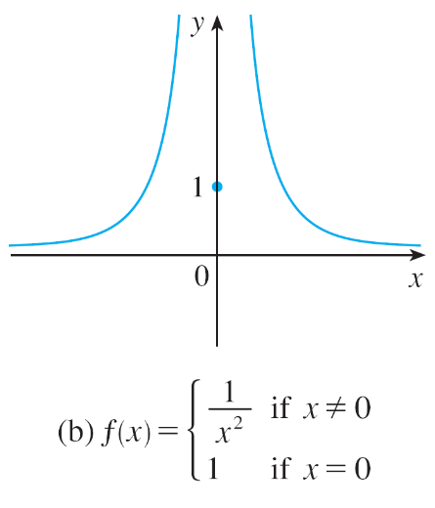
Continuity
Figure 3 shows the graphs of the functions in Example 2.
Graphs of the functions in Example 2
Figure 3

Slide 13
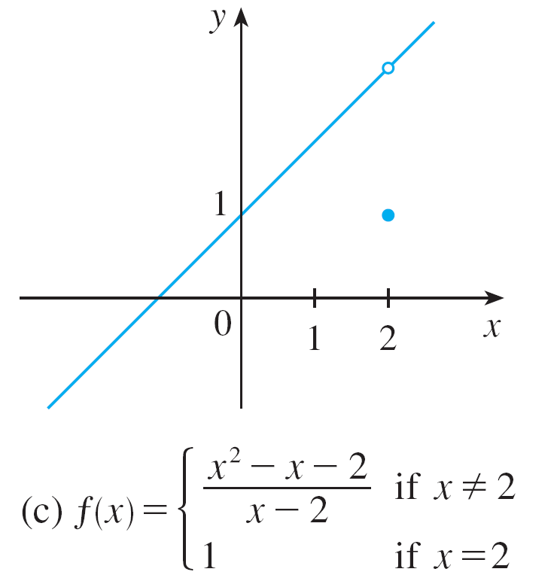
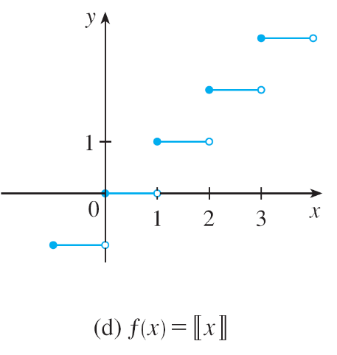
Continuity
Graphs of the functions in Example 2
Figure 3

Slide 14
Continuity
In each case the graph can’t be drawn without lifting the pen from the paper because a hole or break or jump occurs in the graph.
The kind of discontinuity illustrated in parts (a) and (c) is called removable because we could remove the discontinuity by redefining f at just the single number 2. [The function g(x) = x + 1 is continuous.]
The discontinuity in part (b) is called an infinite discontinuity. The discontinuities in part (d) are called jump discontinuities because the function “jumps” from one value to another.

Slide 15
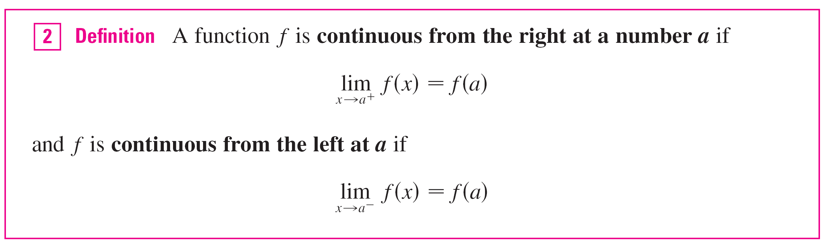
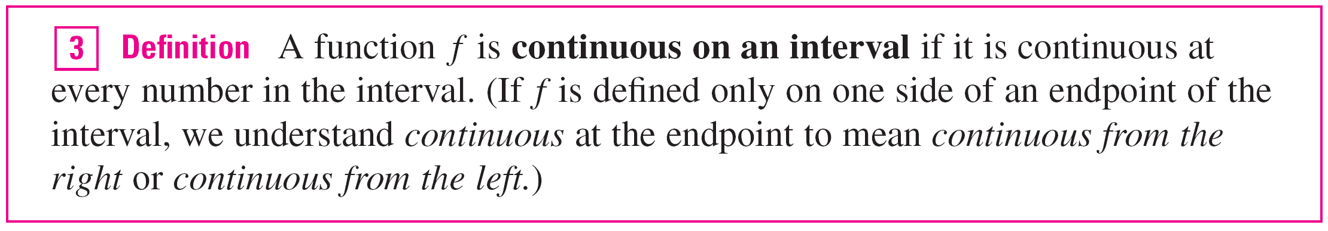
Continuity

Slide 16
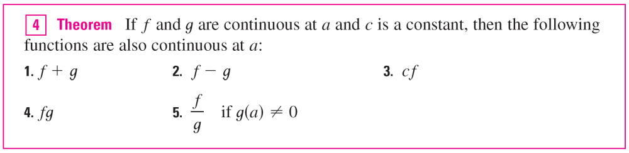
Continuity
Instead of always using Definitions 1, 2, and 3 to verify the continuity of a function, it is often convenient to use the next theorem, which shows how to build up complicated continuous functions from simple ones.

Slide 17
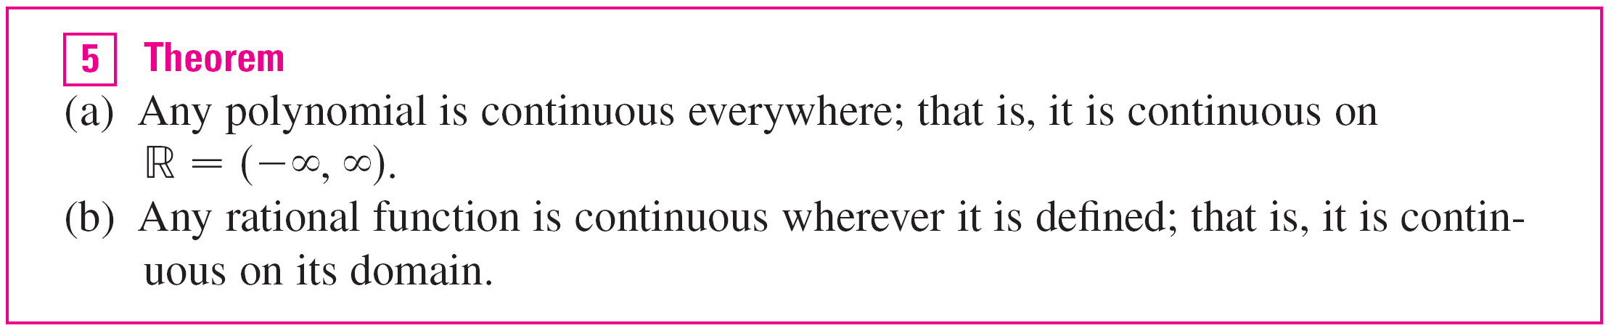
Continuity
It follows from Theorem 4 and Definition 3 that if f and g are continuous on an interval, then so are the functions
f + g, f – g, cf, fg, and (if g is never 0) f/g.
The following theorem was stated as the Direct Substitution Property.

Slide 18

Continuity
As an illustration of Theorem 5, observe that the volume of a sphere varies continuously with its radius because the formula V(r) = π r ³ shows that V is a polynomial function of r.
Likewise, if a ball is thrown vertically into the air with a velocity of 50 ft/s, then the height of the ball in feet t seconds later is given by the formula h = 50t – 16t².
Again this is a polynomial function, so the height is a continuous function of the elapsed time.

Slide 19
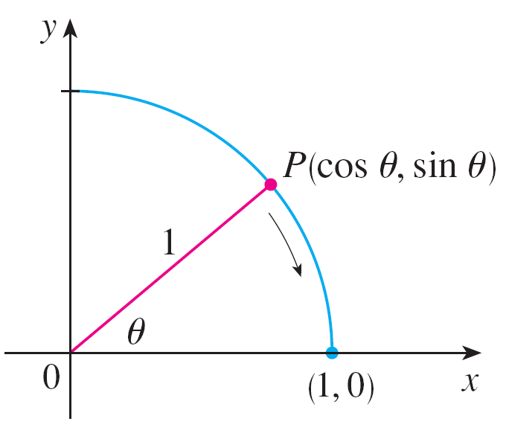
Continuity
It turns out that most of the familiar functions are
continuous at every number in their domains.
From the appearance of the graphs of the sine and cosine functions, we would certainly guess that they are continuous.
We know from the definitions of
sin θ and cos θ that the coordinates
of the point P in Figure 5 are
(cos θ, sin θ ). As θ → 0, we see
that P approaches the point (1, 0)
and so cos θ → 1 and sin θ → 0.
Figure 5

Slide 20
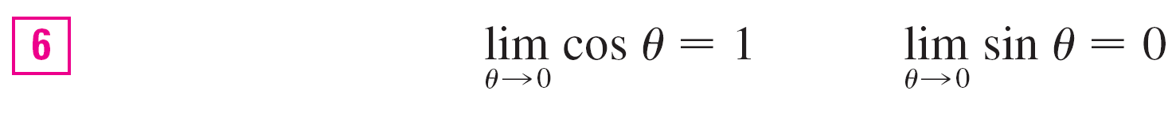

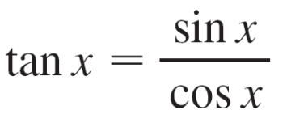
Continuity
Thus
Since cos 0 = 1 and sin 0 = 0, the equations in assert that the cosine and sine functions are continuous at 0.
The addition formulas for cosine and sine can then be used to deduce that these functions are continuous everywhere.
It follows from part 5 of Theorem 4 that
is continuous except where cos x = 0.

Slide 21
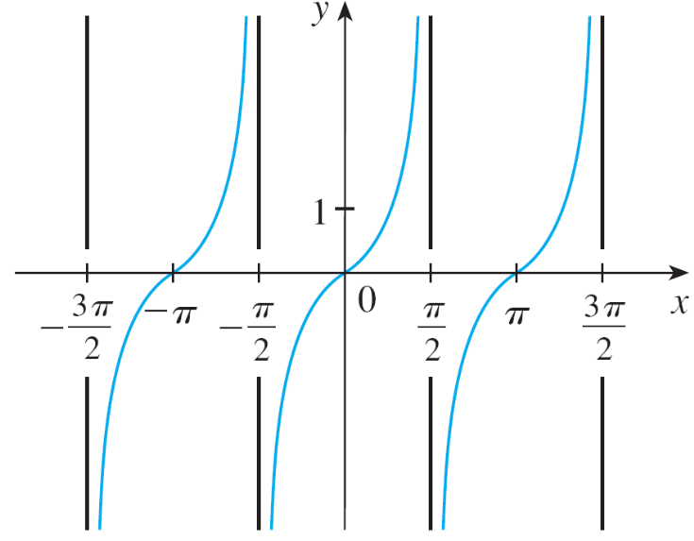
Continuity
This happens when x is an odd integer multiple of π /2, so y = tan x has infinite discontinuities when
x = ±π /2, ±3π /2, ±5π /2, and so on (see Figure 6).
y = tan x
Figure 6

Slide 22
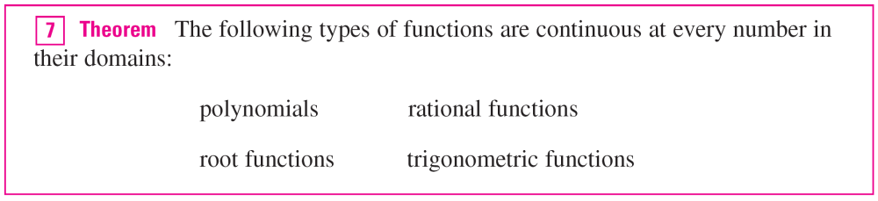
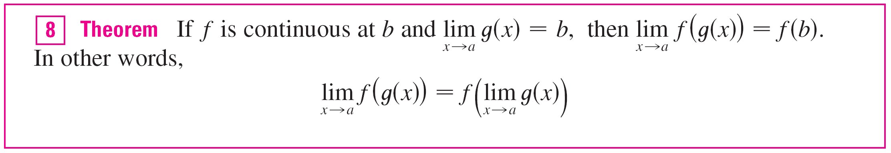
Continuity
Another way of combining continuous functions f and g to get a new continuous function is to form the composite function f ° g. This fact is a consequence of the following theorem.

Slide 23
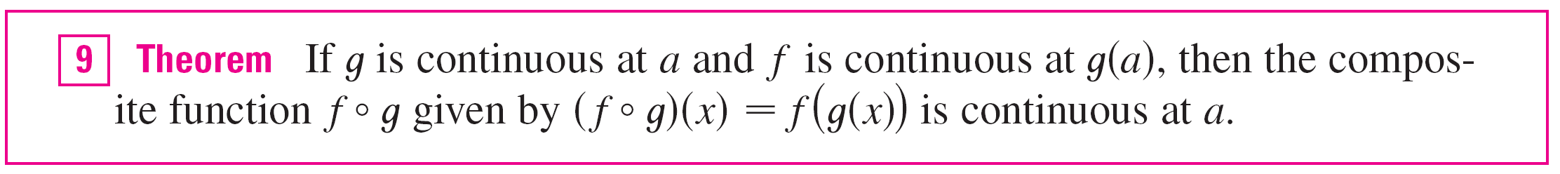
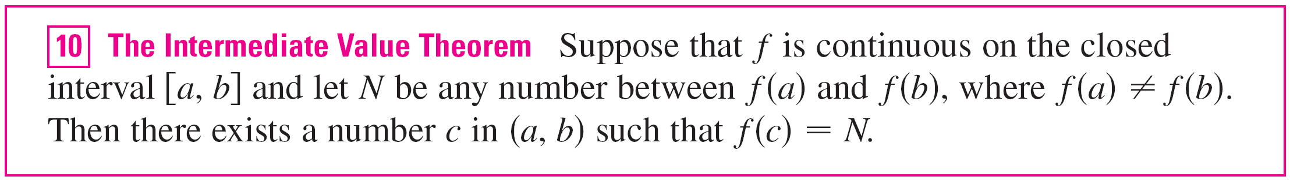
Continuity
Intuitively, Theorem 8 is reasonable because if x is close to a, then g(x) is close to b, and since f is continuous at b, if g(x) is close to b, then f (g(x)) is close to f (b).
An important property of continuous functions is expressed by the following theorem, whose proof is found in more advanced books on calculus.

Slide 24
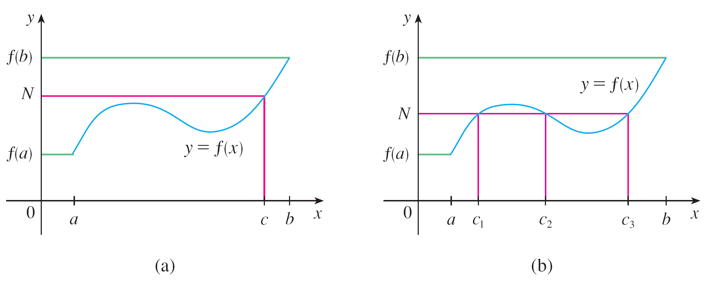
Continuity
The Intermediate Value Theorem states that a continuous function takes on every intermediate value between the function values f (a) and f (b). It is illustrated by Figure 7.
Note that the value N can be taken on once [as in part (a)] or more than once [as in part (b)].
Figure 7

Slide 25
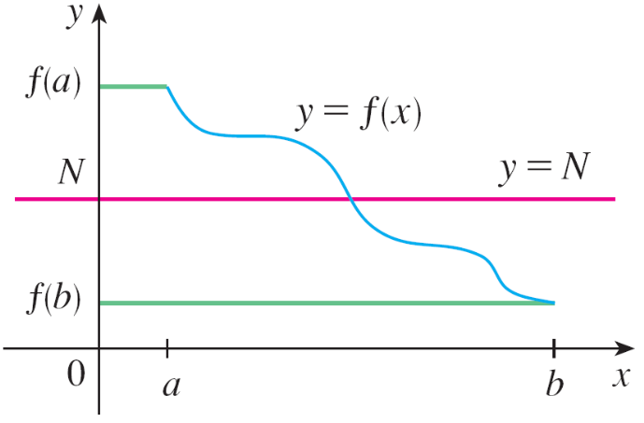
Continuity
If we think of a continuous function as a function whose graph has no hole or break, then it is easy to believe that the Intermediate Value Theorem is true.
In geometric terms it says that if any horizontal line y = N is given between y = f (a) and y = f (b) as in Figure 8, then the graph of f can’t jump over the line. It must intersect y = N somewhere.
Figure 8

Slide 26
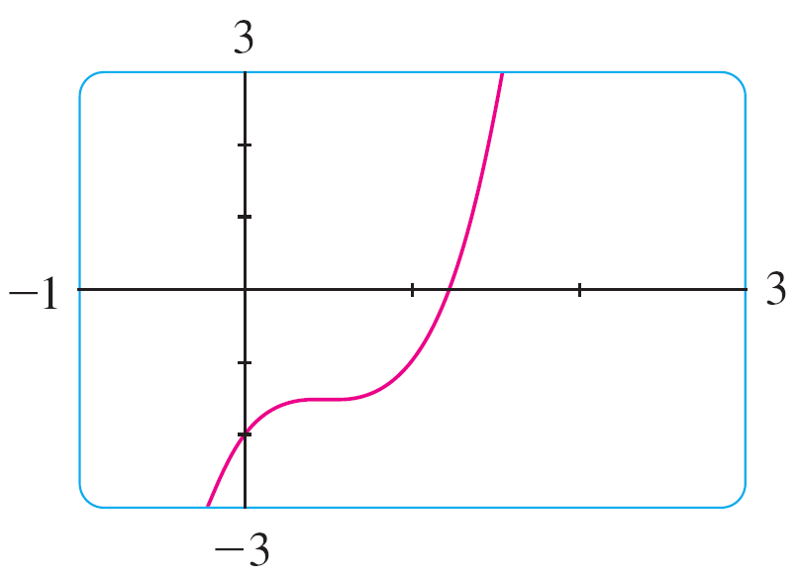
Continuity
It is important that the function f in Theorem 10 be continuous. The Intermediate Value Theorem is not true in general for discontinuous functions.
We can use a graphing calculator or computer to illustrate the use of the Intermediate Value Theorem.
Figure 9 shows the graph of f in the
viewing rectangle [–1, 3] by [–3, 3] and
you can see that the graph crosses the
x-axis between 1 and 2.
Figure 9

Slide 27
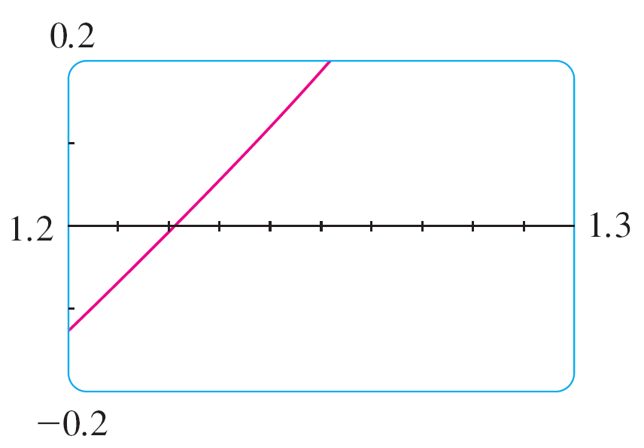
Continuity
Figure 10 shows the result of zooming in to the viewing rectangle [1.2, 1.3] by [–0.2, 0.2].
In fact, the Intermediate Value Theorem plays a role in the very way these graphing devices work.
Figure 10

Slide 28
Continuity
A computer calculates a finite number of points on the graph and turns on the pixels that contain these calculated points.
It assumes that the function is continuous and takes on all the intermediate values between two consecutive points.
The computer therefore connects the pixels by turning on the intermediate pixels.

