Slide 1

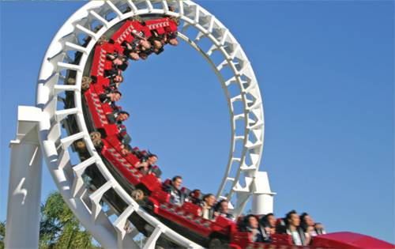
2
Derivatives
Copyright © Cengage Learning. All rights reserved.

Slide 2

2.1
Derivatives and Rates of Change
Copyright © Cengage Learning. All rights reserved.

Slide 3
Derivatives and Rates of Change
The problem of finding the tangent line to a curve and the
problem of finding the velocity of an object both involve
finding the same type of limit.
This special type of limit is called a derivative and we will
see that it can be interpreted as a rate of change in any of
the sciences or engineering.

Slide 4
Tangents

Slide 5
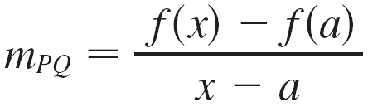
Tangents
If a curve C has equation y = f (x) and we want to find the
tangent line to C at the point P (a, f (a)), then we consider a
nearby point Q (x, f (x)), where x ≠ a, and compute the slope
of the secant line PQ:
Then we let Q approach P along the curve C by letting
x approach a.

Slide 6
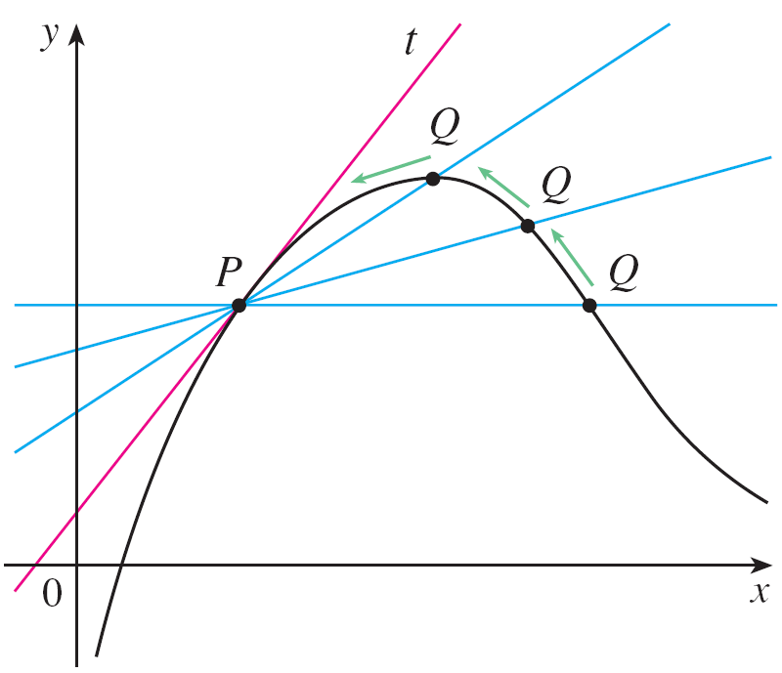
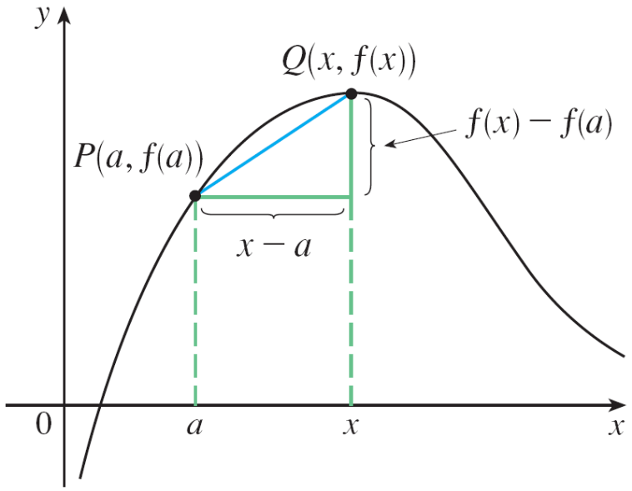
Tangents
If m_{PQ} approaches a number m, then we define the tangent t to be the line through P with slope m. (This amounts to saying that the tangent line is the limiting position of the secant line PQ as Q approaches P. See Figure 1.)
Figure 1

Slide 7
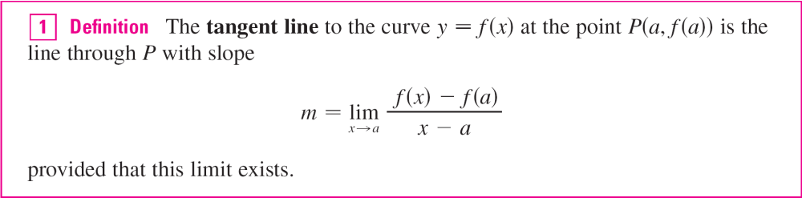
Tangents

Slide 8
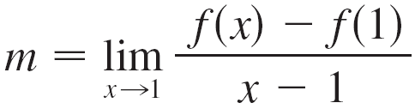
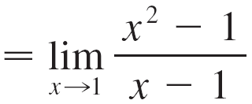
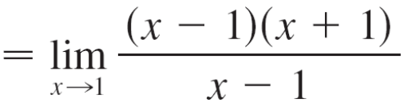

Example 1
Find an equation of the tangent line to the parabola y = x² at the point P(1, 1).
Solution:
Here we have a = 1 and f (x) = x², so the slope is

Slide 9


Example 1 – Solution
cont’d
Using the point-slope form of the equation of a line, we find that an equation of the tangent line at (1, 1) is
y – 1 = 2(x – 1) or y = 2x – 1

Slide 10
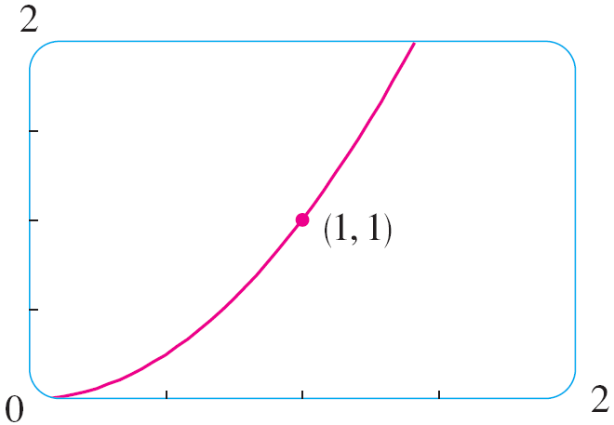
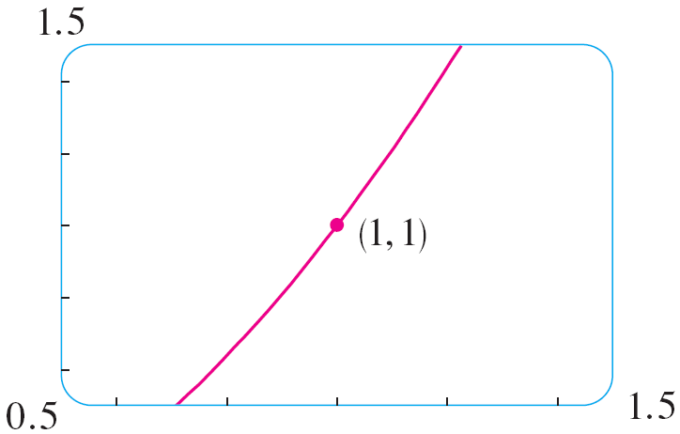
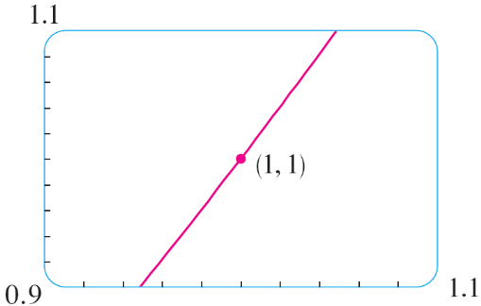
Tangents
We sometimes refer to the slope of the tangent line to a curve at a point as the slope of the curve at the point.
The idea is that if we zoom in far enough toward the point, the curve looks almost like a straight line.
Figure 2 illustrates this procedure for the curve y = x² in Example 1.
Zooming in toward the point (1, 1) on the parabola y = x²
Figure 2

Slide 11
Tangents
The more we zoom in, the more the parabola looks like a line.
In other words, the curve becomes almost indistinguishable from its tangent line.
There is another expression for the slope of a tangent line that is sometimes easier to use.

Slide 12
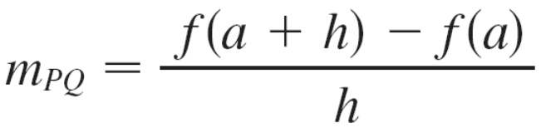
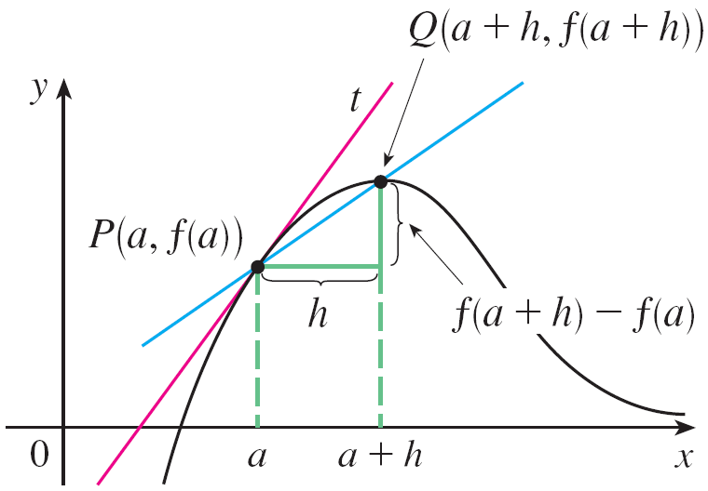
Tangents
If h = x – a, then x = a + h and so the slope of the secant line PQ is
(See Figure 3 where the case h > 0 is illustrated and Q is to the right of P. If it happened that h < 0, however, Q would be to the left of P.)
Figure 3

Slide 13
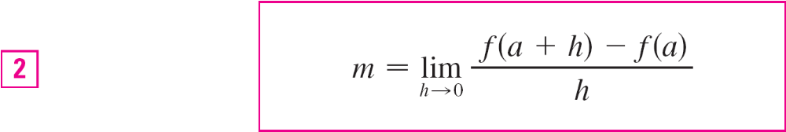
Tangents
Notice that as x approaches a, h approaches 0 (because
h = x – a) and so the expression for the slope of the tangent line in Definition 1 becomes

Slide 14
Velocities

Slide 15
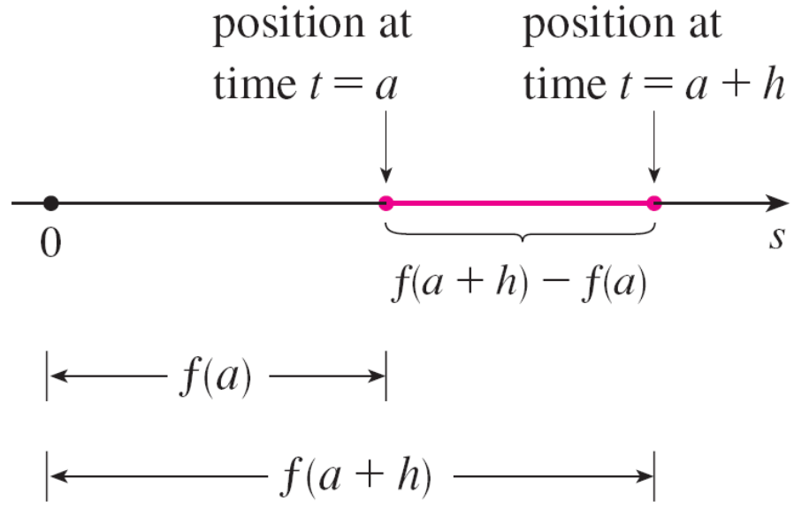
Velocities
In general, suppose an object moves along a straight line according to an equation of motion s = f (t), where s is the displacement (directed distance) of the object from the origin at time t.
The function f that describes
the motion is called the
position function of the
object. In the time interval
from t = a to t = a + h the
change in position
is f (a + h) – f (a).
(See Figure 5.)
Figure 5

Slide 16
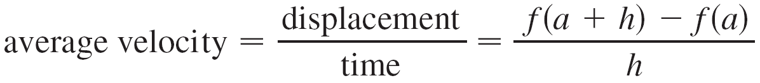
Velocities
The average velocity over this time interval is

Slide 17
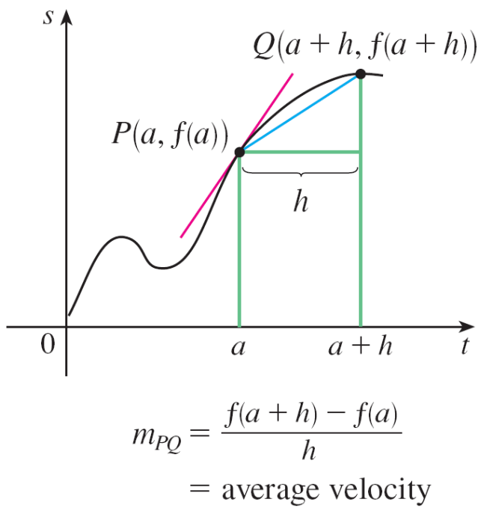
Velocities
which is the same as the slope of the secant line PQ in Figure 6.
Figure 6

Slide 18
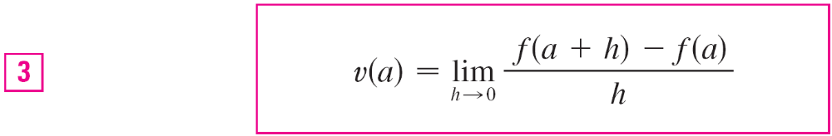
Velocities
Now suppose we compute the average velocities over shorter and shorter time intervals [a, a + h].
In other words, we let h approach 0. As in the example of the falling ball, we define the velocity (or instantaneous velocity) v (a) at time t = a to be the limit of these average velocities:
This means that the velocity at time t = a is equal to the slope of the tangent line at P.

Slide 19
Example 3
Suppose that a ball is dropped from the upper observation deck of the CN Tower, 450 m above the ground.
(a) What is the velocity of the ball after 5 seconds?
(b) How fast is the ball traveling when it hits the ground?
Solution:
We will need to find the velocity both when t = 5 and when the ball hits the ground, so it’s efficient to start by finding the velocity at a general time t = a.

Slide 20
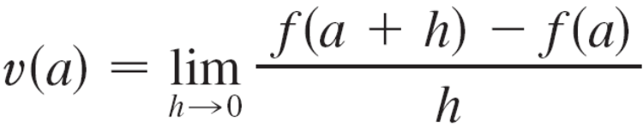
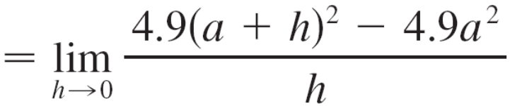
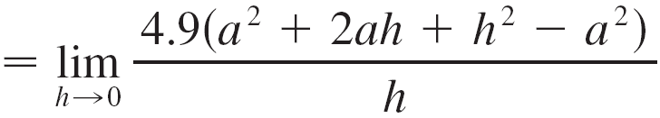
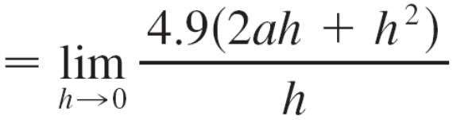


Example 3 – Solution
cont’d
Using the equation of motion s = f (t) = 4.9t ², we have

Slide 21
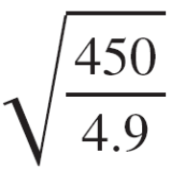
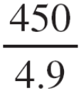
Example 3 – Solution
cont’d
= 49 m/s.
(a) The velocity after 5 s is v(5) = (9.8)(5)
(b) Since the observation deck is 450 m above the ground, the ball will hit the ground at the time t₁ when
s(t₁) = 450, that is,
4.9t₁² = 450
This gives
t₁² = and t₁ = ≈ 9.6 s
The velocity of the ball as it hits the ground is therefore
v(t₁) = 9.8t₁
= 9.8
≈ 94 m/s

Slide 22
Derivatives

Slide 23
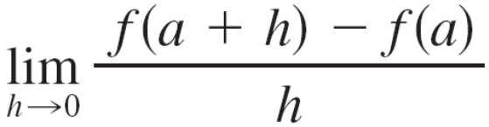
Derivatives
We have seen that the same type of limit arises in finding the slope of a tangent line (Equation 2) or the velocity of an object (Equation 3).
In fact, limits of the form
arise whenever we calculate a rate of change in any of the sciences or engineering, such as a rate of reaction in chemistry or a marginal cost in economics.
Since this type of limit occurs so widely, it is given a special name and notation.

Slide 24
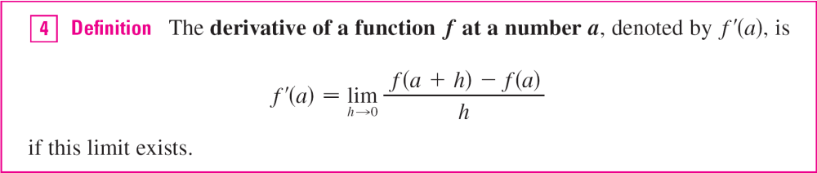
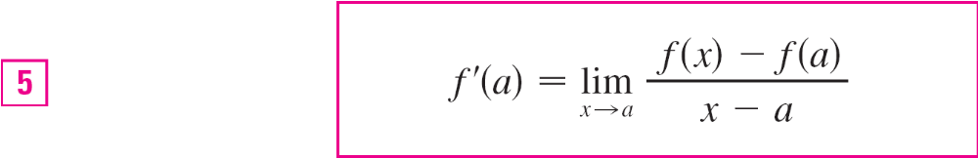
Derivatives
If we write x = a + h, then we have h = x – a and h approaches 0 if and only if x approaches a. Therefore an equivalent way of stating the definition of the derivative, as we saw in finding tangent lines, is

Slide 25
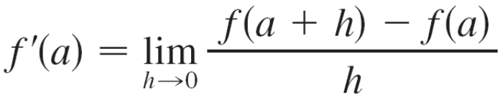
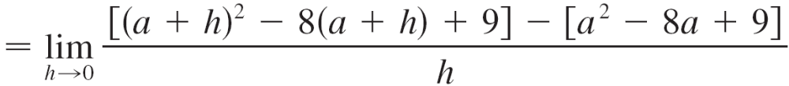
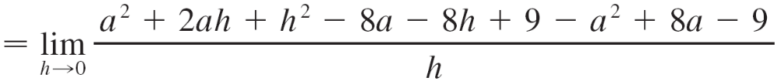
Example 4
Find the derivative of the function f (x) = x² – 8x + 9 at the number a.
Solution:
From Definition 4 we have

Slide 26
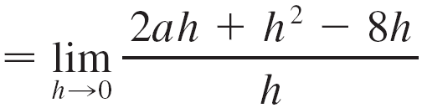


Example 4 – Solution
cont’d

Slide 27
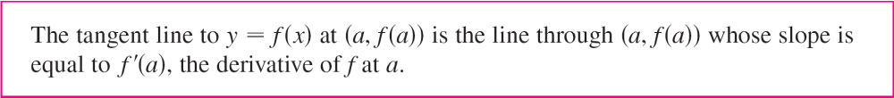
Derivatives
We defined the tangent line to the curve y = f (x) at the point P (a, f (a)) to be the line that passes through P and has slope m given by Equation 1 or 2.
Since, by Definition 4, this is the same as the derivative f ′(a), we can now say the following.

Slide 28
Derivatives
If we use the point-slope form of the equation of a line, we can write an equation of the tangent line to the curve
y = f (x) at the point (a, f (a)):
y – f (a) = f ′(a)(x – a)

Slide 29
Rates of Change

Slide 30
Rates of Change
Suppose y is a quantity that depends on another quantity x. Thus y is a function of x and we write y = f (x). If x changes from x₁ to x₂, then the change in x (also called the increment of x) is
Δx = x₂ – x₁
and the corresponding change in y is
Δy = f (x₂) – f (x₁)

Slide 31
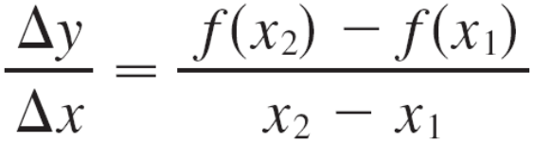
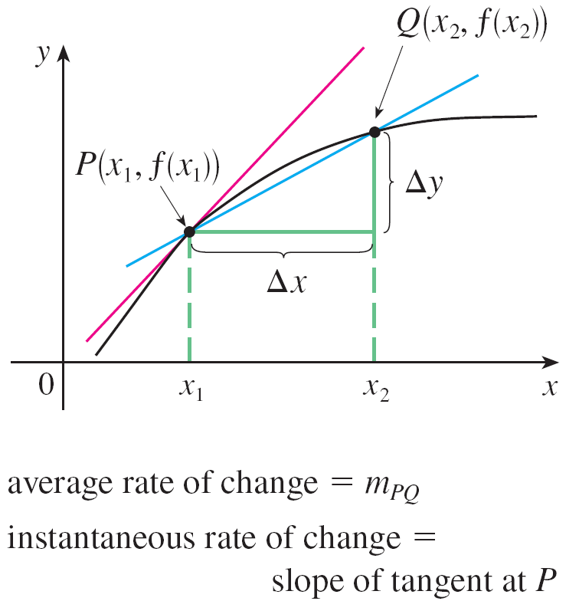
Rates of Change
The difference quotient
is called the average rate of
change of y with respect to x
over the interval [x₁, x₂] and
can be interpreted as the slope
of the secant line PQ
in Figure 8.
Figure 8

Slide 32

Rates of Change
By analogy with velocity, we consider the average rate of change over smaller and smaller intervals by letting x₂ approach x₁ and therefore letting Δx approach 0.
The limit of these average rates of change is called the (instantaneous) rate of change of y with respect to x at x = x₁, which is interpreted as the slope of the tangent to the curve y = f (x) at P(x₁, f (x₁)):
We recognize this limit as being the derivative f ′(x₁).

Slide 33
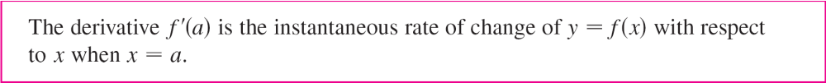
Rates of Change
We know that one interpretation of the derivative f ′(a) is as the slope of the tangent line to the curve y = f (x) when
x = a. We now have a second interpretation:
The connection with the first interpretation is that if we sketch the curve y = f (x), then the instantaneous rate of change is the slope of the tangent to this curve at the point where x = a.

Slide 34
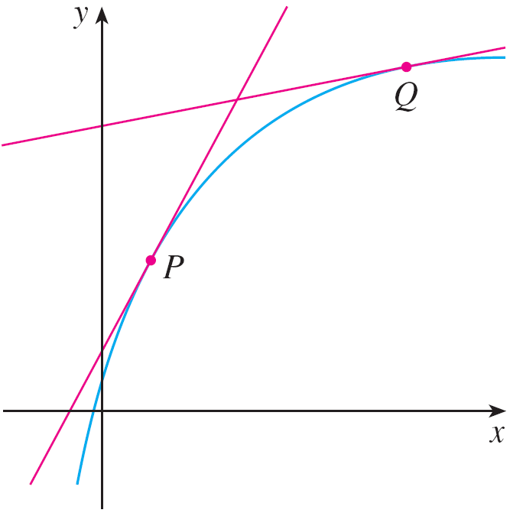
Rates of Change
This means that when the derivative is large (and therefore the curve is steep, as at the point P in Figure 9), the y-values change rapidly.
Figure 9
The y-values are changing rapidly at P and slowly at Q.

Slide 35
Rates of Change
When the derivative is small, the curve is relatively flat (as at point Q) and the y-values change slowly.
In particular, if s = f (t) is the position function of a particle that moves along a straight line, then f ′(a) is the rate of change of the displacement s with respect to the time t.
In other words, f ′(a) is the velocity of the particle at time
t = a.
The speed of the particle is the absolute value of the velocity, that is, | f ′(a) |.

Slide 36
Example 6
A manufacturer produces bolts of a fabric with a fixed width. The cost of producing x yards of this fabric is
C = f (x) dollars.
(a) What is the meaning of the derivative f ′(x)? What are its units?
(b) In practical terms, what does it mean to say that f ′(1000) = 9?
(c) Which do you think is greater, f ′(50) or f ′(500)? What
about f ′(5000)?

Slide 37
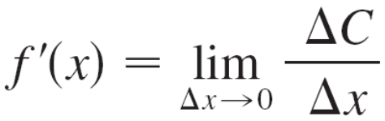
Example 6(a) – Solution
The derivative f ′(x) is the instantaneous rate of change of C with respect to x; that is, f ′(x) means the rate of change of the production cost with respect to the number of yards produced.
Because
the units for f ′(x) are the same as the units for the difference quotient ΔC/Δx.
Since ΔC is measured in dollars and Δx in yards, it follows that the units for f ′(x) are dollars per yard.

Slide 38
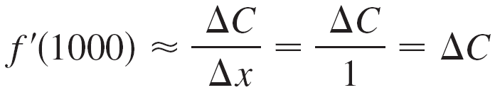
Example 6(b) – Solution
cont’d
The statement that f ′(1000) = 9 means that, after 1000 yards of fabric have been manufactured, the rate at which the production cost is increasing is $9/yard.
(When x = 1000, C is increasing 9 times as fast as x.)
Since Δx = 1 is small compared with x = 1000, we could use the approximation
and say that the cost of manufacturing the 1000th yard (or the 1001st) is about $9.

Slide 39
Example 6(c) – Solution
cont’d
The rate at which the production cost is increasing (per yard) is probably lower when x = 500 than when x = 50 (the cost of making the 500th yard is less than the cost of the 50th yard) because of economies of scale. (The manufacturer makes more efficient use of the fixed costs of production.)
So
f ′(50) > f ′(500)

Slide 40
Example 6(c) – Solution
cont’d
But, as production expands, the resulting large-scale operation might become inefficient and there might be overtime costs.
Thus it is possible that the rate of increase of costs will eventually start to rise.
So it may happen that
f ′(5000) > f ′(500)

