Slide 1


2
Derivatives
Copyright © Cengage Learning. All rights reserved.

Slide 2

2.5
The Chain Rule
Copyright © Cengage Learning. All rights reserved.

Slide 3


The Chain Rule
Suppose you are asked to differentiate the function
The differentiation formulas you learned in the previous sections of this chapter do not enable you to calculate F′(x).
Observe that F is a composite function. In fact, if we let y = f (u) = and let u = g(x) = x² + 1, then we can write y = F (x) = f (g (x)), that is, F = f ° g.
We know how to differentiate both f and g, so it would be useful to have a rule that tells us how to find the derivative of F = f ° g in terms of the derivatives of f and g.

Slide 4
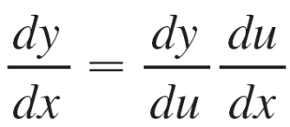
The Chain Rule
It turns out that the derivative of the composite function f ° g is the product of the derivatives of f and g. This fact is one of the most important of the differentiation rules and is called the Chain Rule.
It seems plausible if we interpret derivatives as rates of change. Regard du /dx as the rate of change of u with respect to x, dy/du as the rate of change of y with respect to u, and dy/dx as the rate of change of y with respect to x. If u changes twice as fast as x and y changes three times as fast as u, then it seems reasonable that y changes six times as fast as x, and so we expect that

Slide 5
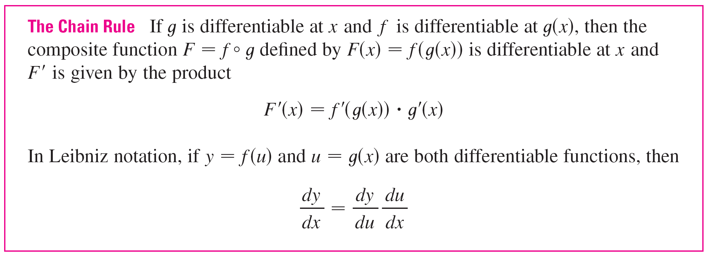
The Chain Rule

Slide 6

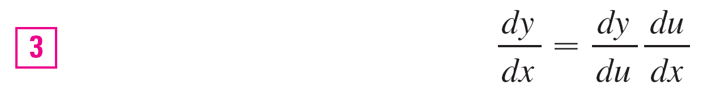
The Chain Rule
The Chain Rule can be written either in the prime notation
(f ° g)′(x) = f ′(g(x))  g′(x)
or, if y = f (u) and u = g(x), in Leibniz notation:
Equation 3 is easy to remember because if dy/du and du/dx were quotients, then we could cancel du.
Remember, however, that du has not been defined and du /dx should not be thought of as an actual quotient.

Slide 7


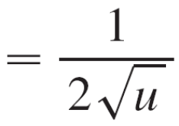

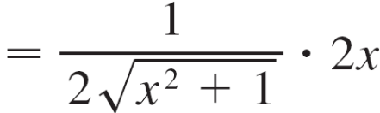
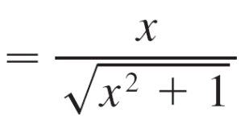
Example 1
Find F '(x) if F (x) = .
Solution 1:
(Using Equation 2): We have expressed F as
F (x) = (f ° g)(x) = f (g(x)) where f (u) = and g (x) = x² + 1.
Since
and g′(x) = 2x
we have F ′(x) = f ′(g (x))  g′ (x)

Slide 8
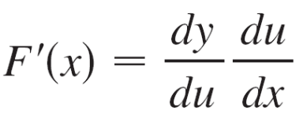
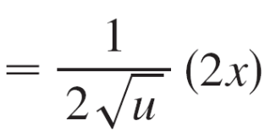
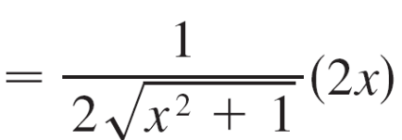
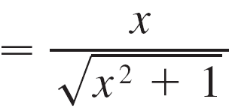
Example 1 – Solution
cont’d
(Using Equation 3): If we let u = x² + 1 and y = , then

Slide 9
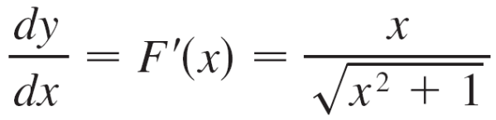
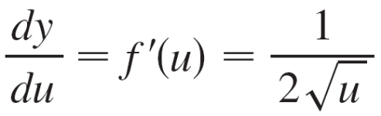
The Chain Rule
When using Formula 3 we should bear in mind that dy/dx refers to the derivative of y when y is considered as a function of x (called the derivative of y with respect to x), whereas dy /du refers to the derivative of y when considered as a function of u (the derivative of y with respect to u). For instance, in Example 1, y can be considered as a function of x (y = ) and also as a function of u (y = ).
Note that
whereas

Slide 10
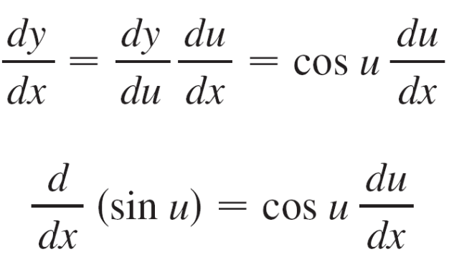
The Chain Rule
In general, if y = sin u, where u is a differentiable function of x, then, by the Chain Rule,
Thus
In a similar fashion, all of the formulas for differentiating trigonometric functions can be combined with the Chain Rule.

Slide 11
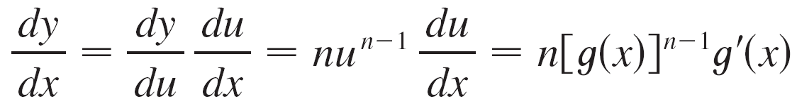
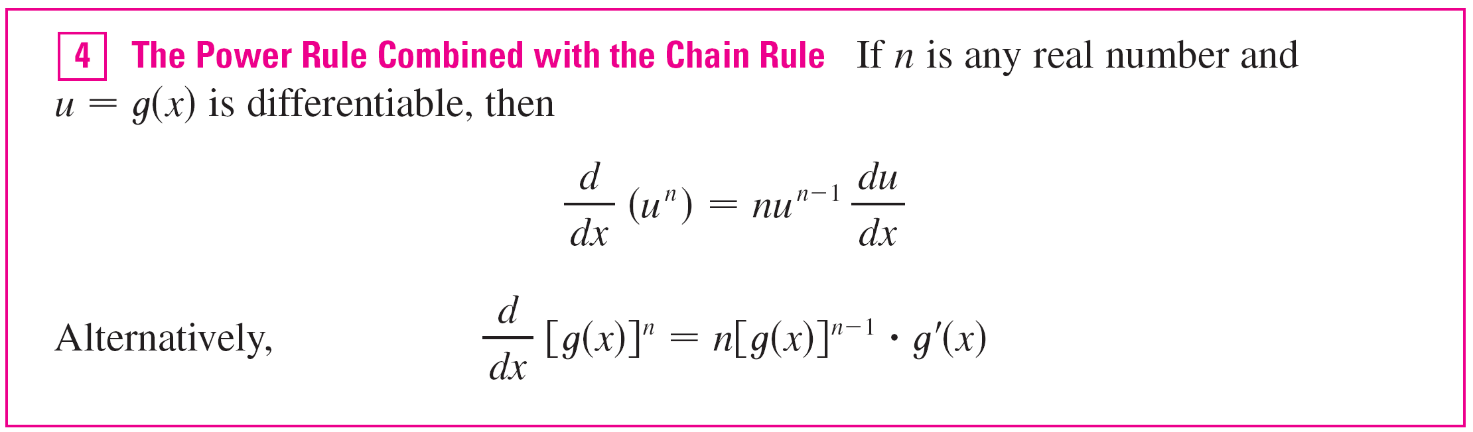
The Chain Rule
Let’s make explicit the special case of the Chain Rule where the outer function f is a power function.
If y = [g (x)]^{n}, then we can write y = f(u) = u^{n} where u = g (x). By using the Chain Rule and then the Power Rule, we get

Slide 12



Example 3
Differentiate y = (x³ – 1)¹⁰⁰.
Solution:
Taking u = g(x) = x³ – 1 and n = 100 in , we have
= (x³ – 1)¹⁰⁰
= 100(x³ – 1)⁹⁹ (x³ – 1)
= 100(x³ – 1)⁹⁹  3x²
= 300x²(x³ – 1)⁹⁹

Slide 13
How to Prove the Chain Rule

Slide 14
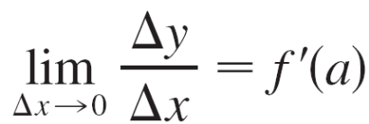
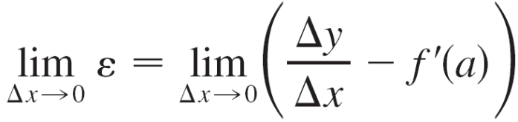
How to Prove the Chain Rule
Recall that if y = f(x) and x changes from a to a + Δx, we defined the increment of y as
Δy = f (a + Δx) – f (a)
According to the definition of a derivative, we have
So if we denote by ε the difference between the difference quotient and the derivative, we obtain
= f '(a) – f '(a) = 0

Slide 15
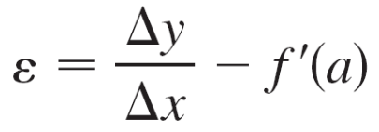


How to Prove the Chain Rule
But
Δy = f ′(a) Δx + ε Δx
If we define ε to be 0 when Δx = 0, then ε becomes a continuous function of Δx. Thus, for a differentiable function f, we can write
Δy = f ′(a) Δx + ε Δx where ε → 0 as Δx → 0
and ε is a continuous function of Δx. This property of differentiable functions is what enables us to prove the Chain Rule.

