Slide 1


2
Derivatives
Copyright © Cengage Learning. All rights reserved.

Slide 2

2.7
Rates of Change in the Natural and Social Sciences
Copyright © Cengage Learning. All rights reserved.

Slide 3
Rates of Change in the Natural and Social Sciences
We know that if y = f (x), then the derivative dy/dx can be interpreted as the rate of change of y with respect to x.
If x changes from x₁ to x₂, then the change in x is
Δx = x₂ – x₁
and the corresponding change in y is
Δy = f (x₂) – f (x₁)

Slide 4
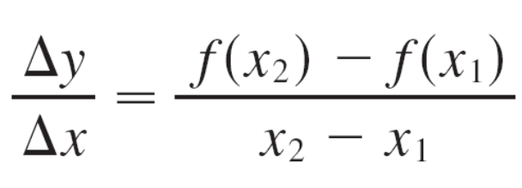
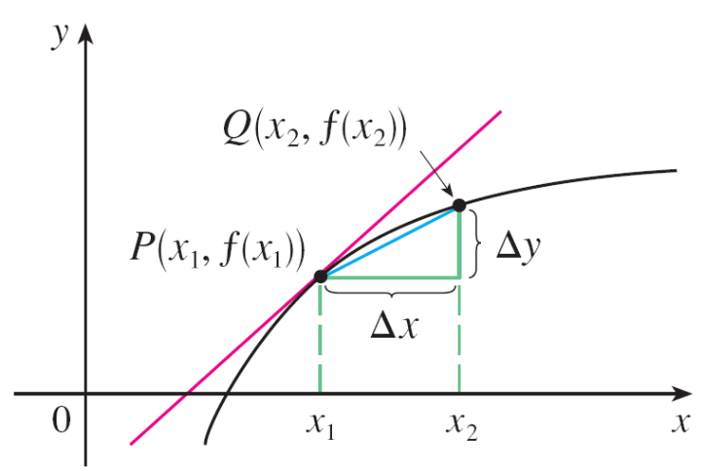
Rates of Change in the Natural and Social Sciences
The difference quotient
is the average rate of change
of y with respect to x over the
interval [x₁, x₂] and can be
interpreted as the slope of the
secant line PQ in Figure 1.
Figure 1
m_{PQ} = average rate of change m = f ′(x₁) = instantaneous rate
of change

Slide 5
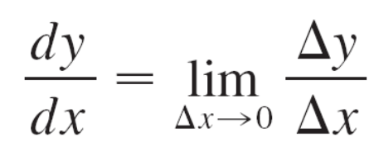
Rates of Change in the Natural and Social Sciences
Its limit as Δx → 0 is the derivative f ′(x₁), which can therefore be interpreted as the instantaneous rate of change of y with respect to x or the slope of the tangent line at P(x₁, f (x₁)).
Using Leibniz notation, we write the process in the form

Slide 6
Physics

Slide 7
Physics
If s = f (t) is the position function of a particle that is moving in a straight line, then Δs/Δt represents the average velocity over a time period Δt, and v = ds/dt represents the instantaneous velocity (the rate of change of displacement with respect to time).
The instantaneous rate of change of velocity with respect to time is acceleration: a(t) = v ′(t) = s″(t).
Now that we know the differentiation formulas, we are able to solve problems involving the motion of objects more easily.

Slide 8
Example 1
The position of a particle is given by the equation
s = f (t) = t ³ – 6t ² + 9t
where t is measured in seconds and s in meters.
(a) Find the velocity at time t.
(b) What is the velocity after 2 s? After 4 s?
(c) When is the particle at rest?
(d) When is the particle moving forward (that is, in the positive direction)?
(e) Draw a diagram to represent the motion of the particle.
(f) Find the total distance traveled by the particle during the first five seconds.
(g) Find the acceleration at time t and after 4 s.

Slide 9

Example 1
(h) Graph the position, velocity, and acceleration functions for 0 ≤ t ≤ 5.
When is the particle speeding up? When is it slowing down?
Solution:
(a) The velocity function is the derivative of the position function.
s = f (t) = t ³ – 6t ² + 9t
v (t) = = 3t ² – 12t + 9

Slide 10
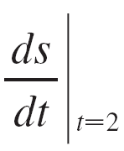
Example 1 – Solution
cont’d
(b) The velocity after 2 s means the instantaneous velocity when t = 2 , that is,
v (2) =
= –3 m/s
The velocity after 4 s is
v (4) = 3(4)² – 12(4) + 9
= 9 m/s
= 3(2)² – 12(2) + 9

Slide 11
Example 1 – Solution
cont’d
(c) The particle is at rest when v (t) = 0, that is,
3t ² – 12t + 9 = 3(t ² – 4t + 3)
= 3(t – 1)(t – 3)
= 0
and this is true when t = 1 or t = 3.
Thus the particle is at rest after 1 s and after 3 s.

Slide 12
Example 1 – Solution
cont’d
(d) The particle moves in the positive direction when
v (t) >0, that is,
3t ² – 12t + 9 = 3(t – 1)(t – 3) > 0
This inequality is true when both factors are positive
(t > 3) or when both factors are negative (t < 1).
Thus the particle moves in the positive direction in the time intervals t < 1 and t > 3.
It moves backward (in the negative direction) when
1 < t < 3.

Slide 13
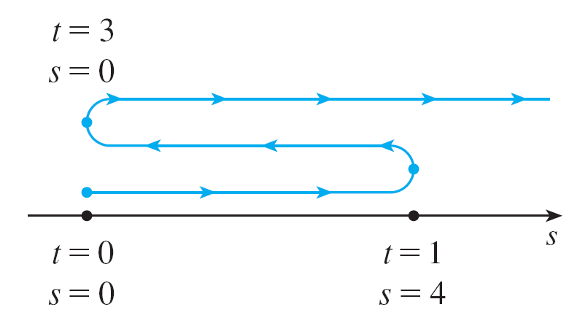
Example 1 – Solution
cont’d
(e) Using the information from part (d) we make a
schematic sketch in Figure 2 of the motion of the particle
back and forth along a line (the s-axis).
Figure 2

Slide 14
Example 1 – Solution
cont’d
(f) Because of what we learned in parts (d) and (e), we
need to calculate the distances traveled during the time
intervals [0, 1], [1, 3], and [3, 5] separately.
The distance traveled in the first second is
| f (1) – f (0) | = | 4 – 0 |
From t = 1 to t = 3 the distance traveled is
| f (3) – f (1) | = | 0 – 4 |
From t = 3 to t = 5 the distance traveled is
| f (5) – f (3) | = | 20 – 0 |
The total distance is 4 + 4 + 20 = 28 m.
= 4 m
= 4 m
= 20 m

Slide 15
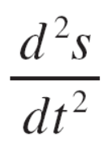
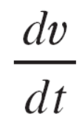
Example 1 – Solution
cont’d
(g) The acceleration is the derivative of the velocity
function:
a(t) =
=
= 6t – 12
a(4) = 6(4) – 12
= 12 m/s²

Slide 16
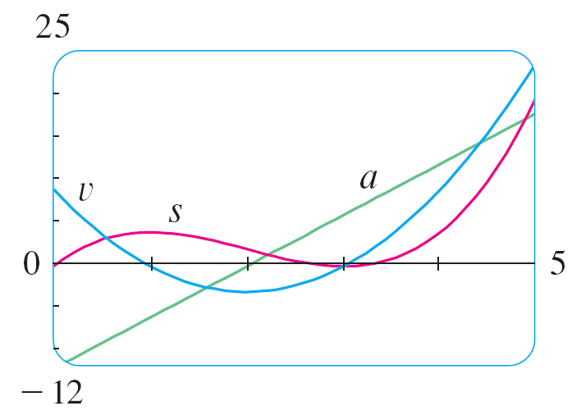
Example 1 – Solution
cont’d
(h) Figure 3 shows the graphs of s, v, and a.
Figure 3

Slide 17
Example 1 – Solution
cont’d
(i) The particle speeds up when the velocity is positive and
increasing (v and a are both positive) and also when the
velocity is negative and decreasing (v and a are both
negative).
In other words, the particle speeds up when the velocity
and acceleration have the same sign. (The particle is
pushed in the same direction it is moving.)
From Figure 3 we see that this happens when 1 < t < 2
and when t > 3.

Slide 18
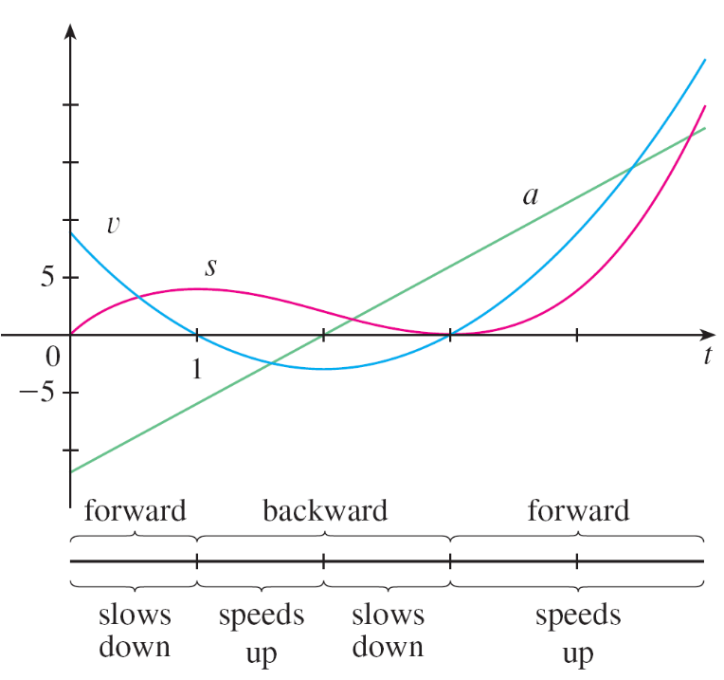
Example 1 – Solution
cont’d
The particle slows down when v and a have opposite signs, that is, when 0 ≤ t < 1 and when 2 < t < 3.
Figure 4 summarizes the motion of the particle.
Figure 4

Slide 19

Example 2
If a rod or piece of wire is homogeneous, then its linear density is uniform and is defined as the mass per unit length (ρ = m / l ) and measured in kilograms per meter.
Suppose, however, that the rod is not homogeneous but that its mass measured from its left end to a point x is m = f (x), as shown in Figure 5.
Figure 5

Slide 20
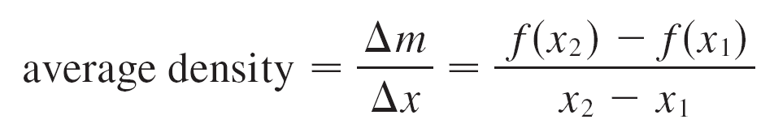
Example 2
cont’d
The mass of the part of the rod that lies between x = x₁ and x = x₂ is given by Δm = f (x₂) – f (x₁), so the average density of that part of the rod is
If we now let Δx → 0 (that is, x₂ → x₁), we are computing the average density over smaller and smaller intervals.
The linear density ρ at x₁ is the limit of these average densities as Δx → 0; that is, the linear density is the rate of change of mass with respect to length.

Slide 21
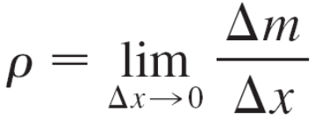
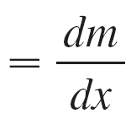
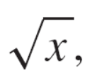
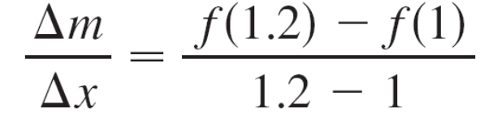
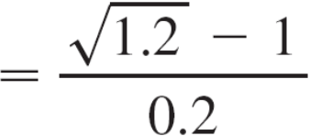
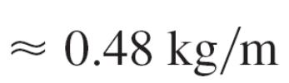
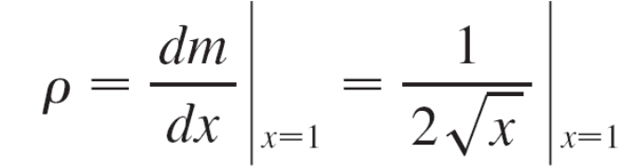
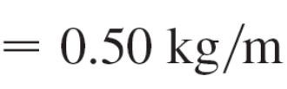
Example 2
cont’d
Symbolically,
Thus the linear density of the rod is the derivative of mass with respect to length.
For instance, if m = f (x) = where x is measured in meters and m in kilograms, then the average density of the part of the rod given by 1 ≤ x ≤ 1.2 is
while the density right at x = 1 is

Slide 22

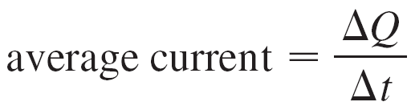
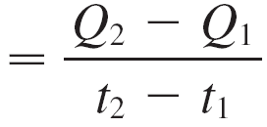
Example 3
A current exists whenever electric charges move. Figure 6 shows part of a wire and electrons moving through a plane surface, shaded red.
If ΔQ is the net charge that passes through this surface during a time period Δt, then the average current during this time interval is defined as
Figure 6

Slide 23
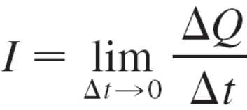
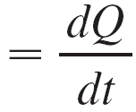
Example 3
cont’d
If we take the limit of this average current over smaller and smaller time intervals, we get what is called the current I at a given time t₁:
Thus the current is the rate at which charge flows through a surface. It is measured in units of charge per unit time (often coulombs per second, called amperes).

Slide 24
Chemistry

Slide 25
Example 4
A chemical reaction results in the formation of one or more substances (called products) from one or more starting materials (called reactants).
For instance, the “equation”
2H₂ + O₂ → 2H₂O
indicates that two molecules of hydrogen and one molecule of oxygen form two molecules of water.
Let’s consider the reaction
A + B → C
where A and B are the reactants and C is the product.

Slide 26
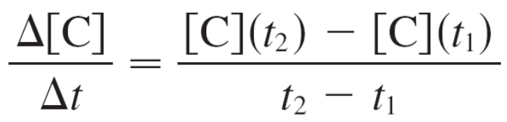
Example 4
cont’d
The concentration of a reactant A is the number of moles (1 mole = 6.022 × 10²³ molecules) per liter and is denoted
by [A].
The concentration varies during a reaction, so [A], [B], and [C] are all functions of time (t).
The average rate of reaction of the product C over a time interval t₁ ≤ t ≤ t₂ is

Slide 27
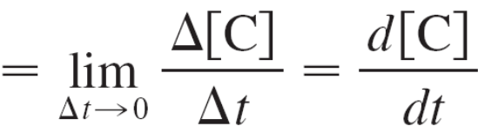
Example 4
cont’d
But chemists are more interested in the instantaneous rate of reaction, which is obtained by taking the limit of the average rate of reaction as the time interval Δt approaches 0:
rate of reaction
Since the concentration of the product increases as the reaction proceeds, the derivative d [C]/dt will be positive, and so the rate of reaction of C is positive.
The concentrations of the reactants, however, decrease during the reaction, so, to make the rates of reaction of
A and B positive numbers, we put minus signs in front of the derivatives d [A]/dt and d [B]/dt.

Slide 28



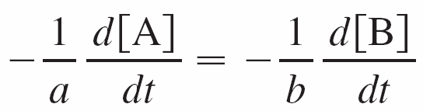
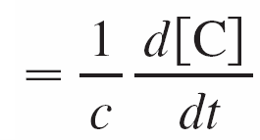
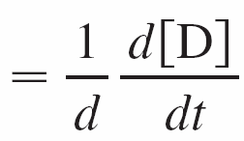
Example 4
cont’d
Since [A] and [B] each decrease at the same rate that [C] increases, we have
rate of reaction
More generally, it turns out that for a reaction of the form
aA + bB → cC + dD
we have
The rate of reaction can be determined from data and
graphical methods. In some cases there are explicit
formulas for the concentrations as functions of time, which
enable us to compute the rate of reaction.

Slide 29
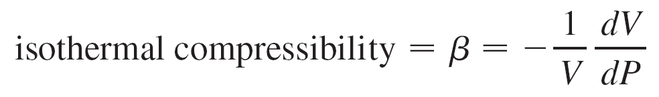
Example 5
One of the quantities of interest in thermodynamics is compressibility. If a given substance is kept at a constant temperature, then its volume V depends on its pressure P. We can consider the rate of change of volume with respect to pressure—namely, the derivative dV/dP. As P increases, V decreases, so dV/dP < 0.
The compressibility is defined by introducing a minus sign and dividing this derivative by the volume V:

Slide 30
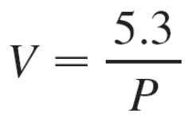
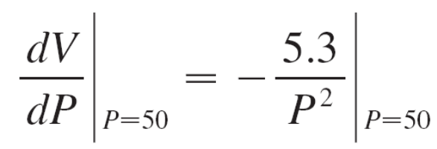
Example 5
cont’d
Thus β measures how fast, per unit volume, the volume of a substance decreases as the pressure on it increases at constant temperature.
For instance, the volume V (in cubic meters) of a sample of air at 25°C was found to be related to the pressure P (in kilopascals) by the equation
The rate of change of V with respect to P when P = 50 kPa is

Slide 31
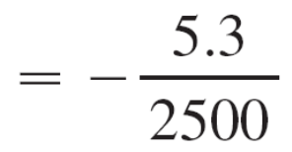
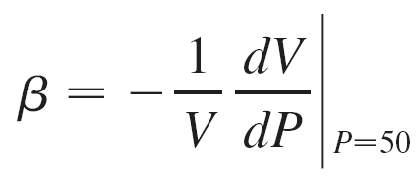
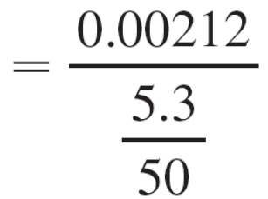
Example 5
cont’d
= –0.00212 m³/kPa
The compressibility at that pressure is
= 0.02 (m³/kPa)/m³

Slide 32
Biology

Slide 33




Example 6
Let n = f (t) be the number of individuals in an animal or plant population at time t.
The change in the population size between the times t = t₁ and t = t₂ is Δn = f (t₂) – f (t₁), and so the average rate of growth during the time period t₁ ≤ t ≤ t₂ is
average rate of growth
The instantaneous rate of growth is obtained from this average rate of growth by letting the time period Δt
approach 0:
growth rate

Slide 34
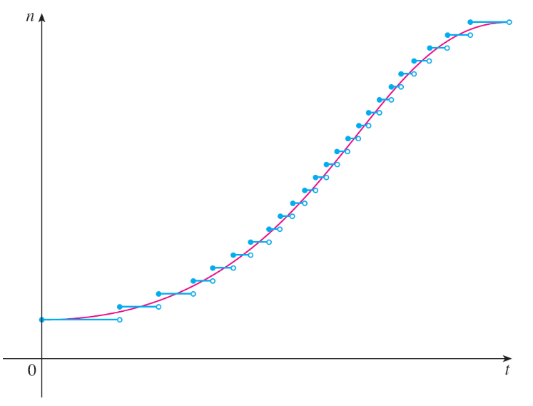
Example 6
cont’d
Strictly speaking, this is not quite accurate because the actual graph of a population function n = f (t) would be a step function that is discontinuous whenever a birth or death occurs and therefore not differentiable.
However, for a large animal
or plant population, we can
replace the graph by a smooth
approximating curve as in
Figure 7.
Figure 7
A smooth curve approximating
a growth function

Slide 35
Example 6
cont’d
To be more specific, consider a population of bacteria in a homogeneous nutrient medium.
Suppose that by sampling the population at certain intervals it is determined that the population doubles every hour. If the initial population is n₀ and the time t is measured in hours, then
f (1) = 2f (0)
f (2) = 2f (1)
f (3) = 2f (2)
and, in general,
f (t) = 2^{t}n₀
= 2n₀
= 2²n₀
= 2³n₀

Slide 36
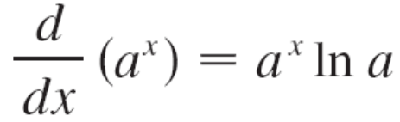
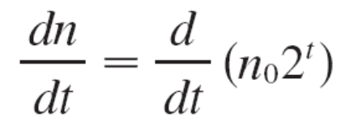

Example 6
cont’d
The population function is n₀ = n₀2^{t}.
We have shown that
So the rate of growth of the bacteria population at time t is
This is an example of an exponential function.

Slide 37
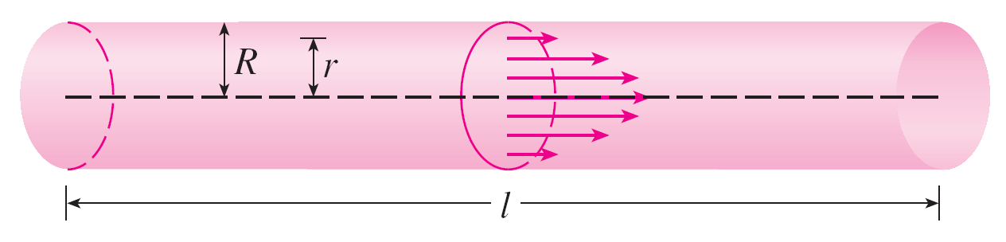
Example 7
When we consider the flow of blood through a blood vessel, such as a vein or artery, we can model the shape of the blood vessel by a cylindrical tube with radius R and length l as illustrated in Figure 8.
Because of friction at the walls of the tube, the velocity v of the blood is greatest along the central axis of the tube and decreases as the distance r from the axis increases until v becomes 0 at the wall.
Figure 8
Blood flow in an artery

Slide 38

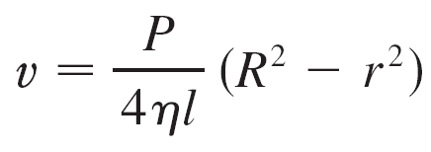
Example 7
cont’d
The relationship between v and r is given by the law of
laminar flow discovered by the French physician
Jean-Louis-Marie Poiseuille in 1840.
This law states that
where η is the viscosity of the blood and P is the pressure difference between the ends of the tube.
If P and l are constant, then v is a function of r with domain [0, R].

Slide 39
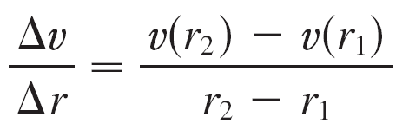
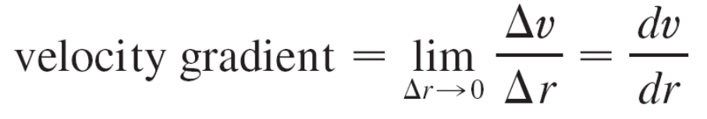


Example 7
cont’d
The average rate of change of the velocity as we move from r = r₁ outward to r = r₂ is given by
and if we let Δr → 0, we obtain the velocity gradient, that is, the instantaneous rate of change of velocity with respect to r :
Using Equation 1, we obtain

Slide 40
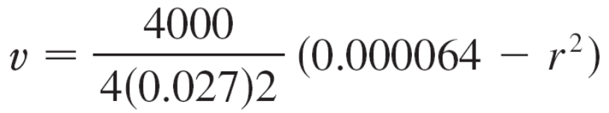
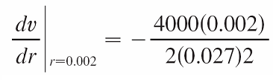

Example 7
cont’d
For one of the smaller human arteries we can take η = 0.027, R = 0.008 cm, l = 2 cm, and P = 4000 dynes/cm², which gives
≈ 1.85 × 10⁴(6.4 × 10^{–5} – r²)
At r = 0.02 cm the blood is flowing at a speed of
v (0.002) ≈ 1.85 × 10⁴(64 × 10^{–6} – 4 × 10^{–6})
= 1.11 cm/s
and the velocity gradient at that point is

Slide 41
Example 7
cont’d
To get a feeling for what this statement means, let’s change our units from centimeters to micrometers
(1 cm = 10,000 μm). Then the radius of the artery is 80 μm.
The velocity at the central axis is 11,850 μm/s, which decreases to 11,110 μm/s at a distance of r = 20 μm.
The fact that dv/dr = –74 (μm/s)/μm means that, when
r = 20 μm, the velocity is decreasing at a rate of about
74 μm/s for each micrometer that we proceed away from the center.

Slide 42
Economics

Slide 43
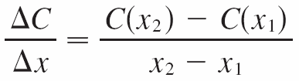
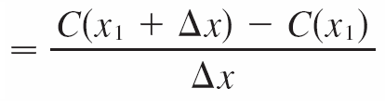
Example 8
Suppose C(x) is the total cost that a company incurs in
producing x units of a certain commodity.
The function C is called a cost function. If the number of items produced is increased from x₁ to x₂, then the additional cost is ΔC = C(x₂) – C (x₁), and the average rate of change of the cost is

Slide 44
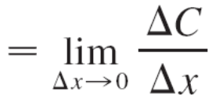
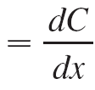
Example 8
cont’d
The limit of this quantity as Δx → 0, that is, the instantaneous rate of change of cost with respect to the number of items produced, is called the marginal cost by economists:
marginal cost
[Since x often takes on only integer values, it may not make literal sense to let Δx approach 0, but we can always replace C(x) by a smooth approximating function as in Example 6.]
Taking Δx = 1 and n large (so that Δx is small compared to n), we have
C ′(n) ≈ C(n + 1) – C(n)

Slide 45
Example 8
cont’d
Thus the marginal cost of producing n units is approximately equal to the cost of producing one more unit [the (n + 1)st unit].
It is often appropriate to represent a total cost function by a polynomial
C(x) = a + bx + cx² + dx³
where a represents the overhead cost (rent, heat, maintenance) and the other terms represent the cost of raw materials, labor, and so on. (The cost of raw materials may be proportional to x, but labor costs might depend partly on higher powers of x because of overtime costs and inefficiencies involved in large-scale operations.)

Slide 46
Example 8
cont’d
For instance, suppose a company has estimated that the cost (in dollars) of producing x items is
C(x) = 10,000 + 5x + 0.01x²
Then the marginal cost function is
C ′(x) = 5 + 0.02x
The marginal cost at the production level of 500 items is
C ′(500) = 5 + 0.02(500)
= $15/ item

Slide 47
Example 8
cont’d
This gives the rate at which costs are increasing with respect to the production level when x = 500 and predicts the cost of the 501st item.
The actual cost of producing the 501st item is
C(501) – C(500) = [10,000 + 5(501) +0.01(501)²]
– [10,000 + 5(500) +0.01(500)²]
= $15.01
Notice that C ′(500) ≈ C(501) – C(500).

Slide 48
Other Sciences

Slide 49
Other Sciences
Rates of change occur in all the sciences. A geologist is interested in knowing the rate at which an intruded body of molten rock cools by conduction of heat into surrounding rocks.
An engineer wants to know the rate at which water flows into or out of a reservoir.
An urban geographer is interested in the rate of change of the population density in a city as the distance from the city center increases.
A meteorologist is concerned with the rate of change of atmospheric pressure with respect to height.

Slide 50
A Single Idea, Many Interpretations

Slide 51
A Single Idea, Many Interpretations
Velocity, density, current, power, and temperature gradient in physics; rate of reaction and compressibility in chemistry; rate of growth and blood velocity gradient in biology; marginal cost and marginal profit in economics; rate of heat flow in geology; rate of improvement of performance in psychology; rate of spread of a rumor in sociology—these are all special cases of a single mathematical concept, the derivative.
This is an illustration of the fact that part of the power of mathematics lies in its abstractness.

Slide 52
A Single Idea, Many Interpretations
A single abstract mathematical concept (such as the derivative) can have different interpretations in each of the sciences.
When we develop the properties of the mathematical concept once and for all, we can then turn around and apply these results to all of the sciences.
This is much more efficient than developing properties of special concepts in each separate science.

