Slide 1


3
Applications of
Differentiation
Copyright © Cengage Learning. All rights reserved.

Slide 2

3.1
Maximum and Minimum Values
Copyright © Cengage Learning. All rights reserved.

Slide 3
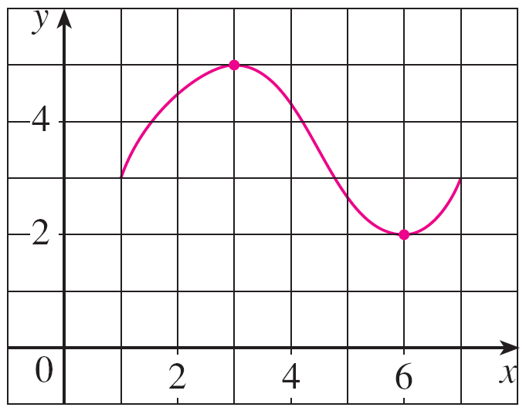
Maximum and Minimum Values
Some of the most important applications of differential calculus are optimization problems, in which we are required to find the optimal (best) way of doing something. These can be done by finding the maximum or minimum values of a function.
Let’s first explain exactly what we mean by maximum and minimum values.
We see that the highest point on
the graph of the function f shown
in Figure 1 is the point (3, 5).
In other words, the largest value of
f is f (3) = 5. Likewise, the smallest
value is f (6) = 2.
Figure 1

Slide 4
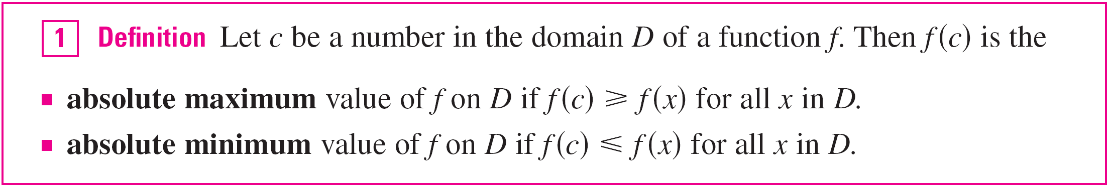
Maximum and Minimum Values
We say that f (3) = 5 is the absolute maximum of f and
f (6) = 2 is the absolute minimum. In general, we use the following definition.
An absolute maximum or minimum is sometimes called a global maximum or minimum.
The maximum and minimum values of f are called extreme values of f.

Slide 5
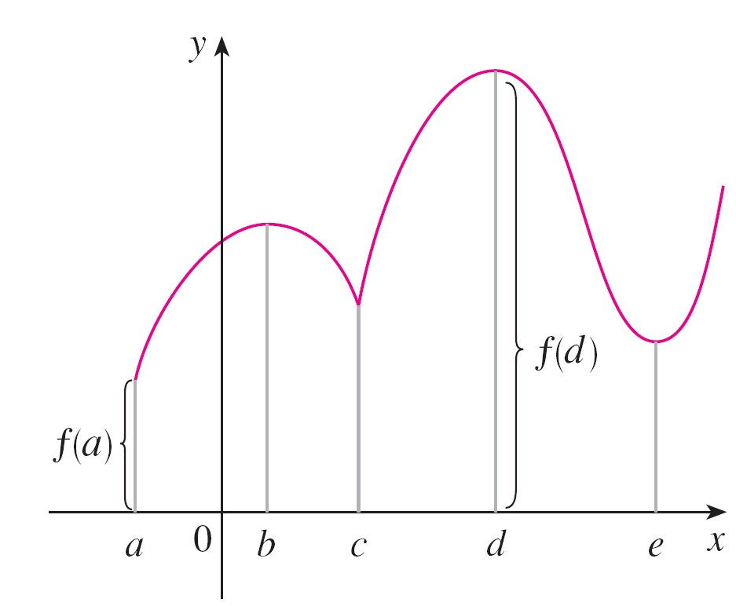
Maximum and Minimum Values
Figure 2 shows the graph of a function f with absolute maximum at d and absolute minimum at a.
Note that (d, f (d)) is the highest
point on the graph and (a, f (a))
is the lowest point.
In Figure 2, if we consider only
values of x near b [for instance,
if we restrict our attention to the
interval (a, c)], then f (b) is the
largest of those values of f (x)
and is called a local maximum
value of f.
Abs min f (a), abs max f (d)
loc min f (c) , f(e), loc max f (b), f (d)
Figure 2

Slide 6
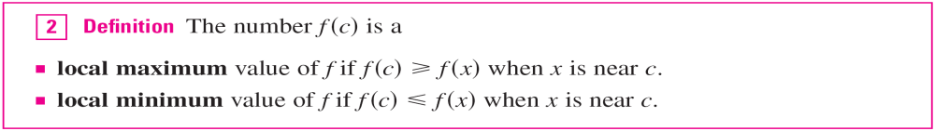
Maximum and Minimum Values
Likewise, f (c) is called a local minimum value of f because
f (c) ≤ f (x) for x near c [in the interval (b, d), for instance].
The function f also has a local minimum at e. In general, we have the following definition.
In Definition 2 (and elsewhere), if we say that something is true near c, we mean that it is true on some open interval containing c.

Slide 7
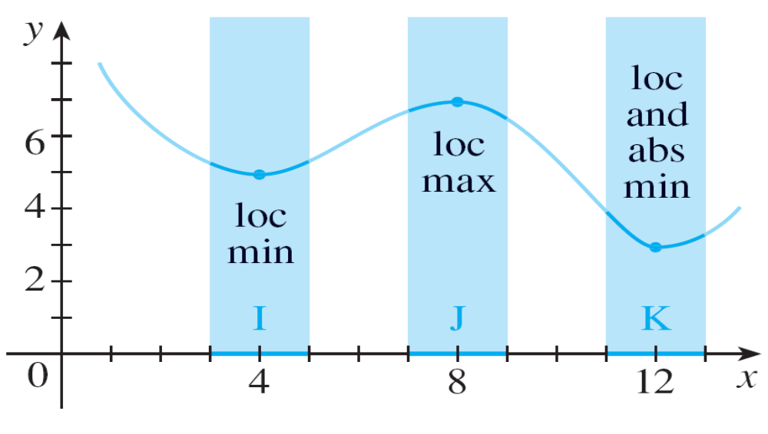
Maximum and Minimum Values
For instance, in Figure 3 we see that f (4) = 5 is a local minimum because it’s the smallest value of f on the
interval I.
Figure 3

Slide 8
Maximum and Minimum Values
It’s not the absolute minimum because f (x) takes smaller values when x is near 12 (in the interval K, for instance).
In fact f (12) = 3 is both a local minimum and the absolute minimum.
Similarly, f (8) = 7 is a local maximum, but not the absolute maximum because f takes larger values near 1.

Slide 9
Example 1
The function f (x) = cos x takes on its (local and absolute) maximum value of 1 infinitely many times, since
cos 2nπ = 1 for any integer n and –1 ≤ cos x ≤ 1 for all x.
Likewise, cos(2n + 1)π = –1 is its minimum value, where n is any integer.

Slide 10
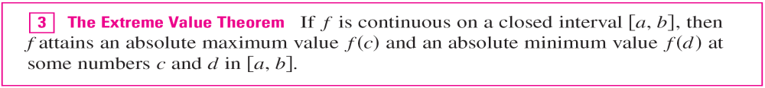
Maximum and Minimum Values
The following theorem gives conditions under which a function is guaranteed to possess extreme values.

Slide 11
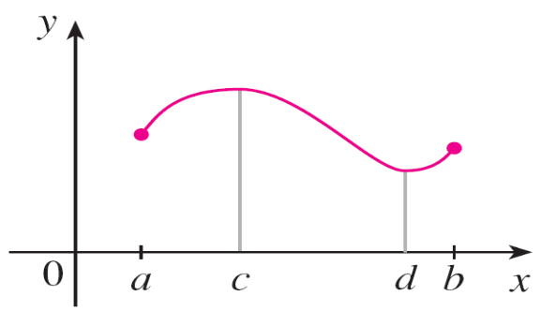
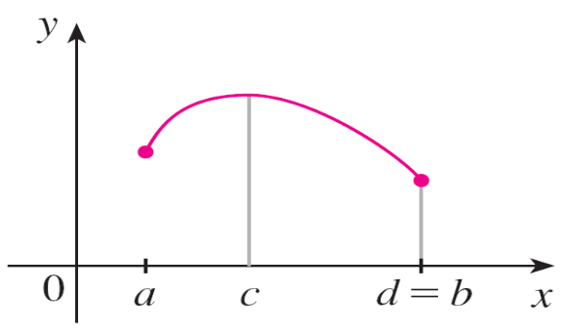
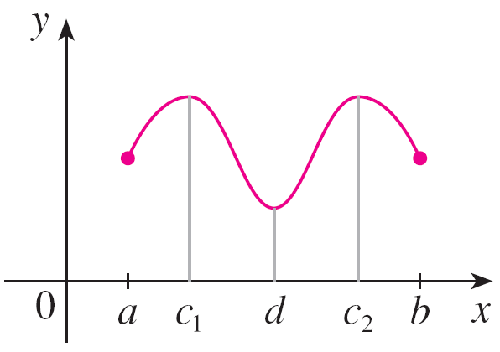
Maximum and Minimum Values
The Extreme Value Theorem is illustrated in Figure 7.
Note that an extreme value can be taken on more than once.
Figure 7

Slide 12
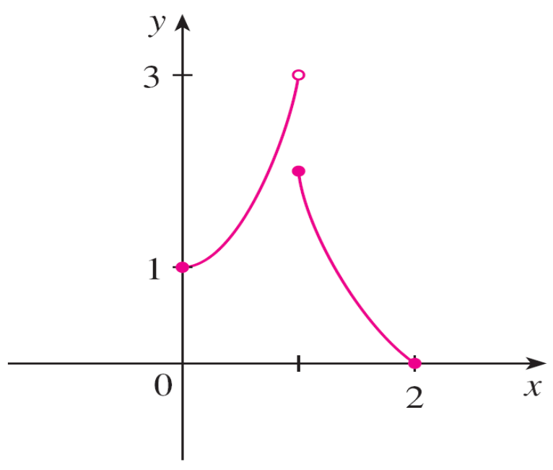
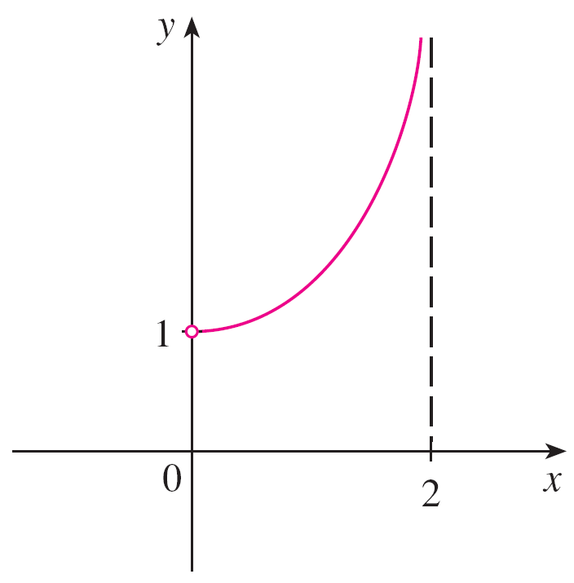
Maximum and Minimum Values
Figures 8 and 9 show that a function need not possess extreme values if either hypothesis (continuity or closed interval) is omitted from the Extreme Value Theorem.
Figure 8
This function has minimum value
f (2) = 0, but no maximum value.
Figure 9
This continuous function g has
no maximum or minimum.

Slide 13
Maximum and Minimum Values
The function f whose graph is shown in Figure 8 is defined on the closed interval [0, 2] but has no maximum value. [Notice that the range of f is [0, 3). The function takes on values arbitrarily close to 3, but never actually attains the value 3.]
This does not contradict the Extreme Value Theorem because f is not continuous.

Slide 14

Maximum and Minimum Values
The function g shown in Figure 9 is continuous on the open interval (0, 2) but has neither a maximum nor a minimum value. [The range of g is (1, ). The function takes on arbitrarily large values.]
This does not contradict the Extreme Value Theorem because the interval (0, 2) is not closed.

Slide 15
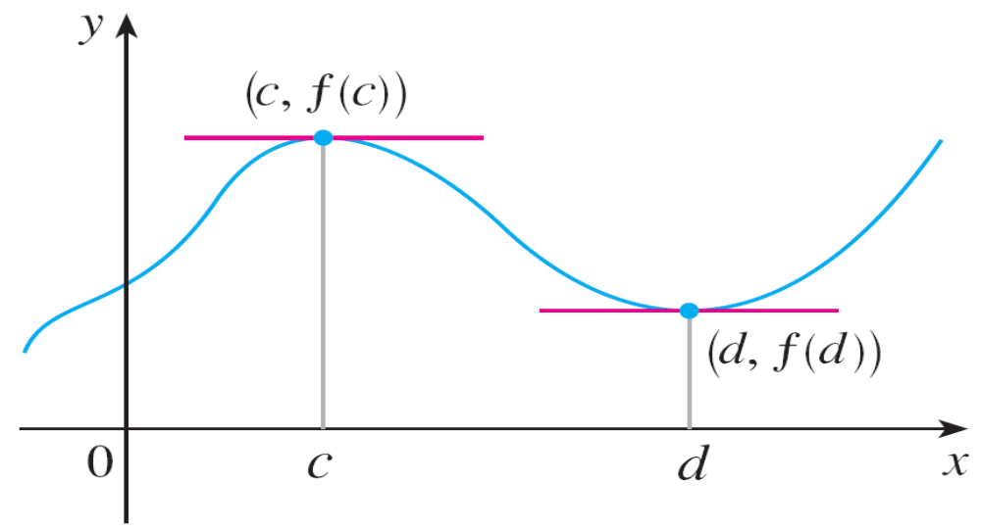
Maximum and Minimum Values
The Extreme Value Theorem says that a continuous function on a closed interval has a maximum value and a minimum value, but it does not tell us how to find these extreme values. We start by looking for local extreme values.
Figure 10 shows the
graph of a function f
with a local maximum
at c and a local
minimum at d.
Figure 10

Slide 16
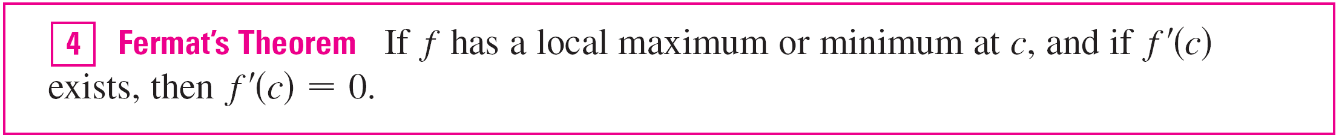
Maximum and Minimum Values
It appears that at the maximum and minimum points the tangent lines are horizontal and therefore each has slope 0.
We know that the derivative is the slope of the tangent line, so it appears that f ′(c) = 0 and f ′(d) = 0. The following theorem says that this is always true for differentiable functions.

Slide 17
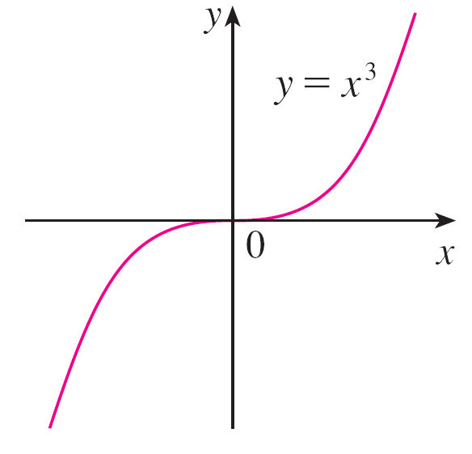
Example 5
If f (x) = x³, then f ′(x) = 3x², so f ′(0) = 0.
But f has no maximum or minimum at 0, as you can see from its graph in Figure 11.
Figure 11
If f (x) = x³, then f ′(0) = 0 but ƒ
has no maximum or minimum.

Slide 18
Example 5
The fact that f ′(0) = 0 simply means that the curve y = x³ has a horizontal tangent at (0, 0).
Instead of having a maximum or minimum at (0, 0), the curve crosses its horizontal tangent there.

Slide 19
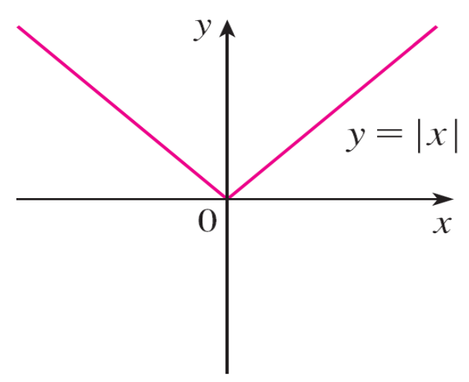
Example 6
The function f (x) = | x | has its (local and absolute) minimum value at 0, but that value can’t be found by setting f ′(x) = 0 because, f ′(0) does not exist. (see Figure 12)
Figure 12
If f (x) = | x |, then f (0) = 0 is a
minimum value, but f ′(0) does not exist.

Slide 20
Maximum and Minimum Values
Examples 5 and 6 show that we must be careful when
using Fermat’s Theorem. Example 5 demonstrates that
even when f ′(c) = 0, f doesn’t necessarily have a
maximum or minimum at c. (In other words, the converse of
Fermat’s Theorem is false in general.)
Furthermore, there may be an extreme value even when
f ′(c) does not exist (as in Example 6).

Slide 21
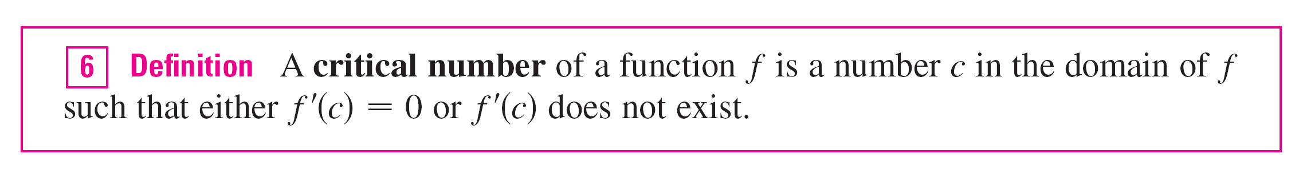
Maximum and Minimum Values
Fermat’s Theorem does suggest that we should at least start looking for extreme values of f at the numbers c where f ′(c) = 0 or where f ′(c) does not exist. Such numbers are given a special name.
In terms of critical numbers, Fermat’s Theorem can be rephrased as follows.

Slide 22
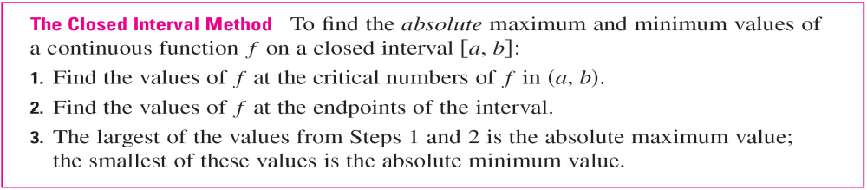
Maximum and Minimum Values
To find an absolute maximum or minimum of a continuous function on a closed interval, we note that either it is local or it occurs at an endpoint of the interval.
Thus the following three-step procedure always works.

