Slide 1


3
Applications of
Differentiation
Copyright © Cengage Learning. All rights reserved.

Slide 2

3.3
How Derivatives Affect the Shape of a Graph
Copyright © Cengage Learning. All rights reserved.

Slide 3
What Does f ′ Say About f ?

Slide 4
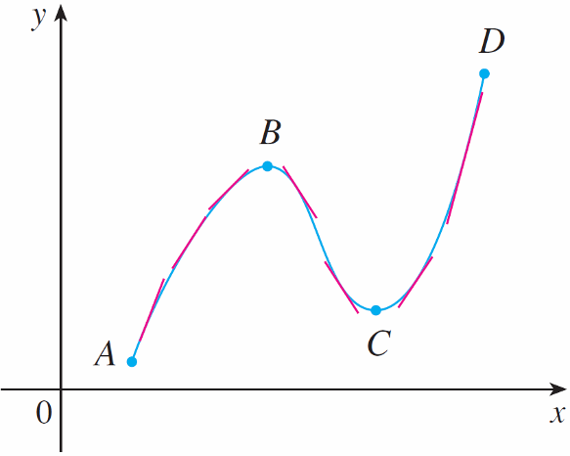
What Does f ′ Say About f ?
To see how the derivative of f can tell us where a function is increasing or decreasing, look at Figure 1.
Figure 1

Slide 5
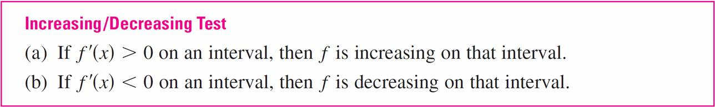
What Does f ′ Say About f ?
Between A and B and between C and D, the tangent lines have positive slope and so f ′ (x) > 0. Between B and C the tangent lines have negative slope and so f ′(x) < 0. Thus it appears that f increases when f ′ (x) is positive and decreases when f ′ (x) is negative.
To prove that this is always the case, we use the Mean Value Theorem.

Slide 6
Example 1
Find where the function f (x) = 3x⁴ – 4x³ – 12x² + 5 is increasing and where it is decreasing.
Solution:
f ′(x) = 12x³ – 12x² – 24x
= 12x(x – 2)(x + 1)
To use the I/D Test we have to know where f ′(x) > 0 and
where f ′(x) < 0. This depends on the signs of the three
factors of f ′(x), namely, 12x, x – 2, and x + 1.

Slide 7
Example 1 – Solution
cont’d
We divide the real line into intervals whose endpoints are the critical numbers –1, 0 and 2 and arrange our work in a chart. A plus sign indicates that the given expression is positive, and a minus sign indicates that it is negative.
The last column of the chart gives the conclusion based on the I/D Test. For instance, f ′(x) < 0 for 0 < x < 2, so f is decreasing on (0, 2). (It would also be true to say that f is decreasing on the closed interval [0, 2].)

Slide 8
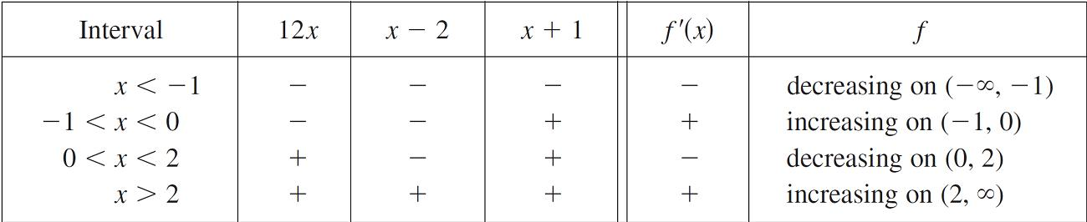
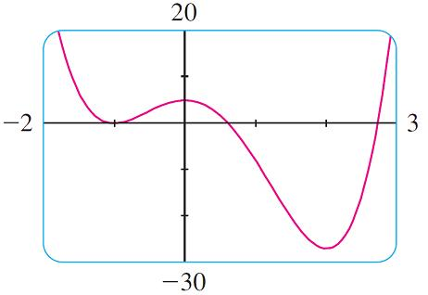
Example 1 – Solution
cont’d
The graph of f shown in Figure 2 confirms the information in the chart.
Figure 2

Slide 9
What Does f ′ Say About f ?
You can see from Figure 2 that f (0) = 5 is a local maximum value of f because f increases on (–1, 0) and decreases on (0, 2).
Or, in terms of derivatives, f ′(x) > 0 for –1 < x < 0 and
f ′(x) < 0 for 0 < x < 2. In other words, the sign of f ′(x) changes from positive to negative at 0. This observation is the basis of the following test.

Slide 10
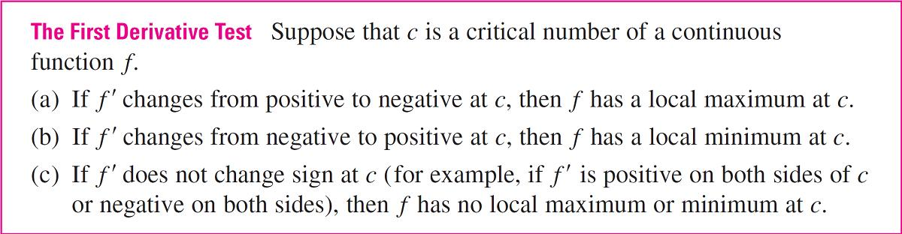
What Does f ′ Say About f ?
The First Derivative Test is a consequence of the I/D Test. In part (a), for instance, since the sign of f ′(x) changes from positive to negative at c, f is increasing to the left of c and decreasing to the right of c.

Slide 11
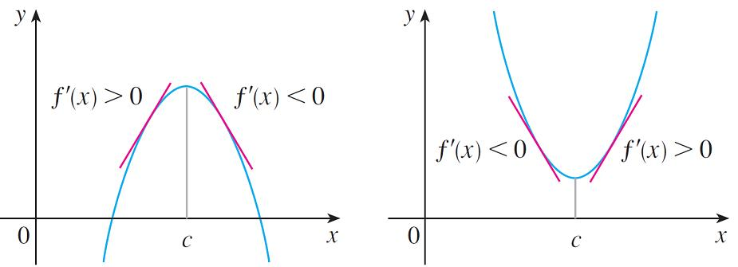
What Does f ′ Say About f ?
It follows that f has a local maximum at c.
It is easy to remember the First Derivative Test by
visualizing diagrams such as those in Figure 3.
(a) Local maximum
(b) Local minimum
Figure 3

Slide 12
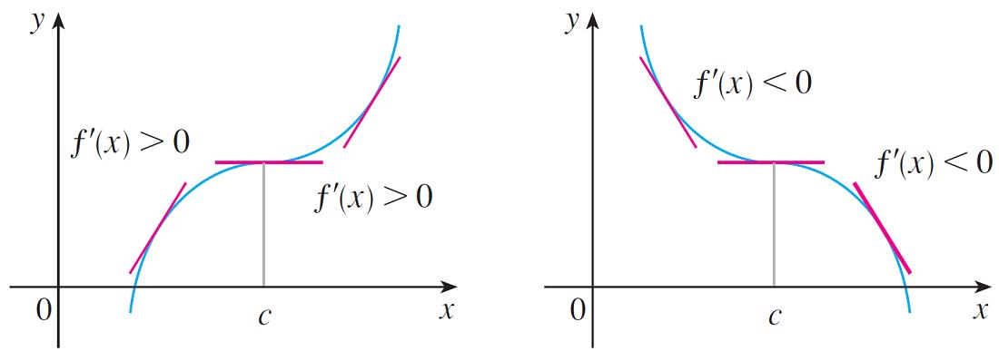
What Does f ′ Say About f ?
(c) No maximum or minimum
(d) No maximum or minimum
Figure 3

Slide 13

Example 3
Find the local maximum and minimum values of the function
g(x) = x + 2 sin x 0 ≤ x ≤ 2π
Solution:
To find the critical numbers of g, we differentiate:
g ′(x) = 1 + 2 cos x
So g ′(x) = 0 when . The solutions of this equation are 2π /3 and 4π /3.

Slide 14
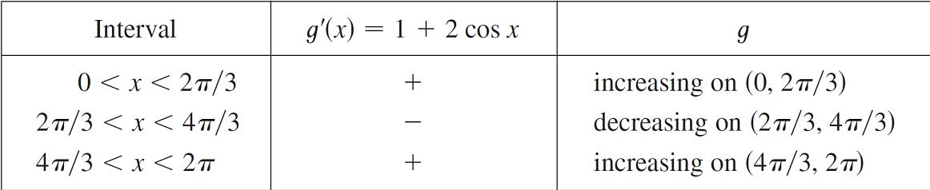
Example 3 – Solution
cont’d
Because g is differentiable everywhere, the only critical
numbers are 2π /3 and 4π /3 and so we analyze g in the following table.

Slide 15
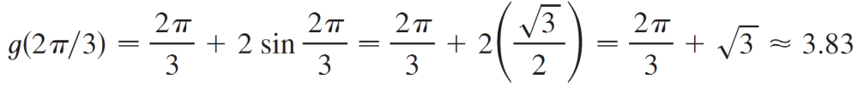
Example 3 – Solution
cont’d
Because g ′(x) changes from positive to negative at 2π /3,
the First Derivative Test tells us that there is a local
maximum at 2π /3 and the local maximum value is

Slide 16
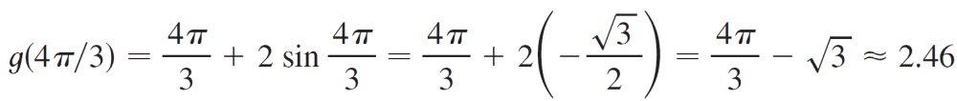
Example 3 – Solution
cont’d
Likewise g ′(x), changes from negative to positive at 4π /3 and so
is a local minimum value.

Slide 17
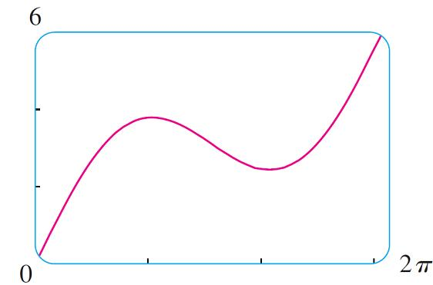
Example 3 – Solution
cont’d
The graph of g in Figure 4 supports our conclusion.
g(x) = x + 2 sin x
Figure 4

Slide 18
What Does f ″ Say About f ?

Slide 19
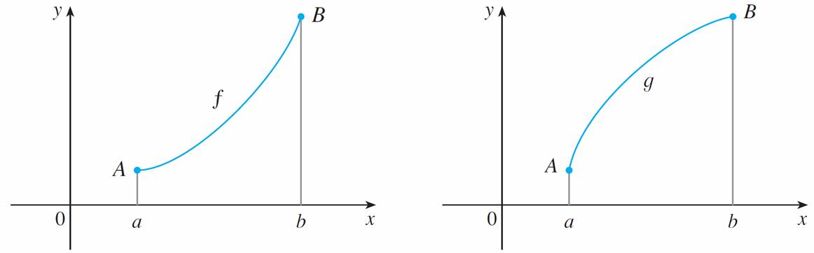
What Does f ″ Say About f ?
Figure 5 shows the graphs of two increasing functions on (a, b). Both graphs join point A to point B but they look different because they bend in different directions.
(a)
(b)
Figure 5

Slide 20
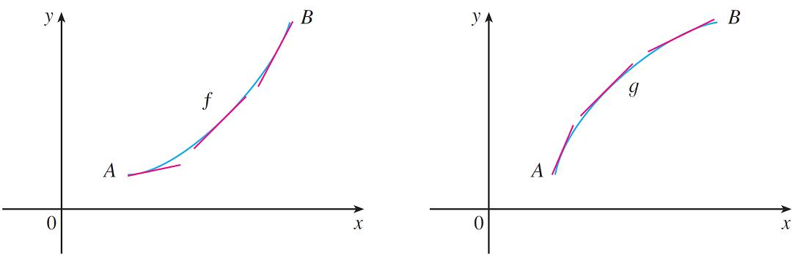
What Does f ″ Say About f ?
In Figure 6 tangents to these curves have been drawn at several points. In (a) the curve lies above the tangents and f is called concave upward on (a, b). In (b) the curve lies below the tangents and g is called concave downward on (a, b).
(a) Concave upward
(b) Concave downward
Figure 6

Slide 21
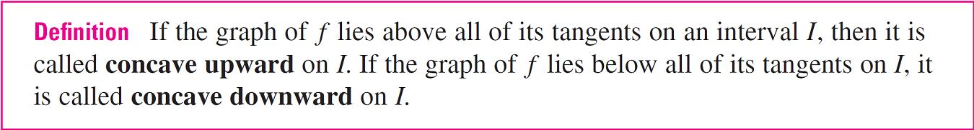
What Does f ″ Say About f ?

Slide 22
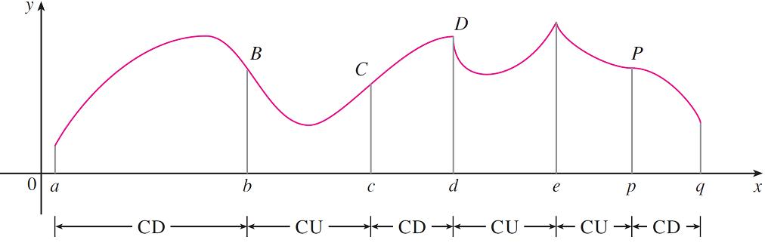
What Does f ″ Say About f ?
Figure 7 shows the graph of a function that is concave upward (abbreviated CU) on the intervals (b, c), (d, e), and (e, p) and concave downward (CD) on the intervals (a, b), (c, d), and (p, q).
Figure 7

Slide 23
What Does f ″ Say About f ?
Let’s see how the second derivative helps determine the intervals of concavity. Looking at Figure 6(a), you can see that, going from left to right, the slope of the tangent increases.
This means that the derivative f ′ is an increasing function and therefore its derivative f ″ is positive.
Likewise, in Figure 6(b) the slope of the tangent decreases from left to right, so f ′ decreases and therefore f ″ is negative.

Slide 24
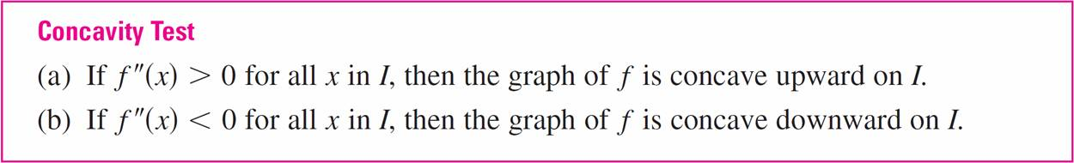
What Does f ″ Say About f ?
This reasoning can be reversed and suggests that the following theorem is true.

Slide 25
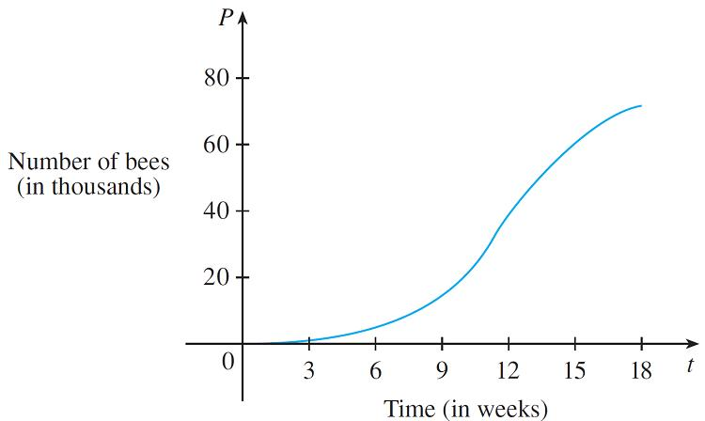
Example 4
Figure 8 shows a population graph for Cyprian honeybees raised in an apiary. How does the rate of population increase change over time? When is this rate highest?
Over what intervals is P concave upward or concave downward?
Figure 8

Slide 26
Example 4 – Solution
cont’d
By looking at the slope of the curve as t increases, we see that the rate of increase of the population is initially very small, then gets larger until it reaches a maximum at about t = 12 weeks, and decreases as the population begins to level off.
As the population approaches its maximum value of about 75,000 (called the carrying capacity), the rate of increase, P′ (t), approaches 0. The curve appears to be concave upward on (0, 12) and concave downward on (12, 18).

Slide 27
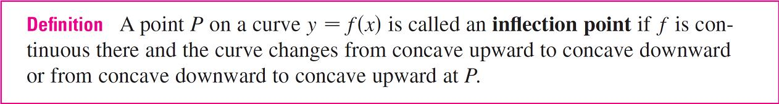
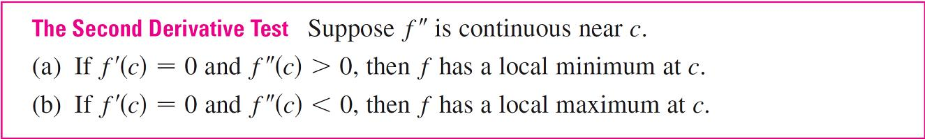
What Does f ″ Say About f ?

Slide 28
Example 6
Discuss the curve y = x⁴ – 4x³ with respect to concavity, points of inflection, and local maxima and minima. Use this information to sketch the curve.
Solution:
If
f (x) = x⁴ – 4x³,
then
f ′(x) = 4x³ – 12x²
= 4x²(x – 3)
\
f ″ (x) = 12x² – 24x
= 12x(x – 2)

Slide 29
Example 6 – Solution
cont’d
To find the critical numbers we set f′ (x) = 0 and obtain
x = 0 and x = 3. To use the Second Derivative Test we evaluate f ″ at these critical numbers:
f ″(0) = 0 f ″(3) = 36 > 0
Since f ′(3) = 0 and f ″(3) > 0, f (3) = –27 is a local minimum. Since f ″(0) = 0, the Second Derivative Test gives no information about the critical number 0.

Slide 30
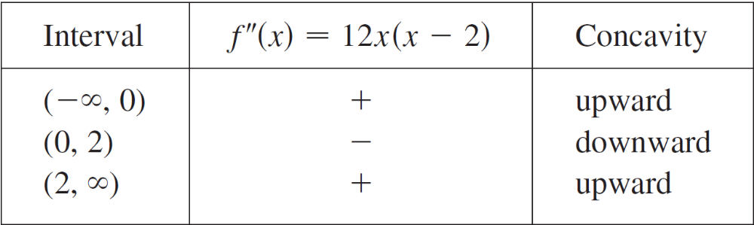
Example 6 – Solution
cont’d
But since f ′(x) < 0 for x < 0 and also for 0 < x < 3, the First Derivative Test tells us that f does not have a local maximum or minimum at 0.
[In fact, the expression for f ′(x) shows that f decreases to the left of 3 and increases to the right of 3.]
Since f ″(x) = 0 when x = 0 or 2, we divide the real line into intervals with these numbers as endpoints and complete the following chart.

Slide 31
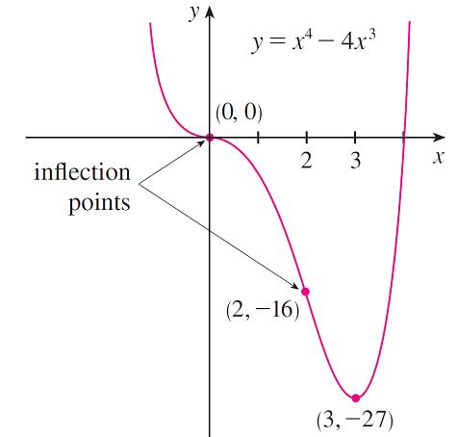
Example 6 – Solution
cont’d
The point (0, 0) is an inflection point since the curve changes from concave upward to concave downward there. Also (2, –16) is an inflection point since the curve changes from concave downward to concave upward there.
Using the local minimum, the
intervals of concavity, and the
inflection points, we sketch
the curve in Figure 11.
Figure 11

Slide 32
What Does f ″ Say About f ?
Note:
The Second Derivative Test is inconclusive when
f ″(c) = 0. In other words, at such a point there might be a maximum, there might be a minimum, or there might be neither (as in Example 6).
This test also fails when f ″ (c) does not exist. In such cases the First Derivative Test must be used. In fact, even when both tests apply, the First Derivative Test is often the easier one to use.

Slide 33
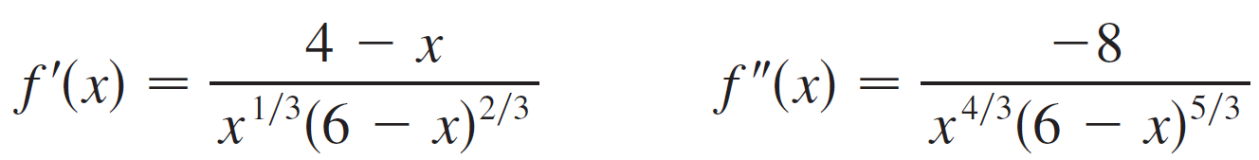
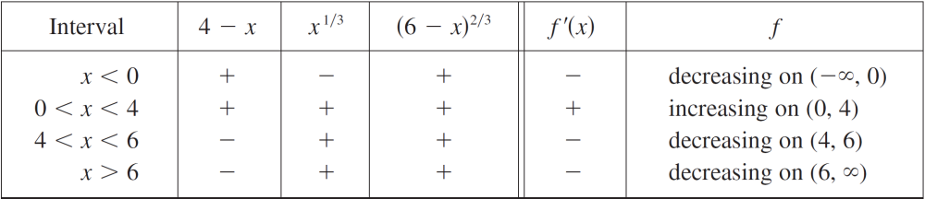
Example 7
Sketch the graph of the function f (x) = x^{2/3}(6 – x)^{1/3}
Solution:
Calculation of the first two derivatives gives
Since f ′(x) = 0 when x = 4 and f ′ (x) does not exist when
x = 0 or x = 6, the critical numbers are 0, 4 and 6.

Slide 34
Example 7 – Solution
cont’d
To find the local extreme values we use the First Derivative Test. Since f ′ changes from negative to positive at 0,
f(0) = 0 is a local minimum. Since f′ changes from positive to negative at 4, f(4) = 2^{5/3} is a local maximum.
The sign of f ′ does not change at 6, so there is no minimum or maximum there.
(The Second Derivative Test could be used at 4 but not at 0 or 6 since f ″ does not exist at either of these numbers.)

Slide 35

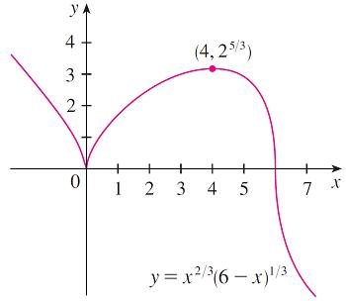
Example 7 – Solution
cont’d
Looking at the expression f ″ (x) for and noting that x^{4/3} ≥ 0 for all x, we have f ″(x) < 0 for x < 0 and for and 0 < x < 6 for x > 6.
So f is concave downward on ( , 0) and (0, 6) concave upward on (6, ), and the only inflection point
is (6, 0). The graph is sketched in Figure 12.
Figure 12

Slide 36
Example 7 – Solution
cont’d
Note that the curve has vertical tangents at (0,0) and (6,0) because |f ′ (x)| as x 0 and as x 6.

