Slide 1


3
Applications of
Differentiation
Copyright © Cengage Learning. All rights reserved.

Slide 2

3.4
Limits at Infinity; Horizontal Asymptotes
Copyright © Cengage Learning. All rights reserved.

Slide 3
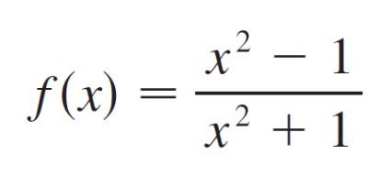
Limits at Infinity; Horizontal Asymptotes
In this section we let x become arbitrarily large (positive or negative) and see what happens to y. We will find it very useful to consider this so-called end behavior when sketching graphs.
Let’s begin by investigating the behavior of the function f defined by
as x becomes large.

Slide 4
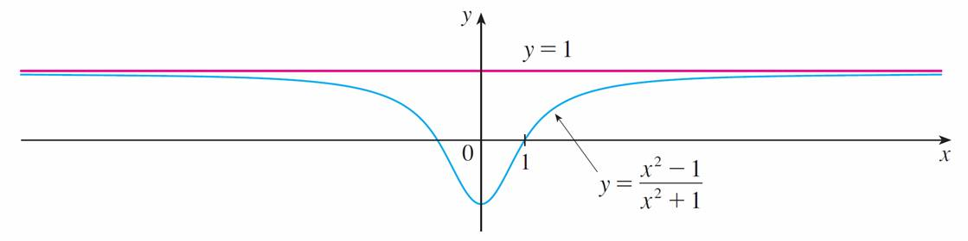
Limits at Infinity; Horizontal Asymptotes
The table at the left gives values of this function correct to six decimal places, and the graph of f has been drawn by a computer in Figure 1.
Figure 1

Slide 5
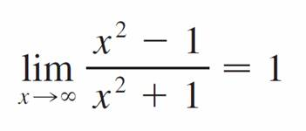
Limits at Infinity; Horizontal Asymptotes
As x grows larger and larger you can see that the values of
f (x) get closer and closer to 1. In fact, it seems that we can make the values of f (x) as close as we like to 1 by taking x sufficiently large.
This situation is expressed symbolically by writing

Slide 6
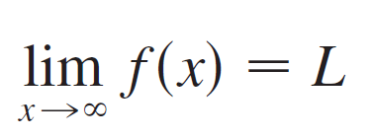
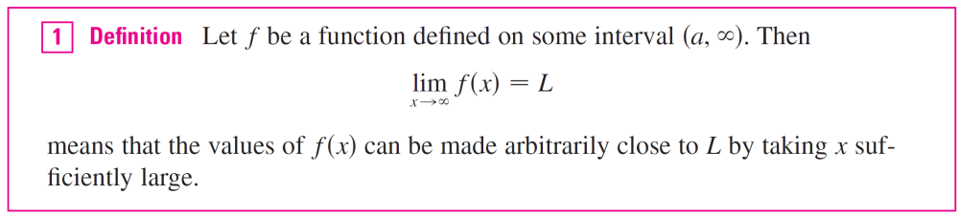
Limits at Infinity; Horizontal Asymptotes
In general, we use the notation
to indicate that the values of f (x) approach L as x becomes larger and larger.

Slide 7


Limits at Infinity; Horizontal Asymptotes
Another notation for is
f (x) → L as x →

Slide 8
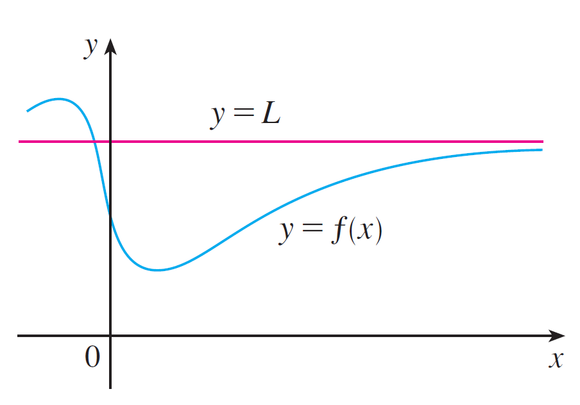
Limits at Infinity; Horizontal Asymptotes
Geometric illustrations of Definition 1 are shown in
Figure 2.
Examples illustrating
Figure 2

Slide 9
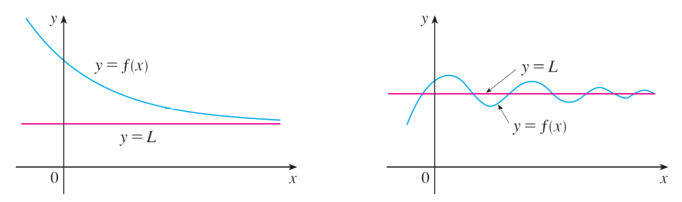
Limits at Infinity; Horizontal Asymptotes
Notice that there are many ways for the graph of f to approach the line y = L (which is called a horizontal asymptote) as we look to the far right of each graph.

Slide 10
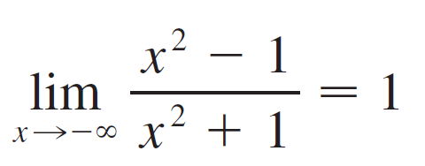
Limits at Infinity; Horizontal Asymptotes
Referring back to Figure 1, we see that for numerically large negative values of x, the values of f (x) are close to 1.
By letting x decrease through negative values without bound, we can make f (x) as close to 1 as we like.
This is expressed by writing

Slide 11
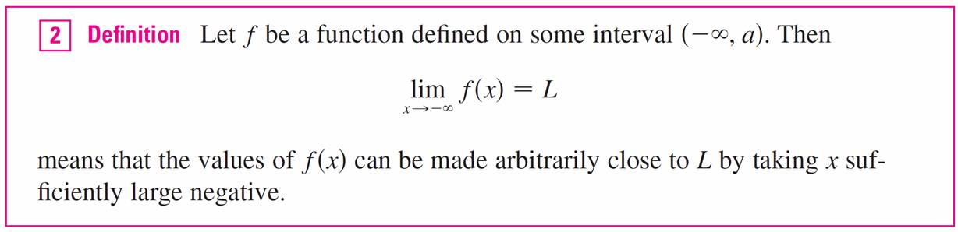
Limits at Infinity; Horizontal Asymptotes
The general definition is as follows.

Slide 12
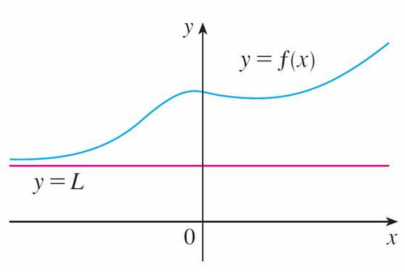
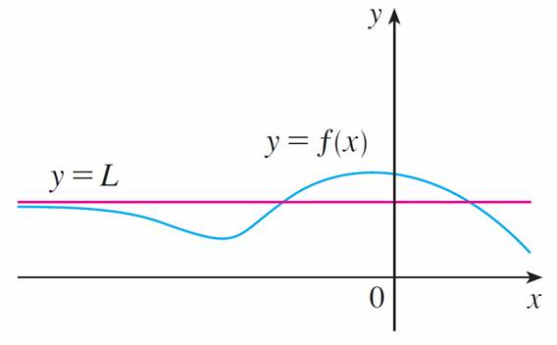
Limits at Infinity; Horizontal Asymptotes
Definition 2 is illustrated in Figure 3. Notice that the graph approaches the line y = L as we look to the far left of each graph.
Examples illustrating
Figure 3

Slide 13
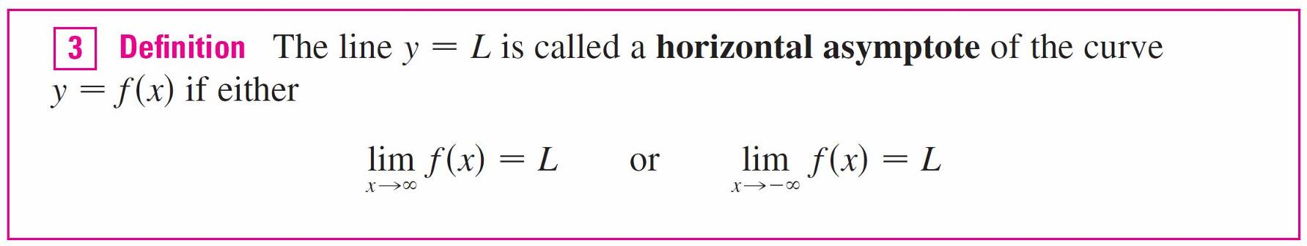
Limits at Infinity; Horizontal Asymptotes

Slide 14
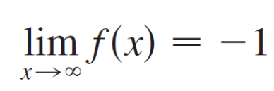
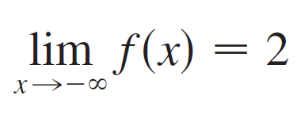
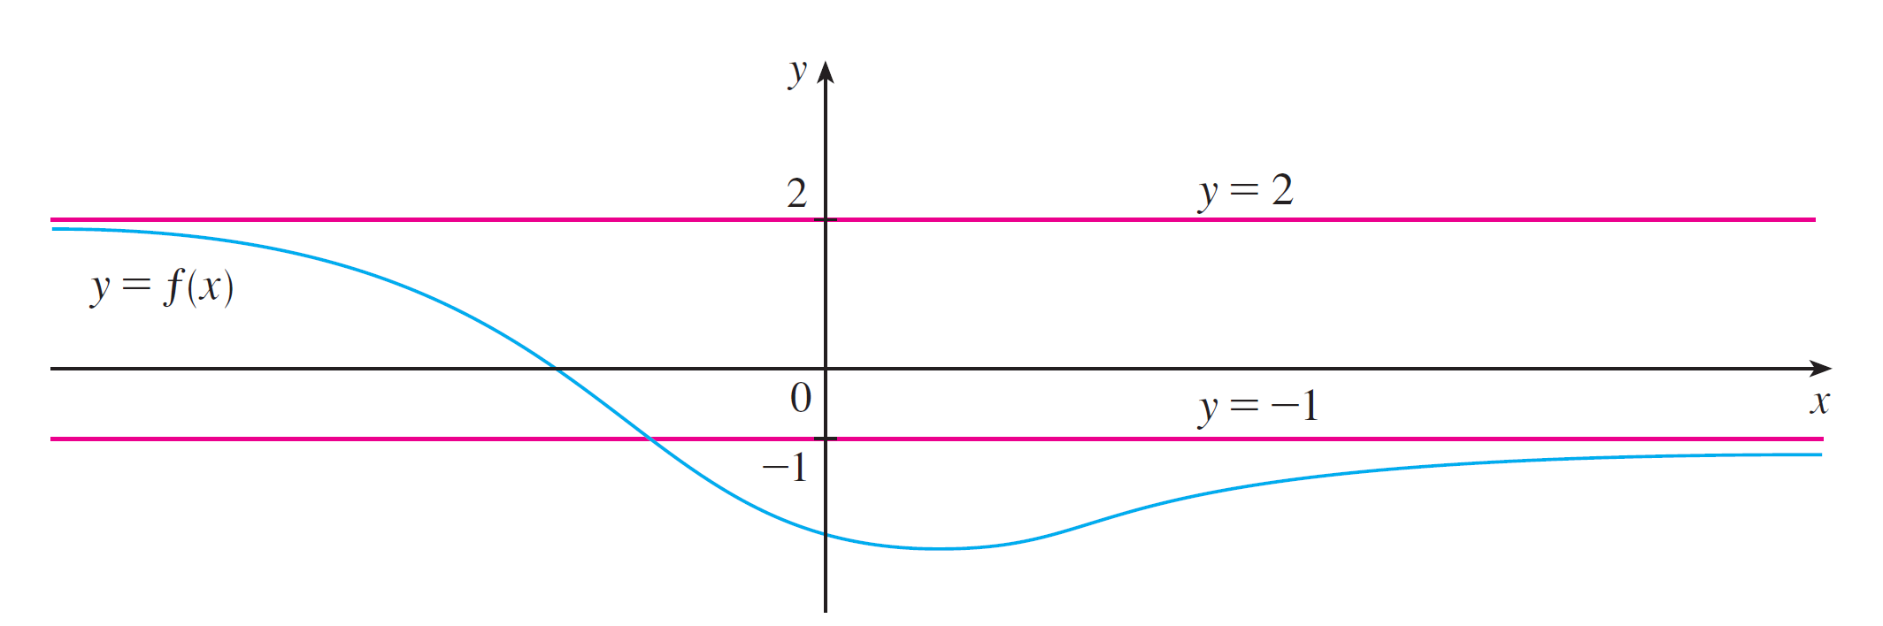
Limits at Infinity; Horizontal Asymptotes
The curve y = f (x) sketched in Figure 4 has both y = –1 and y = 2 as horizontal asymptotes because
and
Figure 4

Slide 15
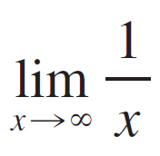
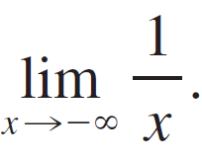
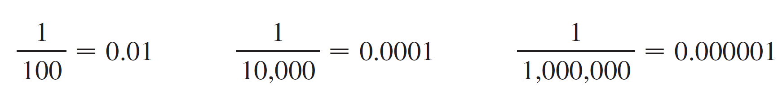
Example 2
Find and
Solution:
Observe that when is large, 1/x is small. For instance,
In fact, by taking x large enough, we can make 1/x as close to 0 as we please.

Slide 16
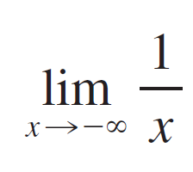
Example 2 – Solution
cont’d
Therefore, according to Definition 1, we have
= 0
Similar reasoning shows that when x is large negative,1/x
is small negative, so we also have
= 0

Slide 17
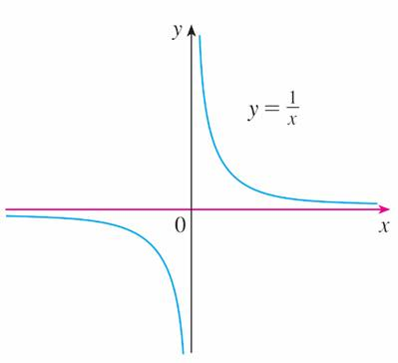
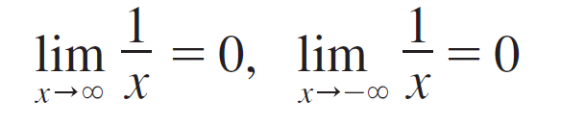
Limits at Infinity; Horizontal Asymptotes
It follows that the line y = 0 (the x-axis) is a horizontal asymptote of the curve y = 1/x. (This is an equilateral hyperbola; see Figure 6.)
Figure 6

Slide 18
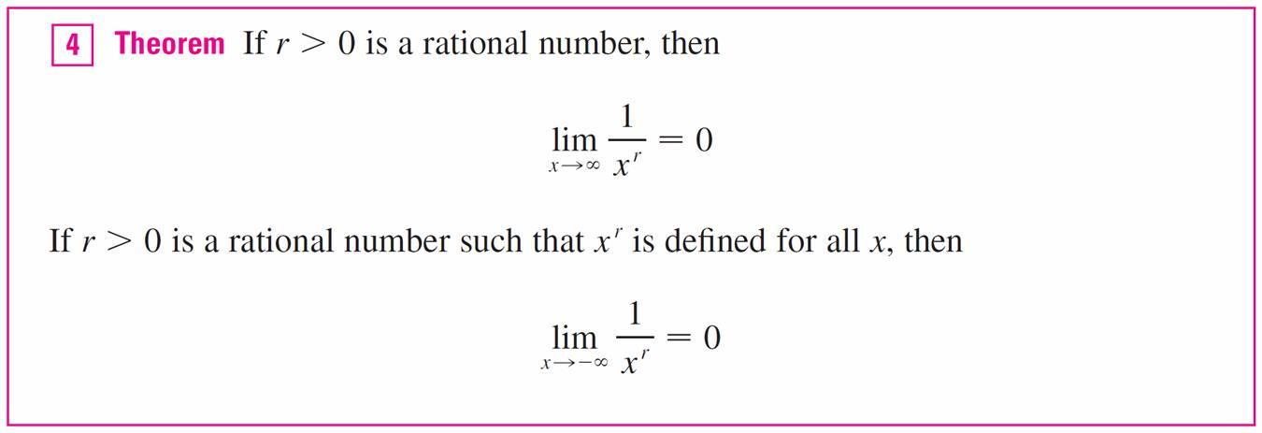
Limits at Infinity; Horizontal Asymptotes

Slide 19
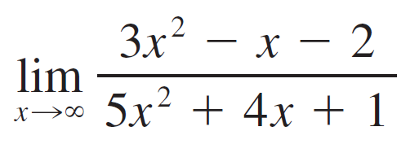
Example 3
Evaluate and indicate which properties of
limits are used at each stage.
Solution:
As x becomes large, both numerator and denominator become large, so it isn’t obvious what happens to their ratio. We need to do some preliminary algebra.
To evaluate the limit at infinity of any rational function, we first divide both the numerator and denominator by the highest power of x that occurs in the denominator. (We may assume that x ≠ 0, since we are interested only in large values of x.)

Slide 20
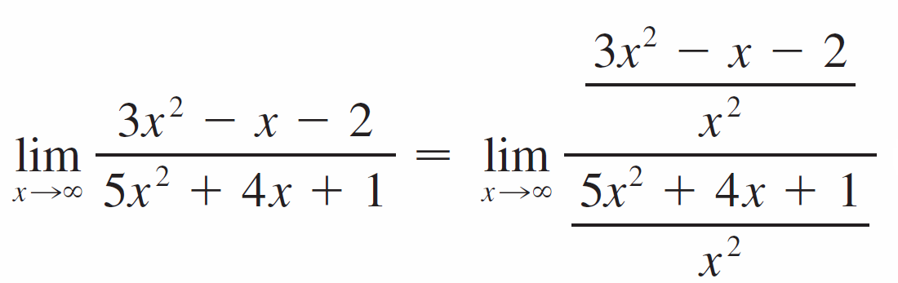
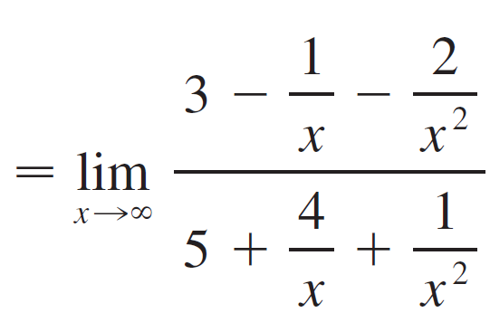
Example 3 – Solution
cont’d
In this case the highest power of x in the denominator is x², so we have

Slide 21
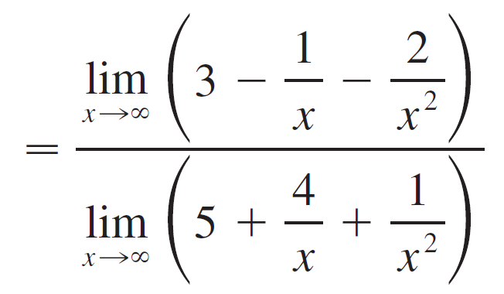
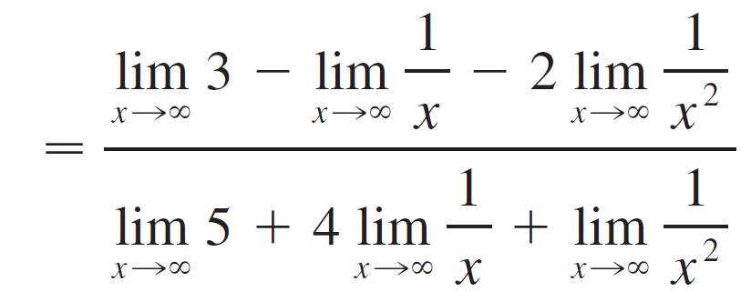
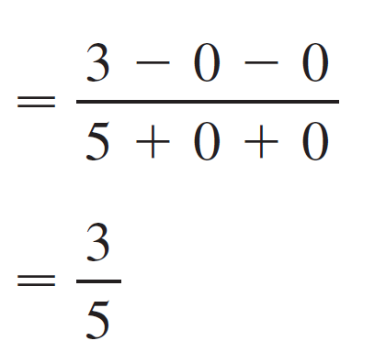
Example 3 – Solution
cont’d
(by Limit Law 5)
(by 1, 2, and 3)
(by 7 and Theorem 4)

Slide 22

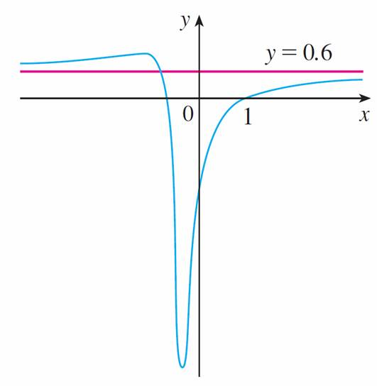
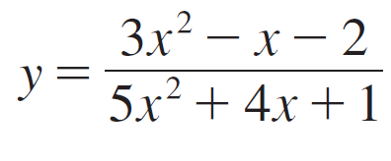
Example 3 – Solution
cont’d
A similar calculation shows that the limit as x → –
is also
Figure 7 illustrates the results
of these calculations by showing
how the graph of the given
rational function approaches
the horizontal asymptote y =
Figure 7

Slide 23
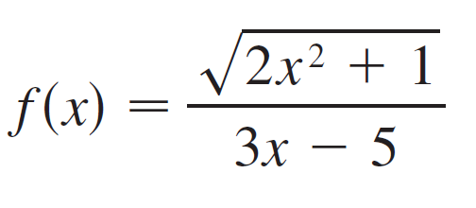
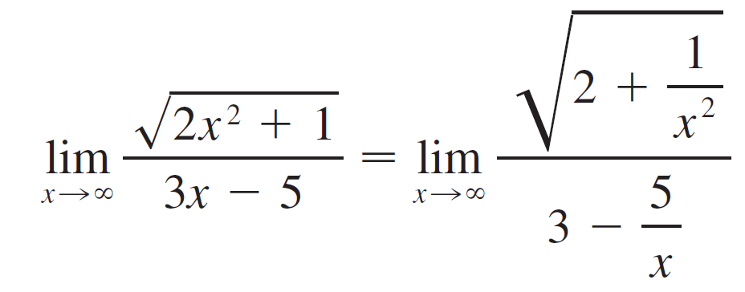

Example 4
Find the horizontal and vertical asymptotes of the graph of the function
Solution:
Dividing both numerator and denominator by x and using the properties of limits, we have
(since – x for x > 0)

Slide 24
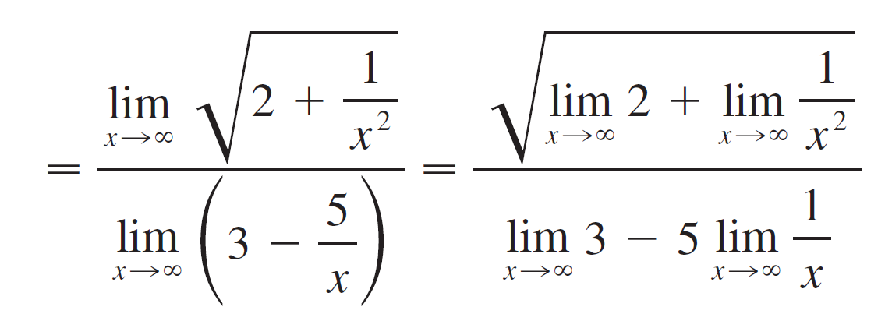
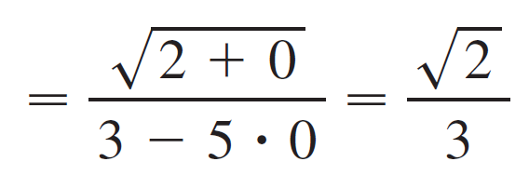
Example 4 – Solution
cont’d

Slide 25
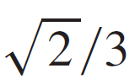
Example 4 – Solution
cont’d
Therefore the line y = is a horizontal asymptote of the graph of f.

Slide 26

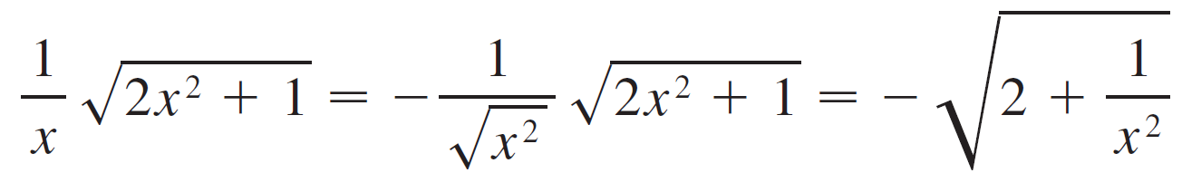
Example 4 – Solution
cont’d
In computing the limit as x → – , we must remember that for x < 0, we have = | x | = –x.
So when we divide the numerator by x, for x < 0 we get

Slide 27
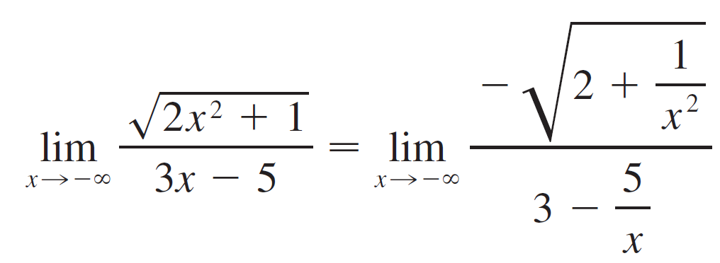
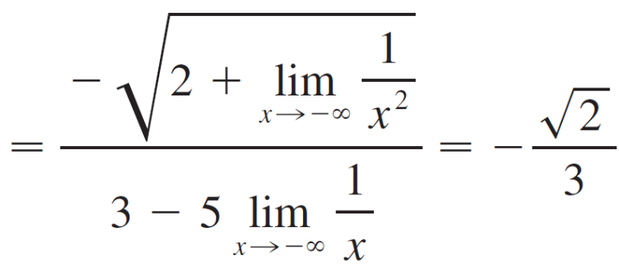
Example 4 – Solution
cont’d
Therefore

Slide 28



Example 4 – Solution
cont’d
Thus the line y = – is also a horizontal asymptote.
A vertical asymptote is likely to occur when the denominator, 3x – 5, is 0, that is, when
If x is close to and x > , then the denominator is close to 0 and 3x – 5 is positive. The numerator is always positive, so f (x) is positive.

Slide 29
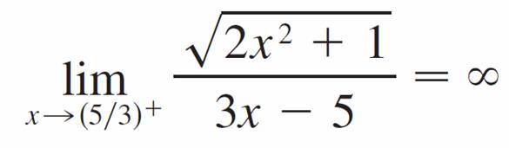
Example 4 – Solution
cont’d
Therefore
If is close to but x < , then 3x – 5 < 0 and so f (x) is large negative.

Slide 30
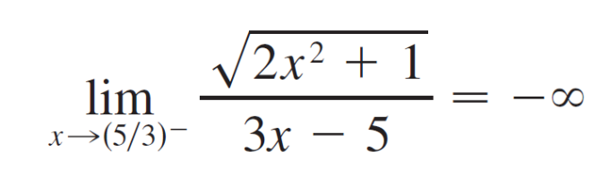
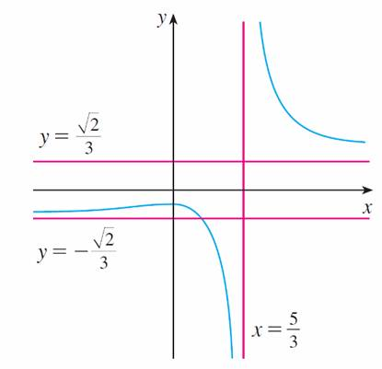
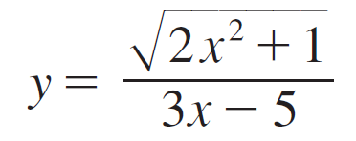
Example 4 – Solution
cont’d
Thus
The vertical asymptote is x = .
All three asymptotes are shown
in Figure 8.
Figure 8

Slide 31
Infinite Limits at Infinity

Slide 32

Infinite Limits at Infinity
The notation
is used to indicate that the values of f (x) become large as x becomes large. Similar meanings are attached to the following symbols:

Slide 33
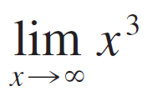
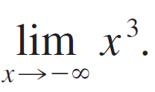
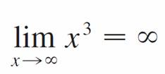
Example 8
Find and
Solution:
When becomes large, x³ also becomes large.
For instance,
In fact, we can make x³ as big as we like by taking x large enough. Therefore we can write

Slide 34
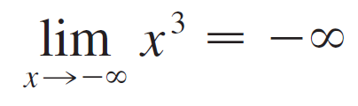
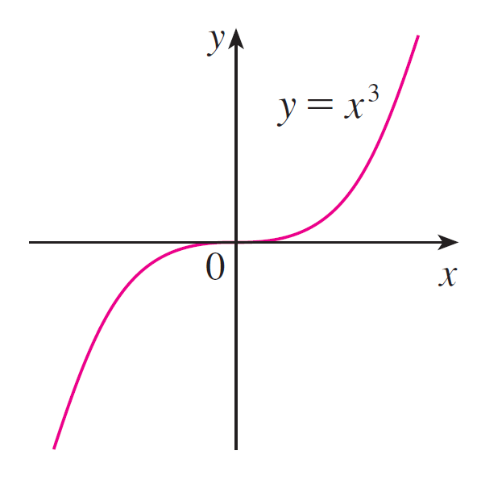
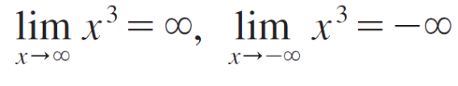
Example 8 – Solution
cont’d
Similarly, when x is large negative, so is x³. Thus
These limit statements can also be seen from the graph
of y = x³ in Figure 10.
Figure 10

Slide 35
Precise Definitions

Slide 36
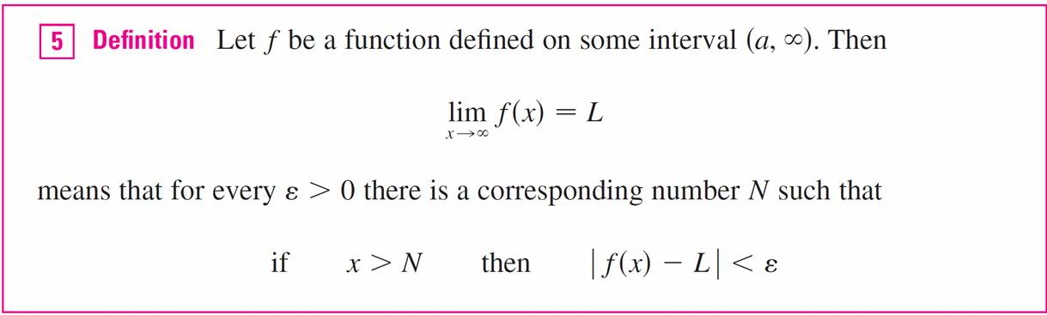
Precise Definitions
Definition 1 can be stated precisely as follows.
In words, this says that the values of f (x) can be made arbitrarily close to L (within a distance ε, where ε is any positive number) by taking x sufficiently large (larger than
N, where depends on ε).

Slide 37
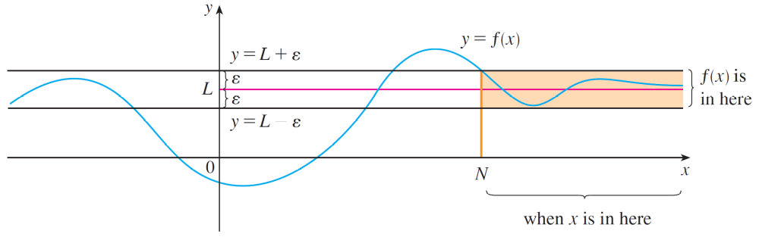

Precise Definitions
Graphically it says that by choosing x large enough (larger than some number N) we can make the graph of f lie between the given horizontal lines y = L – ε and y = L + ε as in Figure 12.
Figure 12

Slide 38


Precise Definitions
This must be true no matter how small we choose ε. Figure 13 shows that if a smaller value of ε is chosen, then a larger value of N may be required.
Figure 13

Slide 39

Precise Definitions

Slide 40


Example 13
Use Definition 5 to prove that = 0.
Solution:
Given ε > 0, we want to find N such that
if x > N then
In computing the limit we may assume that x > 0.
Then
1/x < ε x > 1/ε.

Slide 41


Example 13 – Solution
cont’d
Let’s choose N = 1/ε. So
If then
Therefore, by Definition 5,
= 0

Slide 42

Example 13 – Solution
cont’d
Figure 16 illustrates the proof by showing some values of ε and the corresponding values of N.
Figure 16

Slide 43


Precise Definitions
Finally we note that an infinite limit at infinity can be defined as follows. The geometric illustration is given in Figure 17.
Figure 17

Slide 44

Precise Definitions
Similar definitions apply when the symbol is replaced by – .

