Slide 1


3
Applications of
Differentiation
Copyright © Cengage Learning. All rights reserved.

Slide 2

3.5
Summary of Curve Sketching
Copyright © Cengage Learning. All rights reserved.

Slide 3
Guidelines for Sketching a Curve

Slide 4
Guidelines for Sketching a Curve
The following checklist is intended as a guide to sketching a curve y = f (x) by hand. Not every item is relevant to every function. (For instance, a given curve might not have an asymptote or possess symmetry.)
But the guidelines provide all the information you need to make a sketch that displays the most important aspects of the function.
A. Domain It’s often useful to start by determining the domain D of f, that is, the set of values of for which f (x) is defined.

Slide 5
Guidelines for Sketching a Curve
B. Intercepts The y-intercept is f (0) and this tells us where the curve intersects the y-axis. To find the x-intercepts, we set y = 0 and solve for x. (You can omit this step if the equation is difficult to solve.)
C. Symmetry
(i) If f (–x) = f (x) for all x in D, that is, the equation of the curve is unchanged when x is replaced by –x, then f is an even function and the curve is symmetric about the y-axis.

Slide 6
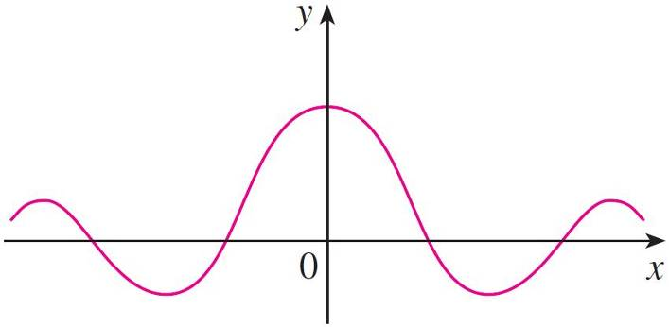
Guidelines for Sketching a Curve
This means that our work is cut in half. If we know what the curve looks like for x ≥ 0, then we need only reflect about the y-axis to obtain the complete curve [see Figure 3(a)].
Here are some examples: y = x², y = x⁴, y = |x|, and
y = cos x.
(a) Even function: reflectional symmetry
Figure 3

Slide 7
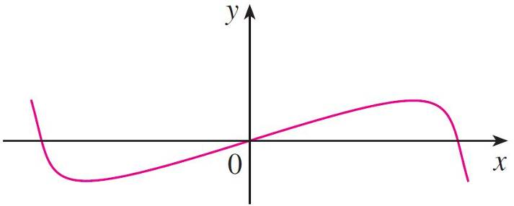
Guidelines for Sketching a Curve
(ii) If f (–x) = –f (x) If for all in x in D, then f is an odd function and the curve is symmetric about the origin.
Again we can obtain the complete curve if we know what it looks like for x ≥ 0.
[Rotate 180° about the origin;
see Figure 3(b).]
Some simple examples of odd functions are y = x, y = x³,
y = x⁵, and y = sin x.
(b) Odd function: rotational symmetry
Figure 3

Slide 8
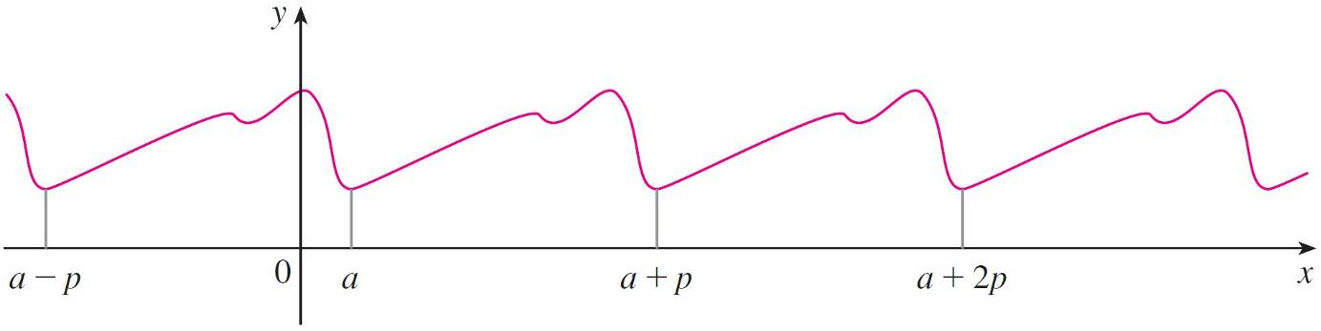
Guidelines for Sketching a Curve
(iii) If f (x + p) = f (x) for all x in D, where p is a positive constant, then f is called a periodic function and the smallest such number p is called the period.
For instance, y = sin x has period 2π and y = tan x has period π. If we know what the graph looks like in an interval of length p, then we can use translation to sketch the entire graph (see Figure 4).
Periodic function: translational symmetry
Figure 4

Slide 9

Guidelines for Sketching a Curve
D. Asymptotes
(i) Horizontal Asymptotes. If either lim_{x→} f (x) = L or
lim_{x→} f (x) = L, then the line y = L is a horizontal asymptote of the curve y = f (x).
If it turns out that lim_{x→} f (x) = (or ), then we do not have an asymptote to the right, but that is still useful information for sketching the curve.

Slide 10

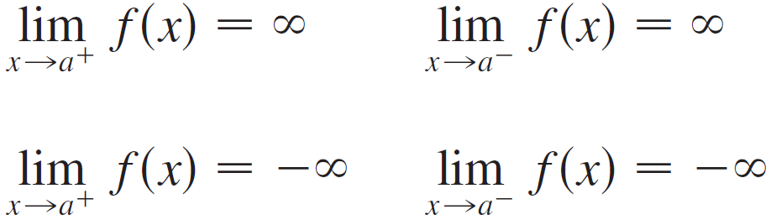
Guidelines for Sketching a Curve
(ii) Vertical Asymptotes. The line x = a is a vertical asymptote if at least one of the following statements is true:
(For rational functions you can locate the vertical
asymptotes by equating the denominator to 0 after
canceling any common factors. But for other functions this method does not apply.)

Slide 11

Guidelines for Sketching a Curve
Furthermore, in sketching the curve it is very useful to know exactly which of the statements in is true.
If f (a) is not defined but a is an endpoint of the domain of f, then you should compute lim_{x→a}– f (x) or lim_{x→a}+ f (x), whether or not this limit is infinite.
(iii) Slant Asymptotes.

Slide 12
Guidelines for Sketching a Curve
E. Intervals of Increase or Decrease Use the I/D Test. Compute f ′ (x) and find the intervals on which f ′ (x) is positive (f is increasing) and the intervals on which f ′ (x) is negative (f is decreasing).
F. Local Maximum and Minimum Values Find the critical numbers of f [the numbers c where f ′ (c) = 0 or f ′ (c) does not exist].
Then use the First Derivative Test. If f ′ changes from positive to negative at a critical number c, then f (c) is a local maximum.

Slide 13
Guidelines for Sketching a Curve
If f ′ changes from negative to positive at c, then f (c) is a local minimum. Although it is usually preferable to use the First Derivative Test, you can use the Second Derivative Test if f ′ (c) = 0 and f ″ (c) ≠ 0.
Then f ″ (c) > 0 implies that f (c) is a local minimum, whereas f ″ (c) < 0 implies that f (c) is a local maximum.
G. Concavity and Points of Inflection Compute f ″ (x) and use the Concavity Test. The curve is concave upward where f ″ (x) > 0 and concave downward where f ″ (x) < 0. Inflection points occur where the direction of concavity changes.

Slide 14
Guidelines for Sketching a Curve
H. Sketch the Curve Using the information in items A–G, draw the graph. Sketch the asymptotes as dashed lines. Plot the intercepts, maximum and minimum points, and inflection points.
Then make the curve pass through these points, rising and falling according to E, with concavity according to G, and approaching the asymptotes.
If additional accuracy is desired near any point, you can compute the value of the derivative there. The tangent indicates the direction in which the curve proceeds.

Slide 15
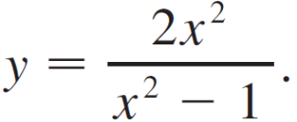
Example 1
Use the guidelines to sketch the curve
A. The domain is
{x | x² – 1 ≠ 0} = {x | x ≠ ±1}
= ( , –1) ∪ (–1, 1), ∪ (1, )
B. The x- and y-intercepts are both 0.
C. Since f (–x) = f (x), the function f is even. The curve is
symmetric about the y-axis.

Slide 16
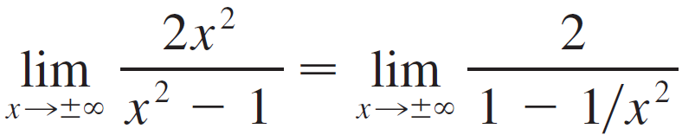

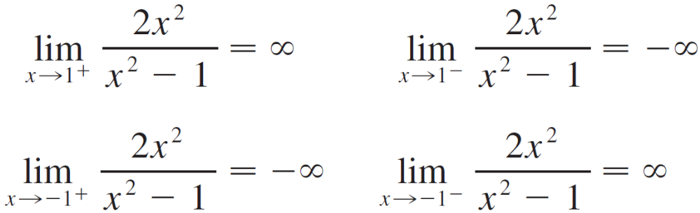
Example 1
cont’d
D.
Therefore the line y = 2 is a horizontal asymptote.
Since the denominator is 0 when x = ±1, we compute the following limits:

Slide 17
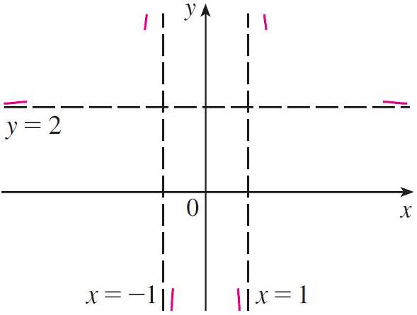
Example 1
cont’d
Therefore the lines x = 1 and x = –1 are vertical asymptotes.
This information about limits and asymptotes enables us to draw the preliminary sketch in Figure 5, showing the parts of the curve near the asymptotes.
Preliminary sketch
Figure 5

Slide 18
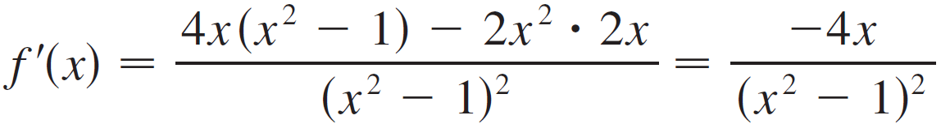
Example 1
cont’d
E.
Since f′ (x) > 0 when x < 0 (x ≠ –1) and f ′ (x) < 0 when
x > 0 (x ≠ 1), f is increasing on ( , –1) and (–1, 0) and
decreasing on (0, 1) and (1, ).
F. The only critical number is x = 0.
Since f ′ changes from positive to negative at 0, f (0) = 0
is a local maximum by the First Derivative Test.

Slide 19
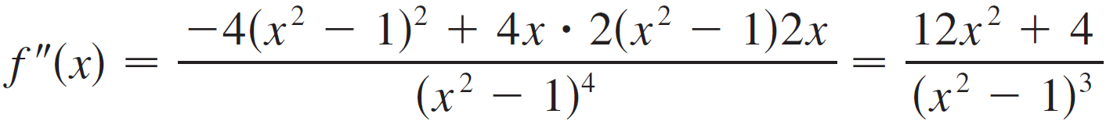

Example 1
cont’d
G.
Since 12x² + 4 > 0 for all x, we have
f ″(x) > 0 x² – 1 > 0 |x| > 1
and f ″(x) < 0 |x| < 1. Thus the curve is concave upward on the intervals ( , –1) and (1, ) and concave downward on (–1, 1). It has no point of inflection since 1 and –1 are not in the domain of f.

Slide 20
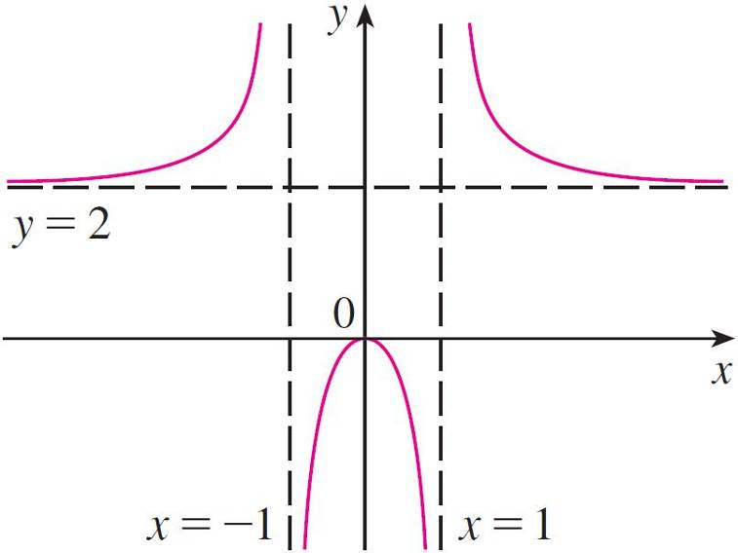

Example 1
cont’d
H. Using the information in E–G, we finish the sketch in Figure 6.
Finished sketch of y =
Figure 6

Slide 21
Slant Asymptotes

Slide 22

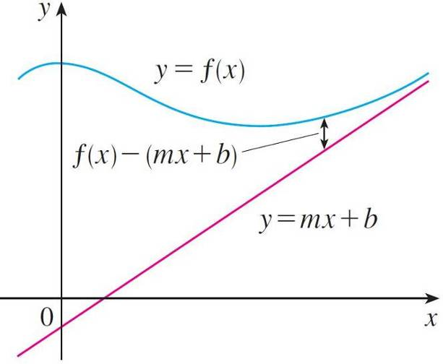
Slant Asymptotes
Some curves have asymptotes that are oblique, that is, neither horizontal nor vertical. If
then the line y = mx + b is called
a slant asymptote because the
vertical distance between the
curve y = f (x) and the line
y = mx + b approaches 0, as in
Figure 10.
(A similar situation exists if we let x → .)
Figure 10

Slide 23
Slant Asymptotes
For rational functions, slant asymptotes occur when the degree of the numerator is one more than the degree of the denominator.
In such a case the equation of the slant asymptote can be found by long division as in the next example.

Slide 24
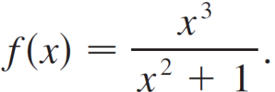

Example 4
Sketch the graph of
A. The domain is = ( , ).
B. The x- and y-intercepts are both 0.
C. Since f(–x) = –f (x), f is odd and its graph is symmetric
about the origin.
D. Since x² + 1 is never 0, there is no vertical asymptote.
Since f (x) → as x → and f (x) → as x → ,
there is no horizontal asymptote.

Slide 25
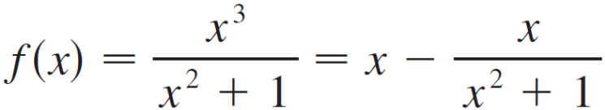
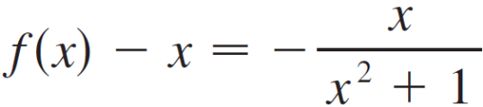
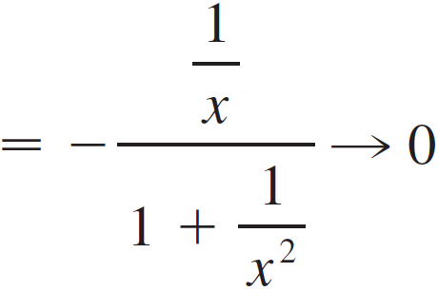

Example 4
cont’d
But long division gives
So the line y = x is a slant asymptote.

Slide 26
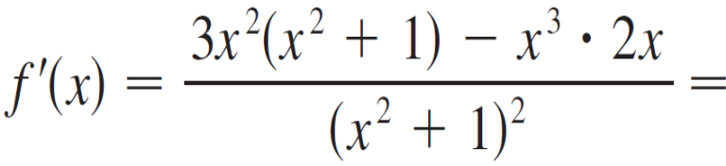
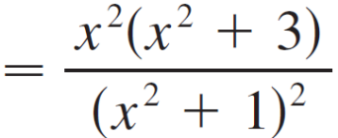
Example 4
cont’d
E.
Since f ′ (x) > 0 for all x (except 0), f is increasing
on ( , ).
F. Although f ′ (0) = 0, f ′ does not change sign at 0, so there
is no local maximum or minimum.

Slide 27
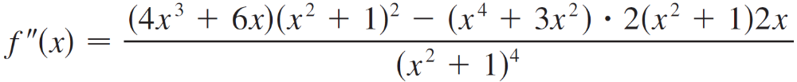
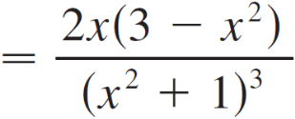

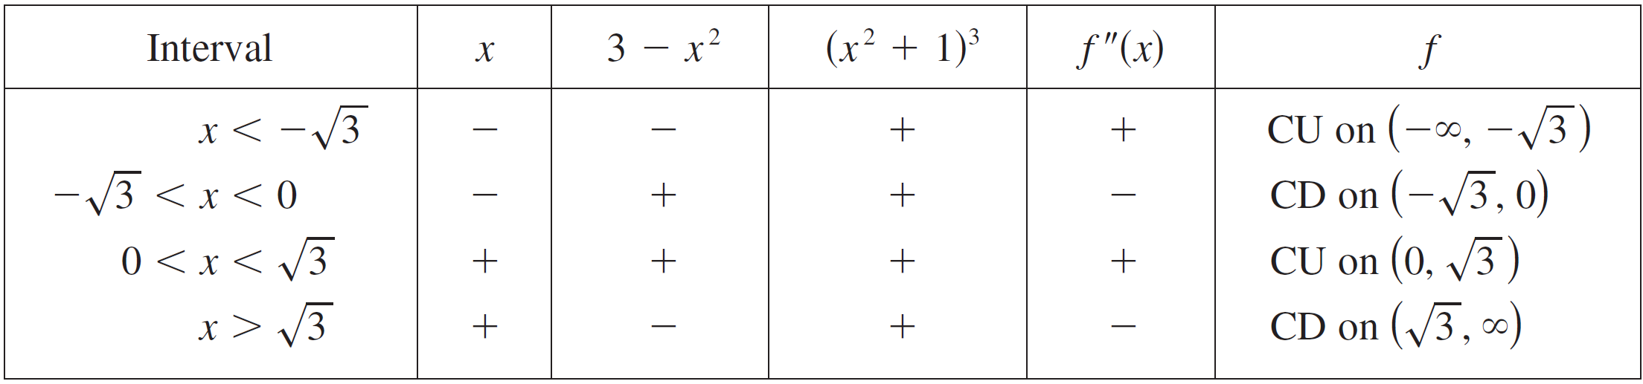


Example 4
cont’d
G.
Since f ″(x) = 0 when x = 0 or x = we set up the following chart:
The points of inflection are (0, 0), and

Slide 28
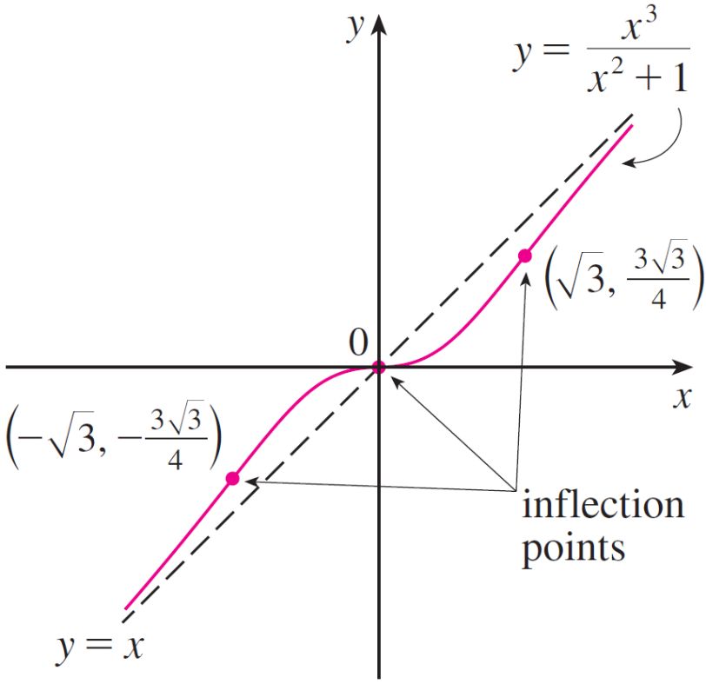
Example 4
cont’d
H. The graph of f is sketched in Figure 11.
Figure 11

