Slide 1


3
Applications of
Differentiation
Copyright © Cengage Learning. All rights reserved.

Slide 2

Graphing with Calculus and Calculators
3.6
Copyright © Cengage Learning. All rights reserved.

Slide 3
Graphing with Calculus and Calculators
In this section we start with a graph produced by a graphing calculator or computer and then we refine it.
We use calculus to make sure that we reveal all the important aspects of the curve.
And with the use of graphing devices we can tackle curves that would be far too complicated to consider without technology. The theme is the interaction between calculus and calculators.

Slide 4
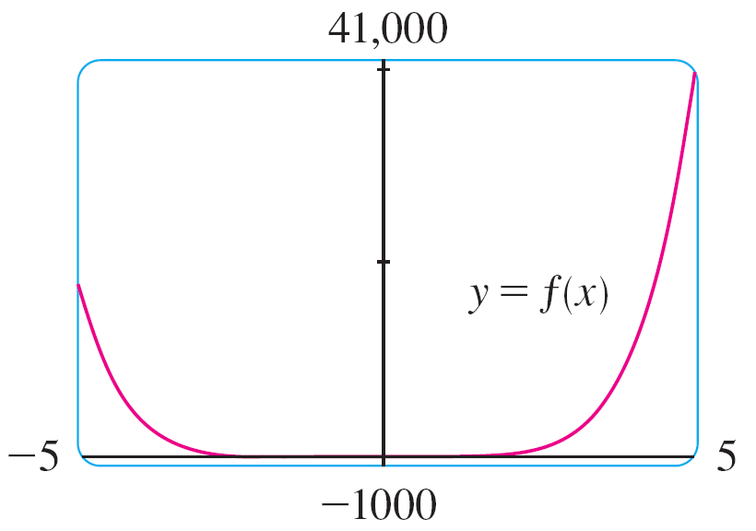
Example 1
Graph the polynomial f (x) = 2x⁶ + 3x⁵ + 3x³ – 2x². Use the graphs of f ′ and f ′′ to estimate all maximum and minimum points and intervals of concavity.
Solution:
If we specify a domain but not a range, many graphing devices will deduce a suitable range from the values computed.
Figure 1 shows the plot
from one such device
if we specify that –5 ≤ x ≤ 5.
Figure 1

Slide 5
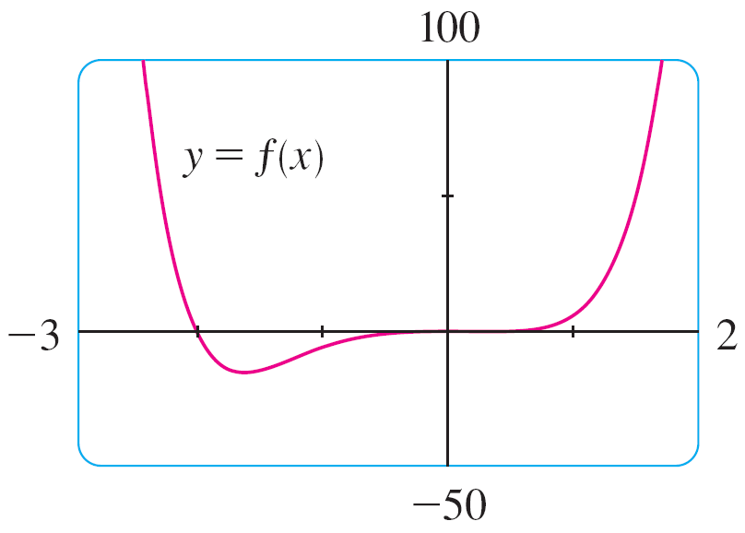
Example 1 – Solution
cont’d
Although this viewing rectangle is useful for showing that the asymptotic behavior (or end behavior) is the same as for y = 2x⁶, it is obviously hiding some finer detail.
So we change to the viewing rectangle [–3, 2] by [–50, 100] shown in Figure 2.
Figure 2

Slide 6

Example 1 – Solution
cont’d
From this graph it appears that there is an absolute minimum value of about –15.33 when x ≈ –1.62 (by using the cursor) and f is decreasing on ( , –1.62) and increasing on (–1.62, ).
Also there appears to be a horizontal tangent at the origin and inflection points when x = 0 and when x is somewhere between –2 and –1.
Now let’s try to confirm these impressions using calculus. We differentiate and get
f ′(x) = 12x⁵ + 15x⁴ + 9x² – 4x
f ′′(x) = 60x⁴ + 60x³ + 18x – 4

Slide 7
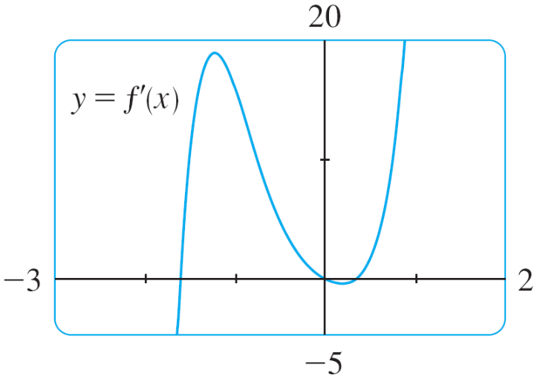
Example 1 – Solution
cont’d
When we graph f ′ in Figure 3 we see that f ′(x) changes from negative to positive when x ≈ –1.62; this confirms (by the First Derivative Test) the minimum value that we found earlier. But, perhaps to our surprise, we also notice that f ′(x) changes from positive to negative when x = 0 and from negative to positive when x ≈ 0.35.
Figure 3

Slide 8
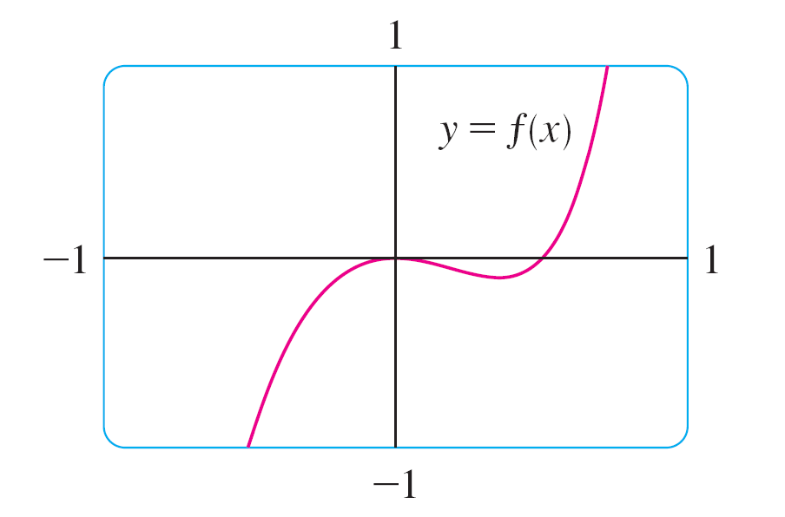
Example 1 – Solution
cont’d
This means that f has a local maximum at 0 and a local minimum when x ≈ 0.35, but these were hidden in Figure 2. Indeed, if we now zoom in toward the origin in Figure 4, we see what we missed before: a local maximum value of 0 when x = 0 and a local minimum value of about –0.1 when x ≈ 0.35.
Figure 2
Figure 4

Slide 9
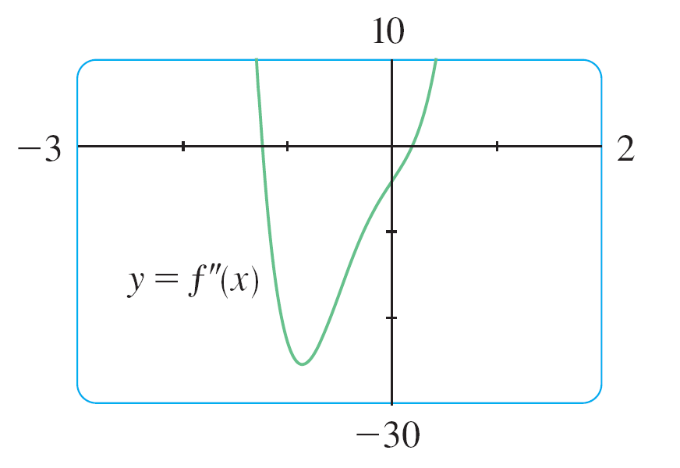
Example 1 – Solution
cont’d
What about concavity and inflection points? From Figures 2 and 4 there appear to be inflection points when x is a little to the left of –1 and when x is a little to the right of 0. But it’s difficult to determine inflection points from the graph of f, so we graph the second derivative f ′′ in Figure 5.
Figure 5

Slide 10
Example 1 – Solution
cont’d
We see that f ′′ changes from positive to negative when x ≈ –1.23 and from negative to positive when x ≈ 0.19.
So, correct to two decimal places, f is concave upward on
( , –1.23) and (0.19, ) and concave downward on
(–1.23, 0.19).
The inflection points are (–1.23, –10.18) and (0.19, –0.05).
We have discovered that no single graph reveals all the important features of this polynomial. But Figures 2 and 4, when taken together, do provide an accurate picture.

