Slide 1


3
Applications of
Differentiation
Copyright © Cengage Learning. All rights reserved.

Slide 2

3.9
Antiderivatives
Copyright © Cengage Learning. All rights reserved.

Slide 3
Antiderivatives
A physicist who knows the velocity of a particle might wish to know its position at a given time.
An engineer who can measure the variable rate at which water is leaking from a tank wants to know the amount leaked over a certain time period.
A biologist who knows the rate at which a bacteria population is increasing might want to deduce what the size of the population will be at some future time.

Slide 4
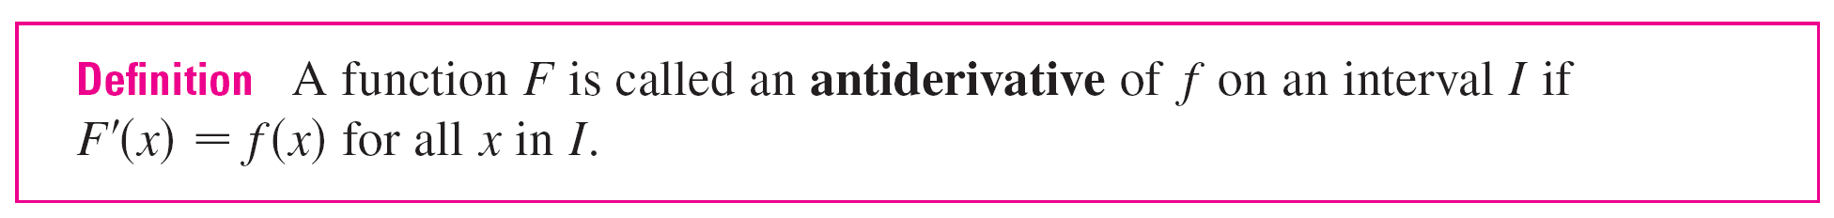
Antiderivatives
In each case, the problem is to find a function F whose derivative is a known function f. If such a function F exists, it is called an antiderivative of f.

Slide 5

Antiderivatives
For instance, let f (x) = x². It isn’t difficult to discover an antiderivative of f if we keep the Power Rule in mind. In fact, if F (x) = x³, then F ′(x) = x² = f (x).
But the function G(x) = x³ + 100 also satisfies G ′ (x) = x².
Therefore both F and G are antiderivatives of f.
Indeed, any function of the form H(x) = x³ + C, where C is
a constant, is an antiderivative of f.

Slide 6
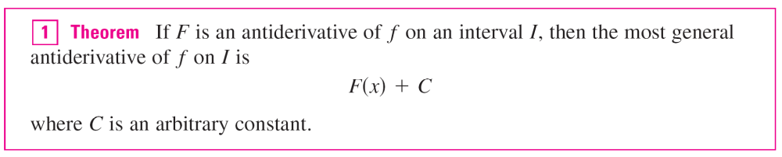
Antiderivatives
Going back to the function f (x) = x², we see that the general antiderivative of f is x³/3 + C.

Slide 7
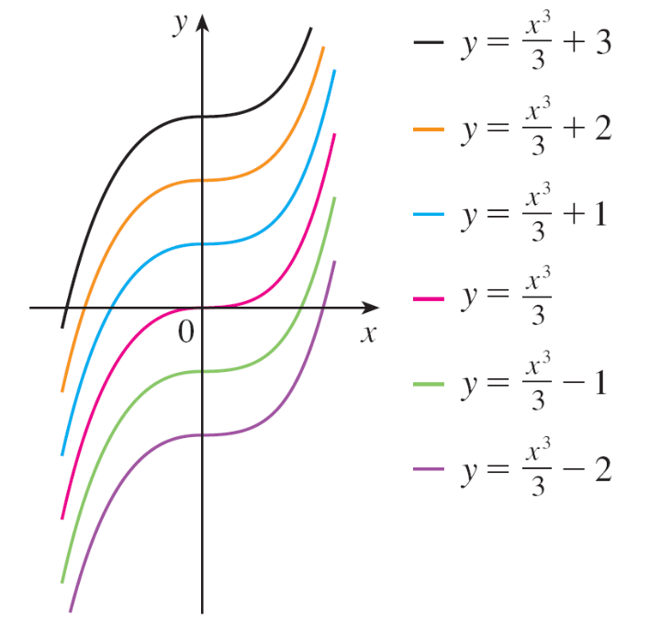
Antiderivatives
By assigning specific values to the constant C, we obtain a family of functions whose graphs are vertical translates of one another (see Figure 1).
This makes sense because
each curve must have the
same slope at any given
value of x.
Members of the family of antiderivatives of f (x) = x²
Figure 1

Slide 8
Example 1
Find the most general antiderivative of each of the following functions.
(a) f (x) = sin x (b) f (x) = x^{n}, n ≥ 0 (c) f (x) = x^{–3}
Solution:
(a) If F (x) = –cos x, then F ′(x) = sin x, so an antiderivative
of sin x is –cos x. By Theorem 1, the most general
antiderivative is G(x) = –cos x + C.

Slide 9
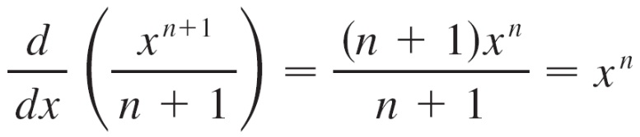
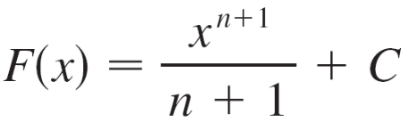
Example 1 – Solution
cont’d
(b) We use the Power Rule to discover an antiderivative of x^{n}:
Thus the general antiderivative of f (x) = x^{n} is
This is valid for n ≥ 0 because f (x) = x^{n} then is defined on an interval.

Slide 10
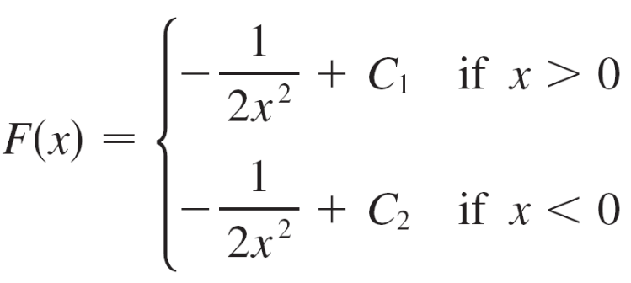
Example 1 – Solution
cont’d
(c) If we put n = –3 in part (b) we get the particular
antiderivative F (x) = x^{–2}/(–2) by the same calculation.
But notice that f (x) = x^{–3} is not defined at x = 0.
Thus Theorem 1 tells us only that the general
antiderivative of f is on any interval that does not contain
0. So the general antiderivative of is f (x) = 1/x³ is

Slide 11

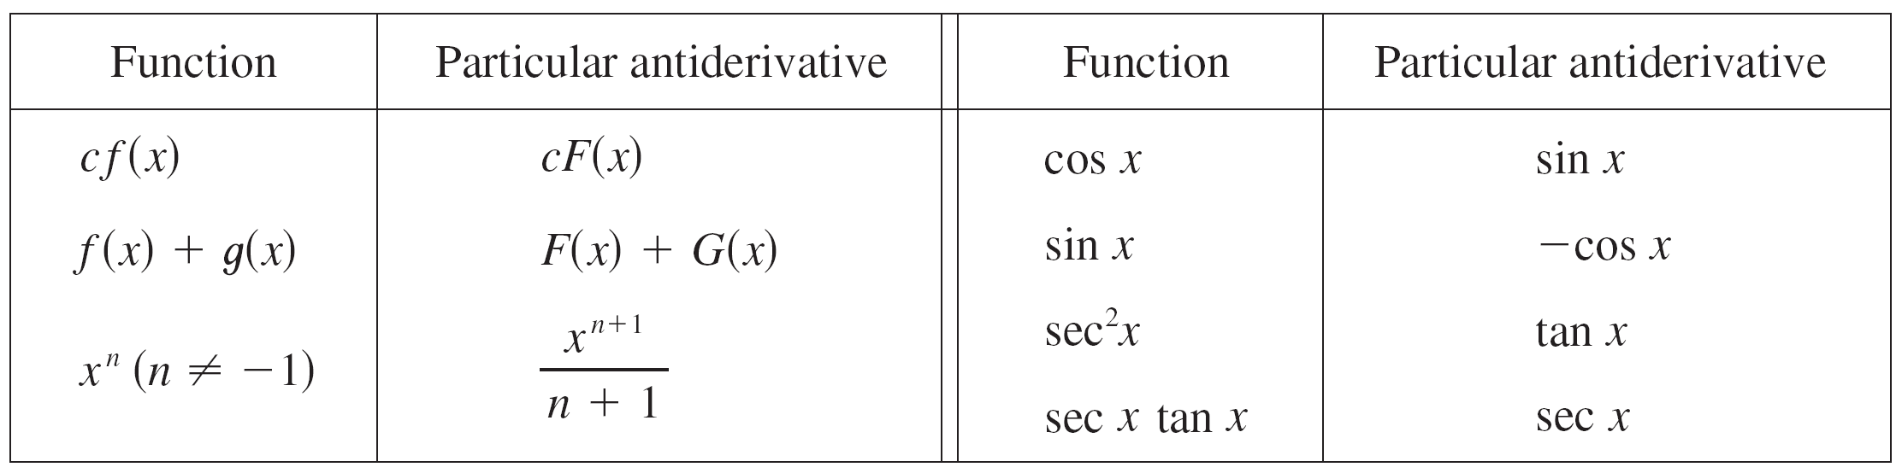
Antiderivatives
As in Example 1, every differentiation formula, when read from right to left, gives rise to an antidifferentiation formula. In Table 2 we list some particular antiderivatives.
To obtain the most general antiderivative from the particular ones in Table 2, we have to add a constant (or constants), as in Example 1.

Slide 12
Antiderivatives
Each formula in the table is true because the derivative of the function in the right column appears in the left column.
In particular, the first formula says that the antiderivative of a constant times a function is the constant times the antiderivative of the function.
The second formula says that the antiderivative of a sum is the sum of the antiderivatives. (We use the notation F ′ = f, G′ = g.)

Slide 13
Antiderivatives
An equation that involves the derivatives of a function is
called a differential equation.
The general solution of a differential equation involves an arbitrary constant (or constants).
However, there may be some extra conditions given that will determine the constants and therefore uniquely specify the solution.

Slide 14
Rectilinear Motion

Slide 15
Rectilinear Motion
Antidifferentiation is particularly useful in analyzing the motion of an object moving in a straight line. Recall that if the object has position function s = f (t), then the velocity function is v(t) = s ′(t).
This means that the position function is an antiderivative of the velocity function.
Likewise, the acceleration function is a (t) = v ′(t), so the velocity function is an antiderivative of the acceleration.
If the acceleration and the initial values s(0) and v(0) are known, then the position function can be found by antidifferentiating twice.

Slide 16

Example 6
A particle moves in a straight line and has acceleration given by a (t) = 6t + 4. Its initial velocity is v(0) = –6 cm/s and its initial displacement is s(0) = 9 cm. Find its position function s (t).
Solution:
Since v ′(t) = a (t) = 6t + 4, antidifferentiation gives
v(t) = 6 + 4t + C
= 3t ² + 4t + C

Slide 17


Example 6 – Solution
cont’d
Note that v(0) = C. But we are given that v(0) = –6, so C = –6 and
v(t) = 3t ² + 4t – 6
Since v(t) = s′(t), s is the antiderivative of v:
s (t) = 3 + 4 – 6t + D
This gives s(0) = D. We are given that s(0) = 9, so D = 9 and the required position function is
s (t) = t ³ + 2t ² – 6t + 9
= t ³ + 2t ² – 6t + D

