Slide 1


4
Integrals
Copyright © Cengage Learning. All rights reserved.

Slide 2

4.1
Areas and Distances
Copyright © Cengage Learning. All rights reserved.

Slide 3
The Area Problem

Slide 4
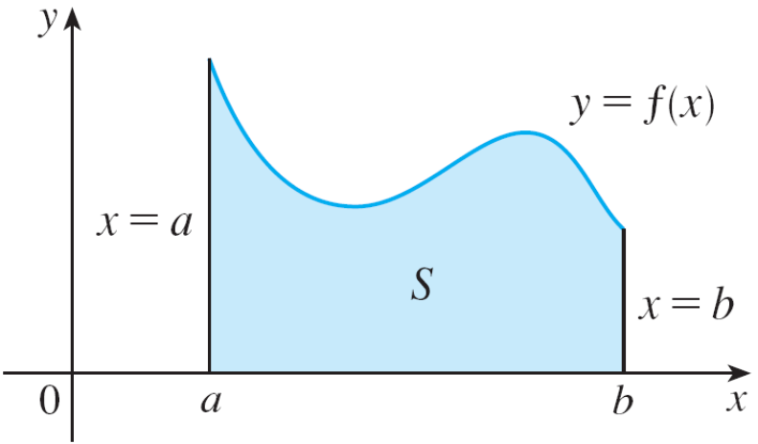
The Area Problems
We begin by attempting to solve the area problem: Find the area of the region S that lies under the curve y = f (x) from
a to b.
This means that S, illustrated in Figure 1, is bounded by the graph of a continuous function f [where f (x) ≥ 0], the vertical lines x = a and x = b, and the x-axis.
S = {(x, y) | a ≤ x ≤ b, 0 ≤ y ≤ f (x)}
Figure 1

Slide 5
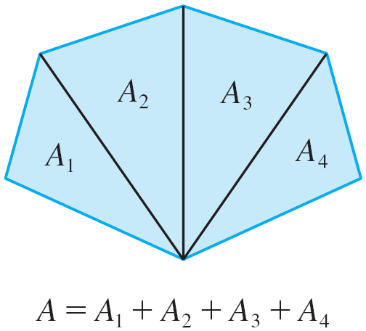
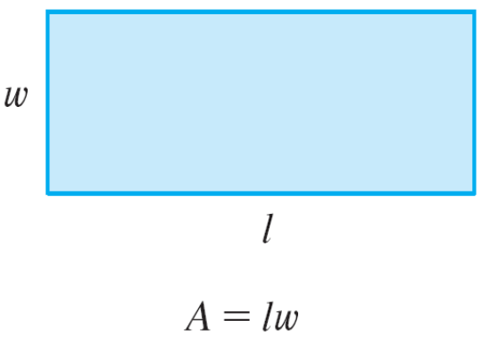
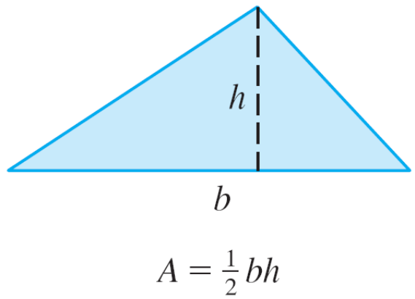
The Area Problems
For a rectangle, the area is defined as the product of the length and the width. The area of a triangle is half the base times the height.
The area of a polygon is found by dividing it into triangles (as in Figure 2) and adding the areas of the triangles.
Figure 2

Slide 6
The Area Problems
However, it isn’t so easy to find the area of a region with curved sides. We all have an intuitive idea of what the area of a region is. But part of the area problem is to make this intuitive idea precise by giving an exact definition of area.
Recall that in defining a tangent we first approximated the slope of the tangent line by slopes of secant lines and then we took the limit of these approximations.
We pursue a similar idea for areas. We first approximate the region S by rectangles and then we take the limit of the areas of these rectangles as we increase the number of rectangles.

Slide 7
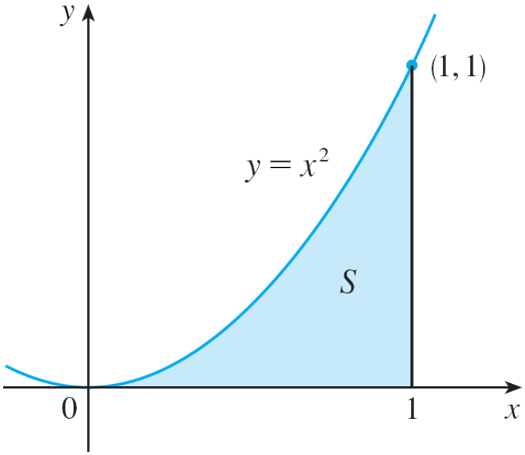
Example 1
Use rectangles to estimate the area under the parabola
y = x² from 0 to 1 (the parabolic region S illustrated in
Figure 3).
Figure 3

Slide 8
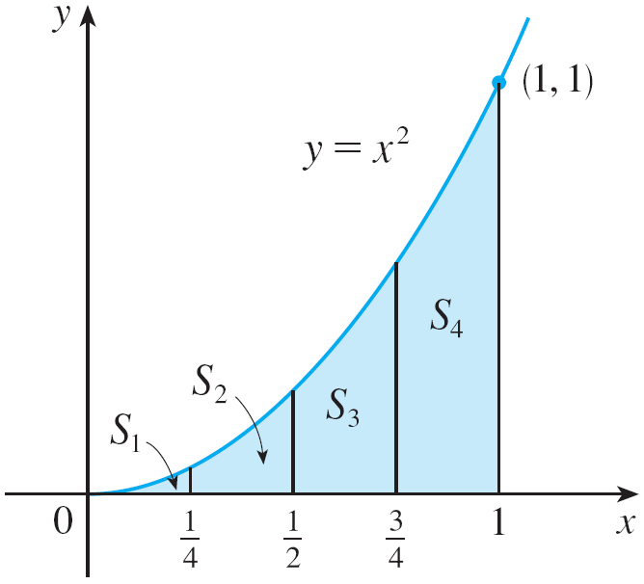
Example 1 – Solution
We first notice that the area of S must be somewhere between 0 and 1 because S is contained in a square with side length 1, but we can certainly do better than that.
Suppose we divide S into four strips S₁, S₂, S₃, and S₄ by
drawing the vertical lines x = , x = , and x = as in
Figure 4(a).
Figure 4(a)

Slide 9
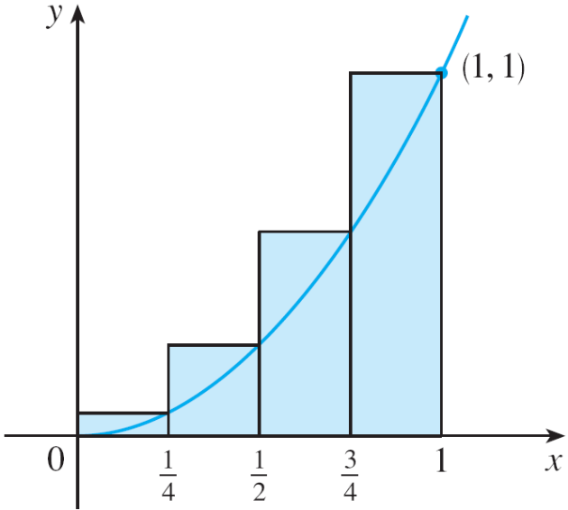



Example 1 – Solution
cont’d
We can approximate each strip by a rectangle that has the same base as the strip and whose height is the same as the right edge of the strip [see Figure 4(b)].
In other words, the heights of
these rectangles are the values
of the function f (x) = x² at the right
endpoints of the subintervals
and
Each rectangle has width and
the heights are and 1².
Figure 4(b)

Slide 10


Example 1 – Solution
cont’d
If we let R₄ be the sum of the areas of these approximating rectangles, we get
From Figure 4(b) we see that the area A of S is less than R₄, so
A < 0.46875

Slide 11
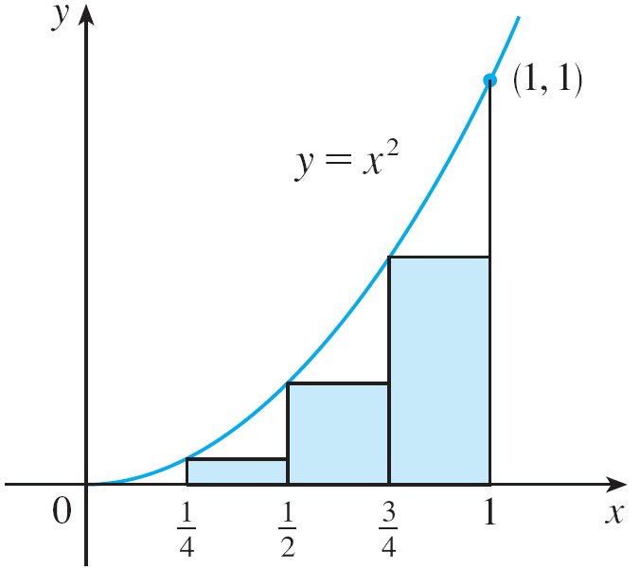
Example 1 – Solution
cont’d
Instead of using the rectangles in Figure 4(b) we could use the smaller rectangles in Figure 5 whose heights are the values of f at the left endpoints of the subintervals. (The leftmost rectangle has collapsed because its height is 0.)
Figure 4(b)
Figure 5

Slide 12


Example 1 – Solution
cont’d
The sum of the areas of these approximating rectangles is
We see that the area of S is larger than L₄, so we have lower and upper estimates for A:
0.21875 < A < 0.46875
We can repeat this procedure with a larger number of strips.

Slide 13
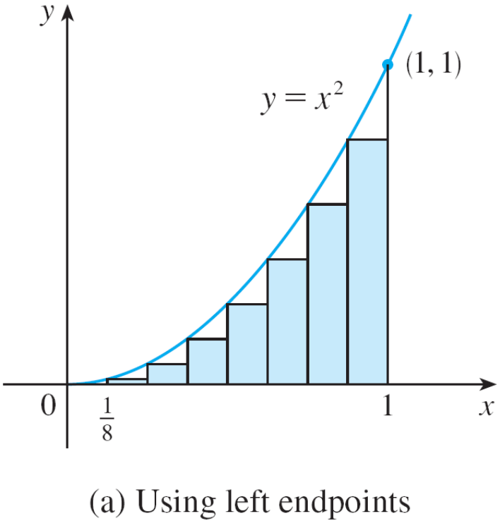
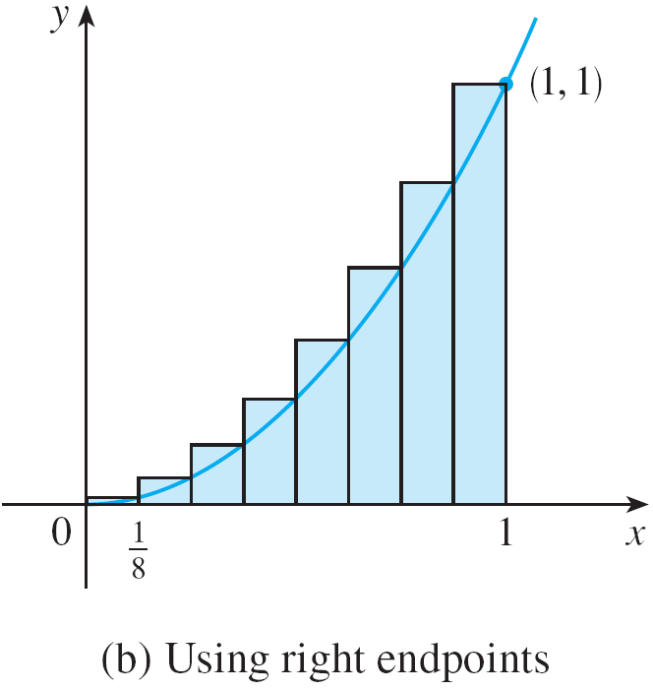
Example 1 – Solution
cont’d
Figure 6 shows what happens when we divide the region
S into eight strips of equal width.
Approximating S with eight rectangles
Figure 6

Slide 14
Example 1 – Solution
cont’d
By computing the sum of the areas of the smaller rectangles (L₈) and the sum of the areas of the larger rectangles (R₈), we obtain better lower and upper estimates for A:
0.2734375 < A < 0.3984375
So one possible answer to the question is to say that the true area of S lies somewhere between 0.2734375 and 0.3984375.
We could obtain better estimates by increasing the number of strips.

Slide 15
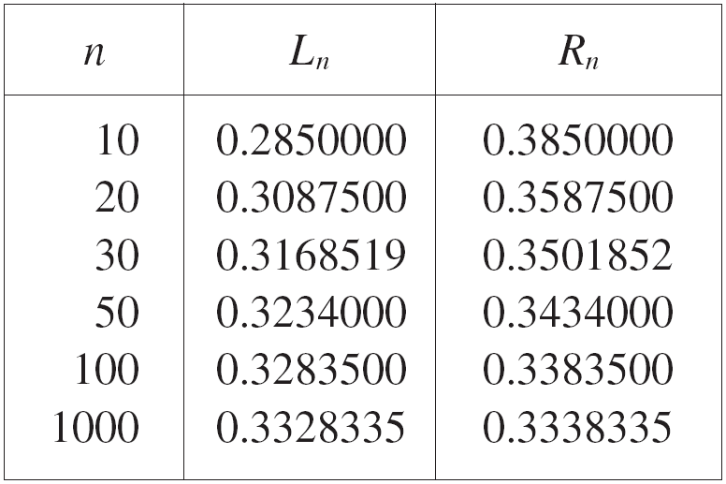
Example 1 – Solution
cont’d
The table at the right shows the
results of similar calculations
(with a computer) using n
rectangles whose heights are
found with left endpoints (L_{n}) or
right endpoints (R_{n}).
In particular, we see by using 50 strips that the area lies between 0.3234 and 0.3434. With 1000 strips we narrow it down even more: A lies between 0.3328335 and 0.3338335.
A good estimate is obtained by averaging these numbers:
A ≈ 0.3333335.

Slide 16
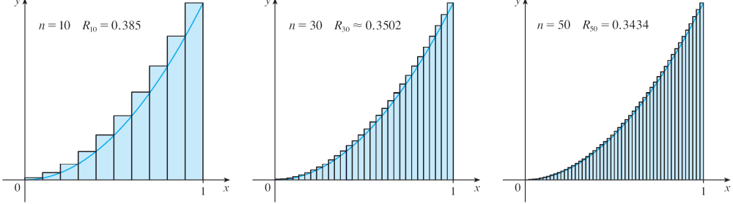
The Area Problems
From Figures 8 and 9 it appears that, as n increases, both L_{n} and R_{n} become better and better approximations to the area of S.
Right endpoints produce upper sums because f (x) = x² is increasing
Figure 8

Slide 17
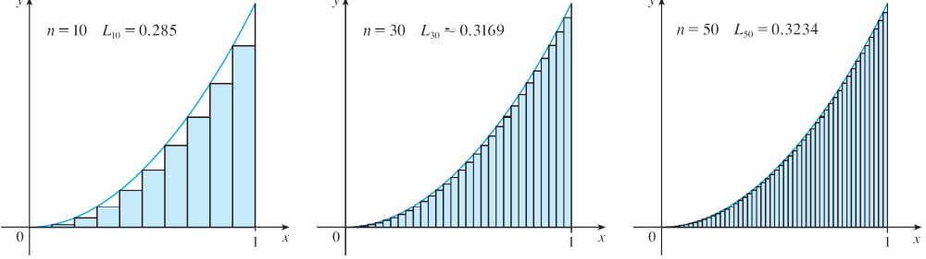
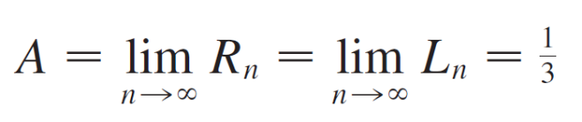
The Area Problems
Therefore we define the area A to be the limit of the sums of the areas of the approximating rectangles, that is,
Left endpoints produce upper sums because f (x) = x² is increasing
Figure 9

Slide 18
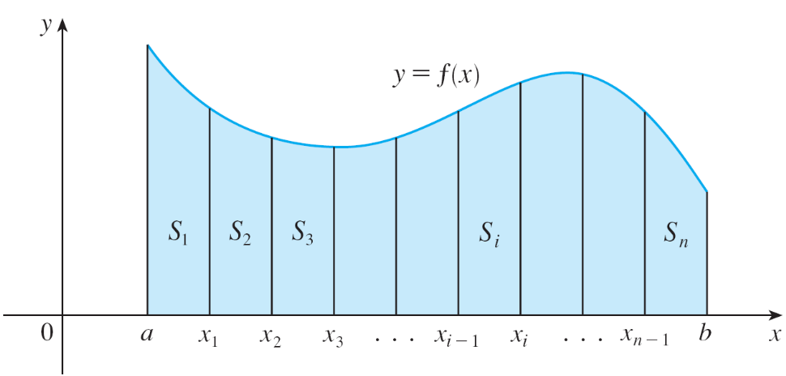
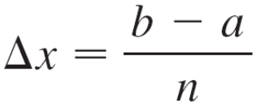
The Area Problems
Let’s apply the idea of Example 1 to the more general region S of Figure 1. We start by subdividing S into n strips
S₁, S₂, …, S_{n} of equal width as in Figure 10.
The width of the interval [a, b] is b – a, so the width of each of the n strips is
S = {(x, y) | a ≤ x ≤ b, 0 ≤ y ≤ f (x)}
Figure 1
Figure 10

Slide 19
The Area Problems
These strips divide the interval [a, b] into n subintervals
[x₀, x₁], [x₁, x₂], [x₂, x₃], . . . , [x_{n – 1}, x_{n}]
where x₀ = a and x_{n} = b. The right endpoints of the subintervals are
x₁ = a + Δx,
x₂ = a + 2 Δx,
x₃ = a + 3 Δx,

Slide 20
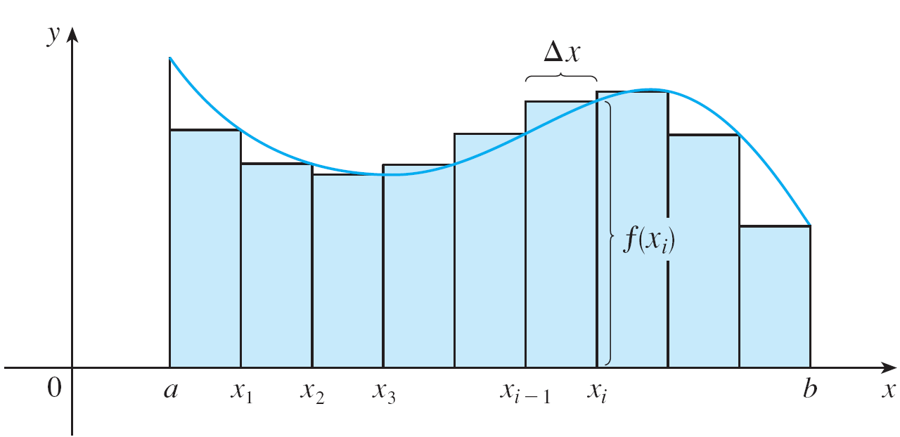
The Area Problems
Let’s approximate the i th strip S_{i} by a rectangle with width Δx and height f (x_{i}), which is the value of f at the right endpoint (see Figure 11).
Then the area of the i th rectangle is f (x_{i}) Δx. What we think of intuitively as the area of S is approximated by the sum of the areas of these rectangles, which is
R_{n} = f (x₁) Δx + f (x₂) Δx + + f (x_{n}) Δx
Figure 11

Slide 21

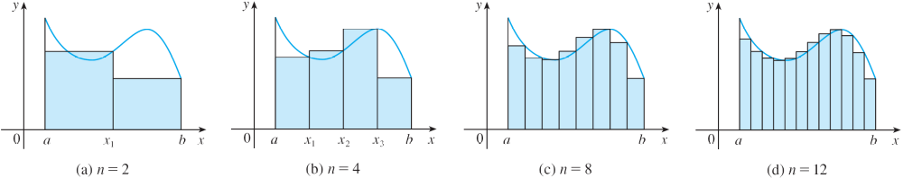
The Area Problems
Figure 12 shows this approximation for n = 2, 4, 8, and 12.
Notice that this approximation appears to become better and better as the number of strips increases, that is, as
n → .
Figure 12

Slide 22
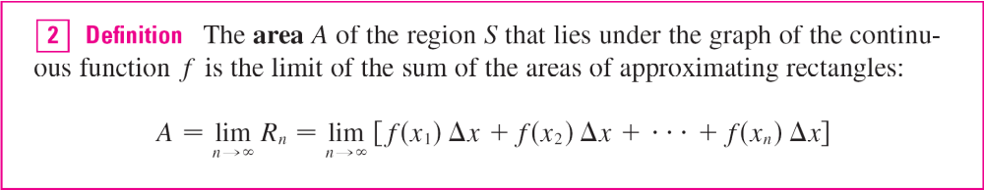
The Area Problems
Therefore we define the area A of the region S in the following way.
It can be proved that the limit in Definition 2 always exists, since we are assuming that f is continuous. It can also be shown that we get the same value if we use left endpoints:

Slide 23
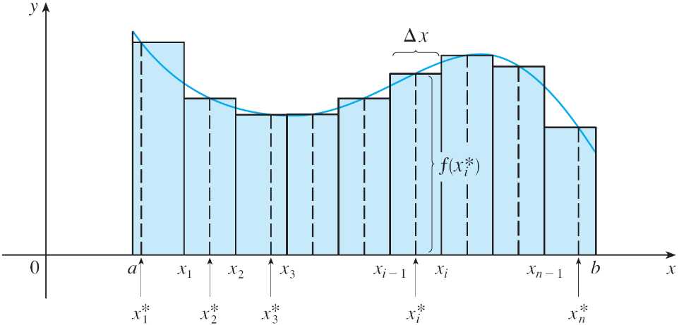

The Area Problems
In fact, instead of using left endpoints or right endpoints, we could take the height of the i th rectangle to be the value of f at any number x_{i}∗ in the i th subinterval [x_{i – 1}, x_{i} ]. We call the numbers x₁∗, x₂∗, . . . , x_{n}∗ the sample points.
Figure 13 shows
approximating rectangles
when the sample points
are not chosen to be
endpoints.
So a more general expression for the area of S is
Figure 13

Slide 24

The Area Problems
Note:
It can be shown that an equivalent definition of area is the following: A is the unique number that is smaller than all the upper sums and bigger than all the lower sums.
We saw in Example 1, for instance, that the area is trapped between all the left approximating sums L_{n} and all the right approximating sums R_{n}. The function in those examples, f (x) = x², happens to be increasing on [0, 1] and so the lower sums arise from left endpoints and the upper sums from right endpoints.

Slide 25


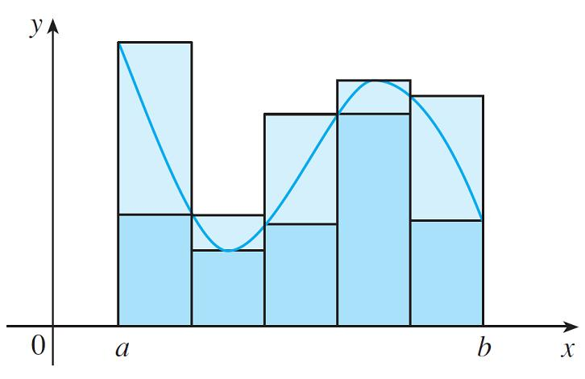
The Area Problems
In general, we form lower (and upper) sums by choosing the sample points so that is the minimum (and
maximum) value of f on the i th subinterval. (See Figure 14)
Lower sums (short rectangles) and upper sums (tall rectangles)
Figure 14

Slide 26
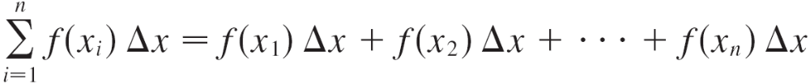
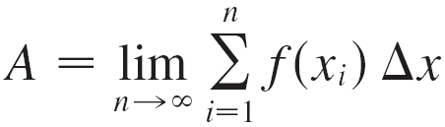
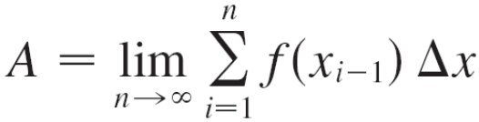
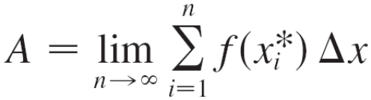
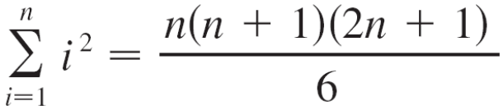
The Area Problems
We often use sigma notation to write sums with many terms more compactly. For instance,
So the expressions for area in Equations 2, 3, and 4 can be written as follows:
We can also rewrite Formula 1 in the following way:

Slide 27
The Distance Problem

Slide 28
The Distance Problems
Now let’s consider the distance problem: Find the distance traveled by an object during a certain time period if the velocity of the object is known at all times.
If the velocity remains constant, then the distance problem is easy to solve by means of the formula
distance = velocity × time
But if the velocity varies, it’s not so easy to find the distance traveled.

Slide 29
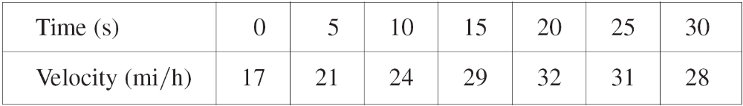
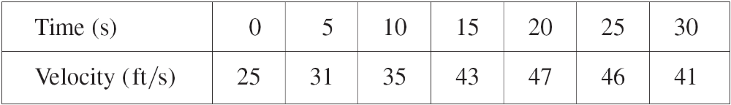
Example 4
Suppose the odometer on our car is broken and we want to estimate the distance driven over a 30-second time interval. We take speedometer readings every five seconds and record them in the following table:
In order to have the time and the velocity in consistent units, let’s convert the velocity readings to feet per second
(1 mi/h = 5280/3600 ft/s):

Slide 30
Example 4
cont’d
During the first five seconds the velocity doesn’t change very much, so we can estimate the distance traveled during that time by assuming that the velocity is constant.
If we take the velocity during that time interval to be the initial velocity (25 ft/s), then we obtain the approximate distance traveled during the first five seconds:
25 ft/s × 5 s = 125 ft

Slide 31
Example 4
cont’d
Similarly, during the second time interval the velocity is approximately constant and we take it to be the velocity when t = 5 s.
So our estimate for the distance traveled from t = 5 s to
t = 10 s is
31 ft/s × 5 s = 155 ft
If we add similar estimates for the other time intervals, we obtain an estimate for the total distance traveled:
(25 × 5) + (31 × 5) + (35 × 5) + (43 × 5) + (47 × 5) + (46 × 5)
= 1135 ft

Slide 32
Example 4
cont’d
We could just as well have used the velocity at the end of each time period instead of the velocity at the beginning as our assumed constant velocity.
Then our estimate becomes
(31 × 5) + (35 × 5) + (43 × 5) + (47 × 5) + (46 × 5) + (41 × 5)
= 1215 ft
If we had wanted a more accurate estimate, we could have taken velocity readings every two seconds, or even every second.

Slide 33
The Distance Problems
In general, suppose an object moves with velocity v = f (t), where a ≤ t ≤ b and f (t) ≥ 0 (so the object always moves in the positive direction).
We take velocity readings at times t₀ (= a), t₁, t₂,. . ., t_{n} (= b) so that the velocity is approximately constant on each subinterval.
If these times are equally spaced, then the time between consecutive readings is Δt = (b – a)/n. During the first time interval the velocity is approximately f (t₀) and so the distance traveled is approximately f (t₀) Δt.

Slide 34
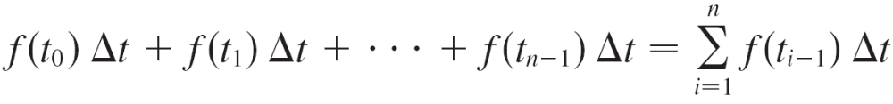
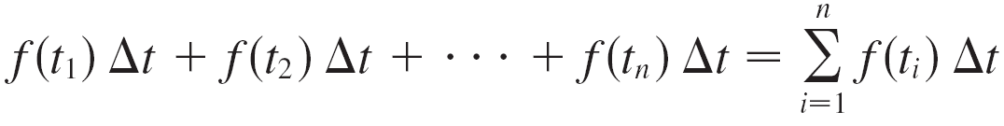
The Distance Problems
Similarly, the distance traveled during the second time interval is about f (t₁) Δt and the total distance traveled during the time interval [a, b] is approximately
If we use the velocity at right endpoints instead of left endpoints, our estimate for the total distance becomes

Slide 35

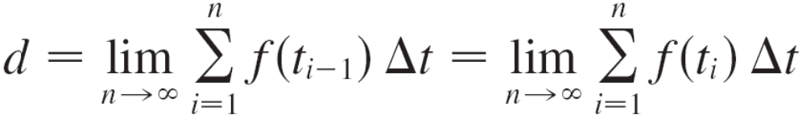
The Distance Problems
The more frequently we measure the velocity, the more accurate our estimates become, so it seems plausible that the exact distance d traveled is the limit of such expressions:

