Slide 1


4
Integrals
Copyright © Cengage Learning. All rights reserved.

Slide 2

The Fundamental Theorem of Calculus
4.3
Copyright © Cengage Learning. All rights reserved.

Slide 3
The Fundamental Theorem of Calculus
The Fundamental Theorem of Calculus is appropriately named because it establishes a connection between the two branches of calculus: differential calculus and integral calculus.
It gives the precise inverse relationship between the
derivative and the integral.

Slide 4

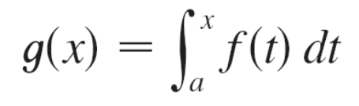

The Fundamental Theorem of Calculus
The first part of the Fundamental Theorem deals with functions defined by an equation of the form
where f is a continuous function on [a, b] and x varies between a and b. Observe that g depends only on x, which appears as the variable upper limit in the integral. If x is a fixed number, then the integral is a definite number.
If we then let x vary, the number also varies and defines a function of x denoted by g(x).

Slide 5
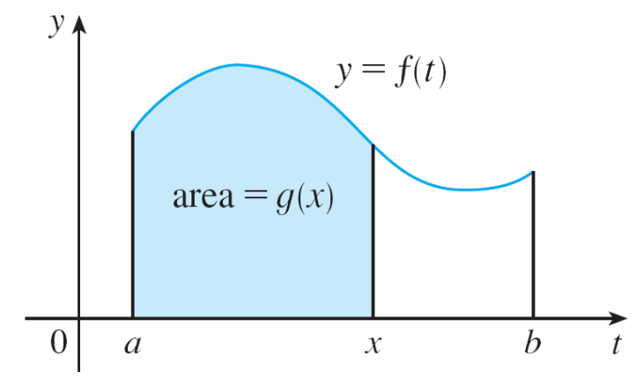
The Fundamental Theorem of Calculus
If f happens to be a positive function, then g(x) can be interpreted as the area under the graph of f from a to x, where x can vary from a to b. (Think of g as the “area so far” function; see Figure 1.)
Figure 1

Slide 6

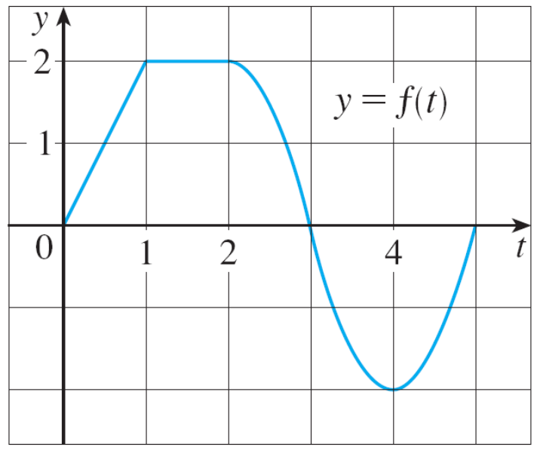
Example 1
If f is the function whose graph is shown in Figure 2 and
find the values of g(0), g(1), g(2), g(3), g(4),
and g(5). Then sketch a rough graph of g.
Figure 2

Slide 7

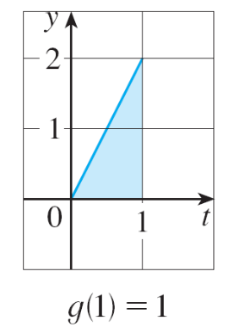
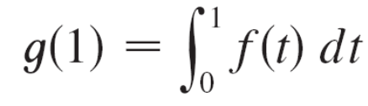

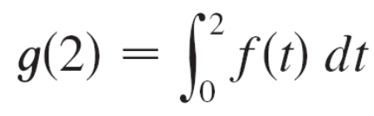
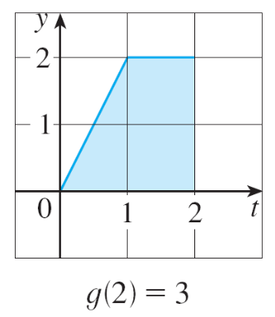
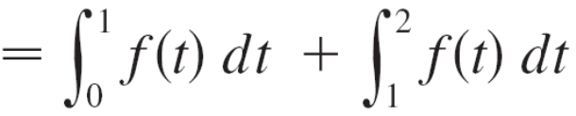
Example 1 – Solution
First we notice that .
From Figure 3 we see that g(1) is the area
of a triangle:
To find g(2) we add to g(1) the area of a rectangle:
= (1  2) = 1
Figure 3
= 1 + (1  2) = 3
Figure 3

Slide 8
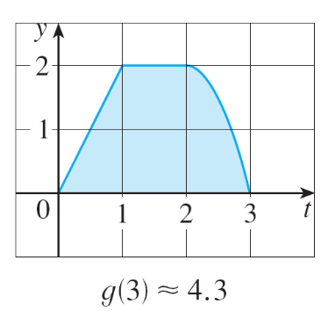
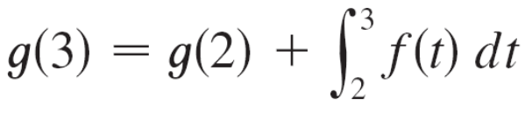
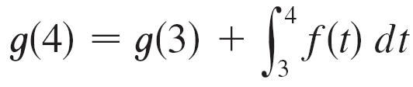
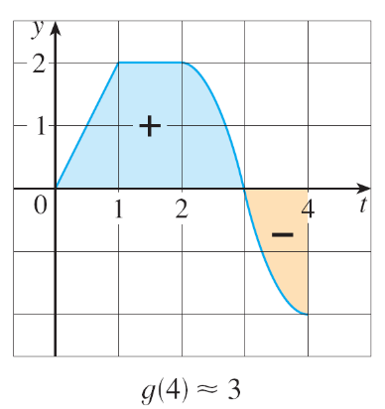
Example 1 – Solution
cont’d
We estimate that the area under f from 2 to 3 is about 1.3, to 3
For t > 3, f (t) is negative and so we start subtracting areas:
≈ 3 + 1.3 = 4.3
Figure 3
≈ 4.3 + (–1.3) = 3.0
Figure 3

Slide 9
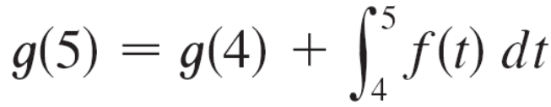
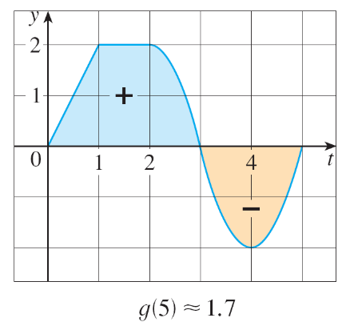
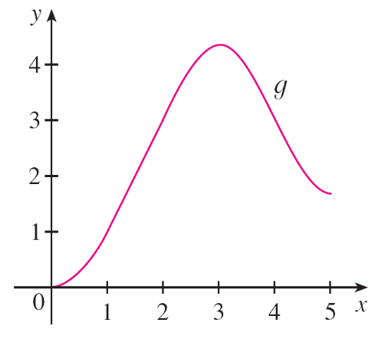

Example 1 – Solution
cont’d
We use these values to sketch the
graph of g in Figure 4.
Notice that, because f (t) is positive
for t < 3, we keep adding area for
t < 3 and so g is increasing up to
x = 3, where it attains a maximum
value. For x > 3, g decreases because
f (t) is negative.
≈ 3 + (–1.3) = 1.7
Figure 3
Figure 4

Slide 10
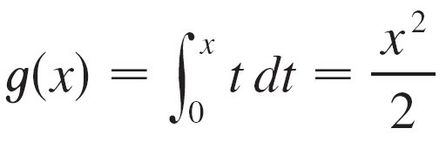
The Fundamental Theorem of Calculus
If we take, f (t) = t and a = 0, then we have Notice that g′(x) = x, that is, g′ = f. In other words, if g is defined as the integral of f by Equation 1, then g turns out to be an antiderivative of f, at least in this case.
And if we sketch the derivative of the function g shown in Figure 4 by estimating slopes of tangents, we get a graph like that of f in Figure 2. So we suspect that g′ = f in
Example 1 too.
Figure 2

Slide 11

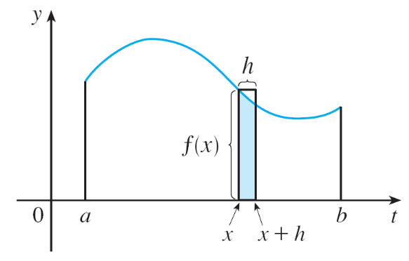
The Fundamental Theorem of Calculus
To see why this might be generally true we consider any continuous function f with f (x) ≥ 0. Then can be interpreted as the area under the graph of f from a to x, as in Figure 1.
In order to compute g′(x) from the definition of a derivative we first observe that, for h > 0, g(x + h) – g(x) is obtained by subtracting areas, so it is the area under the graph of f from x to x + h (the blue area in Figure 5).
Figure 1
Figure 5

Slide 12
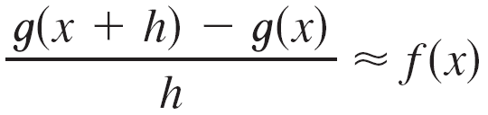
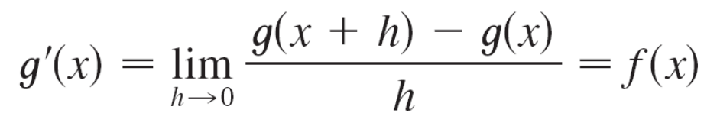
The Fundamental Theorem of Calculus
For small h you can see from the figure that this area is approximately equal to the area of the rectangle with height f (x) and width h:
g(x + h) – g(x) ≈ hf (x)
so
Intuitively, we therefore expect that

Slide 13
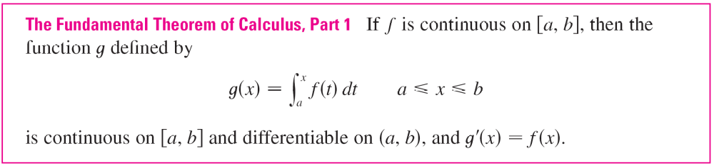
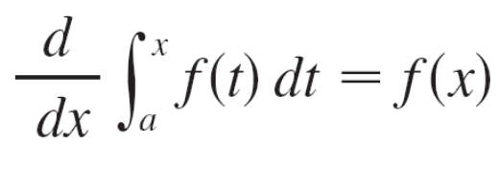
The Fundamental Theorem of Calculus
The fact that this is true, even when f is not necessarily positive, is the first part of the Fundamental Theorem of Calculus.
Using Leibniz notation for derivatives, we can write this theorem as
when f is continuous.

Slide 14
The Fundamental Theorem of Calculus
Roughly speaking, this equation says that if we first integrate f and then differentiate the result, we get back to the original function f.

Slide 15
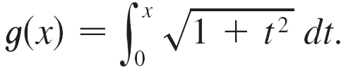

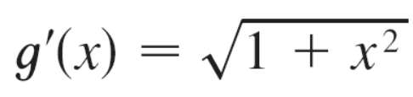
Example 2
Find the derivative of the function
Solution:
Since is continuous, Part 1 of the
Fundamental Theorem of Calculus gives

Slide 16

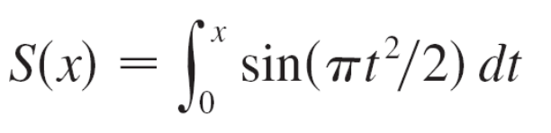
Example 3
Although a formula of the form may seem like a strange way of defining a function, books on physics, chemistry, and statistics are full of such functions. For instance, the Fresnel function
is named after the French physicist Augustin Fresnel
(1788–1827), who is famous for his works in optics.
This function first appeared in Fresnel’s theory of the diffraction of light waves, but more recently it has been applied to the design of highways.

Slide 17

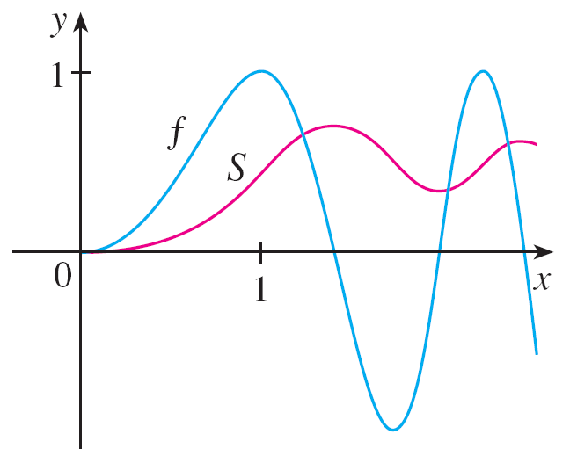

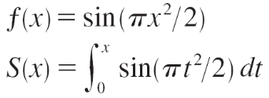
Example 3
cont’d
Part 1 of the Fundamental Theorem tells us how to differentiate the Fresnel function:
This means that we can apply all the methods of differential calculus to analyze S.
Figure 7 shows the graphs of
f (x) = sin(πx²/2) and the
Fresnel function
Figure 7

Slide 18
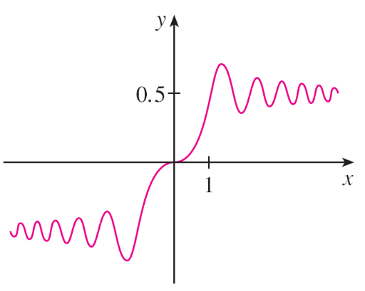
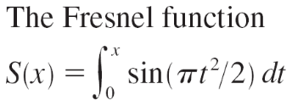
Example 3
cont’d
A computer was used to graph S by computing the value of this integral for many values of x.
It does indeed look as if S(x) is the area under the graph of f from 0 to x [until x ≈ 1.4 when S(x) becomes a difference of areas]. Figure 8 shows a larger part of the graph of S.
Figure 8

Slide 19
Example 3
cont’d
If we now start with the graph of S in Figure 7 and think about what its derivative should look like, it seems reasonable that S′(x) = f (x). [For instance, S is increasing
when f (x) > 0 and decreasing when f (x) < 0.] So this gives a visual confirmation of Part 1 of the Fundamental Theorem of Calculus.
Figure 7

Slide 20
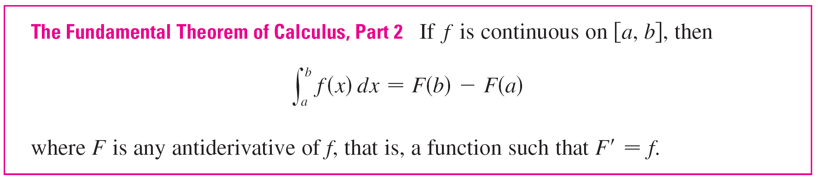
The Fundamental Theorem of Calculus
The second part of the Fundamental Theorem of Calculus, which follows easily from the first part, provides us with
a much simpler method for the evaluation of integrals.

Slide 21
Differentiation and Integration as Inverse Processes

Slide 22
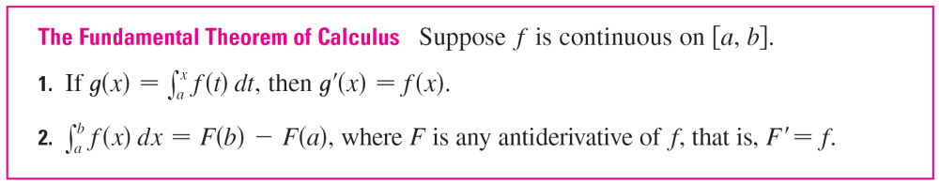
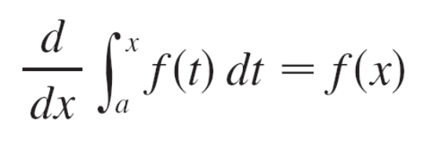
Differentiation and Integration as Inverse Processes
We end this section by bringing together the two parts of the Fundamental Theorem.
We noted that Part 1 can be rewritten as
which says that if f is integrated and then the result is differentiated, we arrive back at the original function f.

Slide 23
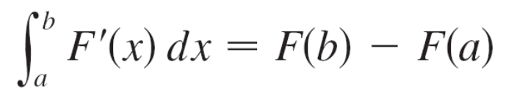
Differentiation and Integration as Inverse Processes
Since F′ (x) = f (x), Part 2 can be rewritten as
This version says that if we take a function F, first differentiate it, and then integrate the result, we arrive back at the original function F, but in the form F(b) – F(a).
Taken together, the two parts of the Fundamental Theorem of Calculus say that differentiation and integration are inverse processes. Each undoes what the other does.

