Slide 1


4
Integrals
Copyright © Cengage Learning. All rights reserved.

Slide 2

Indefinite Integrals and the Net Change Theorem
4.4
Copyright © Cengage Learning. All rights reserved.

Slide 3
Indefinite Integrals and the Net Change Theorem
In this section we introduce a notation for antiderivatives, review the formulas for antiderivatives, and use them to evaluate definite integrals.
We also reformulate FTC2 in a way that makes it easier to apply to science and engineering problems.

Slide 4
Indefinite Integrals

Slide 5



Indefinite Integrals
Both parts of the Fundamental Theorem establish connections between antiderivatives and definite integrals. Part 1 says that if f is continuous, then dt is an antiderivative of f. Part 2 says that can be found by evaluating F(b) – F(a), where F is an antiderivative of f.
We need a convenient notation for antiderivatives that makes them easy to work with.
Because of the relation given by the Fundamental Theorem between antiderivatives and integrals, the notation is traditionally used for an antiderivative of f and is called an indefinite integral.

Slide 6
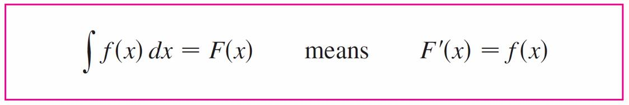
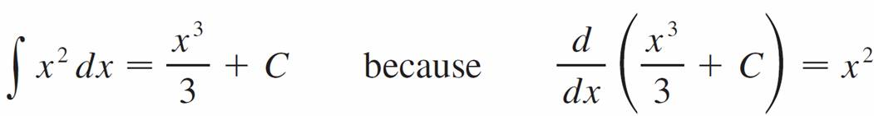
Indefinite Integrals
Thus
For example, we can write
So we can regard an indefinite integral as representing an entire family of functions (one antiderivative for each value of the constant C).

Slide 7



Indefinite Integrals
You should distinguish carefully between definite and indefinite integrals. A definite integral is a number, whereas an indefinite integral is a function (or family of functions).
The connection between them is given by Part 2 of the Fundamental Theorem:
If f is continuous on [a, b], then
The effectiveness of the Fundamental Theorem depends on having a supply of antiderivatives of functions.

Slide 8
Indefinite Integrals
Any formula can be verified by differentiating the function on the right side and obtaining the integrand.
For instance,

Slide 9
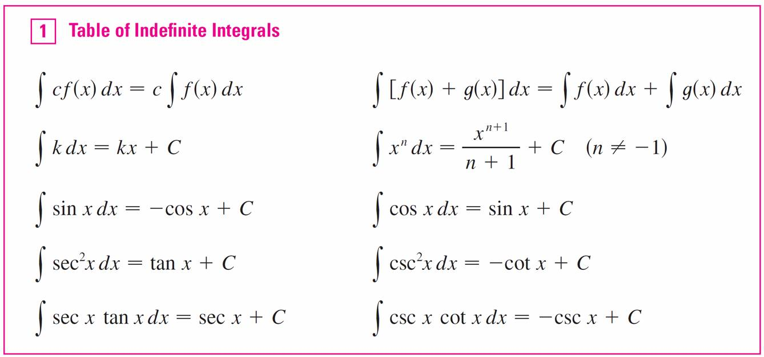
Indefinite Integrals
The most general antiderivative on a given interval is obtained by adding a constant to a particular antiderivative.

Slide 10
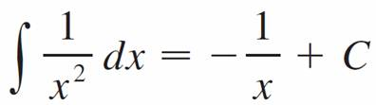

Indefinite Integrals
We adopt the convention that when a formula for a general indefinite integral is given, it is valid only on an interval.
Thus we write
with the understanding that it is valid on the interval (0, ) or on the interval ( 0).

Slide 11
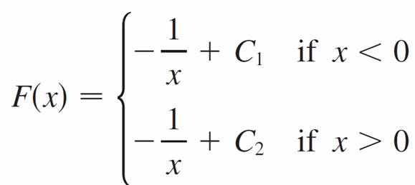
Indefinite Integrals
This is true despite the fact that the general antiderivative of the function f (x) = 1/x², x ≠ 0, is

Slide 12
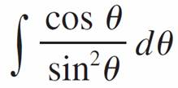
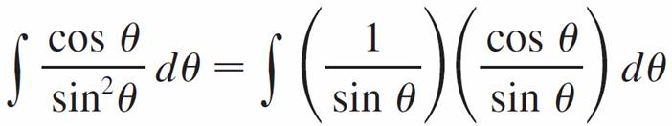


Example 2
Evaluate .
Solution:
This indefinite integral isn’t immediately apparent in
Table 1, so we use trigonometric identities to rewrite the function before integrating:

Slide 13
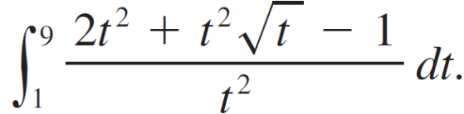
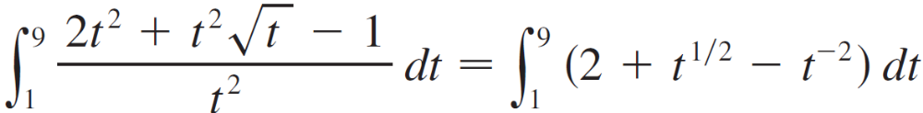
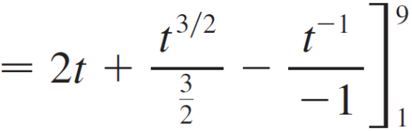
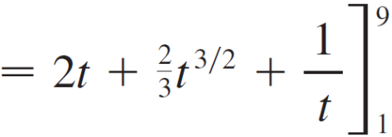
Example 5
Evaluate
Solution:
First we need to write the integrand in a simpler form by carrying out the division:

Slide 14


Example 5 – Solution
cont’d

Slide 15
Applications

Slide 16


Applications
Part 2 of the Fundamental Theorem says that if f is continuous on [a, b], then
where F is any antiderivative of f. This means that F ′ = f, so the equation can be rewritten as

Slide 17
Applications
We know that F ′ (x) represents the rate of change of y = F (x)
with respect to x and F (b) – F (a) is the change in y when x changes from a to b.
[Note that y could, for instance, increase, then decrease, then increase again.
Although y might change in both directions, F (b) – F (a) represents the net change in y.]

Slide 18

Applications
So we can reformulate FTC2 in words as follows.
This principle can be applied to all of the rates of change in the natural and social sciences. Here are a few instances of this idea:
If V (t) is the volume of water in a reservoir at time t, then
its derivative V ′(t) is the rate at which water flows into
the reservoir at time t.

Slide 19

Applications
So
is the change in the amount of water in the reservoir
between time t₁ and time t₂.
If [C](t) is the concentration of the product of a chemical
reaction at time t, then the rate of reaction is the
derivative d [C]/dt.

Slide 20
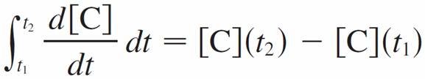

Applications
So
is the change in the concentration of C from time t₁ to
time t₂.
If the mass of a rod measured from the left end to a point
x is m (x), then the linear density is ρ (x) = m ′ (x). So
is the mass of the segment of the rod that lies between
x = a and x = b.

Slide 21
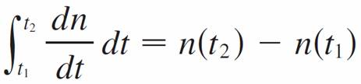
Applications
If the rate of growth of a population is dn/dt, then
is the net change in population during the time period
from t₁ to t₂.
(The population increases when births happen and
decreases when deaths occur. The net change takes into
account both births and deaths.)

Slide 22

Applications
If C (x) is the cost of producing x units of a commodity,
then the marginal cost is the derivative C ′ (x).
So
is the increase in cost when production is increased from
x₁ units to x₂ units.

Slide 23


Applications
If an object moves along a straight line with position
function s (t), then its velocity is v (t) = s ′(t), so
is the net change of position, or displacement, of the
particle during the time period from t₁ to t₂.
This was true for the case where the object moves in the
positive direction, but now we have proved that it is
always true.

Slide 24


Applications
If we want to calculate the distance the object travels
during the time interval, we have to consider the intervals
when v (t) ≥ 0 (the particle moves to the right) and also the
intervals when v (t) ≤ 0 (the particle moves to the left).
In both cases the distance is computed by integrating | v (t) |,
the speed. Therefore

Slide 25
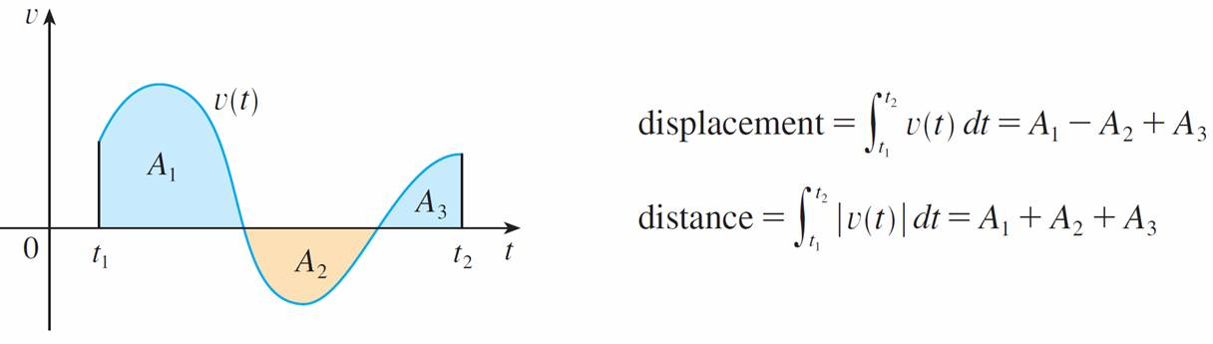
Applications
Figure 3 shows how both displacement and distance traveled can be interpreted in terms of areas under a velocity curve.
Figure 3

Slide 26

Applications
The acceleration of the object is a (t) = v ′(t), so
is the change in velocity from time t₁ to time t₂.

Slide 27
Example 6
A particle moves along a line so that its velocity at time t is v (t) = t² – t – 6 (measured in meters per second).
Find the displacement of the particle during the time
period 1 ≤ t ≤ 4.
(b) Find the distance traveled during this time period.

Slide 28


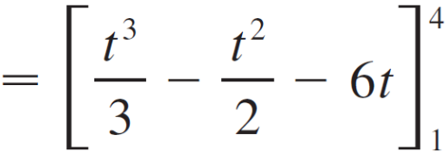
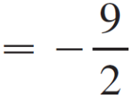
Example 6 – Solution
(a) By Equation 2, the displacement is

Slide 29


Example 6 – Solution
cont’d
This means that the particle moved 4.5 m toward the left.
(b) Note that v (t) = t² – t – 6 = (t – 3)(t + 2) and so v (t) ≤ 0 on the interval [1, 3] and v (t) ≥ 0 on [3, 4].
Thus, from Equation 3, the distance traveled is

Slide 30
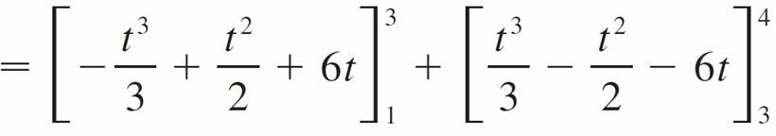
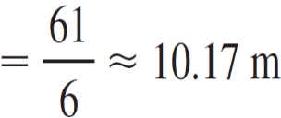
Example 6 – Solution
cont’d

