Slide 1


4
Integrals
Copyright © Cengage Learning. All rights reserved.

Slide 2

4.5
The Substitution Rule
Copyright © Cengage Learning. All rights reserved.

Slide 3

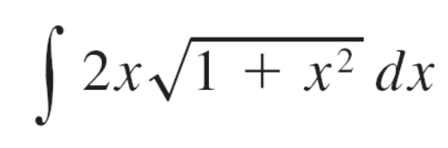
The Substitution Rule
Because of the Fundamental Theorem, it’s important to be able to find antiderivatives.
But our antidifferentiation formulas don’t tell us how to evaluate integrals such as
To find this integral we use the problem-solving strategy of introducing a new variable; we change from the variable x to a new variable u.

Slide 4


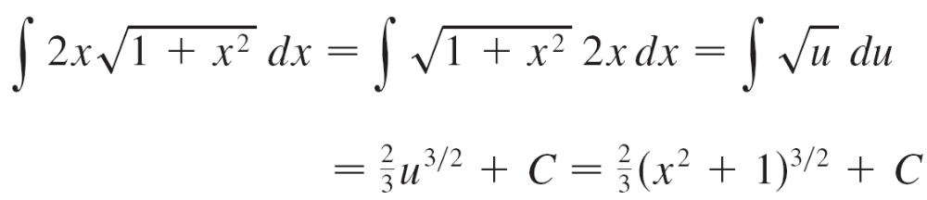
The Substitution Rule
Suppose that we let u be the quantity under the root sign in
, u = 1 + x². Then the differential of u is du = 2x dx.
Notice that if the dx in the notation for an integral were to be interpreted as a differential, then the differential 2x dx would occur in and so, formally, without justifying our calculation, we could write

Slide 5
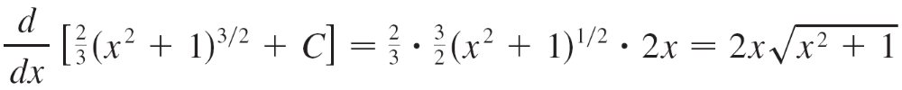
The Substitution Rule
But now we can check that we have the correct answer by using the Chain Rule to differentiate the final function of Equation 2:
In general, this method works whenever we have an integral that we can write in the form ∫f (g(x))g′(x) dx.

Slide 6


The Substitution Rule
Observe that if F ′ = f, then
∫ F′(g(x))g′(x) dx = F (g(x)) + C
because, by the Chain Rule,
[F (g(x))] = F′ (g(x))g′(x)
If we make the “change of variable” or “substitution”
u = g(x), then from Equation 3 we have
∫ F′(g(x))g′(x) dx = F (g(x)) + C = F(u) + C = ∫ F′(u) du
or, writing F′ = f, we get
∫ f (g(x))g′(x) dx = ∫ f (u) du

Slide 7
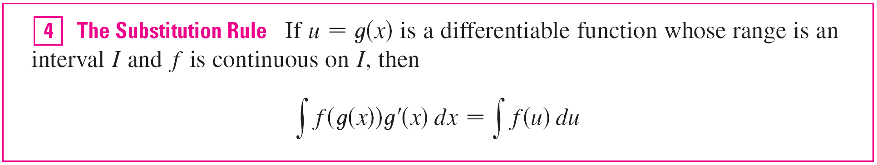

The Substitution Rule
Thus we have proved the following rule.
Notice that the Substitution Rule for integration was proved using the Chain Rule for differentiation.
Notice also that if u = g(x), then du = g′(x) dx, so a way to remember the Substitution Rule is to think of dx and du in
as differentials.

Slide 8
The Substitution Rule
Thus the Substitution Rule says: It is permissible to operate with dx and du after integral signs as if they were differentials.

Slide 9

Example 1
Find ∫ x³ cos(x⁴ + 2) dx.
Solution:
We make the substitution u = x⁴ + 2 because its differential is du = 4x³ dx, which, apart from the constant factor 4, occurs in the integral.
Thus, using x³ dx = du and the Substitution Rule, we have
∫ x³ cos(x⁴ + 2) dx = ∫ cos u  du
= ∫ cos u du

Slide 10
Example 1 – Solution
cont’d
= sin u + C
= sin(x⁴ + 2) + C
Notice that at the final stage we had to return to the original variable x.

Slide 11
Definite Integrals

Slide 12
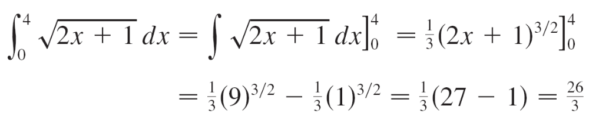
Definite Integrals
When evaluating a definite integral by substitution, two methods are possible. One method is to evaluate the indefinite integral first and then use the Fundamental Theorem.
For example,
Another method, which is usually preferable, is to change the limits of integration when the variable is changed.

Slide 13
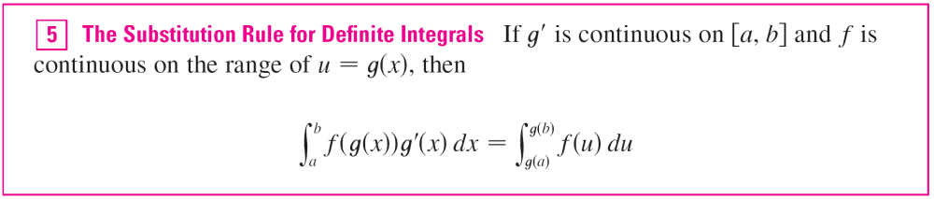
Definite Integrals

Slide 14
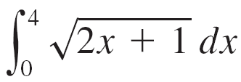

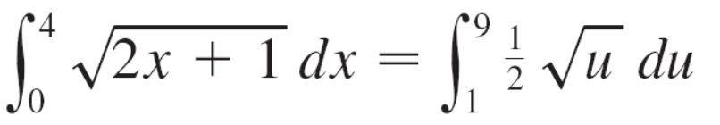
Example 6
Evaluate .
Solution:
Let u = 2x + 1. Then du = 2 dx, so dx = du.
To find the new limits of integration we note that
when x = 0, u = 2(0) + 1 = 1
and
when x = 4, u = 2(4) + 1 = 9
Therefore

Slide 15
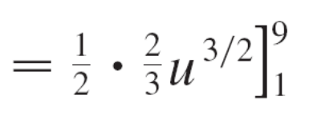
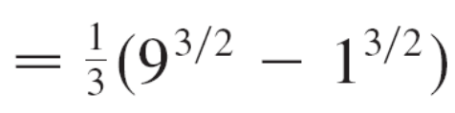
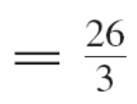

Example 6 – Solution
cont’d
Observe that when using we do not return to the variable x after integrating. We simply evaluate the expression in u between the appropriate values of u.

Slide 16
Symmetry

Slide 17
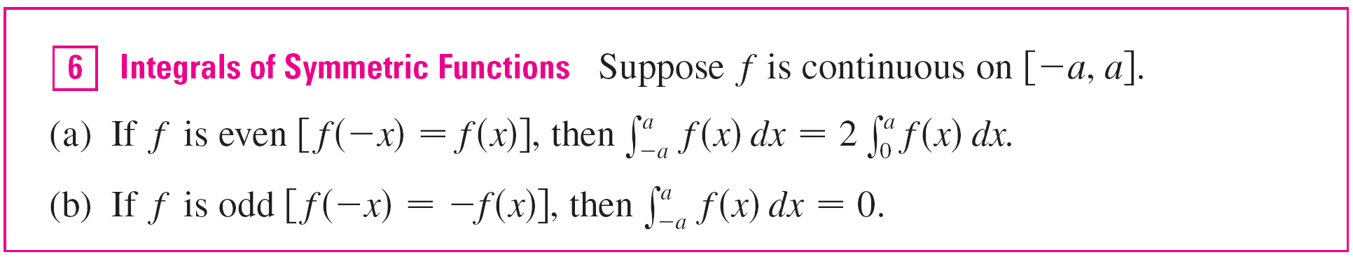
Symmetry
The following theorem uses the Substitution Rule for
Definite Integrals to simplify the calculation of integrals
of functions that possess symmetry properties.

Slide 18
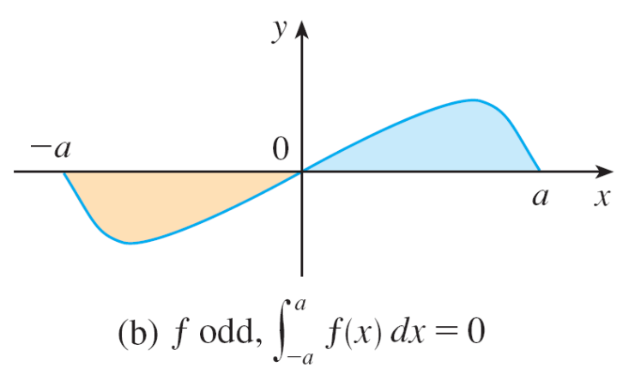
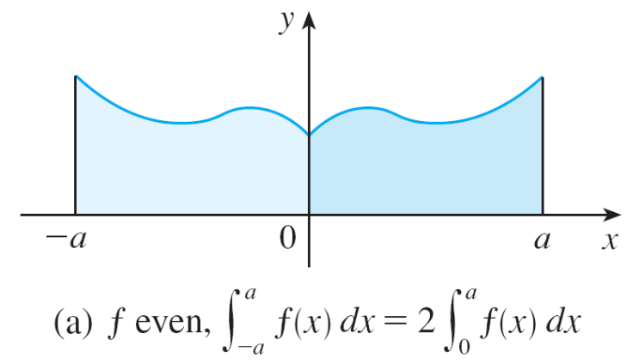
Symmetry
Theorem 6 is illustrated by Figure 2.
For the case where f is positive and even, part (a) says that the area under y = f (x) from –a to a is twice the area from 0 to a because of symmetry.
Figure 2

Slide 19

Symmetry
Recall that an integral can be expressed as the
area above the x-axis and below y = f (x) minus the area
below the axis and above the curve.
Thus part (b) says the integral is 0 because the areas cancel.

Slide 20
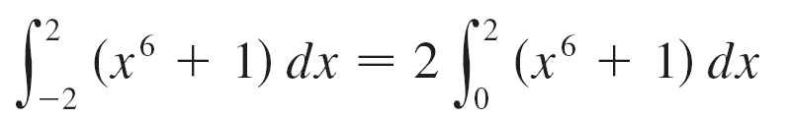
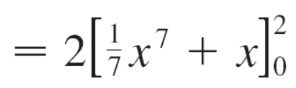
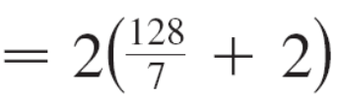
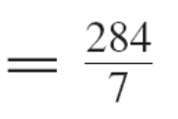
Example 8
Since f (x) = x⁶ + 1 satisfies f (–x) = f (x), it is even and so

Slide 21
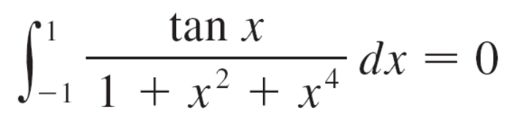
Example 9
Since f (x) = (tan x)/(1 + x² + x⁴) satisfies f (–x) = –f (x), it is odd and so

