Slide 1

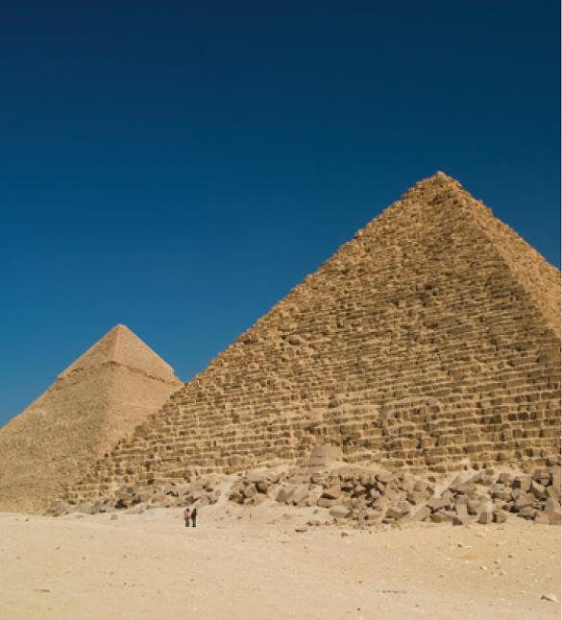
5
Applications of
Integration
Copyright © Cengage Learning. All rights reserved.

Slide 2

5.1
Areas Between Curves
Copyright © Cengage Learning. All rights reserved.

Slide 3
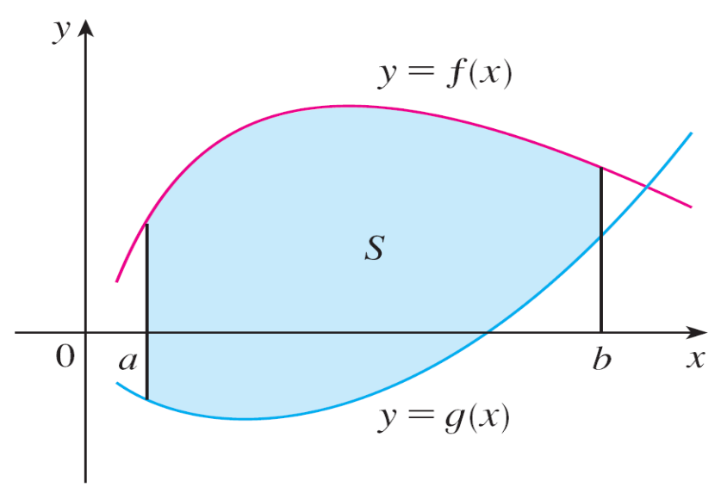
Areas Between Curves
Consider the region S that lies between two curves
y = f (x) and y = g(x) and between the vertical lines x = a and x = b, where f and g are continuous functions and
f (x) ≥ g(x) for all x in [a, b]. (See Figure 1.)
Figure 1
S = {(x, y) | a ≤ x ≤ b, g(x) ≤ y ≤ ƒ(x)}

Slide 4
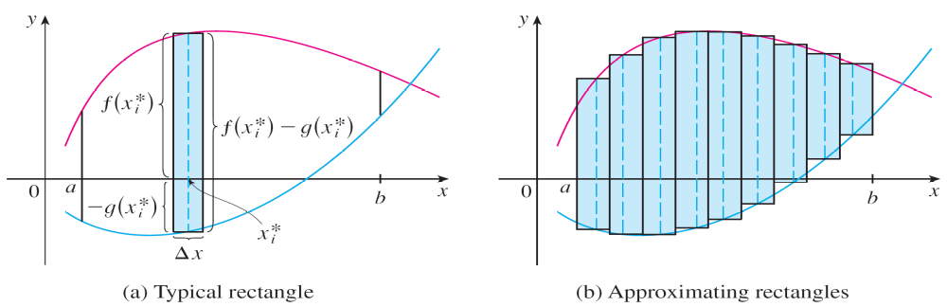
Areas Between Curves
We divide S into n strips of equal width and then we approximate the i th strip by a rectangle with base Δx and height f (x_{i}*) – g(x_{i}*). (See Figure 2. If we like, we could take all of the sample points to be right endpoints, in which
case x_{i}* = x_{i}.)
Figure 2

Slide 5
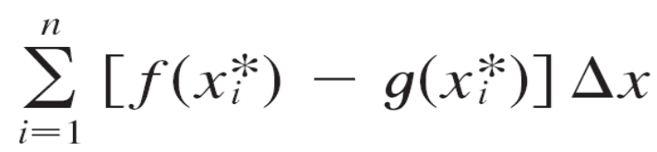

Areas Between Curves
The Riemann sum
is therefore an approximation to what we intuitively think of as the area of S.
This approximation appears to become better and better as n → . Therefore we define the area A of the region S as the limiting value of the sum of the areas of these approximating rectangles.

Slide 6
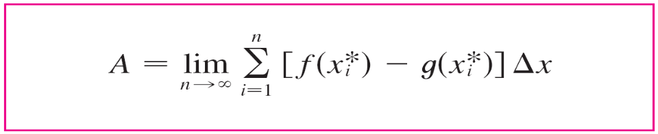

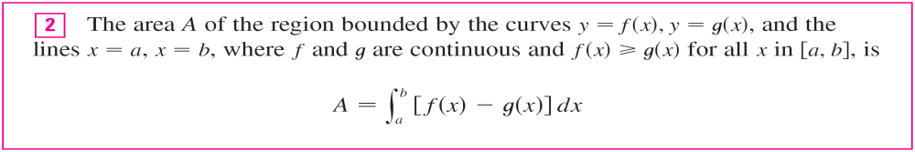
Areas Between Curves
We recognize the limit in (1) as the definite integral of f – g. Therefore we have the following formula for area.
Notice that in the special case where g(x) = 0, S is the region under the graph of f and our general definition of
area (1) reduces.

Slide 7
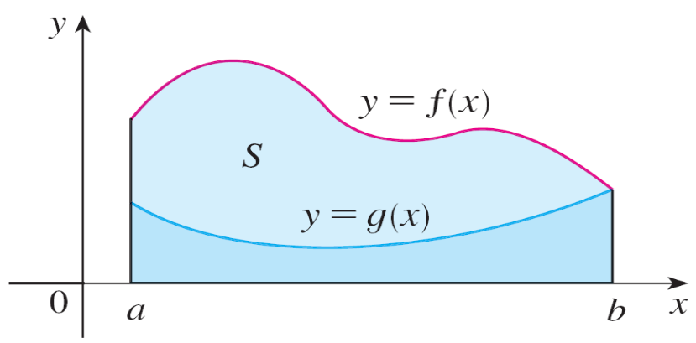

Areas Between Curves
In the case where both f and g are positive, you can see from Figure 3 why (2) is true:
A = [area under y = f (x)] – [area under y = g(x)]
Figure 3

Slide 8
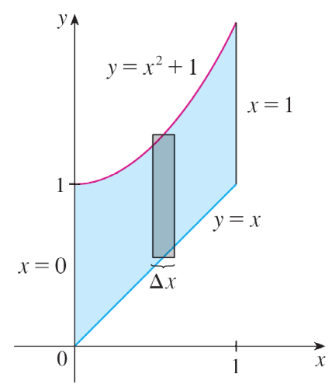
Example 1
Find the area of the region bounded above by y = x² + 1, bounded below by y = x, and bounded on the sides by x = 0 and x = 1.
Solution:
The region is shown in Figure 4. The upper boundary curve is y = x² + 1 and the lower boundary curve is y = x.
Figure 4

Slide 9
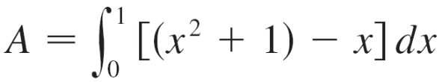
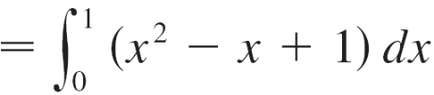
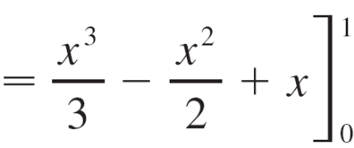
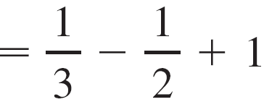
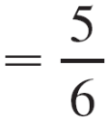
Example 1 – Solution
cont’d
So we use the area formula (2) with f (x) = x² + 1, g(x) = x, a = 0, and b = 1:

Slide 10
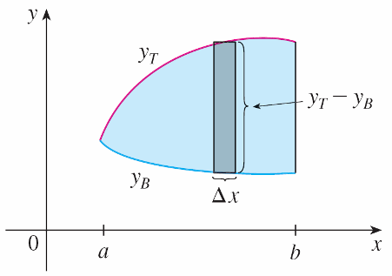
Areas Between Curves
In Figure 4 we drew a typical approximating rectangle with width Δx as a reminder of the procedure by which the area is defined in (1).
In general, when we set up an integral for an area, it’s helpful to sketch the region to identify the top curve y_{T}, the bottom curve y_{B}, and a typical approximating rectangle as in Figure 5.
Figure 4
Figure 5

Slide 11
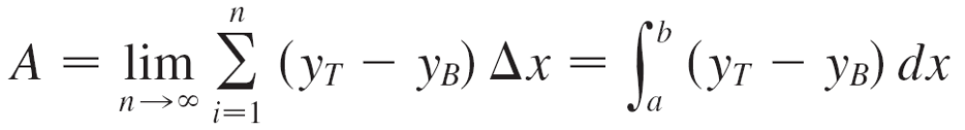
Areas Between Curves
Then the area of a typical rectangle is (y_{T} – y_{B}) Δx and the equation
summarizes the procedure of adding (in a limiting sense) the areas of all the typical rectangles.
Notice that in Figure 5 the left-hand boundary reduces to a point, whereas in Figure 3 the right-hand boundary reduces to a point.
Figure 3

Slide 12
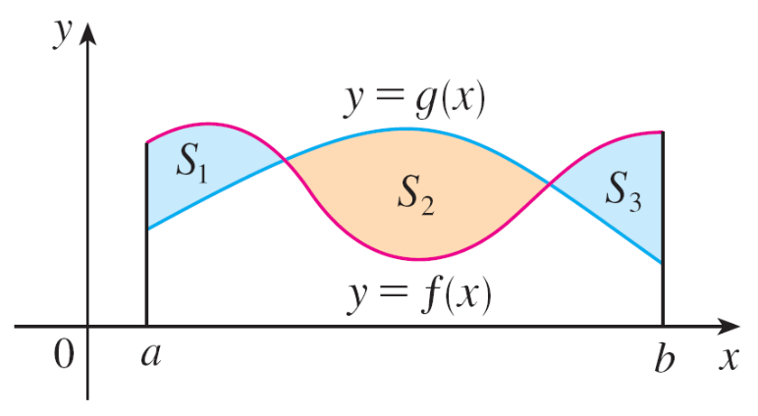

Areas Between Curves
If we are asked to find the area
between the curves y = f (x) and
y = g (x) where f (x) ≥ g (x) for
some values x of but g (x) ≥ f (x)
for other values of x, then we split
the given region S into several regions S₁, S₂ , . . . with areas A₁, A₂ , . . . as shown in Figure 9. We then define the area of the region S to be the sum of the areas of the smaller regions S₁, S₂ , . . . that is A = A₁ + A₂ + . . . Since
f (x) – g (x) when f (x) ≥ g (x)
| f (x) – g (x) | =
g (x) – f (x) when g (x) ≥ f (x)
Figure 9

Slide 13
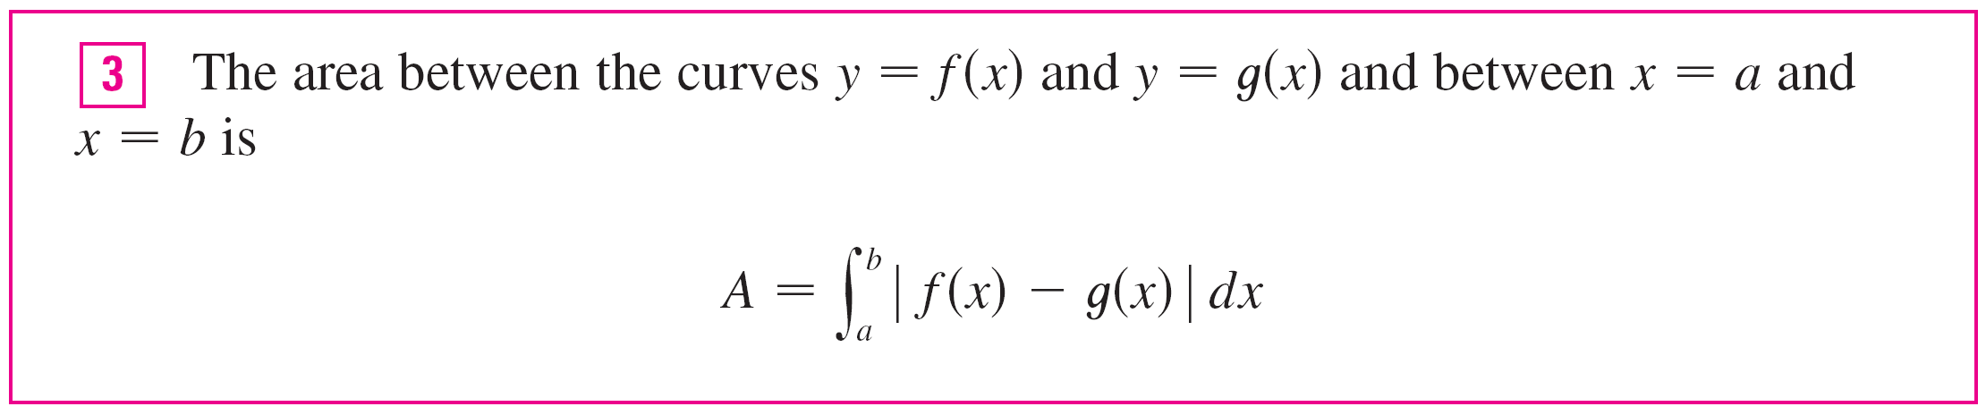
Areas Between Curves
we have the following expression for A.
When evaluating the integral in (3), however, we must still split it into integrals corresponding to A₁, A₂,……

Slide 14
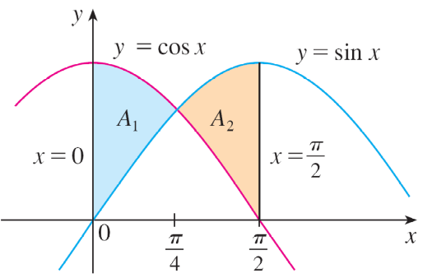
Example 5
Find the area of the region bounded by the curves y = sin x, y = cos x, x = 0, and x = π/2
Solution:
The points of intersection occur when sin x = cos x, that is, when x = π/4 (since 0 ≤ x ≤ π/2). The region is sketched in Figure 10. Observe that cos x ≥ sin x when 0 ≤ x ≤ π/4 but sin x ≥ cos x when π/4 ≤ x ≤ π/2.
Figure 10

Slide 15
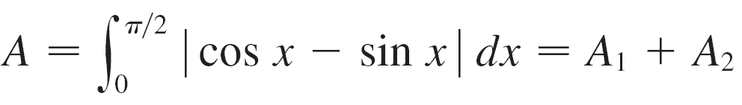
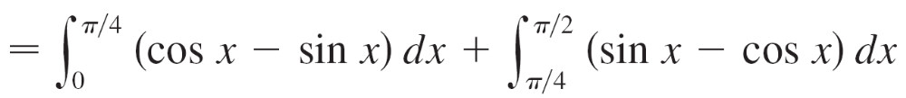
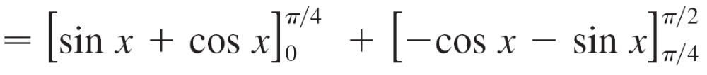
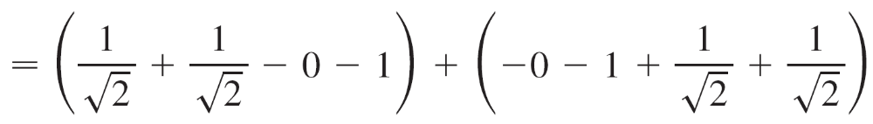

Example 5 – Solution
cont’d
Therefore the required area is

Slide 16
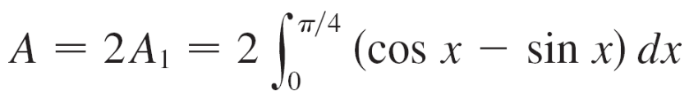
Example 5 – Solution
cont’d
In this particular example we could have saved some work by noticing that the region is symmetric about x = π/4 and so

Slide 17
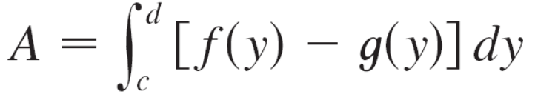
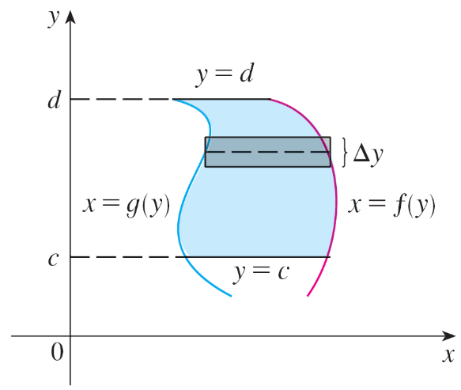
Areas Between Curves
Some regions are best treated by regarding x as a function of y. If a region is bounded by curves with equations
x = f (y), x = g (y), y = c, and y = d, where f and g are continuous and f (y) ≥ g (y) for c ≤ y ≤ d (see Figure 11), then its area is
Figure 11

Slide 18
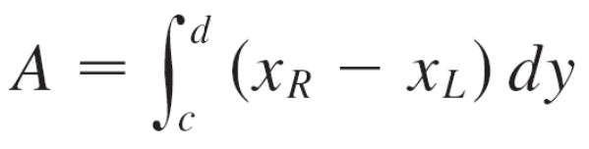
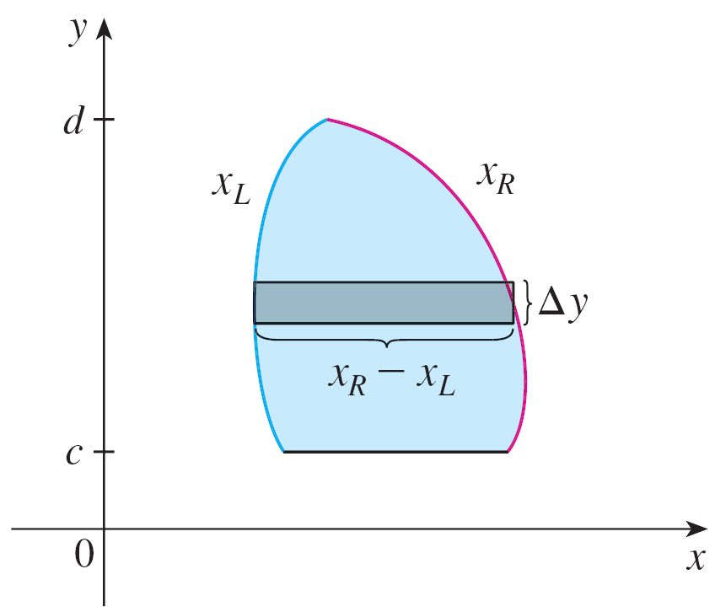
Areas Between Curves
If we write x_{R} for the right boundary and x_{L} for the left boundary, then, as Figure 12 illustrates, we have
Figure 12

