Slide 1


5
Applications of
Integration
Copyright © Cengage Learning. All rights reserved.

Slide 2

5.5
Average Value of a Function
Copyright © Cengage Learning. All rights reserved.

Slide 3
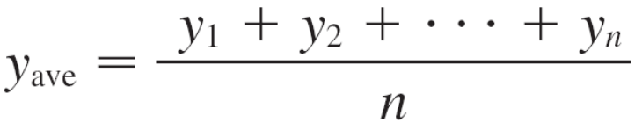
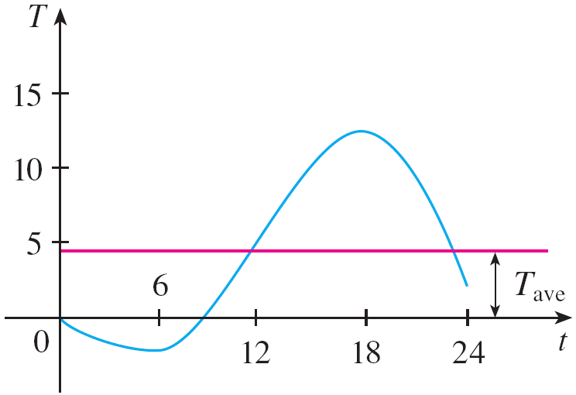
Average Value of a Function
It is easy to calculate the average value of finitely many numbers y₁, y₂, . . . , y_{n}:
But how do we compute the average temperature during a day if infinitely many temperature readings are possible?
Figure 1 shows the graph of a
temperature function T(t),
where t is measured in hours
and T in °C, and a guess at
the average temperature, T_{ave}.
Figure 1

Slide 4
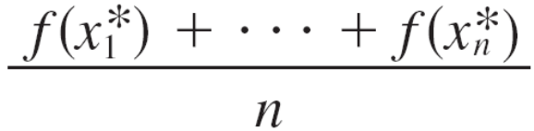
Average Value of a Function
In general, let’s try to compute the average value of a function y = f (x), a ≤ x ≤ b. We start by dividing the interval [a, b] into n equal subintervals, each with length
Δx = (b – a)/n.
Then we choose points x₁*, . . . , x_{n}* in successive subintervals and calculate the average of the numbers
f (x₁*), . . . , f (x_{n}*):
(For example, if f represents a temperature function and
n = 24, this means that we take temperature readings every hour and then average them.)

Slide 5
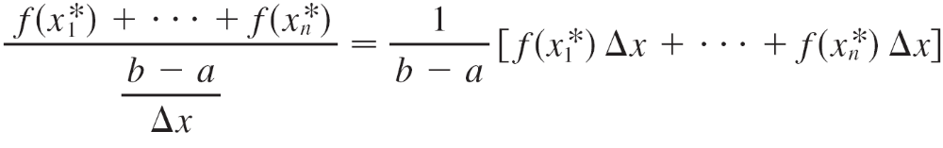
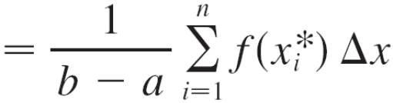
Average Value of a Function
Since Δx = (b – a)/n, we can write n = (b – a)/Δx and the average value becomes
If we let n increase, we would be computing the average value of a large number of closely spaced values.

Slide 6
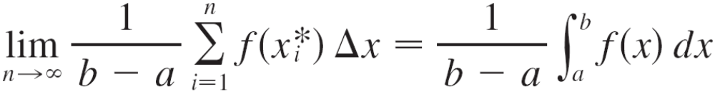
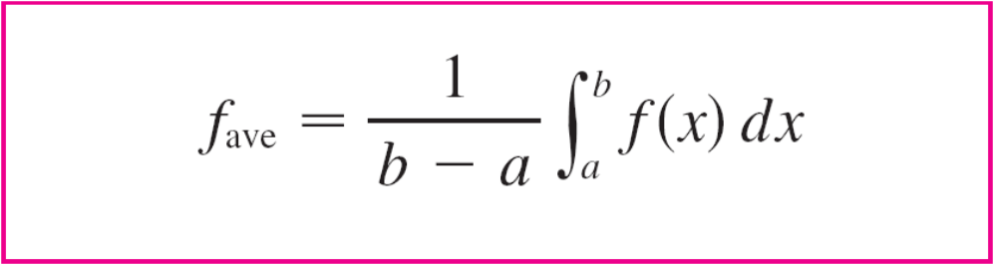
Average Value of a Function
The limiting value is
by the definition of a definite integral.
Therefore we define the average value of f on the interval [a, b] as

Slide 7
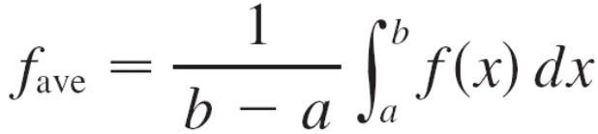
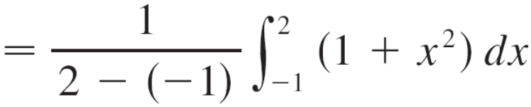
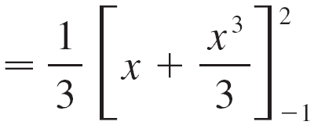

Example 1
Find the average value of the function f (x) = 1 + x² on the interval [–1, 2].
Solution:
With a = –1 and b = 2 we have

Slide 8
Average Value of a Function
If T(t) is the temperature at time t, we might wonder if there is a specific time when the temperature is the same as the average temperature.
For the temperature function
graphed in Figure 1, we see
that there are two such
times––just before noon and
just before midnight.
In general, is there a number c at which the value of a function f is exactly equal to the average value of the function, that is, f (c) = f_{ave}?
Figure 1

Slide 9
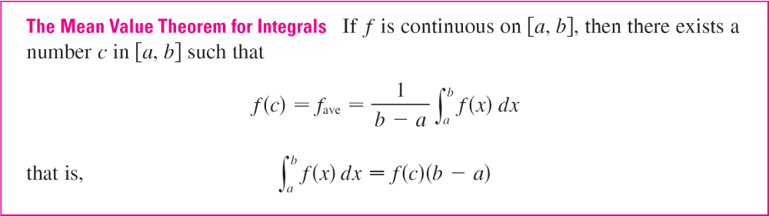
Average Value of a Function
The following theorem says that this is true for continuous functions.
The Mean Value Theorem for Integrals is a consequence of the Mean Value Theorem for derivatives and the Fundamental Theorem of Calculus.

Slide 10
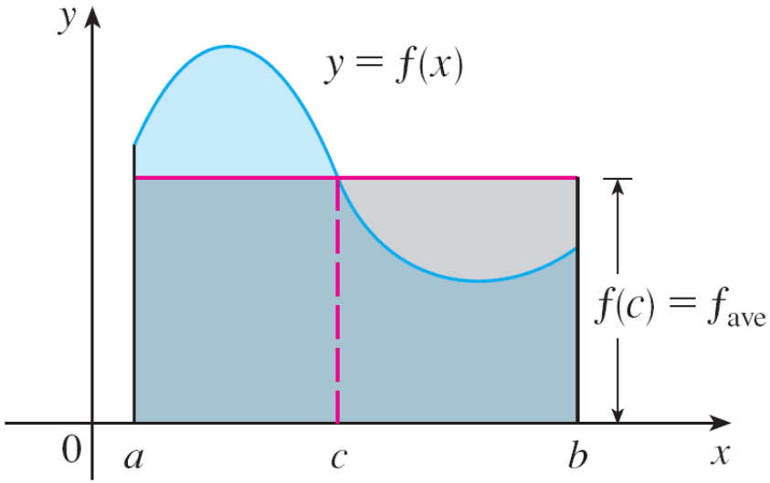
Average Value of a Function
The geometric interpretation of the Mean Value Theorem for Integrals is that, for positive functions f, there is a number c such that the rectangle with base [a, b] and height f (c) has the same area as the region under the graph of f from a to b. (See Figure 2.)
Figure 2

