Slide 1


6
Inverse Functions
Copyright © Cengage Learning. All rights reserved.

Slide 2

6.1
Inverse Functions
Copyright © Cengage Learning. All rights reserved.

Slide 3
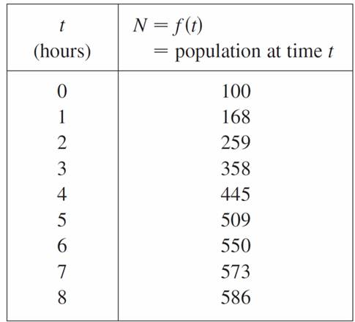
Inverse Functions
Table 1 gives data from an experiment in which a bacteria culture started with 100 bacteria in a limited nutrient medium; the size of the bacteria population was recorded at hourly intervals. The number of bacteria N is a function of the time t : N = f (t).
N as a function of t
Table 1

Slide 4
Inverse Functions
Suppose, however, that the biologist changes her point of view and becomes interested in the time required for the population to reach various levels.
In other words, she is thinking of t as a function of N.
This function is called the inverse function of f, denoted by f ^{–1}, and read “f inverse.” Thus t = f ^{–1}(N) is the time required for the population level to reach N.

Slide 5
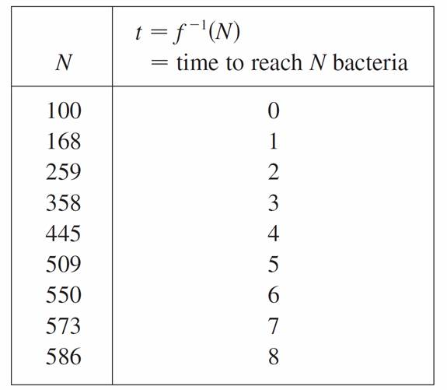
Inverse Functions
The values of f ^{–1} can be found by reading Table 1 from right to left or by consulting Table 2. For instance,
f ^{–1}(550) = 6 because f (6) = 550.
t as a function of N
Table 2

Slide 6
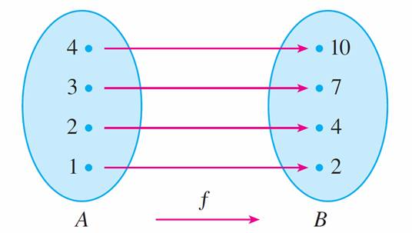
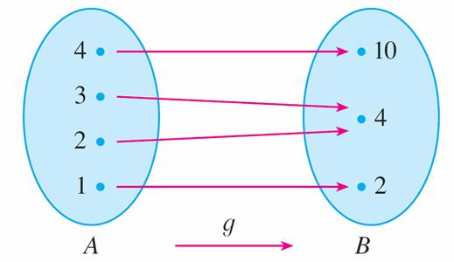
Inverse Functions
Not all functions possess inverses. Let’s compare the functions f and g whose arrow diagrams are shown in
Figure 1.
Note that f never takes on the same value twice (any two inputs in have different outputs), whereas g does take on
the same value twice (both 2 and 3 have the same
output, 4).
f is one-to-one; g is not
Figure 1

Slide 7
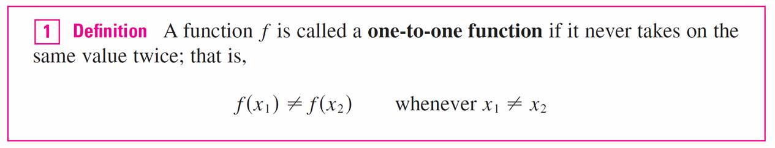
Inverse Functions
In symbols,
g(2) = g(3)
but f (x₁) ≠ f (x₂) whenever x₁ ≠ x₂
Functions that share this property with f are called
one-to-one functions.

Slide 8
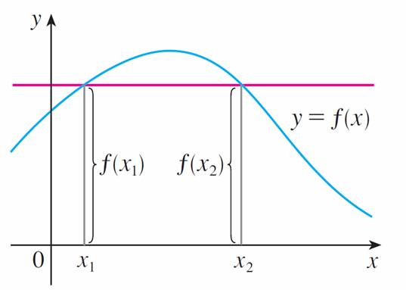
Inverse Functions
If a horizontal line intersects the graph of f in more than one point, then we see from Figure 2 that there are numbers x₁ and x₂ such that f (x₁) = f (x₂). This means that f is not
one-to-one.
This function is not one-to-one because f ( x₁) = f ( x₂).
Figure 2

Slide 9
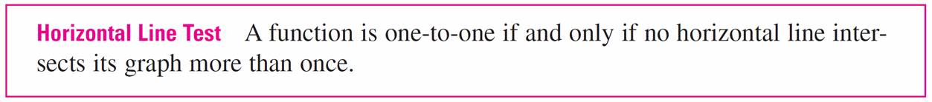
Inverse Functions
Therefore we have the following geometric method for determining whether a function is one-to-one.

Slide 10
Example 1
Is the function f (x) = x³ one-to-one?
Solution 1:
If x₁ ≠ x₂ then x₁³ ≠ x₂³ (two different numbers can’t have the same cube). Therefore, by Definition 1, f (x) = x³ is
one-to-one.

Slide 11
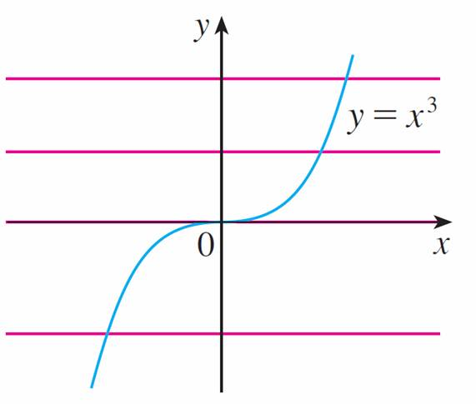
Example 1 – Solution 2
From Figure 3 we see that no horizontal line intersects the graph of f (x) = x³ more than once. Therefore, by the Horizontal Line Test, f is one-to-one.
f( x) = x³ is one-to-one.
Figure 3

Slide 12
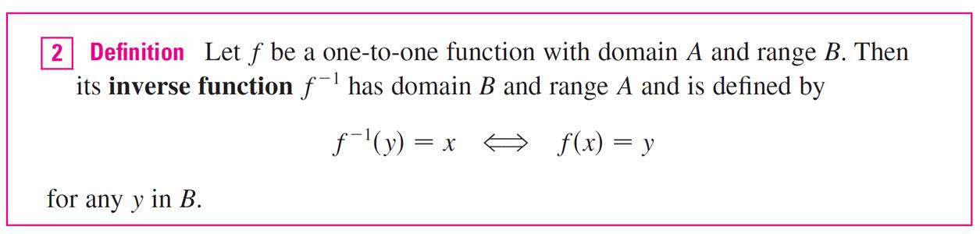
Inverse Functions
One-to-one functions are important because they are precisely the functions that possess inverse functions according to the following definition.
This definition says that if f maps x into y, then f ^{–1} maps y back into x. (If were not one-to-one, then f ^{–1} would not be uniquely defined.)

Slide 13
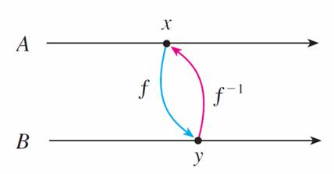
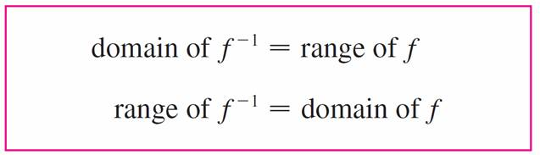
Inverse Functions
The arrow diagram in Figure 5 indicates that f ^{–1} reverses the effect of f.
Note that
Figure 5

Slide 14
Inverse Functions
For example, the inverse function of f (x) = x³ is f ^{–1}(x) = x^{1/3} because if y = x³, then
f ^{–1}(y) = f ^{–1}(x³) = (x³)^{1/3} = x
The reciprocal 1/f (x) could, however, be written as [f (x)] ^{–1}.

Slide 15
Example 3
If f (1) = 5, f (3) = 7, and f (8) = –10, find f ^{–1}(7), f ^{–1}(5), and
f ^{–1}(–10 ).
Solution:
From the definition of f ^{–1} we have
f ^{–1}(7) = 3 because f (3) = 7
f ^{–1}(5) = 1 because f (1) = 5
f ^{–1}(–10 ) = 8 because f (8) = –10

Slide 16
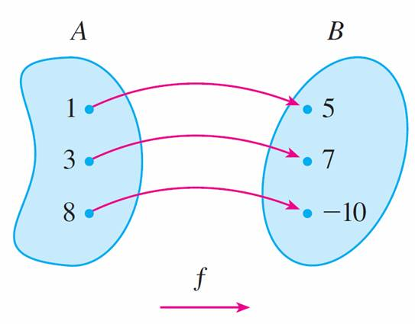
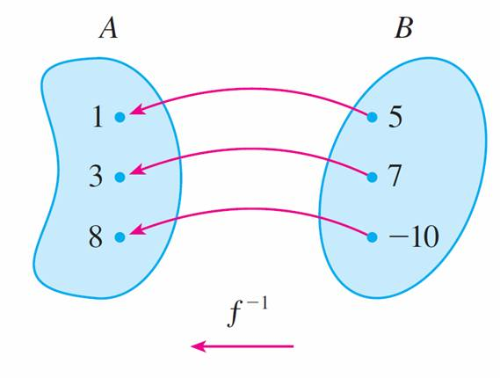
Example 3 – Solution
cont’d
The diagram in Figure 6 makes it clear how f ^{–1} reverses the effect of f in this case.
The inverse function reverses inputs and outputs.
Figure 6

Slide 17


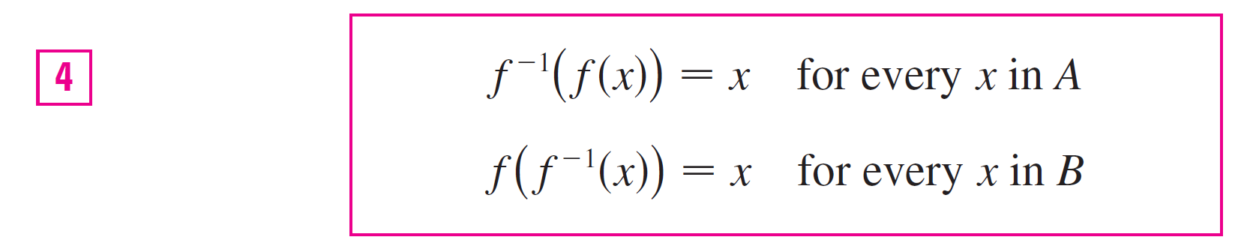
Inverse Functions
The letter x is traditionally used as the independent variable, so when we concentrate on f ^{–1} rather than on f, we usually reverse the roles of x and y in Definition 2 and write
By substituting for y in Definition 2 and substituting for x in
, we get the following cancellation equations:

Slide 18
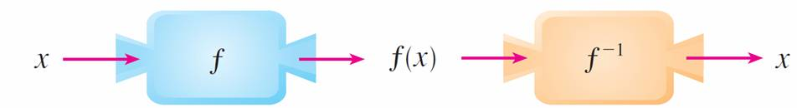
Inverse Functions
The first cancellation equation says that if we start with x, apply f, and then apply f ^{–1}, we arrive back at x, where we started (see the machine diagram in Figure 7).
Thus f ^{–1} undoes what f does. The second equation says that f undoes what f ^{–1} does.
Figure 7

Slide 19
Inverse Functions
For example, if f ( x) = x³, then f ^{–1}( x) = x^{1/3} and so the cancellation equations become
f ^{–1}( f (x)) = (x³)^{1/3} = x
f (f ^{–1}(x)) = (x^{1/3})³ = x
These equations simply say that the cube function and the cube root function cancel each other when applied in succession.

Slide 20
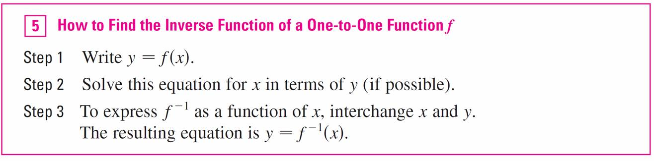
Inverse Functions
Now let’s see how to compute inverse functions. If we have a function y = f (x) and are able to solve this equation for x in terms of y, then according to Definition 2 we must have x = f ^{–1}(y).
If we want to call the independent variable x, we then interchange x and y and arrive at the equation y = f ^{–1}(x).

Slide 21


Example 4
Find the inverse function of f (x) = x³ + 2.
Solution:
According to we first write
y = x³ + 2
Then we solve this equation for x:
x³ = y – 2
x =

Slide 22

Example 4 – Solution
cont’d
Finally, we interchange x and y:
y =
Therefore the inverse function is f ^{–1}(x) =

Slide 23
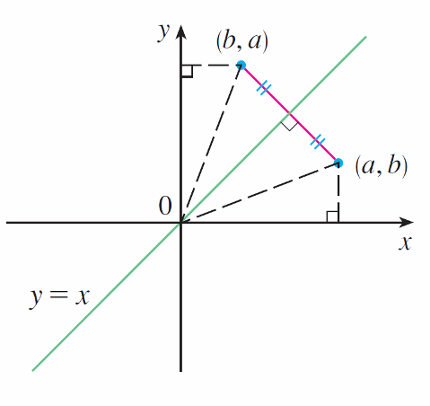
Inverse Functions
The principle of interchanging x and y to find the inverse function also gives us the method for obtaining the graph of f ^{–1} from the graph of f.
Since f (a) = b if and only if f ^{–1}(b) = a, the point (a, b) is on the graph of f if and only if the point (b, a) is on the graph
of f ^{–1}.
But we get the point (b, a) from (a, b)
by reflecting about the line y = x.
(See Figure 8.)
Figure 8

Slide 24
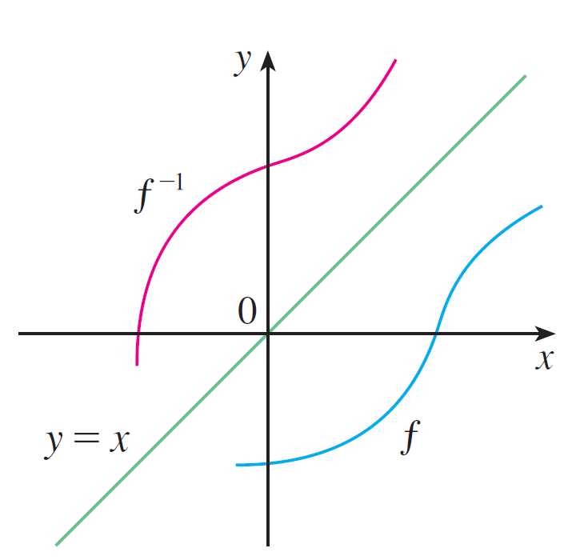
Inverse Functions
Therefore, as illustrated by Figure 9:
Figure 9

Slide 25
The Calculus of Inverse Functions

Slide 26
The Calculus of Inverse Functions
Now let’s look at inverse functions from the point of view of calculus. Suppose that f is both one-to-one and continuous. We think of a continuous function as one whose graph has no break in it. (It consists of just one piece.)
Since the graph of f ^{–1} is obtained from the graph of f by reflecting about the line y = x, the graph of f ^{–1} has no break in it. Thus we might expect that f ^{–1} is also a continuous function.

Slide 27
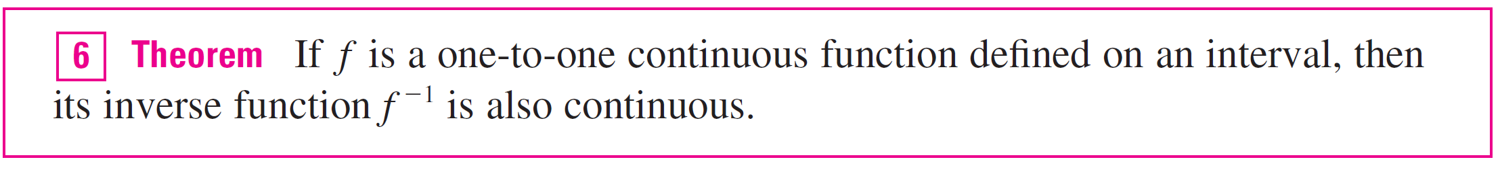
The Calculus of Inverse Functions
This geometrical argument does not prove the following theorem but at least it makes the theorem plausible.
Now suppose that f is a one-to-one differentiable function. Geometrically we can think of a differentiable function as one whose graph has no corner or kink in it.

Slide 28
The Calculus of Inverse Functions
We get the graph of f ^{–1} by reflecting the graph of f about the line y = x, so the graph of f ^{–1} has no corner or kink in it either.
We therefore expect that f ^{–1} is also differentiable (except where its tangents are vertical). In fact, we can predict the value of the derivative of f ^{–1} at a given point by a geometric argument.

Slide 29
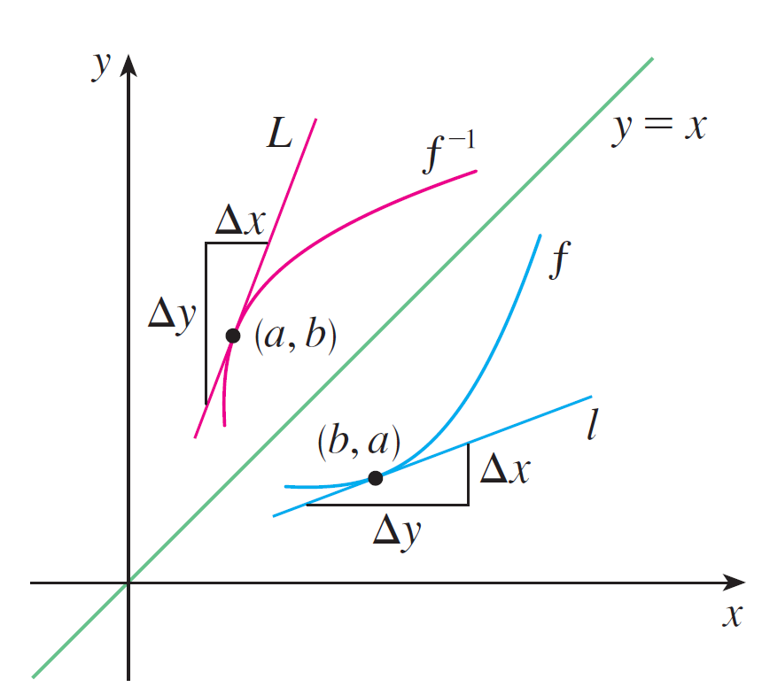
The Calculus of Inverse Functions
In Figure 11 the graphs of f and its inverse f ^{–1} are shown.
If f (b) = a, then f ^{–1}( a) = b and (f ^{–1})′( a) is the slope of the tangent line L to the graph of f ^{–1} at (a, b), which is Δy/Δx.
Reflecting in the line y = x has the effect of interchanging the x- and y-coordinates.
Figure 11

Slide 30
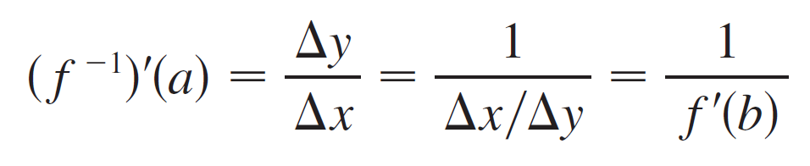
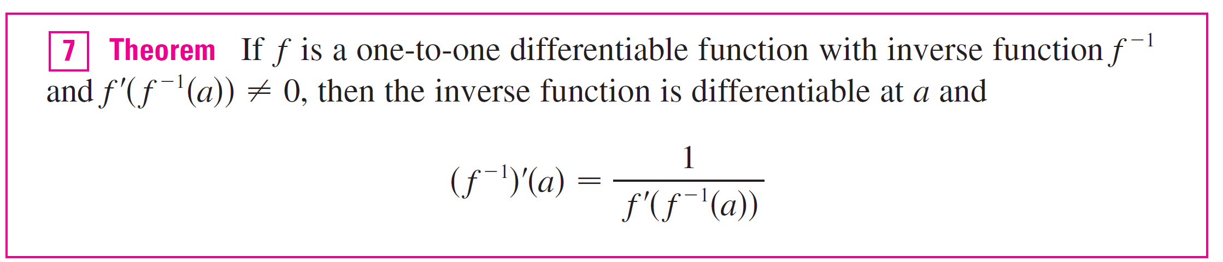
The Calculus of Inverse Functions
So the slope of the reflected line [the tangent to the graph of f at (b, a) is Δx/Δy. Thus the slope of L is the reciprocal of the slope of l, that is,

Slide 31
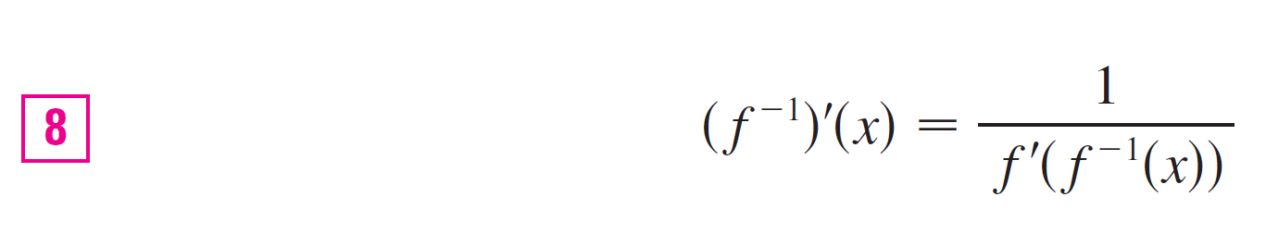
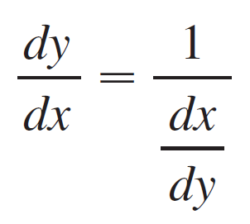
The Calculus of Inverse Functions
Note 1:
Replacing a by the general number x in the formula of Theorem 7, we get
If we write y = f ^{–1}( x), then f (y) = x, so Equation 8, when expressed in Leibniz notation, becomes

Slide 32
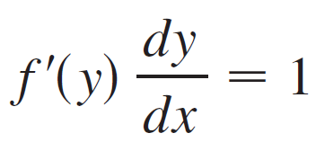
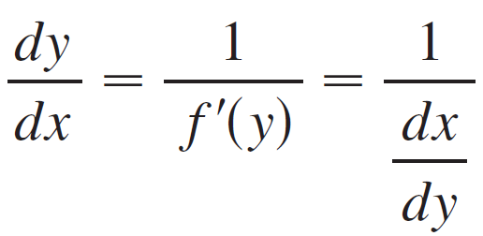
The Calculus of Inverse Functions
Note 2:
If it is known in advance that f ^{–1} is differentiable, then its derivative can be computed more easily than in the proof of Theorem 7 by using implicit differentiation. If y = f ^{–1}( x) ,
then f (y) = x. Differentiating the equation f (y) = x implicitly with respect to x, remembering that y is a function of x, and using the Chain Rule, we get
Therefore

Slide 33

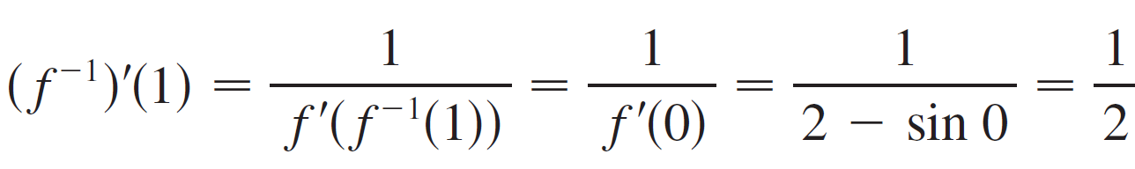
Example 7
If f (x) = 2x + cos x, find (f ^{–1}) ′(1).
Solution:
Notice that f is one-to-one because
f ′(x) = 2 – sin x > 0
and so f is increasing. To use Theorem 7 we need to know f ^{–1}(1) and we can find it by inspection:
F(0) = 1 f ^{–1}(1) = 0
Therefore

