Slide 1


6
Inverse Functions
Copyright © Cengage Learning. All rights reserved.

Slide 2

Exponential Functions and Their Derivatives
6.2
Copyright © Cengage Learning. All rights reserved.

Slide 3
Exponential Functions and Their Derivatives
The function f (x) = 2^{x} is called an exponential function because the variable, x, is the exponent. It should not be confused with the power function g (x) = x², in which the variable is the base.
In general, an exponential function is a function of the form
f (x) = a^{x}
where a is a positive constant.

Slide 4

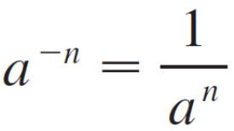
Exponential Functions and Their Derivatives
If x = n, a positive integer, then
a^{n} = a  a  . . .  a
If x = 0 , then a⁰ = 1, and if x = –n, where n is a positive integer, then

Slide 5


Exponential Functions and Their Derivatives
If x is a rational number, x = p/q, where p and q are integers and q > 0, then
But what is the meaning of a^{x} if x is an irrational number? For instance, what is meant by or 5^{π} ?
To help us answer this question we first look at the graph of the function y = 2^{x}, where x is rational.

Slide 6
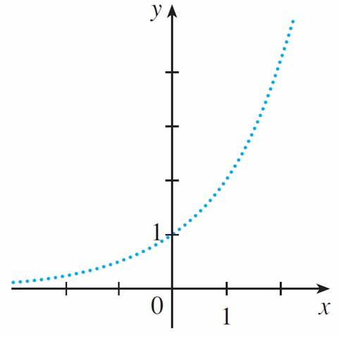
Exponential Functions and Their Derivatives
A representation of this graph is shown in Figure 1.
Representation of y = 2^{x}, x rational
Figure 1

Slide 7



Exponential Functions and Their Derivatives
We want to enlarge the domain of y = 2^{x} to include both rational and irrational numbers.
There are holes in the graph in Figure 1 corresponding to irrational values of x. We want to fill in the holes by defining
f (x) = 2^{x}, where x ∈ so that f is an increasing continuous function.
In particular, since the irrational number satisfies
1.7 < < 1.8

Slide 8

Exponential Functions and Their Derivatives
We must have
2^{1.7} < < 2^{1.8}
and we know what 2^{1.7} and 2^{1.8} mean because 1.7 and 1.8 are rational numbers.
Similarly, if we use better approximations for , we obtain
better approximations for :

Slide 9
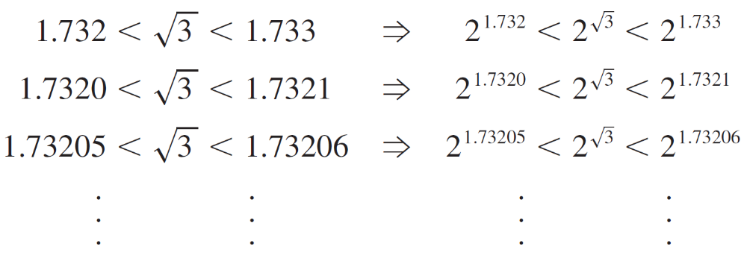
Exponential Functions and Their Derivatives

Slide 10
Exponential Functions and Their Derivatives
It can be shown that there is exactly one number that is greater than all of the numbers
2^{1.7}, 2^{1.73}, 2^{1.732}, 2^{1.7320}, 2^{1.73205}, . . .
and less than all of the numbers
2^{1.8}, 2^{1.74}, 2^{1.733}, 2^{1.7321}, 2^{1.73206}, . . .

Slide 11

Exponential Functions and Their Derivatives
We define to be this number. Using the preceding approximation process we can compute it correct to six decimal places:
≈ 3.321997
Similarly, we can define 2^{x} (or a^{x}, if a > 0 ) where x is any irrational number.

Slide 12

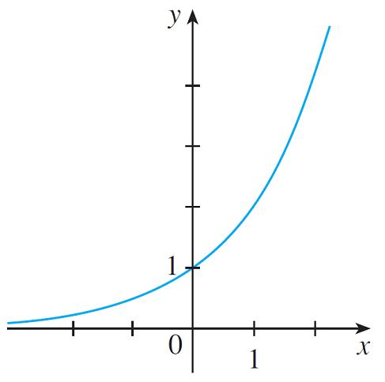
Exponential Functions and Their Derivatives
Figure 2 shows how all the holes in Figure 1 have been filled to complete the graph of the function f (x) = 2^{x}, x ∈ .
y = 2^{x}, x real
Figure 2

Slide 13
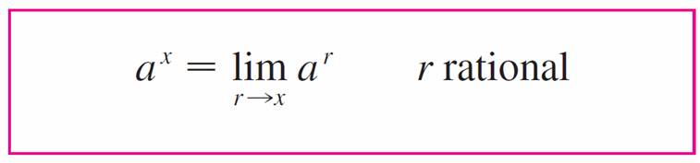

Exponential Functions and Their Derivatives
In general, if a is any positive number, we define
This definition makes sense because any irrational number can be approximated as closely as we like by a rational number.

Slide 14


Exponential Functions and Their Derivatives
For instance, because has the decimal representation
= 1.7320508 . . . , Definition 1 says that is the limit of the sequence of numbers
2^{1.7}, 2^{1.73}, 2^{1.732}, 2^{1.7320}, 2^{1.73205}, 2^{1.732050}, 2^{1.7320508}, . . .
Similarly, 5^{π} is the limit of the sequence of numbers
5^{3.1}, 5^{3.14}, 5^{3.141}, 5^{3.1415}, 5^{3.14159}, 5^{3.141592}, 5^{3.1415926}, . . .
It can be shown that Definition 1 uniquely specifies a^{x} and makes the function f (x) = a^{x} continuous.

Slide 15
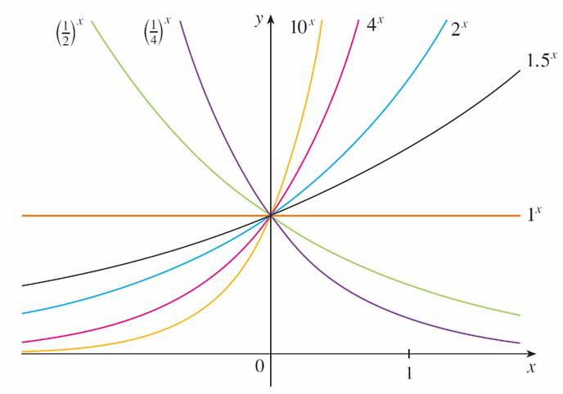
Exponential Functions and Their Derivatives
The graphs of members of the family of functions y = a^{x} are shown in Figure 3 for various values of the base a.
Member of the family of exponential functions
Figure 3

Slide 16
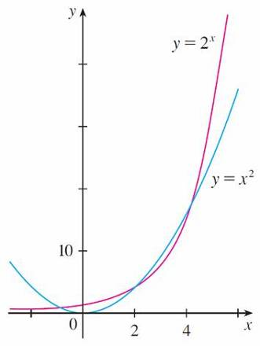
Exponential Functions and Their Derivatives
Notice that all of these graphs pass through the same point (0, 1) because a⁰ = 1 for a ≠ 0. Notice also that as the base a gets larger, the exponential function grows more rapidly (for x > 0).
Figure 4 shows how the exponential function y = 2^{x} compares with the power function y = x².
Member of the family of exponential functions
Figure 4

Slide 17
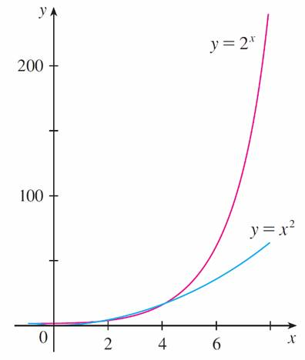
Exponential Functions and Their Derivatives
The graphs intersect three times, but ultimately the exponential curve y = 2^{x} grows far more rapidly than the parabola y = x². (See also Figure 5.)
Member of the family of exponential functions
Figure 5

Slide 18
Exponential Functions and Their Derivatives
There are basically three kinds of exponential functions y = a^{x}.
If 0 < a < 1, the exponential function decreases; if a = 1, it is a constant; and if a > 1, it increases.

Slide 19
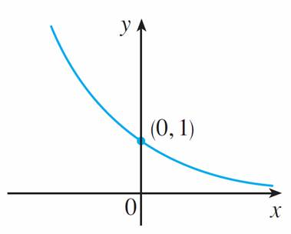
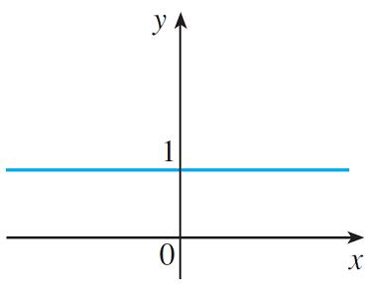
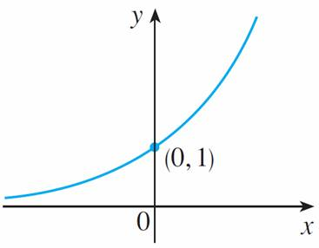
Exponential Functions and Their Derivatives
These three cases are illustrated in Figure 6.
Because (1/a)^{x} = 1/a^{x} = a^{–x}, the graph of y = (1/a)^{x} is just the reflection of the graph of y = a^{x} about the y-axis.
y = a^{x}, 0 < a < 1
y = 1^{x}
y = a^{x}, a > 1
Figure 6(a)
Figure 6(b)
Figure 6(c)

Slide 20
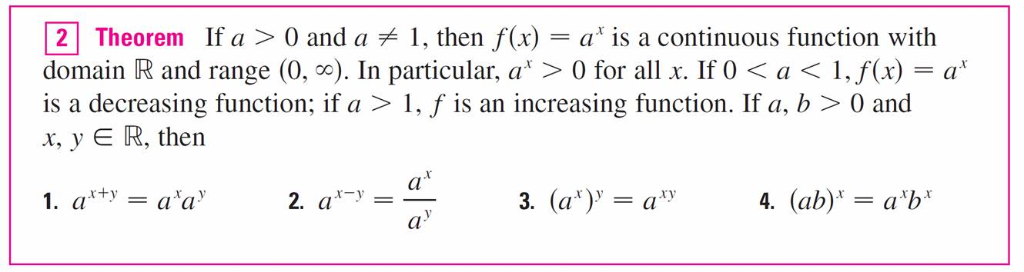
Exponential Functions and Their Derivatives
The properties of the exponential function are summarized in the following theorem.

Slide 21
Exponential Functions and Their Derivatives
The reason for the importance of the exponential function lies in properties 1–4, which are called the Laws of Exponents.
If x and y are rational numbers, then these laws are well known from elementary algebra.
For arbitrary real numbers x and y these laws can be deduced from the special case where the exponents are rational by using Equation 1.

Slide 22
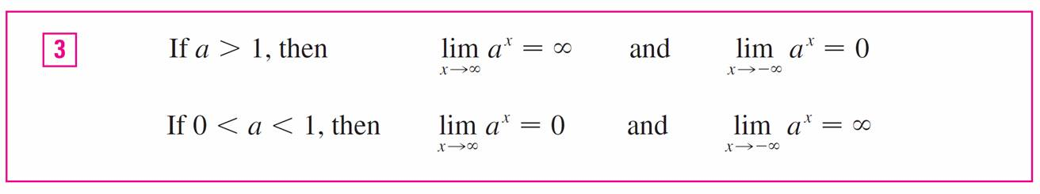
Exponential Functions and Their Derivatives
The following limits can be proved from the definition of a limit at infinity.
In particular, if a ≠ 1, then the x-axis is a horizontal asymptote of the graph of the exponential function y = a^{x}.

Slide 23

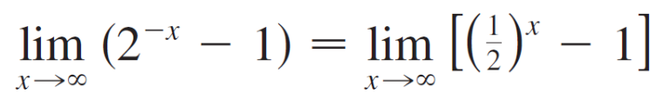

Example 1
Find .
(b) Sketch the graph of the function y = 2^{–x} – 1.
Solution:
(a)
= 0 – 1
= –1

Slide 24
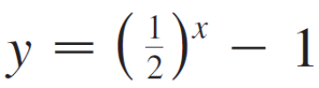
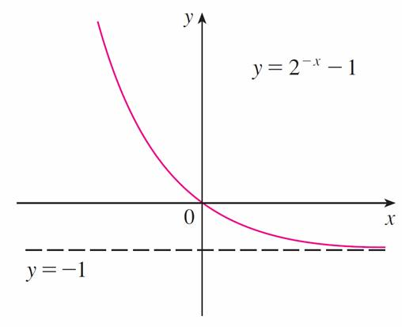
Example 1 – Solution
cont’d
(b) We write as in part (a). The graph of
is shown in Figure 3, so we shift it down one unit to
obtain the graph of shown in Figure 7.
Part (a) shows that the line y = –1 is a horizontal
asymptote.
Member of the family of exponential functions
Figure 3
Figure 7

Slide 25
Applications of
Exponential Functions

Slide 26
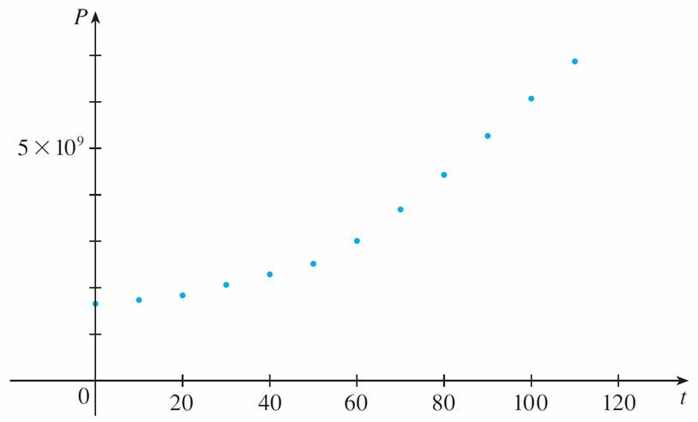
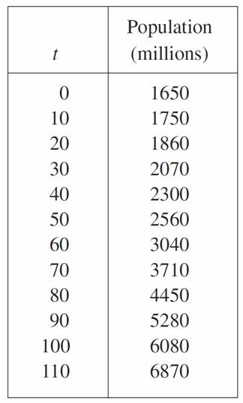
Applications of Exponential Functions
Table 1 shows data for the population of the world in the 20th century, where t = 0 corresponds to 1900. Figure 8 shows the corresponding scatter plot.
Scatter plot for world population growth
Figure 8
Table 1

Slide 27
Applications of Exponential Functions
The pattern of the data points in Figure 8 suggests exponential growth, so we use a graphing calculator with exponential regression capability to apply the method of least squares and obtain the exponential model
P = (1436.53)  (1.01395)^{t}

Slide 28
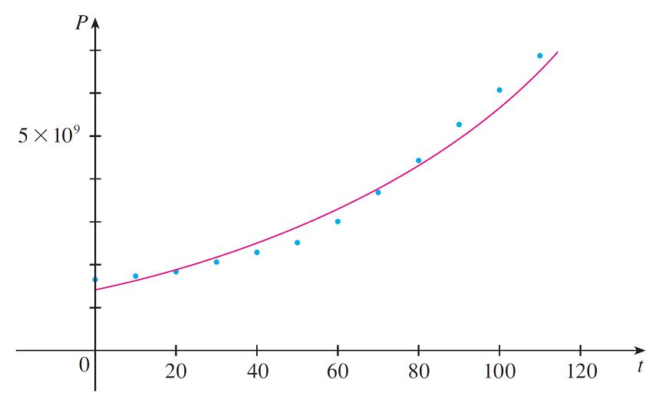
Applications of Exponential Functions
Figure 9 shows the graph of this exponential function together with the original data points.
Exponential model for population growth
Figure 9

Slide 29
Applications of Exponential Functions
We see that the exponential curve fits the data reasonably well.
The period of relatively slow population growth is explained by the two world wars and the Great Depression of the 1930s.

Slide 30
Derivatives of
Exponential Functions

Slide 31
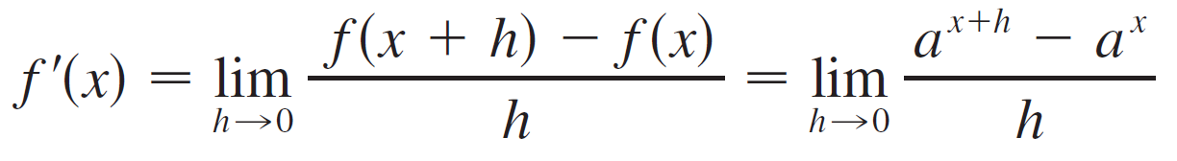
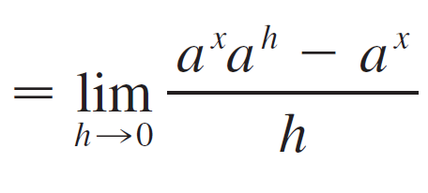
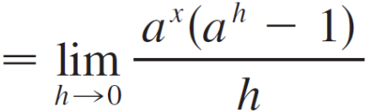
Derivatives of Exponential Functions
Let’s try to compute the derivative of the exponential function f (x) = a^{x} using the definition of a derivative:

Slide 32
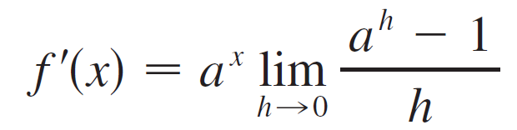
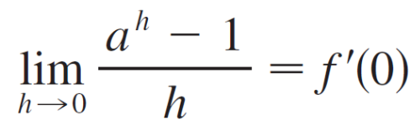
Derivatives of Exponential Functions
The factor a^{x} doesn’t depend on h, so we can take it in front of the limit:
Notice that the limit is the value of the derivative of f at 0, that is,

Slide 33

Derivatives of Exponential Functions
Therefore we have shown that if the exponential function
f (x) = a^{x} is differentiable at 0, then it is differentiable everywhere and
f ′(x) = f ′(0)a^{x}
This equation says that the rate of change of any exponential function is proportional to the function itself. (The slope is proportional to the height.)

Slide 34
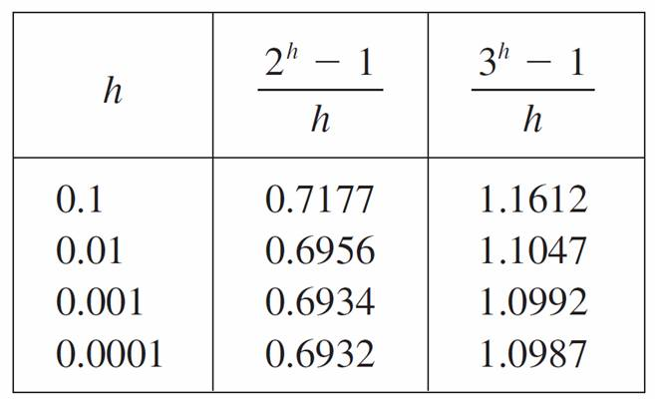
Derivatives of Exponential Functions
Numerical evidence for the existence of f ′(0) is given in the table below for the cases a = 2 and a = 3. (Values are stated correct to four decimal places.)

Slide 35
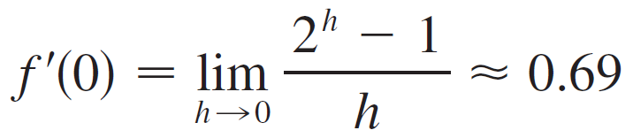
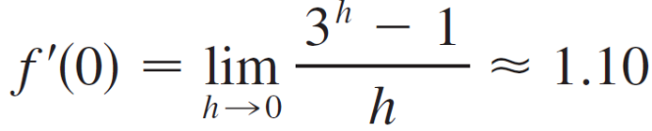
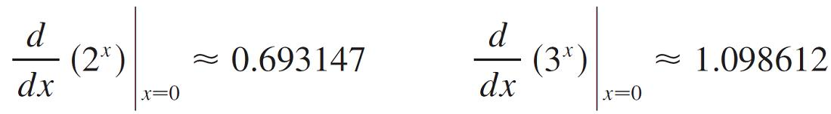

Derivatives of Exponential Functions
It appears that the limits exist and
for a = 2,
for a = 3,
In fact, it can be proved that these limits exist and, correct to six decimal places, the values are

Slide 36

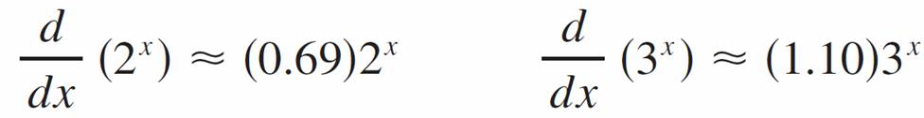
Derivatives of Exponential Functions
Thus, from Equation 4, we have
Of all possible choices for the base a in Equation 4, the simplest differentiation formula occurs when f ′(0) = 1.

Slide 37

Derivatives of Exponential Functions
In view of the estimates of f ′ (0) for a = 2 and a = 3, it seems reasonable that there is a number a between 2 and 3 for which f ′(0) = 1. It is traditional to denote this value by the letter e.
Thus we have the following definition.

Slide 38
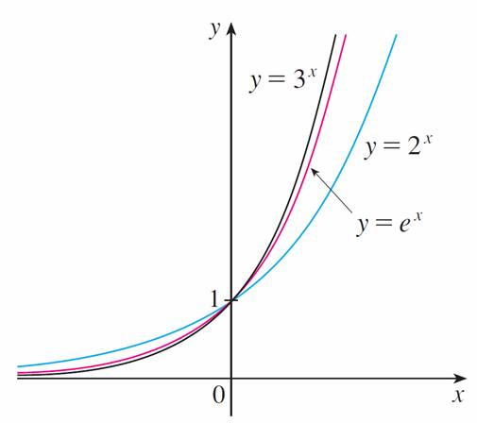
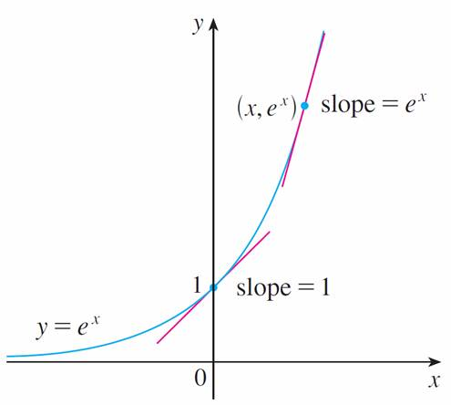
Derivatives of Exponential Functions
Geometrically this means that of all the possible exponential functions y = a^{x}, the function f (x) = e^{x} is the one whose tangent line at (0, 1) has a slope f ′ (0) that is exactly 1. (See Figures 10 and 11.)
Figure 10
Figure 11

Slide 39
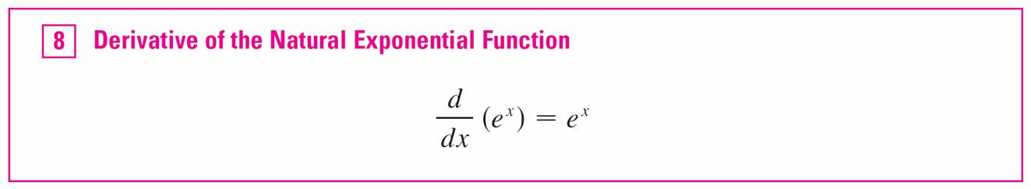
Derivatives of Exponential Functions
We call the function f (x) = e^{x} the natural exponential function.
If we put a = e and, therefore, f ′ (0) = 1 in Equation 4, it becomes the following important differentiation formula.

Slide 40

Derivatives of Exponential Functions
Thus the exponential function f (x) = e^{x} has the property that it is its own derivative.
The geometrical significance of this fact is that the slope of a tangent line to the curve y = e^{x} at any point is equal to the y-coordinate of the point (see Figure 11).
Figure 11

Slide 41
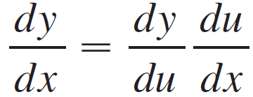
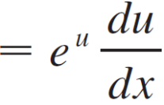

Example 2
Differentiate the function y = e^{tan x}.
Solution:
To use the Chain Rule, we let u = tan x. Then we have y = e^{u}, so

Slide 42

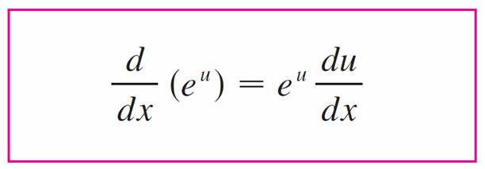

Derivatives of Exponential Functions
In general if we combine Formula 8 with the Chain Rule, as in Example 2, we get

Slide 43
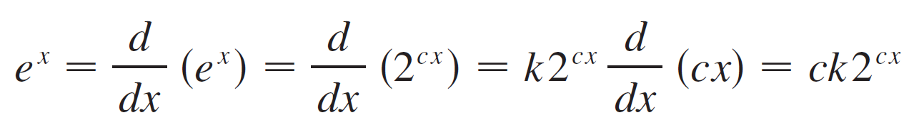
Derivatives of Exponential Functions
We have seen that e is a number that lies somewhere between 2 and 3, but we can use Equation 4 to estimate the numerical value of e more accurately. Let e = 2^{c}. Then e^{x} = 2^{cx}.
If f (x) = 2^{x}, then from Equation 4 we have f ′ (x) = k2^{x}, where the value of k is f ′(0) ≈ 0.693147.
Thus, by the Chain Rule,

Slide 44
Derivatives of Exponential Functions
Putting x = 0, we have 1 = ck , so c = 1/k and
e = 2^{1/k} ≈ 2^{1/0.693147} ≈ 2.71828
It can be shown that the approximate value to 20 decimal places is
e ≈ 2.71828182845904523536
The decimal expansion of e is nonrepeating because e is an irrational number.

Slide 45
Exponential Graphs

Slide 46
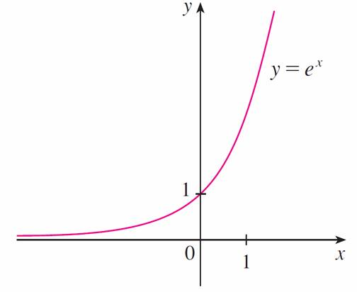
Exponential Graphs
The exponential function f (x) = e^{x} is one of the most frequently occurring functions in calculus and its applications, so it is important to be familiar with its graph (Figure 12) and properties.
The natural exponential function
Figure 12

Slide 47
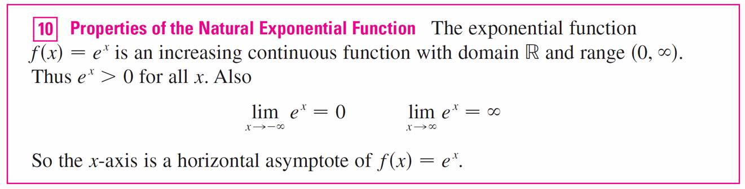
Exponential Graphs
We summarize these properties as follows, using the fact that this function is just a special case of the exponential functions considered in Theorem 2 but with base a = e > 1.

Slide 48
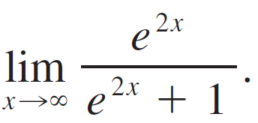
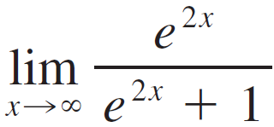
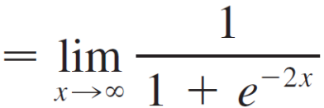
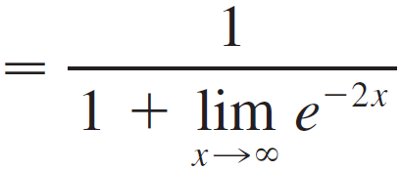
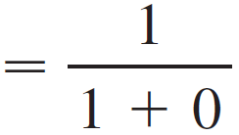
Example 6
Find
Solution:
We divide numerator and denominator by e^{2x}:
= 1

Slide 49


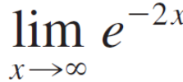
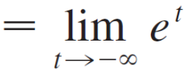
Example 6 – Solution
cont’d
We have used the fact that as and so
= 0

Slide 50
Integration

Slide 51
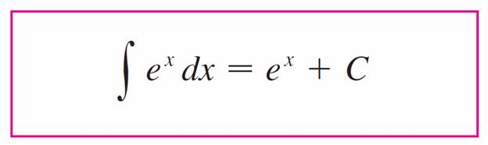

Integration
Because the exponential function y = e^{x} has a simple derivative, its integral is also simple:

Slide 52
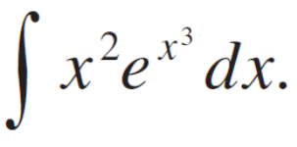

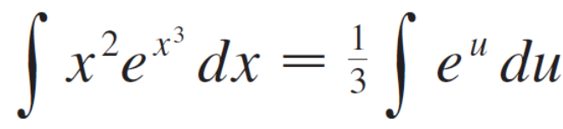


Example 8
Evaluate
Solution:
We substitute u = x³. Then du = 3x² dx , so x² dx = du and

