Slide 1


6
Inverse Functions
Copyright © Cengage Learning. All rights reserved.

Slide 2

6.3
Logarithmic Functions
Copyright © Cengage Learning. All rights reserved.

Slide 3



Logarithmic Functions
If a > 0 and a ≠ 1, the exponential function f (x) = a^{x} is either increasing or decreasing and so it is one-to-one. It therefore has an inverse function f ^{–1}, which is called the logarithmic function with base a and is denoted by log_{a}. If we use the formulation of an inverse function,
f ^{–1} (x) = y f (y) = x
then we have
Thus, if x > 0, then log_{a}x is the exponent to which the base a must be raised to give x.

Slide 4

Example 1
Evaluate (a) log₃ 81, (b) log₂₅ 5, and (c) log₁₀ 0.001.
Solution:
(a) log₃ 81 = 4 because 3⁴ = 81
(b) log₂₅ 5 = because 25^{1/2} = 5
(c) log₁₀ 0.001 = –3 because 10^{–3} = 0.001

Slide 5
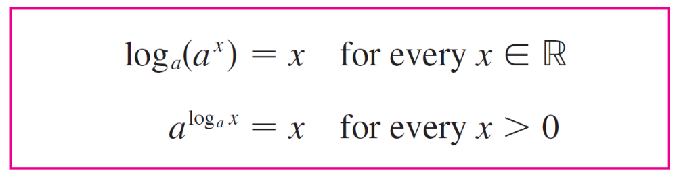



Logarithmic Functions
The cancellation equations, when applied to f (x) = a^{x} and
f ^{–1}(x) = log_{a}x, become
The logarithmic function log_{a} has domain (0, ) and range
and is continuous since it is the inverse of a continuous function, namely, the exponential function.
Its graph is the reflection of the graph of y = a^{x} about the line y = x.

Slide 6
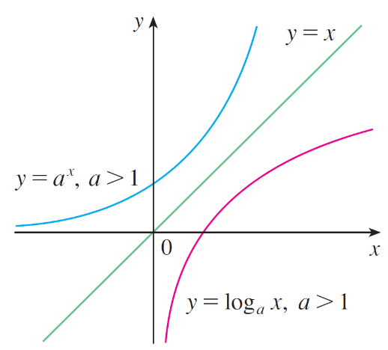
Logarithmic Functions
Figure 1 shows the case where a > 1. (The most important logarithmic functions have base a > 1.)
The fact that y = a^{x} is a very rapidly increasing function for x > 0 is reflected in the fact that y = log_{a}x is a very slowly increasing function for x > 1.
Figure 1

Slide 7
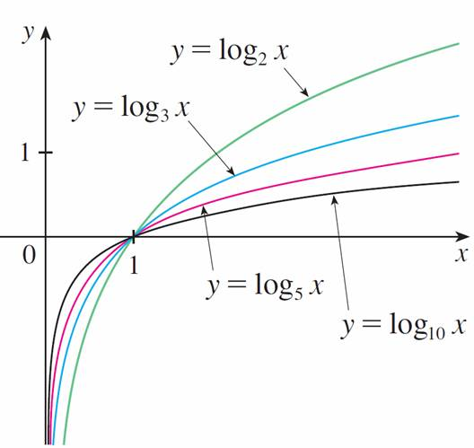
Logarithmic Functions
Figure 2 shows the graphs of y = log_{a}x with various values of the base a. Since log_{a}1 = 0, the graphs of all logarithmic functions pass through the point (1, 0).
The following theorem summarizes the properties of logarithmic functions.
Figure 2

Slide 8
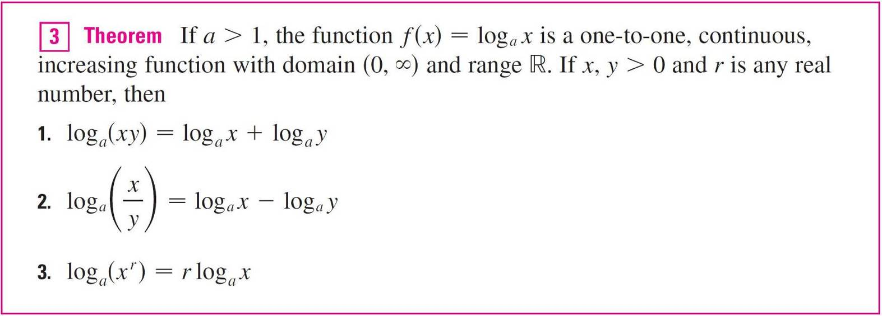
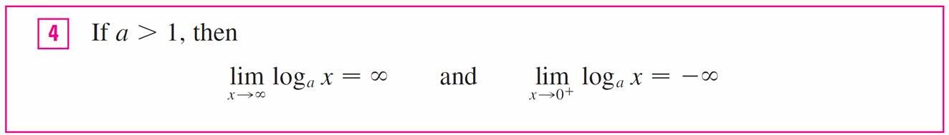
Logarithmic Functions
In particular, the y-axis is a vertical asymptote of the curve y = log_{a}x.

Slide 9


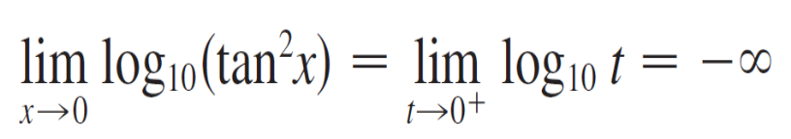
Example 3
Find log₁₀(tan²x).
Solution:
As x → 0, we know that t = tan²x → tan²0 = 0 and the values of t are positive. So by with a = 10 > 1, we have

Slide 10
Natural Logarithms

Slide 11





Natural Logarithms
The logarithm with base is called the natural logarithm and has a special notation:
If we put a = e and replace log_{e} with “ln” in and , then the defining properties of the natural logarithm function become

Slide 12
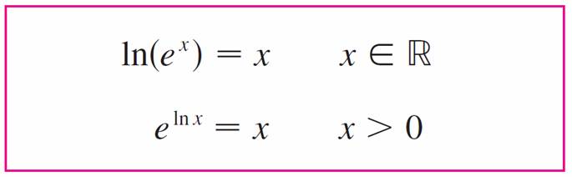


Natural Logarithms
In particular, if we set x = 1, we get

Slide 13

Example 4
Find x if ln x = 5.
Solution1:
From we see that
ln x = 5 means e⁵ = x
Therefore x = e⁵.

Slide 14

Example 4 – Solution 2
cont’d
Start with the equation
ln x = 5
and apply the exponential function to both sides of the equation:
e^{ln x} = e⁵
But the second cancellation equation in says that
e^{ln x} = x. Therefore x = e⁵.

Slide 15

Natural Logarithms

Slide 16
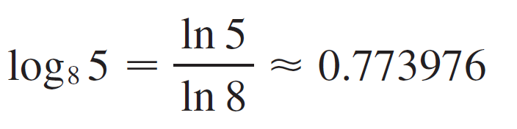
Example 7
Evaluate log₈ 5 correct to six decimal places.
Solution:
Formula 7 gives

Slide 17
Graph and Growth of the
Natural Logarithm

Slide 18
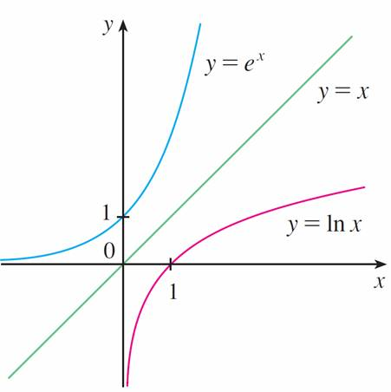
Graph and Growth of the Natural Logarithm
The graphs of the exponential function y = e^{x} and its inverse function, the natural logarithm function, are shown in Figure 3.
The graph of y = ln x is the reflection of the graph of y = e^{x} about the line y = x.
Figure 3

Slide 19


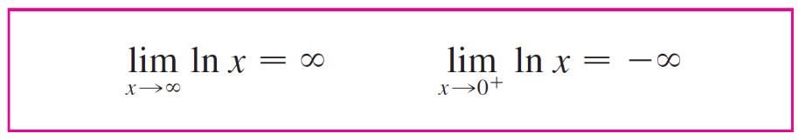
Graph and Growth of the Natural Logarithm
Because the curve y = e^{x} crosses the y-axis with a slope of 1, it follows that the reflected curve y = ln x crosses the x-axis with a slope of 1.
In common with all other logarithmic functions with base greater than 1, the natural logarithm is a continuous, increasing function defined on (0, ) and the y-axis is a vertical asymptote.
If we put a = e in , then we have the following limits:

Slide 20
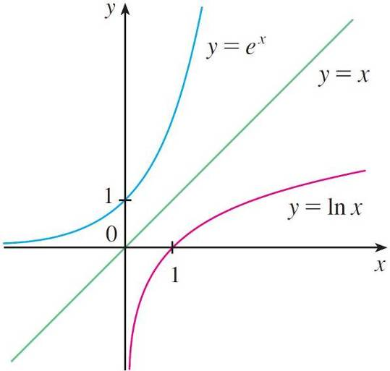
Example 8
Sketch the graph of the function y = ln(x – 2) – 1.
Solution:
We start with the graph of y = ln x as given in Figure 3.
The graph of y = ln x is the reflection of the graph of y = e^{x} about the line y = x.
Figure 3

Slide 21
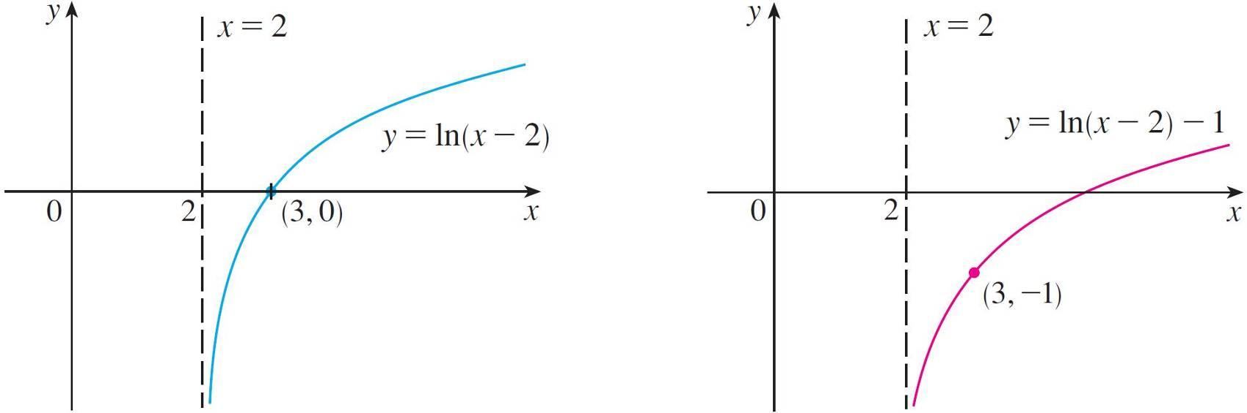
Example 8 – Solution
cont’d
Using the transformations, we shift it 2 units to the right to get the graph of y = ln(x – 2) and then we shift it 1 unit downward to get the graph of y = ln(x – 2) – 1.

Slide 22

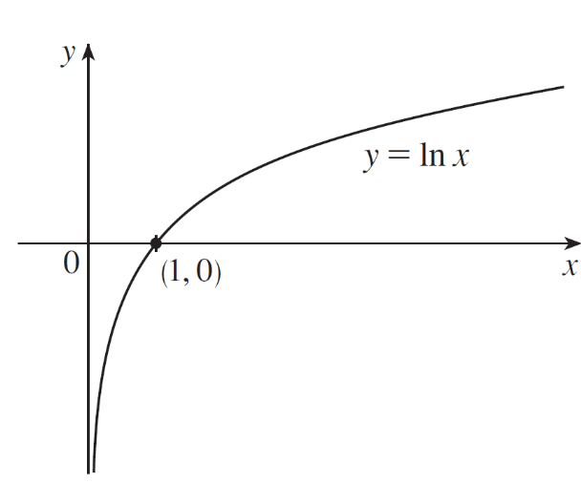
Example 8 – Solution
cont’d
(See Figure 4.) Notice that the line x = 2 is a vertical asymptote since
[ln(x – 2) – 1] =
Figure 4

