Slide 1


6
Inverse Functions
Copyright © Cengage Learning. All rights reserved.

Slide 2

6.7
Hyperbolic Functions
Copyright © Cengage Learning. All rights reserved.

Slide 3
Hyperbolic Functions
Certain even and odd combinations of the exponential functions e^{x} and e^{–x} arise so frequently in mathematics and its applications that they deserve to be given special names.
In many ways they are analogous to the trigonometric functions, and they have the same relationship to the hyperbola that the trigonometric functions have to the circle.

Slide 4
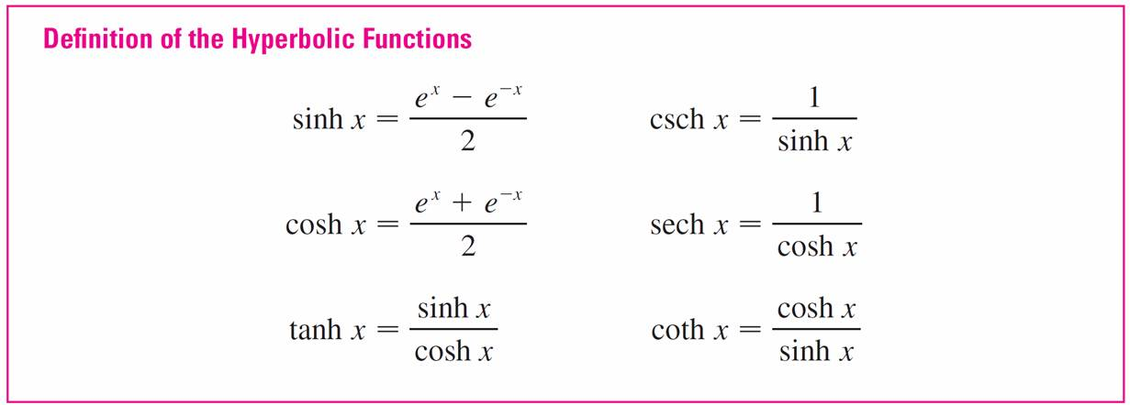
Hyperbolic Functions
For this reason they are collectively called hyperbolic functions and individually called hyperbolic sine, hyperbolic cosine, and so on.

Slide 5
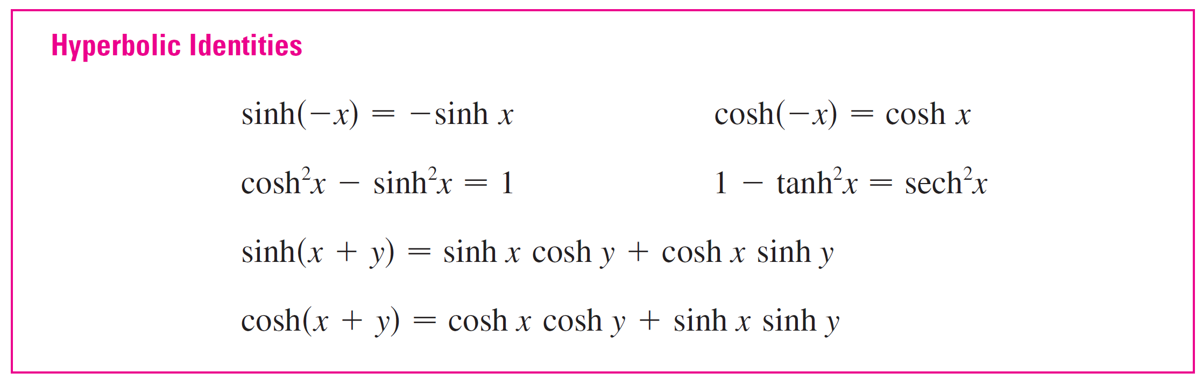
Hyperbolic Functions
The hyperbolic functions satisfy a number of identities that are similar to well-known trigonometric identities.
We list some of them here.

Slide 6
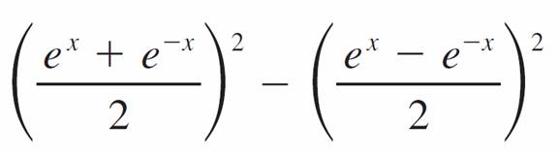
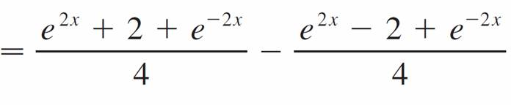

Example 1
Prove (a) cosh²x – sinh²x = 1 and
(b) 1 – tanh²x = sech²x.
Solution:
(a) cosh²x – sinh²x =
=
=
= 1

Slide 7
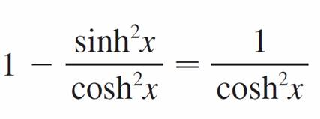

Example 1 – Solution
cont’d
(b) We start with the identity proved in part (a):
cosh²x – sinh²x = 1
If we divide both sides by cosh²x, we get
or

Slide 8
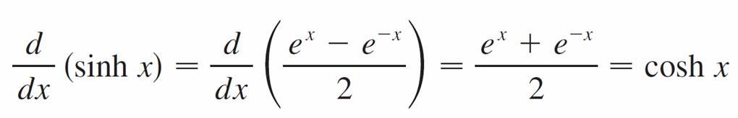
Hyperbolic Functions
The derivatives of the hyperbolic functions are easily computed. For example,

Slide 9
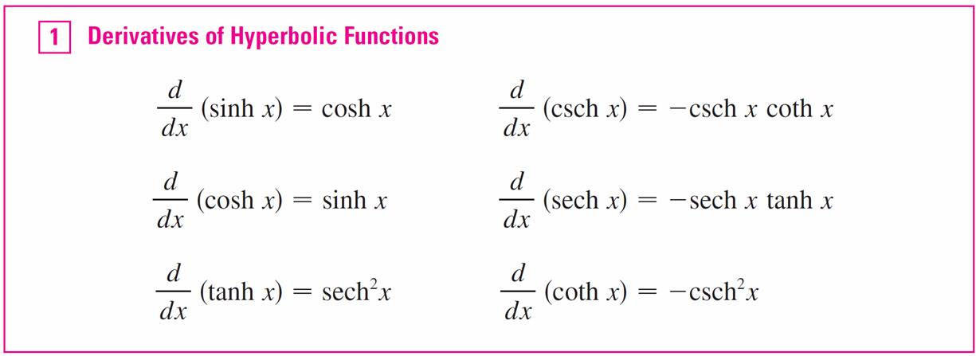
Hyperbolic Functions
We list the differentiation formulas for the hyperbolic functions as Table 1.

Slide 10
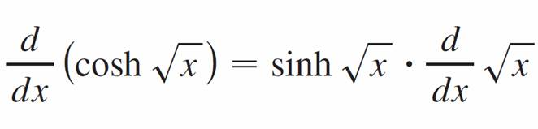
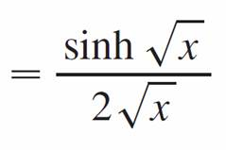
Example 2
Any of these differentiation rules can be combined with the Chain Rule. For instance,

Slide 11
Inverse Hyperbolic Functions

Slide 12

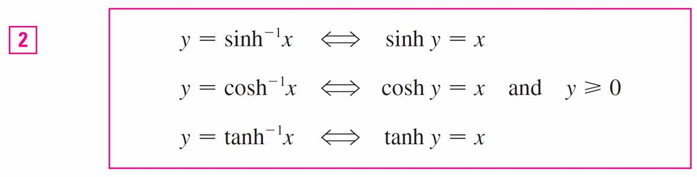
Inverse Hyperbolic Functions
The sinh and tanh are one-to-one functions and so they
have inverse functions denoted by sinh^{–1} and tanh^{–1}. The cosh is not one-to-one, but when restricted to the domain [0, ) it becomes one-to-one.
The inverse hyperbolic cosine function is defined as the inverse of this restricted function.

Slide 13
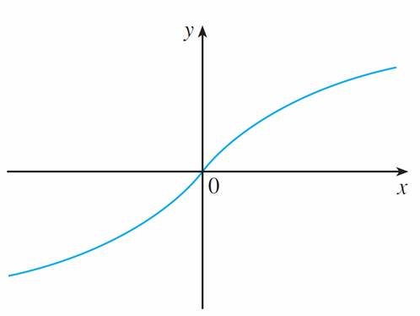
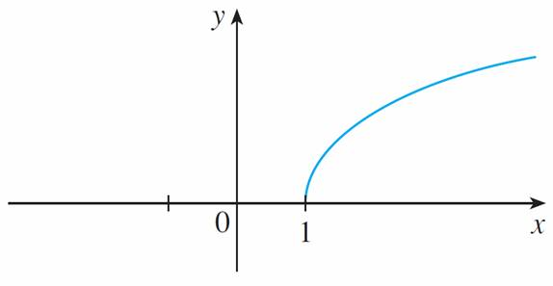



Inverse Hyperbolic Functions
We can sketch the graphs of sinh^{–1}, cosh^{–1}, and tanh^{–1} in Figures 8, 9, and 10.
domain = range =
domain = [1, ) range = [0, )
Figure 8
Figure 9

Slide 14
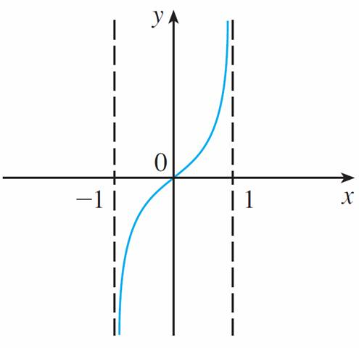

Inverse Hyperbolic Functions
cont’d
domain = (–1, 1) range =
Figure 10

Slide 15

Inverse Hyperbolic Functions
Since the hyperbolic functions are defined in terms of exponential functions, it’s not surprising to learn that the inverse hyperbolic functions can be expressed in terms of logarithms.
In particular, we have:

Slide 16

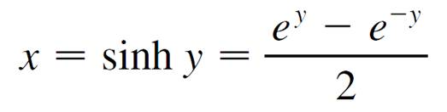
Example 3
Show that sinh^{–1}x =
Solution:
Let y = sinh^{–1}x. Then
so e^{y} – 2x – e^{–y} = 0
or, multiplying by e^{y},
e^{2y} – 2xe^{y} – 1 = 0

Slide 17
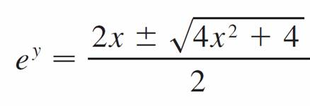
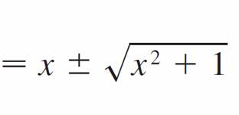
Example 3 – Solution
cont’d
This is really a quadratic equation in e^{y}:
(e^{y})² – 2x(e^{y}) – 1 = 0
Solving by the quadratic formula, we get
Note that e^{y} > 0, but

Slide 18



Example 3 – Solution
cont’d
Thus the minus sign is inadmissible and we have
Therefore

Slide 19
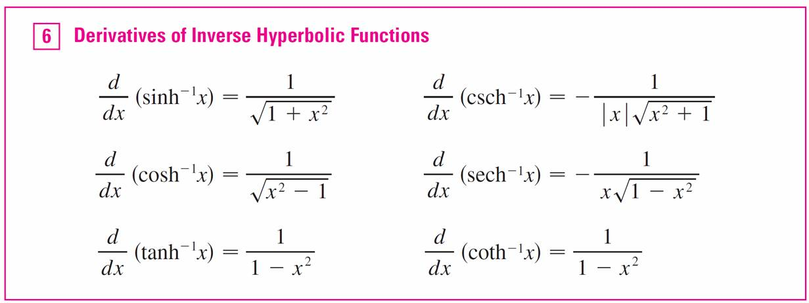
Inverse Hyperbolic Functions
The inverse hyperbolic functions are all differentiable
because the hyperbolic functions are differentiable.

Slide 20
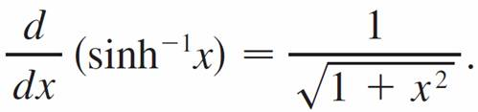
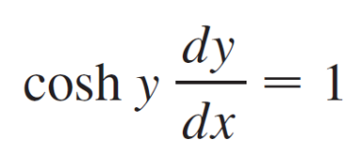
Example 4
Prove that
Solution:
Let y = sinh^{–1}x. Then sinh y = x. If we differentiate this equation implicitly with respect to x, we get

Slide 21

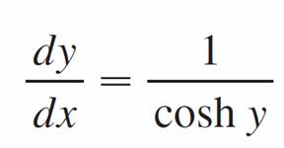
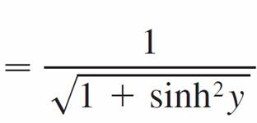
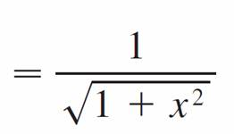
Example 4 – Solution
cont’d
Since cosh²y – sinh²y = 1 and cosh y ≥ 0, we have
cosh y = so

