Slide 1

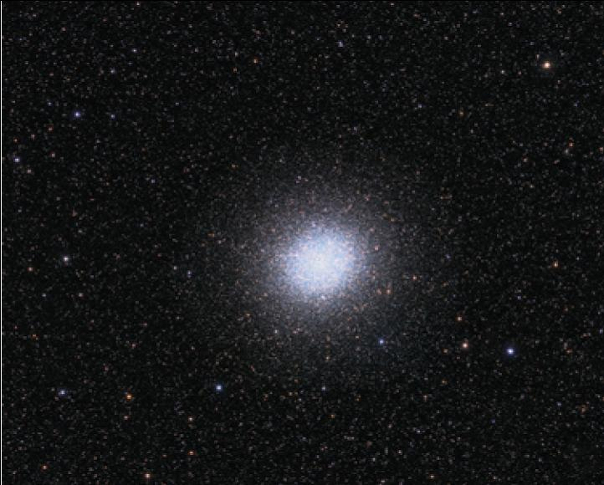
7
Techniques of Integration
Copyright © Cengage Learning. All rights reserved.

Slide 2

7.1
Integration by Parts
Copyright © Cengage Learning. All rights reserved.

Slide 3

Integration by Parts
Every differentiation rule has a corresponding integration rule. For instance, the Substitution Rule for integration corresponds to the Chain Rule for differentiation. The rule that corresponds to the Product Rule for differentiation is called the rule for integration by parts.
The Product Rule states that if f and g are differentiable functions, then
[f (x)g(x)] = f (x)g ′(x) + g(x)f ′(x)

Slide 4
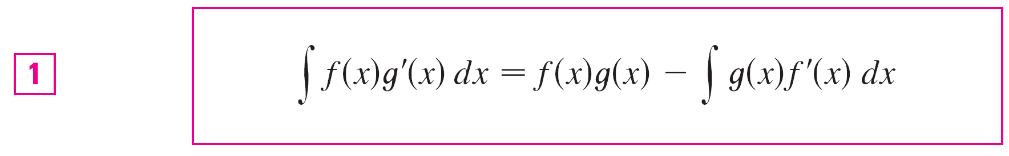
Integration by Parts
In the notation for indefinite integrals this equation becomes
∫ [f (x)g ′(x) + g(x)f ′(x)] dx = f (x)g(x)
or ∫ f (x)g ′(x) dx + ∫ g(x)f ′(x) dx = f (x)g(x)
We can rearrange this equation as
Formula 1 is called the formula for integration by parts.

Slide 5

Integration by Parts
It is perhaps easier to remember in the following notation.
Let u = f (x) and v = g(x). Then the differentials are du = f ′(x) dx and dv = g ′(x) dx, so, by the Substitution Rule, the formula for integration by parts becomes

Slide 6
Example 1
Find ∫ x sin x dx.
Solution Using Formula 1:
Suppose we choose f (x) = x and g ′(x) = sin x. Then
f ′(x) = 1 and g(x) = –cos x. (For g we can choose any antiderivative of g ′.) Thus, using Formula 1, we have
∫ x sin x dx = f (x)g(x) – ∫ g(x)f ′(x) dx
= x(–cos x) – ∫ (–cos x) dx
= –x cos x + ∫ cos x dx
= –x cos x + sin x + C

Slide 7
Example 1 – Solution
cont’d
It’s wise to check the answer by differentiating it. If we do so, we get x sin x, as expected.
Solution Using Formula 2:
Let
u = x dv = sin x dx
Then du = dx v = –cos x
and so
∫ x sin x dx = ∫ x sin x dx
u
dv

Slide 8
Example 1 – Solution
cont’d
u
v
u
du
= x (–cos x) – ∫ (–cos x) dx
= –x cos x + ∫ cos x dx
= –x cos x + sin x + C

Slide 9
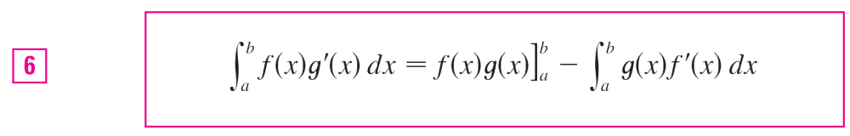
Integration by Parts
If we combine the formula for integration by parts with Part 2 of Fundamental Theorem of Calculus, we can evaluate definite integrals by parts.
Evaluating both sides of Formula 1 between a and b, assuming f ′and g′ are continuous, and using the Fundamental Theorem, we obtain

