Slide 1


7
Techniques of Integration
Copyright © Cengage Learning. All rights reserved.

Slide 2

7.3
Trigonometric Substitution
Copyright © Cengage Learning. All rights reserved.

Slide 3


Trigonometric Substitution
In finding the area of a circle or an ellipse, an integral of the form dx arises, where a > 0.
If it were the substitution u = a² – x² would be
effective but, as it stands, dx is more difficult.

Slide 4
Trigonometric Substitution
If we change the variable from x to θ by the substitution
x = a sin θ, then the identity 1 – sin²θ = cos²θ allows us to get rid of the root sign because

Slide 5
Trigonometric Substitution
Notice the difference between the substitution u = a² – x² (in which the new variable is a function of the old one) and the substitution x = a sinθ (the old variable is a function of the new one).
In general, we can make a substitution of the form x = g(t)
by using the Substitution Rule in reverse.
To make our calculations simpler, we assume that g has an inverse function; that is, g is one-to-one.

Slide 6
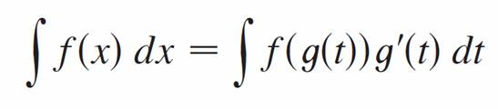
Trigonometric Substitution
In this case, if we replace u by x and x by t in the Substitution Rule, we obtain
This kind of substitution is called inverse substitution.
We can make the inverse substitution x = a sin θ provided that it defines a one-to-one function.

Slide 7
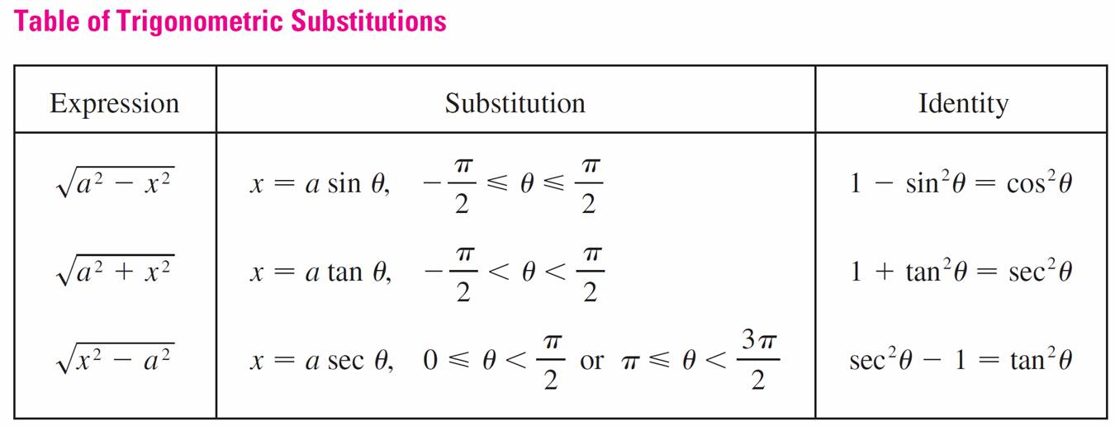
Trigonometric Substitution
This can be accomplished by restricting θ to lie in the interval [–π /2, π /2].
In the following table we list trigonometric substitutions that are effective for the given radical expressions because of the specified trigonometric identities.

Slide 8
Trigonometric Substitution
In each case the restriction on θ is imposed to ensure that the function that defines the substitution is one-to-one.

Slide 9
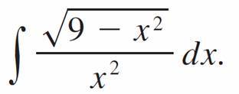
Example 1
Evaluate
Solution:
Let x = 3 sin θ, where –π /2 ≤ θ ≤ π /2. Then dx = 3 cos θ dθ and
(Note that cos θ ≥ 0 because –π /2 ≤ θ ≤ π /2.)

Slide 10
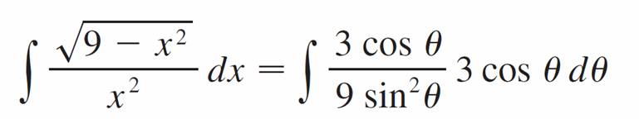
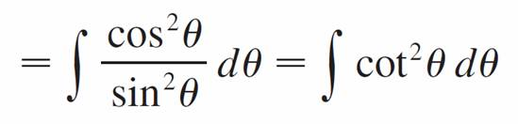
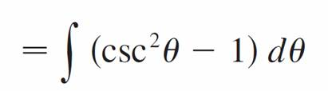

Example 1 – Solution
cont’d
Thus the Inverse Substitution Rule gives

Slide 11
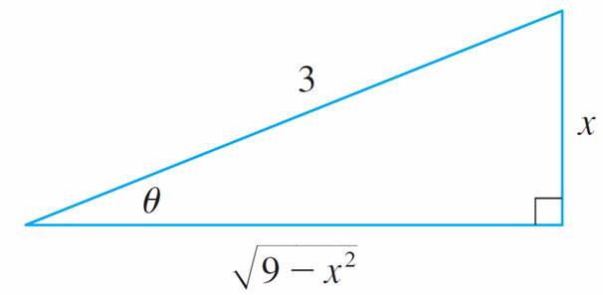

Example 1 – Solution
cont’d
Since this is an indefinite integral, we must return to the original variable x. This can be done either by using trigonometric identities to express cot θ in terms of
sin θ = x/3 or by drawing a diagram, as in Figure 1,
where θ is interpreted as an angle of a right triangle.
sin θ =
Figure 1

Slide 12

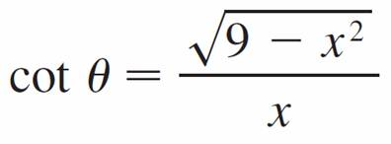
Example 1 – Solution
cont’d
Since sin θ = x/3, we label the opposite side and the hypotenuse as having lengths x and 3.
Then the Pythagorean Theorem gives the length of the adjacent side as so we can simply read the value of cot θ from the figure:
(Although θ > 0 in the diagram, this expression for cot θ
is valid even when θ < 0.)

Slide 13
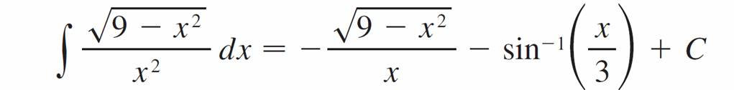
Example 1 – Solution
cont’d
Since sin θ = x/3, we have θ = sin^{–1}(x/3) and so

Slide 14
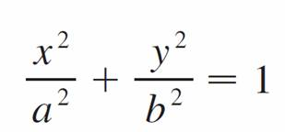
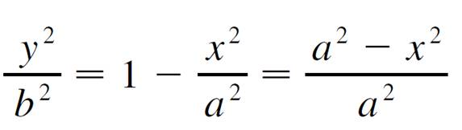
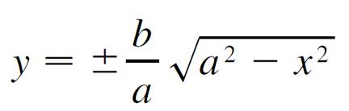
Example 2
Find the area enclosed by the ellipse
Solution:
Solving the equation of the ellipse for y, we get
or

Slide 15
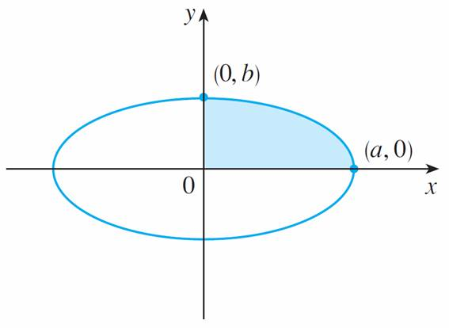
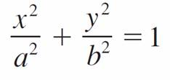
Example 2 – Solution
cont’d
Because the ellipse is symmetric with respect to both axes, the total area A is four times the area in the first quadrant (see Figure 2).
Figure 2

Slide 16
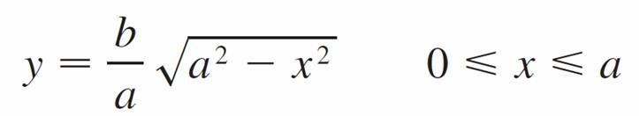
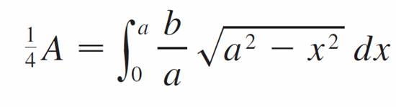
Example 2 – Solution
cont’d
The part of the ellipse in the first quadrant is given by the function
and so
To evaluate this integral we substitute x = a sin θ.
Then dx = a cos θ dθ.

Slide 17




Example 2 – Solution
cont’d
To change the limits of integration we note that when
x = 0, sin θ = 0, so θ = 0; when x = a, sin θ = 1, so θ = π/2. Also

Slide 18
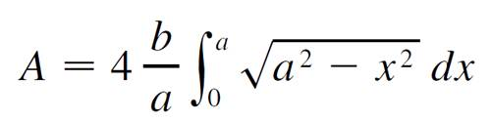
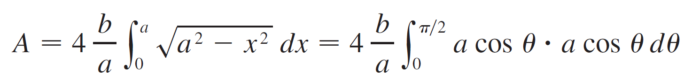
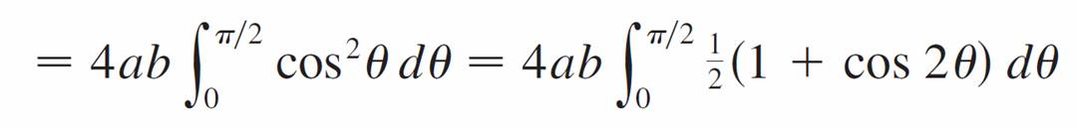
Example 2 – Solution
cont’d
Since 0 ≤ θ ≤ π /2. Therefore

Slide 19
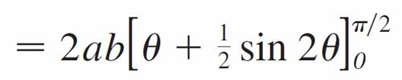
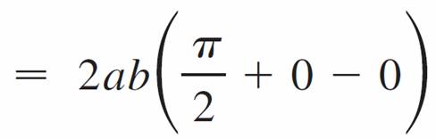

Example 2 – Solution
cont’d
We have shown that the area of an ellipse with semiaxes a and b is πab.
In particular, taking a = b = r, we have proved the famous formula that the area of a circle with radius r is πr².

Slide 20
Trigonometric Substitution
Note:
Since the integral in Example 2 was a definite integral, we changed the limits of integration and did not have to convert back to the original variable x.

Slide 21
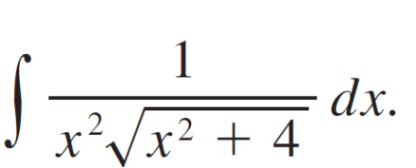


Example 3
Find
Solution:
Let x = 2 tan θ, –π /2 < θ < π /2. Then dx = 2 sec²θ dθ
and
=
= 2| sec θ |
= 2 sec θ

Slide 22
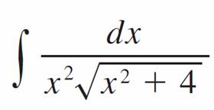
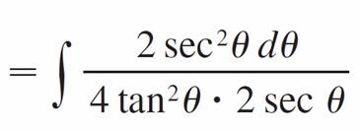
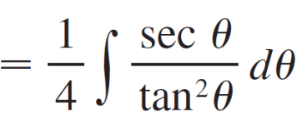
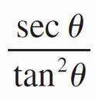
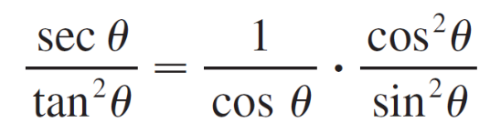
Example 3 – Solution
cont’d
Thus we have
To evaluate this trigonometric integral we put everything in terms of sin θ and cos θ :

Slide 23
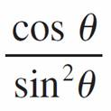

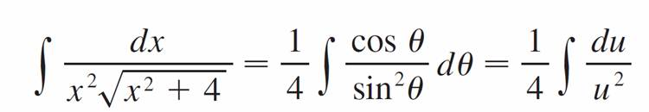
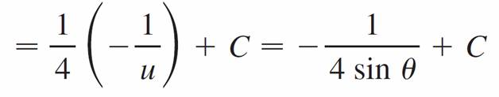
Example 3 – Solution
cont’d
=
Therefore, making the substitution u = sin θ, we have

Slide 24
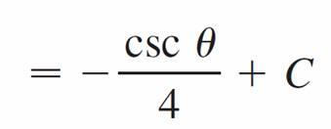
Example 3 – Solution
cont’d

Slide 25


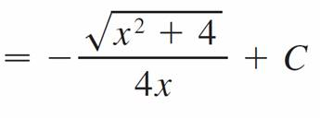
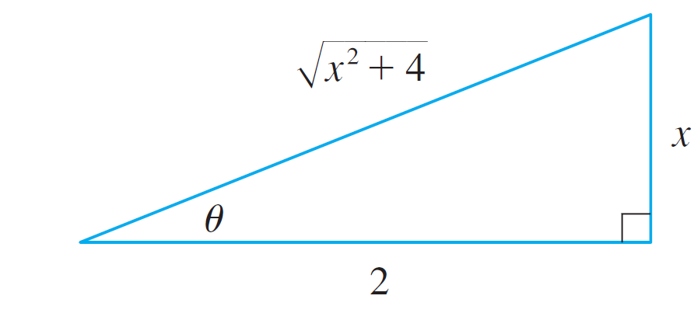
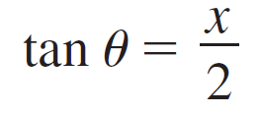
Example 3 – Solution
cont’d
We use Figure 3 to determine that csc θ = and
so
Figure 3

Slide 26
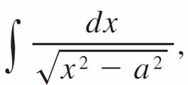




Example 5
Evaluate where a > 0.
Solution 1:
We let x = a sec θ, where 0 < θ < π /2 or π < θ < 3π /2.
Then dx = a sec θ tan θ dθ and

Slide 27
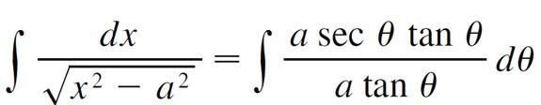


Example 5 – Solution 1
cont’d
Therefore

Slide 28

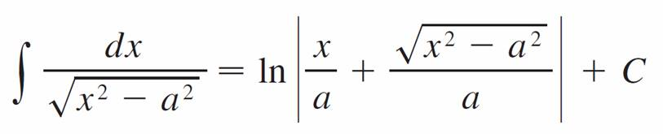

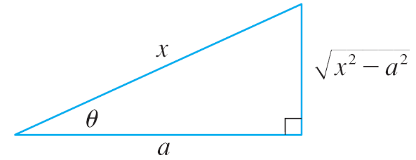
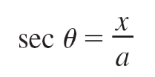
Example 5 – Solution 1
cont’d
The triangle in Figure 4 gives tan θ = so we have
Figure 4

Slide 29
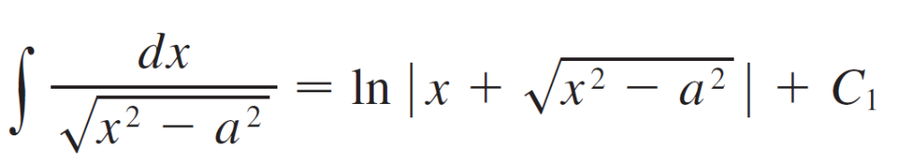

Example 5 – Solution 1
cont’d
Writing C₁ = C – In a, we have

Slide 30



Example 5 – Solution 2
cont’d
For x > 0 the hyperbolic substitution x = a cosh t can also be used.
Using the identity cosh²y – sinh²y = 1, we have

Slide 31
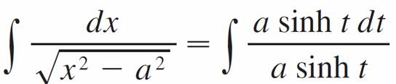
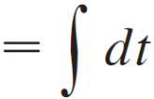

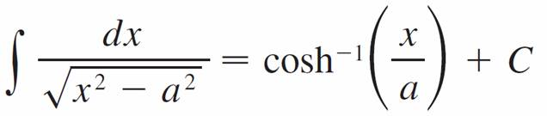

Example 5 – Solution 2
cont’d
Since dx = a sinh t dt, we obtain
Since cosh t = x/a, we have t = cosh^{–1}(x/a) and

Slide 32
Trigonometric Substitution
Note:
As Example 5 illustrates, hyperbolic substitutions
can be used in place of trigonometric substitutions and sometimes they lead to simpler answers.
But we usually use trigonometric substitutions because trigonometric identities are more familiar than hyperbolic identities.

Slide 33
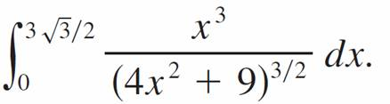


Example 6
Find
Solution:
First we note that (4x² + 9)^{3/2} = so trigonometric substitution is appropriate.
Although is not quite one of the expressions in the table of trigonometric substitutions, it becomes one of them if we make the preliminary substitution u = 2x.

Slide 34




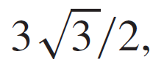

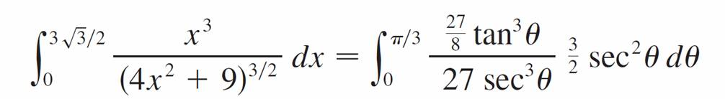
Example 6 – Solution
cont’d
When we combine this with the tangent substitution, we have x = which gives and
When x = 0, tan θ = 0, so θ = 0; when x = tan θ = so θ = π /3.

Slide 35
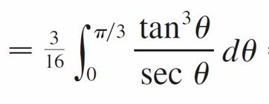
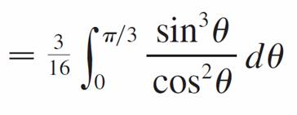
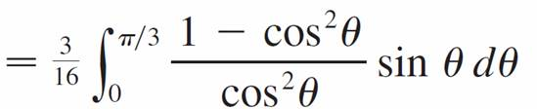

Example 6 – Solution
cont’d
Now we substitute u = cos θ so that du = –sin θ dθ.
When θ = 0, u = 1; when θ = π /3, u =

Slide 36
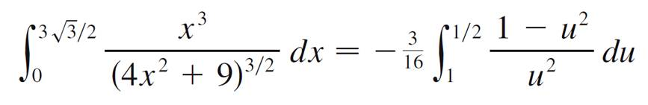



Example 6 – Solution
cont’d
Therefore

