Slide 1


7
Techniques of Integration
Copyright © Cengage Learning. All rights reserved.

Slide 2

7.4
Integration of Rational Functions by Partial Fractions
Copyright © Cengage Learning. All rights reserved.

Slide 3
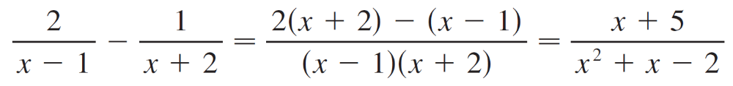
Integration of Rational Functions by Partial Fractions
In this section we show how to integrate any rational function (a ratio of polynomials) by expressing it as a sum of simpler fractions, called partial fractions, that we already know how to integrate.
To illustrate the method, observe that by taking the fractions 2/(x – 1) and 1/(x + 2) to a common denominator we obtain

Slide 4
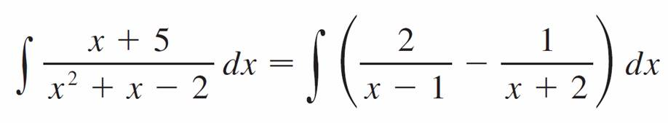
Integration of Rational Functions by Partial Fractions
If we now reverse the procedure, we see how to integrate the function on the right side of this equation:
= 2 ln | x – 1 | – ln | x + 2 | + C

Slide 5
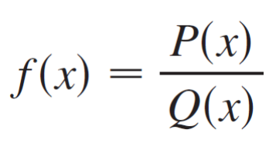
Integration of Rational Functions by Partial Fractions
To see how the method of partial fractions works in general, let’s consider a rational function
where P and Q are polynomials. It’s possible to express f as a sum of simpler fractions provided that the degree of P is less than the degree of Q. Such a rational function is called proper.

Slide 6
Integration of Rational Functions by Partial Fractions
Recall that if
P (x) = a_{n}x^{n} + a_{n} _{– 1}x^{n – 1} + . . . + a₁x + a₀
where a_{n} ≠ 0, then the degree of P is n and we write deg(P) = n.
If f is improper, that is, deg(P) ≥ deg(Q), then we must take the preliminary step of dividing Q into P (by long division) until a remainder R (x) is obtained such that
deg(R) < deg(Q).

Slide 7
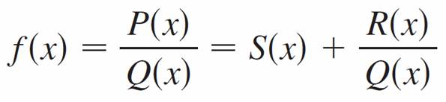

Integration of Rational Functions by Partial Fractions
The division statement is
where S and R are also polynomials.
As the next example illustrates, sometimes this preliminary step is all that is required.

Slide 8
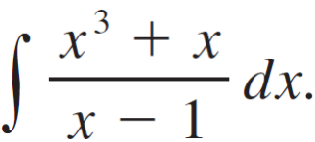
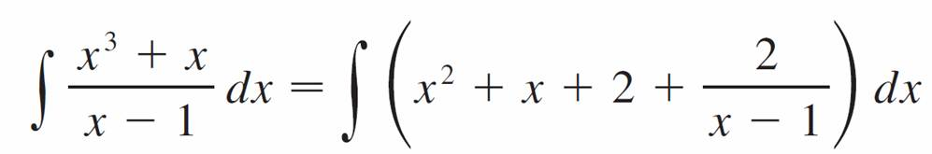
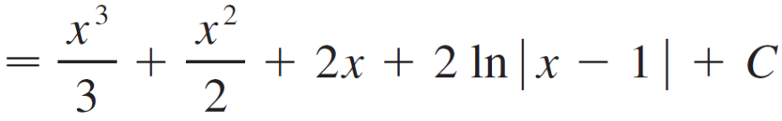
Example 1
Find
Solution:
Since the degree of the numerator is greater than the degree of the denominator, we first perform the long division.
This enables us to write

Slide 9
Integration of Rational Functions by Partial Fractions
The next step is to factor the denominator Q (x) as far as possible.
It can be shown that any polynomial Q can be factored as a product of linear factors (of the form ax + b) and irreducible quadratic factors (of the form ax² + bx + c, where
b² – 4ac < 0).
For instance, if Q (x) = x⁴ – 16, we could factor it as
Q (x) = (x² – 4)(x² + 4) = (x – 2)(x + 2)(x² + 4)

Slide 10
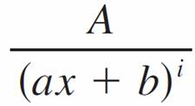
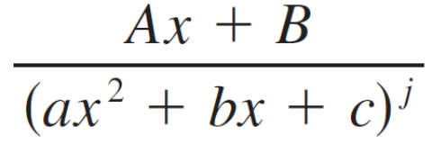
Integration of Rational Functions by Partial Fractions
The third step is to express the proper rational function
R (x)/Q (x)(from Equation 1) as a sum of partial fractions of the form
or
A theorem in algebra guarantees that it is always possible to do this. We explain the details for the four cases that occur.

Slide 11
Integration of Rational Functions by Partial Fractions
Case I The denominator Q (x) is a product of distinct linear
factors.
This means that we can write
Q (x) = (a₁x + b₁)(a₂x + b₂) . . . (a_{k}x + b_{k})
where no factor is repeated (and no factor is a constant multiple of another).

Slide 12
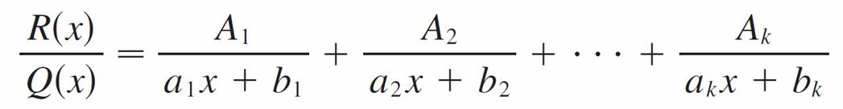

Integration of Rational Functions by Partial Fractions
In this case the partial fraction theorem states that there exist constants A₁, A₂, . . . , A_{k} such that
These constants can be determined as in the next example.

Slide 13
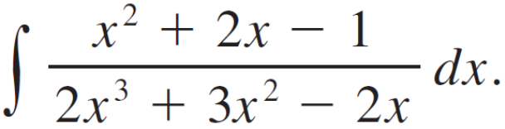
Example 2
Evaluate
Solution:
Since the degree of the numerator is less than the degree of the denominator, we don’t need to divide.
We factor the denominator as
2x³ + 3x² – 2x = x(2x² + 3x – 2)
= x(2x – 1)(x + 2)

Slide 14

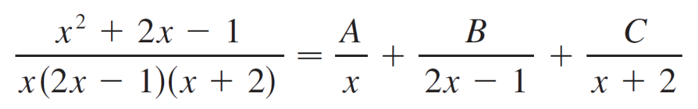


Example 2 – Solution
cont’d
Since the denominator has three distinct linear factors, the partial fraction decomposition of the integrand has the form
To determine the values of A, B, and C, we multiply both sides of this equation by the product of the denominators, x(2x – 1)(x + 2), obtaining
x² + 2x – 1 = A(2x – 1)(x + 2) + Bx(x + 2) + Cx(2x – 1)

Slide 15

Example 2 – Solution
cont’d
Expanding the right side of Equation 4 and writing it in the standard form for polynomials, we get
x² + 2x – 1 = (2A + B + 2C)x² + (3A + 2B – C)x – 2A
The polynomials in Equation 5 are identical, so their coefficients must be equal. The coefficient of x² on the right side, 2A + B + 2C, must equal the coefficient of x² on the left side—namely, 1.
Likewise, the coefficients of x are equal and the constant terms are equal.

Slide 16
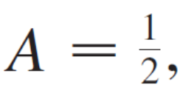

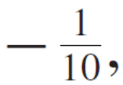
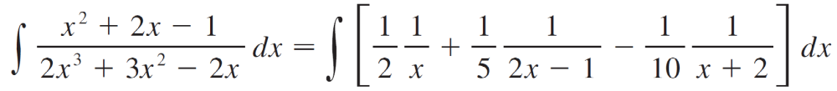
Example 2 – Solution
cont’d
This gives the following system of equations for A, B, and C:
2A + B + 2C = 1
3A + 2B – C = 2
–2A = –1
Solving, we get, A = B = and C = and so

Slide 17
Example 2 – Solution
cont’d
In integrating the middle term we have made the mental substitution u = 2x – 1, which gives du = 2 dx and
dx = du.

Slide 18


Integration of Rational Functions by Partial Fractions
Note:
We can use an alternative method to find the coefficients A, B and C in Example 2. Equation 4 is an identity; it is true for every value of x. Let’s choose values of x that simplify the equation.
If we put x = 0 in Equation 4, then the second and third terms on the right side vanish and the equation then becomes –2A = –1, or A = .
Likewise, x = gives 5B/4 = and x = –2 gives 10C = –1, so B = and C =

Slide 19
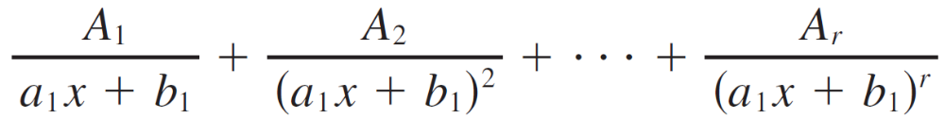

Integration of Rational Functions by Partial Fractions
Case II: Q (x) is a product of linear factors, some of which are repeated.
Suppose the first linear factor (a₁x + b₁) is repeated r times; that is, (a₁x + b₁)^{r} occurs in the factorization of Q (x). Then instead of the single term A₁/(a₁x + b₁) in Equation 2, we would use

Slide 20
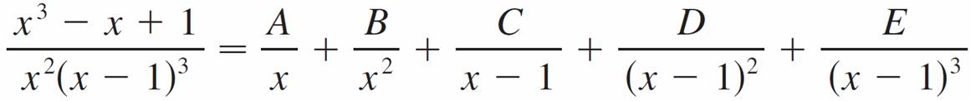
Integration of Rational Functions by Partial Fractions
By way of illustration, we could write
but we prefer to work out in detail a simpler example.

Slide 21
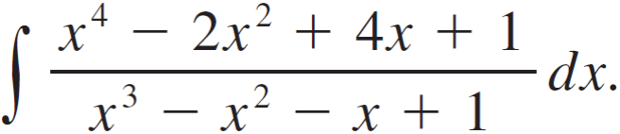
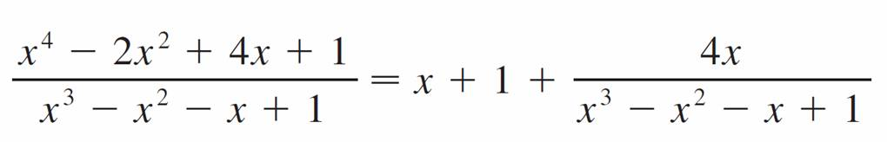
Example 4
Find
Solution:
The first step is to divide. The result of long division is

Slide 22
Example 4 – Solution
cont’d
The second step is to factor the denominator
Q (x) = x³ – x² – x + 1.
Since Q (1) = 0, we know that x – 1 is a factor and we obtain
x³ – x² – x + 1 = (x – 1)(x² – 1)
= (x – 1)(x – 1)(x + 1)
= (x – 1)²(x + 1)

Slide 23
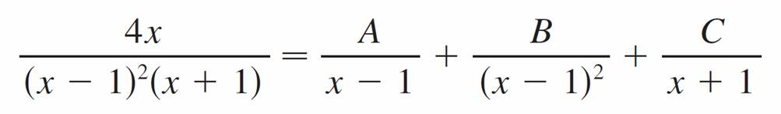

Example 4 – Solution
cont’d
Since the linear factor x – 1 occurs twice, the partial fraction decomposition is
Multiplying by the least common denominator,
(x – 1)²(x + 1), we get
4x = A (x – 1)(x + 1) + B (x + 1) + C (x – 1)²

Slide 24
Example 4 – Solution
cont’d
= (A + C)x² + (B – 2C)x + (–A + B + C)
Now we equate coefficients:
A + C = 0
B – 2C = 4
–A + B + C = 0

Slide 25
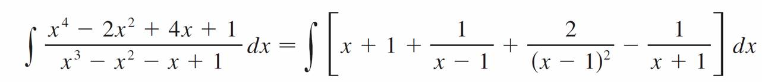
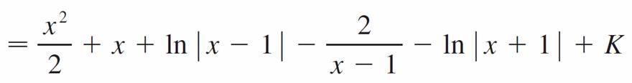
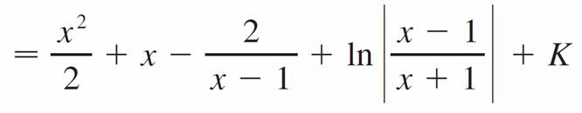
Example 4 – Solution
cont’d
Solving, we obtain A = 1, B = 2, and C = –1, so

Slide 26
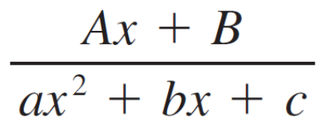

Integration of Rational Functions by Partial Fractions
Case III: Q (x) contains irreducible quadratic factors, none of which is repeated.
If Q (x) has the factor ax² + bx + c, where b² – 4ac < 0, then, in addition to the partial fractions in Equations 2 and 7, the expression for R (x)/Q (x) will have a term of the form
where A and B are constants to be determined.

Slide 27
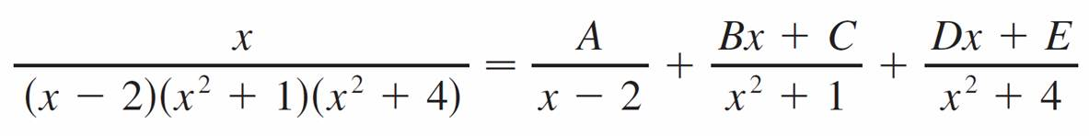

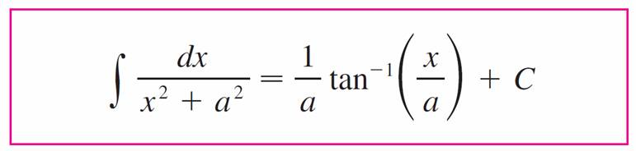

Integration of Rational Functions by Partial Fractions
For instance, the function given by
f (x) = x/[(x – 2)(x² + 1)(x² + 4)] has a partial fraction decomposition of the form
The term given in can be integrated by completing the square (if necessary) and using the formula

Slide 28
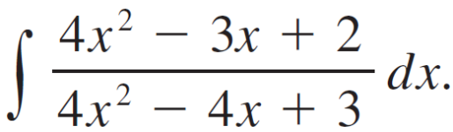
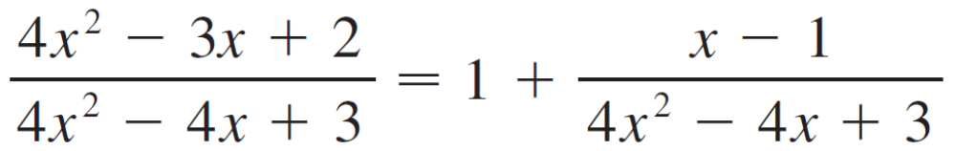
Example 6
Evaluate
Solution:
Since the degree of the numerator is not less than the degree of the denominator, we first divide and obtain

Slide 29
Example 6 – Solution
cont’d
Notice that the quadratic 4x² – 4x + 3 is irreducible because its discriminant is b² – 4ac = –32 < 0. This means it can’t be factored, so we don’t need to use the partial fraction technique.
To integrate the given function we complete the square in the denominator:
4x² – 4x + 3 = (2x – 1)² + 2
This suggests that we make the substitution u = 2x – 1.

Slide 30

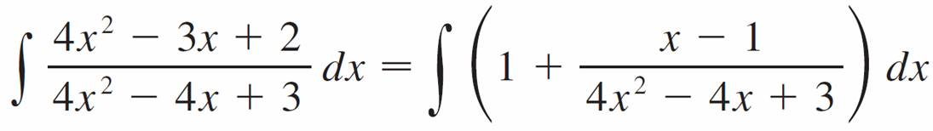
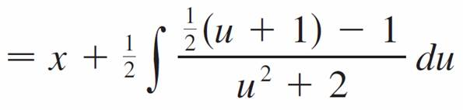
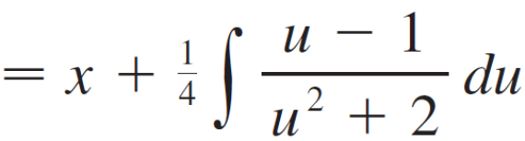
Example 6 – Solution
cont’d
Then du = 2 dx and x = (u + 1), so

Slide 31
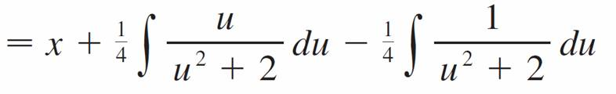
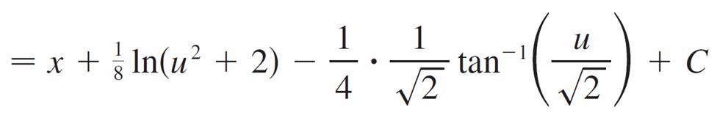
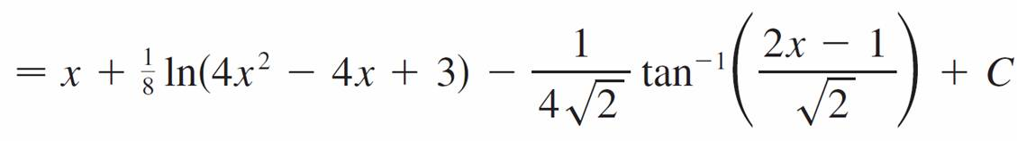
Example 6 – Solution
cont’d

Slide 32
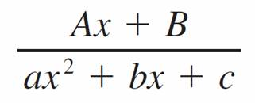
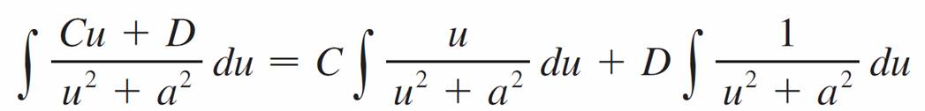

Integration of Rational Functions by Partial Fractions
Note:
Example 6 illustrates the general procedure for integrating a partial fraction of the form
We complete the square in the denominator and then make a substitution that brings the integral into the form
Then the first integral is a logarithm and the second is expressed in terms of
where b² – 4ac < 0

Slide 33

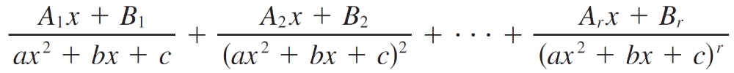


Integration of Rational Functions by Partial Fractions
Case IV: Q (x) contains a repeated irreducible quadratic factor.
If Q (x) has the factor (ax² + bx + c)^{r}, where b² – 4ac < 0, then instead of the single partial fraction , the sum
occurs in the partial fraction decomposition of R (x)/Q (x). Each of the terms in can be integrated by using a substitution or by first completing the square if necessary.

Slide 34
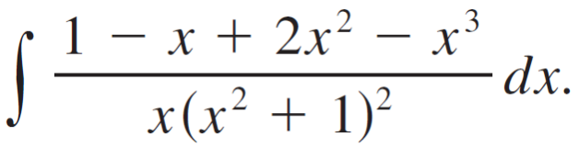
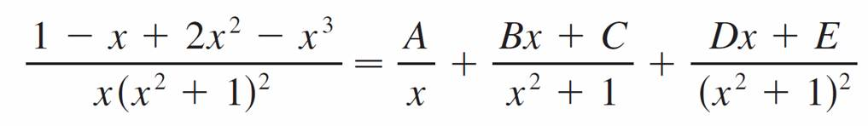
Example 8
Evaluate
Solution:
The form of the partial fraction decomposition is
Multiplying by x(x² + 1)², we have
–x³ + 2x² – x + 1 = A(x² +1)² + (Bx + C)x(x² + 1) + (Dx + E)x

Slide 35
Example 8 – Solution
cont’d
= A(x⁴ + 2x² +1) + B(x⁴ + x²) + C(x³ + x) + Dx² + Ex
= (A + B)x⁴ + Cx³ + (2A + B + D)x² + (C + E)x + A
If we equate coefficients, we get the system
A + B = 0 C = –1 2A + B + D = 2 C + E = –1 A = 1
which has the solution A = 1, B = –1, C = –1, D = 1 and
E = 0.

Slide 36
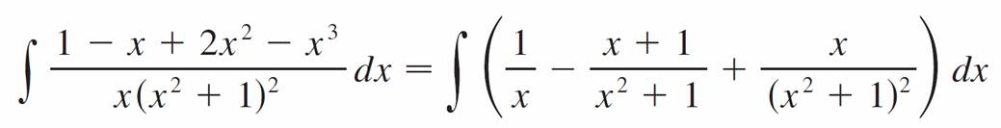
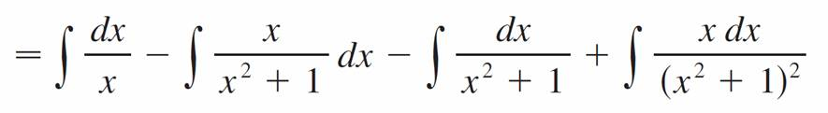

Example 8 – Solution
cont’d
Thus

Slide 37
Rationalizing Substitutions

Slide 38


Rationalizing Substitutions
Some nonrational functions can be changed into rational functions by means of appropriate substitutions.
In particular, when an integrand contains an expression of the form then the substitution may be effective. Other instances appear in the exercises.

Slide 39
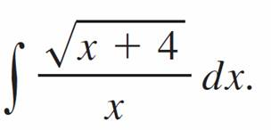

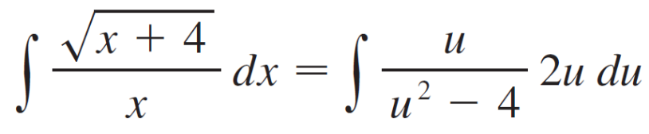
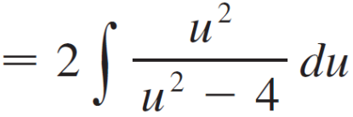
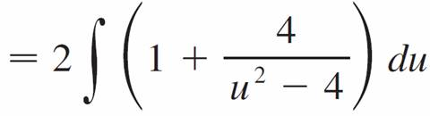
Example 9
Evaluate
Solution:
Let u = Then u² = x + 4, so x = u² – 4 and
dx = 2u du. Therefore

Slide 40
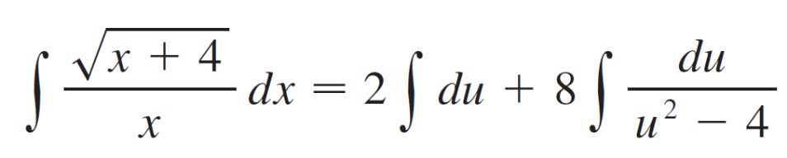
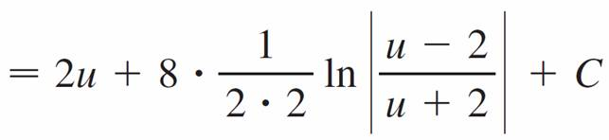
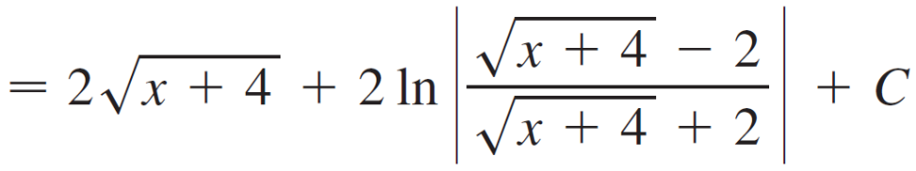
Example 9 – Solution
cont’d
We can evaluate this integral either by factoring u² – 4 as (u – 2)(u + 2) and using partial fractions or by using Formula 6 with a = 2:

