Slide 1


7
Techniques of Integration
Copyright © Cengage Learning. All rights reserved.

Slide 2

7.5
Strategy for Integration
Copyright © Cengage Learning. All rights reserved.

Slide 3
Strategy for Integration
In this section we present a collection of miscellaneous integrals in random order and the main challenge is to recognize which technique or formula to use.
No hard and fast rules can be given as to which method applies in a given situation, but we give some advice on strategy that you may find useful.
A prerequisite for applying a strategy is a knowledge of the basic integration formulas.

Slide 4
Strategy for Integration
In the table of Integration Formulas we have collected the integrals with several additional formulas that we have learned in this chapter.
Most of them should be memorized. It is useful to know them all, but the ones marked with an asterisk need not be memorized since they are easily derived.
Formula 19 can be avoided by using partial fractions, and trigonometric substitutions can be used in place of
Formula 20.

Slide 5
Strategy for Integration

Slide 6
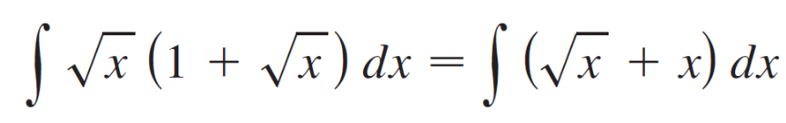
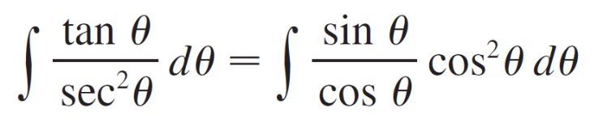
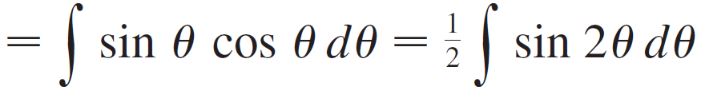
Strategy for Integration
Simplify the Integrand if Possible
Sometimes the use of algebraic manipulation or
trigonometric identities will simplify the integrand and
make the method of integration obvious. Here are some
examples:

Slide 7
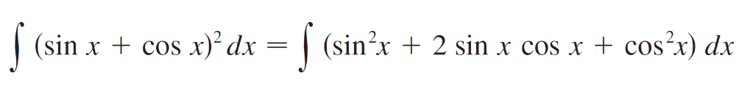
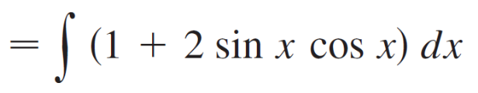
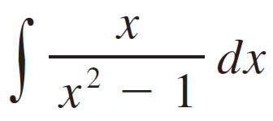
Strategy for Integration
Look for an Obvious Substitution
Try to find some function u = g(x) in the integrand whose differential du = g′(x) dx also occurs, apart from a constant factor. For instance, in the integral
we notice that if u = x² – 1, then du = 2x dx.

Slide 8
Strategy for Integration
Therefore we use the substitution u = x² – 1 instead of
the method of partial fractions.
3. Classify the Integrand According to Its Form
If Steps 1 and 2 have not led to the solution, then we take a look at the form of the integrand f (x).
(a) Trigonometric functions. If f (x) is a product of powers
of sin x and cos x, of tan x and sec x, or of cot x and
csc x, then we use the substitutions.
(b) Rational functions. If f is a rational function, we use
the procedure involving partial fractions.

Slide 9




Strategy for Integration
(c) Integration by parts. If f(x) is a product of a power of x
(or a polynomial) and a transcendental function (such as a trigonometric, exponential, or logarithmic
function), then we try integration by parts, choosing u and dv.
(d) Radicals. Particular kinds of substitutions are
recommended when certain radicals appear.
(i) If occurs, we use a trigonometric
substitution.
(ii) If occurs, we use the rationalizing
substitution More generally, this
sometimes works for .

Slide 10
Strategy for Integration
4. Try Again
If the first three steps have not produced the answer, remember that there are basically only two methods of integration: substitution and parts.
(a) Try substitution. Even if no substitution is obvious
(Step 2), some inspiration or ingenuity (or even
desperation) may suggest an appropriate
substitution.
(b) Try parts. Although integration by parts is used most
of the time on products of the form described in Step
3(c), it is sometimes effective on single functions.

Slide 11
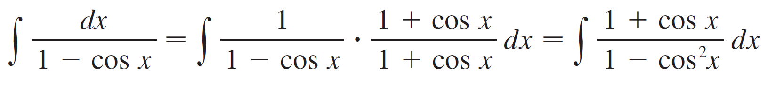
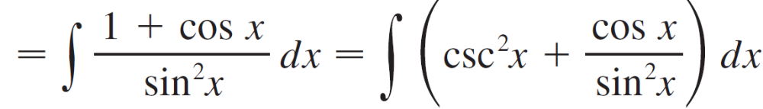
Strategy for Integration
(c) Manipulate the integrand. Algebraic manipulations (perhaps rationalizing the denominator or using
trigonometric identities) may be useful in transforming
the integral into an easier form. These manipulations
may be more substantial than in Step 1 and may
involve some ingenuity. Here is an example:

Slide 12
Strategy for Integration
(d) Relate the problem to previous problems. When you have built up some experience in integration, you may be able to use a method on a given integral that is similar to a method you have already used on a previous integral. Or you may even be able to express the given integral in terms of a previous one.

Slide 13
Strategy for Integration
For instance, ∫ tan²x sec x dx is a challenging integral, but if we make use of the identity tan²x = sec²x – 1,we can write
∫ tan²x sec x dx = ∫ sec³x dx – ∫ sec x dx
and if ∫ sec³x dx has previously been evaluated, then
that calculation can be used in the present problem.

Slide 14
Strategy for Integration
(e) Use several methods. Sometimes two or three methods are required to evaluate an integral. The evaluation could involve several successive substitutions of different types, or it might combine integration by parts with one or more substitutions.

Slide 15
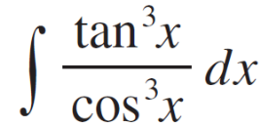
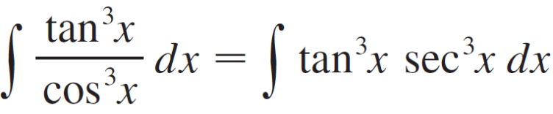
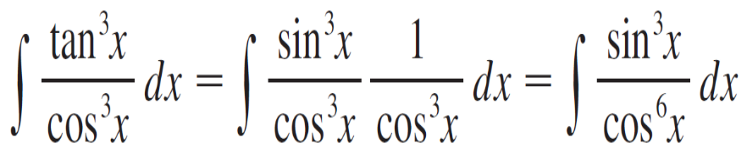
Example 1
In Step 1 we rewrite the integral:
The integral is now of the form ∫ tan^{m}x sec^{n}x dx with m odd.
Alternatively, if in Step 1 we had written

Slide 16
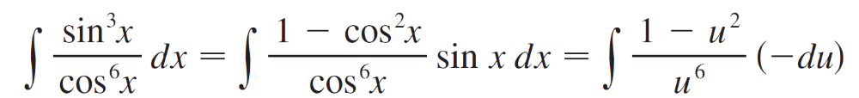
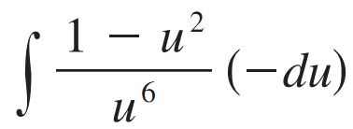
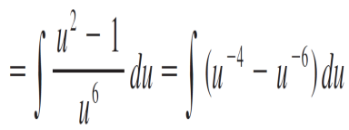
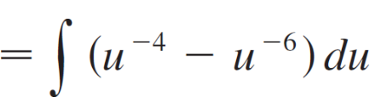
Example 1
cont’d
then we could have continued as follows with the substitution u = cos x:

Slide 17
Can We Integrate All
Continuous Functions?

Slide 18
Can We Integrate All Continuous Functions?
The functions that we have been studied here are called elementary functions.
These are the polynomials, rational functions, power functions (xª), exponential functions (a^{x}), logarithmic functions, trigonometric and inverse trigonometric functions, hyperbolic and inverse hyperbolic functions, and all functions that can be obtained from these by the five operations of addition, subtraction, multiplication, division, and composition.

Slide 19
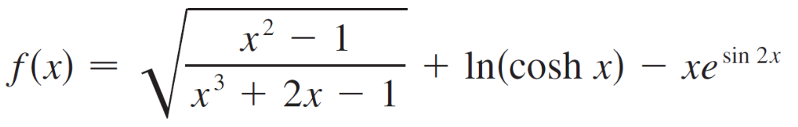

Can We Integrate All Continuous Functions?
For instance, the function
is an elementary function.
If f is an elementary function, then f ′ is an elementary function but ∫ f (x) dx need not be an elementary function. Consider f(x) = .

Slide 20
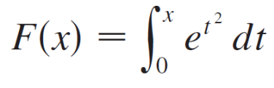

Can We Integrate All Continuous Functions?
Since f is continuous, its integral exists, and if we define the function F by
then we know from Part 1 of the Fundamental Theorem of Calculus that
Thus f (x) = has an antiderivative F, but it has been proved that F is not an elementary function.
This means that no matter how hard we try, we will never succeed in evaluating ∫ dx in terms of the functions we know.

Slide 21
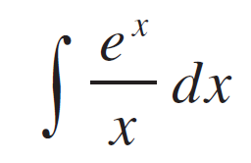
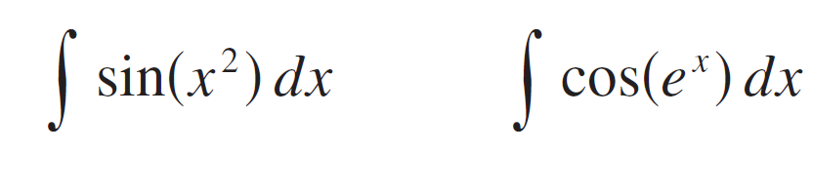
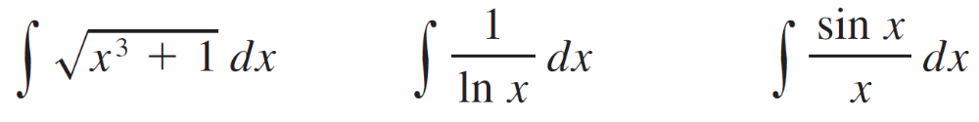
Can We Integrate All Continuous Functions?
The same can be said of the following integrals:
In fact, the majority of elementary functions don’t have elementary antiderivatives.
You may be assured, though, that the integrals in the following exercises are all elementary functions.

