Slide 1

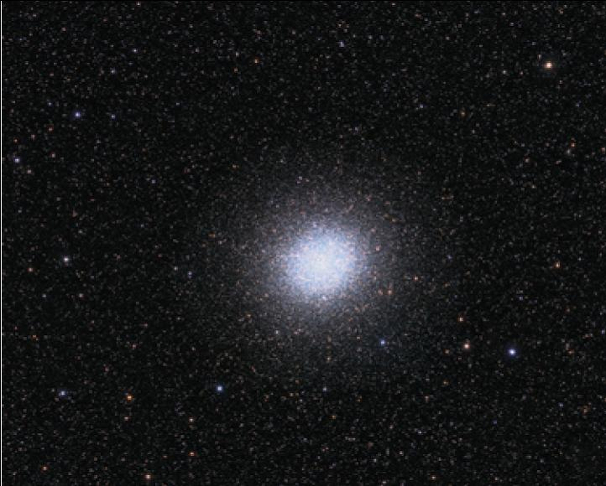
7
Techniques of Integration
Copyright © Cengage Learning. All rights reserved.

Slide 2

7.8
Improper Integrals
Copyright © Cengage Learning. All rights reserved.

Slide 3
Improper Integrals
In this section we extend the concept of a definite integral to the case where the interval is infinite and also to the case where f has an infinite discontinuity in [a, b]. In either case the integral is called an improper integral.

Slide 4
Type 1: Infinite Intervals

Slide 5
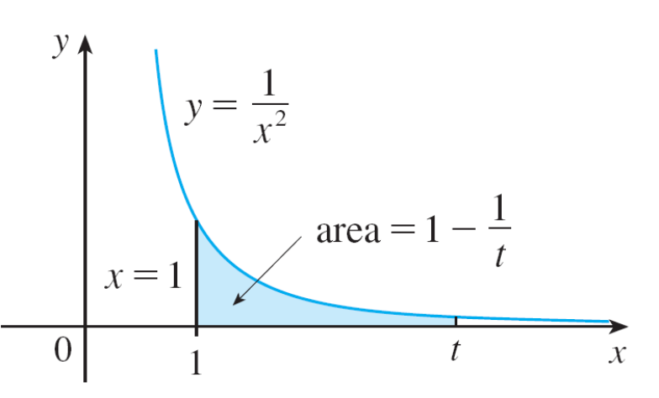
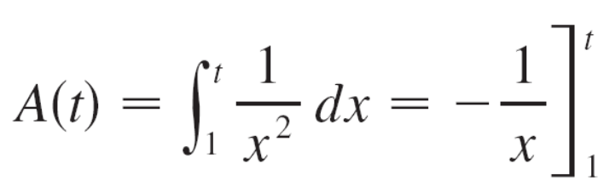
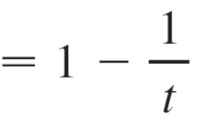
Type 1: Infinite Intervals
Consider the infinite region S that lies under the curve
y = 1/x², above the x-axis, and to the right of the line x = 1.
You might think that, since S is infinite in extent, its area must be infinite, but let’s take a closer look.
The area of the part of S that lies to the left of the line x = t
(shaded in Figure 1) is
Figure 1

Slide 6
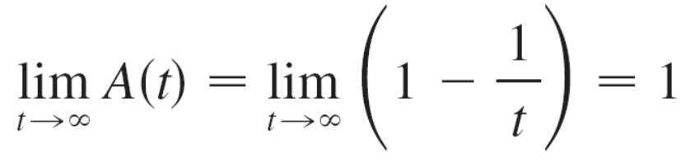

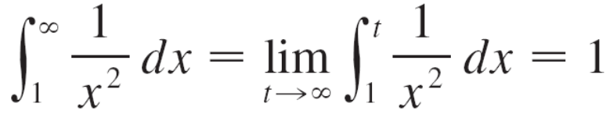
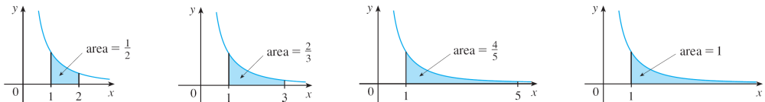
Type 1: Infinite Intervals
Notice that A(t) < 1 no matter how large t is chosen. We also observe that
The area of the shaded region approaches 1 as t → (see Figure 2), so we say that the area of the infinite region S is equal to 1 and we write
Figure 2

Slide 7
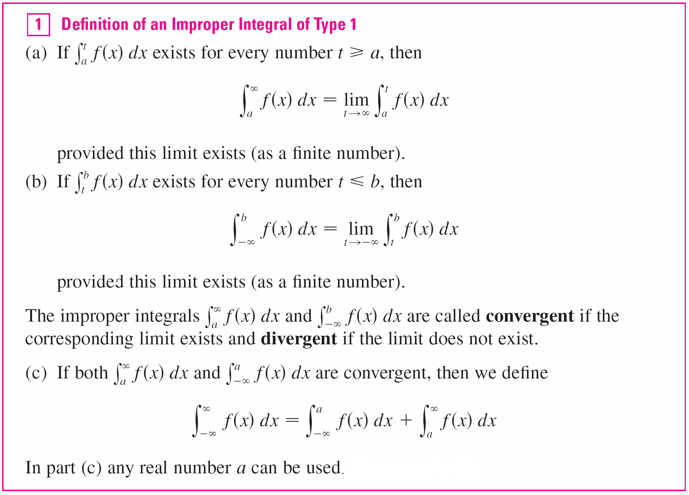
Type 1: Infinite Intervals
Using this example as a guide, we define the integral of f (not necessarily a positive function) over an infinite interval as the limit of integrals over finite intervals.

Slide 8

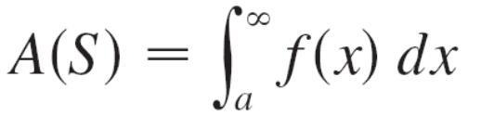
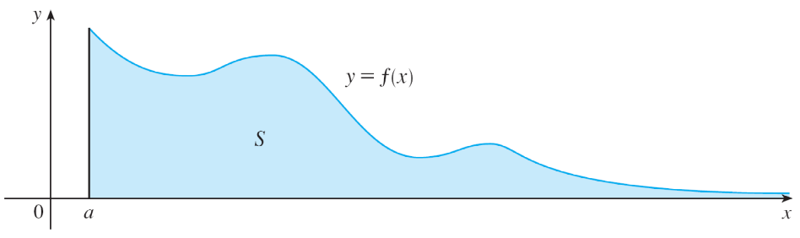
Type 1: Infinite Intervals
Any of the improper integrals in Definition 1 can be interpreted as an area provided that f is a positive function.
For instance, in case (a) if f (x) ≥ 0 and the integral
is convergent, then we define the area of the region
S = {(x, y) | x ≥ a, 0 ≤ y ≤ f (x)} in Figure 3 to be
This is appropriate because is the limit as t → of the area under the graph of f from a to t.
Figure 3

Slide 9
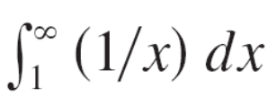
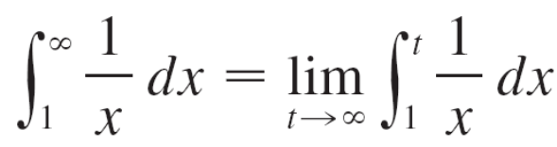
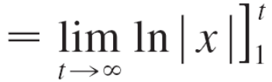
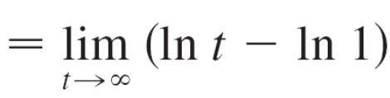
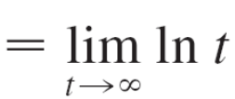

Example 1
Determine whether the integral is convergent or divergent.
Solution:
According to part (a) of Definition 1, we have
The limit does not exist as a finite number and so the
improper integral is divergent.

Slide 10
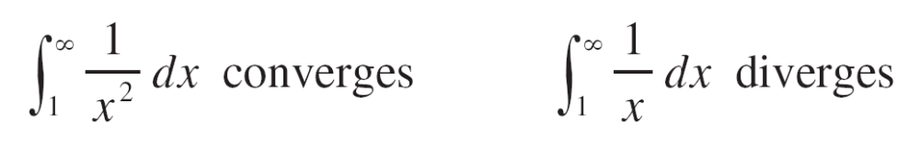
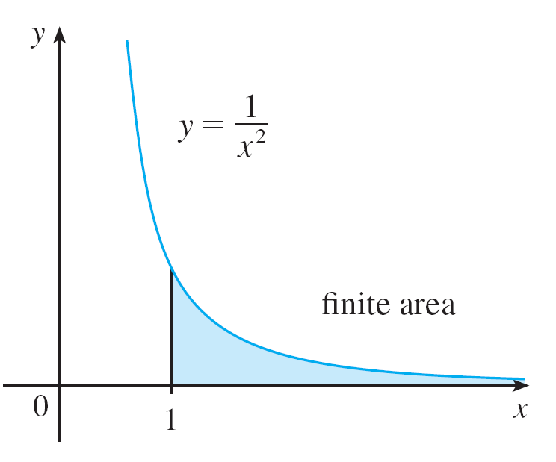
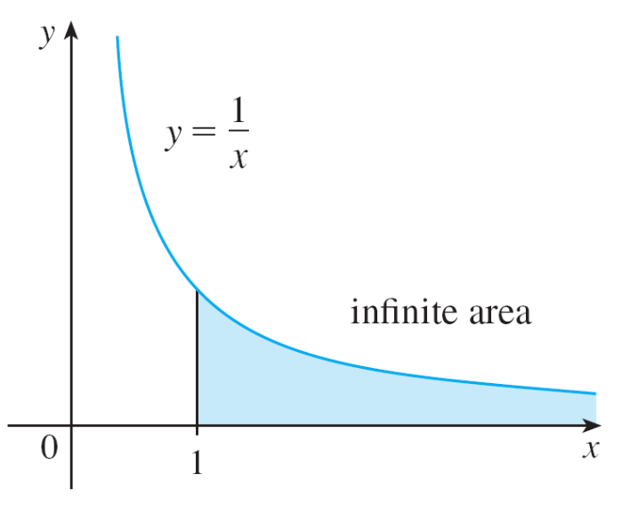


Type 1: Infinite Intervals
Let’s compare the result of Example 1 with the example given at the beginning of this section:
Figure 4
Figure 5

Slide 11

Type 1: Infinite Intervals
Geometrically, this says that although the curves y = 1/x² and y = 1/x look very similar for x > 0, the region under
y = 1/x² to the right of x = 1 (the shaded region in Figure 4) has finite area whereas the corresponding region under
y = 1/x (in Figure 5) has infinite area. Note that both 1/x² and 1/x approach 0 as x → but 1/x² approaches 0 faster than 1/x. The values of 1/x don’t decrease fast enough for its integral to have a finite value.
We summarize this as follows:

Slide 12
Type 2: Discontinuous Integrands

Slide 13
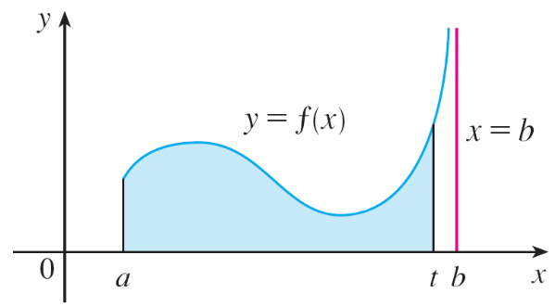
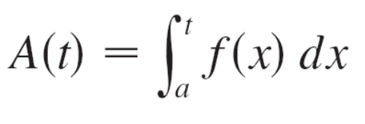
Type 2: Discontinuous Integrands
Suppose that f is a positive continuous function defined on a finite interval [a, b) but has a vertical asymptote at b.
Let S be the unbounded region under the graph of f and above the x-axis between a and b. (For Type 1 integrals, the regions extended indefinitely in a horizontal direction. Here the region is infinite in a vertical direction.)
The area of the part of S between a and t (the shaded region in Figure 7) is
Figure 7

Slide 14
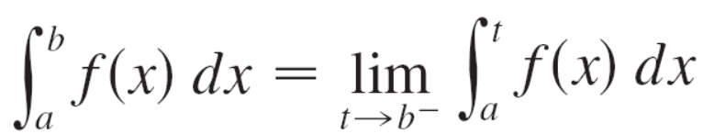
Type 2: Discontinuous Integrands
If it happens that A(t) approaches a definite number A as
t → b–, then we say that the area of the region S is A and we write
We use this equation to define an improper integral of
Type 2 even when f is not a positive function, no matter what type of discontinuity f has at b.

Slide 15
Type 2: Discontinuous Integrands

Slide 16
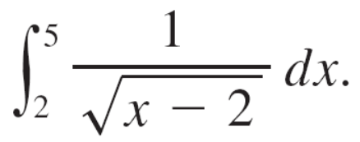

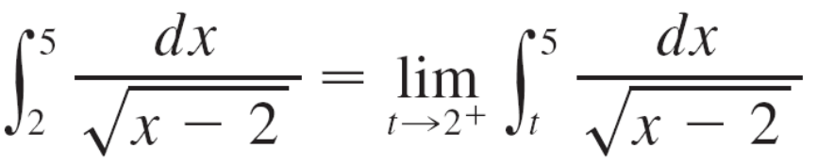
Example 5
Find
Solution:
We note first that the given integral is improper because
has the vertical asymptote x = 2.
Since the infinite discontinuity occurs at the left endpoint of
[2, 5], we use part (b) of Definition 3:

Slide 17
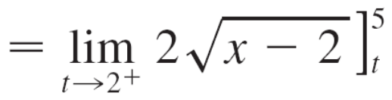
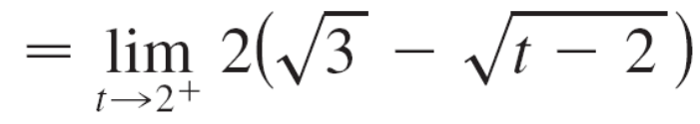

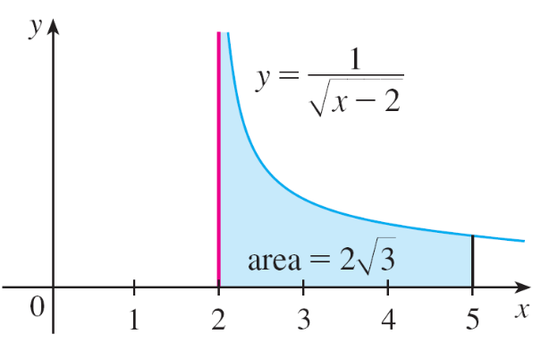
Example 5 – Solution
cont’d
Thus the given improper integral is convergent and, since the integrand is positive, we can interpret the value of the integral as the area of the shaded region in Figure 10.
Figure 10

Slide 18
A Comparison Test for Improper Integrals

Slide 19
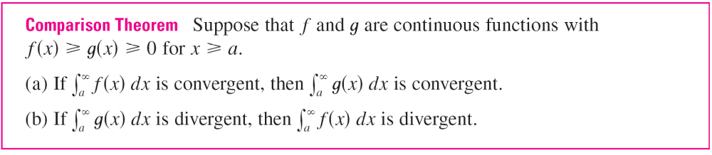
A Comparison Test for Improper Integrals
Sometimes it is impossible to find the exact value of an improper integral and yet it is important to know whether it is convergent or divergent.
In such cases the following theorem is useful. Although we state it for Type 1 integrals, a similar theorem is true for Type 2 integrals.

Slide 20
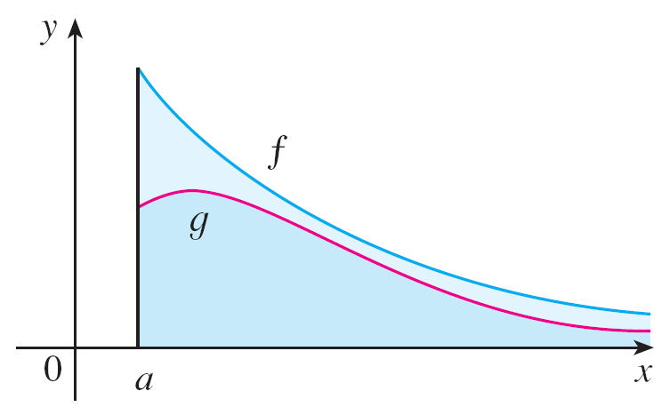
A Comparison Test for Improper Integrals
We omit the proof of the Comparison Theorem, but Figure 12 makes it seem plausible.
If the area under the top curve y = f (x) is finite, then so is the area under the bottom curve y = g (x).
Figure 12

Slide 21


A Comparison Test for Improper Integrals
And if the area under y = g (x) is infinite, then so is the area
under y = f (x). [Note that the reverse is not necessarily true:
If is convergent, may or may not be
convergent, and if is divergent, may or
may not be divergent.]

Slide 22
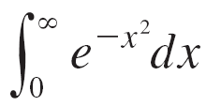
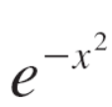
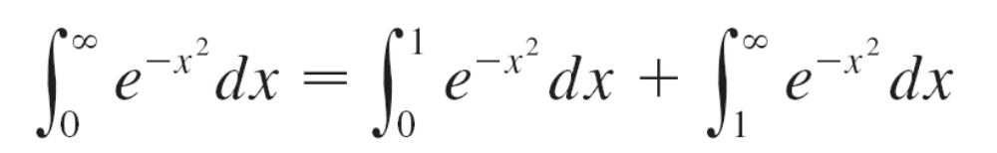
Example 9
Show that is convergent.
Solution:
We can’t evaluate the integral directly because the
antiderivative of is not an elementary function.
We write
and observe that the first integral on the right-hand side is just an ordinary definite integral.

Slide 23
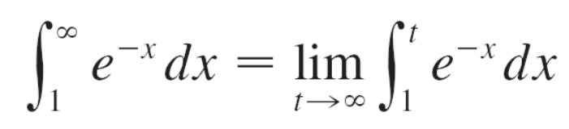
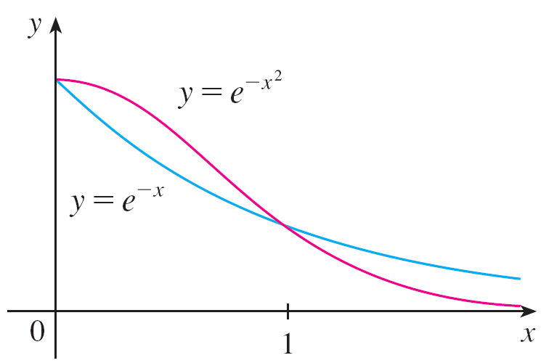
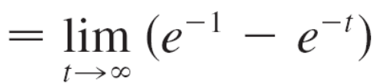

Example 9 – Solution
cont’d
In the second integral we use the fact that for x ≥ 1 we have
x² ≥ x, so –x² ≤ –x and therefore ≤ e^{–x}. (See Figure 13.)
The integral of e^{–x} is easy to evaluate:
Figure 13

Slide 24

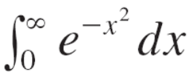
Example 9 – Solution
cont’d
Thus, taking f (x) = e^{–x} and g (x) = in the Comparison
Theorem, we see that is convergent.
It follows that is convergent.

