Slide 1

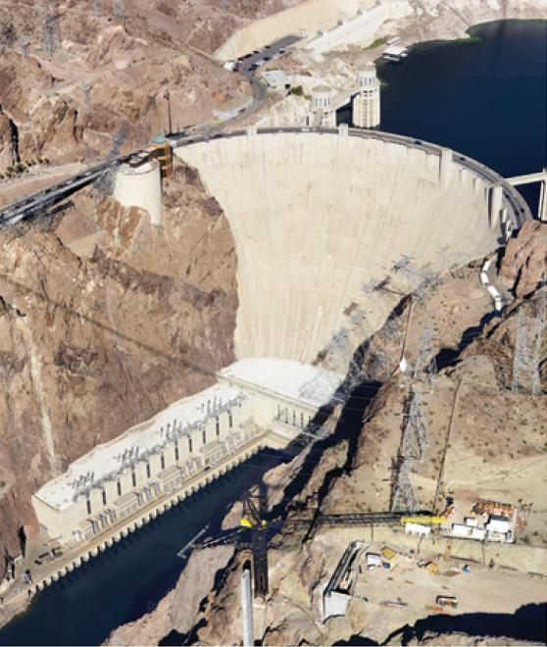
Further Applications
of Integration
8
Copyright © Cengage Learning. All rights reserved.

Slide 2

8.1
Arc Length
Copyright © Cengage Learning. All rights reserved.

Slide 3
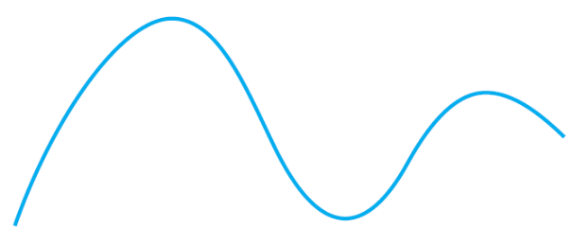
Arc Length
What do we mean by the length of a curve? We might think of fitting a piece of string to the curve in Figure 1 and then measuring the string against a ruler. But that might be difficult to do with much accuracy if we have a complicated curve.
We need a precise definition for the length of an arc of a curve, in the same spirit as the definitions we developed for the concepts of area and volume.
Figure 1

Slide 4
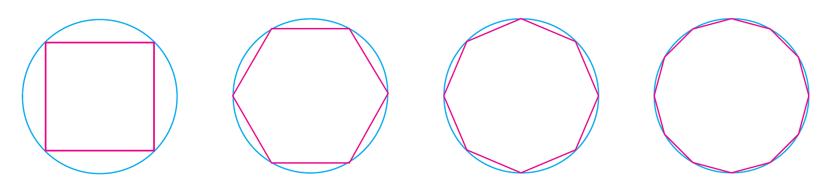
Arc Length
If the curve is a polygon, we can easily find its length; we just add the lengths of the line segments that form the polygon. (We can use the distance formula to find the distance between the endpoints of each segment.) We are going to define the length of a general curve by first approximating it by a polygon and then taking a limit as the number of segments of the polygon is increased. This process is familiar for the case of a circle, where the circumference is the limit of lengths of inscribed polygons (see Figure 2).
Figure 2

Slide 5
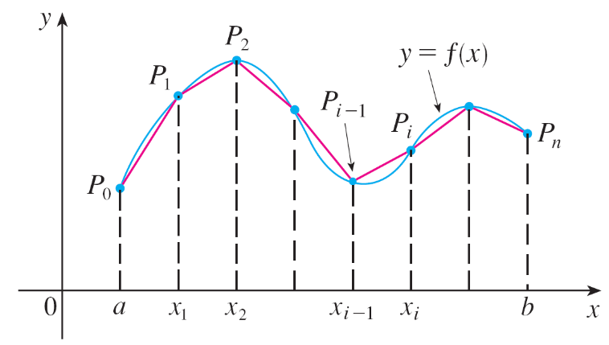
Arc Length
Suppose that a curve C is defined by the equation y = f (x) where f is continuous and a ≤ x ≤ b.
We obtain a polygonal approximation to C by dividing the interval [a, b] into n subintervals with endpoints x₀, x₁,…., x_{n} and equal width Δx. If y_{i} = f (x_{i}), then the point P_{i} (x_{i,} y_{i}) lies on C and the polygon with vertices P₀, P₁, . . . , P_{n}, illustrated in Figure 3, is an approximation to C.
Figure 3

Slide 6
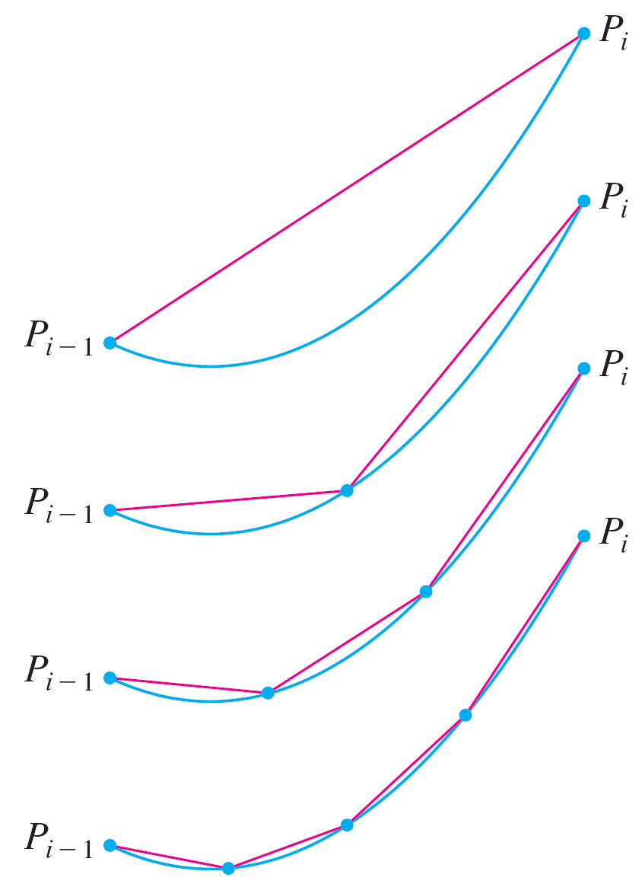
Arc Length
The length L of C is approximately
the length of this polygon and the
approximation gets better as we let
n increase. (See Figure 4, where
the arc of the curve between P_{i – 1}
and P_{i} has been magnified and
approximations with successively
smaller values of Δx are shown.)
Therefore we define the length L of the curve C with equation, y = f (x), a ≤ x ≤ b as the limit of the lengths of these inscribed polygons ( if the limit exists):
Figure 4

Slide 7
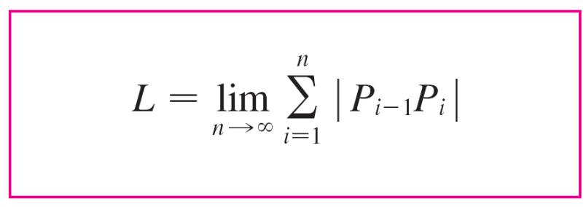


Arc Length
Notice that the procedure for defining arc length is very similar to the procedure we used for defining area and volume: We divided the curve into a large number of small parts. We then found the approximate lengths of the small parts and added them. Finally, we took the limit as n →

Slide 8
Arc Length
The definition of arc length given by Equation 1 is not very convenient for computational purposes, but we can derive an integral formula for L in the case where f has a continuous derivative. [Such a function is called smooth because a small change in x produces a small change in
f′ (x).]
If we let Δy_{i} = y_{i} – y_{i –1}, then

Slide 9
Arc Length
By applying the Mean Value Theorem to f on the interval, [x_{i} – x_{i –1}], we find that there is a number x_{i}* between x_{i –1} and x_{i} such that
f (x_{i}) – f (x_{i –1}) = f ′ (x_{i}* )(x_{i} – x_{i –1})
that is Δy_{i} = f ′ (x_{i}* ) Δx
Thus we have
(since Δx > 0)

Slide 10
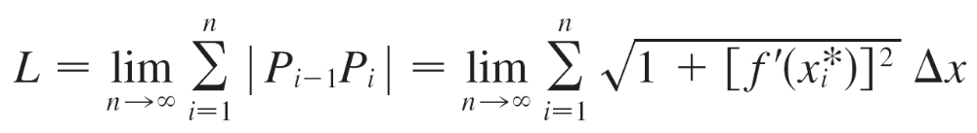
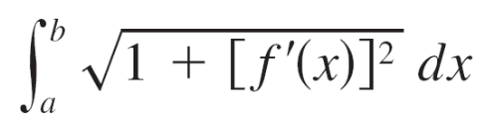

Arc Length
Therefore, by Definition 1,
We recognize this expression as being equal to
by the definition of a definite integral. This integral exists
because the function is continuous.
Thus we have proved the following theorem:

Slide 11
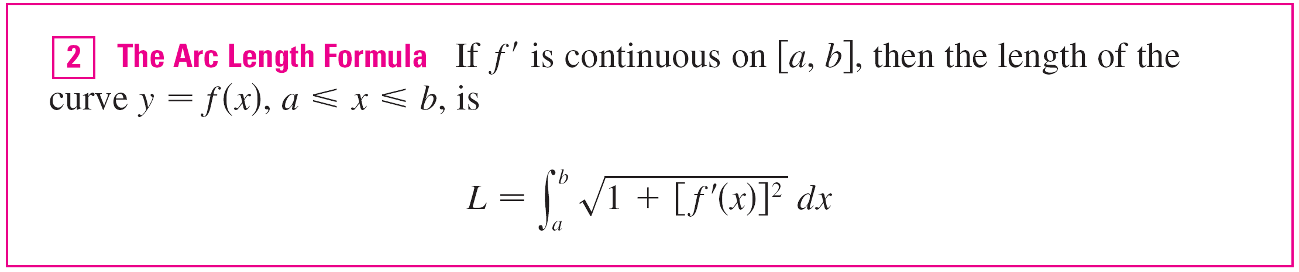
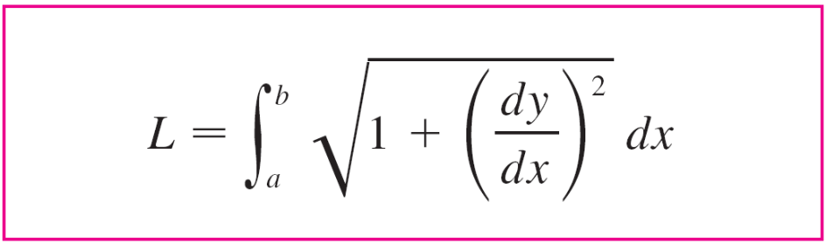

Arc Length
If we use Leibniz notation for derivatives, we can write the arc length formula as follows:

Slide 12
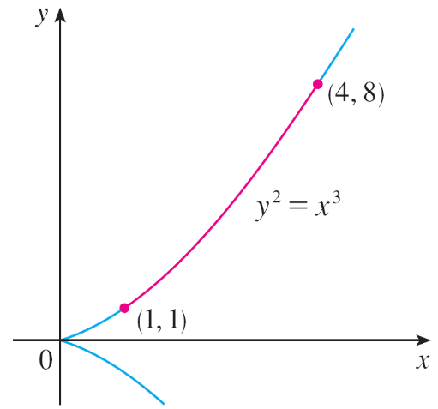
Example 1
Find the length of the arc of the semicubical parabola
y² = x ³ between the points (1, 1) and (4, 8). (See Figure 5.)
Figure 5

Slide 13
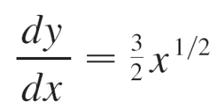
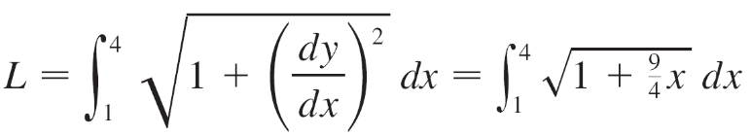



Example 1 – Solution
For the top half of the curve we have
y = x^{3/2}
So the arc length formula gives
If we substitute u = 1 + , then du = dx.
When x = 1, u = ; when x = 4, u = 10.

Slide 14
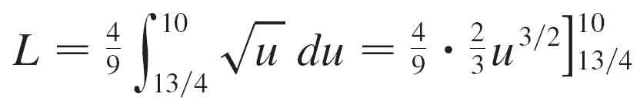
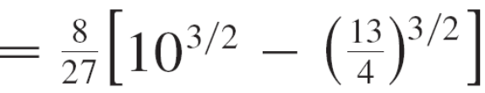
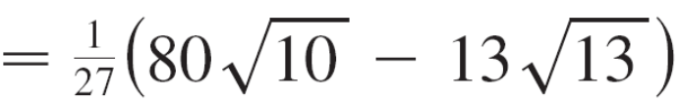
Example 1 – Solution
cont’d
Therefore

Slide 15
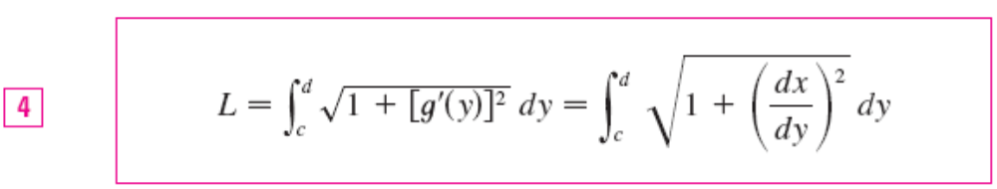
Arc Length
If a curve has the equation x = g (y), c ≤ y ≤ d, and g′ (y) is continuous, then by interchanging the roles of x and y in Formula 2 or Equation 3, we obtain the following formula for its length:

Slide 16
The Arc Length Function

Slide 17
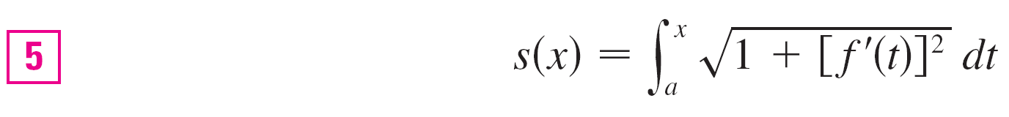
The Arc Length Function
We will find it useful to have a function that measures the arc length of a curve from a particular starting point to any other point on the curve. Thus if a smooth curve C has the equation ,y = f (x), a ≤ x ≤ b let s(x) be the distance along C from the initial point P₀(a, f (a)) to the point Q (x, f (x)). Then s is a function, called the arc length function, and, by Formula 2,

Slide 18
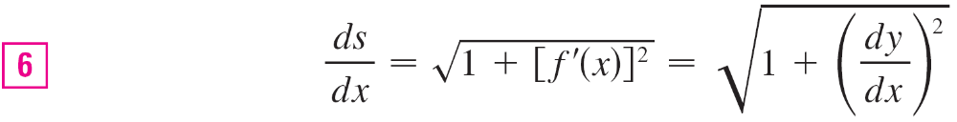
The Arc Length Function
(We have replaced the variable of integration by so that does not have two meanings.) We can use Part 1 of the Fundamental Theorem of Calculus to differentiate Equation 5 (since the integrand is continuous):
Equation 6 shows that the rate of change of s with respect to x is always at least 1 and is equal to 1 when f ′(x), the slope of the curve, is 0.

Slide 19
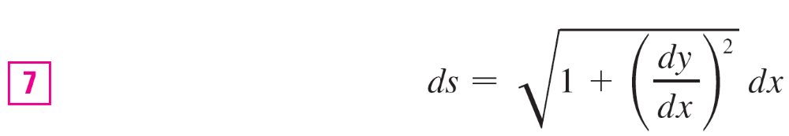
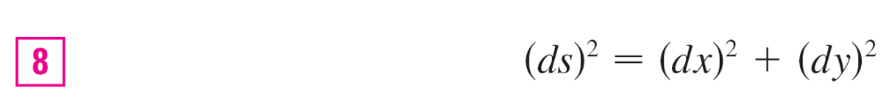
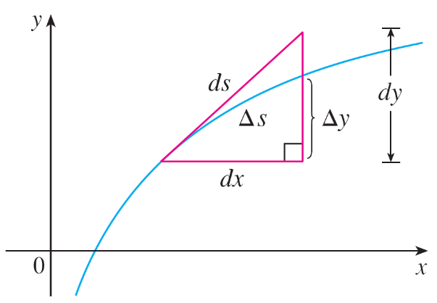
The Arc Length Function
The differential of arc length is
and this equation is sometimes written in the symmetric form
The geometric interpretation of
Equation 8 is shown in Figure 7.
It can be used as a mnemonic
device for remembering both of
the Formulas 3 and 4.
Figure 7

Slide 20

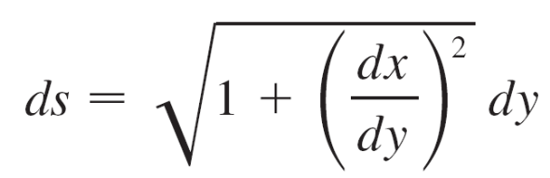
The Arc Length Function
If we write L = ds, then from Equation 8 either we can
solve to get (7), which gives (3), or we can solve to get

Slide 21



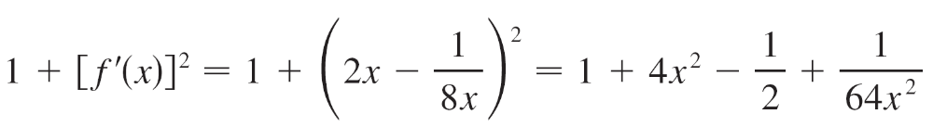
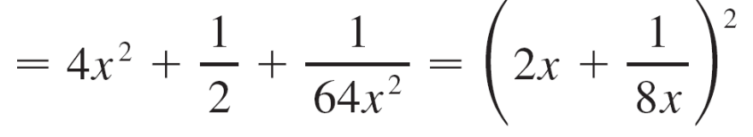
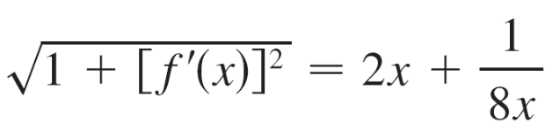
Example 4
Find the arc length function for the curve y = x² – ln x taking P₀(1, 1) as the starting point.
Solution:
If f (x) = x² – ln x, then
f′ (x) = 2x –

Slide 22
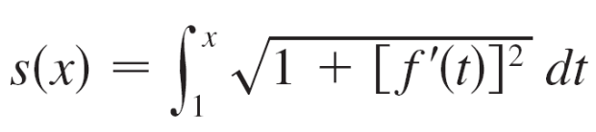
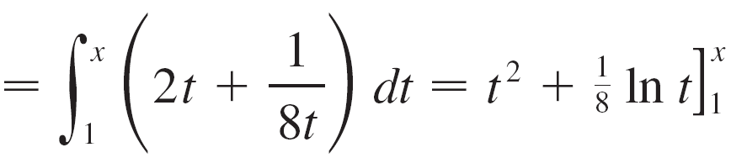

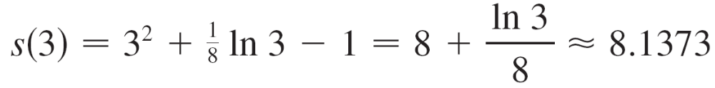
Example 4 – Solution
cont’d
Thus the arc length function is given by
For instance, the arc length along the curve from (1, 1) to
(3, f (3)) is

