Slide 1

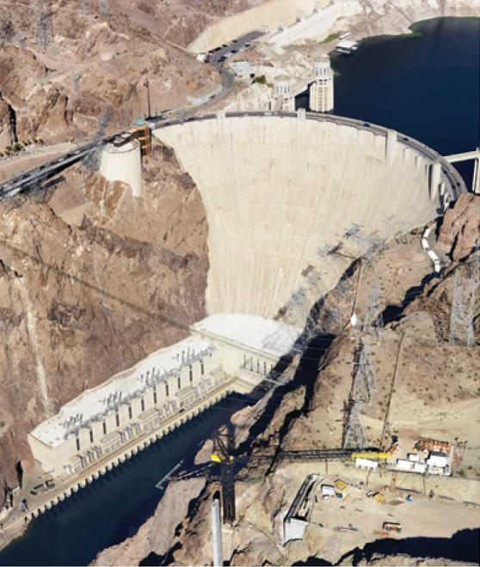
Further Applications
of Integration
8
Copyright © Cengage Learning. All rights reserved.

Slide 2

8.2
Area of a Surface of Revolution
Copyright © Cengage Learning. All rights reserved.

Slide 3
Area of a Surface of Revolution
A surface of revolution is formed when a curve is rotated about a line. Such a surface is the lateral boundary of a solid of revolution.
We want to define the area of a surface of revolution in such a way that it corresponds to our intuition. If the surface area is A, we can imagine that painting the surface would require the same amount of paint as does a flat region with area A.

Slide 4
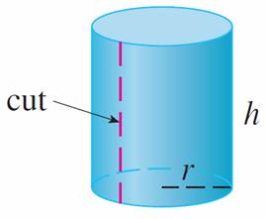
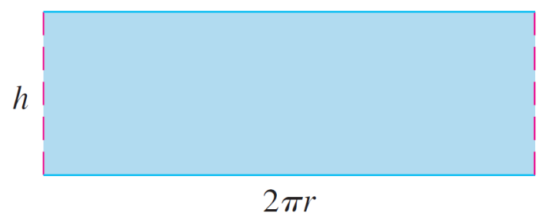
Area of a Surface of Revolution
Let’s start with some simple surfaces. The lateral surface area of a circular cylinder with radius r and height h is taken to be A = 2π rh because we can imagine cutting the cylinder and unrolling it (as in Figure 1) to obtain a rectangle with dimensions 2π r and h.
Figure 1

Slide 5
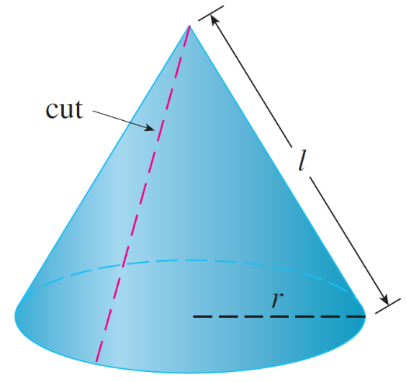
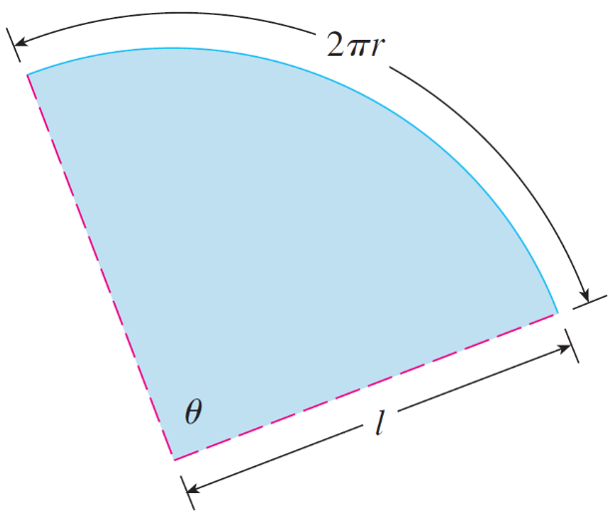
Area of a Surface of Revolution
Likewise, we can take a circular cone with base radius r and slant height l, cut it along the dashed line in Figure 2, and flatten it to form a sector of a circle with radius l and central angle θ = 2π r/l.
Figure 2

Slide 6
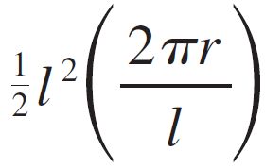
Area of a Surface of Revolution
We know that, in general, the area of a sector of a circle with radius l and angle θ is l ²θ and so in this case the area is
A = l ²θ = = π r l
Therefore we define the lateral surface area of a cone to be A = π r l.
What about more complicated surfaces of revolution? If we follow the strategy we used with arc length, we can approximate the original curve by a polygon.

Slide 7
Area of a Surface of Revolution
When this polygon is rotated about an axis, it creates a simpler surface whose surface area approximates the actual surface area.
By taking a limit, we can determine the exact surface area.
The approximating surface, then, consists of a number of bands, each formed by rotating a line segment about an axis.

Slide 8
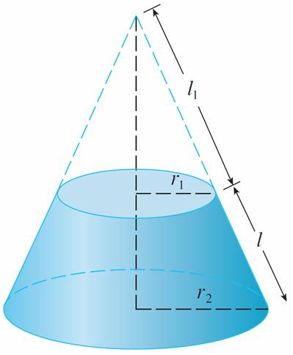
Area of a Surface of Revolution
To find the surface area, each of these bands can be considered a portion of a circular cone, as shown in
Figure 3.
Figure 3

Slide 9

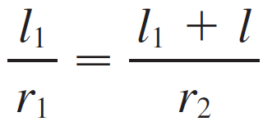
Area of a Surface of Revolution
The area of the band (or frustum of a cone) with slant height l and upper and lower radii r₁ and r₂ is found by subtracting the areas of two cones:
A = π r₂(l₁ + l ) – π r₁l₁ = π [(r₂ – r₁) l₁ + r₂l ]
From similar triangles we have
which gives
r₂l₁ = r₁l₁ + r₁l or (r₂ – r₁)l₁ = r₁l

Slide 10



Area of a Surface of Revolution
Putting this in Equation 1, we get
A = π (r₁l + r₂l )
or
where r = (r₁ + r₂) is the average radius of the band.

Slide 11
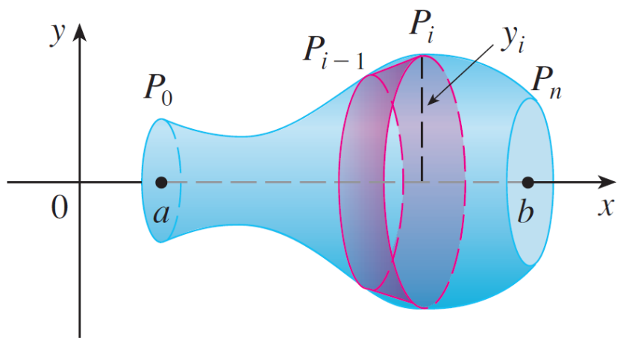
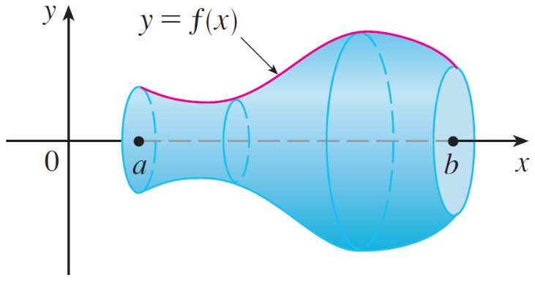
Area of a Surface of Revolution
Now we apply this formula to our strategy. Consider the surface shown in Figure 4, which is obtained by rotating the curve y = f (x), a ≤ x ≤ b, about the x-axis, where f is positive and has a continuous derivative.
(a) Surface of revolution
(b) Approximating band
Figure 4

Slide 12
Area of a Surface of Revolution
In order to define its surface area, we divide the interval
[a, b] into n subintervals with endpoints x₀, x₁, . . . , x_{n} and equal width Δx.
If y_{i} = f (x_{i} ), then the point P_{i}(x_{i}, y_{i} ) lies on the curve.
The part of the surface between x_{i – 1} and x_{i} is approximated by taking the line segment P_{i} – ₁P_{i} and rotating it about the
x-axis.

Slide 13
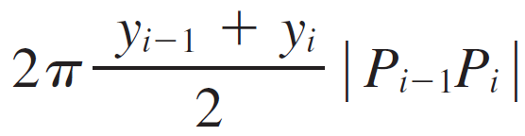

Area of a Surface of Revolution
The result is a band with slant height l = |P_{i – 1}P_{i}| and average radius r = (y_{i – 1} + y_{i}) so, by Formula 2, its surface area is
We have
where x_{i}∗ is some number in [x_{i} – ₁, x_{i} ].

Slide 14
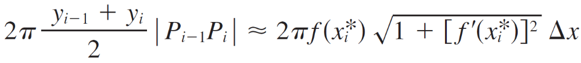
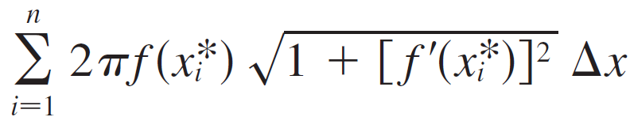

Area of a Surface of Revolution
When Δx is small, we have y_{i} = f (x_{i}) ≈ f (x_{i}∗) and also
Y_{i – 1} = f (x_{i –} ₁) ≈ f (x_{i}∗), since f is continuous.
Therefore
and so an approximation to what we think of as the area of the complete surface of revolution is

Slide 15



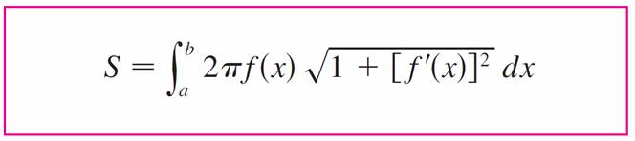

Area of a Surface of Revolution
This approximation appears to become better as n → and, recognizing as a Riemann sum for the function
g(x) = 2π f (x) , we have
Therefore, in the case where f is positive and has a continuous derivative, we define the surface area of the surface obtained by rotating the curve y = f (x), a ≤ x ≤ b, about the x-axis as

Slide 16
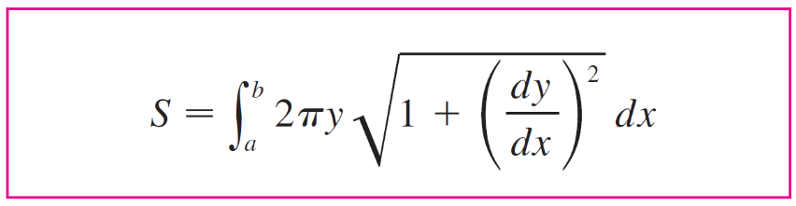

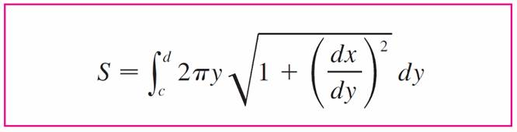

Area of a Surface of Revolution
With the Leibniz notation for derivatives, this formula becomes
If the curve is described as x = g(y), c ≤ y ≤ d, then the formula for surface area becomes

Slide 17

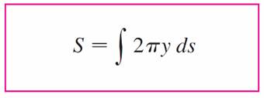
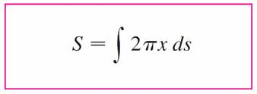

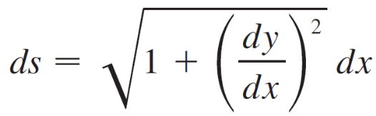
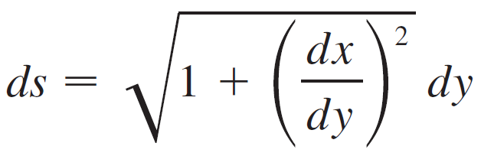
Area of a Surface of Revolution
Now both Formulas 5 and 6 can be summarized symbolically, using the notation for arc length, as
For rotation about the y-axis, the surface area formula becomes
where, as before, we can use either
or

Slide 18
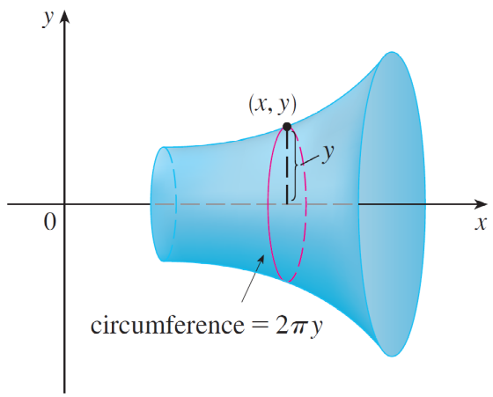
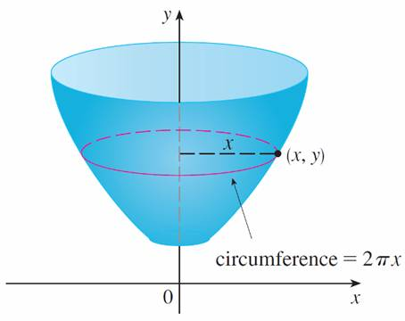
Area of a Surface of Revolution
These formulas can be remembered by thinking of 2π y or
2π x as the circumference of a circle traced out by the point (x, y) on the curve as it is rotated about the x-axis or y-axis, respectively (see Figure 5).
(a) Rotation about x-axis: S = ∫ 2π y ds
(b) Rotation about y-axis: S = ∫ 2π x ds
Figure 5

Slide 19

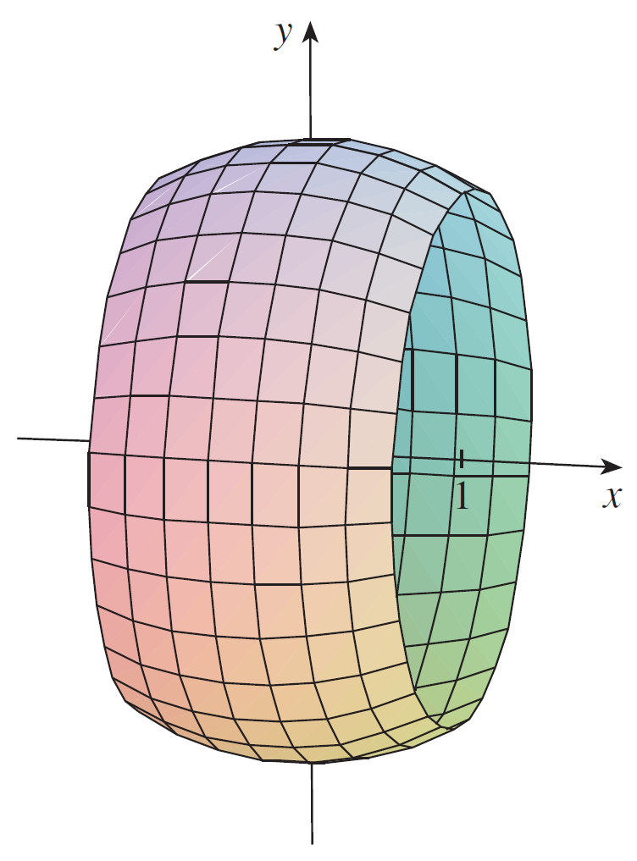
Example 1
The curve y = , –1 ≤ x ≤ 1, is an arc of the circle
x² + y² = 4.
Find the area of the surface obtained by rotating this arc about the x-axis. (The surface is a portion of a sphere of radius 2. See Figure 6.)
Figure 6

Slide 20
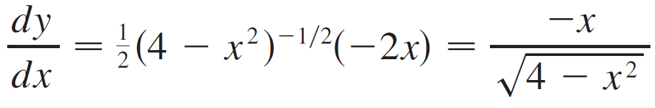
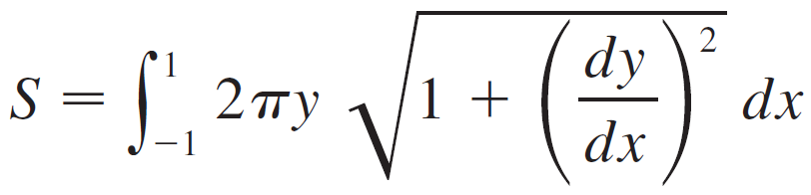
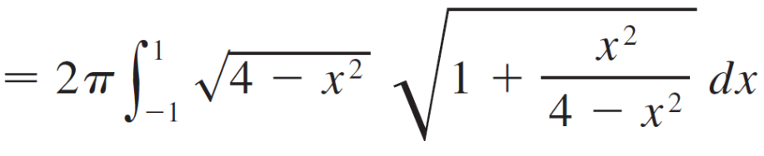
Example 1 – Solution
We have
and so, by Formula 5, the surface area is

Slide 21
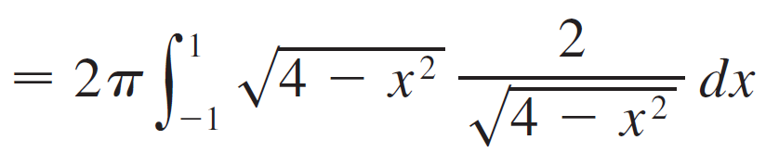

Example 1 – Solution
cont’d
= 4π 1 dx
= 4π (2)
= 8π

Slide 22

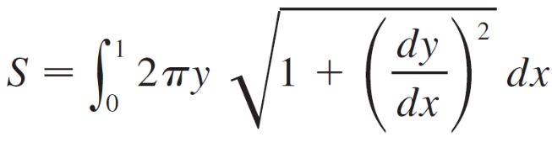
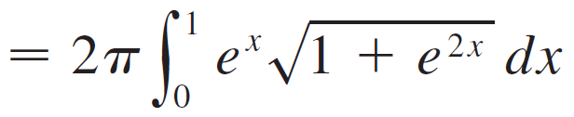
Example 3
Find the area of the surface generated by rotating the curve y = e^{x}, 0 ≤ x ≤ 1, about the x-axis.
Solution:
Using Formula 5 with
y = e^{x} and = e^{x}
we have

Slide 23
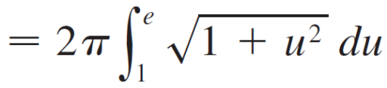
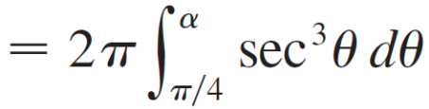

Example 3 – Solution
cont’d
= π [sec α tan α + ln(sec α + tan α) – – ln( + 1)]
(where u = e ^{x})
(where u = tan θ and α = tan^{–1}e)

Slide 24

Example 3 – Solution
cont’d
Since tan α = e, we have sec²α = 1 + tan²α = 1 + e² and
S = π [ + ln( ) – – ln( + 1)]

