Slide 1


9
Differential Equations
Copyright © Cengage Learning. All rights reserved.

Slide 2

Modeling with Differential
Equations
9.1
Copyright © Cengage Learning. All rights reserved.

Slide 3
Modeling with Differential Equations
The mathematical model often takes the form of a differential equation, that is, an equation that contains an unknown function and some of its derivatives.
This is not surprising because in a real-world problem we often notice that changes occur and we want to predict future behavior on the basis of how current values change.
Let’s begin by examining several examples of how differential equations arise when we model physical phenomena.

Slide 4
Models of Population Growth

Slide 5
Models of Population Growth
One model for the growth of a population is based on the assumption that the population grows at a rate proportional to the size of the population.
That is a reasonable assumption for a population of bacteria or animals under ideal conditions (unlimited environment, adequate nutrition, absence of predators, immunity from disease).
Let’s identify and name the variables in this model:
t = time (the independent variable)
P = the number of individuals in the population
(the dependent variable)

Slide 6

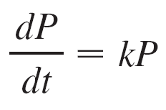
Models of Population Growth
The rate of growth of the population is the derivative dP/dt. So our assumption that the rate of growth of the population is proportional to the population size is written as the equation
where k is the proportionality constant. Equation 1 is our first model for population growth; it is a differential equation because it contains an unknown function P and its derivative dP/dt.

Slide 7
Models of Population Growth
Having formulated a model, let’s look at its consequences. If we rule out a population of 0, then P(t) > 0 for all t. So, if
k > 0, then Equation 1 shows that P′(t) > 0 for all t.
This means that the population is always increasing. In fact, as P(t) increases, Equation 1 shows that dP/dt becomes larger.
In other words, the growth rate increases as the population increases.
Let’s try to think of a solution of Equation 1. This equation asks us to find a function whose derivative is a constant multiple of itself.

Slide 8
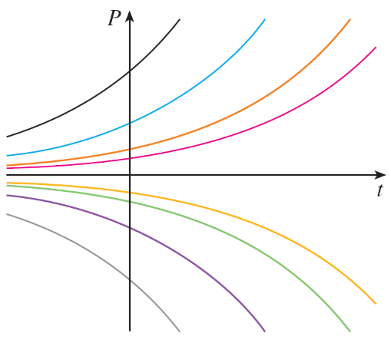
Models of Population Growth
We know that exponential functions have that property. In fact, if we let P(t) = Ce^{kt}, then
P′(t) = C(ke^{kt}) = k(Ce^{kt}) = kP(t)
Thus any exponential function of the form P(t) = Ce^{kt} is a solution of Equation 1.
Allowing C to vary through all the
real numbers, we get the family of
solutions P(t) = Ce^{kt} whose graphs
are shown in Figure 1.
Figure 1
The family of solutions of dP/dt = kP

Slide 9
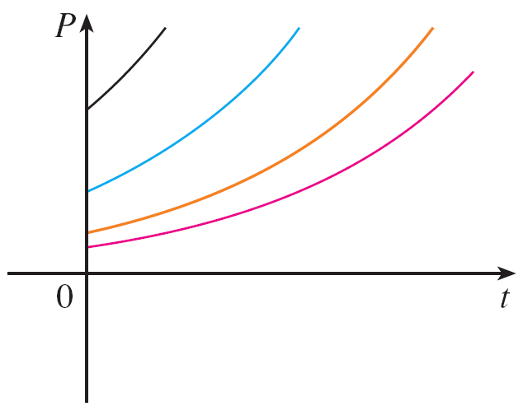
Models of Population Growth
But populations have only positive values and so we are interested only in the solutions with C > 0. And we are probably concerned only with values of t greater than the initial time t = 0. Figure 2 shows the physically meaningful solutions.
Figure 2
The family of solutions of P(t) = Ce ^{kt} with C > 0 and t ≥ 0

Slide 10
Models of Population Growth
Putting t = 0, we get P(0) = Ce^{k(0)} = C, so the constant C
turns out to be the initial population, P(0).
Equation 1 is appropriate for modeling population growth under ideal conditions, but we have to recognize that a more realistic model must reflect the fact that a given environment has limited resources.
Many populations start by increasing in an exponential manner, but the population levels off when it approaches its carrying capacity M (or decreases toward M if it ever exceeds M).

Slide 11
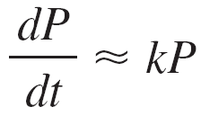
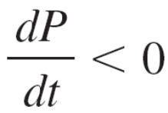
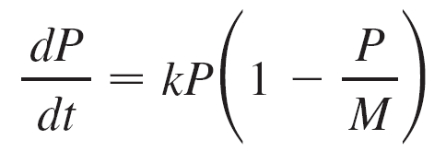

Models of Population Growth
For a model to take into account both trends, we make two
assumptions:
if P is small (Initially, the growth rate is proportional to P.)
if P > M (P decreases if it ever exceeds M.)
A simple expression that incorporates both assumptions is given by the equation

Slide 12
Models of Population Growth
Notice that if P is small compared with M, then P/M is close to 0 and so dP/dt ≈ kP. If P > M, then 1 – P/M is negative and so dP/dt < 0.
Equation 2 is called the logistic differential equation and was proposed by the Dutch mathematical biologist
Pierre-François Verhulst in the 1840s as a model for world population growth.
We first observe that the constant functions P(t) = 0 and
P(t) = M are solutions because, in either case, one of the factors on the right side of Equation 2 is zero. These two constant solutions are called equilibrium solutions.

Slide 13
Models of Population Growth
If the initial population P(0) lies between 0 and M, then the right side of Equation 2 is positive, so dP/dt > 0 and the population increases. But if the population exceeds the carrying capacity (P > M), then 1 – P/M is negative, so
dP/dt < 0 and the population decreases.
Notice that, in either case, if the population approaches the carrying capacity (P → M), then dP/dt → 0, which means the population levels off.

Slide 14
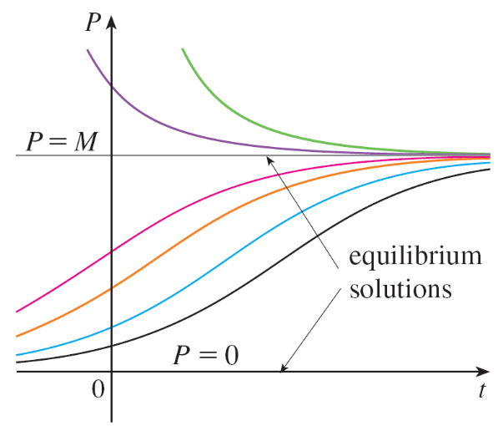
Models of Population Growth
So we expect that the solutions of the logistic differential equation have graphs that look something like the ones in Figure 3.
Notice that the graphs move away from the equilibrium solution P = 0 and move toward the equilibrium solution
P = M.
Figure 3
Solutions of the logistic equation

Slide 15
A Model for the Motion of a Spring

Slide 16
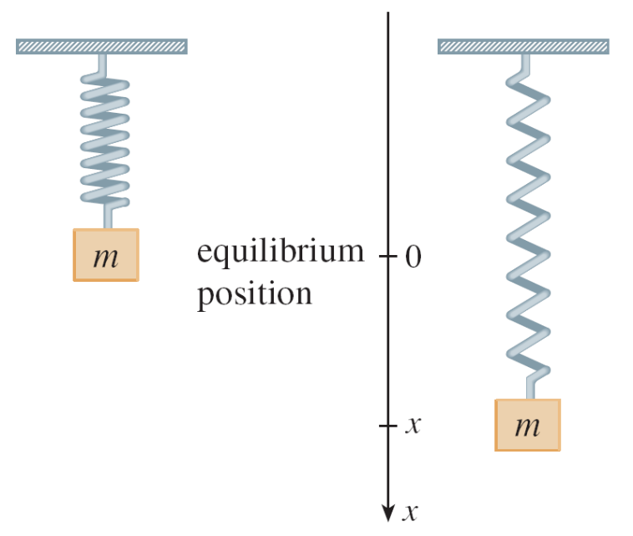
A Model for the Motion of a Spring
Let’s now look at an example of a model from the physical sciences. We consider the motion of an object with mass m at the end of a vertical spring (as in Figure 4).
Figure 4

Slide 17
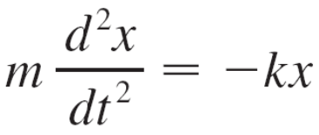

A Model for the Motion of a Spring
We have discussed Hooke’s Law, which says that if the spring is stretched (or compressed) x units from its natural length, then it exerts a force that is proportional to x:
restoring force = –kx
where k is a positive constant (called the spring constant). If we ignore any external resisting forces (due to air resistance or friction) then, by Newton’s Second Law (force equals mass times acceleration), we have

Slide 18
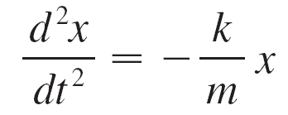
A Model for the Motion of a Spring
This is an example of what is called a second-order differential equation because it involves second derivatives.
Let’s see what we can guess about the form of the solution directly from the equation. We can rewrite Equation 3 in the form
which says that the second derivative of x is proportional to x but has the opposite sign.

Slide 19
General Differential Equations

Slide 20
General Differential Equations
In general, a differential equation is an equation that contains an unknown function and one or more of its derivatives.
The order of a differential equation is the order of the highest derivative that occurs in the equation. Thus Equations 1 and 2 are first-order equations and Equation 3 is a second-order equation.
In all three of those equations the independent variable is called t and represents time, but in general the independent variable doesn’t have to represent time.

Slide 21

General Differential Equations
For example, when we consider the differential equation
y′ = xy
it is understood that y is an unknown function of x.
A function f is called a solution of a differential equation if the equation is satisfied when y = f (x) and its derivatives are substituted into the equation. Thus f is a solution of
Equation 4 if
f ′(x) = xf (x)
for all values of x in some interval.

Slide 22
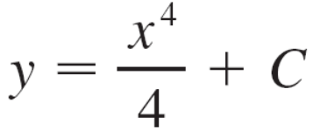
General Differential Equations
When we are asked to solve a differential equation we are expected to find all possible solutions of the equation. We have already solved some particularly simple differential equations, namely, those of the form
y ′ = f (x)
For instance, we know that the general solution of the differential equation
y ′ = x³
is given by
where C is an arbitrary constant.

Slide 23
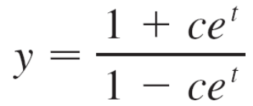

Example 1
Show that every member of the family of functions
is a solution of the differential equation .

Slide 24
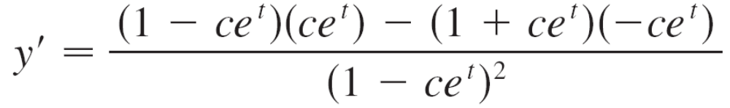
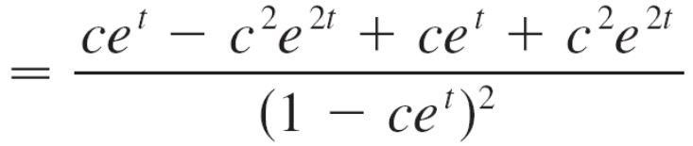
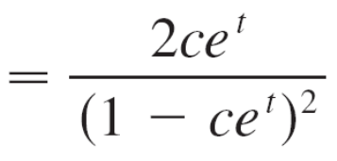
Example 1 – Solution
We use the Quotient Rule to differentiate the expression
for y:

Slide 25
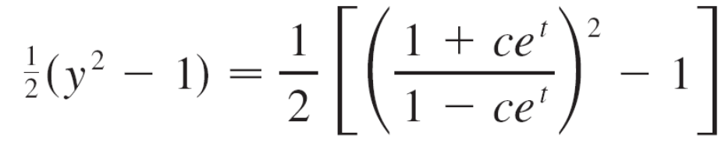
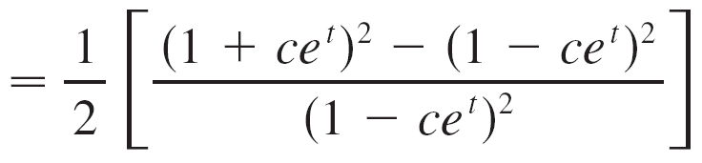
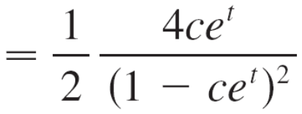

Example 1 – Solution
cont’d
The right side of the differential equation becomes
Therefore, for every value of c, the given function is a solution of the differential equation.

Slide 26
General Differential Equations
When applying differential equations, we are usually not as interested in finding a family of solutions (the general solution) as we are in finding a solution that satisfies some additional requirement.
In many physical problems we need to find the particular solution that satisfies a condition of the form y(t₀) = y₀.
This is called an initial condition, and the problem of finding a solution of the differential equation that satisfies the initial condition is called an initial-value problem.

