Slide 1

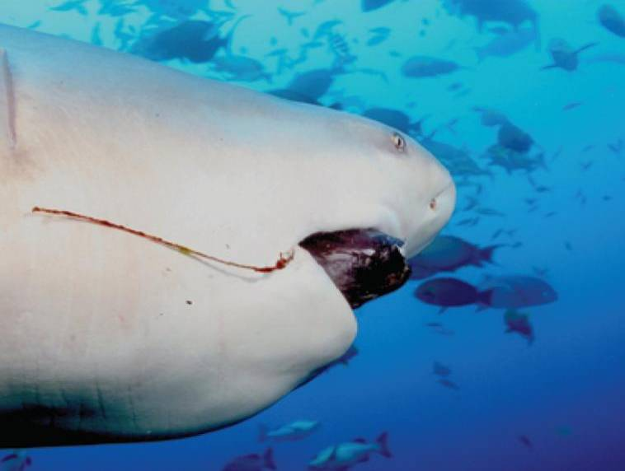
9
Differential Equations
Copyright © Cengage Learning. All rights reserved.

Slide 2

9.3
Separable Equations
Copyright © Cengage Learning. All rights reserved.

Slide 3
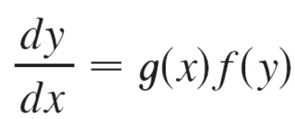
Separable Equations
A separable equation is a first-order differential equation in which the expression for dy/dx can be factored as a function of x times a function of y.
In other words, it can be written in the form
The name separable comes from the fact that the expression on the right side can be “separated” into a function of x and a function of y.

Slide 4
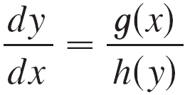

Separable Equations
Equivalently, if f (y) ≠ 0, we could write
where h(y) = 1/f (y).
To solve this equation we rewrite it in the differential form
h(y) dy = g(x) dx
so that all y’s are on one side of the equation and all x’s are on the other side.

Slide 5

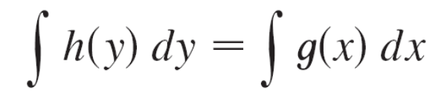
Separable Equations
Then we integrate both sides of the equation:
Equation 2 defines y implicitly as a function of x. In some cases we may be able to solve for y in terms of x.

Slide 6
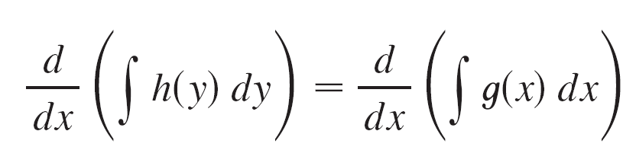
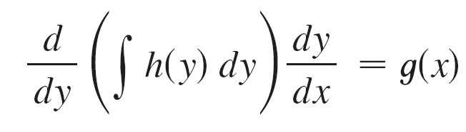
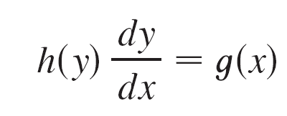
Separable Equations
We use the Chain Rule to justify this procedure: If h and g satisfy (2), then
so
and
Thus Equation 1 is satisfied.

Slide 7
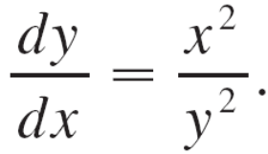
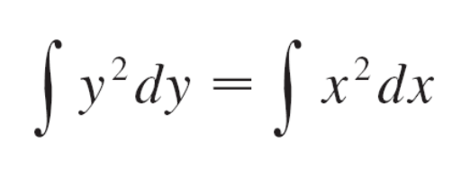
Example 1
(a) Solve the differential equation
(b) Find the solution of this equation that satisfies the initial
condition y(0) = 2.
Solution:
(a) We write the equation in terms of differentials and
integrate both sides:
y² dy = x² dx

Slide 8
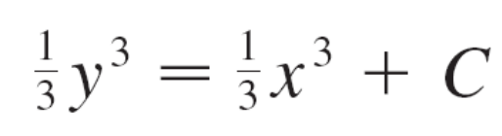
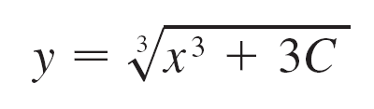
Example 1 – Solution
cont’d
where C is an arbitrary constant. (We could have used a constant C₁ on the left side and another constant C₂ on the right side. But then we could combine these constants by writing C = C₂ – C₁.)
Solving for y, we get

Slide 9
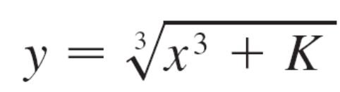


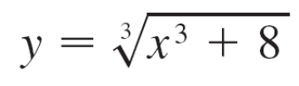
Example 1 – Solution
cont’d
We could leave the solution like this or we could write it
in the form
where K = 3C. (Since C is an arbitrary constant, so is
K.)
(b) If we put x = 0 in the general solution in part (a),
we get
To satisfy the initial condition y(0) = 2, we must have
and so K = 8.
Thus the solution of the initial-value problem is

Slide 10
Orthogonal Trajectories

Slide 11
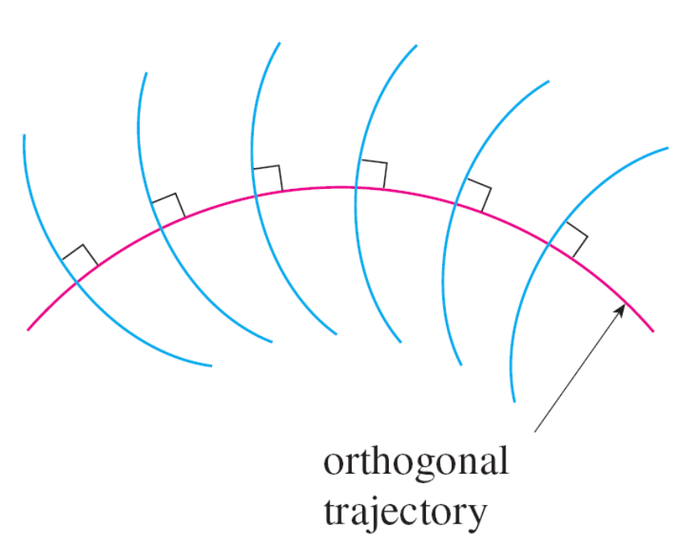
Orthogonal Trajectories
An orthogonal trajectory of a family of curves is a curve that intersects each curve of the family orthogonally, that is, at right angles (see Figure 7).
Figure 7

Slide 12
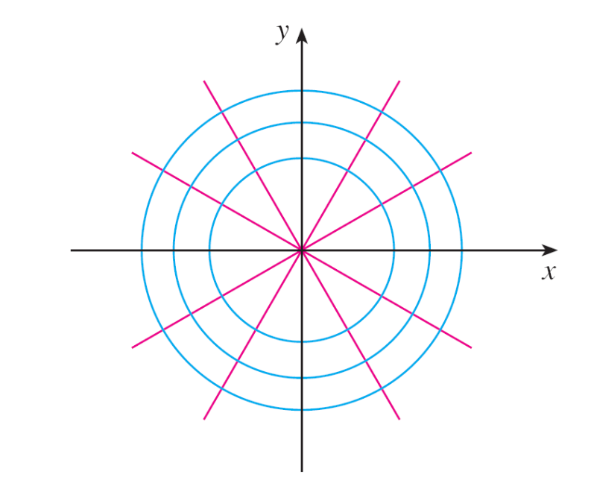
Orthogonal Trajectories
For instance, each member of the family y = mx of straight lines through the origin is an orthogonal trajectory of the
family x² + y² = r² of concentric circles with center the origin (see Figure 8). We say that the two families are orthogonal trajectories of each other.
Figure 8

Slide 13
Example 5
Find the orthogonal trajectories of the family of curves x = ky², where is k an arbitrary constant.
Solution:
The curves x = ky² form a family of parabolas whose axis of symmetry is the x-axis.
The first step is to find a single differential equation that is satisfied by all members of the family.

Slide 14
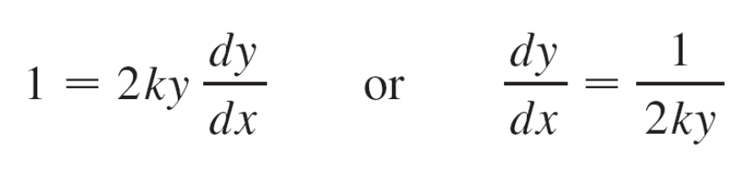
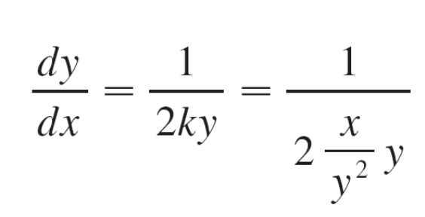
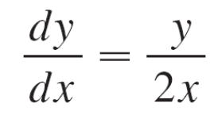
Example 5 – Solution
cont’d
If we differentiate x = ky², we get
This differential equation depends on k, but we need an equation that is valid for all values of k simultaneously.
To eliminate k we note that, from the equation of the given general parabola x = ky², we have k = x/y² and so the
differential equation can be written as
or

Slide 15
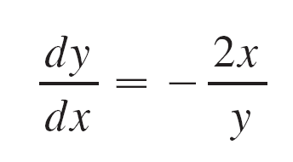
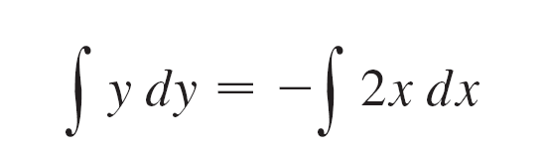
Example 5 – Solution
cont’d
This means that the slope of the tangent line at any point (x, y) on one of the parabolas is y ′ = y/(2x).
On an orthogonal trajectory the slope of the tangent line must be the negative reciprocal of this slope.
Therefore the orthogonal trajectories must satisfy the differential equation
This differential equation is separable, and we solve it as follows:

Slide 16
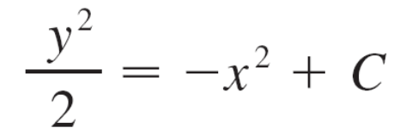

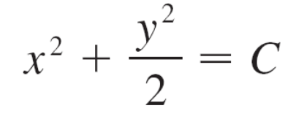
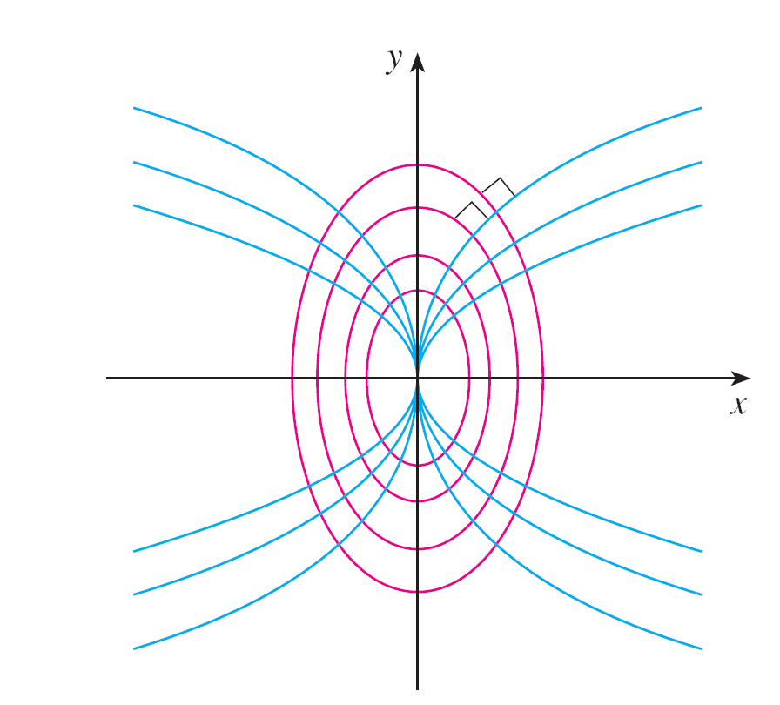
Example 5 – Solution
cont’d
where C is an arbitrary
positive constant.
Thus the orthogonal trajectories
are the family of ellipses
given by Equation 4 and
sketched in Figure 9.
Figure 9

Slide 17
Mixing Problems

Slide 18
Mixing Problems
A typical mixing problem involves a tank of fixed capacity filled with a thoroughly mixed solution of some substance, such as salt.
A solution of a given concentration enters the tank at a fixed rate and the mixture, thoroughly stirred, leaves at a fixed rate, which may differ from the entering rate.
If y(t) denotes the amount of substance in the tank at time t, then y ′(t) is the rate at which the substance is being added minus the rate at which it is being removed.

Slide 19
Mixing Problems
The mathematical description of this situation often leads to a first-order separable differential equation.
We can use the same type of reasoning to model a variety of phenomena: chemical reactions, discharge of pollutants into a lake, injection of a drug into the bloodstream.

Slide 20
Example 6
A tank contains 20 kg of salt dissolved in 5000 L of water. Brine that contains 0.03 kg of salt per liter of water enters the tank at a rate of 25 L/min. The solution is kept thoroughly mixed and drains from the tank at the same rate. How much salt remains in the tank after half an hour?
Solution:
Let y(t) be the amount of salt (in kilograms) after t minutes.
We are given that y(0) = 20 and we want to find y(30). We do this by finding a differential equation satisfied by y(t).

Slide 21
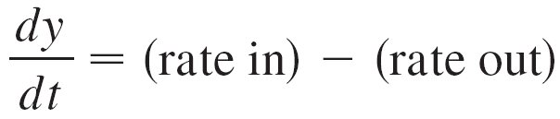

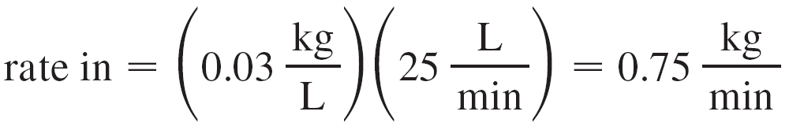
Example 6 – Solution
cont’d
Note that dy/dt is the rate of change of the amount of salt, so
where (rate in) is the rate at which salt enters the tank and (rate out) is the rate at which salt leaves the tank.
We have
The tank always contains 5000 L of liquid, so the concentration at time t is y(t)/5000 (measured in kilograms per liter).

Slide 22
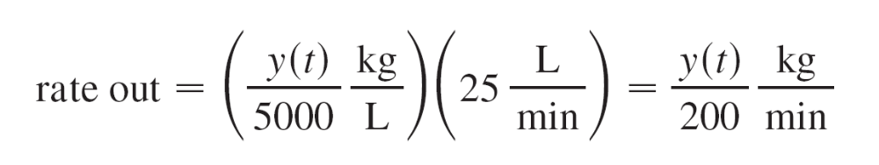
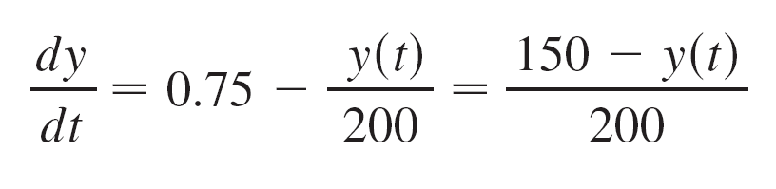
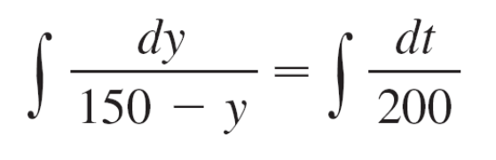
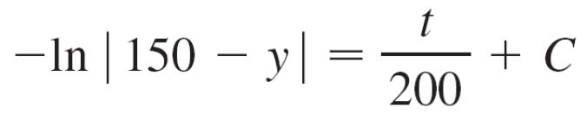
Example 6 – Solution
cont’d
Since the brine flows out at a rate of 25 L/min, we have
Thus, from Equation 5, we get
Solving this separable differential equation, we obtain

Slide 23
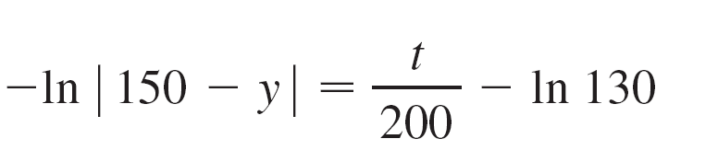
Example 6 – Solution
cont’d
Since y(0) = 20, we have –ln 130 = C, so
Therefore
| 150 – y | = 130e^{–t/200}
Since y(t) is continuous and y(0) = 20 and the right side is never 0, we deduce that 150 – y(t) is always positive.

Slide 24
Example 6 – Solution
cont’d
Thus | 150 – y | = 150 – y and so
y (t) = 150 – 130e^{–t/200}
The amount of salt after 30 min is
y (30) = 150 – 130e^{–30/200}
≈ 38.1kg

