Slide 1

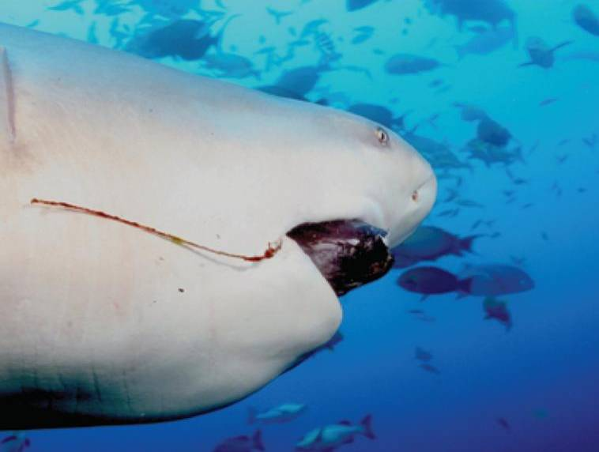
9
Differential Equations
Copyright © Cengage Learning. All rights reserved.

Slide 2

9.4
Models for Population Growth
Copyright © Cengage Learning. All rights reserved.

Slide 3
Models for Population Growth
In this section we investigate differential equations that are used to model population growth: the law of natural growth, the logistic equation, and several others.

Slide 4
The Law of Natural Growth

Slide 5
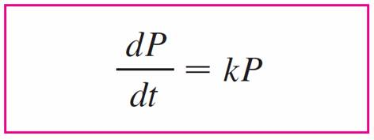

The Law of Natural Growth
In general, if P(t) is the value of a quantity y at time t and if the rate of change of P with respect to t is proportional to its size P(t) at any time, then
where k is a constant.
Equation 1 is sometimes called the law of natural growth. If k is positive, then the population increases; if k is negative, it decreases.

Slide 6
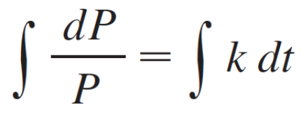
The Law of Natural Growth
Because Equation 1 is a separable differential equation, we can solve it by the methods given below:
ln | P | = kt + C
| P | = e^{kt + C} = e^{C}e^{kt}
P = Ae^{kt}
where A (= ±e^{C} or 0) is an arbitrary constant.

Slide 7
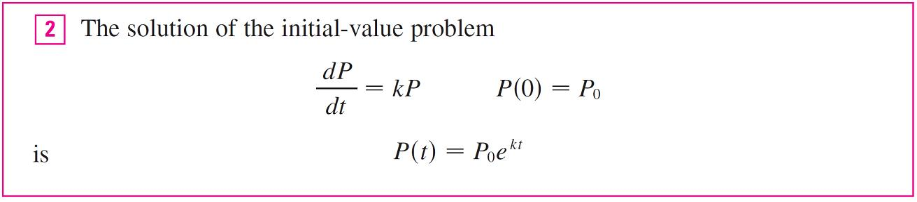
The Law of Natural Growth
To see the significance of the constant A, we observe that
P(0) = Ae^{k } ⁰ = A
Therefore A is the initial value of the function.

Slide 8
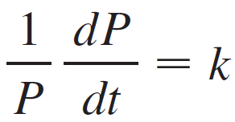

The Law of Natural Growth
Another way of writing Equation 1 is
which says that the relative growth rate (the growth rate divided by the population size) is constant.
Then says that a population with constant relative growth rate must grow exponentially.

Slide 9
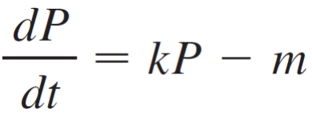

The Law of Natural Growth
We can account for emigration (or “harvesting”) from a population by modifying Equation 1: If the rate of emigration is a constant m, then the rate of change of the population is modeled by the differential equation

Slide 10
The Logistic Model

Slide 11
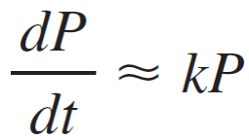
The Logistic Model
As we studied earlier, a population often increases exponentially in its early stages but levels off eventually and approaches its carrying capacity because of limited resources.
If P(t) is the size of the population at time t, we assume that
if P is small
This says that the growth rate is initially close to being proportional to size.

Slide 12
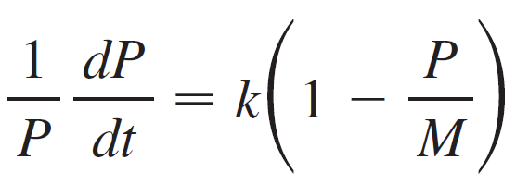
The Logistic Model
In other words, the relative growth rate is almost constant when the population is small. But we also want to reflect the fact that the relative growth rate decreases as the population P increases and becomes negative if P ever exceeds its carrying capacity M, the maximum population that the environment is capable of sustaining in the long run.
The simplest expression for the relative growth rate that incorporates these assumptions is

Slide 13
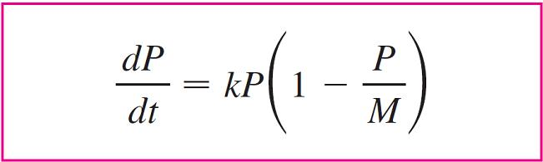

The Logistic Model
Multiplying by P, we obtain the model for population growth known as the logistic differential equation:

Slide 14
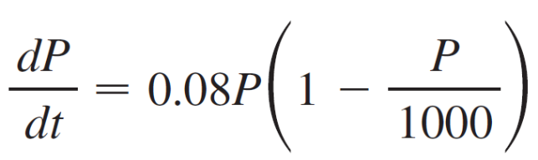
Example 1
Draw a direction field for the logistic equation with k = 0.08 and carrying capacity M = 1000. What can you deduce about the solutions?
Solution:
In this case the logistic differential equation is

Slide 15
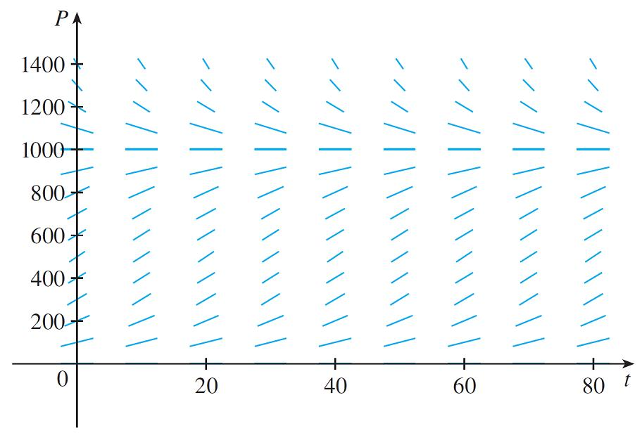
Example 1 – Solution
cont’d
A direction field for this equation is shown in Figure 1.
Direction field for the logistic equation in Example 1
Figure 1

Slide 16
Example 1 – Solution
cont’d
We show only the first quadrant because negative populations aren’t meaningful and we are interested only in what happens after t = 0.
The logistic equation is autonomous (dP/dt depends only on P, not on t), so the slopes are the same along any horizontal line. As expected, the slopes are positive for
0 < P < 100 and negative for P > 1000.
The slopes are small when P is close to 0 or 1000 (the carrying capacity). Notice that the solutions move away from the equilibrium solution P = 0 and move toward the equilibrium solution P = 1000.

Slide 17
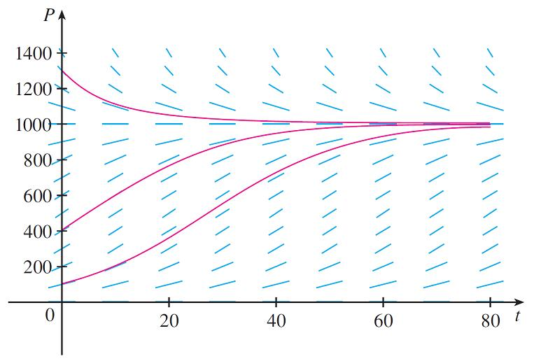
Example 1 – Solution
cont’d
In Figure 2 we use the direction field to sketch solution curves with initial populations P(0) = 100, P(0) = 400, and
P(0) = 1300.
Solution curves for the logistic equation in Example 1
Figure 2

Slide 18
Example 1 – Solution
cont’d
Notice that solution curves that start below P = 1000 are increasing and those that start above P = 1000 are decreasing.
The slopes are greatest when P ≈ 500 and therefore the solution curves that start below P = 1000 have inflection points when P ≈ 500.
In fact we can prove that all solution curves that start below P = 500 have an inflection point when P is exactly 500.

Slide 19

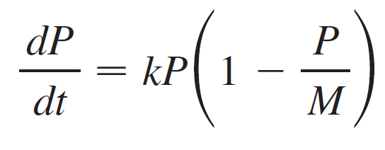
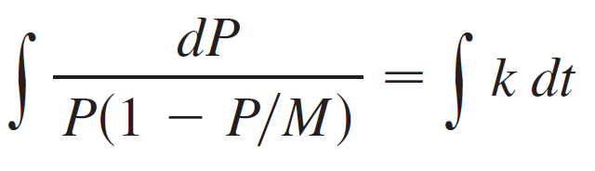

The Logistic Model
The logistic equation is separable and so we can solve it explicitly. Since
we have

Slide 20
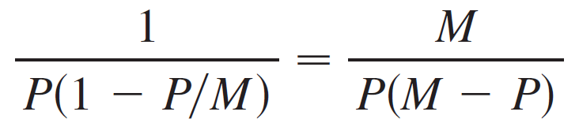
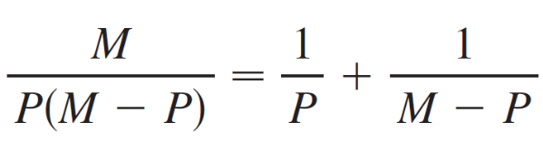
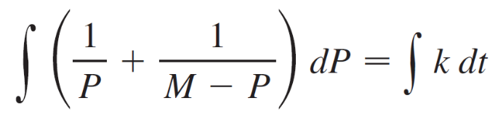
The Logistic Model
To evaluate the integral on the left side, we write
Using partial fractions, we get
This enables us to rewrite Equation 5:

Slide 21

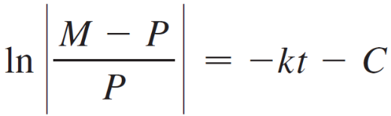
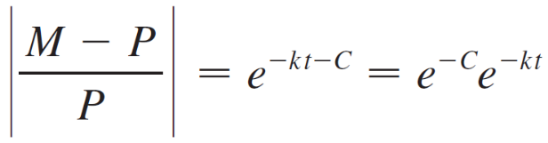

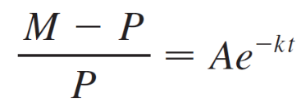
The Logistic Model
where A = ±e^{–C}.

Slide 22
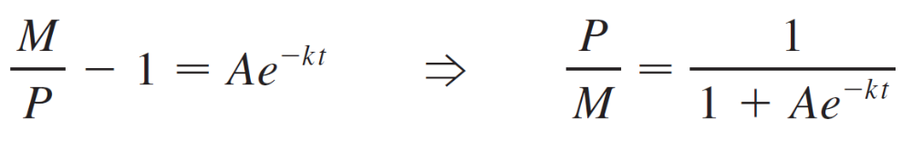
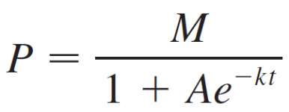
The Logistic Model
Solving Equation 6 for P, we get
so

Slide 23
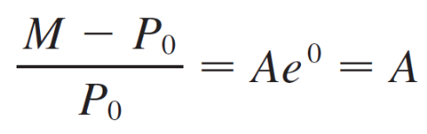
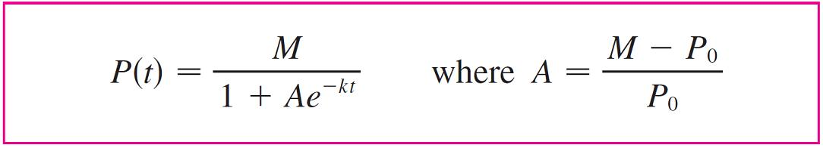

The Logistic Model
We find the value of A by putting t = 0 in Equation 6. If t = 0, then P = P₀(the initial population), so
Thus the solution to the logistic equation is

Slide 24
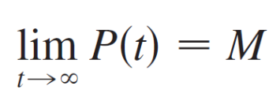
The Logistic Model
Using the expression for P(t) in Equation 7, we see that
which is to be expected.

Slide 25
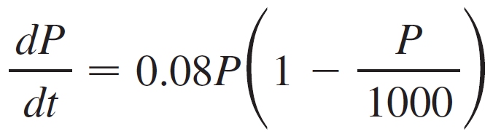
Example 2
Write the solution of the initial-value problem
P(0) = 100
and use it to find the population sizes P(40) and P(80). At what time does the population reach 900?

Slide 26
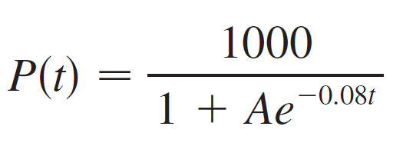
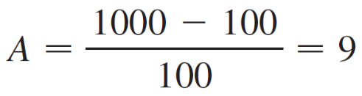
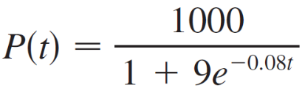
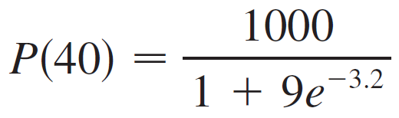
Example 2 – Solution
The differential equation is a logistic equation with k = 0.08, carrying capacity M = 1000, and initial population P₀ = 100.
So Equation 7 gives the population at time t as
where
Thus
So the population sizes when t = 40 and 80 are

Slide 27

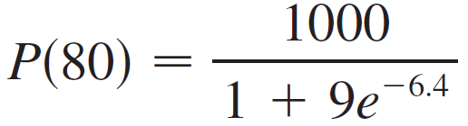

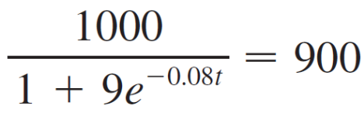
Example 2 – Solution
cont’d
The population reaches 900 when

Slide 28
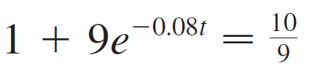


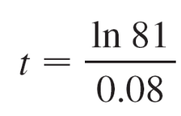
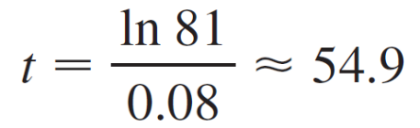
Example 2 – Solution
cont’d
Solving this equation for t, we get
So the population reaches 900 when t is approximately 55.

Slide 29
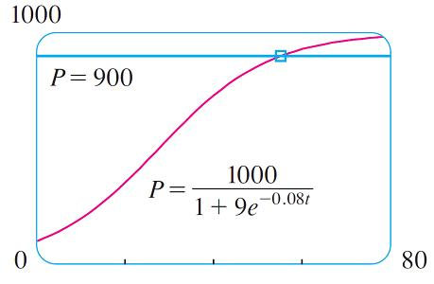
Example 2 – Solution
cont’d
As a check on our work, we graph the population curve in Figure 3 and observe where it intersects the line P = 900.
The cursor indicates that t ≈ 55.
Figure 3

Slide 30
Comparison of the Natural Growth
and Logistic Models

Slide 31
Comparison of the Natural Growth and Logistic Models
In the 1930s the biologist G. F. Gause conducted an experiment with the protozoan Paramecium and used a logistic equation to model his data. The table gives his daily count of the population of protozoa.
He estimated the initial relative growth rate to be 0.7944 and the carrying capacity to be 64.

Slide 32
Example 3
Find the exponential and logistic models for Gause’s data. Compare the predicted values with the observed values and comment on the fit.
Solution:
Given the relative growth rate k = 0.7944 and the initial population P₀ = 2, the exponential model is
P (t) = P₀e^{kt}
= 2e^{0.7944t}

Slide 33
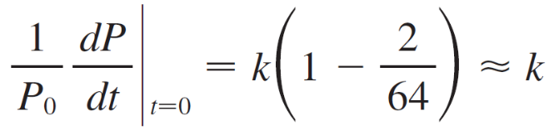
Example 3 – Solution
cont’d
Gause used the same value of k for his logistic model. [This is reasonable because P₀ = 2 is small compared with the carrying capacity (M = 64).
The equation
shows that the value of k for the logistic model is very close to the value for the exponential model.]

Slide 34
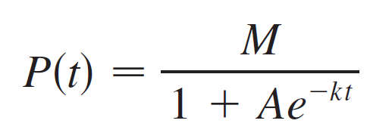
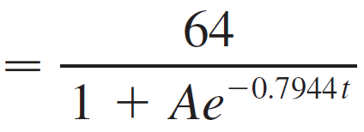
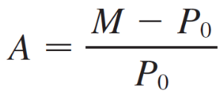
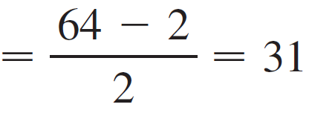
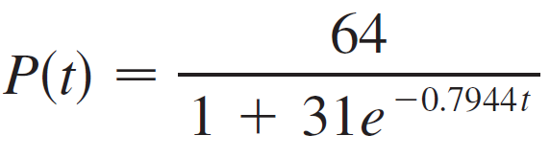
Example 3 – Solution
cont’d
Then the solution of the logistic equation in Equation 7 gives
where
So

Slide 35
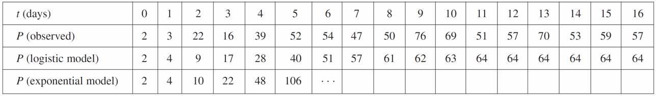
Example 3 – Solution
cont’d
We use these equations to calculate the predicted values (rounded to the nearest integer) and compare them in the following table.

Slide 36
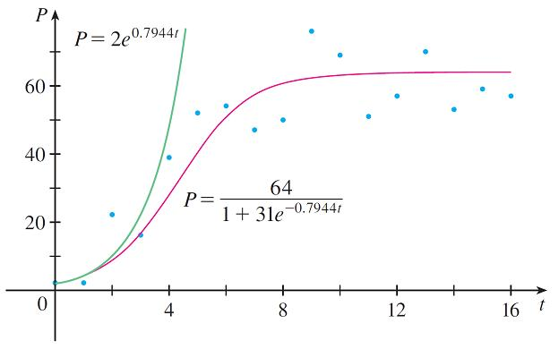
Example 3 – Solution
cont’d
We notice from the table and from the graph in Figure 4 that for the first three or four days the exponential model gives results comparable to those of the more sophisticated logistic model.
For t ≥ 5, however, the
exponential model is
hopelessly inaccurate, but
the logistic model fits the
observations reasonably
well.
The exponential and logistic
models for the Paramecium data
Figure 4

Slide 37
Other Models for
Population Growth

Slide 38
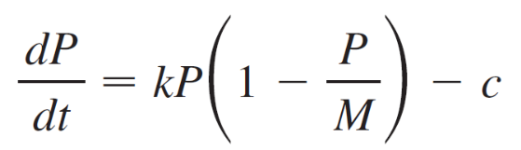
Other Models for Population Growth
The Law of Natural Growth and the logistic differential equation are not the only equations that have been proposed to model population growth.
Two of the other models are modifications of the logistic model. The differential equation
has been used to model populations that are subject to harvesting of one sort or another. (Think of a population of fish being caught at a constant rate.)

Slide 39
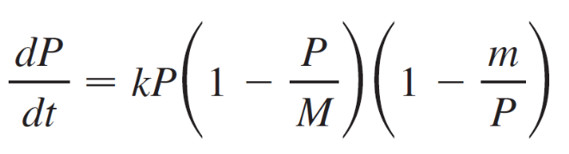
Other Models for Population Growth
For some species there is a minimum population level m below which the species tends to become extinct. (Adults may not be able to find suitable mates.) Such populations have been modeled by the differential equation
where the extra factor, 1 – m/p, takes into account the consequences of a sparse population.

