Slide 1


9
Differential Equations
Copyright © Cengage Learning. All rights reserved.

Slide 2

9.5
Linear Equations
Copyright © Cengage Learning. All rights reserved.

Slide 3

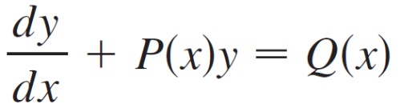
Linear Equations
A first-order linear differential equation is one that can be put into the form
where P and Q are continuous functions on a given interval. This type of equation occurs frequently in various sciences, as we will see.

Slide 4
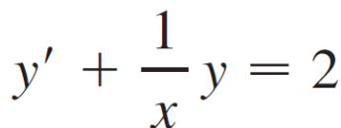

Linear Equations
An example of a linear equation is xy ′ + y = 2x because, for x ≠ 0, it can be written in the form
Notice that this differential equation is not separable because it’s impossible to factor the expression for y ′ as a function of x times a function of y.

Slide 5
Linear Equations
But we can still solve the equation by noticing, by the Product Rule, that
xy ′ + y = (xy)′
and so we can rewrite the equation as
(xy)′ = 2x

Slide 6
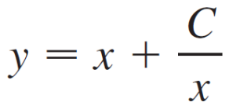
Linear Equations
If we now integrate both sides of this equation, we get
xy = x² + C or
If we had been given the differential equation in the form of Equation 2, we would have had to take the preliminary step of multiplying each side of the equation by x.
It turns out that every first-order linear differential equation can be solved in a similar fashion by multiplying both sides of Equation 1 by a suitable function I (x) called an
integrating factor.

Slide 7

Linear Equations
We try to find I so that the left side of Equation 1, when multiplied by I (x), becomes the derivative of the product
I (x)y:
I (x)(y ′ + P (x)y) = (I (x)y)′
If we can find such a function I, then Equation 1 becomes
(I (x)y)′ = I (x) Q (x)

Slide 8
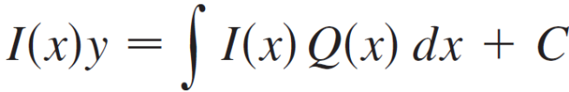
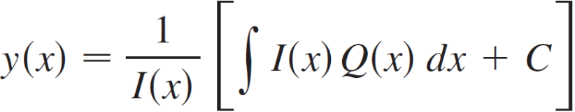

Linear Equations
Integrating both sides, we would have
so the solution would be

Slide 9
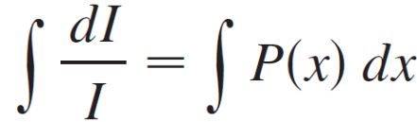
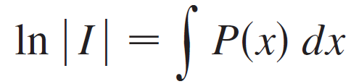
Linear Equations
To find such an I, we expand Equation 3 and cancel terms:
I (x)y ′ + I (x)P (x)y = (I (x)y)′ = I ′(x)y + I (x)y ′
I (x) P (x) = I ′(x)
This is a separable differential equation for I, which we solve as follows:

Slide 10



Linear Equations
where A = ±e^{C}. We are looking for a particular integrating factor, not the most general one, so we take A = 1 and use
Thus a formula for the general solution to Equation 1 is provided by Equation 4, where I is given by Equation 5.

Slide 11
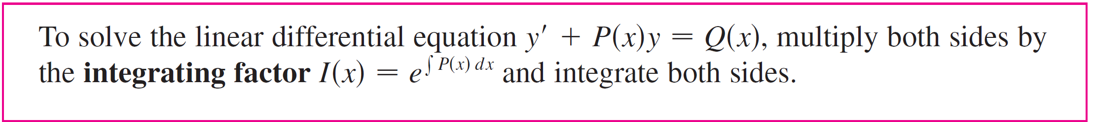
Linear Equations
Instead of memorizing this formula, however, we just remember the form of the integrating factor.

Slide 12
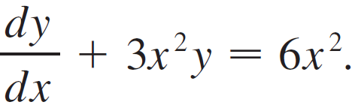

Example 1
Solve the differential equation
Solution:
The given equation is linear since it has the form of Equation 1 with P (x) = 3x² and Q (x) = 6x². An integrating factor is

Slide 13

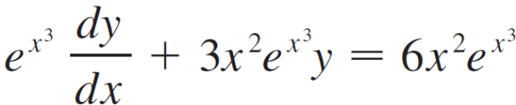
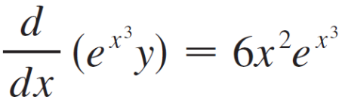
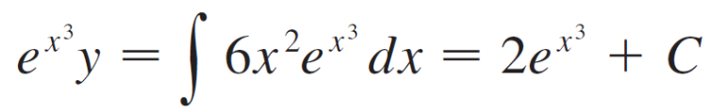

Example 1 – Solution
cont’d
Multiplying both sides of the differential equation by , we get
or
Integrating both sides, we have

Slide 14
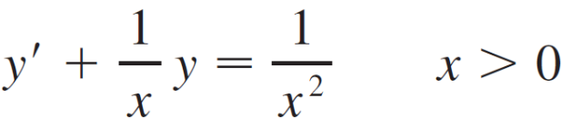


Example 2
Find the solution of the initial-value problem
X²y ′ + xy = 1 x > 0 y (1) = 2
Solution:
We must first divide both sides by the coefficient of y ′ to put the differential equation into standard form:
The integrating factor is

Slide 15
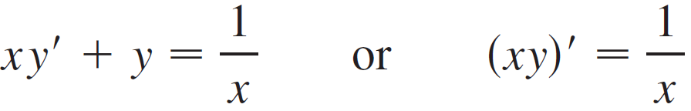
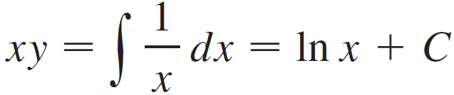
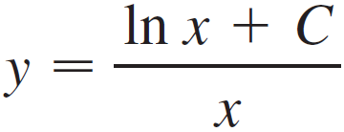
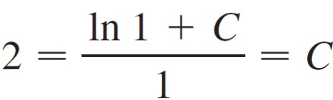
Example 2 – Solution
cont’d
Multiplication of Equation 6 by x gives
Then
and so
Since y (1) = 2, we have

Slide 16
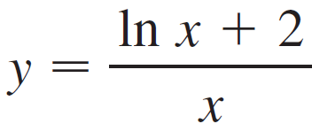
Example 2 – Solution
cont’d
Therefore the solution to the initial-value problem is

Slide 17
Application to Electric Circuits

Slide 18
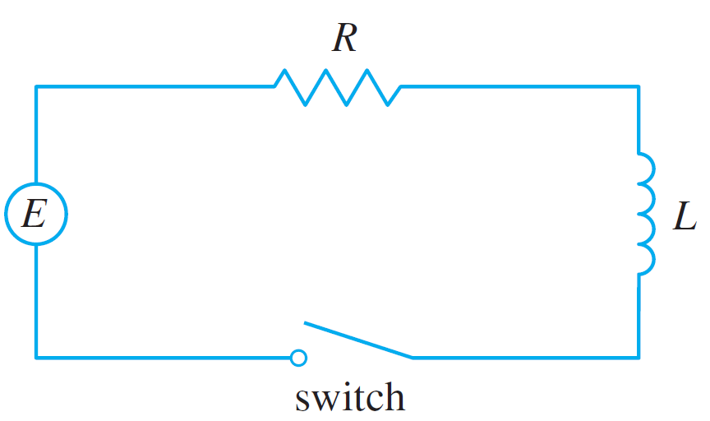
Application to Electric Circuits
Here, we consider the simple electric circuit shown in Figure 4: An electro-motive force (usually a battery or generator) produces a voltage of E (t) volts (V) and a current of I (t) amperes (A) at time t.
Figure 4

Slide 19
Application to Electric Circuits
The circuit also contains a resistor with a resistance of R ohms (Ω) and an inductor with an inductance of L henries (H).
Ohm’s Law gives the drop in voltage due to the resistor as RI. The voltage drop due to the inductor is L (dI/dt). One of Kirchhoff’s laws says that the sum of the voltage drops is equal to the supplied voltage E (t).

Slide 20
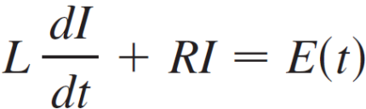

Application to Electric Circuits
Thus we have
which is a first-order linear differential equation. The solution gives the current I at time t.

Slide 21
Example 4
Suppose that in the simple circuit of Figure 4 the resistance is 12Ω and the inductance is 4 H. If a battery gives a constant voltage of 60 V and the switch is closed when
t = 0 so the current starts with I (0) = 0, find (a) I (t), (b) the current after 1 s, and (c) the limiting value of the current.
Figure 4

Slide 22
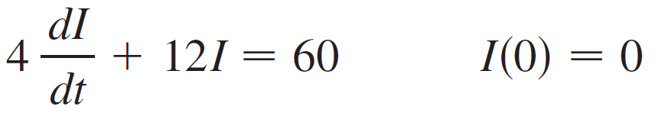
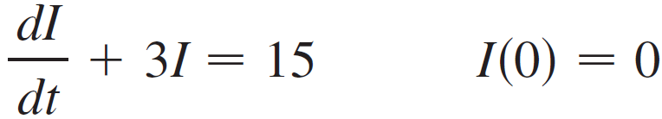

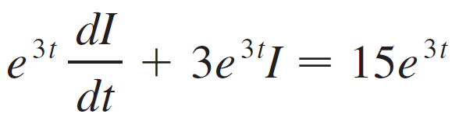
Example 4 – Solution
(a) If we put L = 4, R = 12, and E (t) = 60 in Equation 7, we
obtain the initial-value problem
or
Multiplying by the integrating factor we get

Slide 23
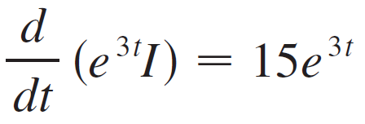
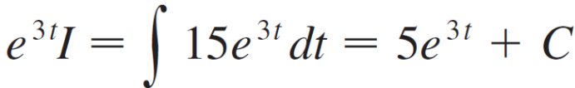

Example 4 – Solution
cont’d
Since I(0) = 0, we have 5 + C = 0, so C = –5 and
I (t) = 5(1 – e^{–3t})

Slide 24
Example 4 – Solution
cont’d
(b) After 1 second the current is
I (1) = 5(1 – e^{–3}) ≈ 4.75 A
(c) The limiting value of the current is given by

