Slide 1

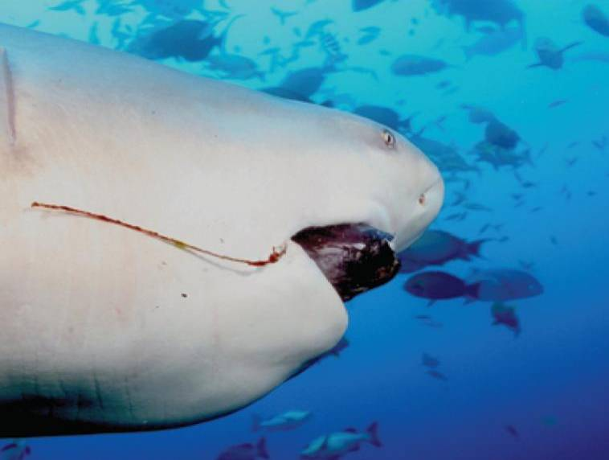
9
Differential Equations
Copyright © Cengage Learning. All rights reserved.

Slide 2

9.6
Predator-Prey Systems
Copyright © Cengage Learning. All rights reserved.

Slide 3
Predator-Prey Systems
We have looked at a variety of models for the growth of a single species that lives alone in an environment. In this section we consider more realistic models that take into account the interaction of two species in the same habitat.
We will see that these models take the form of a pair of linked differential equations. We first consider the situation in which one species, called the prey, has an ample food supply and the second species, called the predators, feeds on the prey.
Examples of prey and predators include rabbits and wolves in an isolated forest, food fish and sharks, aphids and ladybugs, and bacteria and amoebas.

Slide 4

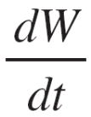
Predator-Prey Systems
Our model will have two dependent variables and both are functions of time. We let R(t) be the number of prey (using R for rabbits) and W(t) be the number of predators (with W for wolves) at time t.
In the absence of predators, the ample food supply would support exponential growth of the prey, that is,
= kR where k is a positive constant
In the absence of prey, we assume that the predator population would decline at a rate proportional to itself, that is,
= –rW where r is a positive constant

Slide 5
Predator-Prey Systems
With both species present, however, we assume that the principal cause of death among the prey is being eaten by a predator, and the birth and survival rates of the predators depend on their available food supply, namely, the prey.
We also assume that the two species encounter each other at a rate that is proportional to both populations and is therefore proportional to the product RW. (The more there are of either population, the more encounters there are likely to be.)

Slide 6

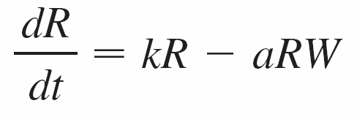
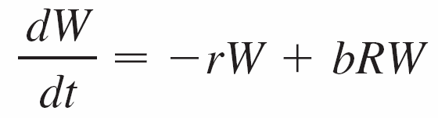
Predator-Prey Systems
A system of two differential equations that incorporates these assumptions is as follows:
where k, r, a, and b are positive constants.
Notice that the term –aRW decreases the natural growth rate of the prey and the term bRW increases the natural growth rate of the predators.
W represents the predator.
R represents the prey.

Slide 7

Predator-Prey Systems
The equations in are known as the predator-prey equations, or the Lotka-Volterra equations.
A solution of this system of equations is a pair of functions R(t) and W(t) that describe the populations of prey and predator as functions of time.
Because the system is coupled (R and W occur in both equations), we can’t solve one equation and then the other; we have to solve them simultaneously.
Unfortunately, it is usually impossible to find explicit formulas for R and W as functions of t. We can, however, use graphical methods to analyze the equations.

Slide 8
Example 1
Suppose that populations of rabbits and wolves are described by the Lotka-Volterra equations with k = 0.08, a = 0.001, r = 0.02, and b = 0.00002. The time t is measured in months.
Find the constant solutions (called the equilibrium
solutions) and interpret the answer.
Use the system of differential equations to find an
expression for dW/dR.
(c) Draw a direction field for the resulting differential
equation in the RW-plane. Then use that direction field
to sketch some solution curves.

Slide 9
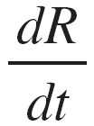
Example 1
cont’d
(d) Suppose that, at some point in time, there are
1000 rabbits and 40 wolves. Draw the corresponding
solution curve and use it to describe the changes in both
population levels.
(e) Use part (d) to make sketches of R and W as functions
of t.
Solution:
With the given values of k, a, r, and b, the Lotka-
Volterra equations become
      = 0.08R – 0.001RW

Slide 10
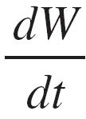
Example 1 – Solution
cont’d
= –0.02W + 0.00002RW
Both R and W will be constant if both derivatives are 0, that is,
R ′ = R(0.08 – 0.001W) = 0
W ′ = W(–0.02W + 0.00002R) = 0
One solution is given by R = 0 and W = 0. (This makes sense: If there are no rabbits or wolves, the populations are certainly not going to increase.)

Slide 11
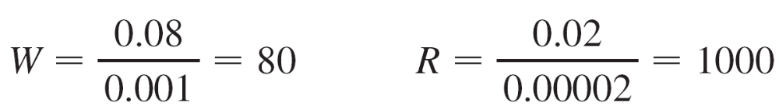
Example 1 – Solution
cont’d
The other constant solution is
So the equilibrium populations consist of 80 wolves and 1000 rabbits.
This means that 1000 rabbits are just enough to support a constant wolf population of 80.
There are neither too many wolves (which would result in fewer rabbits) nor too few wolves (which would result in more rabbits).

Slide 12
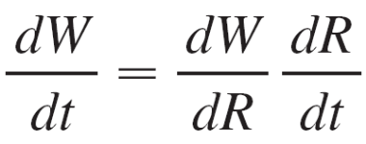
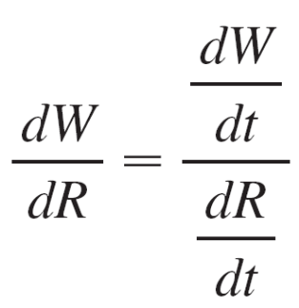
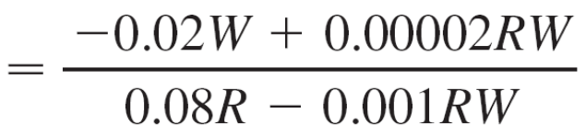
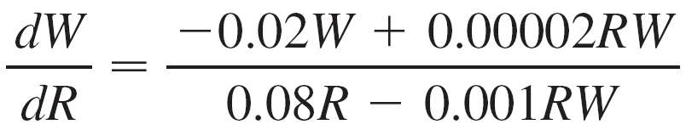
Example 1 – Solution
cont’d
(b) We use the Chain Rule to eliminate t:
so
(c) If we think of W as a function of R, we have the
differential equation

Slide 13
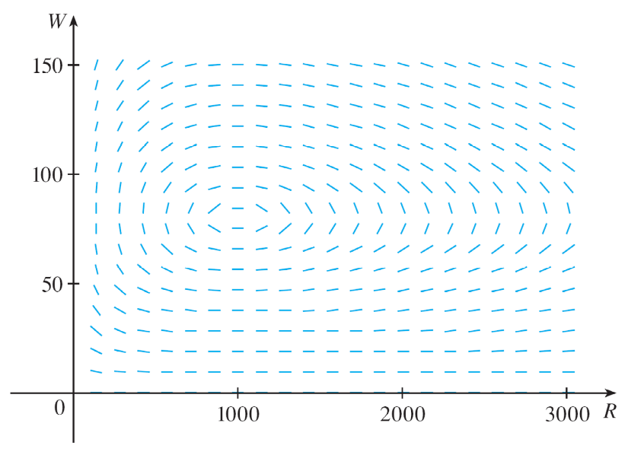
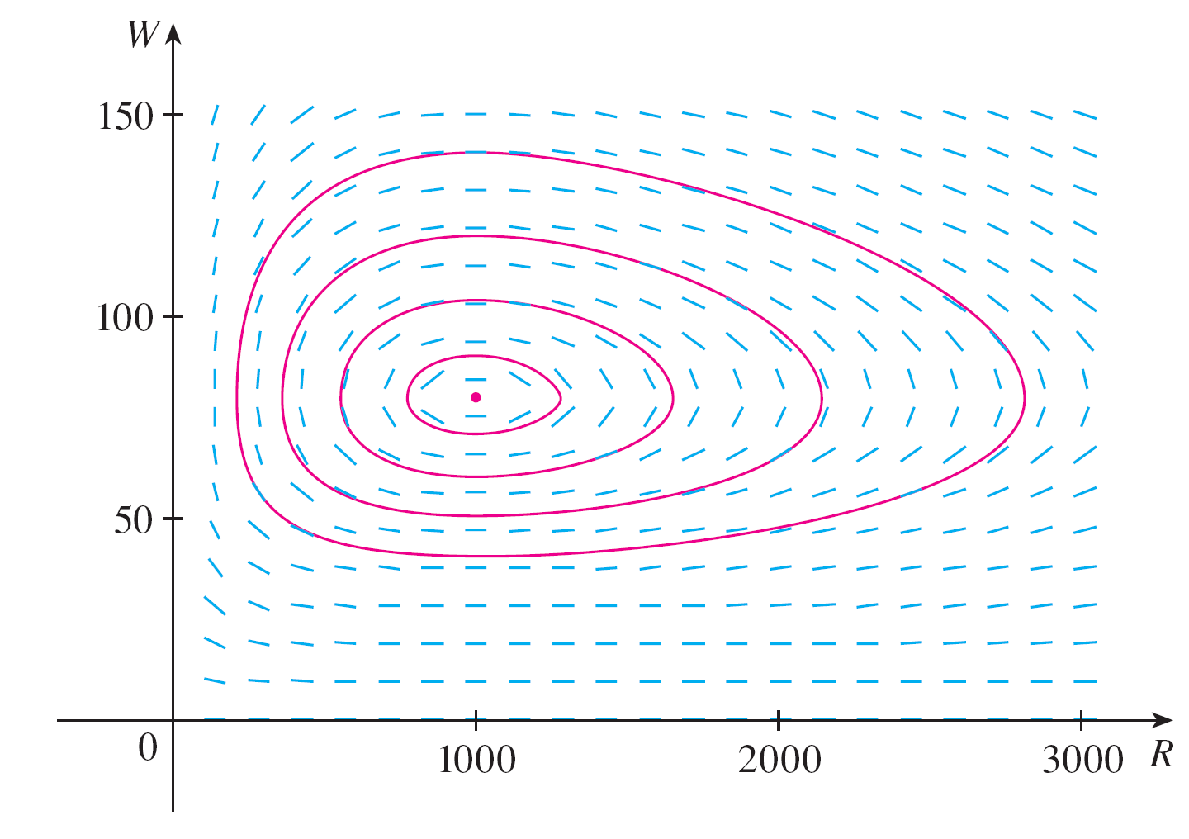
Example 1 – Solution
cont’d
We draw the direction field for this differential equation in Figure 1 and we use it to sketch several solution curves in Figure 2.
Figure 1
Figure 2
Direction field for the predator-prey system
Phase portrait of the system

Slide 14
Example 1 – Solution
cont’d
If we move along a solution curve, we observe how the relationship between R and W changes as time passes.
Notice that the curves appear to be closed in the sense that if we travel along a curve, we always return to the same point.
Notice also that the point (1000, 80) is inside all the solution curves.
That point is called an equilibrium point because it corresponds to the equilibrium solution R = 1000, W = 80.

Slide 15
Example 1 – Solution
cont’d
When we represent solutions of a system of differential equations as in Figure 2, we refer to the RW-plane as the phase plane, and we call the solution curves phase trajectories.
So a phase trajectory is a
path traced out by solutions
(R, W ) as time goes by.
A phase portrait consists of
equilibrium points and typical
phase trajectories, as shown
in Figure 2.
Figure 2
Phase portrait of the system

Slide 16
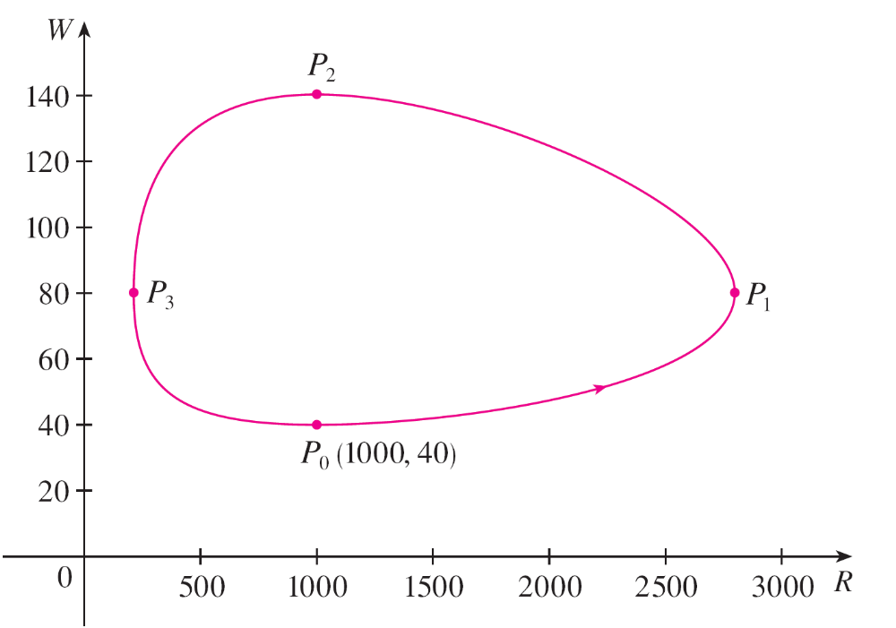
Example 1 – Solution
cont’d
(d) Starting with 1000 rabbits and 40 wolves corresponds to
drawing the solution curve through the point
P₀(1000, 40).
Figure 3 shows this phase trajectory with the direction field removed.
Figure 3
Phase trajectory through (1000, 40)

Slide 17
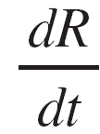
Example 1 – Solution
cont’d
Starting at the point P₀ at time t = 0 and letting t increase, do we move clockwise or counterclockwise around the phase trajectory?
If we put R = 1000 and W = 40 in the first differential equation, we get
= 0.08(1000) – 0.001(1000)(40)
= 80 – 40
= 40
Since dR/dt > 0, we conclude that R is increasing at P₀ and so we move counterclockwise around the phase trajectory.

Slide 18
Example 1 – Solution
cont’d
We see that at P₀ there aren’t enough wolves to maintain a balance between the populations, so the rabbit population increases.
That results in more wolves and eventually there are so many wolves that the rabbits have a hard time avoiding them. So the number of rabbits begins to decline (at P₁, where we estimate that R reaches its maximum population of about 2800).
This means that at some later time the wolf population starts to fall (at P₂, where R = 1000 and W ≈ 140).

Slide 19
Example 1 – Solution
cont’d
But this benefits the rabbits, so their population later starts to increase (at P₃, where W = 80 and R ≈ 210 ). As a consequence, the wolf population eventually starts to increase as well.
This happens when the populations return to their initial values of R = 1000 and W = 40, and the entire cycle begins again.
(e) From the description in part (d) of how the rabbit and
wolf populations rise and fall, we can sketch the graphs
of R(t) and W(t).

Slide 20
Example 1 – Solution
cont’d
Suppose the points P₁, P₂, and P₃ in Figure 3 are reached at times t₁, t₂, and t₃.
Figure 3
Phase trajectory through (1000, 40)

Slide 21
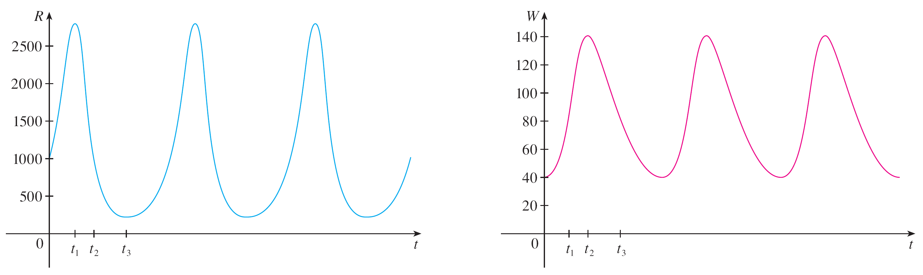
Example 1 – Solution
cont’d
Then we can sketch graphs of R and W as in Figure 4.
Figure 4
Graphs of the rabbit and wolf populations as functions of time

Slide 22
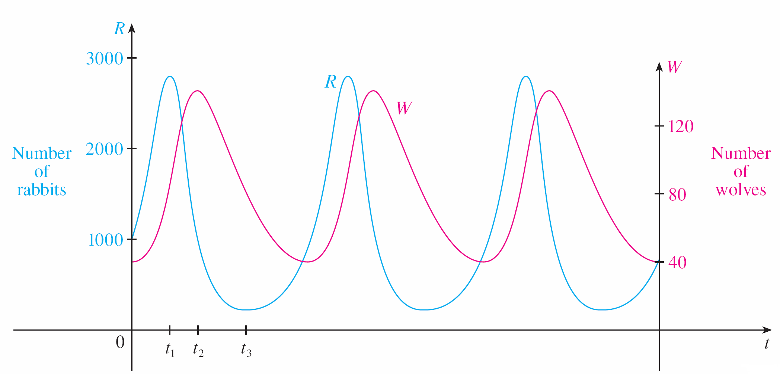
Example 1 – Solution
cont’d
To make the graphs easier to compare, we draw the graphs on the same axes but with different scales for R and W, as in Figure 5. Notice that the rabbits reach their maximum populations about a quarter of a cycle before the wolves.
Figure 5
Comparison of the rabbit and wolf populations

