Slide 1


10
Parametric Equations
and Polar Coordinates
Copyright © Cengage Learning. All rights reserved.

Slide 2

10.2
Calculus with Parametric Curves
Copyright © Cengage Learning. All rights reserved.

Slide 3
Tangents

Slide 4
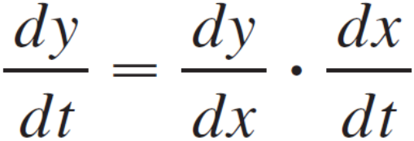
Tangents
Suppose f and g are differentiable functions and we want to find the tangent line at a point on the curve where y is also a differentiable function of x.
Then the Chain Rule gives

Slide 5
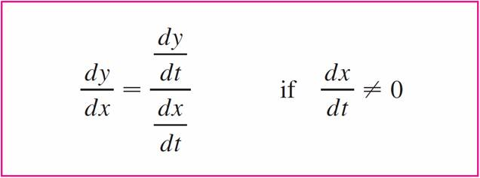

Tangents
If dx/dt ≠ 0, we can solve for dy/dx:
Equation 1 (which you can remember by thinking of canceling the dt’s) enables us to find the slope dy/dx of the tangent to a parametric curve without having to eliminate the parameter t.

Slide 6

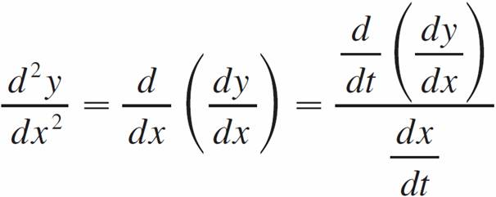
Tangents
We see from that the curve has a horizontal tangent when dy/dt = 0 (provided that dx/dt ≠ 0) and it has a vertical tangent when dx/dt = 0 (provided that dy/dt ≠ 0).
This information is useful for sketching parametric curves.
It is also useful to consider d²y/dx². This can be found by replacing y by dy/dx in Equation 1:

Slide 7
Example 1
A curve C is defined by the parametric equations x = t²,
y = t³ – 3t.
(a) Show that C has two tangents at the point (3, 0) and
find their equations.
(b) Find the points on C where the tangent is horizontal or
vertical.
(c) Determine where the curve is concave upward or
downward.
(d) Sketch the curve.

Slide 8



Example 1(a) – Solution
Notice that y = t³ – 3t = t(t² – 3) = 0 when t = 0 or t =
Therefore the point (3, 0) on C arises from two values of
the parameter, t = and t = .
This indicates that C crosses itself at (3, 0).

Slide 9
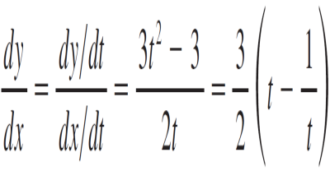

Example 1(a) – Solution
cont’d
Since
the slope of the tangent when t = is dy/dx , so the equations of the tangents at (3, 0) are

Slide 10
Example 1(b) – Solution
cont’d
C has a horizontal tangent when dy/dx = 0, that is, when dy/dt = 0 and dx/dt ≠ 0. Since dy/dt = 3t² – 3, this happens when t² = 1, that is, t = ±1.
The corresponding points on C are (1, –2) and (1, 2).
C has a vertical tangent when dx/dt = 2t = 0, that is, t = 0. (Note that dy/dt ≠ 0 there.)
The corresponding point on C is (0, 0).

Slide 11
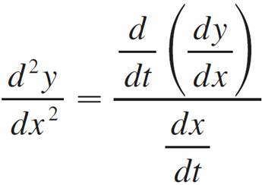
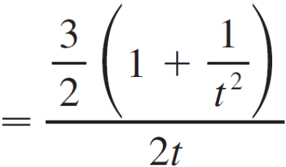
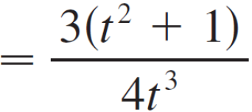
Example 1(c) – Solution
cont’d
To determine concavity we calculate the second derivative:
Thus the curve is concave upward when t > 0 and concave downward when t < 0.

Slide 12
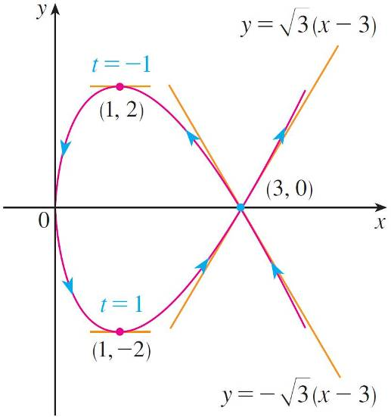
Example 1(d) – Solution
cont’d
Using the information from parts (b) and (c), we sketch C in Figure 1.
Figure 1

Slide 13
Areas

Slide 14

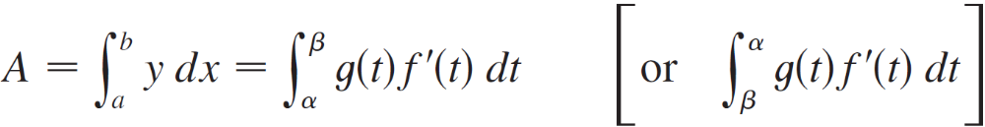
Areas
We know that the area under a curve y = F (x) from a to b is
A = F (x) dx, where F (x) ≥ 0.
If the curve is traced out once by the parametric equations
x = f (t) and y = g (t), α ≤ t ≤ β, then we can calculate an area formula by using the Substitution Rule for Definite Integrals as follows:

Slide 15
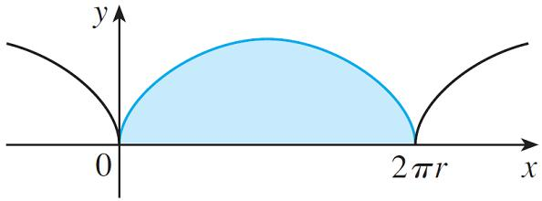
Example 3
Find the area under one arch of the cycloid
x = r(θ – sin θ ) y = r(1 – cos θ)
(See Figure 3.)
Figure 3

Slide 16
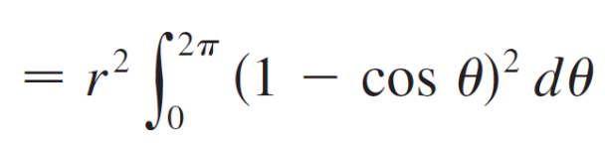
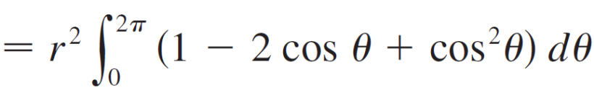
Example 3 – Solution
One arch of the cycloid is given by 0 ≤ θ ≤ 2π.
Using the Substitution Rule with y = r(1 – cos θ ) and
dx = r(1 – cos θ) dθ, we have

Slide 17



Example 3 – Solution
cont’d

Slide 18
Arc Length

Slide 19
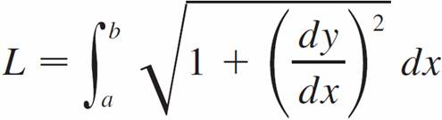

Arc Length
We already know how to find the length L of a curve C given in the form y = F (x), a ≤ x ≤ b.
If F ′ is continuous, then
Suppose that C can also be described by the parametric equations x = f (t) and y = g (t), α ≤ t ≤ β, where dx/dt = f ′ (t) > 0.

Slide 20
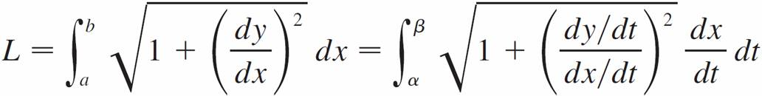
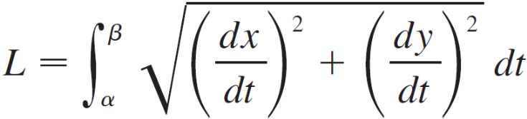

Arc Length
This means that C is traversed once, from left to right, as t increases from α to β and f (α) = a, f (β) = b.
Putting Formula 1 into Formula 2 and using the Substitution Rule, we obtain
Since dx/dt > 0, we have

Slide 21
Arc Length
Even if C can’t be expressed in the form y = F (x), Formula 3 is still valid but we obtain it by polygonal approximations.
We divide the parameter interval [α, β] into n subintervals of equal width Δt.
If t₀, t₁, t₂, . . . , t_{n} are the endpoints of these subintervals, then x_{i} = f (t_{i}) and y_{i} = g (t_{i}) are the coordinates of points
P_{i}(x_{i}, y_{i}) that lie on C and the polygon with vertices
P₀, P₁, . . . , P_{n} approximates C.

Slide 22
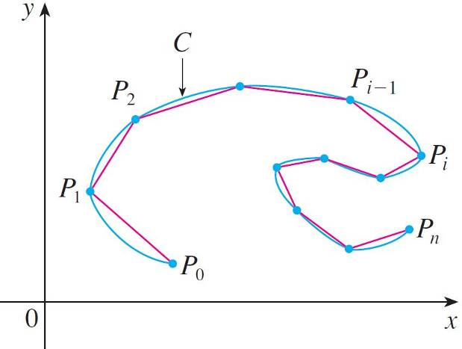

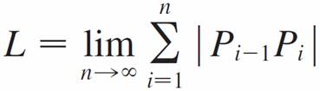
Arc Length
(See Figure 4.)
We define the length L of C to be the limit of the lengths of these approximating polygons as n → :
Figure 4

Slide 23


Arc Length
The Mean Value Theorem, when applied to f on the interval [t_{i – 1}, t_{i}], gives a number in (t_{i – 1}, t_{i}) such that
f(t_{i}) – f (t_{i – 1}) = f ′ ( ) (t_{i} – t_{i – 1})
If we let Δx_{i} = x_{i} – x_{i – 1} and Δy_{i} = y_{i} – y_{i – 1}, this equation becomes
Δx_{i} = f ′ ( ) Δt
Similarly, when applied to g, the Mean Value Theorem gives a number in (t_{i – 1}, t_{i}) such that
Δy_{i} = g ′ ( ) Δt

Slide 24

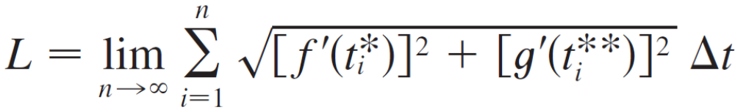

Arc Length
Therefore
and so

Slide 25



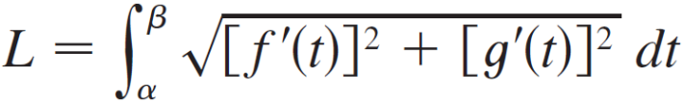
Arc Length
The sum in resembles a Riemann sum for the function
but it is not exactly a Riemann sum because ≠ in general.
Nevertheless, if f ′ and g ′ are continuous, it can be shown that the limit in is the same as if and were equal, namely,

Slide 26
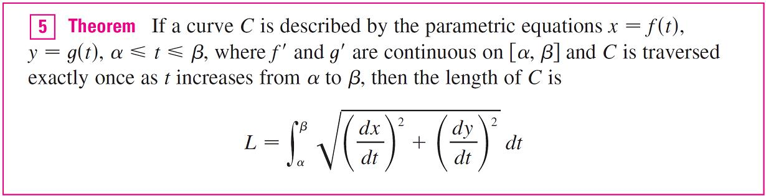
Arc Length
Thus, using Leibniz notation, we have the following result, which has the same form as Formula 3.
Notice that the formula in Theorem 5 is consistent with the general formulas L = ∫ ds and (ds)² = (dx)² + (dy)².

Slide 27
Arc Length
Notice that the integral gives twice the arc length of the circle because as t increases from 0 to 2π, the point (sin 2t, cos 2t) traverses the circle twice.
In general, when finding the length of a curve C from a parametric representation, we have to be careful to ensure that C is traversed only once as t increases from α to β.

Slide 28
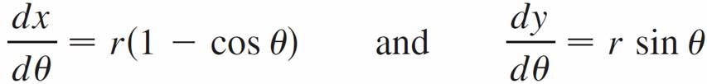
Example 5
Find the length of one arch of the cycloid x = r(θ – sin θ),
y = r(1 – cos θ).
Solution:
From Example 3 we see that one arch is described by the parameter interval 0 ≤ θ ≤ 2π.
Since

Slide 29
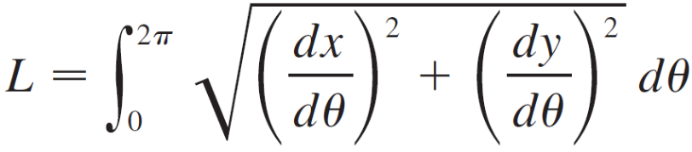

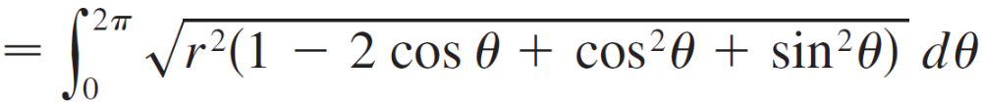
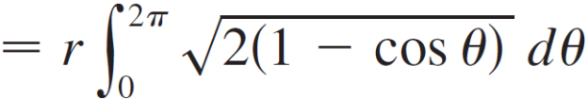
Example 5 – Solution
cont’d
We have

Slide 30



Example 5 – Solution
cont’d
To evaluate this integral we use the identity
sin²x = (1 – cos 2x) with θ = 2x, which gives
1 – cos θ = 2 sin²(θ/2).
Since 0 ≤ θ ≤ 2π, we have 0 ≤ θ/2 ≤ π and so sin(θ/2) ≥ 0.
Therefore

Slide 31
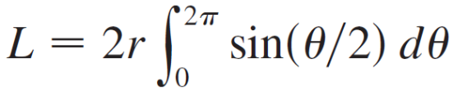
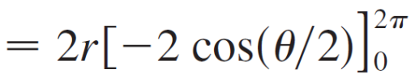


Example 5 – Solution
cont’d
And so

Slide 32
Surface Area

Slide 33
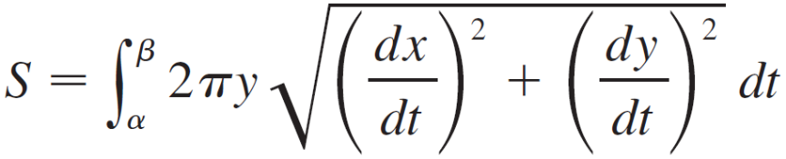

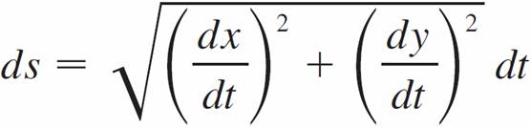
Surface Area
If the curve given by the parametric equations x = f (t),
y = g (t), α ≤ t ≤ β, is rotated about the x-axis, where f ′, g ′ are continuous and g (t) ≥ 0, then the area of the resulting surface is given by
The general symbolic formulas S = ∫ 2πy ds and
S = ∫ 2πx ds are still valid, but for parametric curves we use

Slide 34
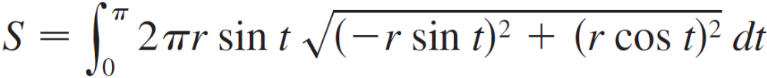
Example 6
Show that the surface area of a sphere of radius r is 4πr².
Solution:
The sphere is obtained by rotating the semicircle
x = r cos t y = r sin t 0 ≤ t ≤ π
about the x-axis.
Therefore, from Formula 6, we get

Slide 35
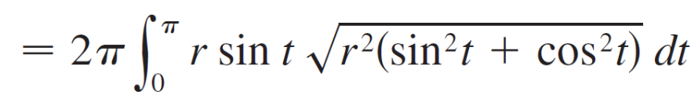
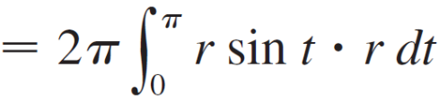
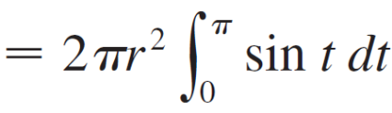


Example 6 – Solution
cont’d

