Slide 1


10
Parametric Equations
and Polar Coordinates
Copyright © Cengage Learning. All rights reserved.

Slide 2

10.5
Conic Sections
Copyright © Cengage Learning. All rights reserved.

Slide 3
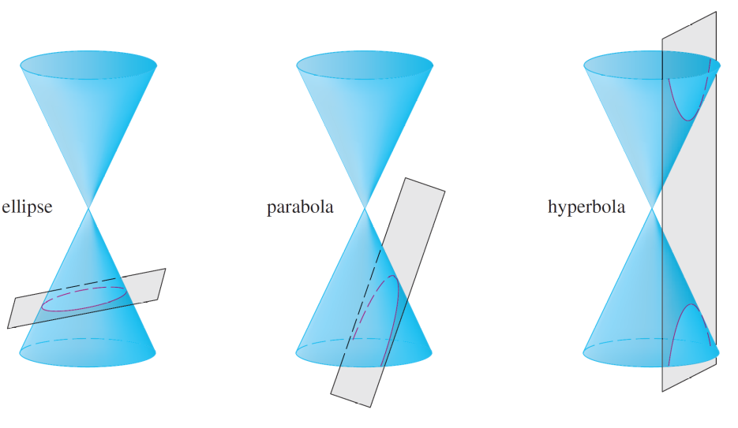
Conic Sections
In this section we give geometric definitions of parabolas, ellipses, and hyperbolas and derive their standard equations. They are called conic sections, or conics, because they result from intersecting a cone with a plane as shown in Figure 1.
Conics
Figure 1

Slide 4
Parabolas

Slide 5
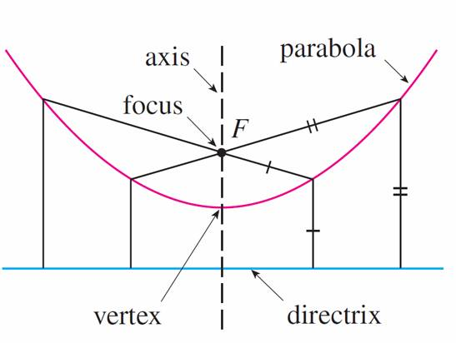
Parabolas
A parabola is the set of points in a plane that are equidistant from a fixed point F (called the focus) and a fixed line (called the directrix). This definition is illustrated by Figure 2.
Figure 2

Slide 6
Parabolas
Notice that the point halfway between the focus and the directrix lies on the parabola; it is called the vertex.
The line through the focus perpendicular to the directrix is called the axis of the parabola.
In the 16th century Galileo showed that the path of a projectile that is shot into the air at an angle to the ground is a parabola. Since then, parabolic shapes have been used in designing automobile headlights, reflecting telescopes, and suspension bridges.

Slide 7
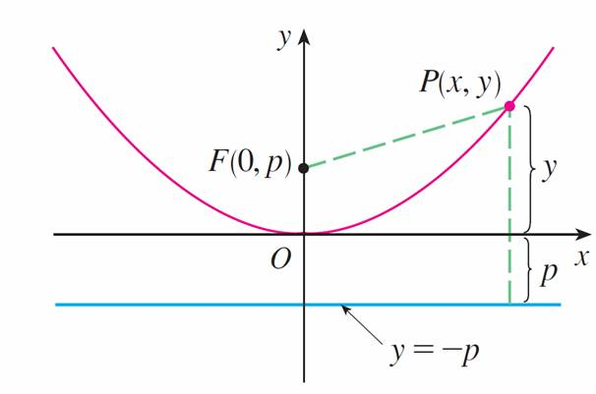
Parabolas
We obtain a particularly simple equation for a parabola if we place its vertex at the origin O and its directrix parallel to the x-axis as in Figure 3.
Figure 3

Slide 8

Parabolas
If the focus is the point (0, p), then the directrix has the equation y = –p. If P (x, y) is any point on the parabola,
then the distance from P to the focus is
| PF | =
and the distance from P to the directrix is | y + p |. (Figure 3 illustrates the case where p > 0.)

Slide 9
Parabolas
The defining property of a parabola is that these distances are equal:
= | y + p |
We get an equivalent equation by squaring and
simplifying:
x² + (y – p)² = | y + p |² = (y + p )²
x² + y² – 2py + p² = y² + 2py + p²

Slide 10
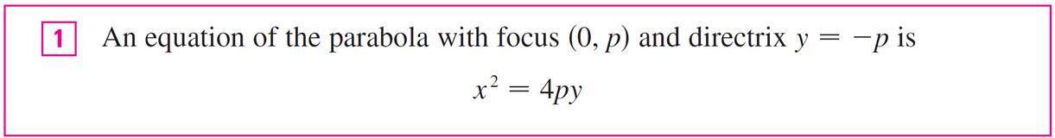

Parabolas
x² = 4py
If we write a = 1/(4p), then the standard equation of a parabola becomes y = ax².

Slide 11
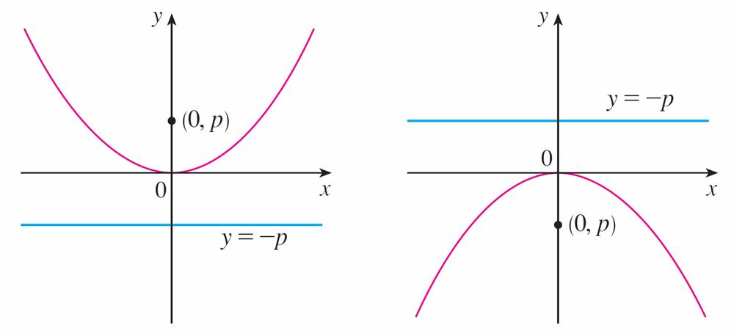
Parabolas
It opens upward if p > 0 and downward if p < 0 [see Figure 4, parts (a) and (b)].
(a) x² = 4py, p > 0
(a) x² = 4py, p < 0
Figure 4

Slide 12
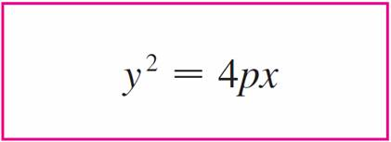

Parabolas
The graph is symmetric with respect to the y-axis because
is unchanged when is replaced by –x.
If we interchange x and y in , we obtain
which is an equation of the parabola with focus (p, 0)
and directrix x = –p.

Slide 13
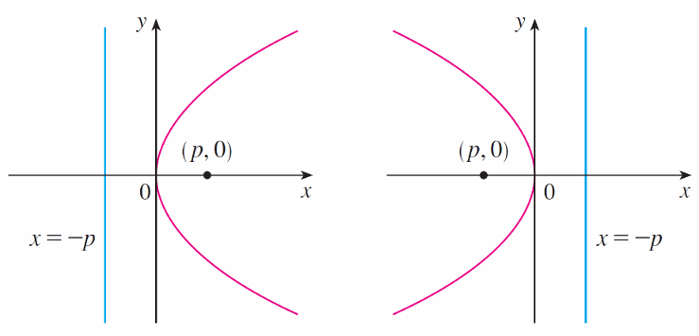
Parabolas
(Interchanging x and y amounts to reflecting about the diagonal line y = x.)
The parabola opens to the right if p > 0 and to the left if
p < 0 [see Figure 4, parts (c) and (d)].
(c) y² = 4px, p > 0
(d) y² = 4px, p < 0
Figure 4

Slide 14
Parabolas
In both cases the graph is symmetric with respect to the
x-axis, which is the axis of the parabola.

Slide 15



Example 1
Find the focus and directrix of the parabola y² + 10x = 0
and sketch the graph.
Solution:
If we write the equation as y² = –10x and compare it with Equation 2, we see that 4p = –10, so p =
Thus the focus is (p, 0) = ( , 0) and the directrix is x =

Slide 16
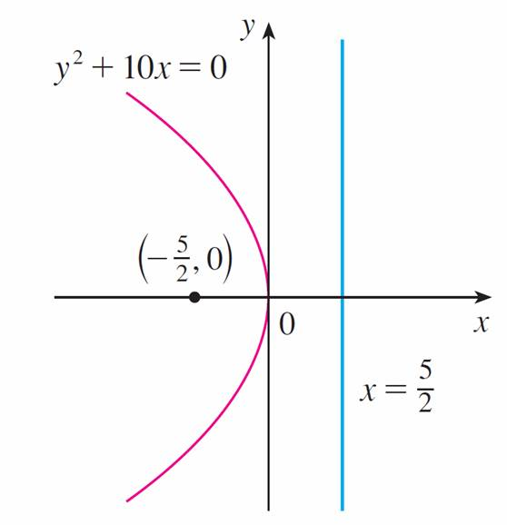
Example 1 – Solution
cont’d
The sketch is shown in Figure 5.
Figure 5

Slide 17
Ellipses

Slide 18
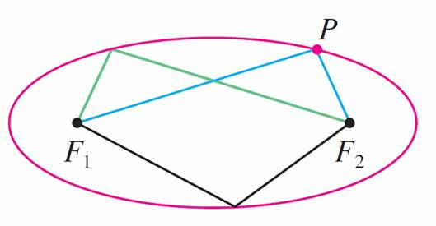
Ellipses
An ellipse is the set of points in a plane the sum of whose distances from two fixed points F₁ and F₂ is a constant
(see Figure 6).
Figure 6

Slide 19
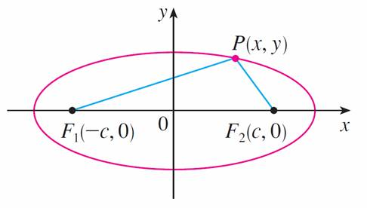
Ellipses
These two fixed points are called the foci (plural of focus). One of Kepler’s laws is that the orbits of the planets in the solar system are ellipses with the sun at one focus.
In order to obtain the simplest equation for an ellipse, we place the foci on the x-axis at the points (– c, 0) and (c, 0) as in Figure 7 so that the origin is halfway between the foci.
Figure 7

Slide 20
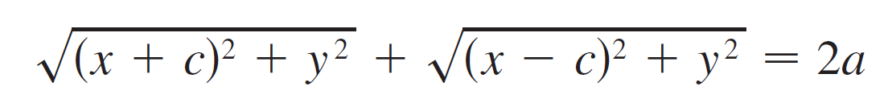
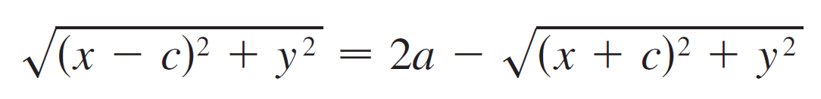
Ellipses
Let the sum of the distances from a point on the ellipse to the foci be 2a > 0. Then P (x, y) is a point on the ellipse when
| PF₁ | + | PF₂ | = 2a
that is,
or

Slide 21
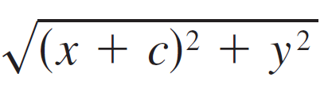
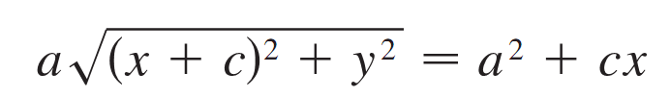
Ellipses
Squaring both sides, we have
x² – 2cx + c² + y²
= 4a² – 4a + x² + 2cx + c² + y²
which simplifies to
We square again:
a²(x² + 2cx + c² + y²) = a⁴ + 2a²cx + c²x²
which becomes
(a² – c²)x² + a²y² = a²(a² – c²)

Slide 22
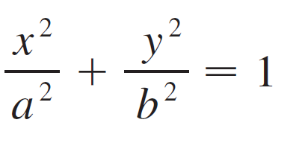

Ellipses
From triangle F₁F₂P in Figure 7 we see that 2c < 2a, so
c < a and therefore a² – c² > 0. For convenience,
let b² = a² – c².
Then the equation of the ellipse becomes
b²x² + a²y² = a²b² or, if both sides are divided by a²b²,
Since b² = a² – c² < a² , it follows that b < a.

Slide 23
Ellipses
The x-intercepts are found by setting y = 0. Then
x²/a² = 1, or x² = a², so x = ±a.
The corresponding points (a, 0) and (–a, 0) are called the vertices of the ellipse and the line segment joining the vertices is called the major axis. To find the y-intercepts we set x = 0 and obtain y² = b², so y = ±b.
The line segment joining (0, b) and (0, –b) is the minor axis.

Slide 24
Ellipses
Equation 3 is unchanged if x is replaced by –x or y is replaced by –y, so the ellipse is symmetric about both axes.
Notice that if the foci coincide, then c = 0, so a = b and the ellipse becomes a circle with radius r = a = b.

Slide 25
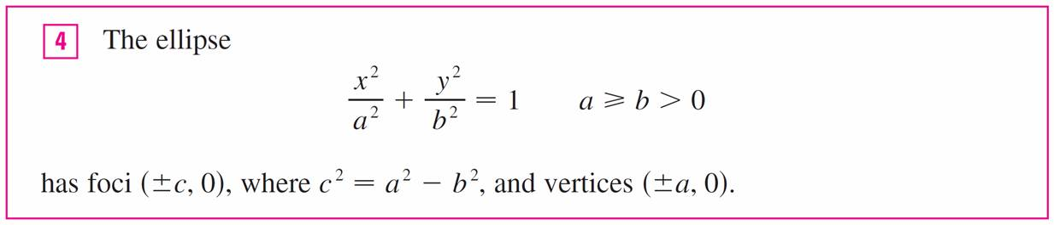
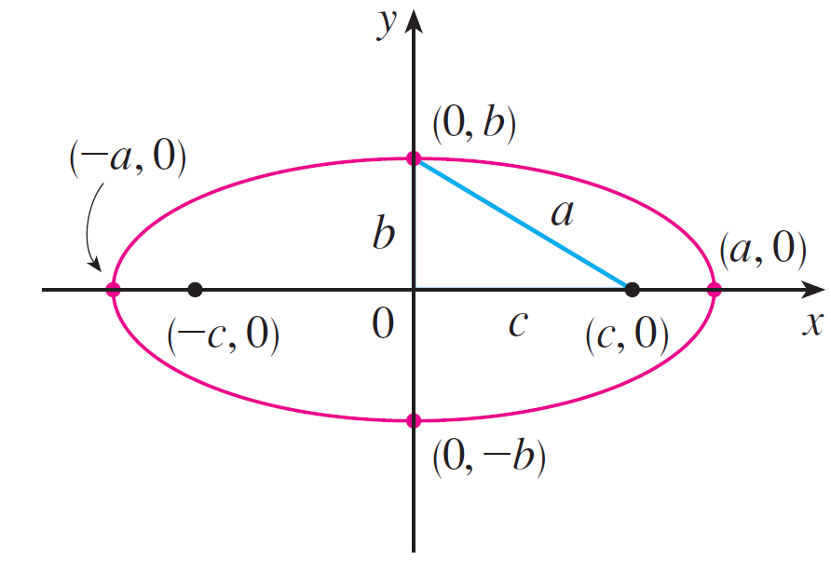
Ellipses
We summarize this discussion as follows (see also Figure 8).
a ≥ b
Figure 8

Slide 26

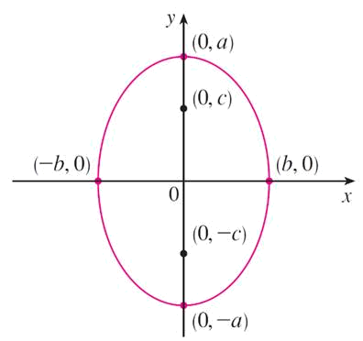
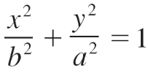
Ellipses
If the foci of an ellipse are located on the y-axis at (0, ±c),
then we can find its equation by interchanging x and y in
(See Figure 9.)
,a ≥ b
Figure 9

Slide 27
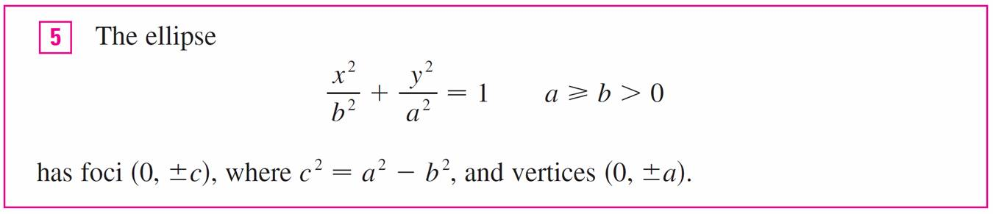
Ellipses

Slide 28
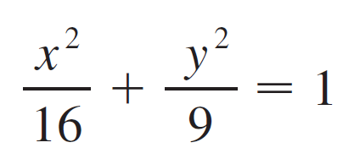
Example 2
Sketch the graph of 9x² + 16y² = 144 and locate the foci.
Solution:
Divide both sides of the equation by 144:
The equation is now in the standard form for an ellipse,
so we have a² = 16, b² = 9, a = 4, and b = 3.
The x-intercepts are ±4 and the y-intercepts are ±3.

Slide 29

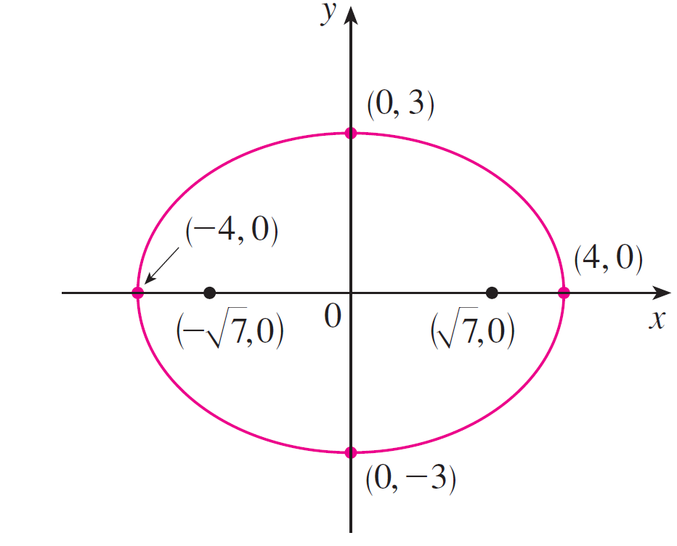
Example 2 – Solution
cont’d
Also, c² = a² – b² = 7, so c = and the foci are
(± , 0). The graph is sketched in Figure 10.
9x² + 16y² = 144
Figure 10

Slide 30
Hyperbolas

Slide 31
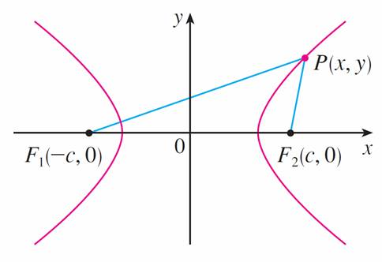
Hyperbolas
A hyperbola is the set of all points in a plane the difference of whose distances from two fixed points F₁ and F₂
(the foci) is a constant. This definition is illustrated in Figure 11.
P is on the hyperbola when
| PF₁ | – | PF₂ | = ±2a.
Figure 11

Slide 32
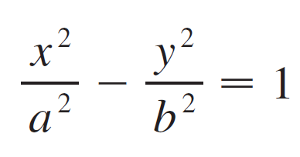

Hyperbolas
Notice that the definition of a hyperbola is similar to that of an ellipse; the only change is that the sum of distances has become a difference of distances.
In fact, the derivation of the equation of a hyperbola is also similar to the one given earlier for an ellipse.
When the foci are on the x-axis at (±c, 0) and the difference of distances is | PF₁ | – | PF₂ | = ±2a, then the equation of the hyperbola is
where c² = a² + b².

Slide 33
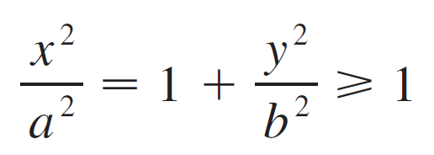

Hyperbolas
Notice that the x-intercepts are again ±a and the points
(a, 0) and (–a, 0) are the vertices of the hyperbola.
But if we put x = 0 in Equation 6 we get y² = –b², which is impossible, so there is no y-intercept. The hyperbola is symmetric with respect to both axes.
To analyze the hyperbola further, we look at Equation 6 and obtain
This shows that x² ≥ a², so | x | =
Therefore we have x ≥ a or x ≤ –a.

Slide 34
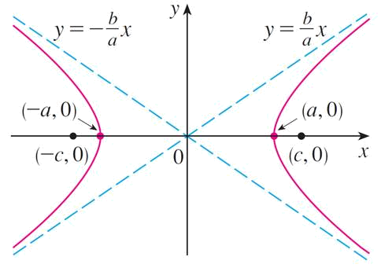
Hyperbolas
This means that the hyperbola consists of two parts, called its branches. When we draw a hyperbola it is useful to first draw its asymptotes, which are the dashed lines y = (b/a)x and y = –(b/a)x shown in Figure 12.
Figure 12

Slide 35
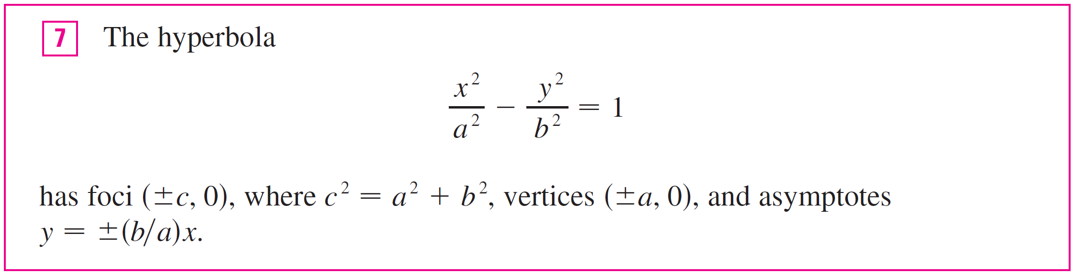
Hyperbolas
Both branches of the hyperbola approach the asymptotes; that is, they come arbitrarily close to the asymptotes.

Slide 36
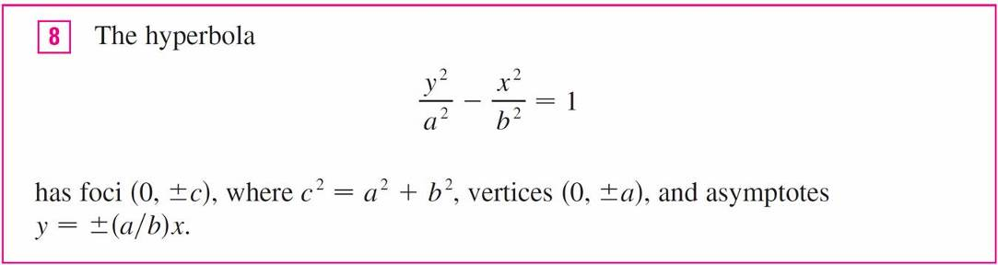
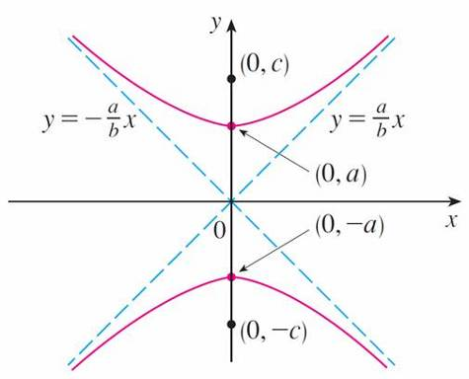

Hyperbolas
If the foci of a hyperbola are on the y-axis, then by reversing the roles of x and y we obtain the following information, which is illustrated in Figure 13.
Figure 13

Slide 37
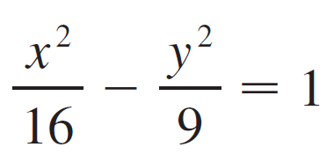

Example 4
Find the foci and asymptotes of the hyperbola
9x² – 16y² = 144 and sketch its graph.
Solution:
If we divide both sides of the equation by 144, it becomes
which is of the form given in with a = 4 and b = 3.

Slide 38

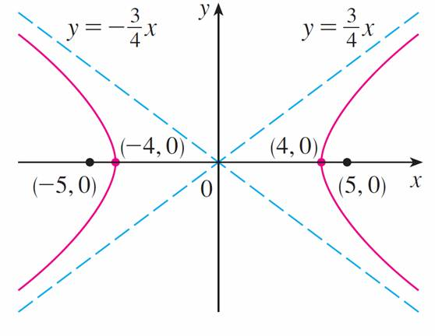
Example 4 – Solution
cont’d
Since c² = 16 + 9 = 25, the foci are (±5, 0). The asymptotes are the lines y = and y = – . The graph is shown in Figure 14.
9x² – 16y² = 144
Figure 14

Slide 39
Shifted Conics

Slide 40



Shifted Conics
We shift conics by taking the standard equations
and and replacing x and y by x – h and y – k.

Slide 41

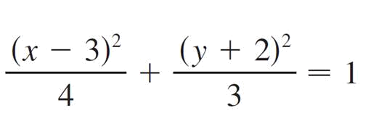
Example 6
Find an equation of the ellipse with foci (2, –2),(4, –2)
and vertices (1, –2),(5, –2).
Solution:
The major axis is the line segment that joins the vertices
(1, –2),(5, –2) and has length 4, so a = 2. The distance between the foci is 2, so c = 1. Thus b² = a² – c² = 3.
Since the center of the ellipse is (3, –2), we replace x and
y in by x – 3 and y + 2 to obtain
as the equation of the ellipse.

Slide 42
Example 7
Sketch the conic 9x² – 4y² – 72x + 8y + 176 = 0 and find its foci.
Solution:
We complete the squares as follows:
4(y² – 2y) – 9(x² – 8x) = 176
4(y² – 2y + 1) – 9(x² – 8x + 16) = 176 + 4 – 144
4(y – 1)² – 9(x – 4)² = 36

Slide 43
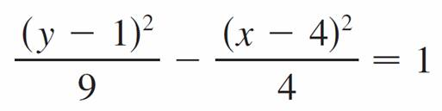

Example 7 – Solution
cont’d
This is in the form except that x and y are replaced by
x – 4 and y – 1. Thus a² = 9, b² = 4, and c² = 13.
The hyperbola is shifted four units to the right and one
unit upward.

Slide 44


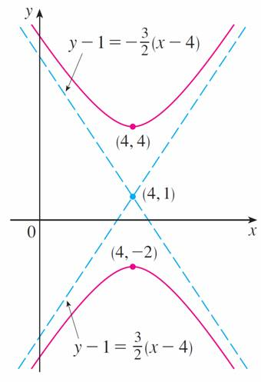
Example 7 – Solution
cont’d
The foci are (4, 1 + ) and (4, 1 – ) and the vertices are (4, 4) and (4, –2). The asymptotes are
y – 1 = The hyperbola is sketched in Figure 15.
9x² – 4y² – 72x + 8y + 176 = 0
Figure 15

