Slide 1

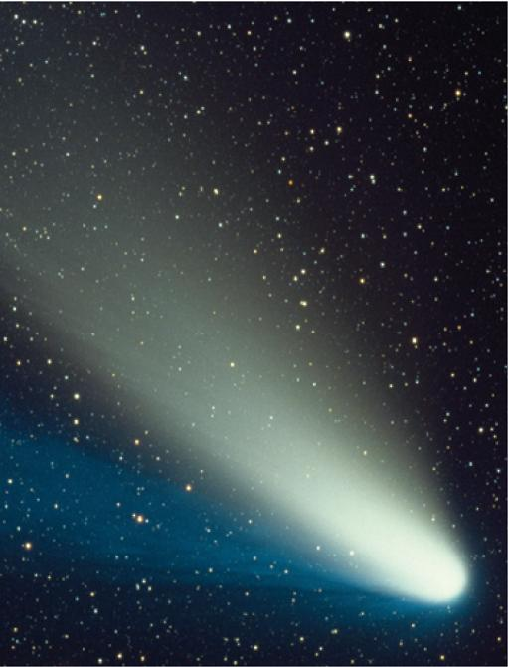
10
Parametric Equations
and Polar Coordinates
Copyright © Cengage Learning. All rights reserved.

Slide 2

Conic Sections in Polar Coordinates
10.6
Copyright © Cengage Learning. All rights reserved.

Slide 3
Conic Sections in Polar Coordinates
In this section we give a more unified treatment of all three types of conic sections in terms of a focus and directrix.
Furthermore, if we place the focus at the origin, then a conic section has a simple polar equation, which provides a convenient description of the motion of planets, satellites, and comets.

Slide 4
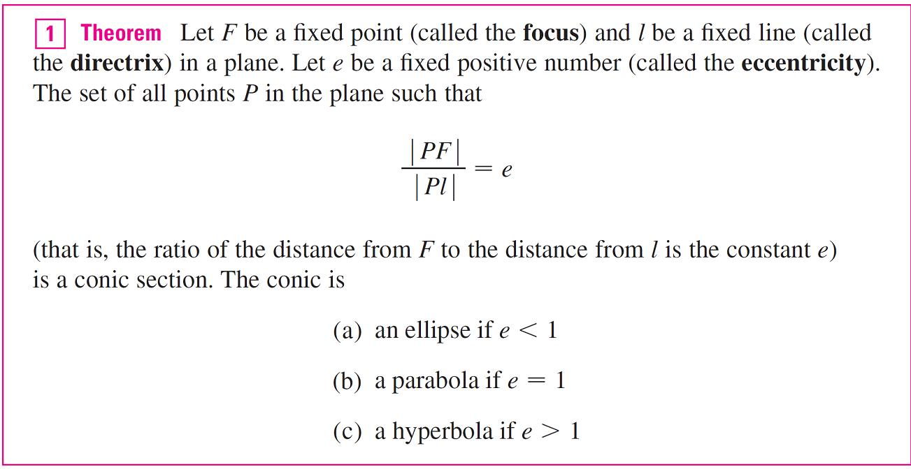
Conic Sections in Polar Coordinates

Slide 5
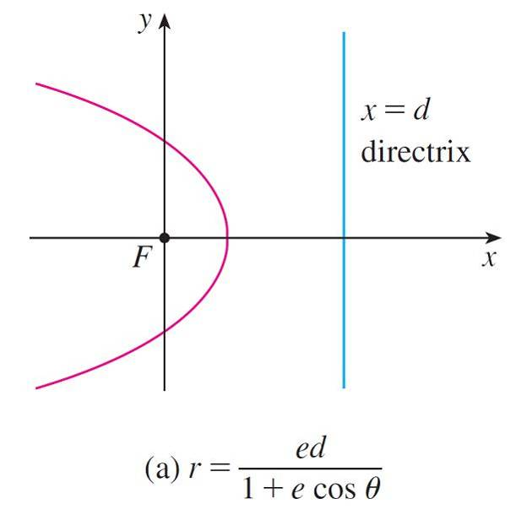
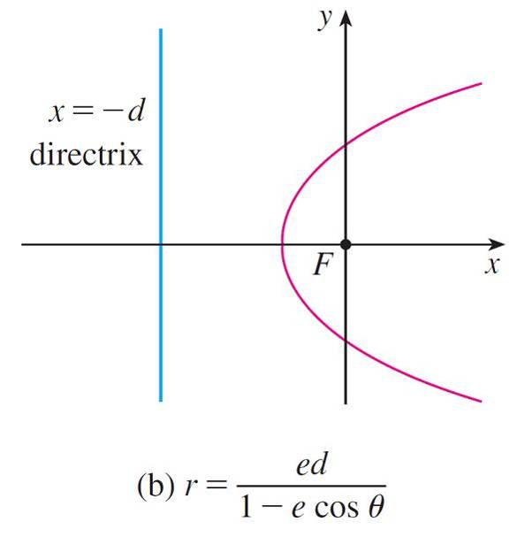
Conic Sections in Polar Coordinates
If the directrix is chosen to be to the left of the focus as
x = –d, or if the directrix is chosen to be parallel to the polar axis as y = ±d, then the polar equation of the conic is given by the following theorem, which is illustrated by Figure 2.
Polar equations of conics
Figure 2

Slide 6
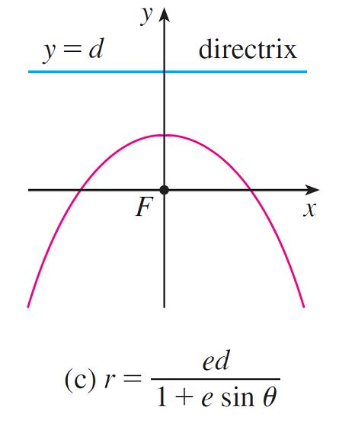
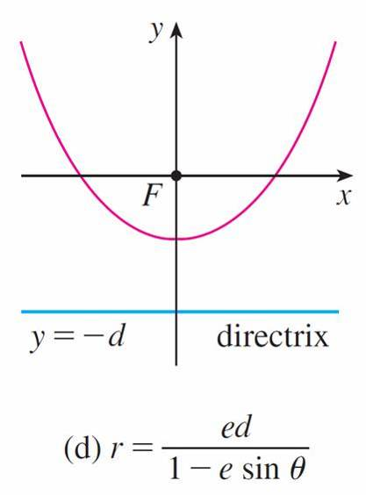
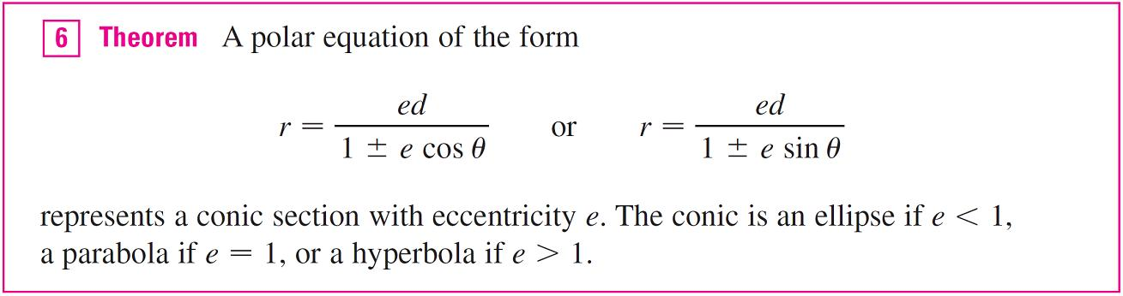
Conic Sections in Polar Coordinates
cont’d
Polar equations of conics
Figure 2

Slide 7
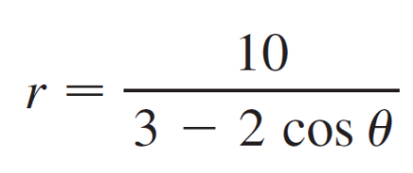
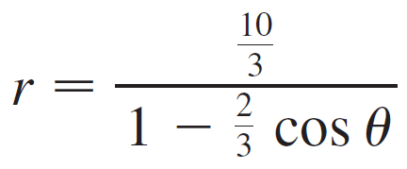
Example 2
A conic is given by the polar equation
Find the eccentricity, identify the conic, locate the directrix, and sketch the conic.
Solution:
Dividing numerator and denominator by 3, we write the equation as

Slide 8


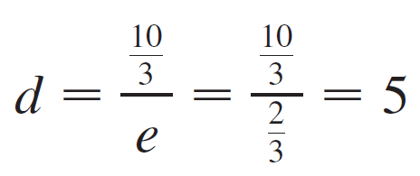
Example 2 – Solution
cont’d
From Theorem 6 we see that this represents an ellipse with e = .
Since ed = , we have

Slide 9
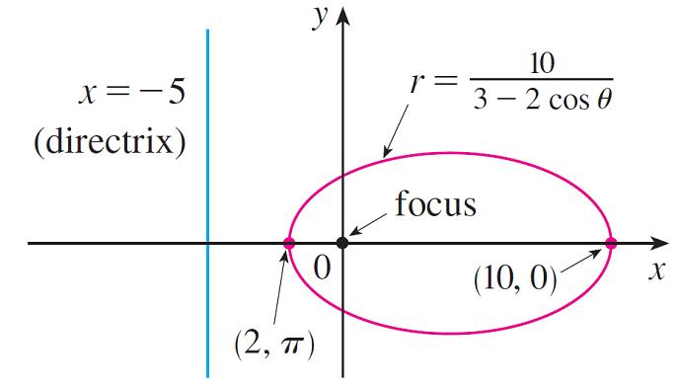
Example 2 – Solution
cont’d
so the directrix has Cartesian equation x = –5. When θ = 0, r = 10; when θ = π, r = 2. So the vertices have polar coordinates (10, 0) and (2, π). The ellipse is sketched in Figure 3.
Figure 3

Slide 10
Kepler’s Laws

Slide 11
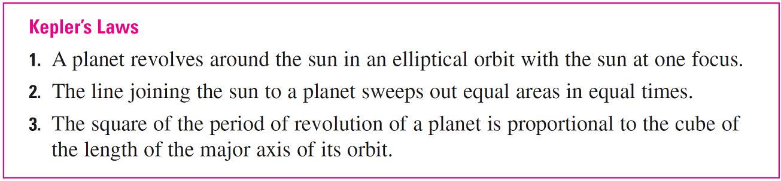
Kepler’s Laws
In 1609 the German mathematician and astronomer Johannes Kepler, on the basis of huge amounts of astronomical data, published the following three laws of planetary motion.

Slide 12
Kepler’s Laws
Although Kepler formulated his laws in terms of the motion of planets around the sun, they apply equally well to the motion of moons, comets, satellites, and other bodies that orbit subject to a single gravitational force.
Here we use Kepler’s First Law, together with the polar equation of an ellipse, to calculate quantities of interest in astronomy.
For purposes of astronomical calculations, it’s useful to express the equation of an ellipse in terms of its eccentricity e and its semimajor axis a.

Slide 13

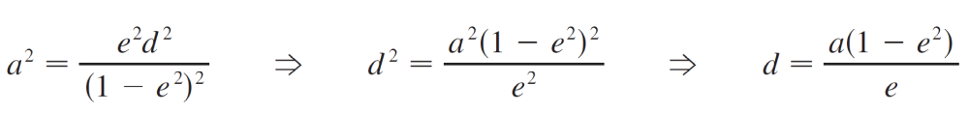
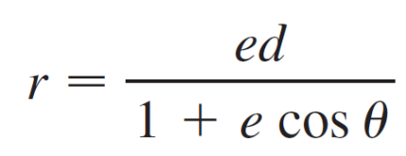
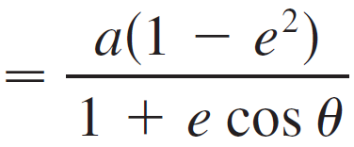
Kepler’s Laws
We can write the distance d from the focus to the directrix in terms of a if we use :
So ed = a(1 – e²). If the directrix is x = d, then the polar equation is

Slide 14
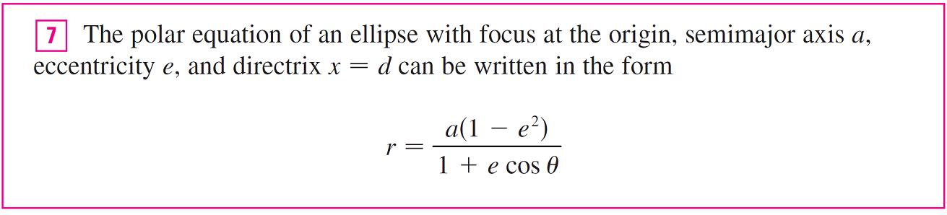
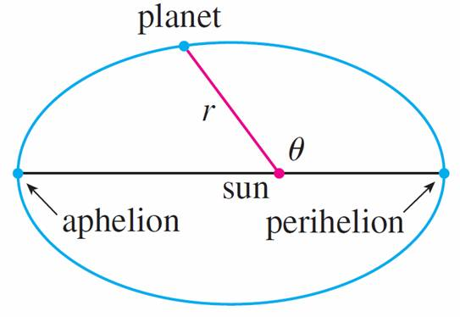
Kepler’s Laws
The positions of a planet that
are closest to and farthest
from the sun are called its
perihelion and aphelion,
respectively, and correspond
to the vertices of the ellipse.
(See Figure 7.)
Figure 7

Slide 15
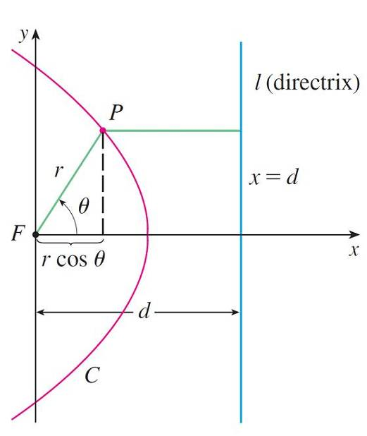
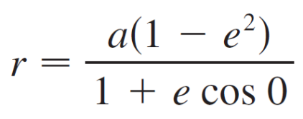
Kepler’s Laws
The distances from the sun to the perihelion and aphelion are called the perihelion distance and aphelion distance, respectively.
In Figure 1 the sun is at the
focus F, so at perihelion we
have θ = 0 and, from
Equation 7,
Figure 1

Slide 16
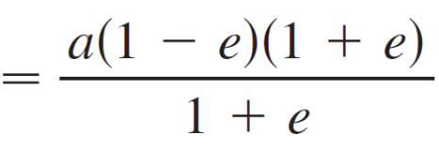
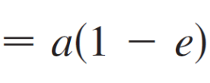
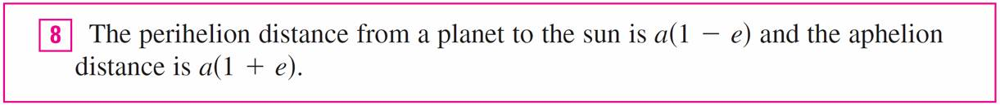
Kepler’s Laws
Similarly, at aphelion θ = π and r = a(1 + e).

Slide 17
Example 5
(a) Find an approximate polar equation for the elliptical
orbit of the earth around the sun (at one focus) given
that the eccentricity is about 0.017 and the length of the
major axis is about 2.99 × 10⁸ km.
(b) Find the distance from the earth to the sun at perihelion
and at aphelion.
Solution:
(a) The length of the major axis is 2a = 2.99 × 10⁸, so
a = 1.495 × 10⁸.

Slide 18
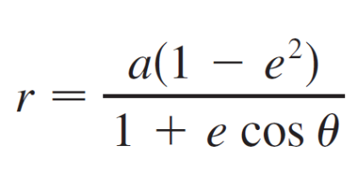
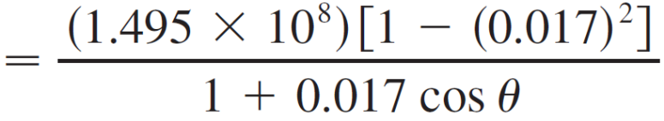
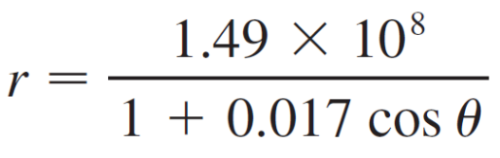
Example 5 – Solution
cont’d
We are given that e = 0.017 and so, from Equation 7, an equation of the earth’s orbit around the sun is
or, approximately,

Slide 19

Example 5 – Solution
cont’d
(b) From , the perihelion distance from the earth to the
sun is
a(1 – e) ≈ (1.495 × 10⁸)(1 – 0.017)
≈ 1.47 × 10⁸ km
and the aphelion distance is
a(1 + e) ≈ (1.495 × 10⁸)(1 + 0.017)
≈ 1.52 × 10⁸ km

