Slide 1


Infinite Sequences
and Series
11
Copyright © Cengage Learning. All rights reserved.

Slide 2

11.1
Sequences
Copyright © Cengage Learning. All rights reserved.

Slide 3
Sequences
A sequence can be thought of as a list of numbers written in a definite order:
a₁, a₂, a₃, a₄, . . . , a_{n}, . . .
The number a₁ is called the first term, a₂ is the second term, and in general a_{n} is the nth term. We will deal exclusively with infinite sequences and so each term a_{n} will have a successor a_{n + 1}.
Notice that for every positive integer n there is a corresponding number a_{n} and so a sequence can be defined as a function whose domain is the set of positive integers.

Slide 4

Sequences
But we usually write a_{n} instead of the function notation f (n)
for the value of the function at the number n.
Notation: The sequence {a₁, a₂, a₃, . . .} is also denoted by
{a_{n}} or

Slide 5
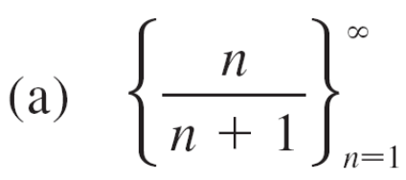
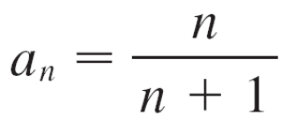
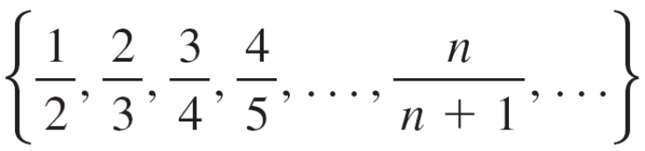
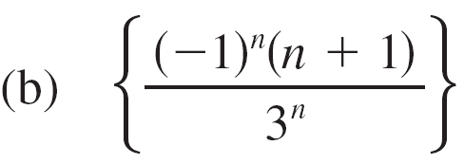
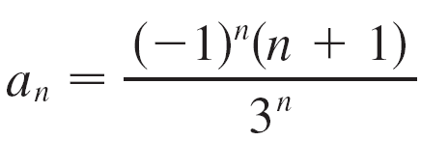
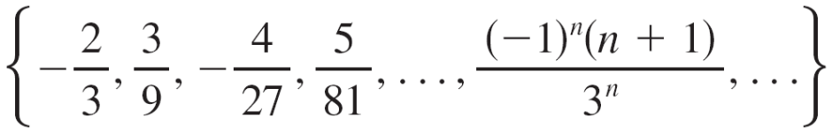
Example 1
Ways to define a sequence:
Use the sequence brace notation
Define the nth term using a formula
Write the terms explicitly (with ellipses)
Note: the sequence start index doen’t have to be 1.
∞
n=1

Slide 6



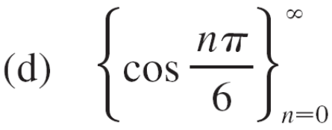
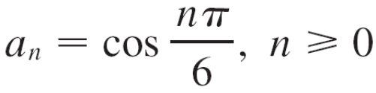
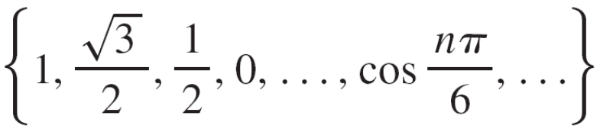
Example 1
cont’d

Slide 7
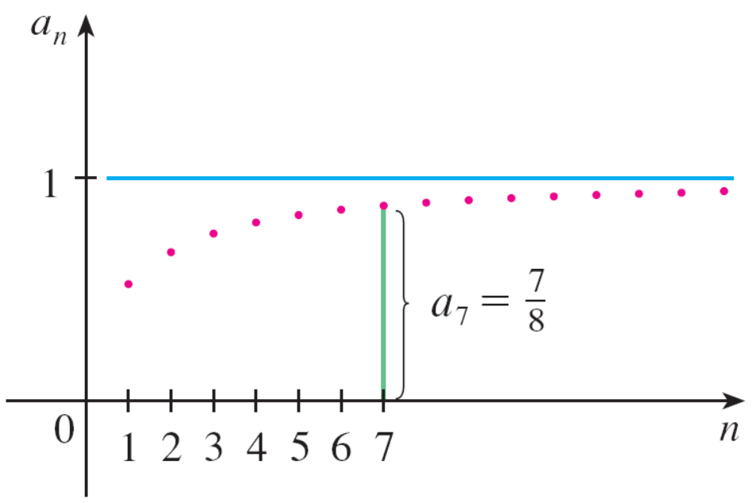
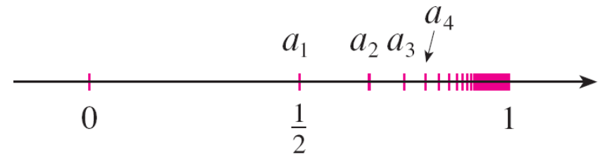
Sequence visualization
A sequence such as the one in Example 1(a),
a_{n} = n/(n + 1), can be pictured either by plotting its terms on a number line, as in Figure 1, or by plotting its graph, as in Figure 2.
Figure 1
Figure 2

Slide 8
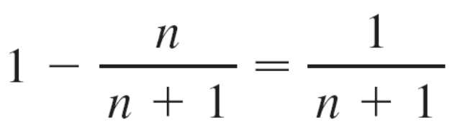
Sequence limit, introduction
Note that, since a sequence is a function whose domain is the set of positive integers, its graph consists of isolated points with coordinates
(1, a₁) (2, a₂) (3, a₃) . . . (n, a_{n}) . . .
From Figure 1 or Figure 2 it appears that the terms of the sequence a_{n} = n/(n + 1) are approaching 1 as n becomes large. In fact, the difference
can be made as small as we like by taking n sufficiently large.

Slide 9
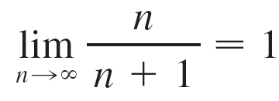
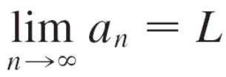
Sequence limit, introduction
We indicate this by writing
In general, the notation
means that the terms of the sequence {a_{n}} approach L as n becomes large.

Slide 10
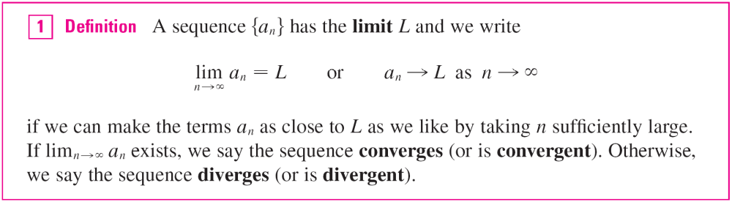
Sequence limit, informal
Notice that the following definition of the limit of a sequence is very similar to the definition of a limit of a function at infinity.

Slide 11
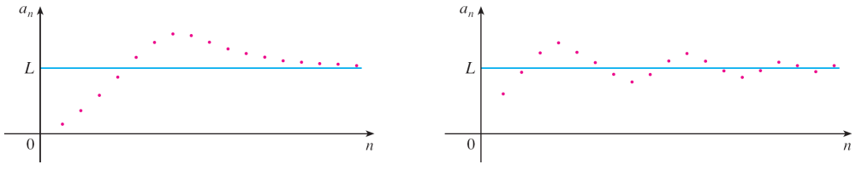

Sequence limit, informal
Figure 3 illustrates Definition 1 by showing the graphs of two sequences that have the limit L.
Figure 3
Graphs of two sequences with

Slide 12
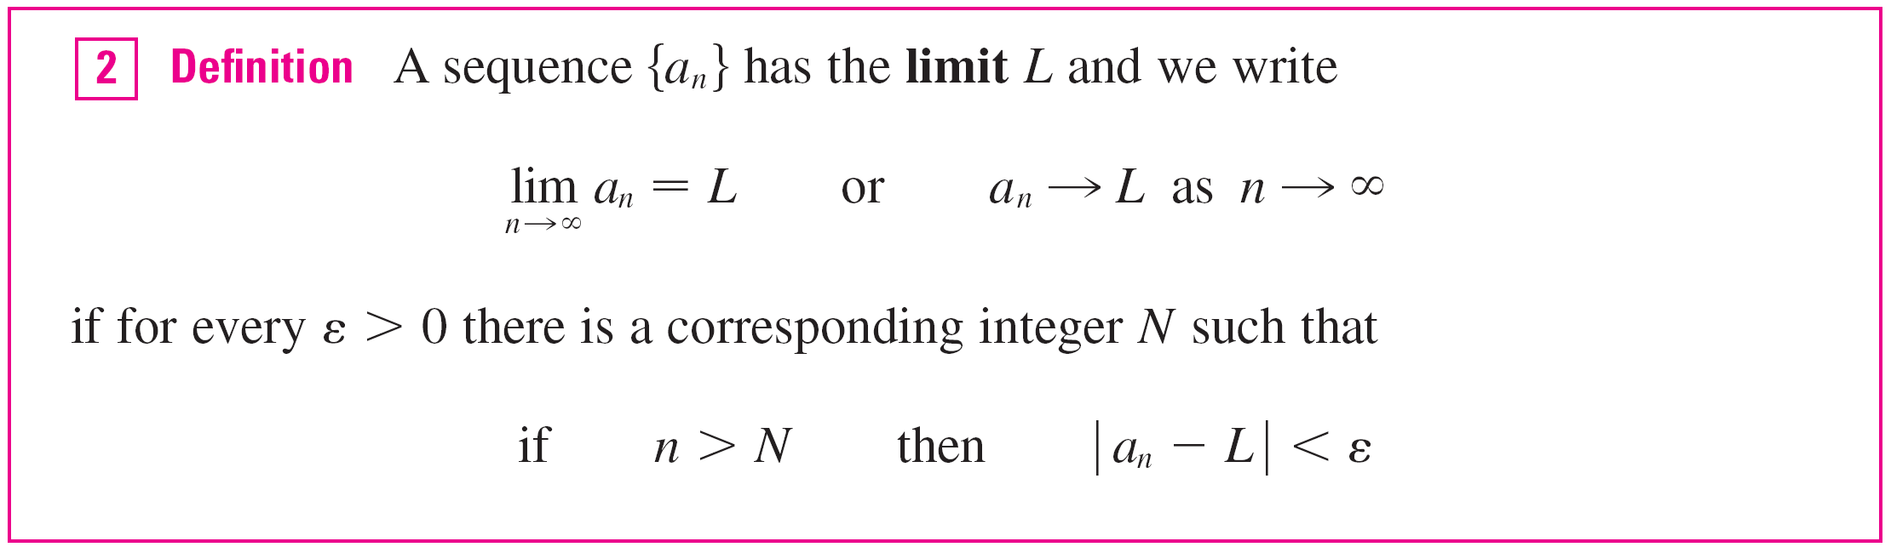
Sequence limit, formal
A more precise version of Definition 1 is as follows.

Slide 13
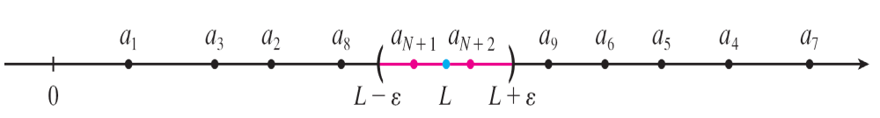
Sequence limit, formal
Definition 2 is illustrated by Figure 4, in which the terms a₁,a₂,a₃ , . . . are plotted on a number line.
No matter how small an interval (L – ε, L + ε) is chosen, there exists an N such that all terms of the sequence from a_{N+1} onward must lie in that interval.
Figure 4

Slide 14
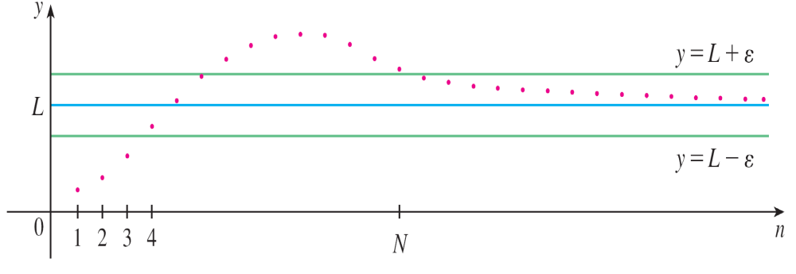
Sequence limit, formal
Another illustration of Definition 2 is given in Figure 5. The points on the graph of {a_{n}} must lie between the horizontal lines y = L + ε and y = L – ε if n > N. This picture must be valid no matter how small ε is chosen, but usually a smaller ε requires a larger N.
Figure 5

Slide 15

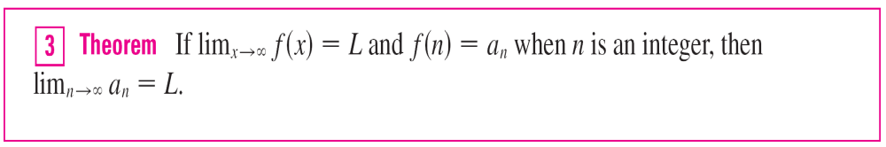
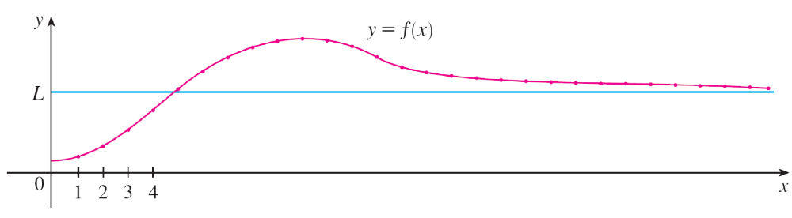
Sequence limit from function limit
You will see that the only difference between lim_{n→} a_{n} = L and lim_{x→} f(x)= L is that n is required to be an integer. Thus we have the following theorem, which is illustrated by Figure 6.
Figure 6

Slide 16
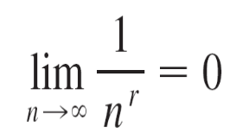

Sequence limit from function limit
In particular, since we know that lim_{x →} (1/x^{r}) = 0 when r > 0, we have
if r > 0

Slide 17

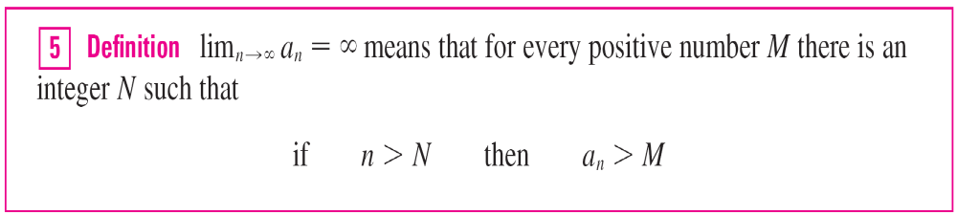
Sequences diverging to infinity
If a_{n} becomes large as n becomes large, we use the notation . Consider the definition
If lim_{n →} a_{n} = , then the sequence {a_{n}} is divergent but in a special way. We say that {a_{n}} diverges to .

Slide 18
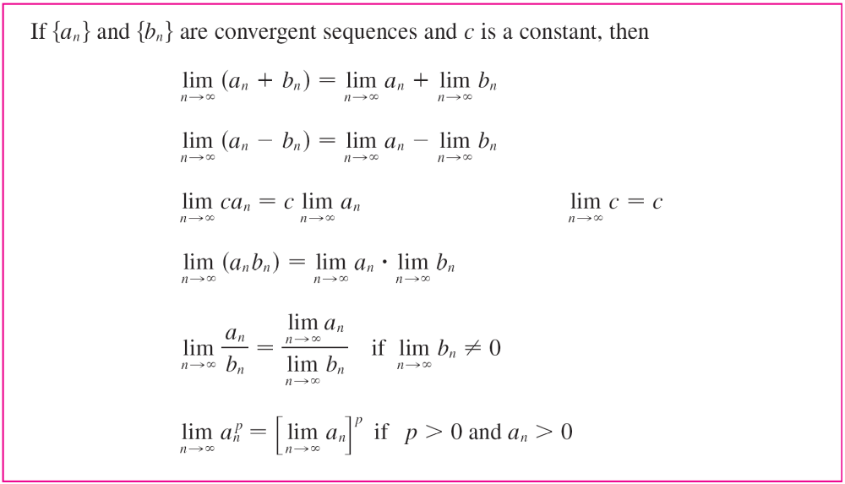
Sequence limit laws

Slide 19
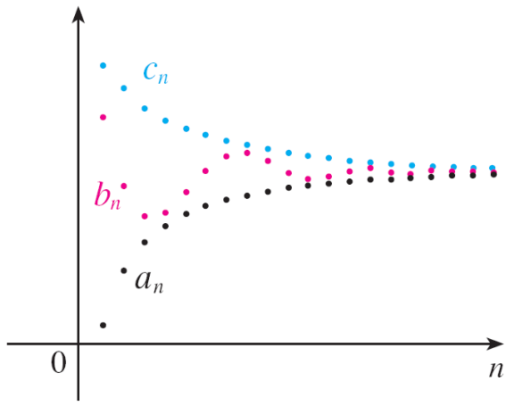
Squeeze Theorem for sequences
The Squeeze Theorem can also be adapted for sequences as follows (see Figure 7).
Squeeze Theorem for Sequences
The sequence {b_{n}} is squeezed between the sequences {a_{n}} and {c_{n}}.
Figure 7

Slide 20

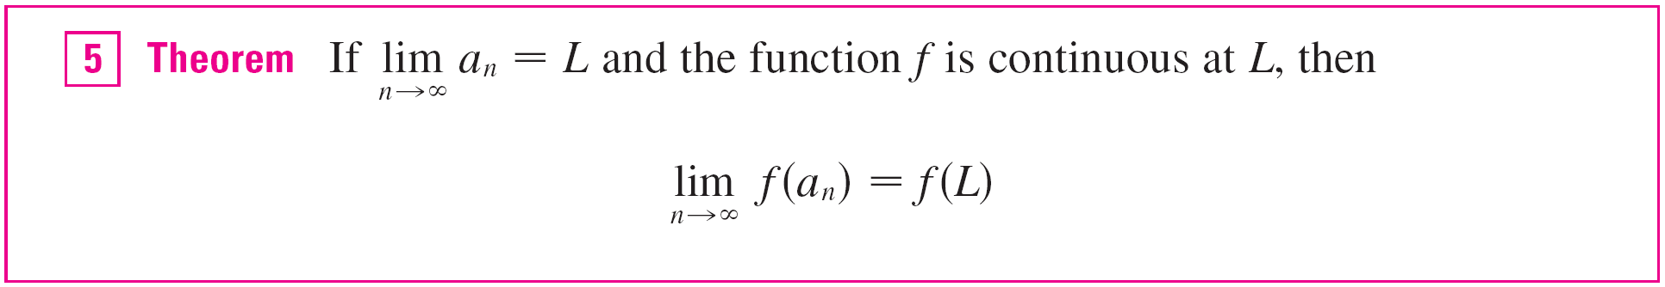

Sequence limit theorems
If the magnitude of sequence terms goes to zero, then so do the terms themselves:
If f is a continuous function evaluated on a sequence, the limit can be passed inside.

Slide 21
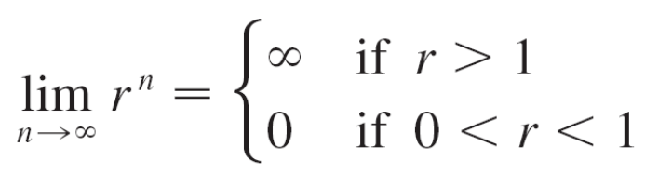
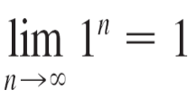
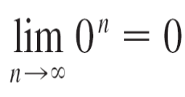

Example 11
For what values of r is the sequence {r ^{n}} convergent ?
Solution:
We know that lim_{x →} a^{x} = for a > 1, and lim_{x →} a^{x} = 0 for 0 < a < 1. Therefore, putting a = r and using Theorem 3, we have
It is obvious that
and
If –1 < r < 0, then 0 < | r | < 1, so
and therefore lim_{n →} r ^{n} = 0 by Theorem 6.

Slide 22
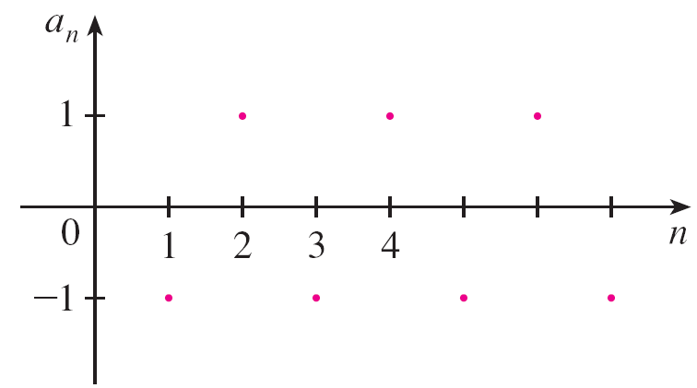
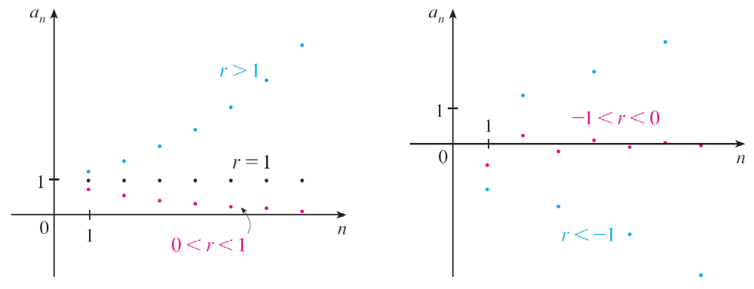
Example 11 – Solution
cont’d
If r ≤ –1, then {r ^{n}} diverges. Figure 11 shows the graphs for various values of r. (The case r = –1 is shown in Figure 8.)
Figure 8
Figure 11
The sequence a_{n} = r ^{n}

Slide 23
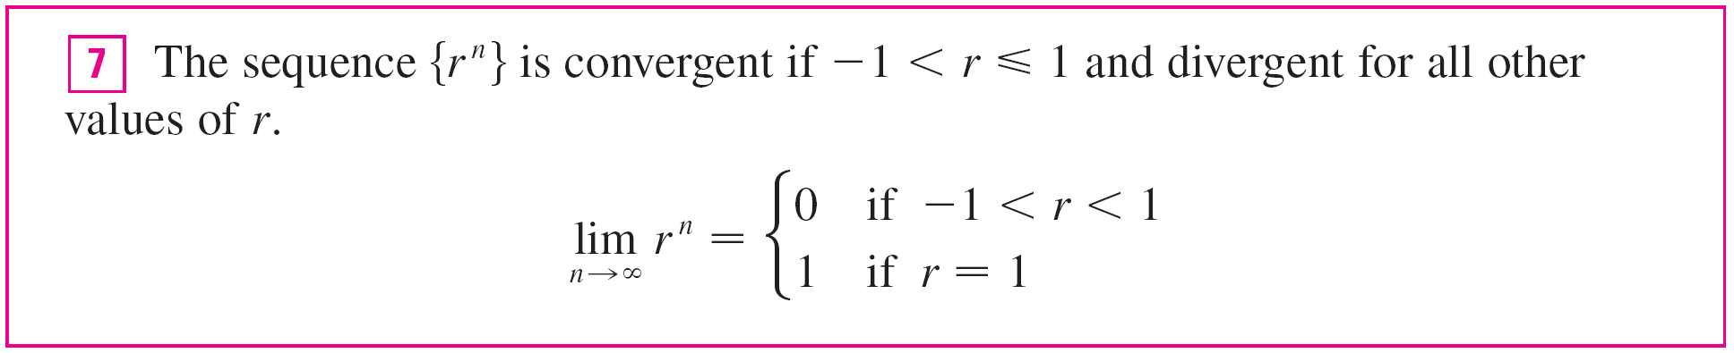

Example 11: Summary
The results of Example 11 are summarized as follows.

Slide 24
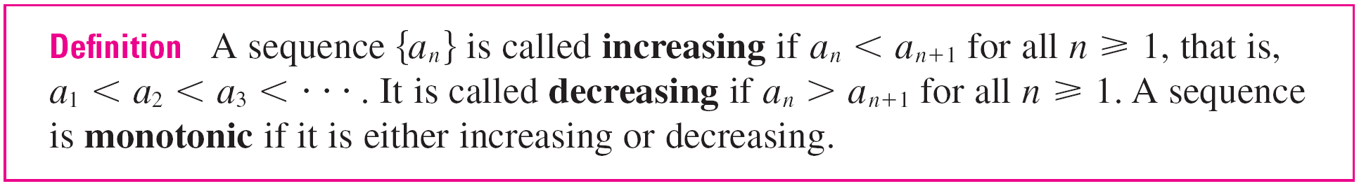
Monotonic sequences
A monotonic sequence has terms for which
Every term is greater than the previous term,
OR
Every term is less than the previous term

Slide 25
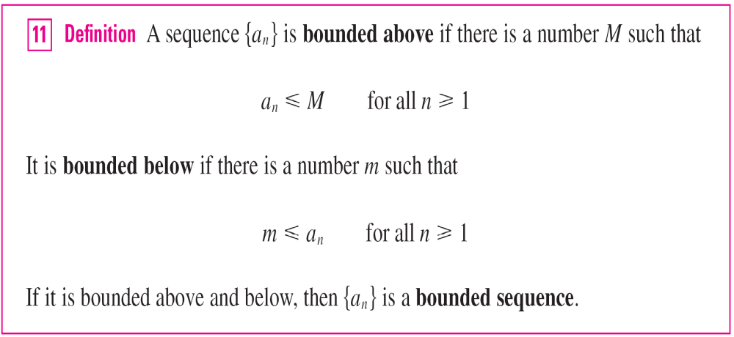
Bounded sequences
For instance, the sequence a_{n} = n is bounded below (a_{n} > 0) but not above. The sequence a_{n} = n/(n + 1) is bounded because 0 < a_{n} < 1 for all n.

Slide 26
Bounded monotonic sequences
We know that not every bounded sequence is convergent [for instance, the sequence a_{n} = (–1)^{n} satisfies –1 ≤ a_{n} ≤ 1 but is divergent,] and not every monotonic sequence is convergent (a_{n} = n → ).
But if a sequence is both bounded and monotonic, then it must be convergent.

Slide 27
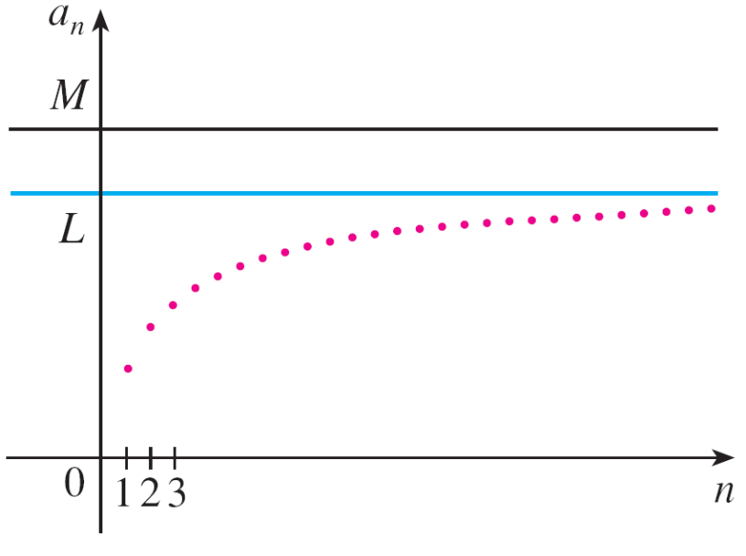
Bounded monotonic sequences
This fact is stated without proof as Theorem 12, but intuitively you can understand why it is true by looking at Figure 12.
If {a_{n}} is increasing and a_{n} ≤ M for all n, then the terms are forced to crowd together and approach some number L.
Figure 12

Slide 28

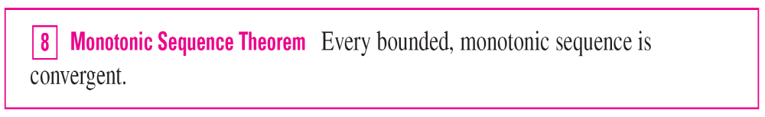

Monotone sequence theorem
The proof of Theorem 12 is based on the Completeness Axiom for the set of real numbers, which says that if S is a nonempty set of real numbers that has an upper bound M
(x ≤ M for all x in S), then S has a least upper bound b.
(This means that b is an upper bound for S, but if M is any other upper bound, then b ≤ M .)
The Completeness Axiom is an expression of the fact that there is no gap or hole in the real number line.

