Slide 1


Infinite Sequences
and Series
11
Copyright © Cengage Learning. All rights reserved.

Slide 2

The Integral Test and Estimates of Sums
11.3
Copyright © Cengage Learning. All rights reserved.

Slide 3
The Integral Test and Estimates of Sums
In general, it is difficult to find the exact sum of a series. We were able to accomplish this for geometric series and the series Σ 1/[n(n + 1)] because in each of those cases we could find a simple formula for the nth partial sum s_{n}.
But usually it isn’t easy to discover such a formula.

Slide 4
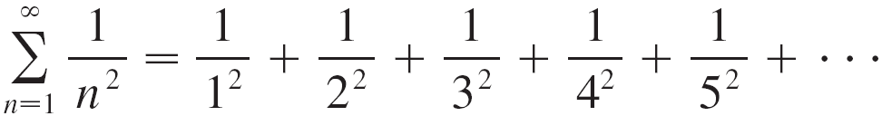
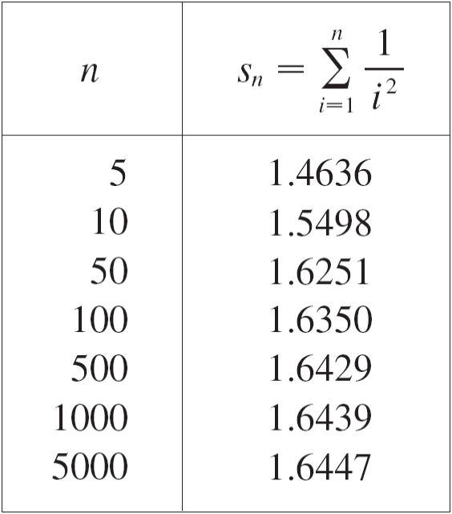

The Integral Test and Estimates of Sums
We begin by investigating the series whose terms are the reciprocals of the squares of the positive integers:
There’s no simple formula for
the sum s_{n} of the first n terms,
but the computer-generated
table of values given to the right
suggests that the partial sums
are approaching a number
near 1.64 as n → and so it
looks as if the series is convergent.

Slide 5
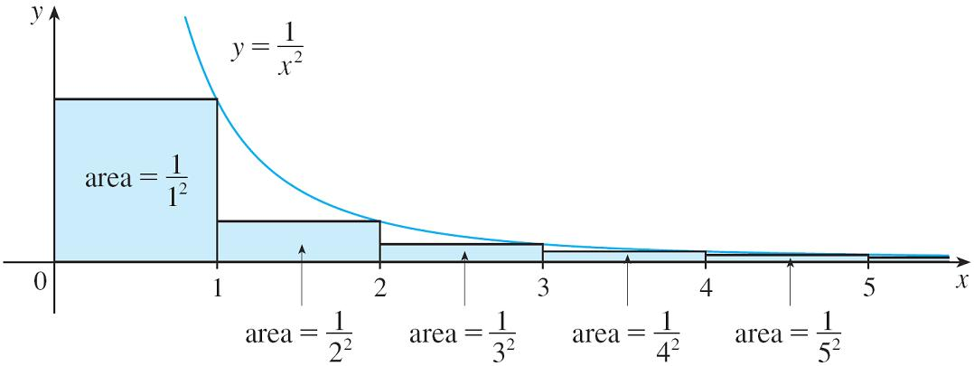
The Integral Test and Estimates of Sums
We can confirm this impression with a geometric argument. Figure 1 shows the curve y = 1/x² and rectangles that lie below the curve.
The base of each rectangle is an interval of length 1; the height is equal to the value of the function y = 1/x² at the right endpoint of the interval.
Figure 1

Slide 6
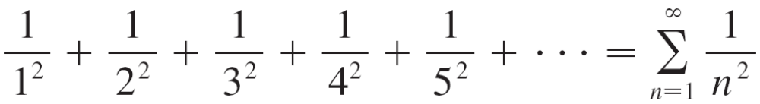

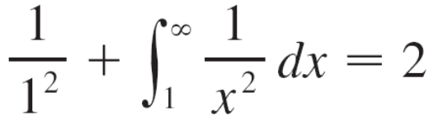
The Integral Test and Estimates of Sums
So the sum of the areas of the rectangles is
If we exclude the first rectangle, the total area of the remaining rectangles is smaller than the area under the curve y = 1/x² for x ≥ 1, which is the value of the
integral
The improper integral is convergent and has value 1. So the picture shows that all the partial sums are less than

Slide 7
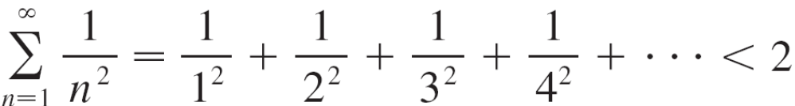
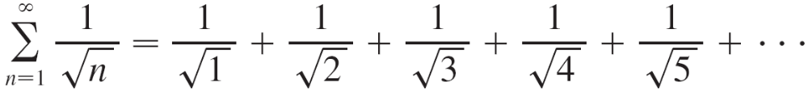
The Integral Test and Estimates of Sums
Thus the partial sums are bounded. We also know that the partial sums are increasing (because all the terms are positive). Therefore the partial sums converge (by the Mono tonic Sequence Theorem) and so the series is convergent. The sum of the series (the limit of the partial sums) is also less than 2:
Now let’s look at the series

Slide 8
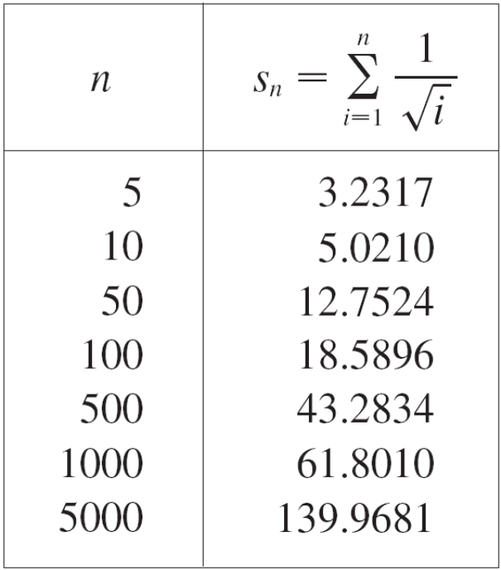
The Integral Test and Estimates of Sums
The table of values of s_{n} suggests that the partial sums aren’t approaching a finite number, so we suspect that the given series may be divergent.

Slide 9

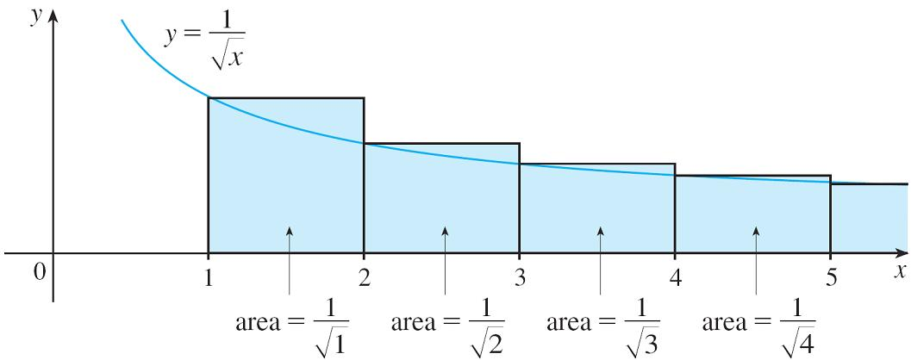

The Integral Test and Estimates of Sums
Again we use a picture for confirmation. Figure 2 shows the curve but this time we use rectangles whose tops lie above the curve.
The base of each rectangle is an interval of length 1. The height is equal to the value of the function at the left endpoint of the interval.
Figure 2

Slide 10
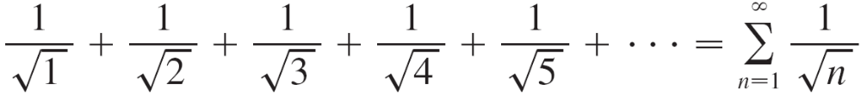

The Integral Test and Estimates of Sums
So the sum of the areas of all the rectangles is
This total area is greater than the area under the curve
for x ≥ 1, which is equal to the integral
But we know that this improper integral is divergent. In other words, the area under the curve is infinite. So the sum of the series must be infinite, that is, the series is divergent.

Slide 11
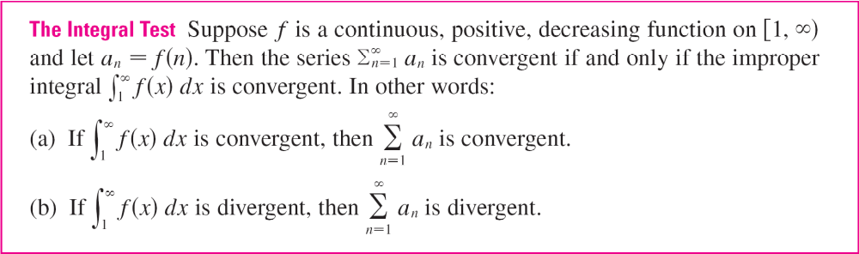
The Integral Test and Estimates of Sums
The same sort of geometric reasoning that we used for these two series can be used to prove the following test.

Slide 12
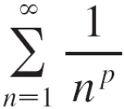

The Integral Test and Estimates of Sums
The series is called the p-series.

Slide 13
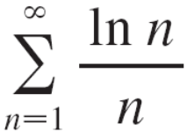
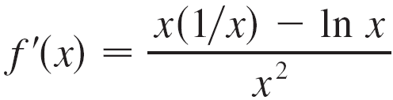
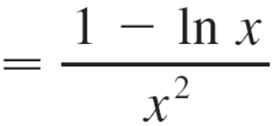
Example 4
Determine whether the series converges or diverges.
Solution:
The function f (x) = (ln x)/x is positive and continuous for
x > 1 because the logarithm function is continuous.
But it is not obvious whether or not f is decreasing, so we compute its derivative:

Slide 14
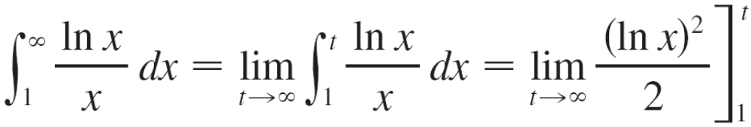
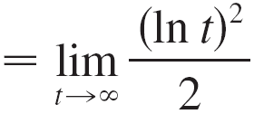

Example 4 – Solution
cont’d
Thus f '(x) < 0 when ln x > 1, that is, x > e. It follows that f is decreasing when x > e and so we can apply the Integral Test:
Since this improper integral is divergent, the series
Σ (ln n)/n is also divergent by the Integral Test.

Slide 15
Estimating the Sum of a Series

Slide 16
Estimating the Sum of a Series
Suppose we have been able to use the Integral Test to show that a series Σ a_{n} is convergent and we now want to find an approximation to the sum s of the series.
Of course, any partial sum s_{n} is an approximation to s because lim_{n →} s_{n} = s. But how good is such an approximation? To find out, we need to estimate the size of the remainder
R_{n} = s – s_{n} = a_{n + 1} + a_{n + 2} + a_{n + 3} +
The remainder R_{n} is the error made when s_{n}, the sum of the first n terms, is used as an approximation to the total sum.

Slide 17
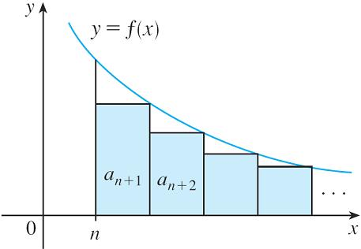
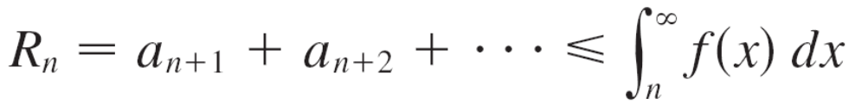
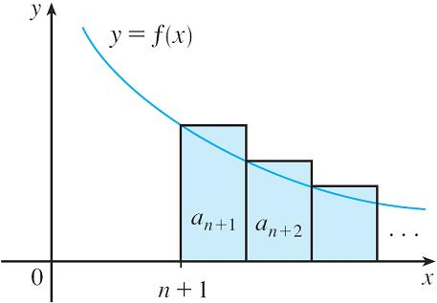

Estimating the Sum of a Series
We use the same notation and ideas as in the Integral Test, assuming that f is decreasing on [n, ). Comparing the areas of the rectangles with the area under y = f (x) for
x > n in Figure 3, we see that
Similarly, we see from Figure 4 that
Figure 3
Figure 4

Slide 18
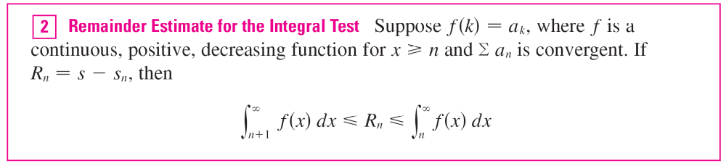
Estimating the Sum of a Series
So we have proved the following error estimate.

Slide 19

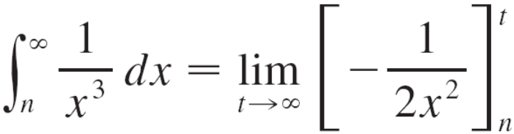
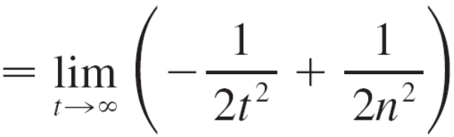
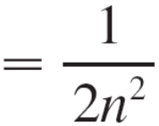
Example 5
(a) Approximate the sum of the series Σ 1/n³ by using the sum of the first 10 terms. Estimate the error involved in this approximation.
(b) How many terms are required to ensure that the sum is accurate to within 0.0005?
Solution:
In both parts (a) and (b) we need to know With
f (x) = 1/x³, which satisfies the conditions of the Integral Test, we have

Slide 20
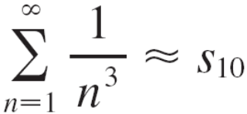
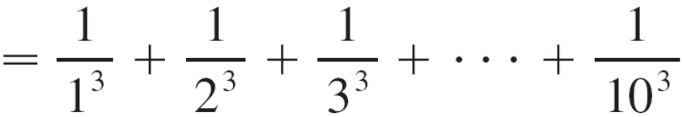

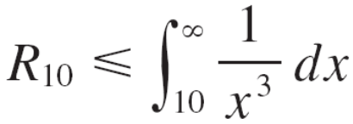
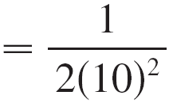
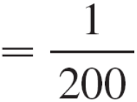
Example 5 – Solution
cont’d
(a) Approximating the sum of the series by the 10th partial sum, we have
According to the remainder estimate in (2), we have
So the size of the error is at most 0.005.

Slide 21
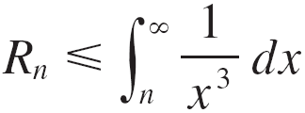
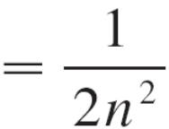
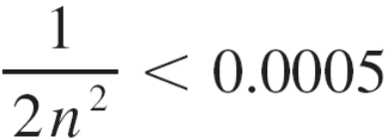
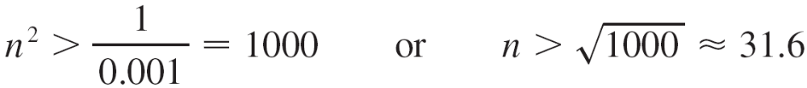
Example 5 – Solution
cont’d
(b) Accuracy to within 0.0005 means that we have to find a value of n such that R_{n} ≤ 0.0005. Since
we want
Solving this inequality, we get
We need 32 terms to ensure accuracy to within 0.0005.

Slide 22
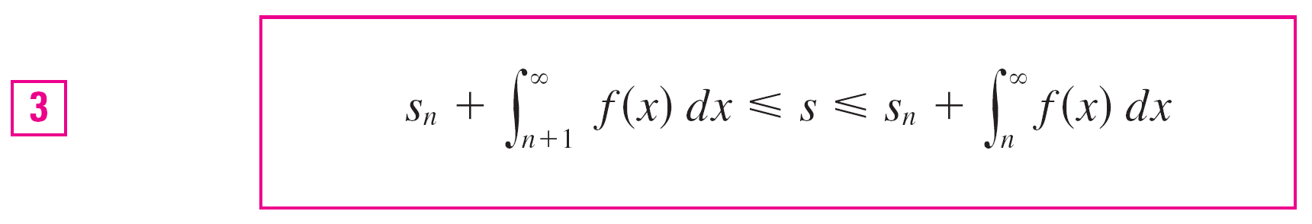
Estimating the Sum of a Series
If we add s_{n} to each side of the inequalities in (2), we get
because s_{n} + R_{n} = s. The inequalities in (3) give a lower bound and an upper bound for s.
They provide a more accurate approximation to the sum of the series than the partial sum s_{n} does.

