Slide 1


Infinite Sequences
and Series
11
Copyright © Cengage Learning. All rights reserved.

Slide 2

11.4
The Comparison Tests
Copyright © Cengage Learning. All rights reserved.

Slide 3
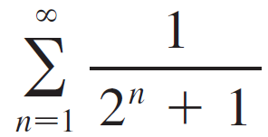





The Comparison Tests
In the comparison tests the idea is to compare a given series with a series that is known to be convergent or divergent. For instance, the series
reminds us of the series which is a geometric series with and and is therefore convergent. Because the series is so similar to a convergent series, we have the feeling that it too must be convergent. Indeed, it is.

Slide 4
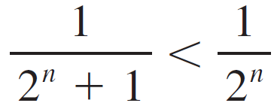

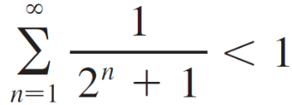
The Comparison Tests
The inequality
shows that our given series has smaller terms than those of the geometric series and therefore all its partial sums are also smaller than 1 (the sum of the geometric series).
This means that its partial sums form a bounded increasing sequence, which is convergent. It also follows that the sum of the series is less than the sum of the geometric series:

Slide 5
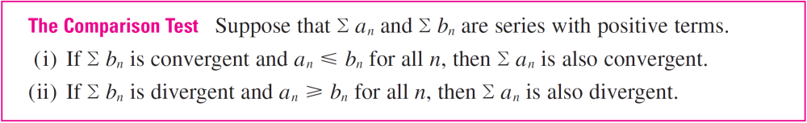
The Comparison Tests
Similar reasoning can be used to prove the following test, which applies only to series whose terms are positive. The first part says that if we have a series whose terms are smaller than those of a known convergent series, then our series is also convergent.
The second part says that if we start with a series whose terms are larger than those of a known divergent series, then it too is divergent.

Slide 6

The Comparison Tests
In using the Comparison Test we must, of course, have some known series for the purpose of comparison. Most of the time we use one of these series:
A p-series [Σ 1/n^{p} converges if p > 1 and diverges if p ≤ 1]
A geometric series [Σ ar ^{n – 1} converges if | r | < 1 and
diverges if | r | ≥ 1]

Slide 7
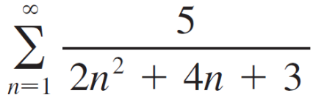
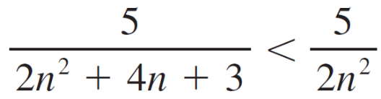
Example 1
Determine whether the series converges or diverges.
Solution:
For large n the dominant term in the denominator is 2n², so we compare the given series with the series Σ 5/(2n²). Observe that
because the left side has a bigger denominator. (In the notation of the Comparison Test, a_{n} is the left side and b_{n} is the right side.)

Slide 8
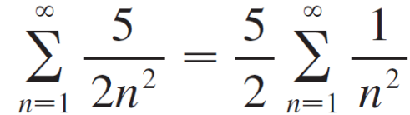
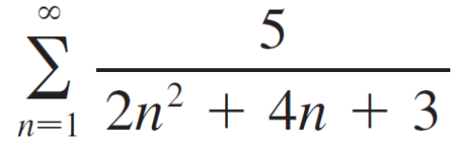
Example 1 – Solution
cont’d
We know that
is convergent because it’s a constant times a p-series with
p = 2 > 1.
Therefore
is convergent by part (i) of the Comparison Test.

Slide 9
The Comparison Tests
Note 1:
Although the condition a_{n} ≤ b_{n} or a_{n} ≥ b_{n} in the Comparison Test is given for all n, we need verify only that it holds for
n ≥ N, where N is some fixed integer, because the convergence of a series is not affected by a finite number of terms.

Slide 10
The Comparison Tests
Note 2:
The terms of the series being tested must be smaller than those of a convergent series or larger than those of a divergent series.
If the terms are larger than the terms of a convergent series or smaller than those of a divergent series, then the Comparison Test doesn’t apply.

Slide 11
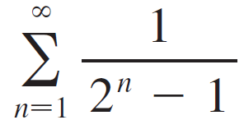
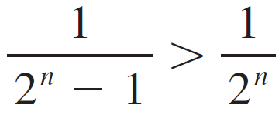

The Comparison Tests
Consider, for instance, the series
The inequality
is useless as far as the Comparison Test is concerned because is convergent and a_{n} > b_{n}.

Slide 12

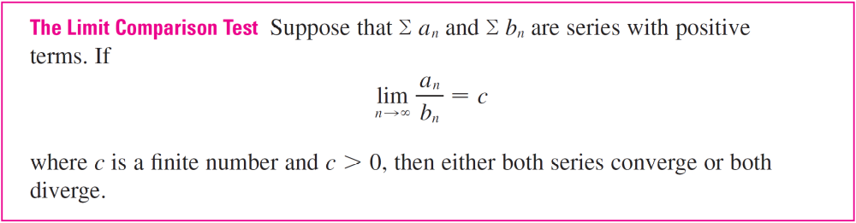
The Comparison Tests
Nonetheless, we have the feeling that Σ 1/(2^{n} – 1) ought to be convergent because it is very similar to the convergent geometric series .
In such cases the following test can be used.

Slide 13
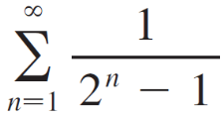
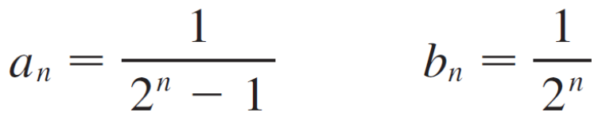
Example 3
Test the series for convergence or divergence.
Solution:
We use the Limit Comparison Test with
and obtain

Slide 14
Example 3 – Solution
cont’d
Since this limit exists and Σ 1/2^{n} is a convergent geometric series, the given series converges by the Limit Comparison Test.

Slide 15
Estimating Sums

Slide 16
Estimating Sums
If we have used the Comparison Test to show that a series Σ a_{n} converges by comparison with a series Σ b_{n}, then we may be able to estimate the sum Σ a_{n} by comparing remainders.
We consider the remainder
R_{n} = s – s_{n} = a_{n + 1} + a_{n + 2} + . . .

Slide 17
Estimating Sums
For the comparison series Σ b_{n} we consider the corresponding remainder
T_{n} = t – t_{n} = b_{n + 1} + b_{n + 2} + . . .
Since a_{n} ≤ b_{n} for all n, we have R_{n} ≤ T_{n}. If Σ b_{n} is a p-series, we can estimate its remainder T_{n}.
If Σ b_{n} is a geometric series, then T_{n} is the sum of a geometric series and we can sum it exactly.
In either case we know that R_{n} is smaller than T_{n}.

Slide 18
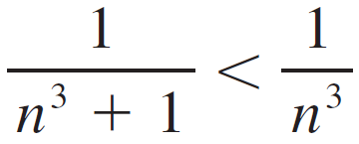
Example 5
Use the sum of the first 100 terms to approximate the sum of the series Σ 1/(n³ + 1). Estimate the error involved in this approximation.
Solution:
Since
the given series is convergent by the Comparison Test.

Slide 19
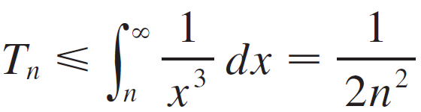
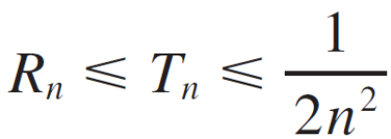
Example 5 – Solution
cont’d
The remainder T_{n} for the comparison series Σ 1/n³ was estimated earlier using the Remainder Estimate for the Integral Test.
There we found that
Therefore the remainder R_{n} for the given series satisfies

Slide 20
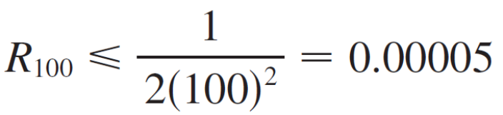
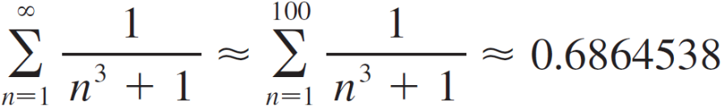
Example 5 – Solution
cont’d
With n = 100 we have
Using a programmable calculator or a computer, we find that
with error less than 0.00005.

