Slide 1


Infinite Sequences
and Series
11
Copyright © Cengage Learning. All rights reserved.

Slide 2

11.11
Applications of Taylor Polynomials
Copyright © Cengage Learning. All rights reserved.

Slide 3
Approximating Functions
by Polynomials

Slide 4
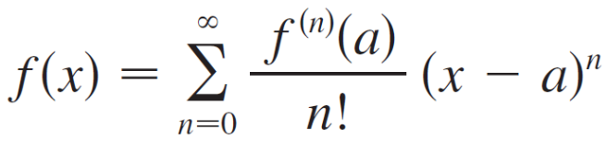
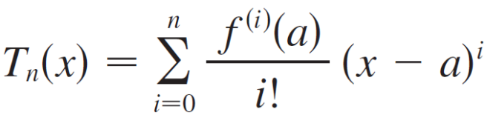
Approximating Functions by Polynomials
Suppose that f (x) is equal to the sum of its Taylor series
at a:
The notation T_{n} (x) is used to represent the nth partial sum of this series and we can call it as it the nth-degree Taylor polynomial of f at a.
Thus

Slide 5
Approximating Functions by Polynomials
Since f is the sum of its Taylor series, we know that
T_{n} (x) f (x) as n and so T_{n} can be used as an approximation to f:
f (x) ≈ T_{n} (x).
Notice that the first-degree Taylor polynomial
T₁(x) = f (a) + f ′(a)(x – a)
is the same as the linearization of f at a.

Slide 6
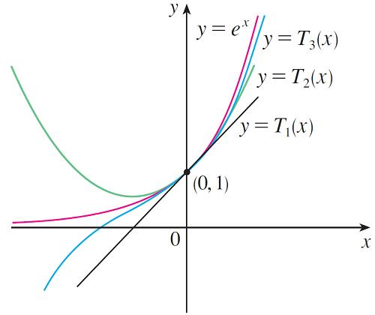
Approximating Functions by Polynomials
Notice also that T₁ and its derivative have the same values at a that f and f ′ have. In general, it can be shown that the derivatives of T_{n} at a agree with those of f up to and including derivatives of order n.
To illustrate these ideas let’s
take another look at the graphs
of y = e^{x} and its first few Taylor
polynomials, as shown in Figure 1.
Figure 1

Slide 7
Approximating Functions by Polynomials
The graph of T₁ is the tangent line to y = e^{x} at (0, 1); this tangent line is the best linear approximation to e^{x} near
(0, 1); The graph of T₂ is the parabola y = 1 + x + x²/2, and the graph of T₃ is the cubic curve y = 1 + x + x²/2 + x³/6, which is a closer fit to the exponential curve y = e^{x} than T₂.
The next Taylor polynomial T₄ would be an even better approximation, and so on.

Slide 8
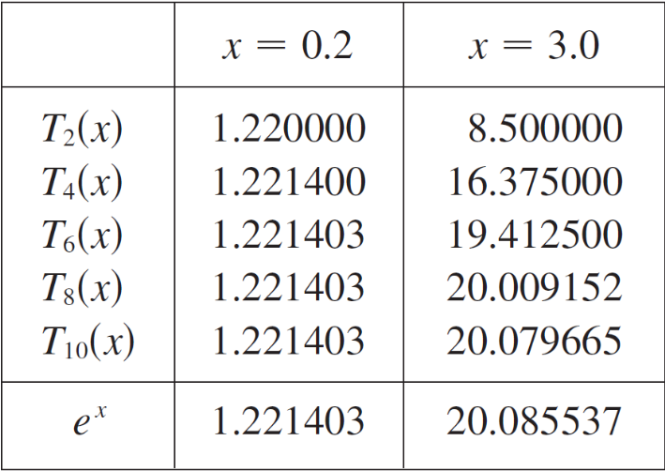
Approximating Functions by Polynomials
The values in the table give a numerical demonstration of the convergence of the Taylor polynomials T_{n} (x) to the function y = e^{x}. We see that when x = 0.2 the convergence is very rapid, but when x = 3 it is somewhat slower.
In fact, the farther x is from 0, the
more slowly T_{n} (x) converges to e^{x}.
When using a Taylor polynomial
T_{n} to approximate a function f, we
have to ask the questions:
How good an approximation is it?

Slide 9
Approximating Functions by Polynomials
How large should we take n to be in order to achieve a desired accuracy? To answer these questions we need to look at the absolute value of the remainder:
| R_{n} (x) | = | f (x) – T_{n} (x)|
There are three possible methods for estimating the size of the error:
1. If a graphing device is available, we can use it to graph
| R_{n} (x) | and thereby estimate the error.

Slide 10

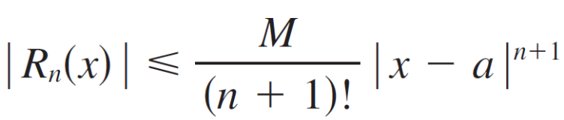
Approximating Functions by Polynomials
2. If the series happens to be an alternating series, we can
use the Alternating Series Estimation Theorem.
3. In all cases we can use Taylor’s Inequality which says
that if then

Slide 11

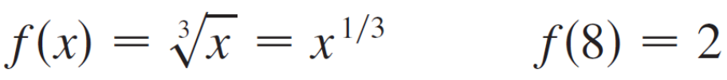

Example 1
(a) Approximate the function by a Taylor
polynomial of degree 2 at a = 8.
(b) How accurate is this approximation when 7 ≤ x ≤ 9?
Solution:
(a)

Slide 12
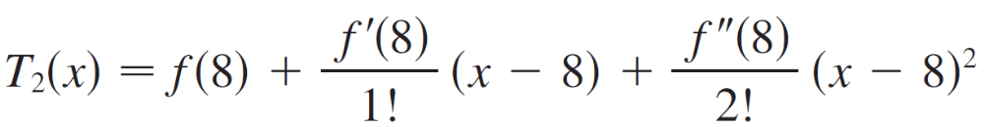
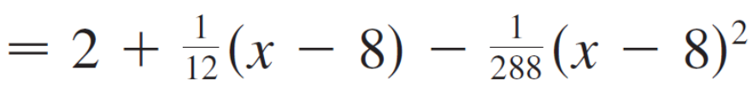
Example 1 – Solution
cont’d
Thus the second-degree Taylor polynomial is
The desired approximation is

Slide 13
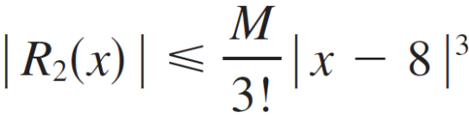
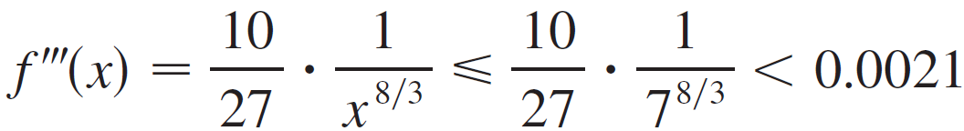
Example 1 – Solution
cont’d
(b) The Taylor series is not alternating when x < 8, so we
can’t use the Alternating Series Estimation Theorem in
this example.
But we can use Taylor’s Inequality with n = 2 and a = 8:
where | f ′″ (x) | ≤ M.
Because x ≥ 7, we have x^{8/3} ≥ 7^{8/3} and so

Slide 14
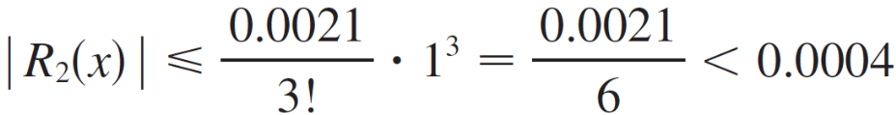
Example 1 – Solution
cont’d
Therefore we can take M = 0.0021. Also 7 ≤ x ≤ 9, so
–1 ≤ x –8 ≤ 1 and | x – 8 | ≤ 1.
Then Taylor’s Inequality gives
Thus, if 7 ≤ x ≤ 9, the approximation in part (a) is accurate to within 0.0004.

Slide 15

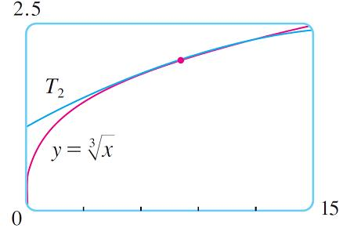
Approximating Functions by Polynomials
Let’s use a graphing device to check the calculation in Example 1. Figure 2 shows that the graphs of and
y = T₂ (x) are very close to each other when x is near 8.
Figure 2

Slide 16
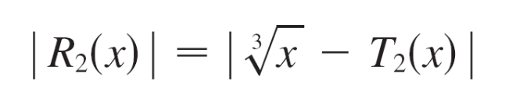
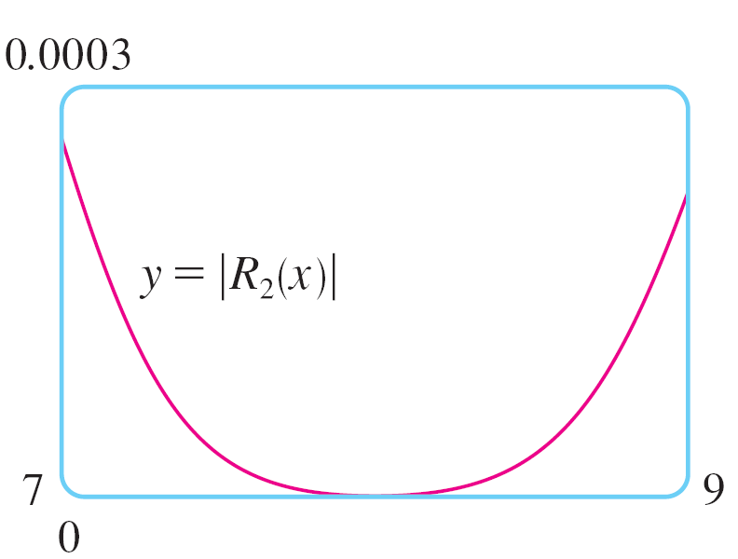
Approximating Functions by Polynomials
Figure 3 shows the graph of |R₂(x)|computed from the expression
We see from the graph that
|R₂(x)| < 0.0003
when 7 ≤ x ≤ 9.
Thus the error estimate from
graphical methods is slightly
better than the error estimate
from Taylor’s Inequality in this case.
Figure 3

Slide 17
Applications to Physics

Slide 18
Applications to Physics
Taylor polynomials are also used frequently in physics. In order to gain insight into an equation, a physicist often simplifies a function by considering only the first two or three terms in its Taylor series.
In other words, the physicist uses a Taylor polynomial as an approximation to the function. Taylor’s Inequality can then be used to gauge the accuracy of the approximation. The next example shows one way in which this idea is used in special relativity.

Slide 19
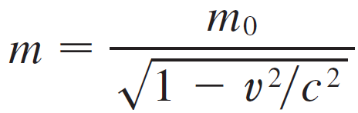
Example 3
In Einstein’s theory of special relativity the mass of an object moving with velocity v is
where m₀ is the mass of the object when at rest and c is the speed of light. The kinetic energy of the object is the difference between its total energy and its energy at rest:
K = mc² – m₀c²

Slide 20

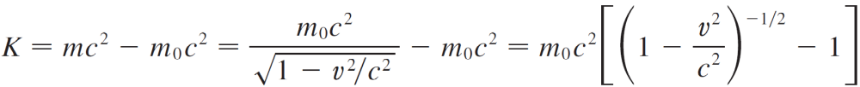
Example 3
cont’d
(a) Show that when v is very small compared with c, this
expression for K agrees with classical Newtonian physics: K = m₀v².
(b) Use Taylor’s Inequality to estimate the difference in
these expressions for K when | v | ≤ 100 m/s.
Solution:
(a) Using the expressions given for K and m, we get

Slide 21

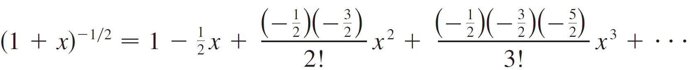
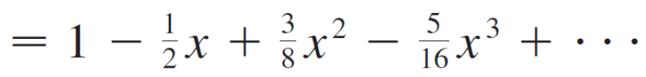
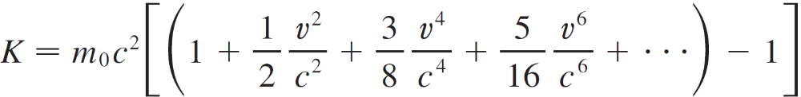
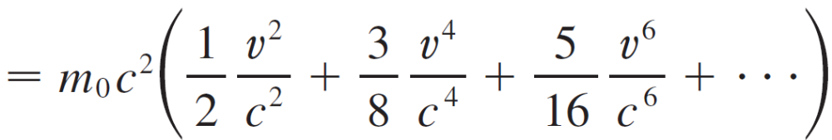
Example 3 – Solution
cont’d
With x = –v²/c², the Maclaurin series for (1 + x)^{–1/2} is most easily computed as a binomial series with k = (Notice that | x | < 1 because v < c.) Therefore we have
and

Slide 22
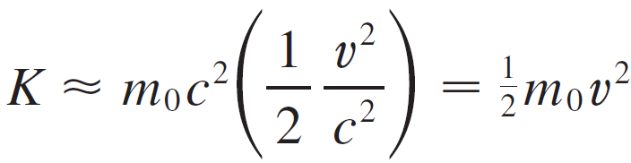
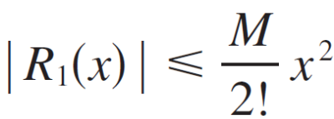
Example 3 – Solution
cont’d
If v is much smaller than c, then all terms after the first are very small when compared with the first term. If we omit them, we get
(b) If x = –v²/c², f (x) = m₀c² [(1 + x)^{–1/2} – 1], and M is a
number such that | f ″(x) | ≤ M, then we can use Taylor’s
Inequality to write

Slide 23

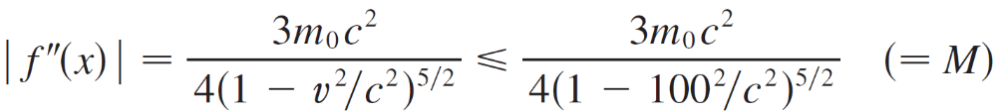
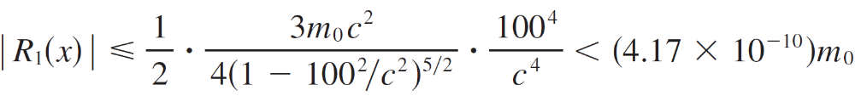
Example 3 – Solution
cont’d
We have f ″(x) = m₀c² (1 + x)^{–5/2} and we are given that
| v | ≤ 100 m/s, so
Thus, with c = 3 × 10⁸ m/s,
So when |v | ≤ 100 m/s, the magnitude of the error in using the Newtonian expression for kinetic energy is at most (4.2 × 10^{–10} )_{m0}.

